Slide 1



OBS-ONE Platform
Gaseous, PM and PN
Horiba Instruments, Inc.

Slide 2

System Features
OBS-ONE-PM (Particulate Mass)
OBS-ONE-PN (Particle Number)

Slide 3

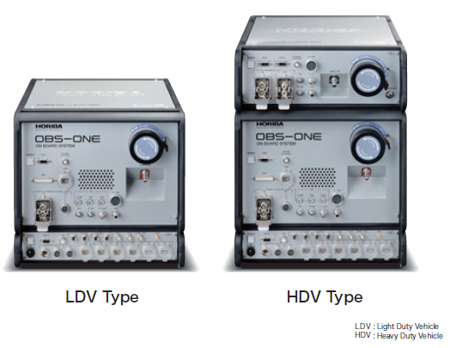
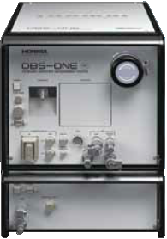
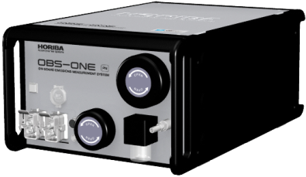
Gaseous Components:
CO, CO₂, NO, NOx, THC, CH₄
Particulate:
Mass, Solid Particle Number
OBS-ONE -PM
OBS-ONE -PN

Slide 4
OBS ONE Concept
Same base software package for new generation laboratory equipment (MEXA ONE, CVS ONE, etc.)
  Horiba One Platform
  Windows based interface
  Linux machine for equipment control
Software includes test automation (sequence for PEMS)
  Flexible test sequences
  Large amount of entry fields for documentation of test
Post processing software based on National Instruments DIADEM software
  Standard graphical and mathematics package
  Emission calculation and analysis
  Default basic reports
  Customizable report formats

Slide 5

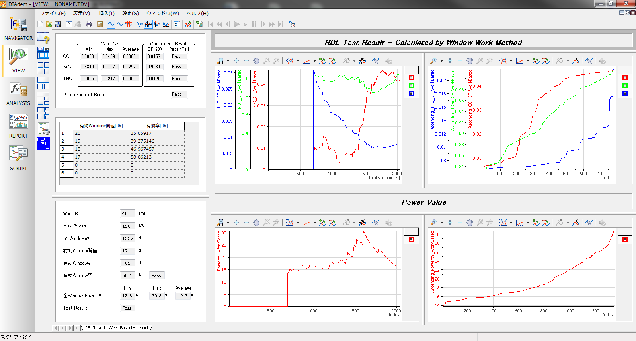
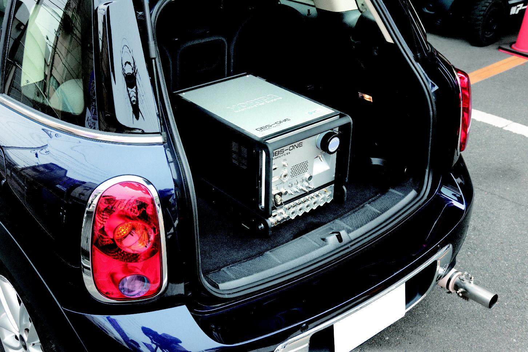
Post data analysis(1)
Example of Type approval result (MAW)
Notes:
5

Slide 6
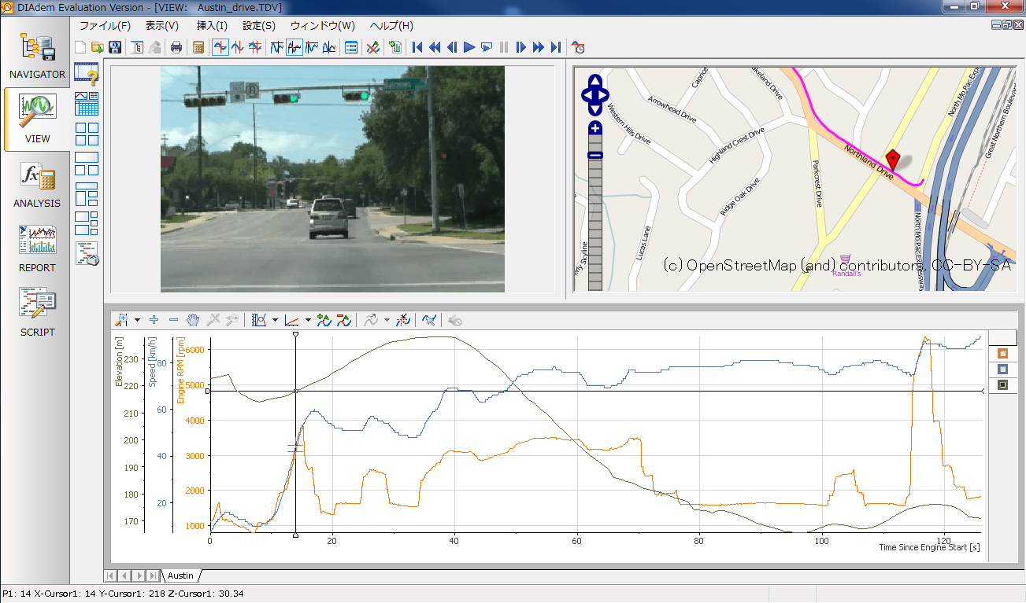
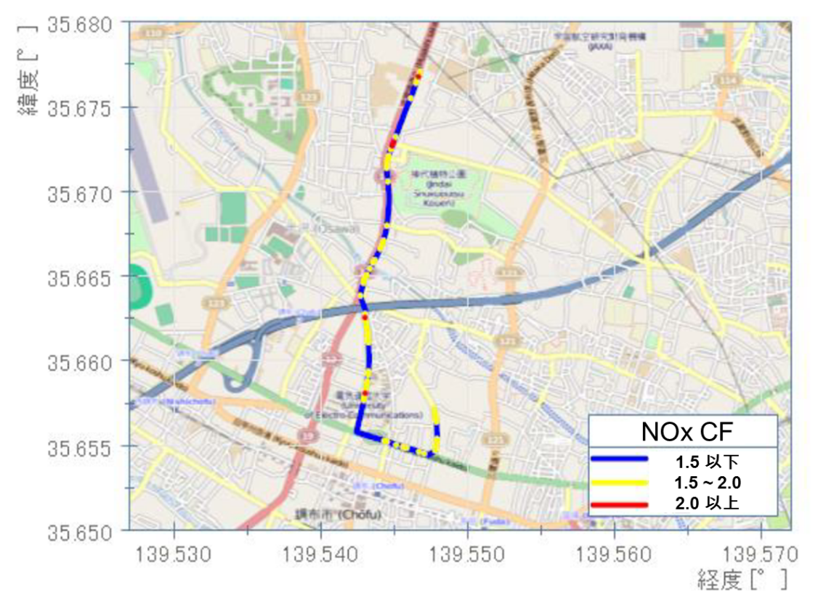
Post data analysis(2)
Example of data analysis
Optional function with video, map data
Notes:
6

Slide 7
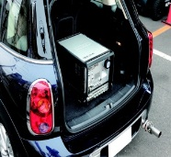
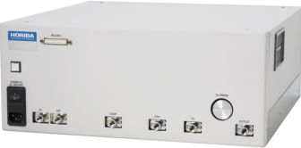
System Flexibility..
Maintenance
  Gas analyzers use many common parts with MEXA-ONE, MEXA-7000 and OBS-2000.
  Linearization sequence identical to MEXA ONE
    Automated sequence with Horiba MFC based gas dividers
    User can update curve coefficients
  Automated interference checks with heated bubbler
    User can update correction coefficients
GDC-ONE
GDC-703
Notes:
Consumable parts :
Sample gas filter element, NO2 to NO converter material etc
Periodical replacement parts :
Ozone generator, Sampling pump, electrical circuit bards etc
Software for controller is designed with HORIBA ONE PLATFORM.
MEXA-ONE quality check, maintenance support function (IO controller with flow diagram etc) and notification function.
The software can control MEXA-ONE device for maintenance.
For example : GDC-703 and GDC-ONE for linearity check and NOx converter efficiency check

Slide 8
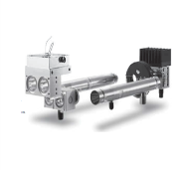
High performance detection
“Wet” based concentration measurement for better performance
  Direct conversion to mass from exhaust flow without dry to wet correction
  Faster response using “Hot wet measurement” technique (no cooler)
  More accurate real CO and CO₂ measurement by Heated NDIR
  Reliable / accurate NOx measurement by CLD
Component | Detection principle | Advantage
NO, NOx | Heated Dual-CLD | No dehumidifier : fast response Small size, low sample flow rate
NO₂ | (Calculated by Dual-CLD) | No dehumidifier so no loss of NO₂
CO | Heated NDIR | No dehumidifier : fast response Integral H₂O measurement for compensation
CO₂
THC | Heated FID | Vacuum type sampling for fast response. 191̊ C for diesel THC measurement
CH₄ | Heated FID with non-methane cutter | Vacuum type sampling for fast response.
Notes:
8

Slide 9
Feature of Heated-NDIR
Heated-NDIR (H-NDIR)
CO and CO2 signal are compensated by H2O signal and optimized algorithm for more accurate measureament
【Patent No. JP 03771849】
FTP-75 Phase 1 (Cold start) Lean burn gasoline vehicle
CO₂
[vol%]
Real concentration at measuring point can be measured by H-NDIR
NDIR with dehumidifier increases error due to dry to wet base correction during cold start of engine or for dual fuelled vehicles
Velocity
[km/h]

Slide 10

Sampling optimized
Vacuum type sampling system for size reduction
Heated region
Sample in
P
FILTER
191℃
Detector
Heated Pump
    Heated pump is bigger than cold pump
    More electrical power is required
Sample in
P
Heated region
P
FILTER
191℃
Detector
Non Heated Pump
    Smaller size and lower power consumption of pump
    Less heat insulation required
    Smaller instrument size and smaller battery due to lower power consumption => Smaller size of total system

Slide 11
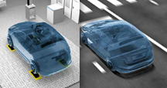
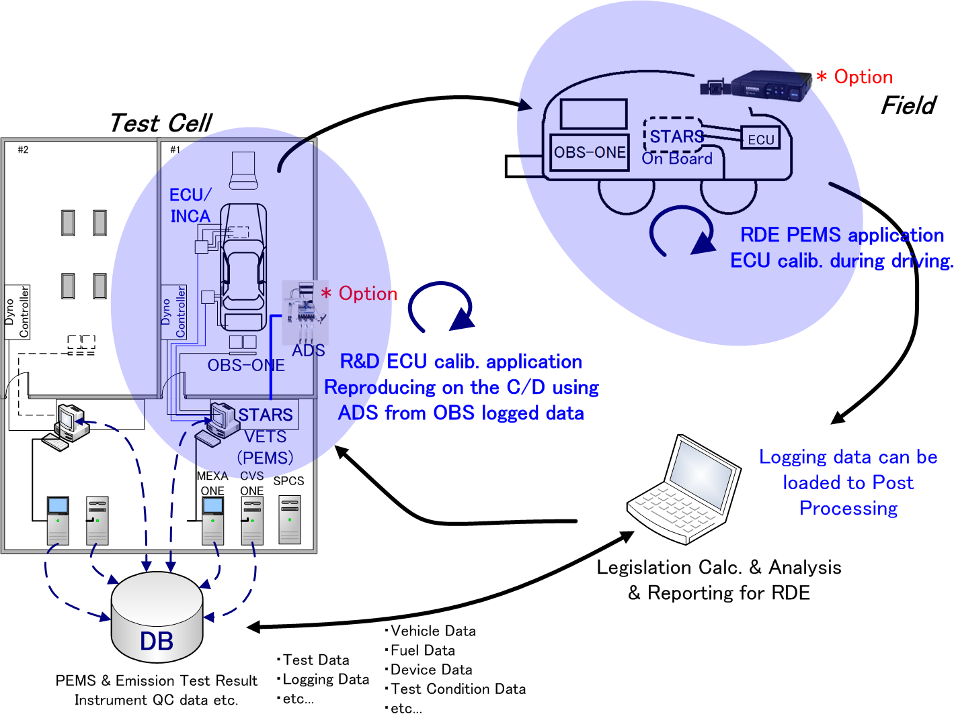
Work flow Test cell & PEMS
Test cell & PEMS
Simulate real world data on test cell
Testing vehicle with PEMS,
Compact test automation system
Store the data on DB
Data analysis & reporting

Slide 12
System Features
OBS-ONE-PM (Particulate Mass)
OBS-ONE-PN (Particle Number)

Slide 13
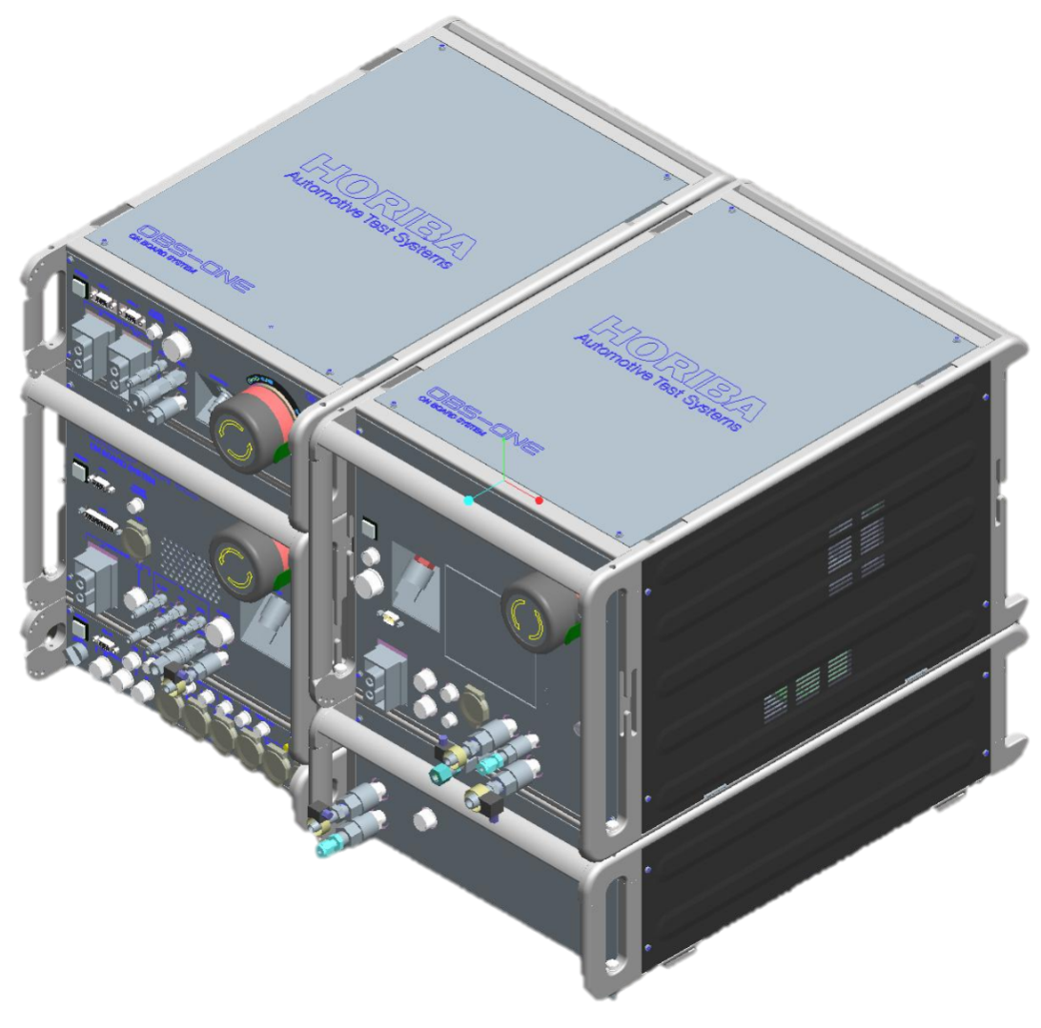
OBS-ONE-PM
Design/concept
Gas analyzer
PM analyzer
FA
460 mm
FS: Filter Sampler
GA
CC
RP: Real-time PM Sensor
350 mm
350 mm
470 mm
Key points
  Same size as OBS-ONE-GAS
  Keep the same concept: Front Access, no tools needed for operation

Slide 14
PM Sampler and Real-Time Sensor
Gravimetric Method
Real time measurement
○ Correlation
○ Traceability
○ High sensitivity
○ Real time measurement
Exhaust pipe
Exhaust flow rate signal from pitot tube flow meter used to control proportional dilution as certification method and calculate real time particle measurement
mixer
Dilution Air
Diffusion Charger Sensor (DCS)
47℃
DCS is a real-time particle sensor, based on diffusion charge principle
DCS signal is calibrated to actual PM mass post-testing using the filter based method.
The use of the diffusion screens to eliminate PM mass over-reading during DPF regeneration
Cyclone
Filter
Bypass
P
PM mass measured by filter using a portable exhaust flow rate proportional partial flow dilution system
【Patent No.JP 4956178】
This method is approved by EPA alternative approval letter

Slide 15
Method of OBS-PM for NTE
The ratio of integrated real time particle signal to PM mass (from PM filter) is used to calculate real time PM mass for US NTE and EU moving average window methods
NTE-1
NTE-2
NTE-3
NTE-4
NTE-5
Filter Filter Filter Filter Filter
Gravimetric method
DCS signal (mm/cm³)
Bypass Bypass Bypass Bypass Bypass Bypass
Total PM mass
Real time measurement
Fraction of NTE
PM mass in Individual NTE events = Total PM × Fraction
allows subtraction of the PM mass loaded during invalid NTE events < 30 seconds
Also allows determination of real time PM concentration for Moving Average Window

Slide 16
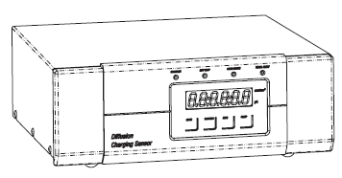
Real time PM (DCS-100)
Measures Particle Length d^{1.13}
Specification:
Measurement range: 0 ... 2500 mm/cm³
Sensitivity limit: 0.01 mm/cm³
Sample flow: 2.5 liters/min. (approx.)

Slide 17
Filter change method
Open the door
Step 2
Release Filter lock
Step 3
Remove Filter and holder
Step 1

Slide 18
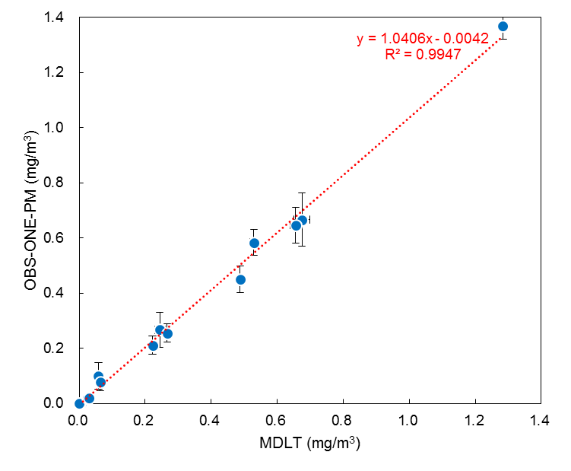
OBS-ONE-PM Correlation with MDLT
Correlation between laboratory HORIBA MDLT partial flow and HORIBA OBS-ONE-PM PEMS
Good agreement across wide range of PM emissions
Y=1.046x – 0.0042
R2 = 0.9947

Slide 19
Proportionality of PM Sample Flow
Y=0.0014X -0.0013
R2=0.9971
Proportionality of the PEMS-PM sample flow to engine exhaust flow during FTP cycle
Fast response of flow controller was verified

Slide 20
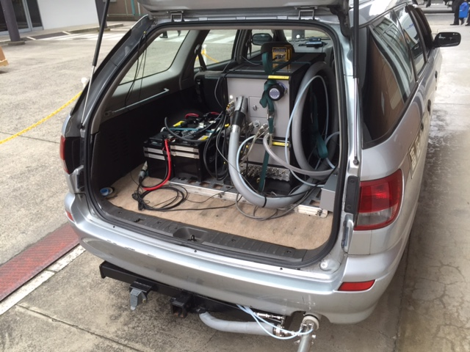
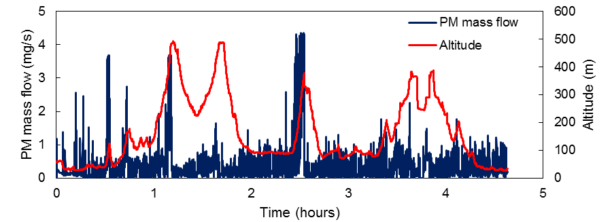
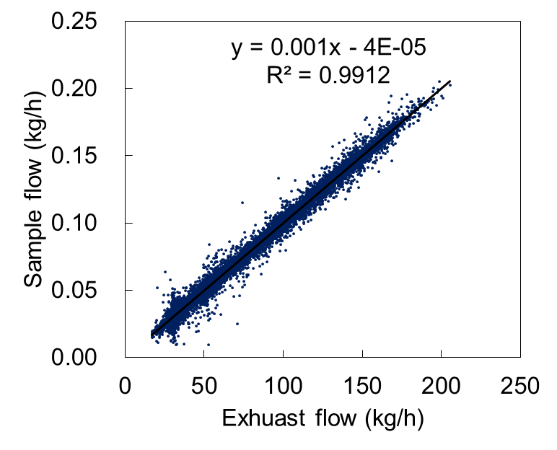
OBS-ONE-PM Real-Time PM Test Result
Evaluation by on board testing
Sample flow rate proportionality
High emission at sloping road
Good linearity at real time testing

Slide 21
System Features
OBS-ONE-PM (Particulate Mass)
OBS-ONE-PN (Particle Number)

Slide 22
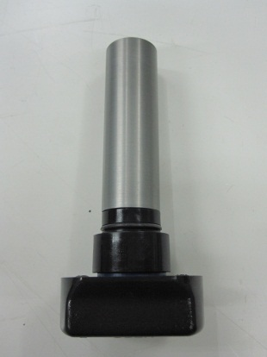
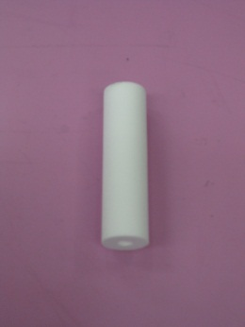
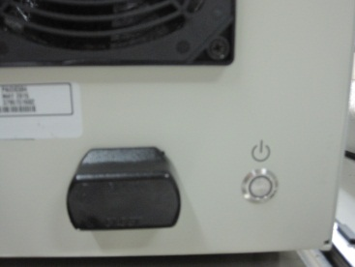
HORIBA PN-PEMS Solution
HORIBA utilized the CPC based system
  Main advantage of CPC
    Particle count principle (R83)
    No particle size dependency
    High accuracy and high sensitivity
  HORIBA’s CPC does not have a liquid reservoir of IPA (soaked wick only)
    “Easy” and “Safe” operation by using Cartridge
Notes:
22

Slide 23
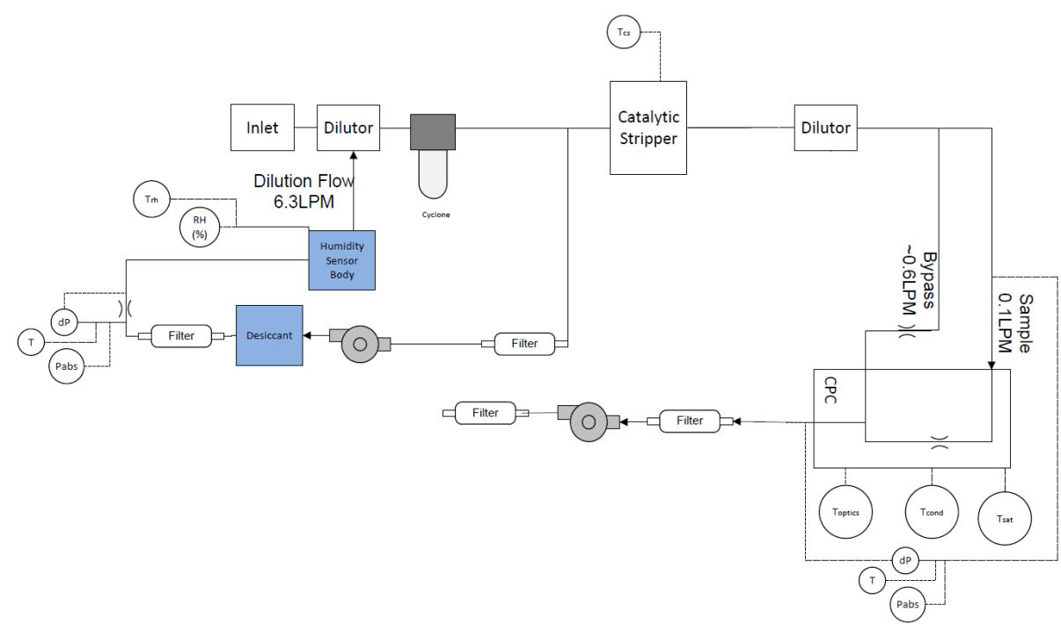
OBS-ONE-PN flow schematics
System configuration
  Two diluters
  Volatile particle remover: Catalytic Stripper (350 degC)
  CPC (Isopropanol based)
Catalytic stripper
2nd diluter
1st diluter
Sample In
CPC

Slide 24
Detection Efficiency
Detection efficiency of the system
VL-05
Detection efficiencies were within all criteria defined by the draft RDE regulation

Slide 25
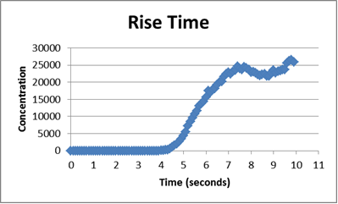
Response Time
VL-07
90%
T_{d}+T₁₀
T₁₀-T₉₀
10%
 | Criteria | Results
Delay time (T_{d}+T₁₀) | ≦5.0 sec | 4.8 Sec
Rise time (T₁₀-T₉₀) | ≦3.5 sec | 2.0 Sec
System Response Time | - | 6.8 Sec

Slide 26
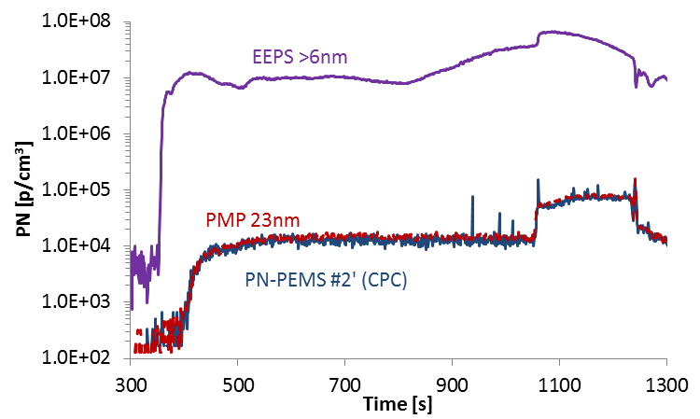
HORIBA PN-PEMS result (Phase II)
Regeneration (Volatile particle removal)
HORIBA PN-PEMS
Data obtained by JRC (published in the evaluation report
“Feasibility study on the extension of the RDE procedure to PN“)

Slide 27
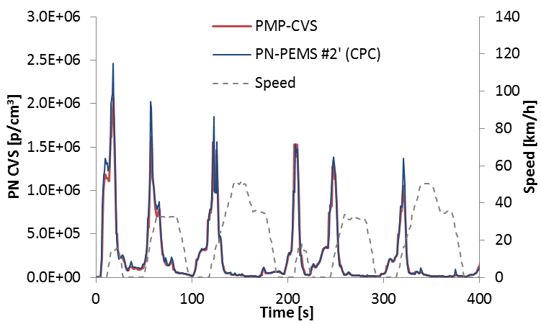
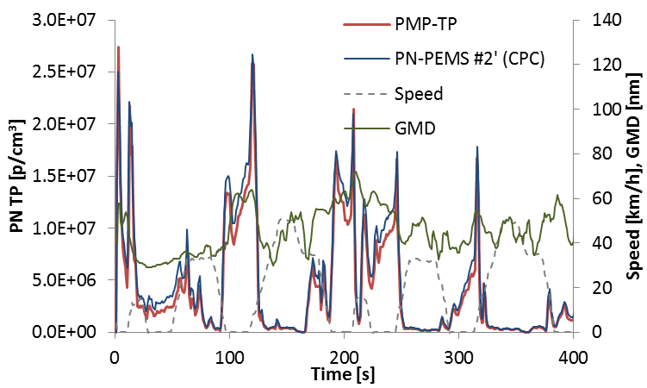
HORIBA PN-PEMS result (Phase II)
Real time
NEDC (Cold, PMP@CVS)
NEDC (Hot, PMP@tailpipe)
HORIBA
HORIBA
Data obtained by JRC (published in the evaluation report
“Feasibility study on the extension of the RDE procedure to PN“)

