Slide 1


RTG EcoCrane
In-Use Emissions and Fuel Economy Test Program at POLA
2013 PEMS Conference and Workshop
April 10, 2013
CE-CERT, Riverside, California
Energy and Emissions Technology Consulting

Slide 2
Outline
Emisstar Overview
Project
Technology
Test Phases
Test Cycle Development
Instrumentation
Results
Conclusions

Slide 3
Emisstar LLC
  Technology consulting firm
  3 US Offices (NY, TX, CA)
  Energy and Emissions Focus – Transportation
  Alt Fuels, Vehicle Tech and Clean Energy
  Wide Range of Engineering, Verification Support and Testing Services
  Founded in 2005

Slide 4
Project
Eco
Hybrid
Systems
Technology Developer
Hybrid RTG Manufacturer
Canadian Subsidiary of MiJack Inc.
Ports
America
Project demonstration partner
RTG Operator
Tenant @ POLA
Emisstar LLC
POLA
Port of Los Angeles
Host, with jurisdiction and oversight
Beneficiary of technology – CAAP
US
EPA
Emerging Technology Program
QAPP review, duty cycle approval
Technology verification

Slide 5
Objectives
Develop new duty cycle - RTG crane
Gain EPA authorization to proceed
Test unconventional application at POLA
Submit Results
Achieve USEPA Verification
Prove out viable and dynamic energy and emission reduction technology

Slide 6
Emisstar/EcoPower Approach
RTG EcoCrane Testing Project
EPA
Duty Cycle QAPP
Phase I: Baseline
Phase II: De-Green
Phase III: 1000 hour durability
QA/QC, Analysis and Reporting
EPA Verification

Slide 7
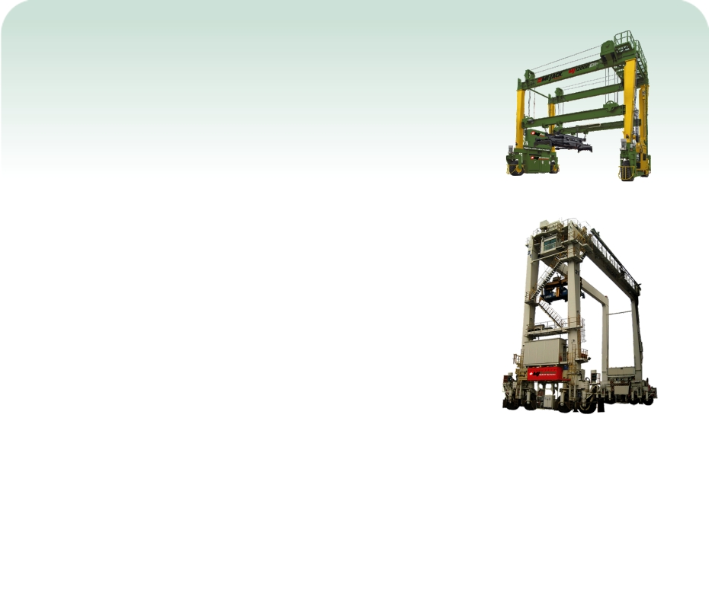
Technology
EcoCrane Battery Hybrid RTG Crane
- patented system: US Patent # 7,554,278
- clean energy power plant
- smaller diesel engine + batteries
Expected Benefits
- reduced fuel consumption (up to 70%)
- quieter operation
- reduced criteria and GHG emissions
- energy conservation
- 3 to 4 year ROI

Slide 8
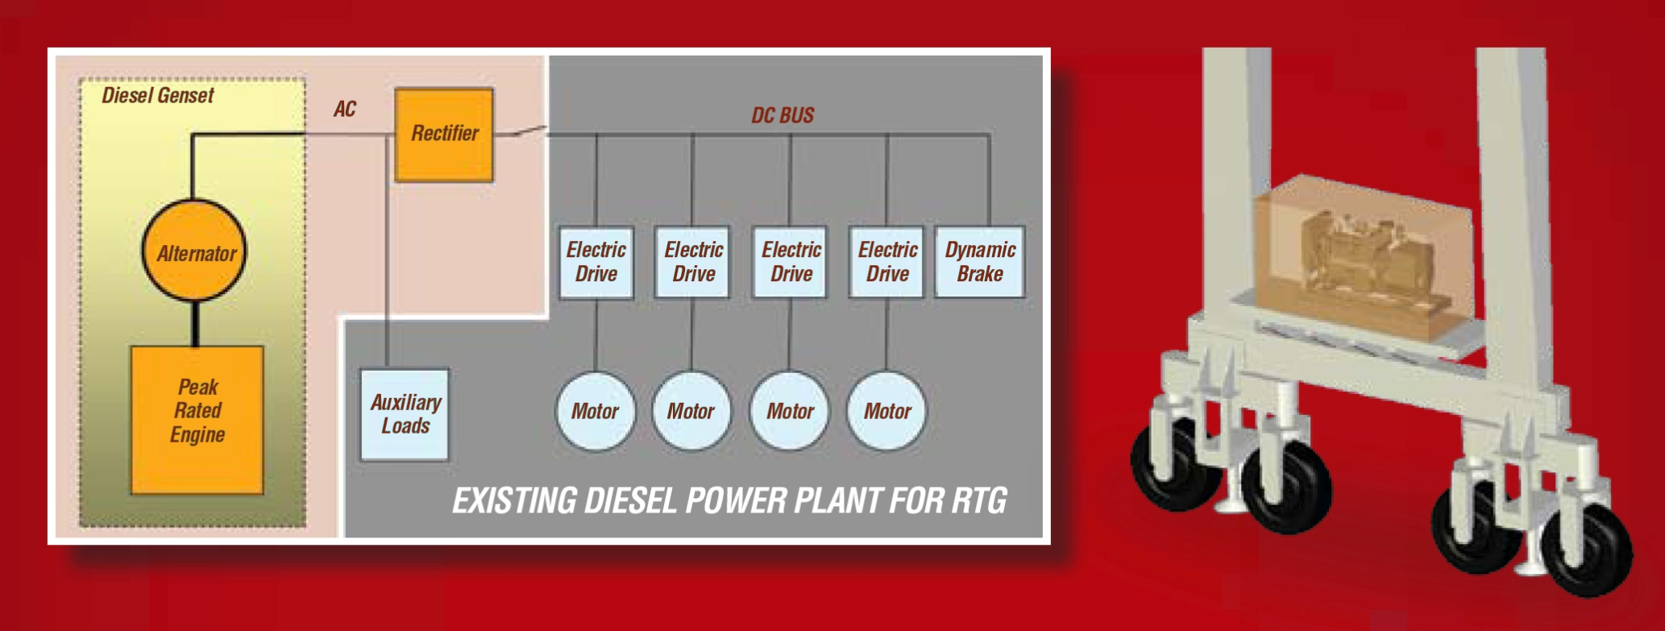

Technology – Conventional Power for RTG
Notes:
Discuss
Small engine operating at constant load/speed
Opportunity to reduce aux loads
Behavior of system during transients
Energy capture during lowering of load.
Opportunity to optimise aux loads.

Slide 9
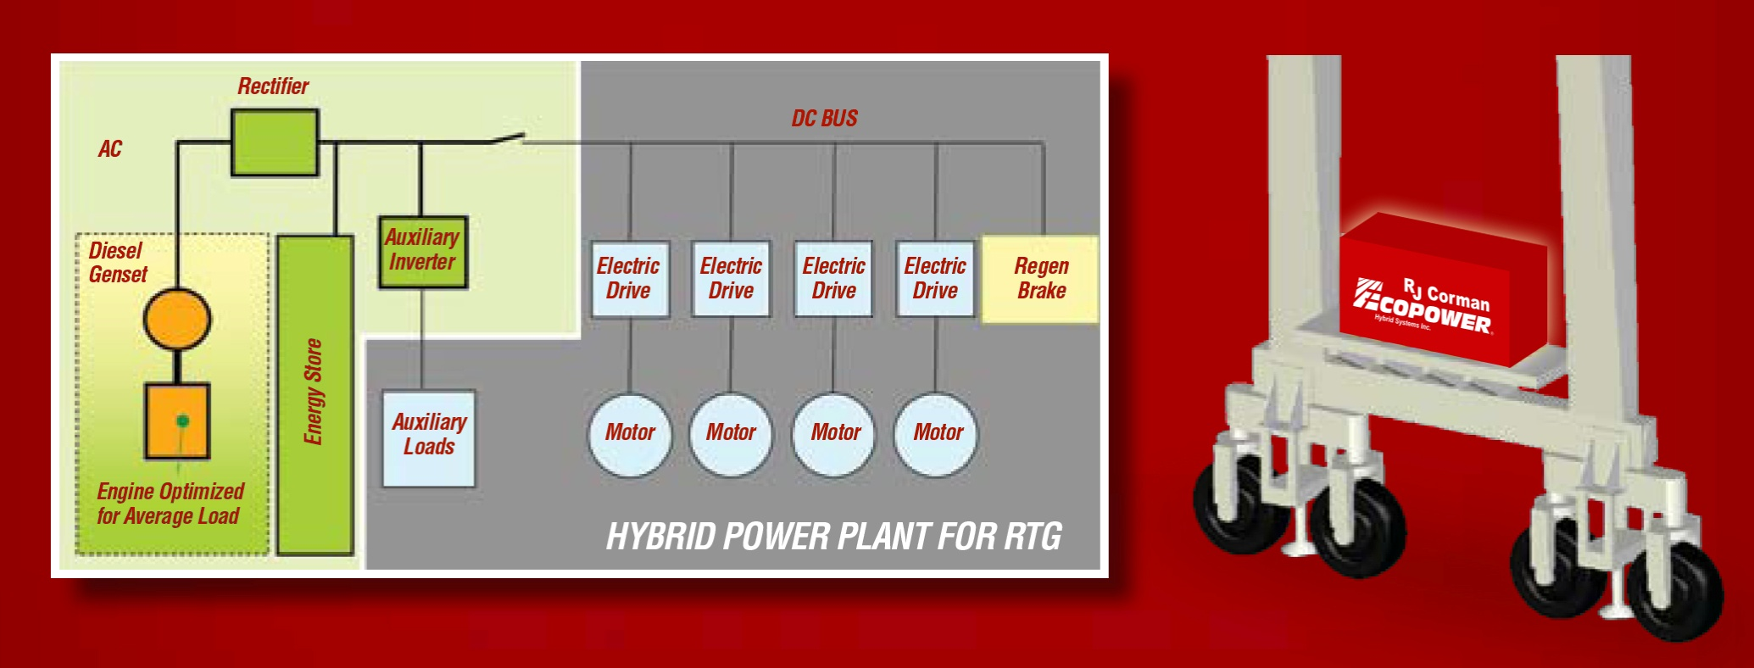
Technology – Hybrid Power for RTG
Replacement of the old GenSet by the newest GenSet technology, battery pack and EcoPower energy management system.
EcoPower Patented Technology, US Patent 7,554,278, June 2009
Notes:
Discuss
Small engine operating at constant load/speed
Opportunity to reduce aux loads
Behavior of system during transients
Energy capture during lowering of load.
Opportunity to optimise aux loads.

Slide 10
Technology – Conventional vs. Hybrid Power for RTG

Slide 11
Technology – How Do We Get The Fuel Savings?
Average Power vs. Peak Power
Using Smaller GenSet
Energy Recovery through
POWER REGENERATION

Slide 12
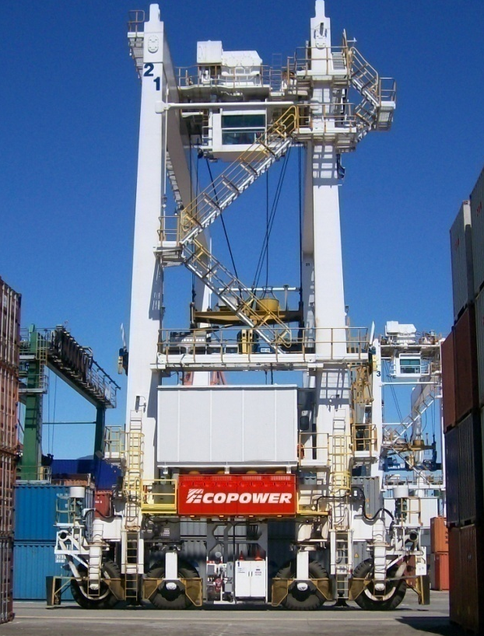
Technology – Typical Crane Applications
Port Crane or Rail Yard Cranes
  Up to 60 long tons,
  Ports America 40 LT
  Able to stack up to 5+1 containers high
  Up to 6 rows containers and 1 truck lane
Before Conversion
  Cummins QSX15 Tier 2
  15 liter
  890 hp
After Conversion
  John Deere 4045HF485E+ batteries + control
  4.5 L
  197 hp Tier III
Up to 70% Fuel Savings

Slide 13
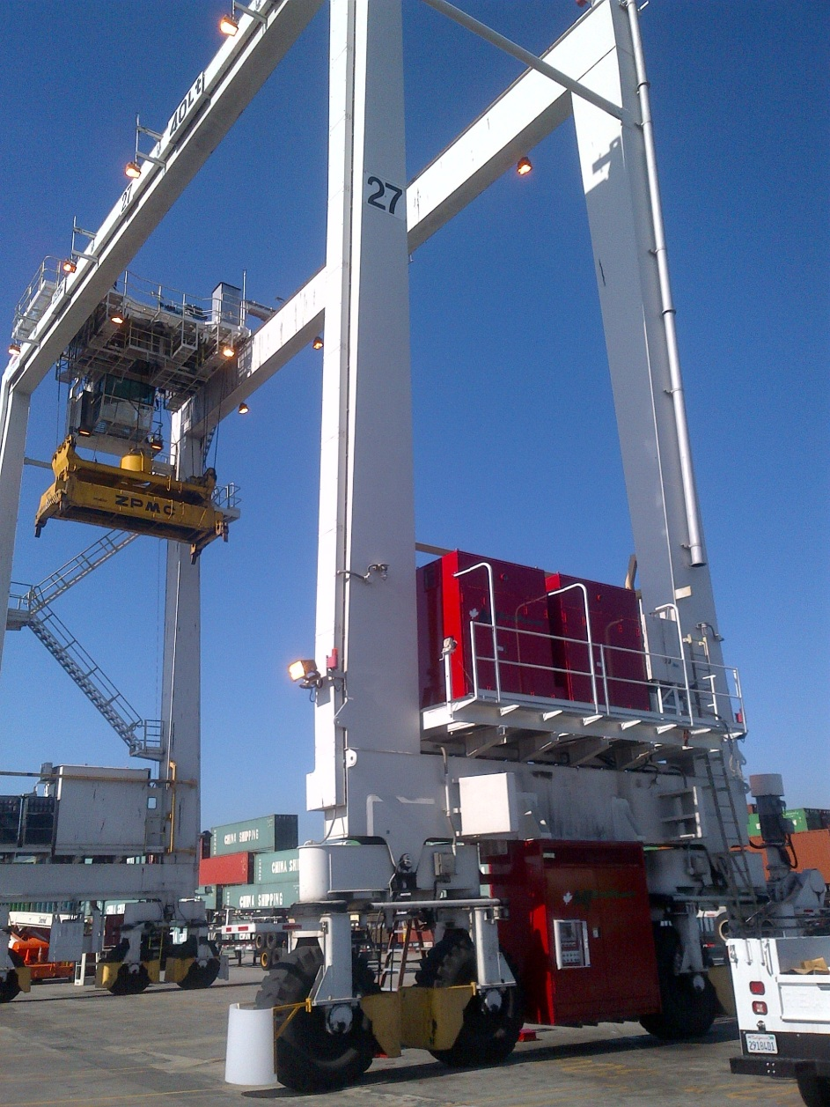
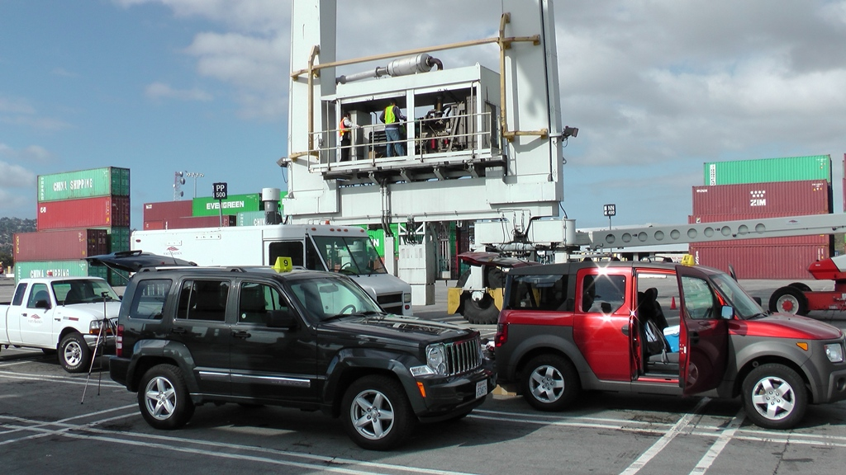
Technology – RTG Conventional to Hybrid
Conversion at Ports America
400 Ah of batteries added
Small generator between wheels
Hydraulic unit moved

Slide 14
Test Phases
Phase 1: Baseline conventional diesel RTG
Phase 2: “De-Greened” EcoCrane Hybrid RTG (100 hrs)
Phase 3: “Aged” EcoCrane Hybrid RTG (1000 hrs)

Slide 15
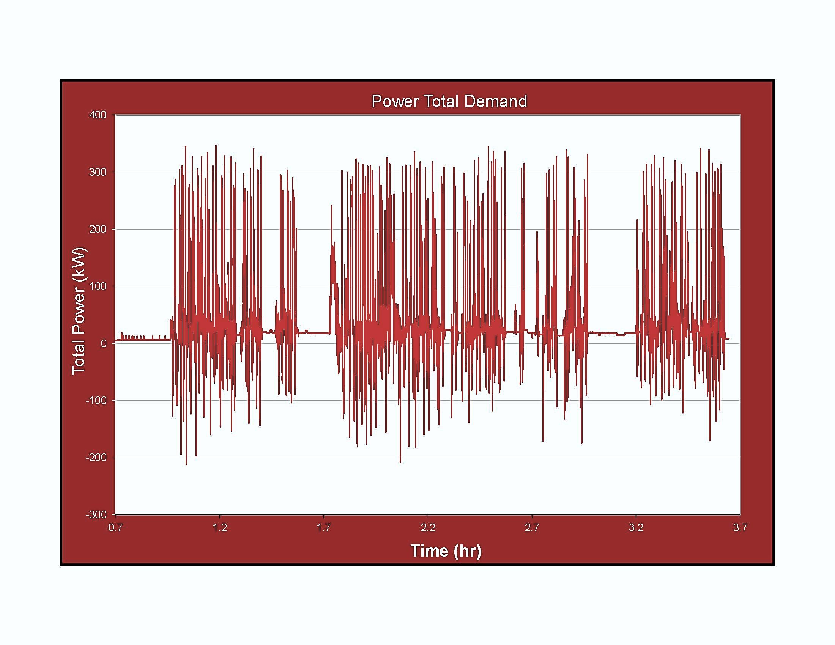
US patent 7,554,278 / June 2009
Test Cycle – Duty Cycle Comparison / Transitory vs. Continuous
Power Used to Perform Work
Regeneration or loss
Power supplied
Total work performed remains the same with both configurations

Slide 16
Test Cycle – Baseline Power Profile Recorded at 1 Hz
Parameter | Value kWe
Average power including long idling | 26
Average power without considering long idling | 41
Peak power observed during monitoring | 271
Maximum average power over 10 minutes | 55
Maximum average power over 30 minutes | 52
RMS power/ all data/ without idling | 46/71
Combination of a genset supplying 80kWe continuous and a VRLA battery pack of 400kWh supply more than all power required in all situations

Slide 17
Test Cycle
7.5 lifts per hour followed by 20 min idle
15 lifts per hour followed by 20 min idle
Study “Rubber tired Gantry (RTG) crane load factor study” , Starcrest,
POLA & POLB, November 2009:
Two RTG cranes were monitored in for a total of 751.5 hours.
During this time 7376 moves are reported for an average of 10 container moves per hour or 20 lifts if you count empty hoisting.

Slide 18
Test Cycle: Standardized Duty Cycle Used to Compare Conventional and Hybrid
1
2
3
4
5
6
7
8
1
2a
3a
4a
5a
6a
7a
8a
9
Performed at 15 lifts/hour and 7.5 lifts/hour
8 sequences of 25.5 minutes
6 idling of 20 minutes
Container weight 52,000 lbs
Clear 5 heights
6 rows span
after 720s the crane gantry for 45s

Slide 19
Test Cycle

Slide 20
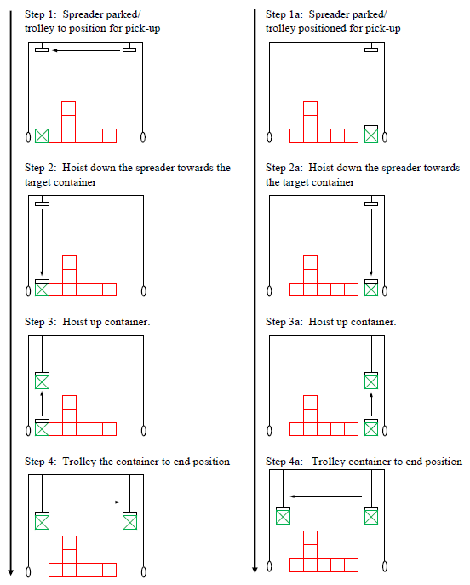
Test Cycle

Slide 21
Test Cycle

Slide 22
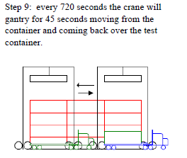
Test Cycle

Slide 23
Test Cycle – Review of Duty Cycle
Test Sequence | Action | A. Timing 7.5 moves/hour | B. Timing 15 moves/hour | C. Timing 30 moves/hour
1, 1a | Spreader parked/ trolley to position for pick-up | t₁ | t₁ | t₁
2, 2a | Hoist down the spreader towards the target container | t₂ | t₂ | t₂
3, 3a | Hoist up container | t₃ | t₃ | t₃
4, 4a | Trolley the container to end position | t₄ | t₄ | t₄
5, 5a | Lower container to the ground | t₅ | t₅ | t₅
6 | Lift empty spreader at clear max high | t₆ | t₆ | t₆
7 | Move or maintain spreader at default position | t₇ | t₇ | t₇
8 | Idle the balance of cycle time | 480 seconds (t₁+t₂+t₃+t₄+t₅+t₆+ t₇) | 240 seconds (t₁+t₂+t₃+t₄+t₅+t₆+ t₇) | 120 seconds (t₁+t₂+t₃+t₄+t₅+t₆+ t₇)

Slide 24
Monitoring in test at 15 lifts/ hour

Slide 25
Instrumentation
SEMTECH DS
AVL 494 PM PEMS
Kral fuel flow meter – onboard fuel flow measurement, temperature compensated (*)
* 40 CFR §86.345-79

Slide 26
Instrumentation
26

Slide 27
Results (Baseline vs. Aged)
Idle Emissions & Fuel Consumption:
  72% reduction in FC
  98% reduction in HC
  90% reduction in NOx
  83% reduction in PM

Slide 28
Results (Baseline vs. Aged)
Load Emissions (7.5 & 15 lifts per hour):
  35-39% reduction in FC
  93-98% reduction in HC
  78-90% reduction in NOx
  62-70% reduction in PM

Slide 29
Conclusions
Robust technology with superior fuel economy and emissions benefits
Proven results over EPA approved duty cycles
Attractive ROI
Effective diesel emission control strategy and energy savings technology for port environments

Slide 30
Contact Information
Michael C. Block
Emisstar LLC
30982 Ariana Lane
Laguna Niguel, CA 92677
michael.block@emisstar.com
(949) 218-8229

