Slide 1
PEMS activities in China: A research tool to characterize the expanding vehicle fleet in China
Prof Lei Yu, Texas Southern University
Prof. William Song, Beijing Jiaotong University
Sandeep Kishan, ERG
CE CERT PEMS Conference
Riverside, California.
March 24th, 2011

Slide 2
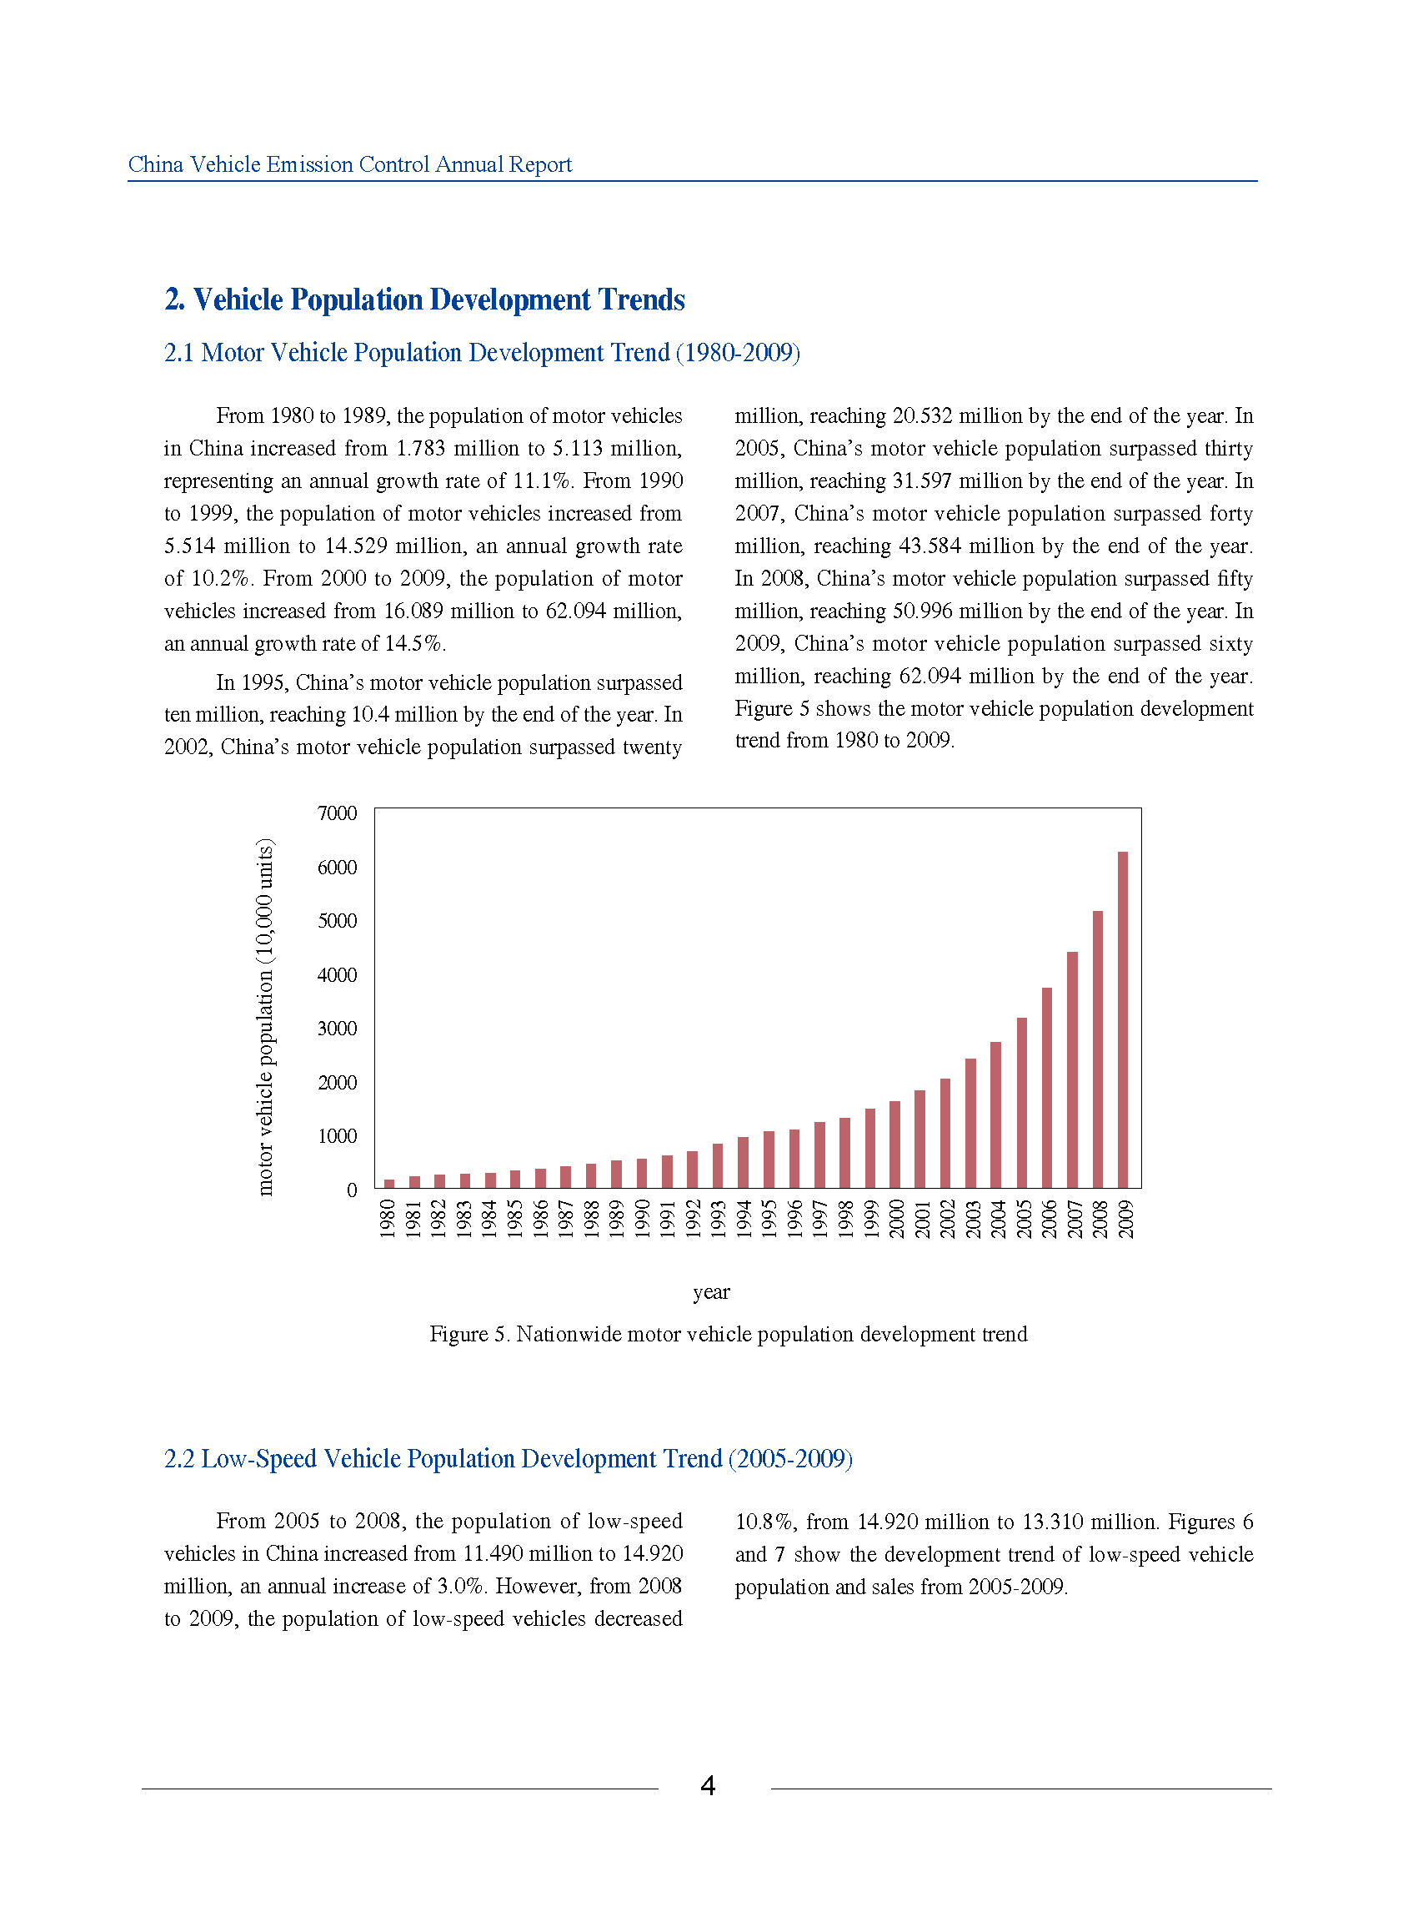
China Total Number of Vehicles by Year
60 million in 2009
Source :China Vehicle Emissions Annual Report, Ministry of Environmental Protection, People’s Republic of China

Slide 3
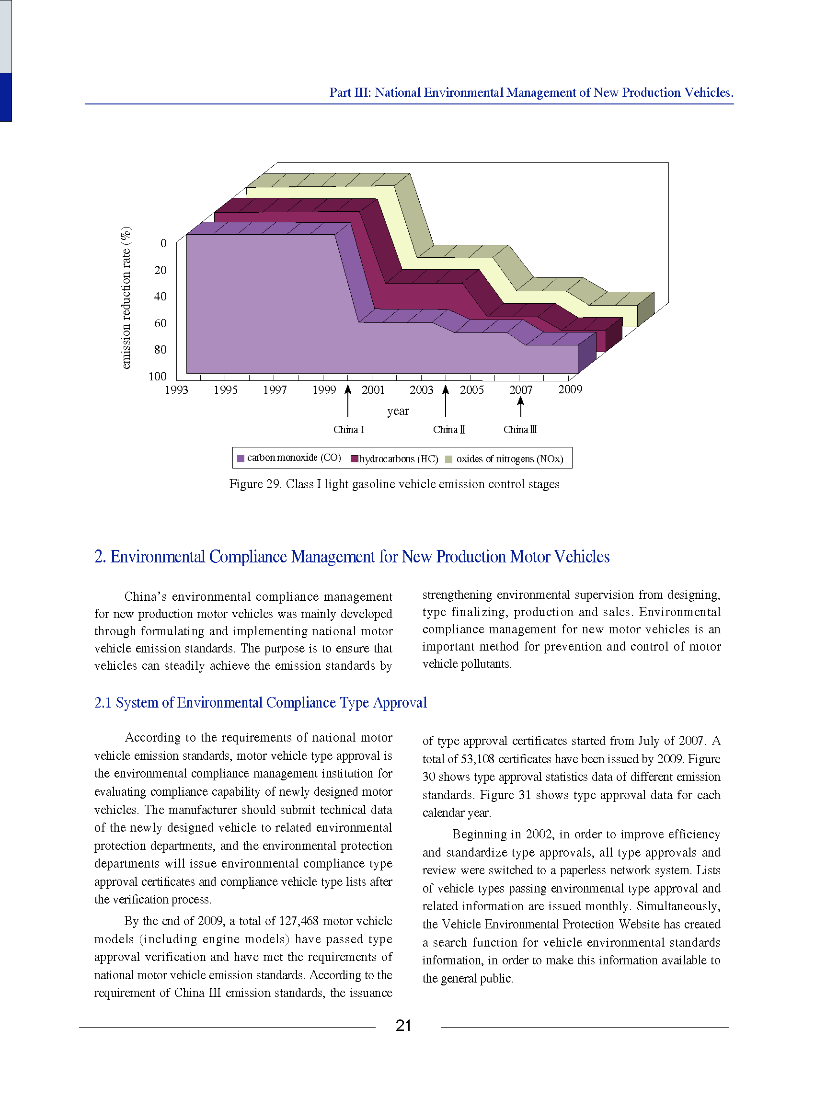
Source :China Vehicle Emissions Annual Report, Ministry of Environmental Protection, People’s Republic of China

Slide 4
Mobile Source Conference in China
Many universities and research organizations are using PEMS to characterize the emissions of the growing vehicle fleet
2010 International Workshop on Mobile Source Emissions Testing and Modeling in December, in Xiamen, China

Slide 5
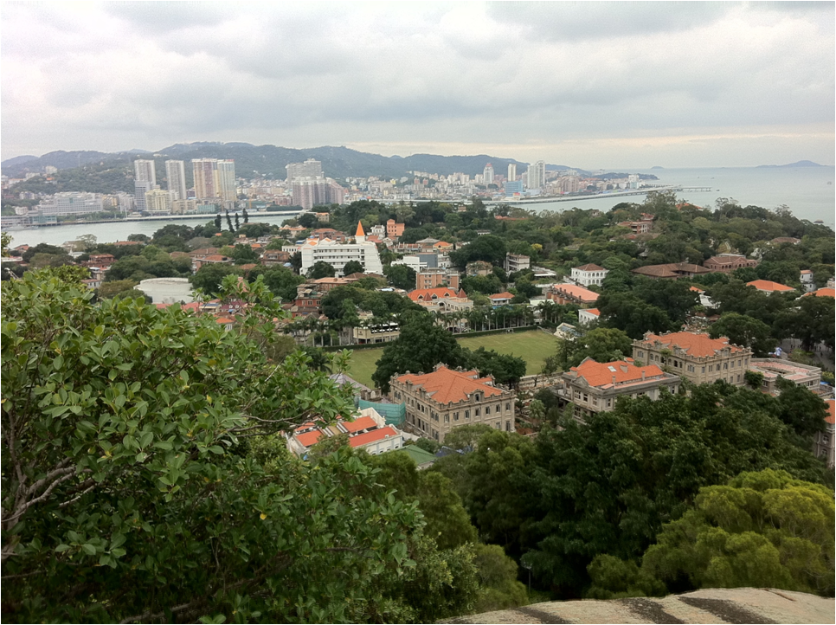
Xiamen, China

Slide 6
Mobile Source Conference in China
Sponsored by
VECC, Ministry of Environmental Protection in China
The Energy Foundation
Beijing Jiaotong University
Technology Center of Vehicle Emissions Control, Xiamen
China Automotive Technology and Research Center
Tsinghua University
TRB Committee on Transportation and Air Quality
Texas Southern University
Main organizers were Prof. Lei Yu, Texas Southern University and Prof. William Song, Beijing Jiaotong University and their students

Slide 7
Research Organizations Represented
Presentations by US EPA, US DOT, EU, NC State, and other US organizations
The Chinese Researchers Included:
VECC, Ministry of Environmental Protection, China
Beijing Jiaotong University
Tsinghua University
China Automotive Technology and Research Center
Beijing Institute of Technology
Shanghai Academy of Environmental Sciences
Hong Kong Environmental Protection Department

Slide 8
Beijing Jiaotong University

Slide 9
Beijing Jiaotong University

Slide 10
Beijing Jiaotong University

Slide 13
Tsinghua University

Slide 14
CATRC

Slide 15
CATRC

Slide 21
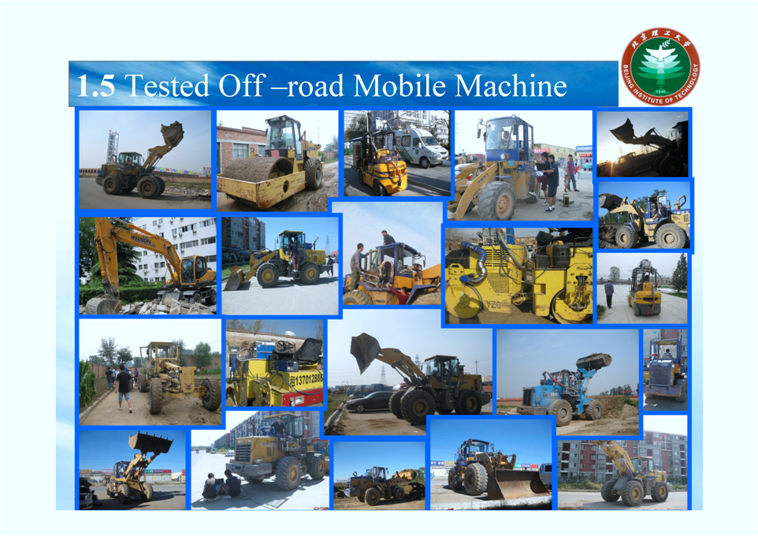

Slide 24
Hong Kong EPD

Slide 25
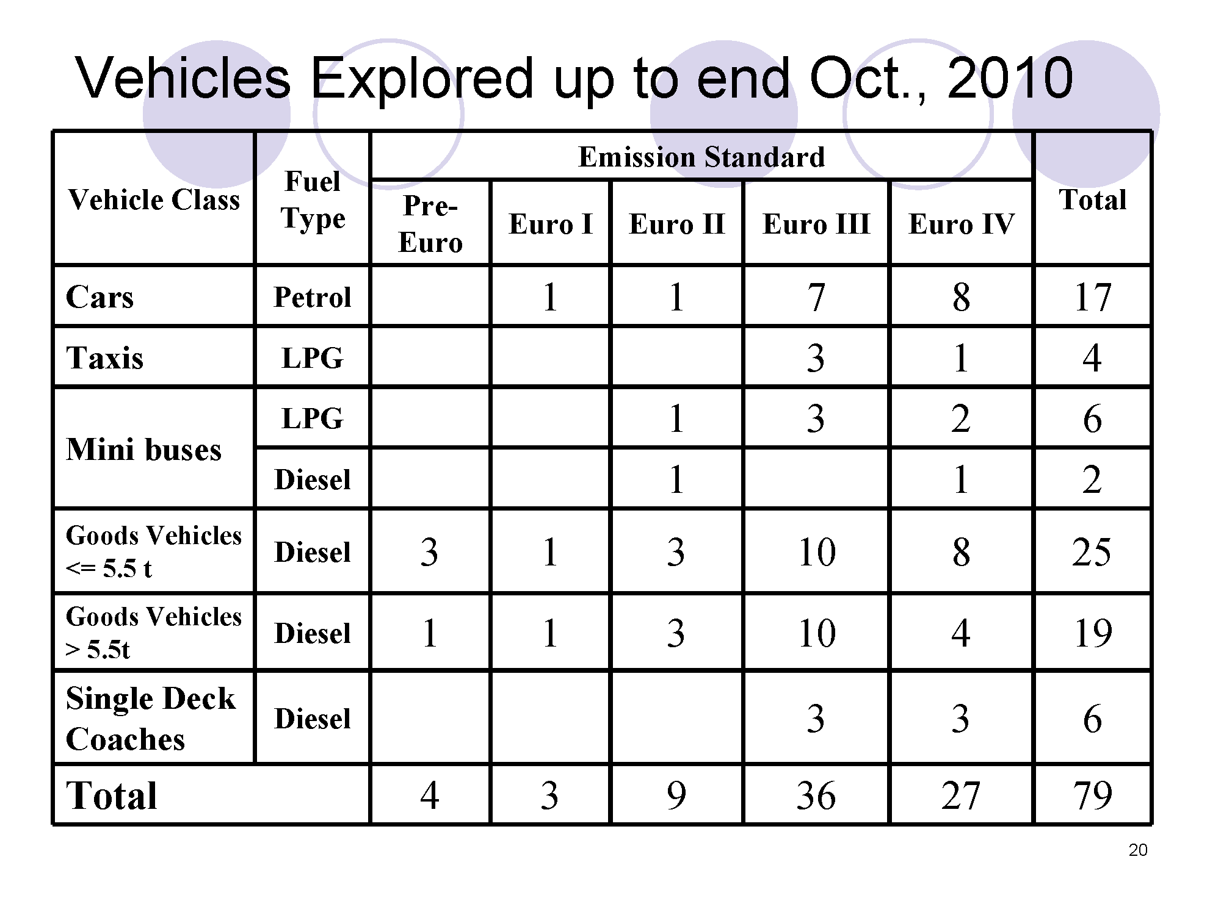
Hong Kong EPD

Slide 26
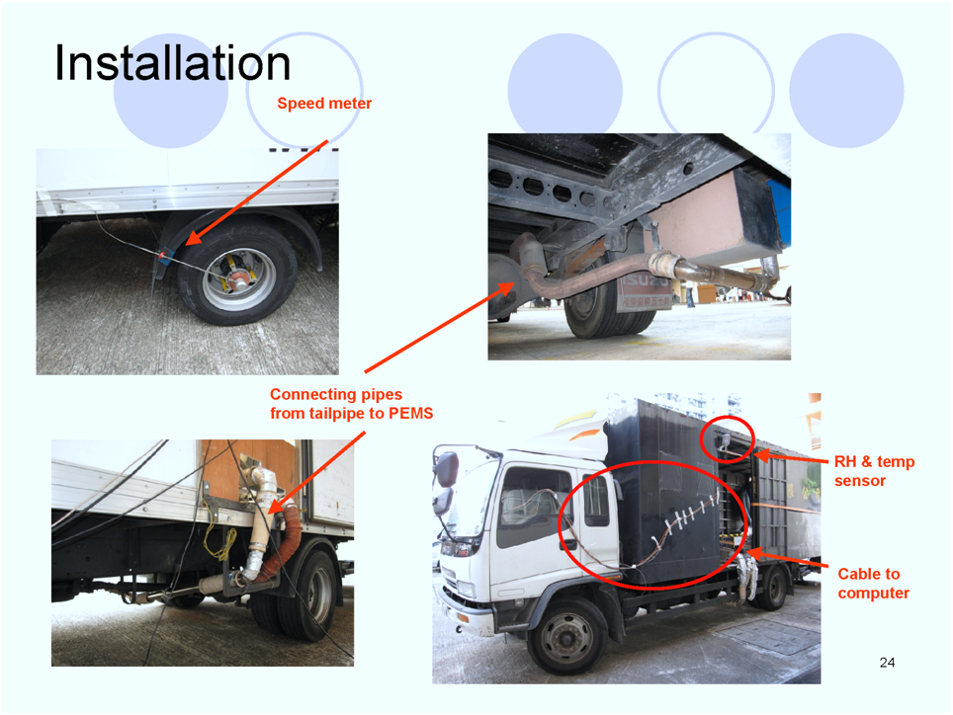
Hong Kong EPD

Slide 27
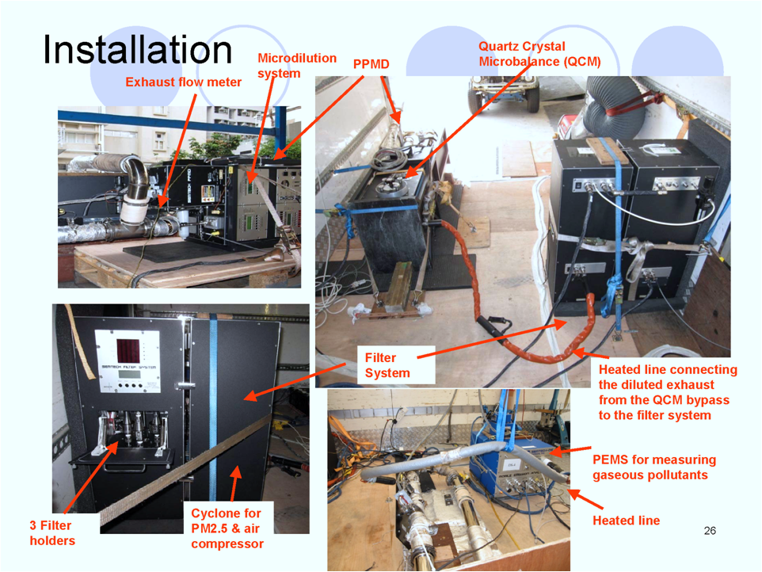
Hong Kong EPD

Slide 28
Hong Kong EPD

Slide 29
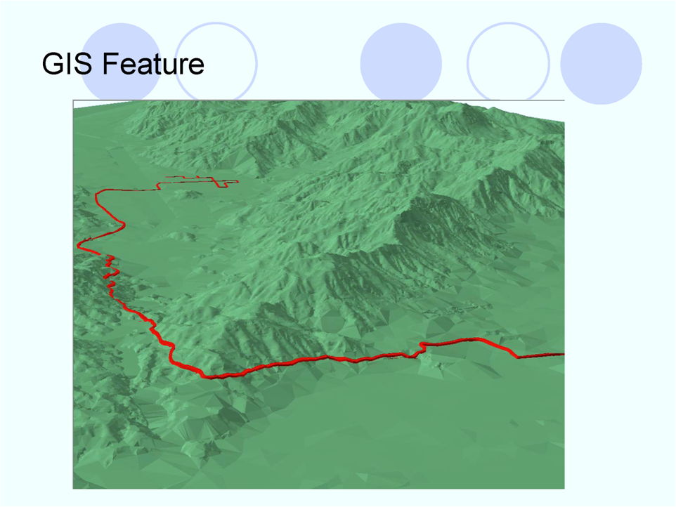
Hong Kong EPD

Slide 30
Summary
PEMS work is going on at a feverish pace in China
This technology is being used to understand and control mobile source emissions
With a fast growing fleet, control actions need to be taken soon
Many researchers are conducting measurements, developing models and looking for strategies to reduce emissions

