Slide 1
Sensor Based Emissions:
Perspectives On ‘REAL’ and Future Directions
William Robertson, Ph.D., Vehicle Program Specialist
UCR CE-CERT PEMS Conference, March 11, 2021

Slide 2
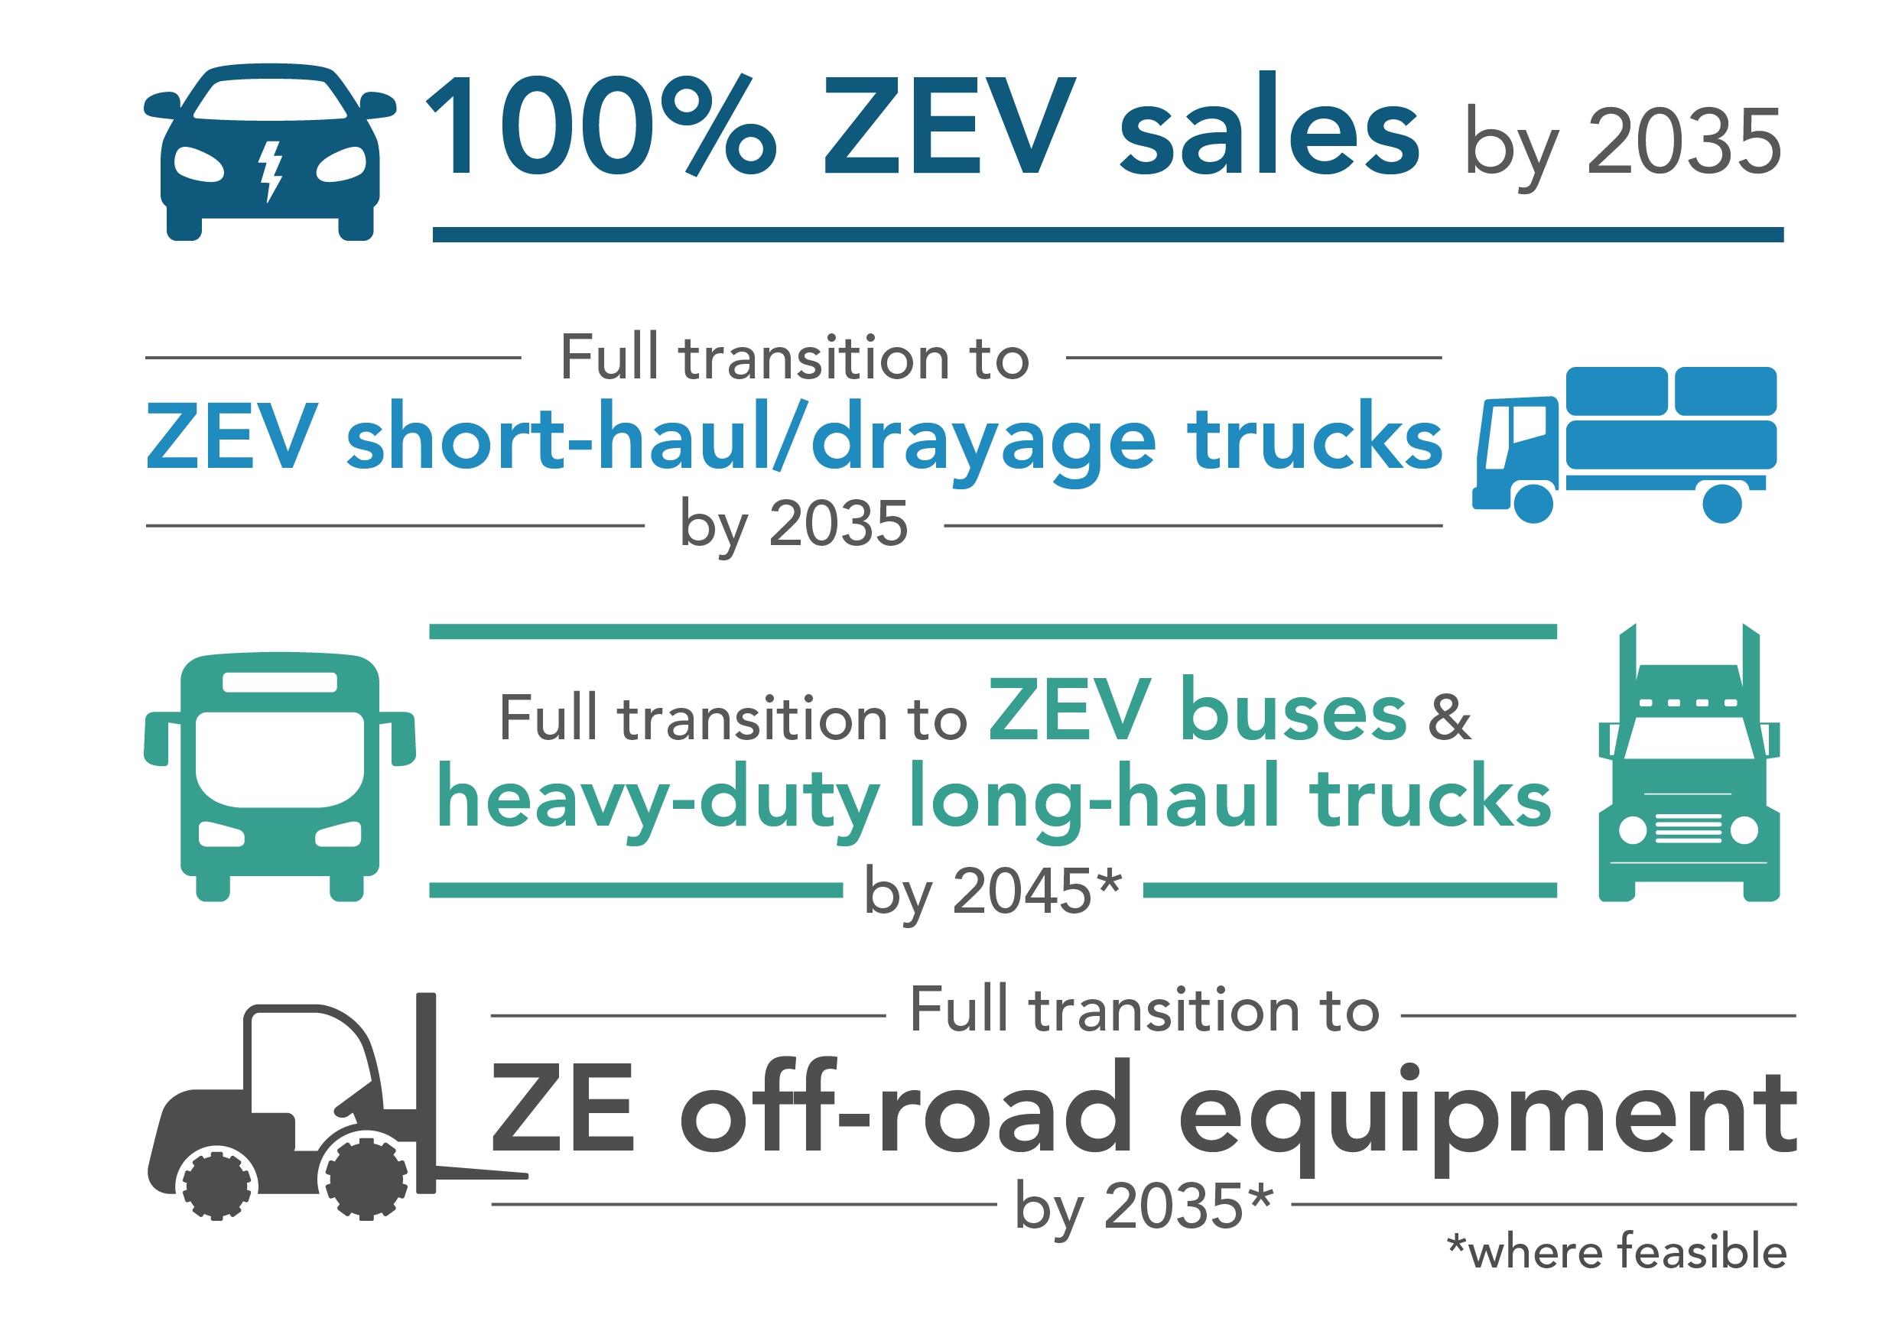
CA pushing into a ZEV Future
But: many long-lived ICE engines yet to be sold during transition

Slide 3
Steep NOx Reductions for HD
CARB rulemakings on NOx and ZEVs
US-EPA Cleaner Trucks Initiative and
Phase 3 GHG/ZEV process
Ozone Transport Commission and
Multi-state ZEV MOU each call for
lowering ICE NOx
NJ, NY, MA publicly analyzing S177 adoption
Related international efforts ongoing in Europe, China and elsewhere

Slide 4
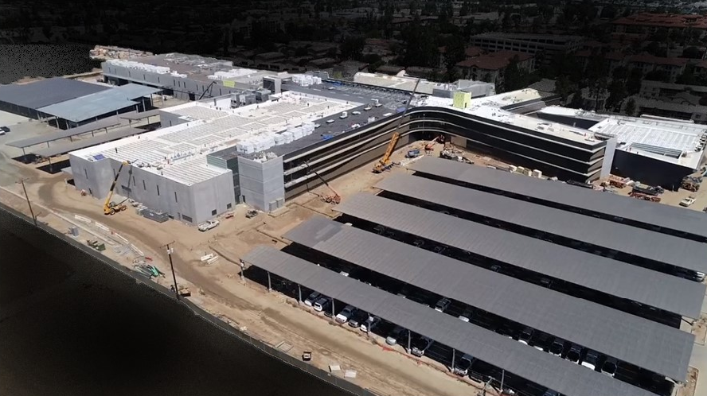
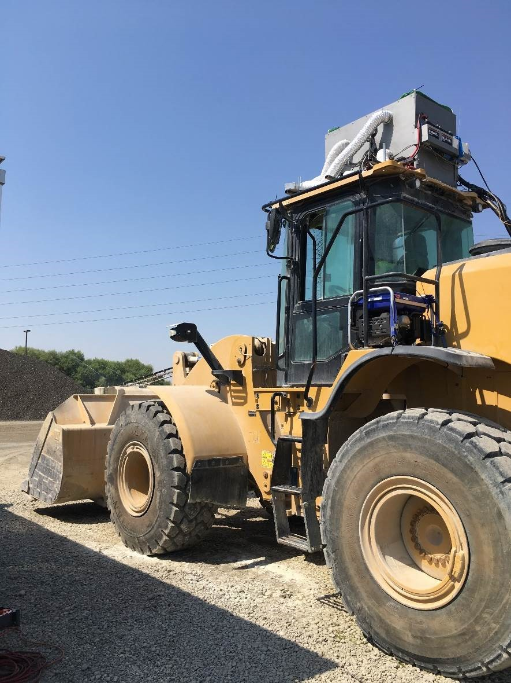
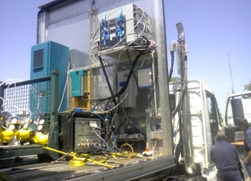
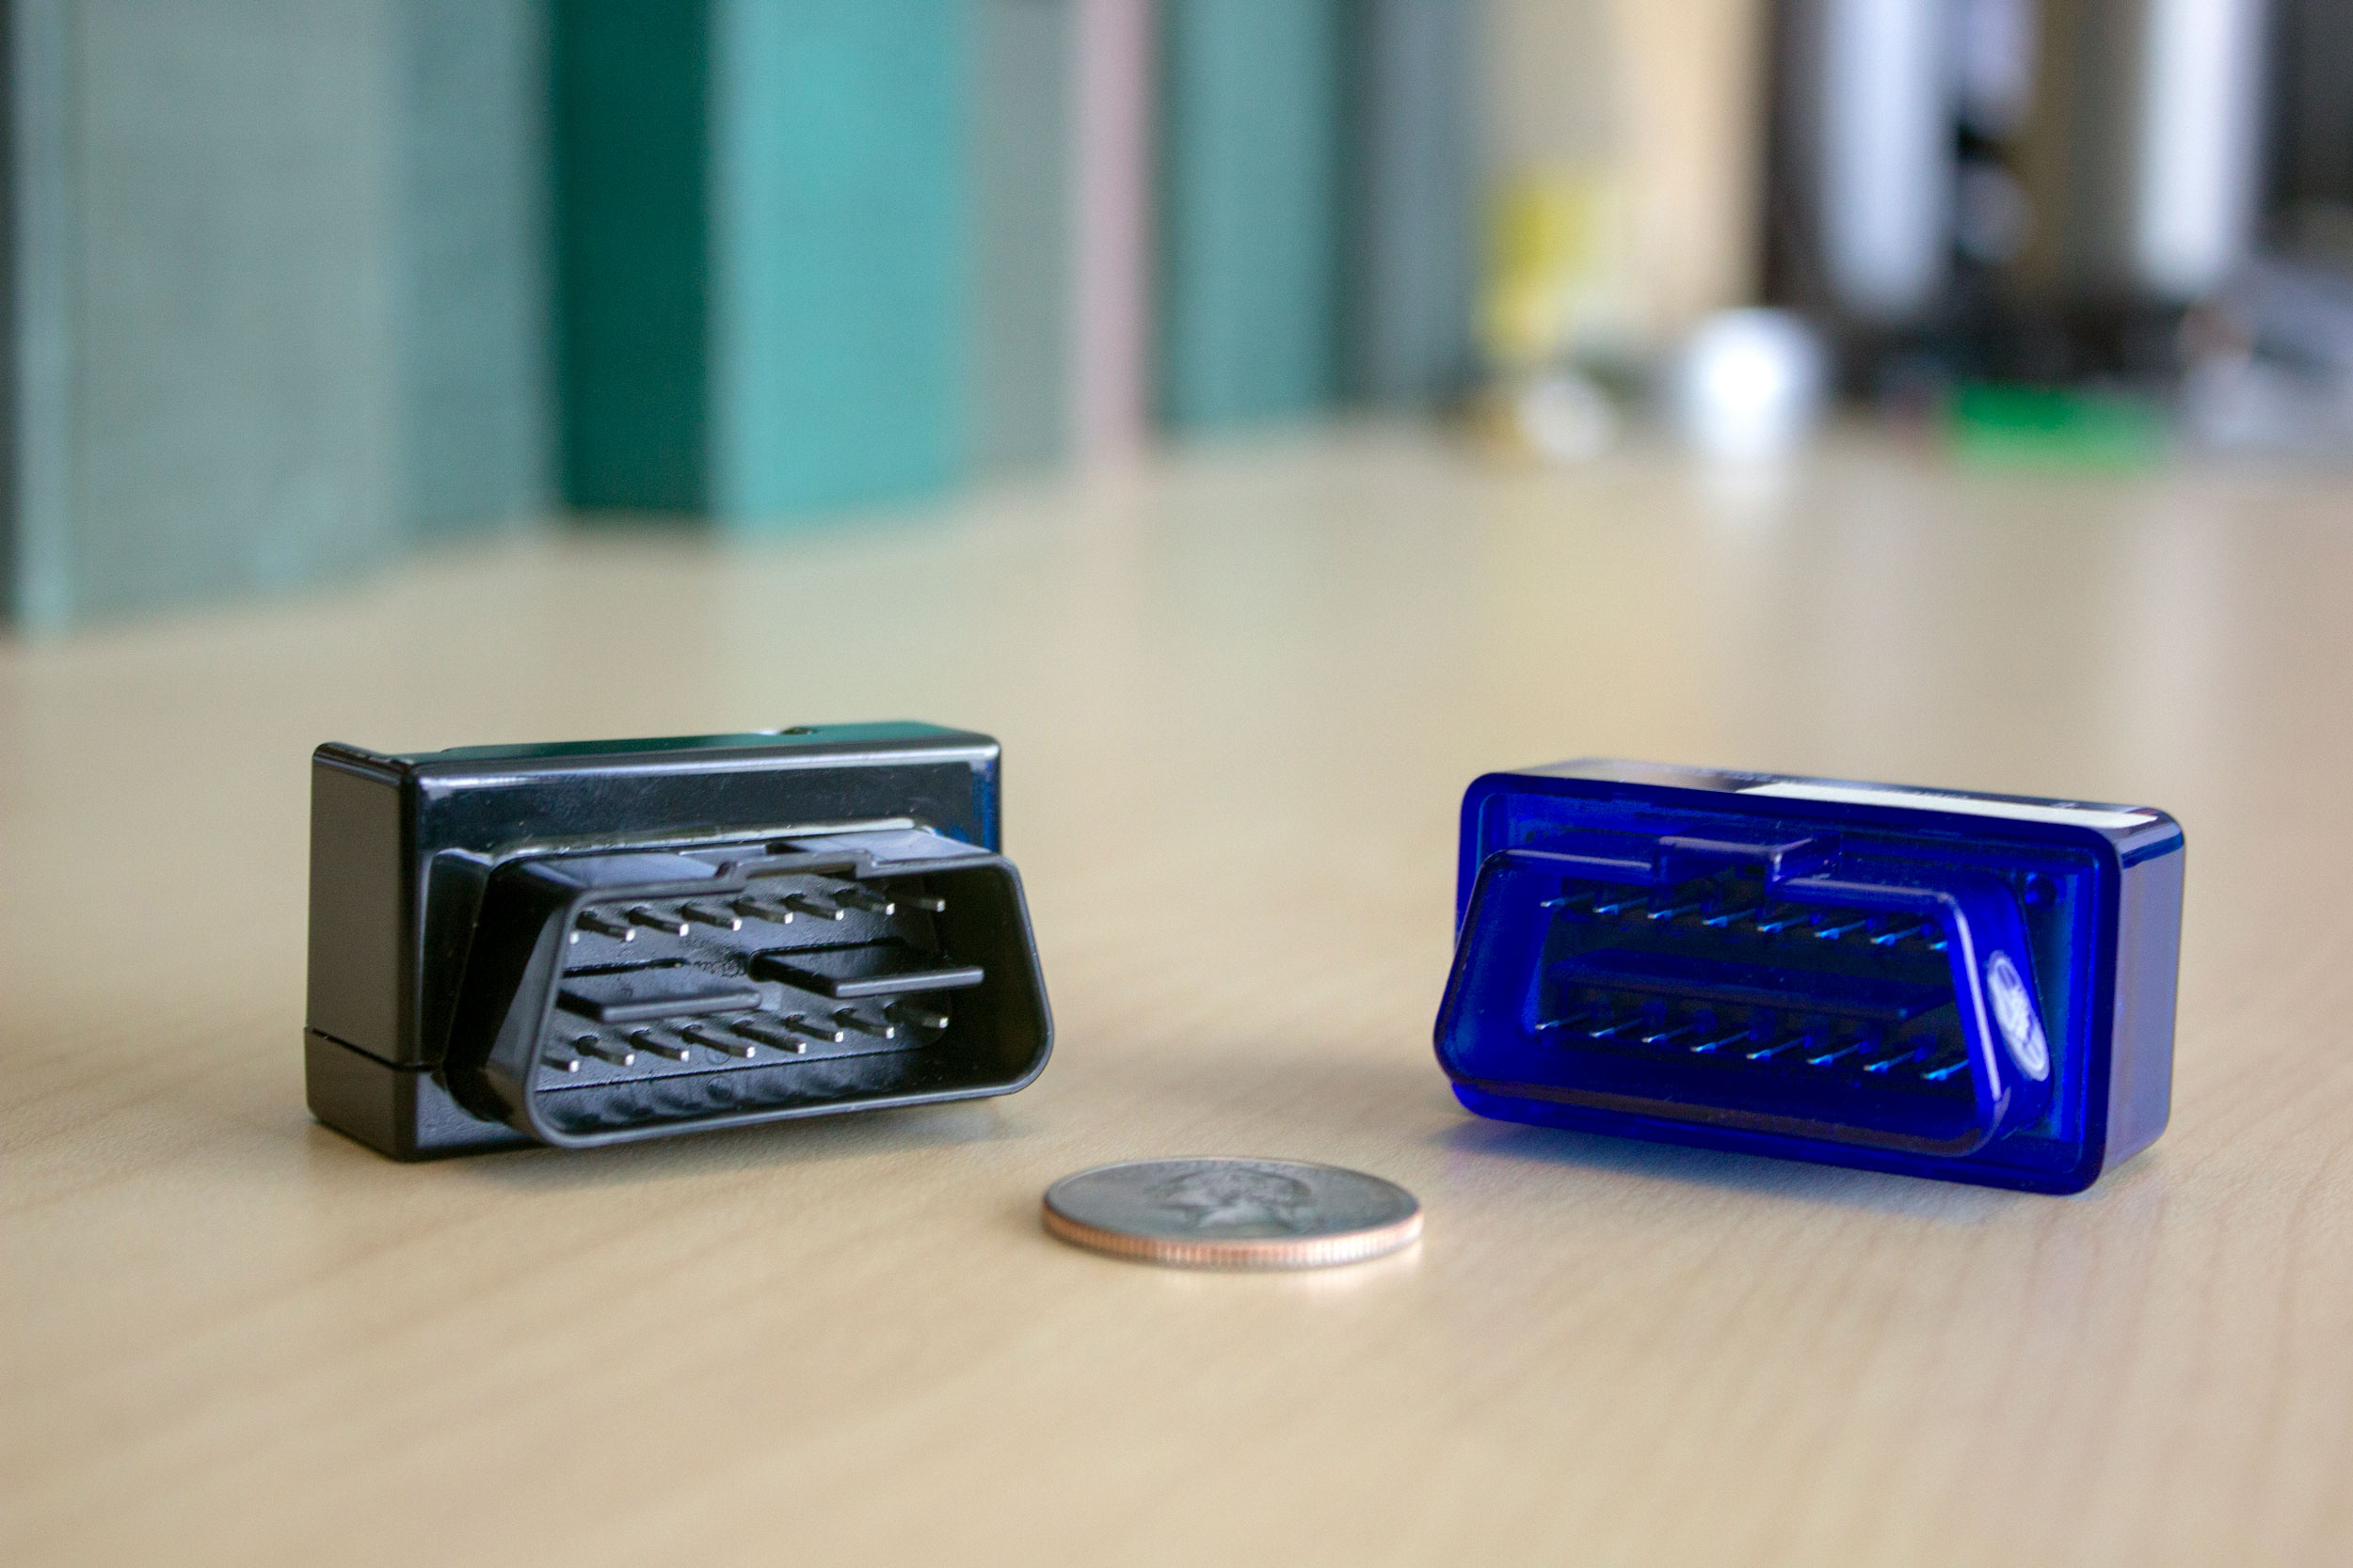
CARB looking with many Emissions Tools:
Sensors add additional dimension
New 19 acre campus
Chassis & Engine Labs
Field Testing Support
  PEMS
  OBD
  Datalogging
Chemistry Labs

Slide 5
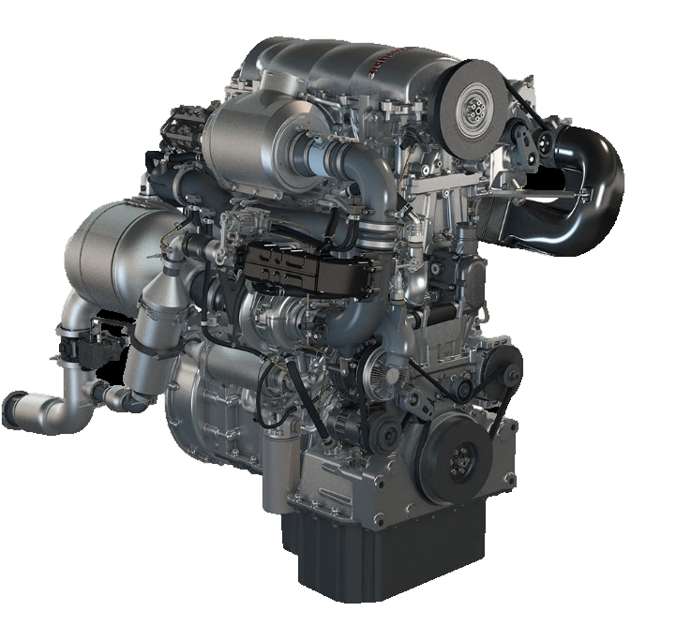
High Efficiency NOx Control
Success depends on:
Robustness across Dutycycles
Capable Controls for engine and dosing
Avoiding Tampering/ Malmaintenance
Achates demonstrated 0.02g NOx
with simple DPF/SCR
SwRI Stage 3 Dual Dosing SCR 0.02g Approach
SwRI Stage 3: https://ww3.arb.ca.gov/board/books/2020/082720/sharpguest.pdf
Achates Power: https://achatespower.com/wp-content/uploads/2020/12/Achates-Power-Opposed-Piston-Heavy-Duty-Diesel-Engine-Demonstration-Performance-Results-Ultralow-NOx-without-additional-hardware.pdf

Slide 6
Ubiquitous Emissions Transparency
Need to understand actual field emissions across:
Applications and Dutycycles
Much lower Concentration Ranges
Much longer regulatory Use-Life Periods
Engine Family-wide performance
Individual users’ behavior

Slide 7
Recognition of Sensors Potential
Sampling Statistics and Enabling Technologies:
EMA has proposed developing sensor-based policies
EPA requested sensor-based comments in CTI ANPRM
Ongoing existing-sensor evaluation projects
Federal Grants to novel NOx sensor technology developers
CARB Policy Action already taken for REAL and optional DF procedures

Slide 8
Remembering is the First Step
Real Emissions Assessment Logging (REAL)
NOx and activity data
calculated from CAN signals
Sorted into rough activity bins
Longterm and Recent
averages retained in ECU
Standardized communication
access to REAL data
Initiates the sensor conversations: evaluation, engineering and algorithms

Slide 9
Early CARB Applications of REAL
Omnibus option: Reduced DF testing obligations exchanged for OEMs Collecting REAL data
Potential for inventory augmentation: Considering opportunities to collect REAL data via HD I/M process

Slide 10
“Enabling Performance Thresholds”
?
Basic functionality needed
How do sensor-based strategies meet core programmatic needs?
How does sensor drift, noise, missing data, etc. manifest in evaluations?
How do sensor-based strategies achieve an equivalent level of protection?
What is a sensor’s “enabling performance threshold” for each policy concept?
Emissions Inventories
Pre-Sale Design Review
In-use Design Review
Maintenance Prognostics
Fault Detection
Repair Pinpointing
State of Good Repair
Enforcement

Slide 11
Apparent Tensions:
What do you want to do with Sensors?
Comparative valuing of:
Better population sampling statistics
Reduced testing/field work
Vs.
Actionable timescales relevant to public health deadlines
Any needed investment toward ‘enabling performance thresholds’
Perceptions of individual comparative risk
Clear possibilities, but in need of certainty

Slide 12
Bill Robertson
CARB Vehicle Program Specialist
william.robertson@arb.ca.gov
(626) 459-4467

