Slide 1
Company Profile
◉
URL: www.multicore-photonics.com Industry: Industrial Sensing → Transportation → Automotive
Employees: 6 (3 founders)
Founded 2015
IP: 1 Licensed | 5 Filed
Contact Information
◉
Christian Adams
Email: chris.adams@multicore-photonics.com
Cell: (352) 989-7717
NSF Sponsored Research: Fiber Optic Based NOx Sensor
PEMS Conference, March 2019 at UC Riverside
1

Slide 2
01. Agenda
◉
Who we are and what we do
Current NOx sensor state of the art
Background on how a different kind of chemical sensor was conceived
One slide summary of NSF Phase 1
Two slides covering NSF Phase 2
Summary
◉
◉
◉
◉
◉
Copyright 2019 Multicore Photonics, Inc. All Rights Reserved. Confidential Information.
Do not disclose, reproduce or use otherwise without written consent of Multicore Photonics, Inc.
1

Slide 3
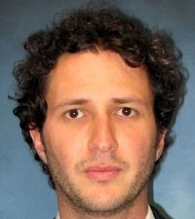
02. Our Team
Darren Engle
Jody Wilson
CEO
COO
Christian Adams
Dr. Kenneth Thompson
SVP of Science & Technology, (Principal Investigator, NSF SBIR)
Director of Data Science (Principal Investigator, Air Force SBIR)
Patrick Clark
Zachary Wilson
Director of Product Development
Technician
Advisors & Investors
Dr. Axel Schulzgen
Dr. Rodrigo Correa
Florida Institute
Hardin Bethea
Technical Advisor
Technical Advisor
Investor
Advisor
Copyright 2019 Multicore Photonics, Inc. All Rights Reserved. Confidential Information.
Do not disclose, reproduce or use otherwise without written consent of Multicore Photonics, Inc.

Slide 4
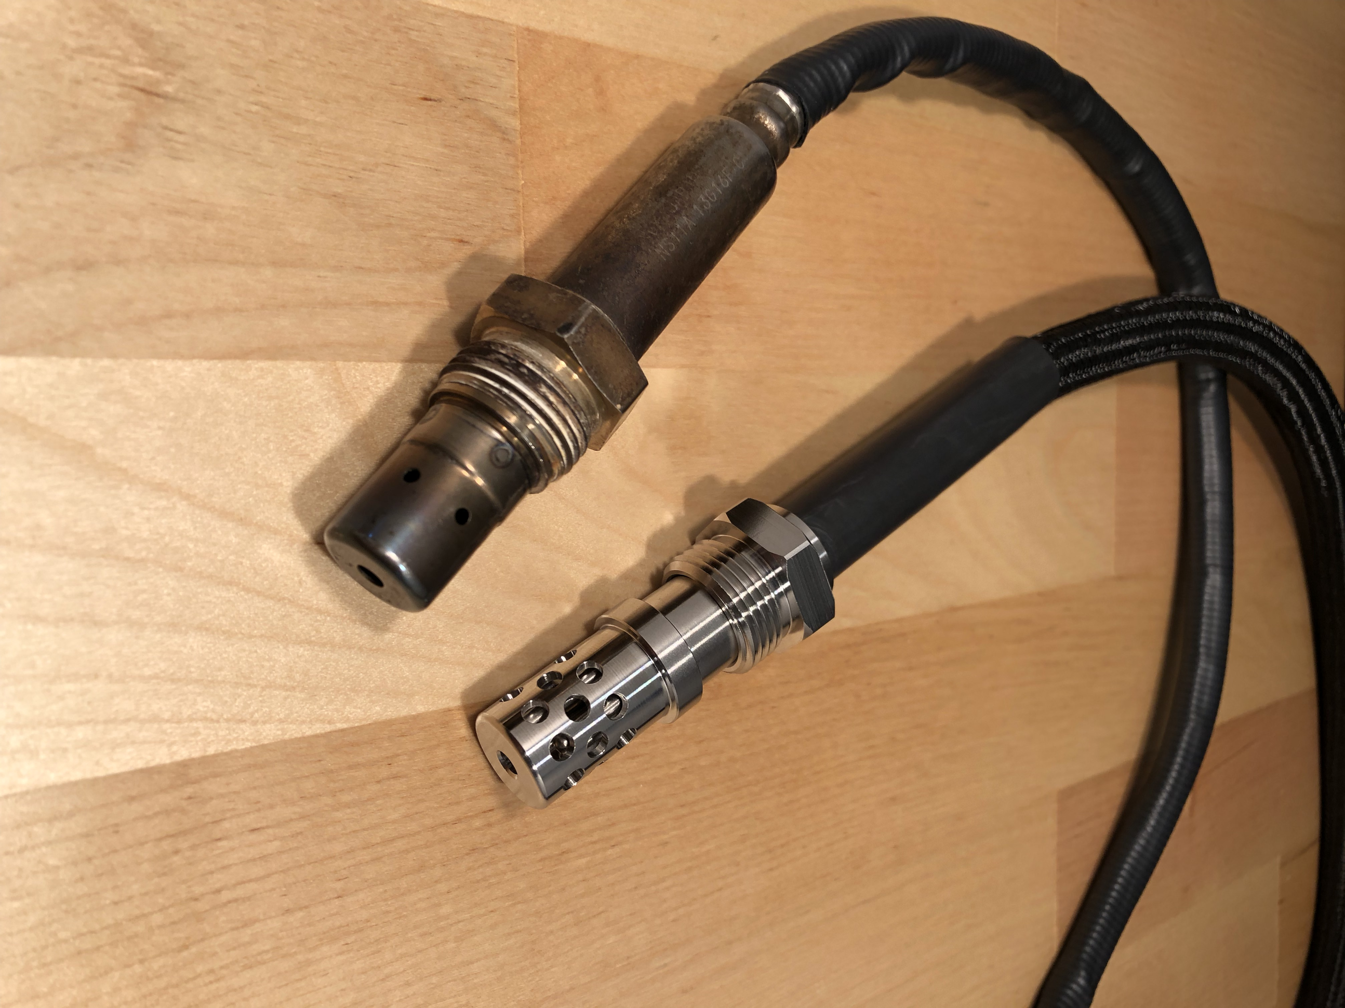
03. Sensor Principles Review
It’s critical to understand what’s involved with the oxygen sensor derivatives in detecting NOx
◉
The following slides summarize what is out there now, and how we are different (<2 min)
Bosch OEM NOx Sensor
Multicore Photonics NOx Sensor
Copyright 2019 Multicore Photonics, Inc. All Rights Reserved. Confidential Information.
Do not disclose, reproduce or use otherwise without written consent of Multicore Photonics, Inc.
3

Slide 5
04. Sensor Principles Review
A clever way to leverage thick film processing that includes platinum, gold, rhodium, and copper metallization techniques:
Goal of this portion of presentation is to step through the current process in detail. Know thy competition.
Copyright 2019 Multicore Photonics, Inc. All Rights Reserved. Confidential Information.
Do not disclose, reproduce or use otherwise without written consent of Multicore Photonics, Inc.
4

Slide 6
05. Sensor Principles Review
Step 1: Gas Into 1st Cavity
Once the exhaust gas has entered into the first internal cavity, pumping electrodes reduce the O₂ concentration in that cavity to a given set-point. The measured concentration in the Air Duct provides a set-point voltage reference.
Copyright 2019 Multicore Photonics, Inc. All Rights Reserved. Confidential Information.
Do not disclose, reproduce or use otherwise without written consent of Multicore Photonics, Inc.
5

Slide 7
06. Sensor Principles Review
Step 2: Gas Into 2nd Cavity
Since the second cavity O₂ content is known with the help of the reference signal in the air duct, exhaust NO_{x} that is reduced on the Rh measuring electrode adds additional O₂ to the 2nd cavity as O₂ is the reduction product of NO_{x}. So now [NO_{x}] can now be inferred.
Copyright 2019 Multicore Photonics, Inc. All Rights Reserved. Confidential Information.
Do not disclose, reproduce or use otherwise without written consent of Multicore Photonics, Inc.
6

Slide 8
07. Background & Conception of Multicore NOx Sensor
Based on the Issues with Current NOx Sensor Technology, a Solution was Generated:
◉
Previously: Set Up a Corporate Hardware Anti-Tamper Laboratory Center of Excellence
10 years identifying repeatable physical and electronic “fingerprints” or patterns from platform subcomponents that could be combined to create inviolable electronic signatures, among other cryptograph generation activities
Besides generating 12 patents, this experience resulted a unique way of looking at the world that later lead to sensor designs not based on conventional approaches, yet still utilizing existing physical principles and accepted metrology.
Multicore IP: Map Physical Phenomena “Outputs” as n-Dimensional Fingerprints
Our patented sensor layout is comprised of sub-sensors, where each sub-sensor may respond in a slightly different but still repeatable manner across a set of known multi-dimensional inputs.
The key (literally) lies in the device calibration with an n-dimensional database lookup table (LUT), a set of equations, or both; this sufficiently maps the output of sub-sensors monitoring a given environmental calibration space (i.e. exhaust).
The calibration map must be of sufficient fidelity that it forms the outline of a “response surface” where interpolation between measured points can be done with confidence. Separate and distinct calibrations can exist on same device.
Non-sub-sensor (i.e. external) inputs can be included in LUT as long as they are reliable, and repeatably coincident.
Agnostic to Sensor Type
The measurement technology employed among the sub-sensor array is not relevant. Besides thermo-catalytic activity (see following slides), spectroscopic information can be measured using multiple photo-detectors that measure the respective intensities of a matching number of slightly overlapping wavelength excitation bands; this can also generate the required “fingerprint” to identify the makeup of many fluid streams – gas or liquid. The possibilities are endless!
◉
◉
Copyright 2019 Multicore Photonics, Inc. All Rights Reserved. Confidential Information.
Do not disclose, reproduce or use otherwise without written consent of Multicore Photonics, Inc.
7

Slide 9
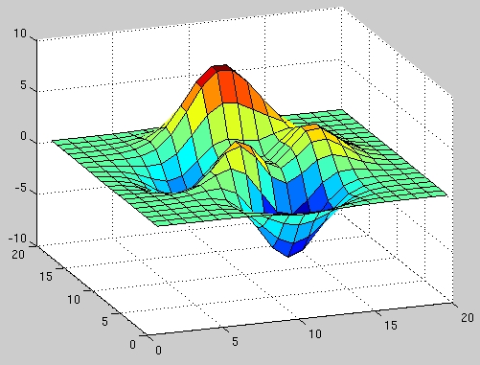
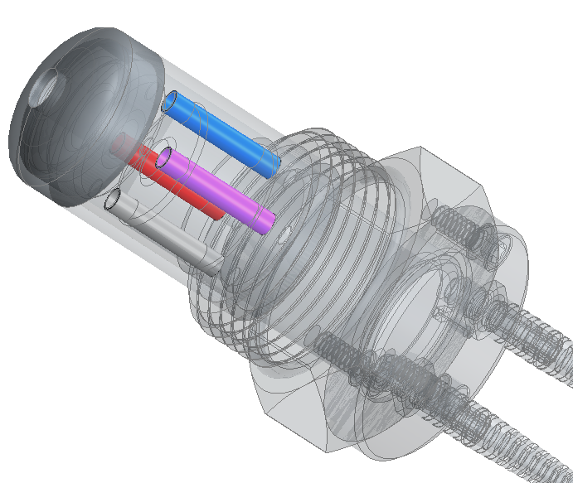
08. New Sensor Concept
Clean-sheet Design:
◉
Multiple catalysts sensitive to multiple exhaust gas components
Besides an inert reference, design has multiple and different catalyst coated sensors
Virtually instantaneous thermal response to CO, NOx, NH₃, & unburned HC
The different catalysts generate varying responses according to temperature trends and changes in gas composition
When individual thermocatalytic responses are mapped a very specific and repeatable calibration hyper-surface emerges
Initial design completely passive
Greatly reduces complexity of design
Allows for fiber-optic measurement of ΔT
No power required
◉
Copyright 2019 Multicore Photonics, Inc. All Rights Reserved. Confidential Information.
Do not disclose, reproduce or use otherwise without written consent of Multicore Photonics, Inc.
8

Slide 10
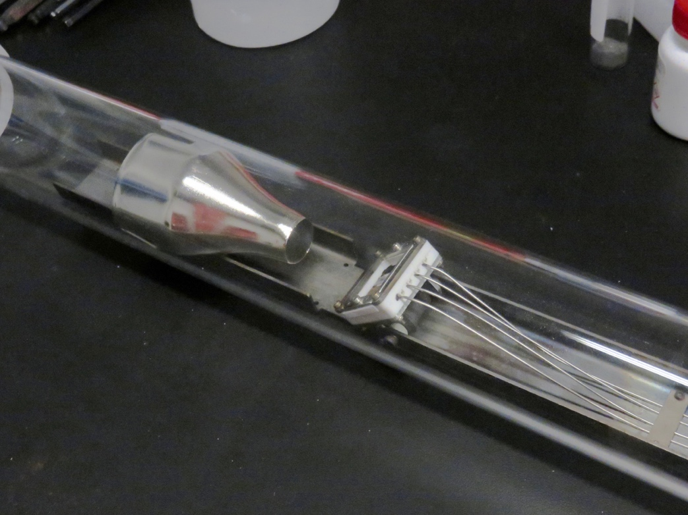
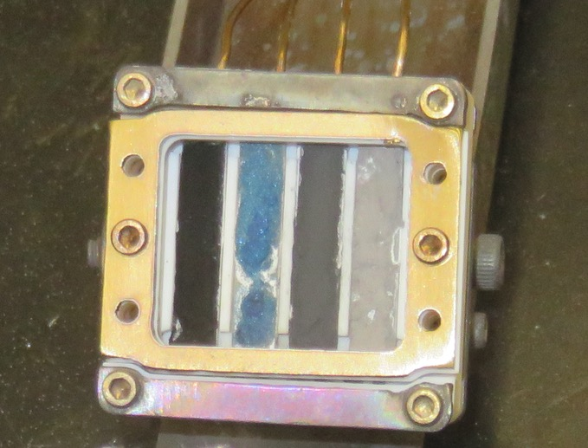
09. NSF Proposal – Fiber Optic Based NOx Sensor
Phase I Proposal Submitted to the National Science Foundation in June of 2015
◉
6-Month Program, Told at Git-go we Had to Dedicate 3 Months to “Customer Discovery.”
This lead to discussions with high-level employees at CARB, which in turn lead to our initial discussion with Kent and our invitation here! Unfortunately there wasn’t very much time to build a multi-element high-temperature exhaust sensor, but we managed.
Thermocatalytic Response Mapping:
NSF Phase I outcome demonstrated the principle of a “response surface” that shows how multiple catalytic sub-sensors can respond differently across varying combinations and concentrations of multiple exhaust gases; all measured at multiple temperatures.
$150K
Add pic of fiber optic
◉
3 equations 3 unknowns
Copyright 2019 Multicore Photonics, Inc. All Rights Reserved. Confidential Information.
Do not disclose, reproduce or use otherwise without written consent of Multicore Photonics, Inc.
9

Slide 11
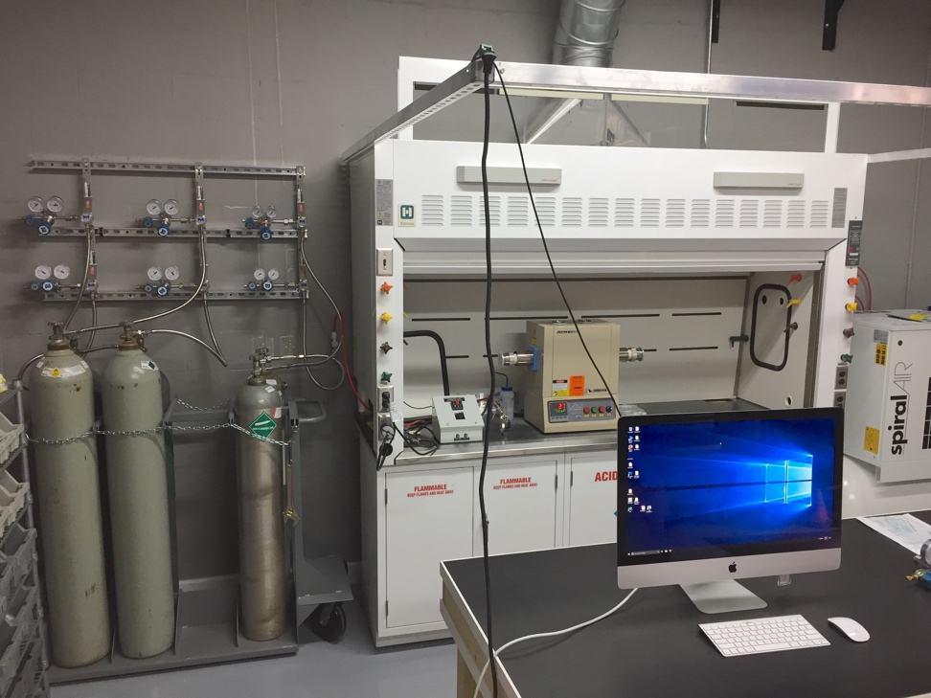
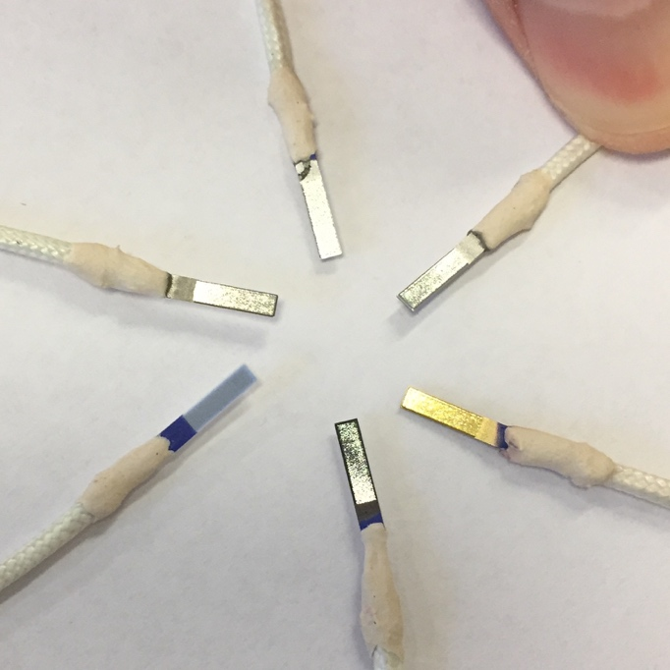
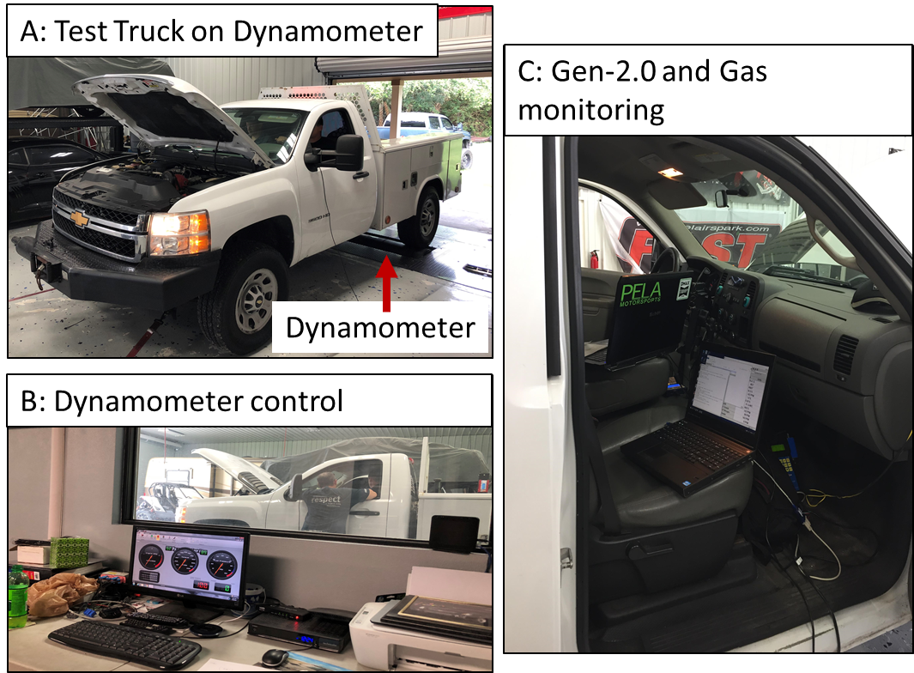
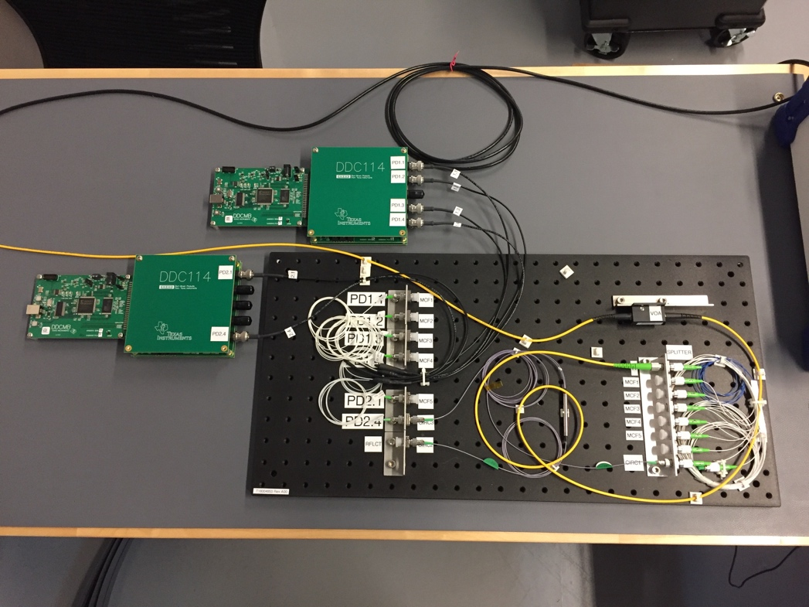
10. NSF Proposal – Fiber Optic Based NOx Sensor
Phase II Proposal Submitted to the National Science Foundation in August of 2016
◉
Award notice March 2017: 2-year Technical Program with Emphasis on Product Development and Commercialization
Setting up laboratory and hiring
Synthetic diesel exhaust (fume hood, mass flow controllers, gases and plumbing)
Optical bench (laser source, spectrometers, optical fiber equipment, etc.)
Electrical/optical engineer, software engineer, mechanical engineer, technician
Two parallel thrusts of the research: materials development (maximize the catalytic signals) and sensor development (maximize the measurement sensitivity)
Started with PVD of catalysts directly on to COTS (Omega) RTD sensor elements
Ended up with a custom mixture applied directly on to thermocouples
Continued work on multicore fiber sensor
Initial installation of RTD-based laboratory NOx sensor onto test truck
$750K++
Copyright 2019 Multicore Photonics, Inc. All Rights Reserved. Confidential Information.
Do not disclose, reproduce or use otherwise without written consent of Multicore Photonics, Inc.
10

Slide 12
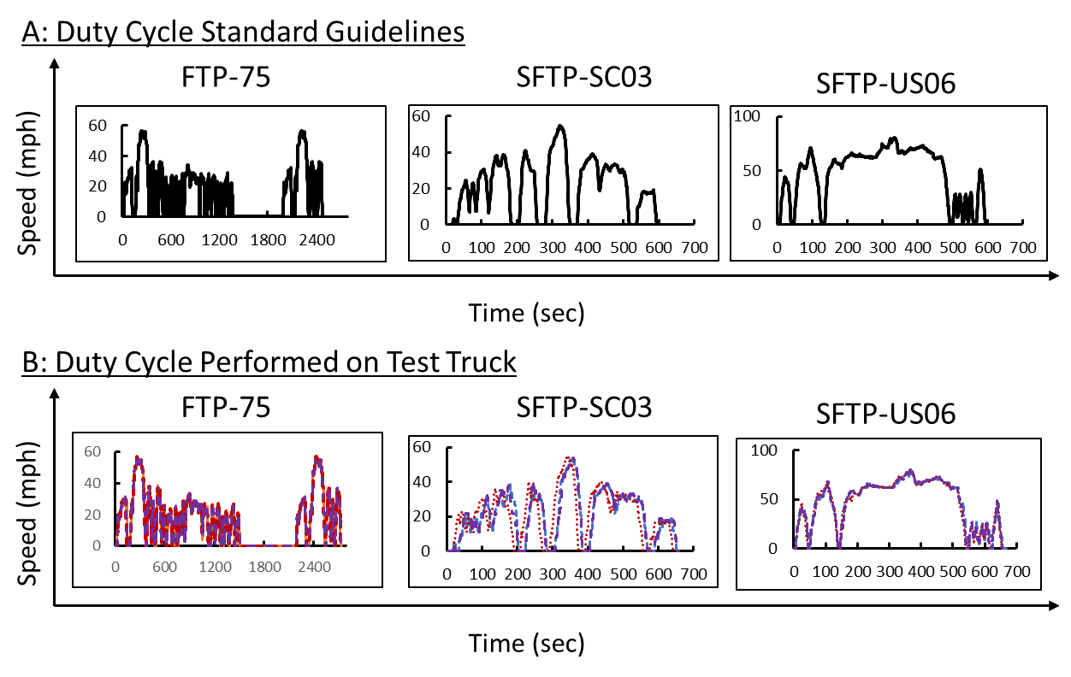
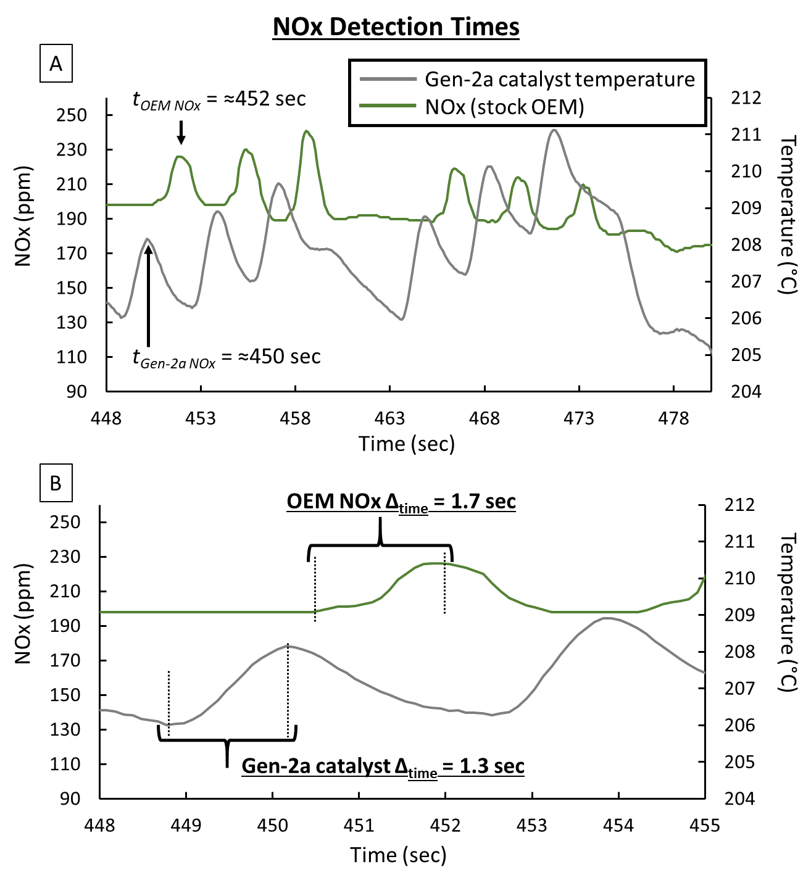
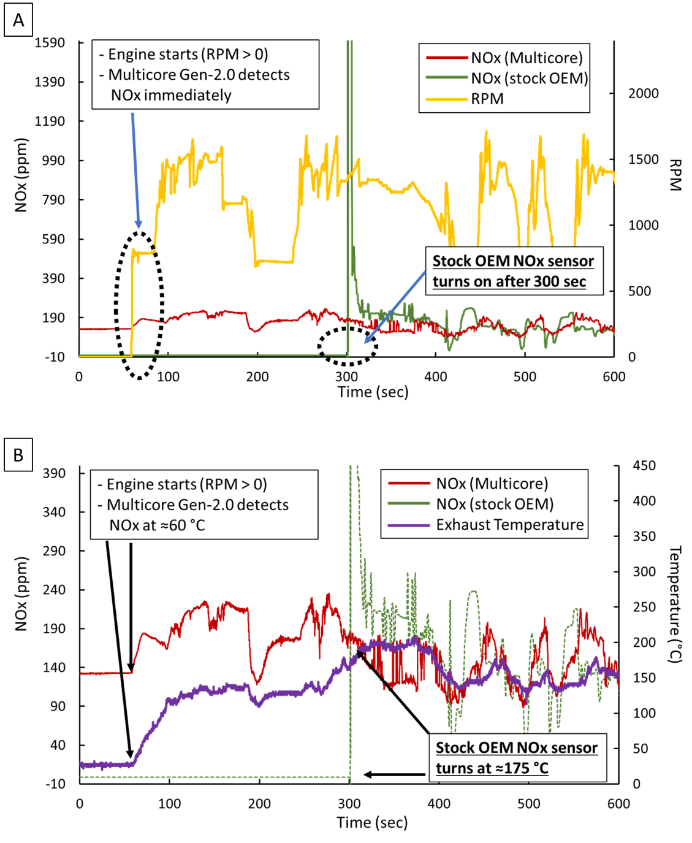
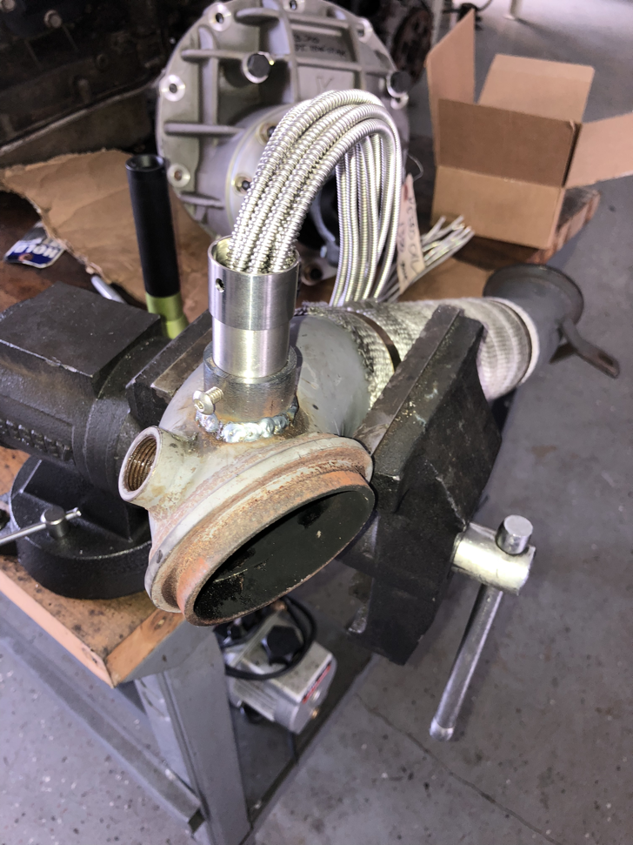
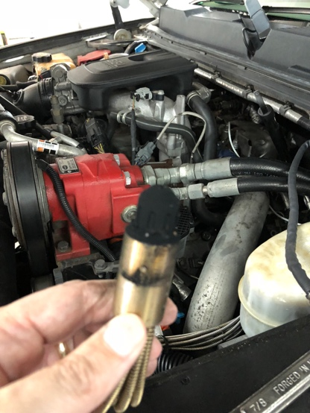
11. NSF Proposal – Fiber Optic Based NOx Sensor
Important Data Points
◉
Noteworthy tests conducted so far include
DOT test parameters where the light off & response times were recorded.
A: Three EPA duty cycles. B: Data from test truck, each test was performed in triplicate.
Test Truck Install and Removal
Detection time of Multicore Gen-2a sense is faster than the OEM NOx sensor. A: Shows six NOx peaks (OEM NOx sensor) vs. six temperature peaks (Gen-2a). The six temperature peaks precede the six peaks of the OEM sensor. B: Gen-2a sensor measures the increase in time in ≈1.3 seconds vs. ≈1.7 seconds for the slower OEM NOx sensor. Next NOx event is captured before OEM finishes the first.
Light-off time of Multicore Gen-2a sense is faster than the OEM NOx sensor. A: Light-off times. Multicore NOx sensors detects emissions as soon as the engine starts, as indicated by the RPM going from zero to non-zero once the system starts. The OEM stock NOx sensor does not have a NOx reading until >250 seconds from the start of the engine. B: Light-off times are also related to temperatures. Multicore NOx sensors detects NOx at ~60⁰C, while OEM stock NOx sensor detects NOx at ~175⁰C
Copyright 2019 Multicore Photonics, Inc. All Rights Reserved. Confidential Information.
Do not disclose, reproduce or use otherwise without written consent of Multicore Photonics, Inc.
11

Slide 13
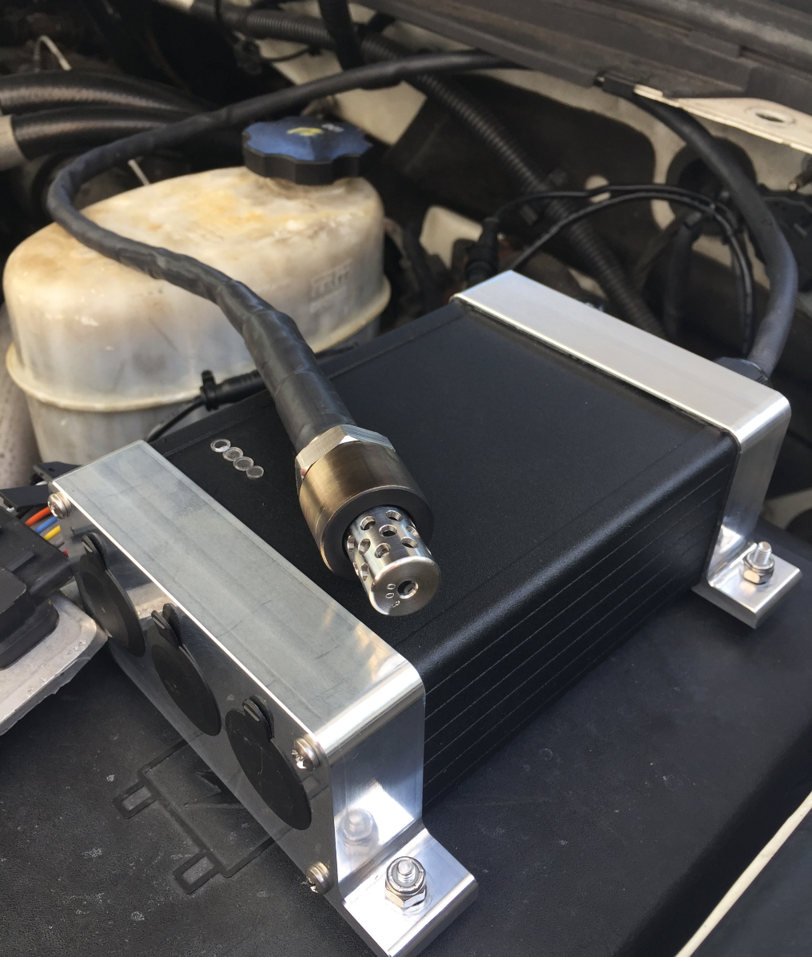
12. Conclusion & Summary
◉
Multicore’s Gen-2a NOx sensor:
Has a faster light-off time (nearly instantaneous) than both the stock OEM NOx sensor (≈300 seconds) and a commercial 5-gas exhaust gas analyzer (≈120 sec)
Has a detection speed greater than both Multicore's Gen-1 NOx sensor variant and the stock OEM NOx sensor. (Gen-2a > Gen-1 > stock OEM).
NOx accuracy is commensurate with a commercial 5-gas exhaust gas analyzer in two of the three tested duty cycles.
Is ready for pre-commercial sales.
Next Steps
Improve Software Detection Algorithm
Deploy 20 pre-commercial Multicore Gen-2b NOx sensors to gather additional field data.
Conduct additional laboratory synthetic exhaust tests
Third-Party Verification
General Motors
Cummins
Universities/Agencies
Commercial Sales
Manufacture, assemble and qualify the first run of 1,000-units (Gen-2c NOx sensor)
Continued Development of the Optical Sensor Variant (Gen-3a NOx sensor)
◉
Copyright 2019 Multicore Photonics, Inc. All Rights Reserved. Confidential Information.
Do not disclose, reproduce or use otherwise without written consent of Multicore Photonics, Inc.
12

