Slide 1
Mobile Source In-use Emissions Compliance - A Reality Check and Future Vision
9th Annual PEMS Conference
March 14th, 2019
1

Slide 2
Overview
Agency changes, accomplishments and goals
Current MS contribution on NOx and GHG inventories
Reductions accomplished and planned
2

Slide 3
Overview (cont’d)
Reality check - Current HD In-use emissions and warranty rates
CARBs PEMS program only growing
Paradigm shift to continuous monitoring of In-use emissions performance
Preview REAL
SCCP Update
3

Slide 4
Organizational Changes to Align with Priorities
(Establishing New Divisions)
Sustainable Transportation and Communities Division
Emissions Certification and Compliance Division
Mobile Source Laboratory Division
4

Slide 5
Major 2018
Accomplishments
Launched AB617 Community Protection Program
Reduced emissions below 2020 Greenhouse Gas Target
Made Significant Progress on Zero Technologies
Enhanced Cap-and-Trade and Low Carbon Fuel Standard
Adopted Criteria Pollutant and Toxics Emission Reporting Regulation
Major 2019
Priorities
Implementing AB 617
Pursuing Carbon Neutrality
Executing Scoping Plan and State Implementation Plans
Approaching Transportation Holistically
Strengthening Collaboration with States/Nations
5

Slide 6

Themes
Focusing on Communities
Acting on Climate Change
Advancing Clean Transportation
Collaborating with Partners
6

Slide 7
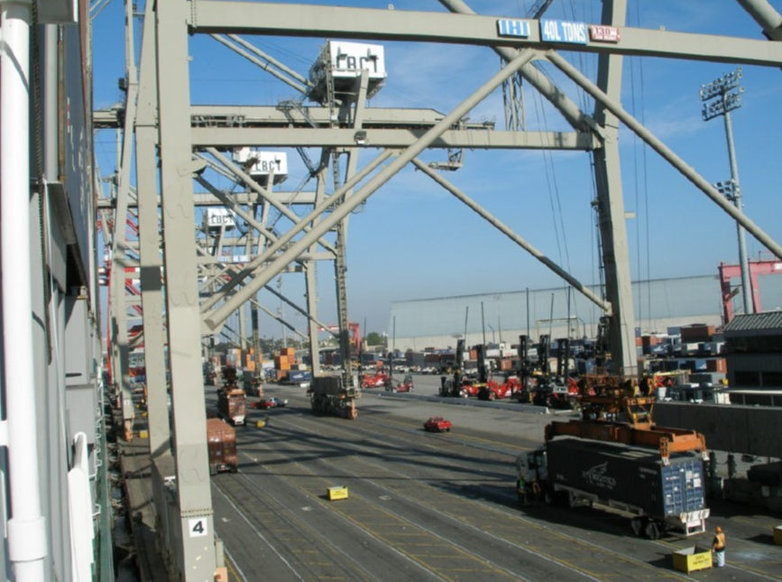
Reduced Community Impacts From Freight
2018 Accomplishments
Awarded $415 million to freight projects in disadvantaged communities
Provided formal comments on 10 proposed freight projects
7

Slide 8
Enhancing Community Data
2019 Priorities
More granular mobile source data
Update Pollution Mapping Tool
Statewide Community Air Monitoring Data Portal
Update toxics emissions data
Board hearing on amendments to Air Toxics “Hot Spots” Emission Inventory Criteria and Guidelines Regulation
8

Slide 9
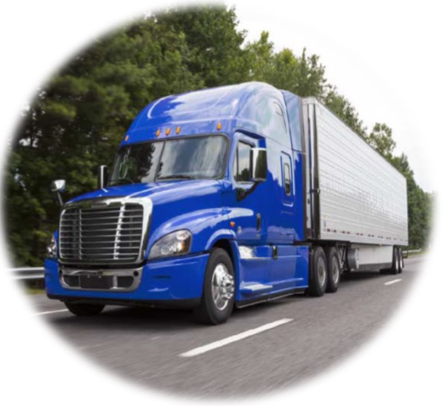
Transitioned to Cleaner Trucks
2018 Accomplishments
Cummins truck recall: 500,000+ vehicles
Board approved:
  Tractor-Trailer GHG regulation amendments
  Innovative Clean Transit regulation
  Heavy-duty Vehicle Inspection Program (HDVIP)/Periodic Smoke Inspection Program (PSIP) amendments
  Heavy-duty Warranty amendments
Enhanced truck and bus enforcement leading to implementation of SB 1
9

Slide 10
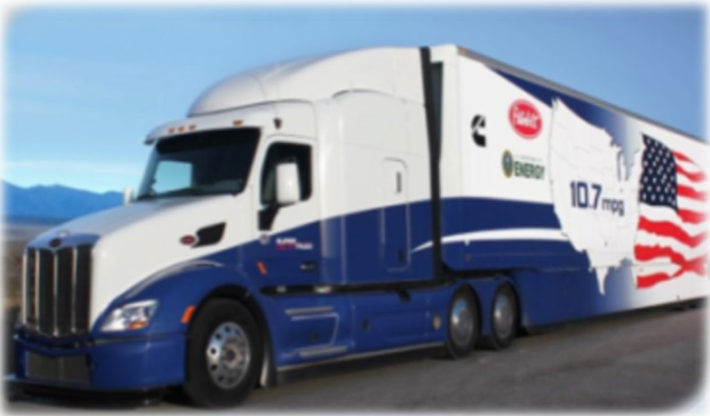
Establishing Next Generation Clean Trucks
2019 Priorities
Heavy Duty Omnibus including Low NOx Standard
Zero emission truck fleet rules per recent Governor’s Executive Order
Board Hearings on
  Zero-Emission Truck Manufacturing
  Zero-Emission Airport Shuttle
  Emission Powertrain Certification Regulation
10

Slide 11
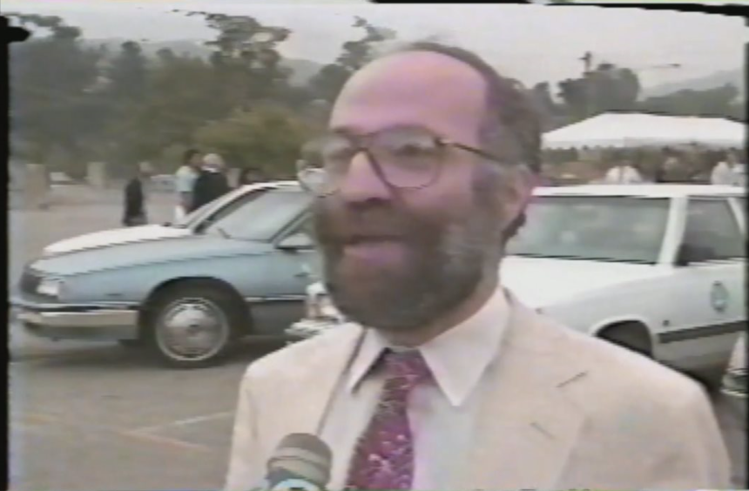
After 50 Years of Standards, Mobile Source Emissions Still Significant Share of Inventory
Mobile Sources >80%
Mobile Sources ~35%
Mobile sources represent ~50% of GHG inventory when including emissions from fuel production

Slide 12
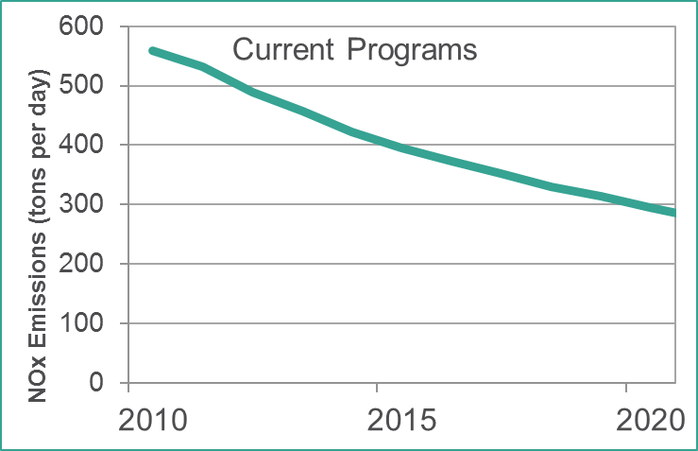
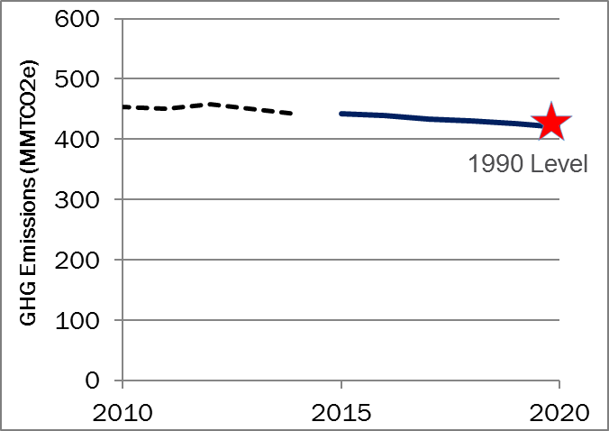
Current Programs Have Achieved Significant Reductions
NOx, South Coast, All Sources
GHGs, Statewide, All Sources

Slide 13
Reductions Achieved via Many Individual Elements
Certification
Early Vehicle Life
Mid-Vehicle
Life
▪ Design Review
▪ Emission data
▪ Durability data
▪ OBD
▪ AECDs
▪ Warranty
Late Vehicle Life
▪ Manufacturer Testing: Assembly line, IUVP, HDIUT, OBD PVE/MST
▪ CARB Testing: IUCP, HD NTE, OBD confirmatory testing
▪ Warranty Reporting
CARB Testing
▪ Manufacturer Testing: IUVP, OBD MST
▪ CARB Testing: HD NTE
▪ Inspection/ Maintenance: Smog Check, HDVIP, PSIP
▪ Inspection/ Maintenance: Smog Check, HDVIP, PSIP
▪ CARB Testing: EMFAC, Smog Check Support
▪ Fleet turnover: Truck & Bus rule, incentives
▪ Research/Lab Studies
▪ PEMS on-road
▪ Tunnel/Remote Sensing
▪ Data Logging
▪ Ambient Air Quality
▪ Regulatory Development
13

Slide 14
But We Still Need More
NO_{X} Emissions, South Coast Air Basin
(All Sources)
Greenhouse Gas Emissions, Statewide
(All Sources)
Current Programs
1990 Level
Reference Scenario
SB 32 40% Reduction
2023 Target
2031 Target
Executive Order Carbon Neutrality
Source: CARB, 2016 Mobile Source Strategy
Source: CARB, 2017 Climate Change Scoping Plan;
2018 Exec. Order B-55-18

Slide 15
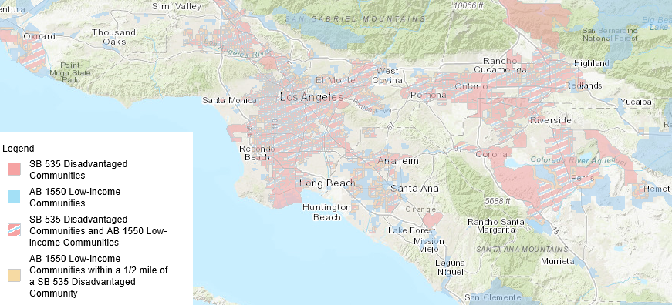
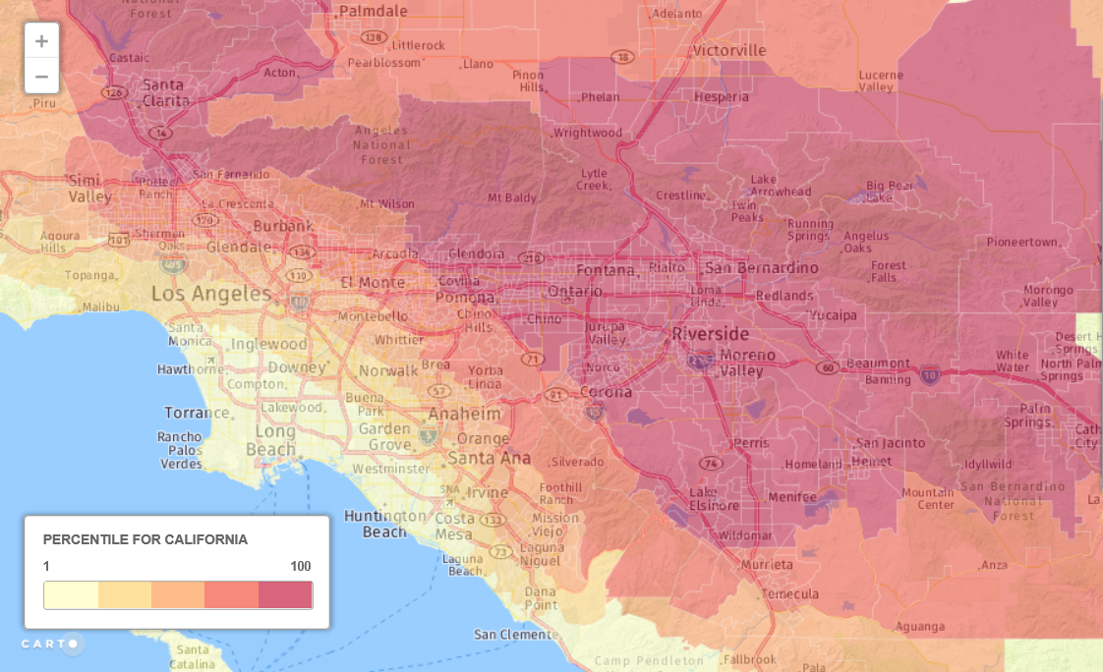
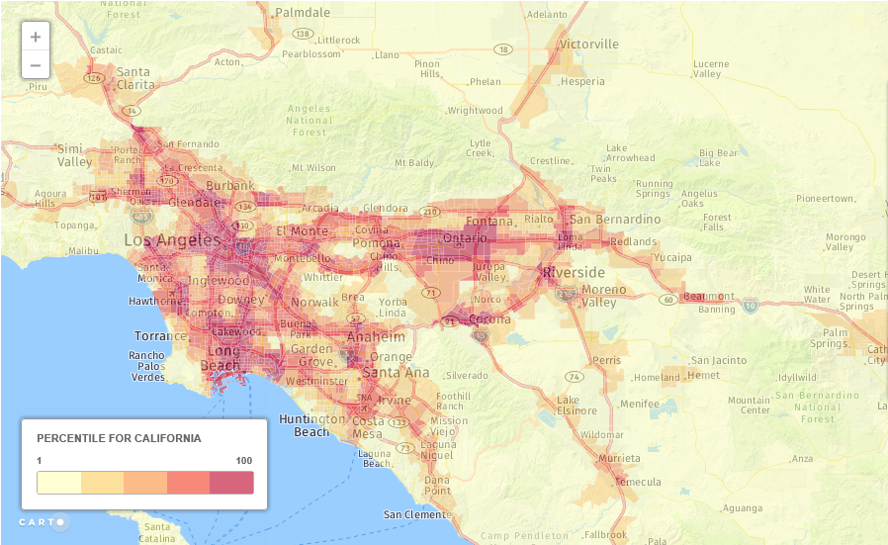
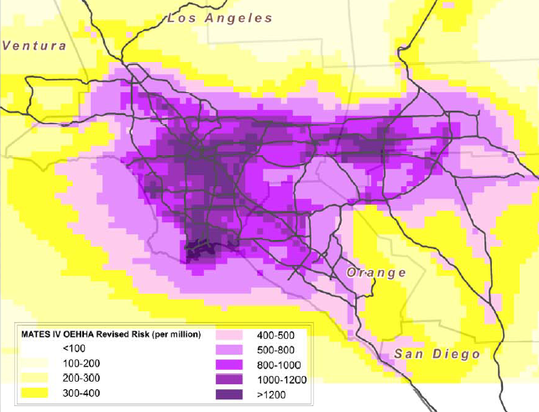
And In The Most Critical Areas
Environmental Justice communities are widespread
Mobile Source Emissions overlay these vulnerable populations
Ozone
Diesel PM
Air Toxics Risk

Slide 16
Investing in the Transformation: Incentive programs
Low Carbon
Transportation
GHG reductions and AB 1550 benefits
$560M for 2017-18
AQIP
Criteria pollutant and toxics reductions
$28M for 2017-18
Zero-Emission
Warehouses
Criteria pollutant, toxics, and GHG reductions
$50M for 2017-18
VW ZEV Car Scrap/Replace
ZEV deployment and equity
$25M for 2017-18
VW Mitigation
Trust
NOx mitigation
$423M for 2017+
Agricultural
Incentives
Criteria pollutant, toxics, and GHG reductions
$135M for 2017-18
Community Air Protection
Criteria, toxics, GHG reductions for communities
$250M for 2017-18
Carl Moyer Program
SIP emission reductions
$69M for 2017-18
Prop 1B Goods Movement
NOx and PM reductions in freight corridors
~$250M remaining

Slide 17
How are heavy-duty vehicles really performing?

Slide 18
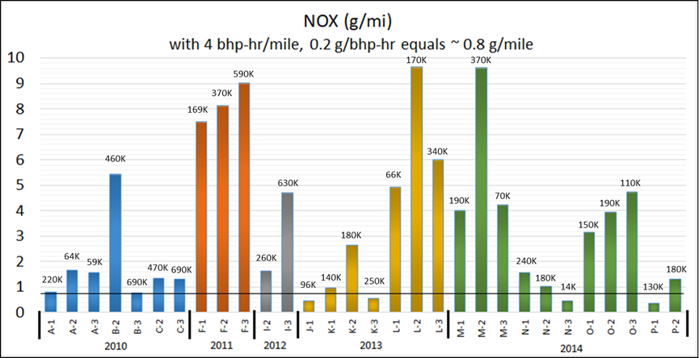
Heavy Duty Emissions Higher Than Expected
Expected UDDS NOx level of ~0.8 g/mile
Truck and Bus Surveillance Program: UDDS chassis test cycle (65,000 lbs., chassis UDDS power ~ engine FTP for many engine platforms)
18

Slide 19
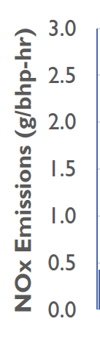
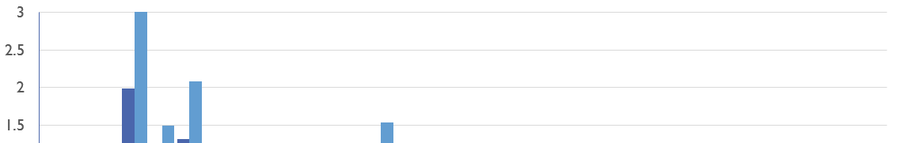
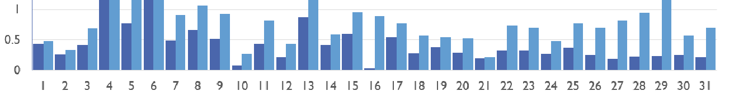
Heavy Duty In-Use NTE Compliance PEMS Data
NOx emission standard 0.20 g/bhp-hr
In-Use Compliance Program:
Mostly Freeway Driving, 31 Trucks, All SCR equipped

Slide 20
Overall Warranty Claims Rates Improving
Component | 2010 Industry Average Rate | 2014 Industry Average Rate
Diesel Particulate Filter | 15.1% | 4.1%
EGR Cooler | 28.8% | 5.3%
EGR System | 11.7% | 4.4%
Fuel Injector | 22.2% | 5.6%
NOx Sensor | 20.5% | 2.4%
SCR Catalyst | 12.7% | 3.3%
Turbocharger | 11.7% | 2.5%
20

Slide 21
However Individual Component High Warranty Claims Rates Persists*
Component | Warranty Rate
Catalytic Converter | >14%
Diesel Particulate Filter | >14%
EGR Cooler | >53%
Exhaust Manifold | >2%
Fuel Injector | >23%
Fuel Pump | >1%
Turbocharger | >50%
*High warranty examples based on 2014 MY data
21

Slide 22
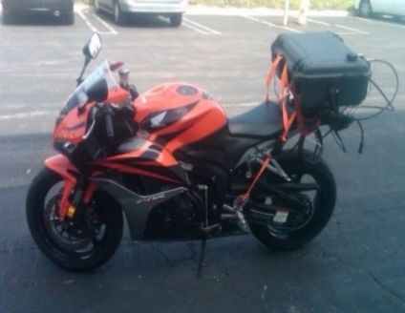
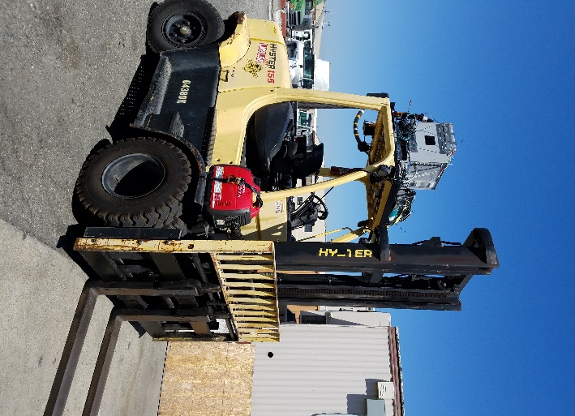
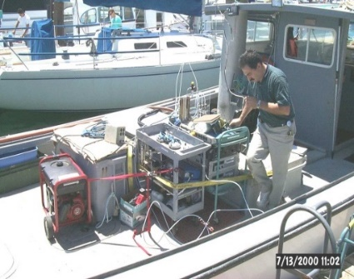
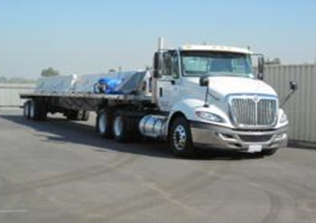
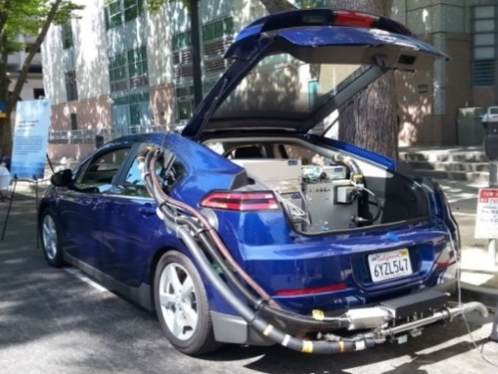
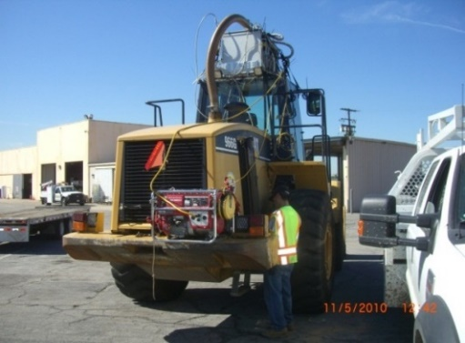
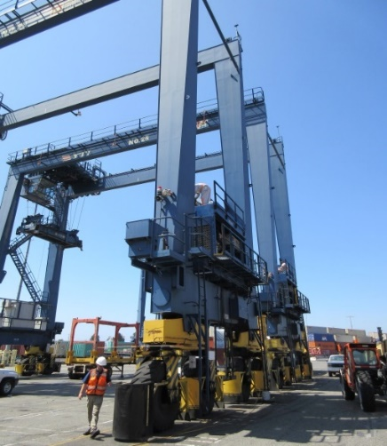
Overview - CARBs PEMS Program
PEMS testing demand at CARB has been increasing exponentially
CARB has been PEMS testing heavy-duty, light-duty, and off-road vehicles/engines for various reasons such as inventory, screening, in-use compliance, research, etc.
CARB has 10 PEMS at the El Monte facility

Slide 23
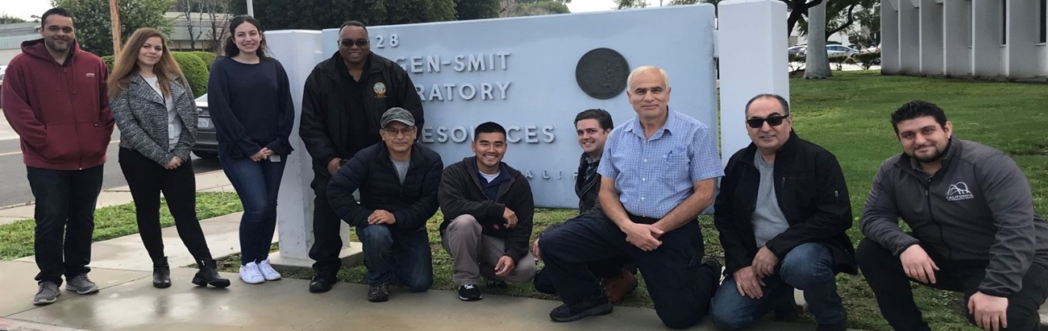
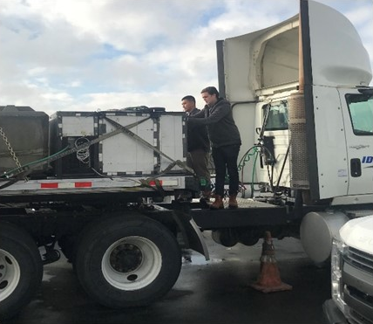
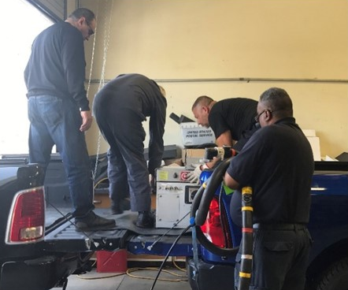
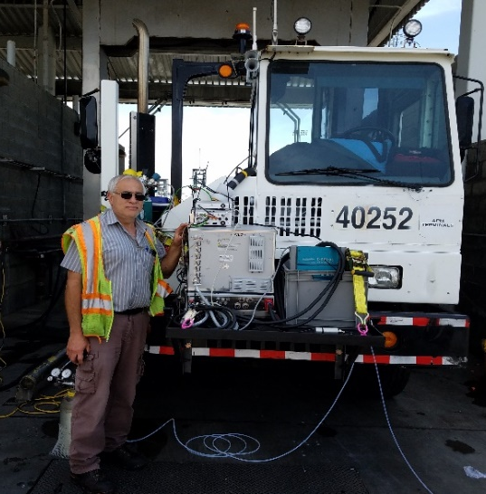
CARB’s PEMS Staff

Slide 24
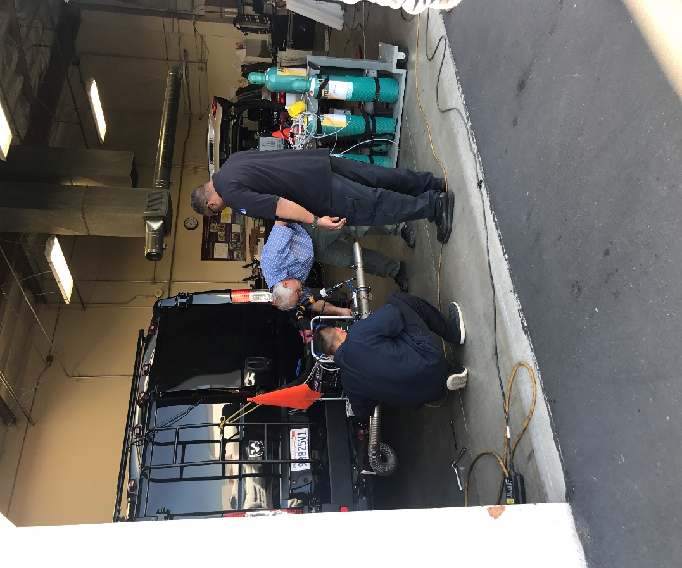
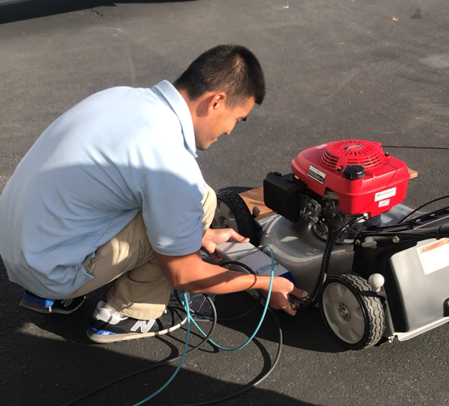
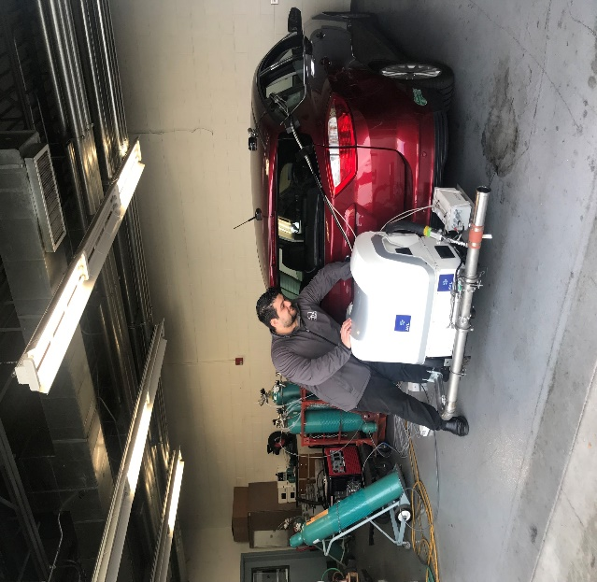
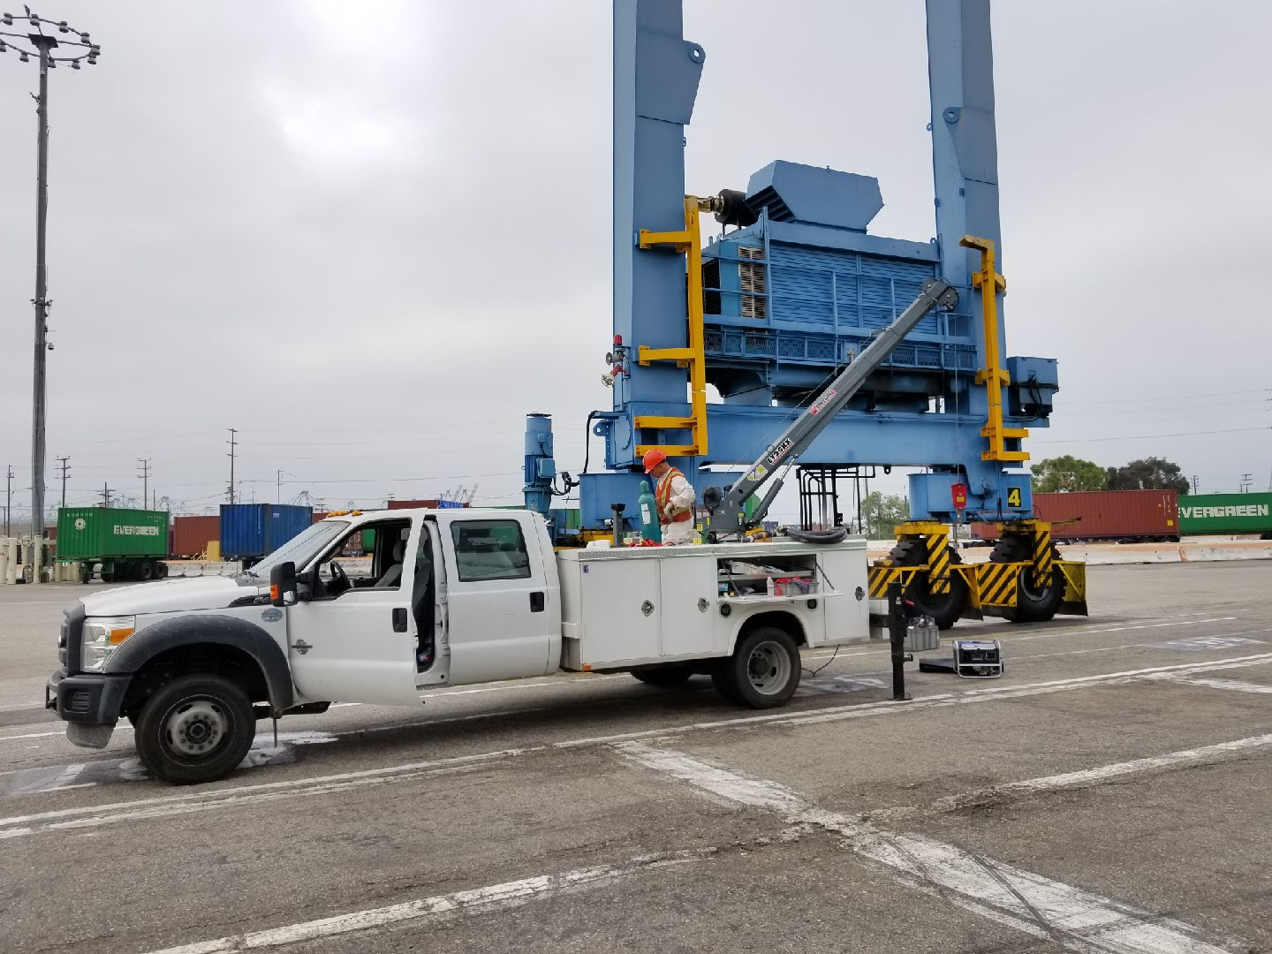
CARB’s PEMS Staff

Slide 25
PEMS Supported Programs
Regulatory Development
Certification
Defeat Device Screening
Light and Heavy-Duty In-Use Compliance and Enforcement
Emission Modeling and Inventory
Off-Road Equipment Evaluation
Small On- and Off-road Engine Testing
Road-to-Rig Correlation
Research

Slide 26
CARB Future PEMS Expectations
Wider PEMS operational envelope
  Thermal control housing for constant temperature
  Wider temperature tolerance
  Better Lab-to-PEMS correlation
Enhanced PEMS usability and efficiency
  Full automation: QC, warm-up, and testing automated and unattended
  Remote viewing and control options
  Real-time emissions metric availability
Increased PEMS capabilities
  Electrified drivetrain energy flow quantification and integration
  New species detectable NH₃ and N₂O
  Better small engine exhaust flow

Slide 27
Is It Time for A Paradigm Shift?
Goal: Ensure actual in-use emissions are well controlled
California’s air quality targets mean future powertrains need to be:
  cleaner
  more durable
  better maintained, and
  when they aren’t clean, durable or maintained, they need to be identified sooner and resolved more quickly
27

Slide 28
Continuous Monitoring of Emission Performance
Concept:
  Use on-board sensors and algorithms to measure, track and report in-use emissions performance
  Accuracy of on-board sensors has been established to be less than 15% different than laboratory analyzers
Potential uses/benefits:
  Motivate optimal control during all driving conditions
  Powerful feedback on actual performance
  Faster and cheaper than laboratory or PEMS testing
  Potential for streamlined certification or in-use compliance
  New approaches for diagnostic and repair

Slide 29
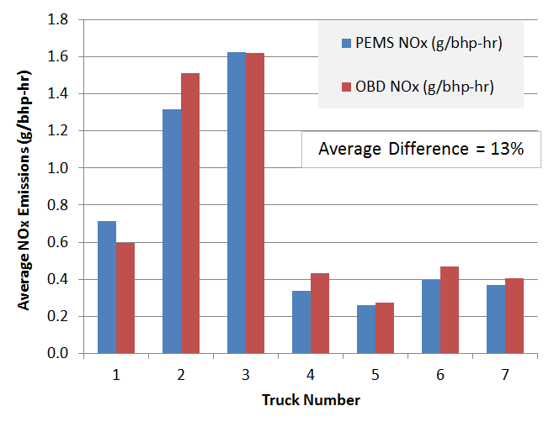
On-Board Sensor Data vs PEMS
7 diesel HD trucks
  2 different engine families
  All equipped w/SCR and NOx sensors
Mostly freeway driving
  Data excluded when NOx sensor reported as not active
OBS NOx (g/bhp-hr)
3*
4
5
6
*Truck 3 tested as received and after new SCR system installed
29

Slide 30
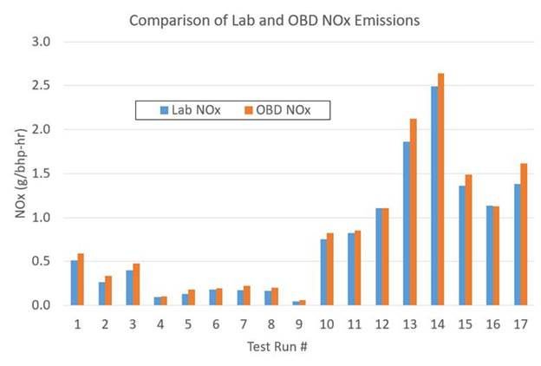
On-Board Sensor Data vs Lab
11 different engines
  3 engine makers
  4 displacement
Overall average difference is 15%
30

Slide 31
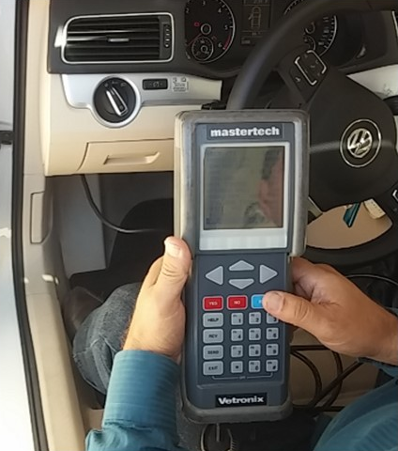
How Does This Concept Intersect with OBD?
OBD is a logical place for the portion related to on-board data requirements
  Standardized data has always been integral to OBD
  Single regulation to follow for all required data
OBD already includes data to support other ARB needs:
  Smog Check inspections (VIN, etc.)
  OBD compliance testing (rate-based, etc.)
  Tailpipe testing (torque, modeled exhaust flow volume, etc.)
  Certification review (EI-AECD tracking, PM filter regeneration frequency)
31

Slide 32
How Could The Data Be Used?
Screening?
  Simpler way to identify problems for follow-up investigation/testing?
Compliance?
  Develop in-use standards to compare the stored data to?
  Limit and confirm emission impact of IRAFs and AECDs?
  Retroactively adjust (up or down) certified emission levels?
Certification?
  Use past data to support certification?
Future Regulatory Development?
  Use data to identify areas of needed improvement?
Inventory Modeling?
  Improve accuracy of inventory to better inform future policies?

Slide 33
Implementation Concepts
    Near term: Adopt requirement to track and report
    Standardized OBD data stream (upon request)
    Could be reported to ARB as part of required post certification activities
    ARB/contractor could get data from vehicles
    Could eventually be collected during Smog Check or HD IM program inspections
    Longer term: Data collected remotely?
    Quickly and thoroughly identify underperforming vehicles for corrective action
    Redesign certification and compliance

Slide 34
Next steps: REAL Concept
Real Emissions Assessment Logging
Require vehicles to track emission performance
  Add software to store aggregated data on vehicle
Start with existing sensors
  Accuracy of on-board NOx sensors already within 15%
  Fuel usage (to infer CO₂ emissions) already even more accurate
Potential benefits:
  Comprehensive feedback
  More efficient than laboratory or PEMS testing
  Future standards linked to on-road performance

Slide 35
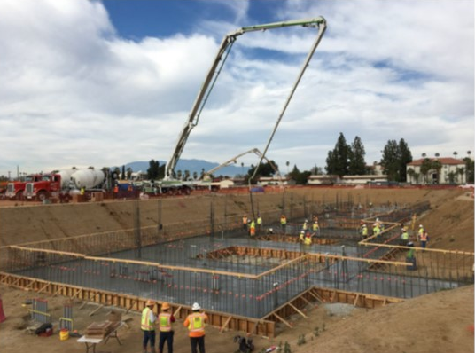
Groundbreaking Emissions Testing and Research
2018 Accomplishments
New laboratory facility began construction July 2018
Procurement of lab equipment underway
Lab to host public artworks addressing climate change
LEED Platinum and ZNE Facility
35

Slide 36

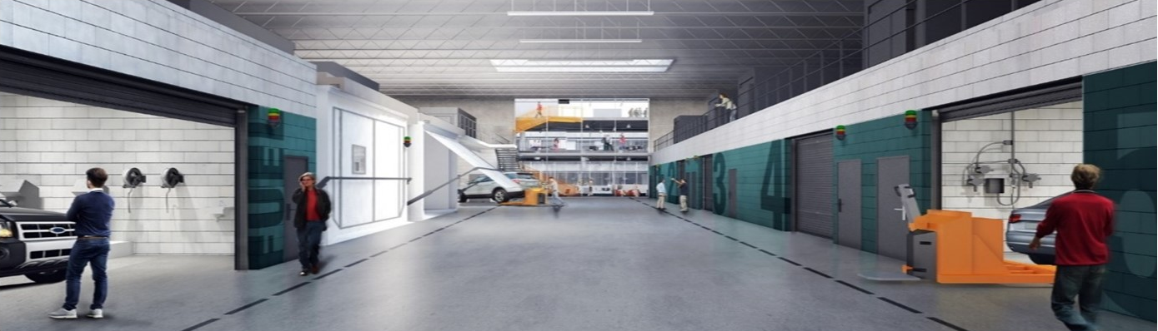
Next Steps: Expanding Testing
New Southern California Laboratory
  Increased HD and LD dyno and on-road PEMS & OBD testing capacity
  Scheduled for
  2021 opening

Slide 37
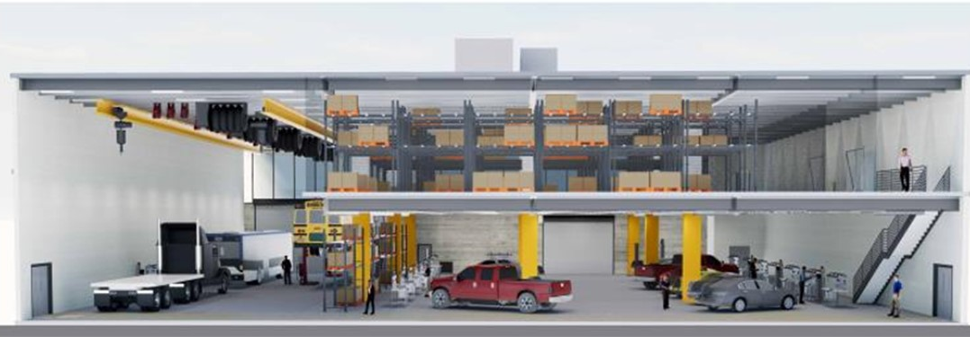
Dedicated PEMS Workshop in New Riverside Facility
CARB will be purchasing 10 new and improved Gaseous and PM PEMS
CARB’s new facility will implement a futuristic PEMS testing approach and will enable testing of more light-duty, heavy-duty, and off-road vehicles
14 light-duty and 4 heavy-duty testing stations
Plumbed calibration and span gases, and power at each station
EV chargers
Dashboards for remote monitoring

Slide 38
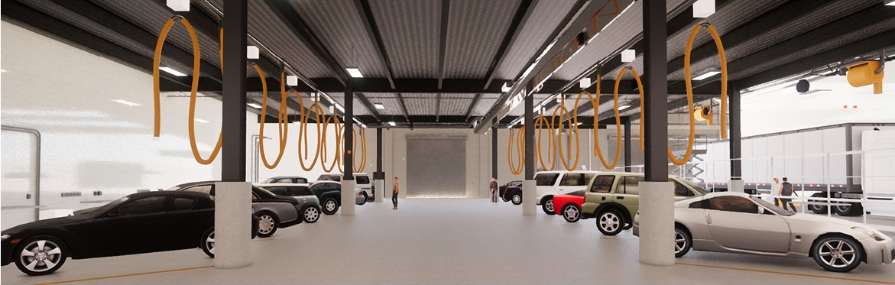
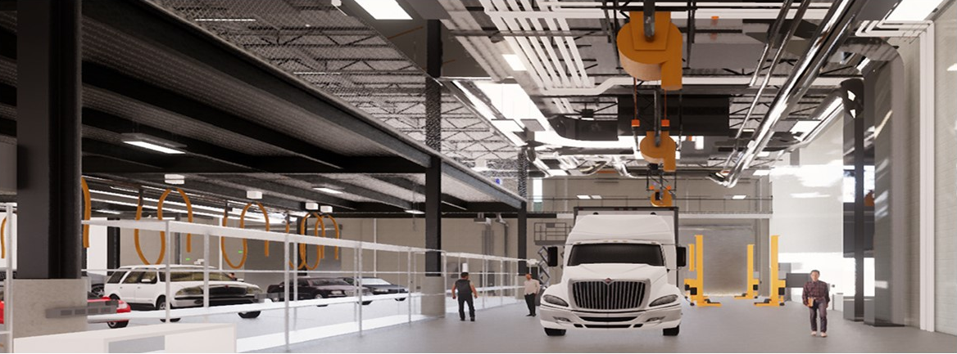
Dedicated PEMS Workshop in New Riverside Facility

Slide 39
39

Slide 40
Reality Checks – Many Programs in Place to Assess Emissions
Certification
Warranty Reporting
Manufacturer In-Use Testing
  Light Duty In-Use Verification Program (IUVP)
  Heavy-Duty In-Use Testing (HDIUT) Program
  HD OBD Manufacturer Self Testing program
Laboratory Dynamometer Testing
  Engine and chassis dynamometer testing
  Confirmatory and compliance testing
On-Road Emissions Measurements
  Portable Emissions Measurement Systems
  Remote Sensing
Vehicle and Smoke Inspections
  Smog Check
  Periodic Smoke Inspection Program (PSIP)
  Heavy-Duty Vehicle Inspection Program (HDVIP)
40

Slide 41
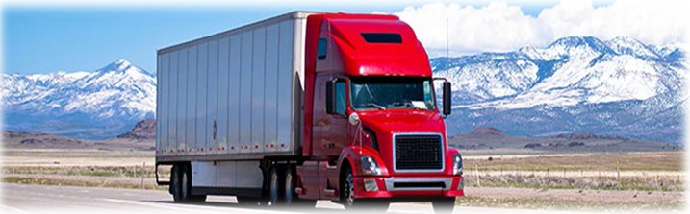
Vehicles and Engines Must Stay Clean In-Use
Enhanced programs for HD being developed based on LD history
  Comprehensive inspection and maintenance program
    OBD, visual, opacity elements
  Expanded warranty requirements
  Revise in-use testing program
  Lengthen useful life
  Improved durability demonstrations
41

