Slide 1


Utilizing Portable Emissions Measurement to Evaluate EPA Emerging Technologies
Rachel L. Muncrief, Eddie Allison, Miguel Cruz, Charles Rooks, Michael P. Harold
University of Houston, Dept. of Chemical & Biomolecular Engineering
Texas Diesel Testing and Research Center
UCR PEMS Workshop
March 24, 2011, Riverside, CA

Slide 2

Top 10 in Ozone (2010; U.S.)
The American Lung Association's State of the Air 2010 lists these 10 cities as the country's most polluted by ozone:
Los Angeles, Calif., metropolitan area (including Long Beach and Riverside)
Bakersfield, Calif.
Visalia and Porterville, Calif.
Fresno and Madera, Calif.
Sacramento, Calif., metropolitan area (including Arden-Arcade and Yuba City)
Hanford and Corcoran, Calif.
Houston, Texas, metropolitan area (including Baytown and Huntsville)
San Diego, Calif., metropolitan area (including Carlsbad and San Marcos)
San Luis Obispo and Paso Robles, Calif.
Charlotte, N.C., metropolitan area (including Gastonia and Salisbury)
Source: http://www.stateoftheair.org/2010/city-rankings/most-polluted-cities.html

Slide 3
Emerging Technology Program
The Clean Diesel Emerging Technologies Program is an opportunity to advance new, cutting edge technologies that reduce diesel emissions from existing fleets.
Two components of the Emerging Technology Program:
  Technology manufacturer → seek placement of their technology on the Emerging Technologies List.
  Grant competition → eligible entity applies for funds to purchase an emerging technology.

Slide 4
Emerging Technology List
Manufacturer | Technology | Application | Reductions (%) |  |  |  | Effective Date/Status
 |  |  | PM | NOx | HC | CO
Caterpillar, Inc. | Urea-SCR and DOC | Locomotive | 25 | 65 | 70 | N/A | December 2, 2009
EcoPower Hybrid Systems Inc. | Hybrid System | Non-road Gantry Crane | 25 | 30 | 0 | 0 | December 8, 2009
Engine Control Systems | Urea-SCR | On-highway | 25 | 65 | 85 | 85 | March 27, 2009
Engine Control Systems | Active DPF | On-highway | 90 | N/A | 80 | 80 | July 9, 2010
Johnson Matthey | Urea-SCR and DPF | On-highway | 90 | 65 | 95 | 85 | April 9, 2009
Krystallon, Plc | PM Seawater Scrubber | Marine | 50 | 0 | 50 | 0 | December 8, 2009
Nett Technologies, Inc. | Urea-SCR | On-highway | 25 | 65 | 60 | 60 | March 26, 2009
Parker Hannifin Corporation | Hybrid Drive | On-highway - refuse | 0 | 30 | 30 | 30 | January 27, 2011
Delphi Corporation | Solid Oxide Fuel Cell (SOFC) Auxiliary Power Unit (APU) | On-highway - class-8 tractors |  |  |  |  | January 27, 2011
Advanced Cleanup Technologies, Inc. | Advanced Maritime Emissions Control System (AMECS) | Marine | 70 | 70 | 70 | 30 | Pursuing Verification
Caterpillar, Inc. | Upgrade Kit 1 | Marine | 25 | N/A | N/A | N/A | Pursuing Verification
 | Upgrade Kit 2 |  | 25 | 21 - 29 | N/A | N/A
 | Upgrade Kit 3 |  | 25 | 41 - 49 | N/A | N/A
ESW Canada | DOC and CCV | Marine | 25 | 0 | 25 | 70 | Not Pursuing Verification
Johnson Matthey | Urea-SCR and DPF | On-highway | 90 | 65 | 95 | 85 | Verified
Miratech Corporation | DOC | Marine | 25 | 0 | 50 | 70 | Certified (EMD 710 engines)
Nett Technologies, Inc. | Urea-SCR | Non-road | 20 | 65 | 60 | 60 | Verified
Tinnerman/ Shadowood | LNT-SCR and DPF | On-highway | 90 | 65 | 90 | 90 | Pursuing Verification
Truck Emission Control Technologies Inc. | EGR and DOC/DPF | On-highway | 50 | 40 | 60 | 70 | Pursuing Verification
Manufacturer | Technology | Application | Reductions (%) |  |  |  | Effective Date/Status
 |  |  | PM | NOx | HC | CO
Caterpillar, Inc. | Urea-SCR and DOC | Locomotive | 25 | 65 | 70 | N/A | December 2, 2009
EcoPower Hybrid Systems Inc. | Hybrid System | Non-road Gantry Crane | 25 | 30 | 0 | 0 | December 8, 2009
Engine Control Systems | Urea-SCR | On-highway | 25 | 65 | 85 | 85 | March 27, 2009
Engine Control Systems | Active DPF | On-highway | 90 | N/A | 80 | 80 | July 9, 2010
Johnson Matthey | Urea-SCR and DPF | On-highway | 90 | 65 | 95 | 85 | April 9, 2009
Krystallon, Plc | PM Seawater Scrubber | Marine | 50 | 0 | 50 | 0 | December 8, 2009
Nett Technologies, Inc. | Urea-SCR | On-highway | 25 | 65 | 60 | 60 | March 26, 2009
Parker Hannifin Corporation | Hybrid Drive | On-highway - refuse | 0 | 30 | 30 | 30 | January 27, 2011
Delphi Corporation | Solid Oxide Fuel Cell (SOFC) Auxiliary Power Unit (APU) | On-highway - class-8 tractors |  |  |  |  | January 27, 2011
Advanced Cleanup Technologies, Inc. | Advanced Maritime Emissions Control System (AMECS) | Marine | 70 | 70 | 70 | 30 | Pursuing Verification
Caterpillar, Inc. | Upgrade Kit 1 | Marine | 25 | N/A | N/A | N/A | Pursuing Verification
 | Upgrade Kit 2 |  | 25 | 21 - 29 | N/A | N/A
 | Upgrade Kit 3 |  | 25 | 41 - 49 | N/A | N/A
ESW Canada | DOC and CCV | Marine | 25 | 0 | 25 | 70 | Not Pursuing Verification
Johnson Matthey | Urea-SCR and DPF | On-highway | 90 | 65 | 95 | 85 | Verified
Miratech Corporation | DOC | Marine | 25 | 0 | 50 | 70 | Certified (EMD 710 engines)
Nett Technologies, Inc. | Urea-SCR | Non-road | 20 | 65 | 60 | 60 | Verified
Tinnerman/ Shadowood | LNT-SCR and DPF | On-highway | 90 | 65 | 90 | 90 | Pursuing Verification
Truck Emission Control Technologies Inc. | EGR and DOC/DPF | On-highway | 50 | 40 | 60 | 70 | Pursuing Verification
Manufacturer | Technology | Application | Reductions (%) |  |  |  | Effective Date/Status
 |  |  | PM | NOx | HC | CO
Caterpillar, Inc. | Urea-SCR and DOC | Locomotive | 25 | 65 | 70 | N/A | December 2, 2009
EcoPower Hybrid Systems Inc. | Hybrid System | Non-road Gantry Crane | 25 | 30 | 0 | 0 | December 8, 2009
Engine Control Systems | Urea-SCR | On-highway | 25 | 65 | 85 | 85 | March 27, 2009
Engine Control Systems | Active DPF | On-highway | 90 | N/A | 80 | 80 | July 9, 2010
Johnson Matthey | Urea-SCR and DPF | On-highway | 90 | 65 | 95 | 85 | April 9, 2009
Krystallon, Plc | PM Seawater Scrubber | Marine | 50 | 0 | 50 | 0 | December 8, 2009
Nett Technologies, Inc. | Urea-SCR | On-highway | 25 | 65 | 60 | 60 | March 26, 2009
Parker Hannifin Corporation | Hybrid Drive | On-highway - refuse | 0 | 30 | 30 | 30 | January 27, 2011
Delphi Corporation | Solid Oxide Fuel Cell (SOFC) Auxiliary Power Unit (APU) | On-highway - class-8 tractors |  |  |  |  | January 27, 2011
Advanced Cleanup Technologies, Inc. | Advanced Maritime Emissions Control System (AMECS) | Marine | 70 | 70 | 70 | 30 | Pursuing Verification
Caterpillar, Inc. | Upgrade Kit 1 | Marine | 25 | N/A | N/A | N/A | Pursuing Verification
 | Upgrade Kit 2 |  | 25 | 21 - 29 | N/A | N/A
 | Upgrade Kit 3 |  | 25 | 41 - 49 | N/A | N/A
ESW Canada | DOC and CCV | Marine | 25 | 0 | 25 | 70 | Not Pursuing Verification
Johnson Matthey | Urea-SCR and DPF | On-highway | 90 | 65 | 95 | 85 | Verified
Miratech Corporation | DOC | Marine | 25 | 0 | 50 | 70 | Certified (EMD 710 engines)
Nett Technologies, Inc. | Urea-SCR | Non-road | 20 | 65 | 60 | 60 | Verified
Tinnerman/ Shadowood | LNT-SCR and DPF | On-highway | 90 | 65 | 90 | 90 | Pursuing Verification
Truck Emission Control Technologies Inc. | EGR and DOC/DPF | On-highway | 50 | 40 | 60 | 70 | Pursuing Verification

Slide 5
Project Information
Vehicle Selection
Degreen Retrofit
Partially Age Retrofit
Data Logging
Degreened Test (#1):
PEMS or Chassis
Degreened Test (#1):
PEMS or Chassis
Partially Aged Test (#2): PEMS or Chassis
Retrofit Installation
Continuous: Feedback and Reporting

Slide 6
Vehicle Information
Quantity | Vehicle Type | Fleet Owner | Retrofit | Engine | Year
2 | Asphalt Reclaimer | TxDOT | Urea-SCR | CAT | 2004
2 | Loader/Crawler | TxDOT | Urea-SCR | CAT | 2000
1 | Tractor/Crawler | TxDOT | Urea-SCR | CAT | 2002
10 | School Bus | HISD | Urea-SCR | CAT | 2003
15 | School Bus | HISD | LNT-SCR/DPF | International | 2004
2 | School Bus | HISD | EGR/DOC-DPF | CAT | 2003
15 | Dump Truck | TxDOT | EGR/DOC-DPF | CAT | 2000
3 | Aerial Utility Truck | TxDOT | EGR/DOC-DPF | CAT | 2000
Quantity | Vehicle Type | Fleet Owner | Retrofit | Engine | Year
2 | Asphalt Reclaimer | TxDOT | Urea-SCR | CAT | 2004
2 | Loader/Crawler | TxDOT | Urea-SCR | CAT | 2000
1 | Tractor/Crawler | TxDOT | Urea-SCR | CAT | 2002
10 | School Bus | HISD | Urea-SCR | CAT | 2003
15 | School Bus | HISD | LNT-SCR/DPF | International | 2004
2 | School Bus | HISD | EGR/DOC-DPF | CAT | 2003
15 | Dump Truck | TxDOT | EGR/DOC-DPF | CAT | 2000
3 | Aerial Utility Truck | TxDOT | EGR/DOC-DPF | CAT | 2000
Total Retrofits = 50

Slide 7
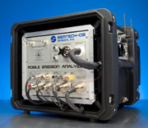
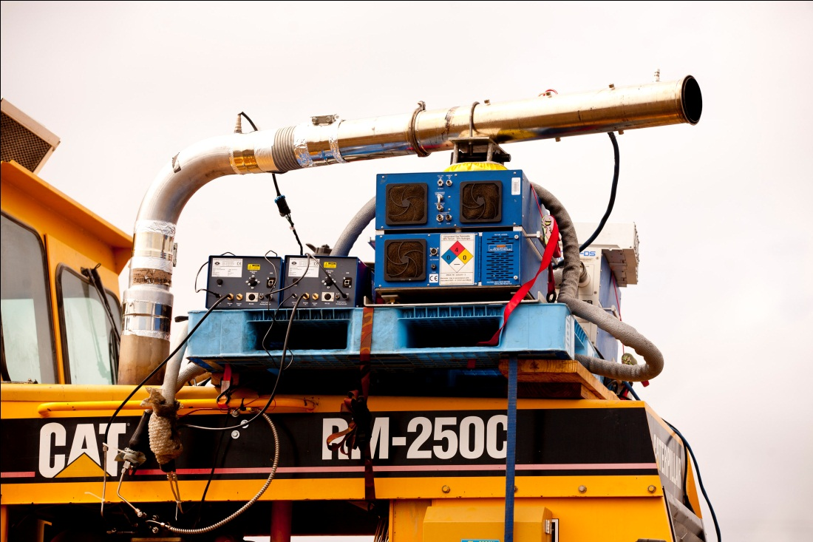
Portable (PEMS) Testing Equipment
(2) Semtech DS (pre and post).
  NOx (NO+NO₂), CO, THC, CO₂, O₂
(2) Maha MPM4 (pre and post)
  PM (mg/m³)
NH₃ sensor (post, NH₃-slip)
Exhaust Flow Meter (post, SCFM)

Slide 8
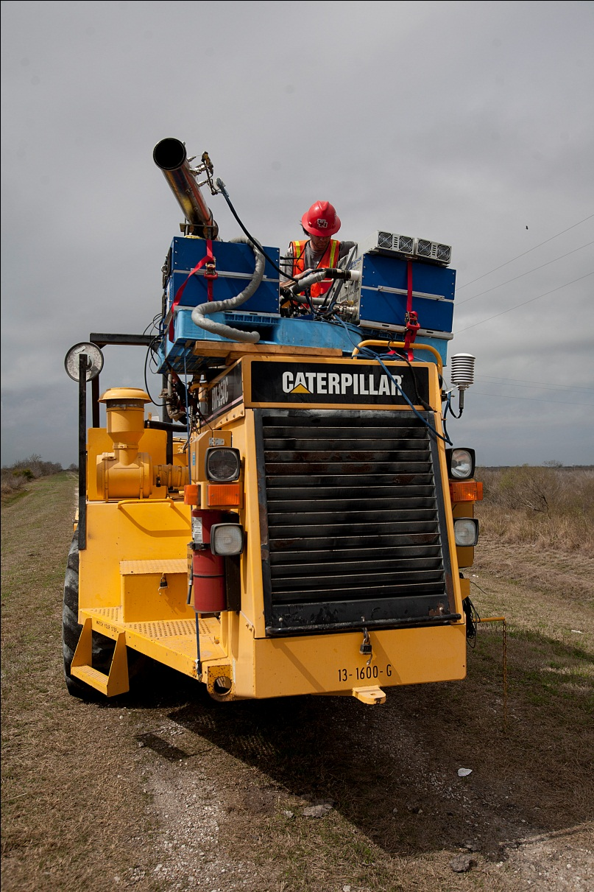
PEMS Challenges – Non-Road
No Shore Power
Hours from Nearest Supply Shop
Vehicle Differences/Dimensions
Weather
  Precipitation/Heat
Light
  Nighttime/Pre-dawn testing
Other Ambient Conditions
  Dust/Snakes
Safety/Security
  Personnel
  Equipment

Slide 9
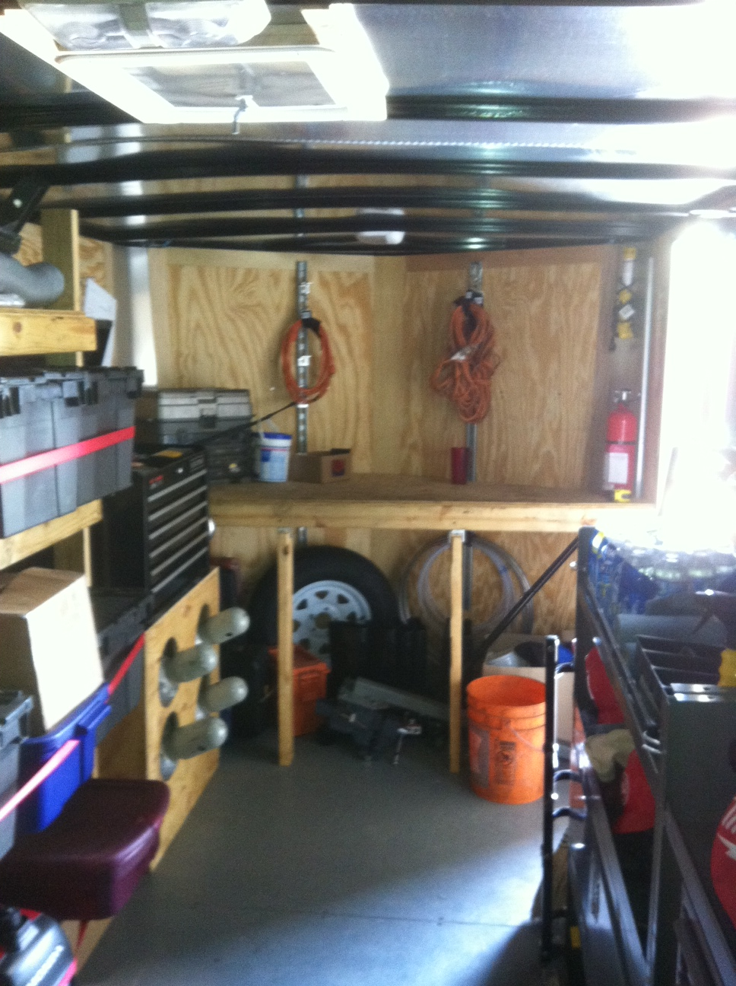
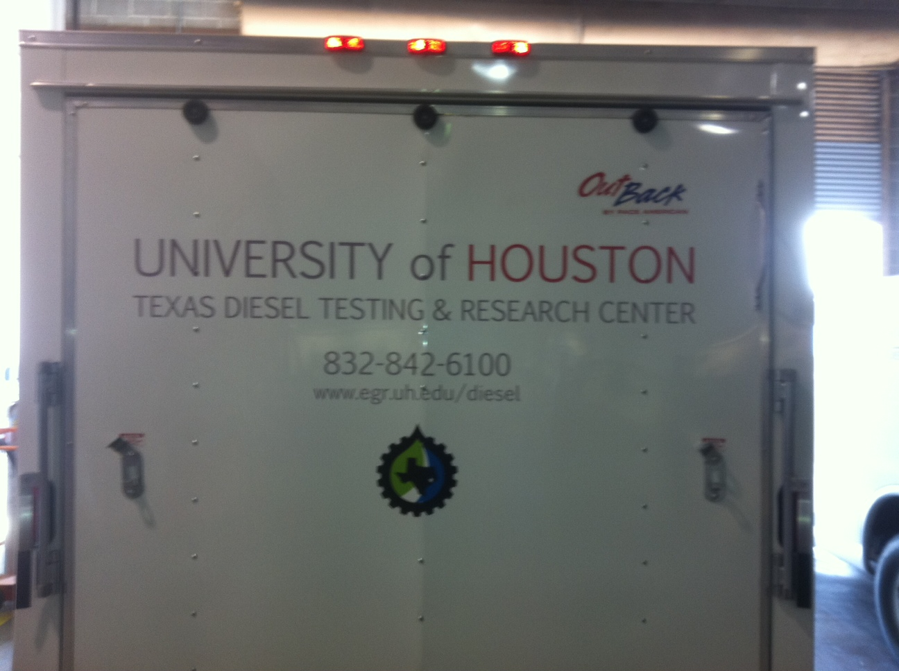
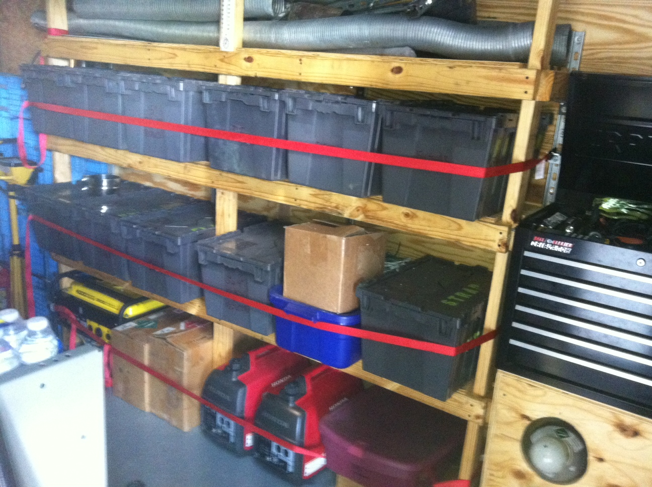
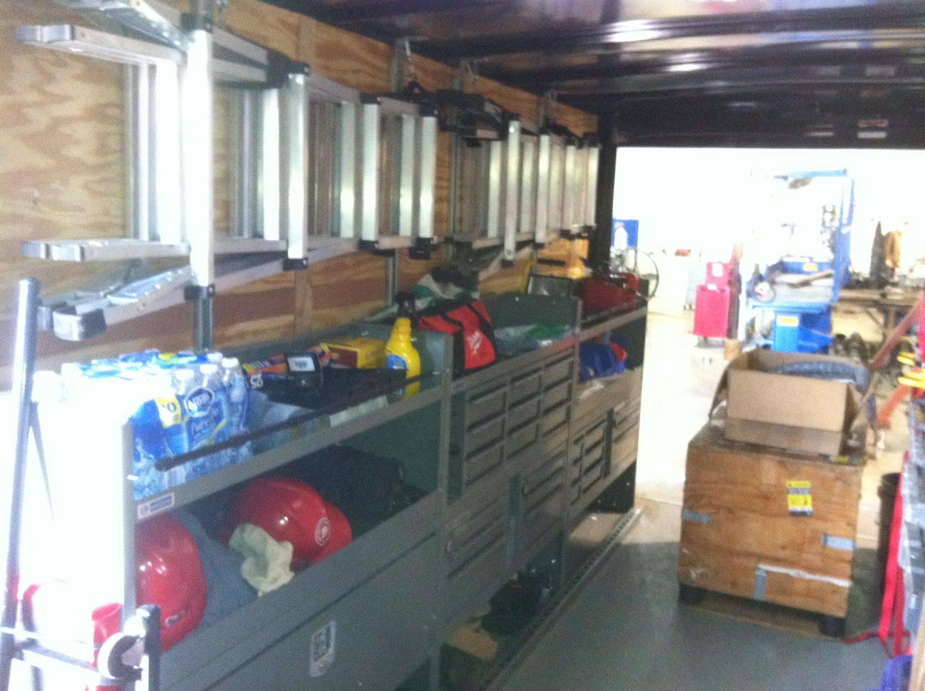
Preparation – Trailer

Slide 10
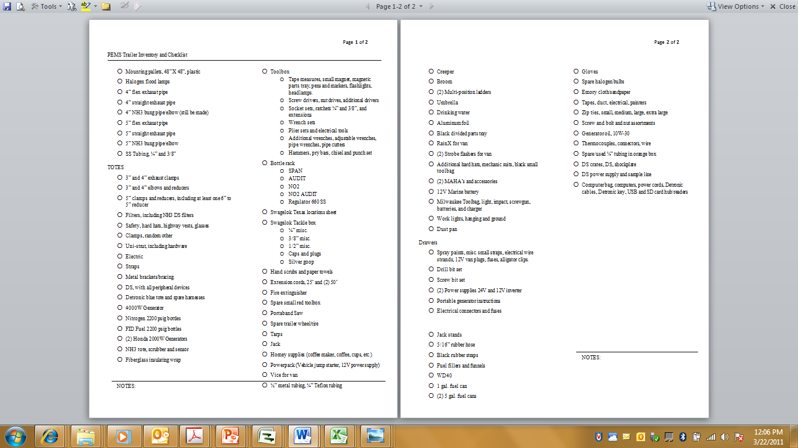
Preparation - Inventory

Slide 11
Preparation – Pallet Setup
Maha 1
Maha 2
Semtech 2
Generator 2
Flow Meter
Exhaust Flow w/Sample Lines
Semtech 1
Generator 1
Power Supply

Slide 12
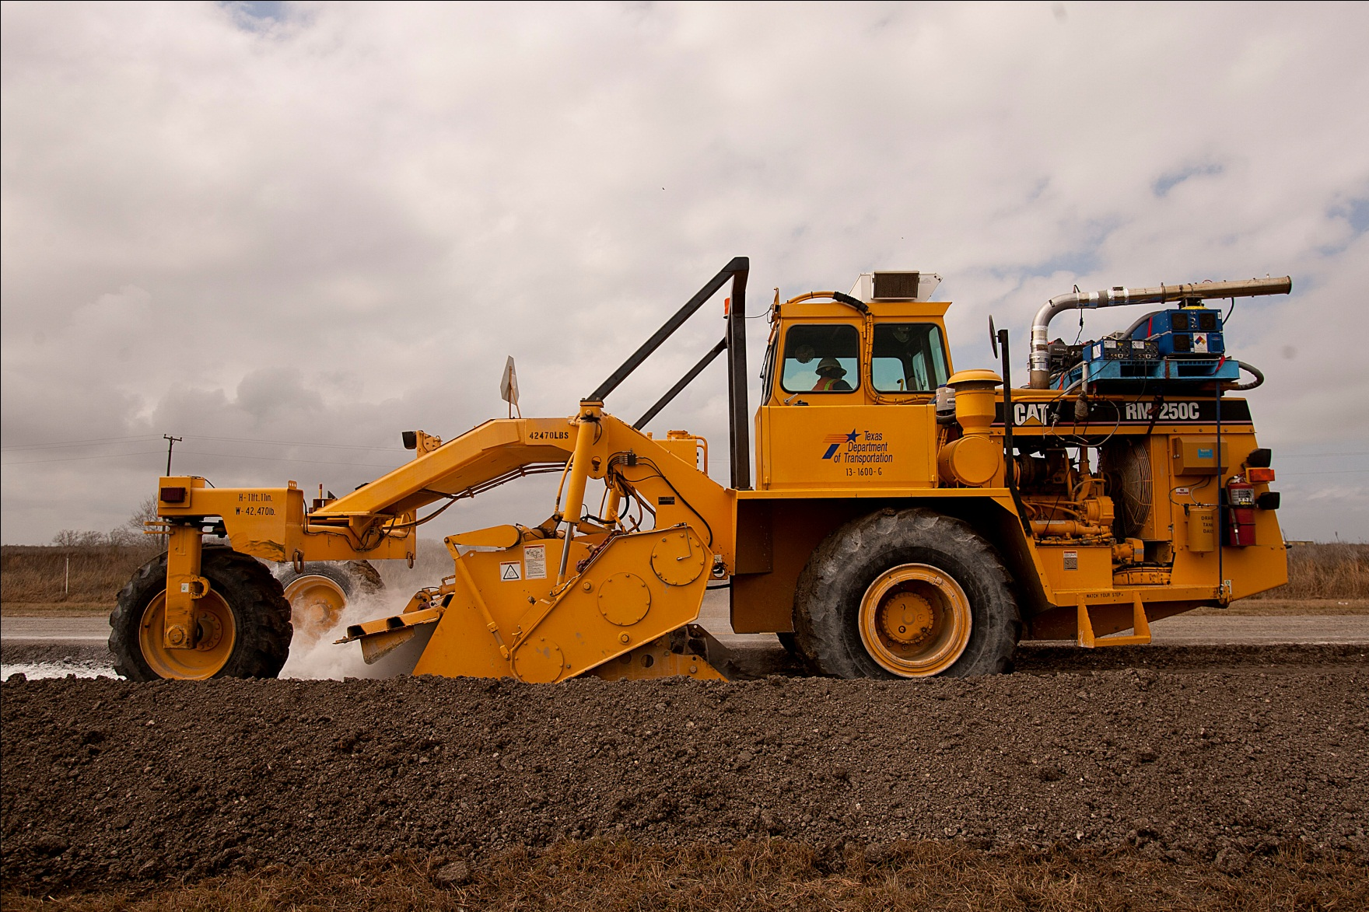

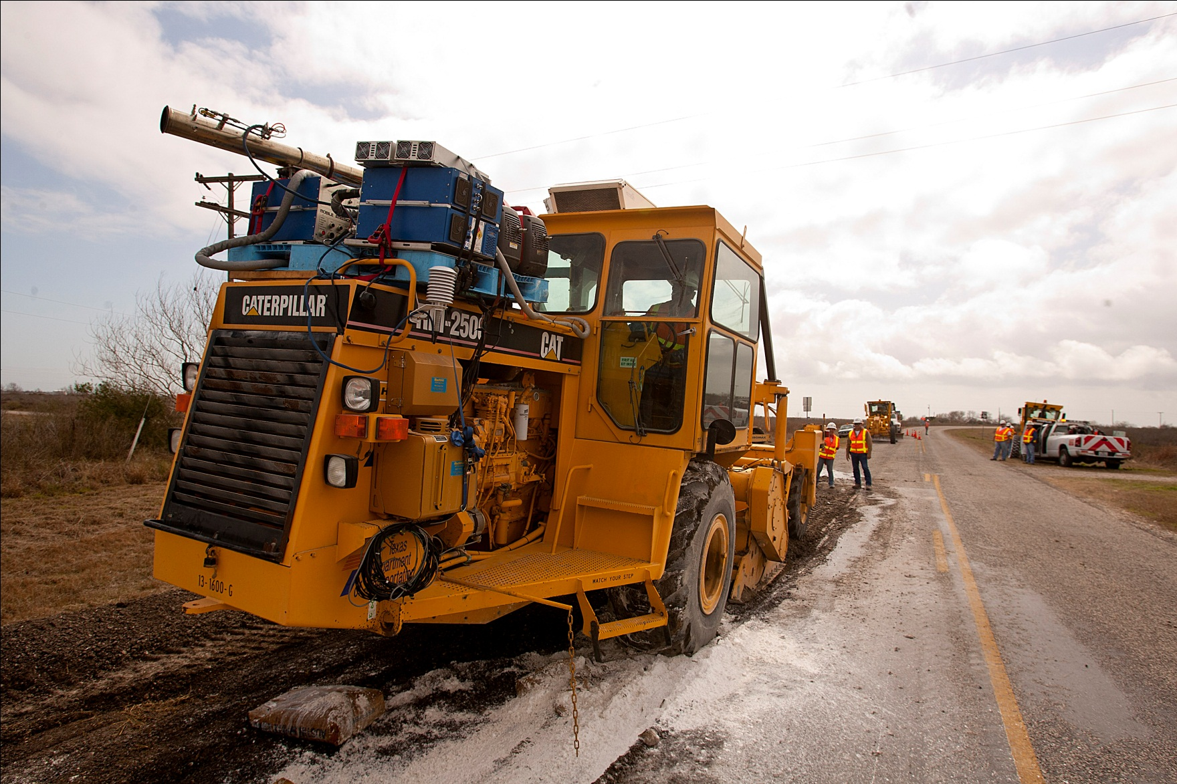
In use Photos

Slide 13
Asphalt Reclaimer – Duty Cycle
4 Different Modes
Wait/Idle – low load
Drive – mid load
Mix – mid load
Cut – high load

Slide 14
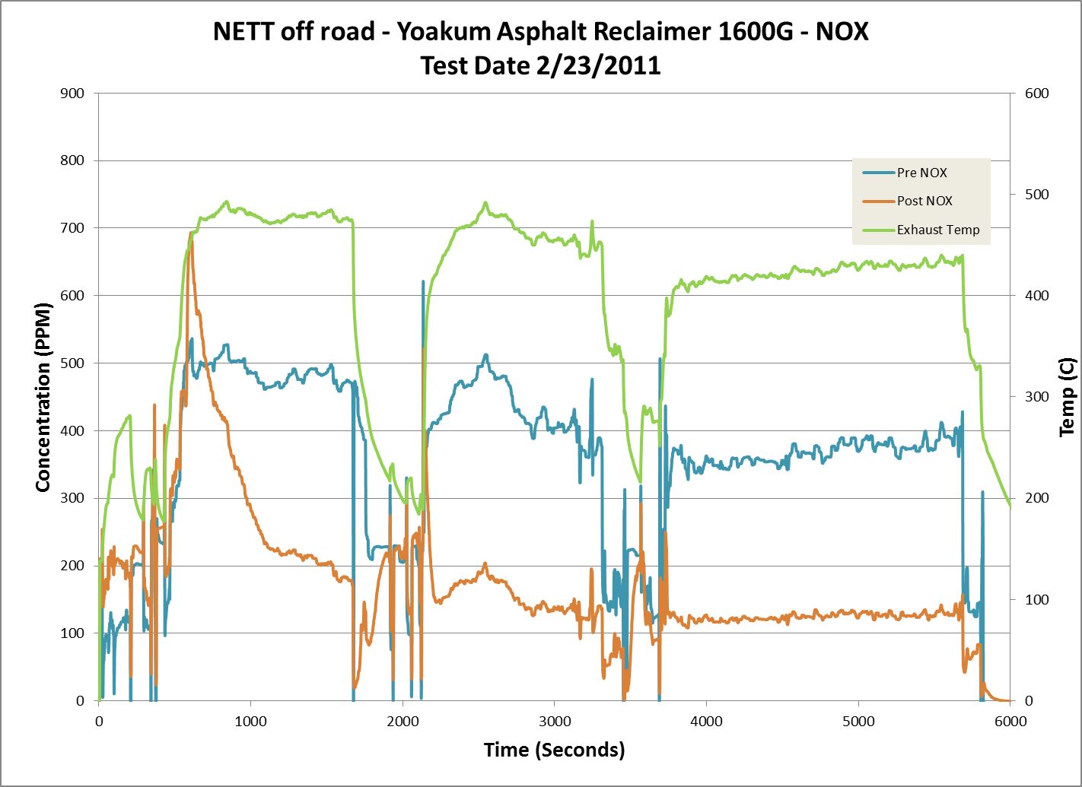
Data from PEMS Testing
Red-Drive
Blue-Wait
Green-Mix
Purple-Cut

Slide 15
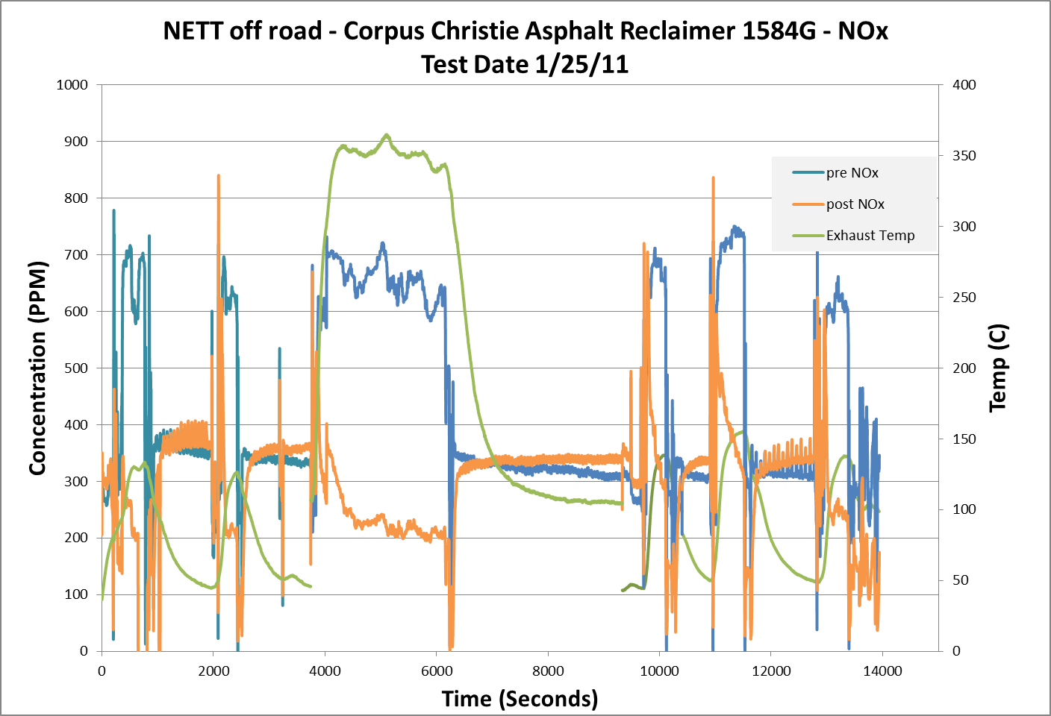
Data from PEMS Testing
Red-Drive
Blue-Wait
Green-Mix
Purple-Cut

Slide 16
Data from PEMS Testing
Component | Reduction (%) Unit # 1600 | Reduction (%) Unit # 1584
NOx | 52 | 43
Data is weighted using Exhaust Flow rate

Slide 17
Summary
Keys for successful testing
  Preparation
  Large amounts of data will help eliminate one-off errors
  Know the variables
    Duty cycle
    Vehicle differences

Slide 18
Future Work
Complete further testing (100+ tests at the end of 4 projects)
Further improvements in PEMS methodology
Acknowledgement: EPA Emerging Technology Program

