Slide 1

On-road emissions measured by chase techniques in China
An approach that can compliment PEMS, but not replace it!
Dane Westerdahl, Xing Wang and K. Max Zhang (PI)
Energy and the Environment Research Laboratory

Slide 2
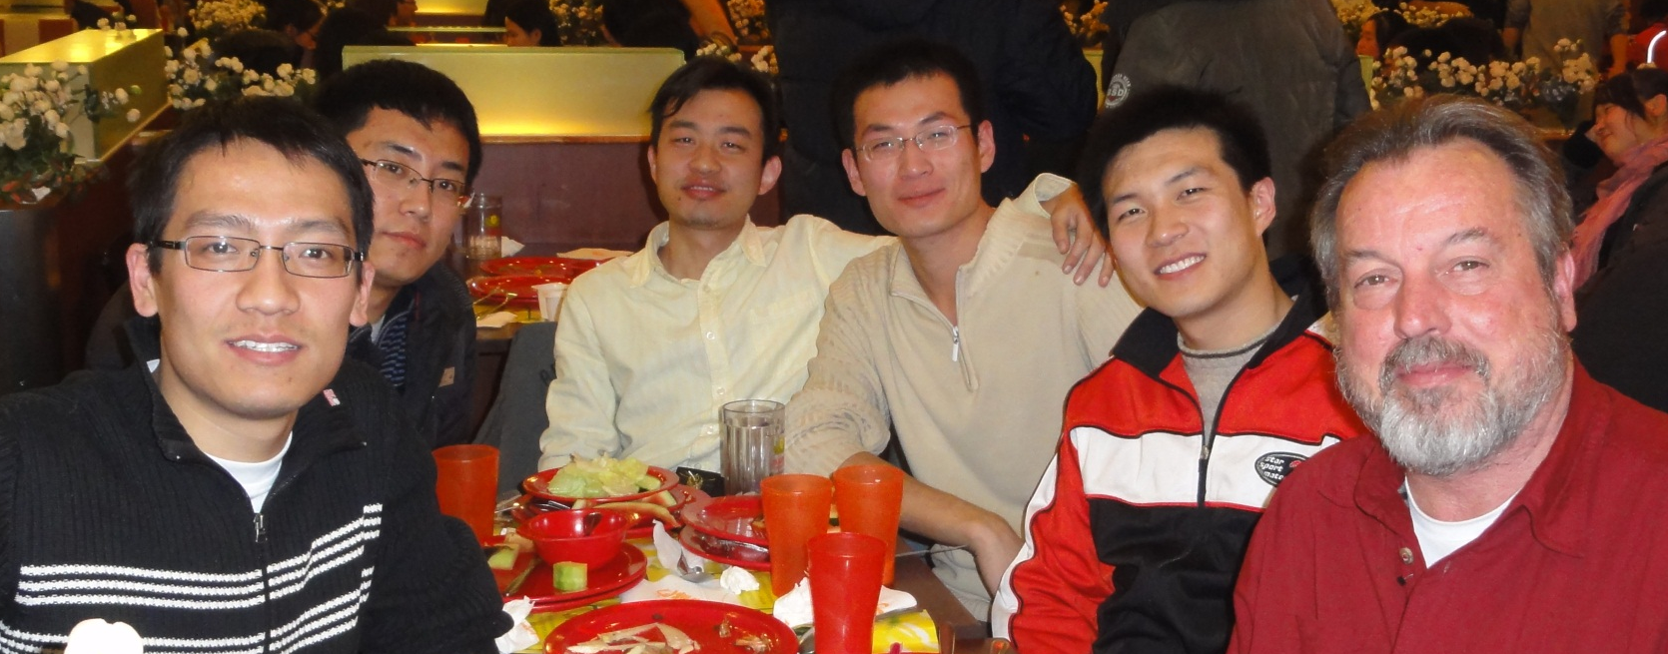
How did we end up in China?
The Olympic Games and the opportunity it offered
  Aggressive controls applied to a very polluted city
Two investigators from China
Good food and friends

Slide 3
Heroic controls placed on Beijing and the region as Olympics approached
Construction halted
New taxis replaced old ones
High emitting cars banned from city
Trucks largely banned from city
Odd/Even car use
New buses purchased
Industry closed
Coal burning replaced by natural gas
Cement plants and quarries closed
Dirt/debris covered
Landscape planted
Streets cleaned
No street bar b ques
Unconfirmed weather modification
Most measures were implemented well before Games and had different start dates

Slide 4
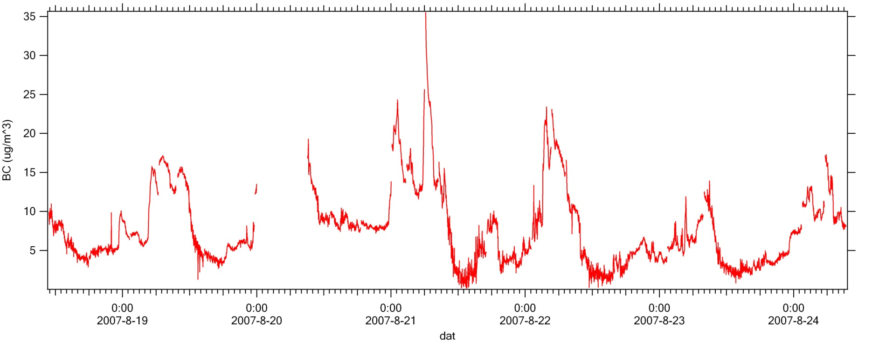
Black Carbon Observations
Summer community measurements (2007)
Truck Activity 1
Truck Activity 2
Truck Activity 3
Truck Activity 4
Truck Activity 5
Truck Activity 6
Truck Activity refers to the period between 11:-00 pm and 6:00 am. Beijing residents are exposed to much higher diesel particulate matter levels at night.

Slide 5
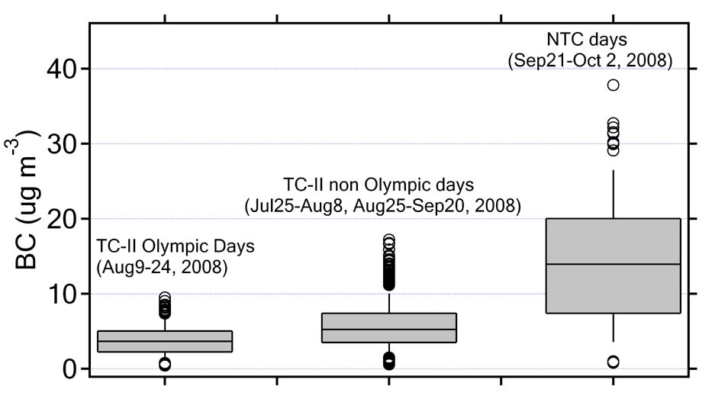
BC Comparison – I: Traffic-Control days vs. Non-Traffic-Control days Summer 2008
The significant increases of BC concentrations on NTC days demonstrate the positive impact of traffic control regulations in reducing BC emissions.

Slide 6
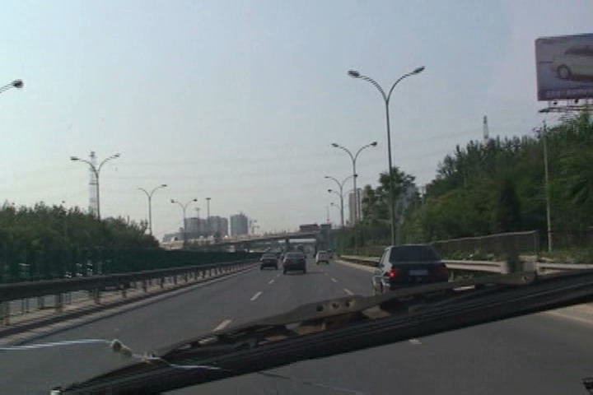
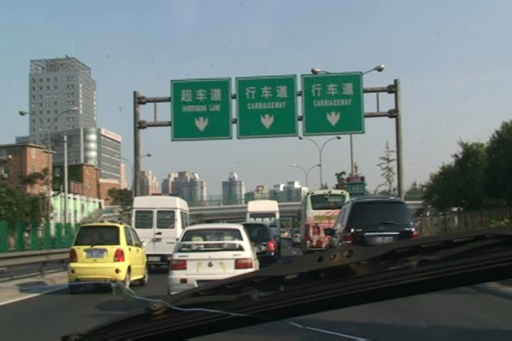
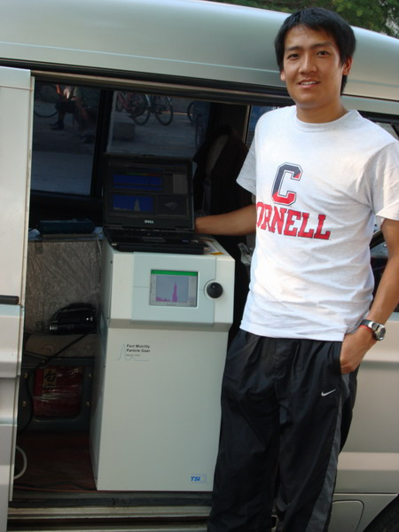
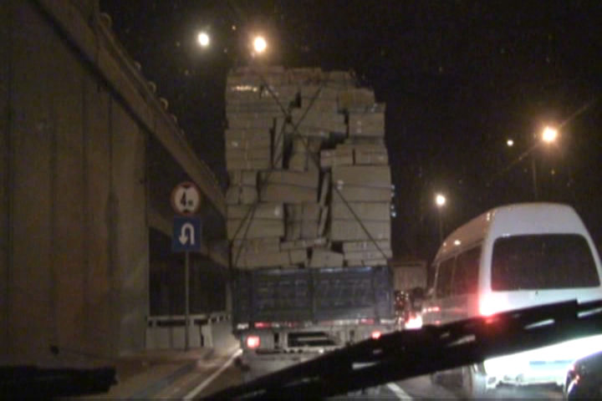
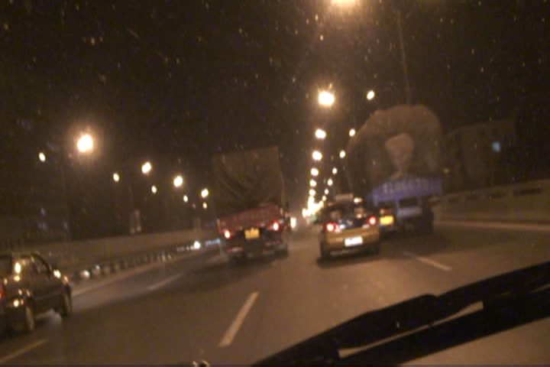
On-road Measurements in Beijing
Studying emissions in the real world

Slide 7
Measuring On-road Emission Factors
The main objective of our research efforts is to obtain real-world emissions information using a mobile platform chasing method.
Our work demonstrates that this method can become a cost-effective way to determine mobile emission factors.

Slide 8
Methods to derive emission factors
Methods | Advantages | Disadvantages
Dynamometer | Repeatable driving condition Vehicle and engine conditions well characterized | Highest cost per vehicle Driving and dilution conditions are artificial* Facilities are complex
PEMS | Real-world driving conditions Vehicle and engine conditions may be characterized | Dilution conditions are artificial Not time efficient for large diesel vehicles
On-road Chasing using mobile platform | Lowest cost per vehicles Real-world driving conditions Real-world on-road vehicle population Atmospheric dilution process | Vehicles and engine conditions are less known (but may be acquired through license plates) Driving conditions not controlled. (Also a strength*)

Slide 9
EERL Expertise in Mobile Platform Operation and Emission Factor Determination
2003-2006: Designed platform/conducted mobile platform measurements on-road, in community air, and near airport ^{1,2}
2005: Derived, for the first time, the size-resolved on-road particulate emission factors³
2007: Measured fleet average on-road emission factors for cars and trucks in Beijing using mobile platform⁴
2008: Measured fleet average and some individual emission factors for cars, trucks, and buses during Olympics using mobile platform⁵
2009: Sampled 243 individual trucks and 57 individual buses in and around Beijing (within two weeks), and derived emission factor distributions⁶
2010: Conducting emissions measurements in Beijing and Chongqing, focusing on NOx emissions
¹Westerdahl et al. (2005) Atmospheric Environment 2005, 39, (20), 3597-3610.
²Westerdahl et al. (2008) Atmospheric Environment 2008, 42, (13), 3143-3155.
³Zhang et al., (2005) Atmospheric Environment 2005, 39, (22), 4155-4166.
⁴Westerdahl et al. (2009) Atmospheric Environment 2009, 43, (3), 697-705.
⁵Wang et al., (2009) Atmospheric Environment 2009, 43, 4535–4543.
⁶Wang et al., (2010) Atmospheric Environment 2010, 44

Slide 10
Chase study instruments
Fast Mobility Particle Sizer (TSI 3091)
MicroAethalometer (Magee Scientific AE 51)
CO/temp/humidity (Q-Trak (TSI 7545)
CO2 analyzer (Vaisala CarboCap GM70)
NO analyzer (2b Tech Model 410)
NOx converter (2b Tech Model 401)
Computer datalogger
Video camera
Gps
Time resolution—10 seconds

Slide 11
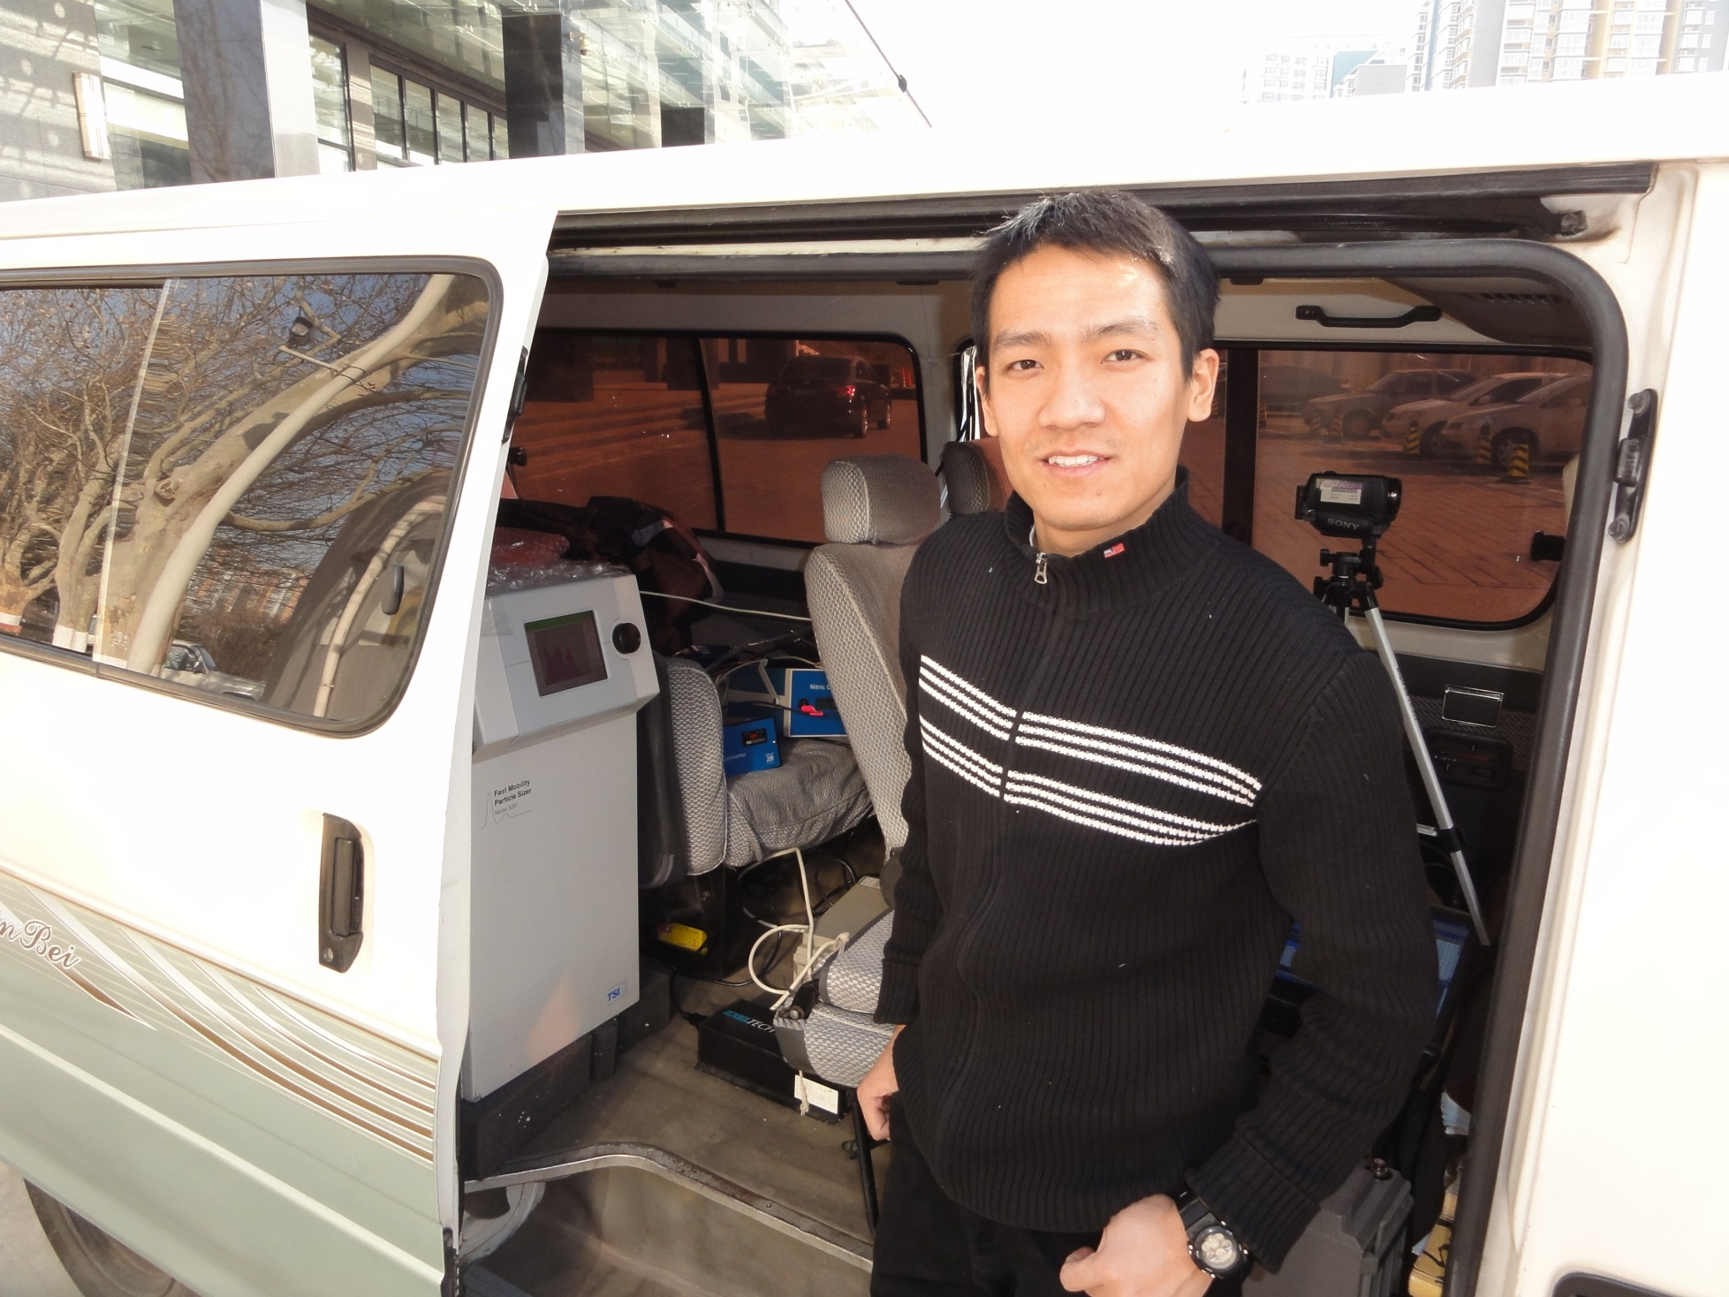

Slide 12
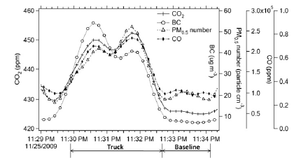
Plume concentrations from a truck
Wang et al., (2010) Atmospheric Environment

Slide 13

Deriving Emission Factors based on Carbon Balance
w_{c} : mass fraction of carbon in fuel
MW: molecular weight
∆: concentration increase
=conc_{realtime} – conc_{baseline}
Method used by Stedman for EF calculation from remote sensing and Harley in tunnel studies

Slide 14
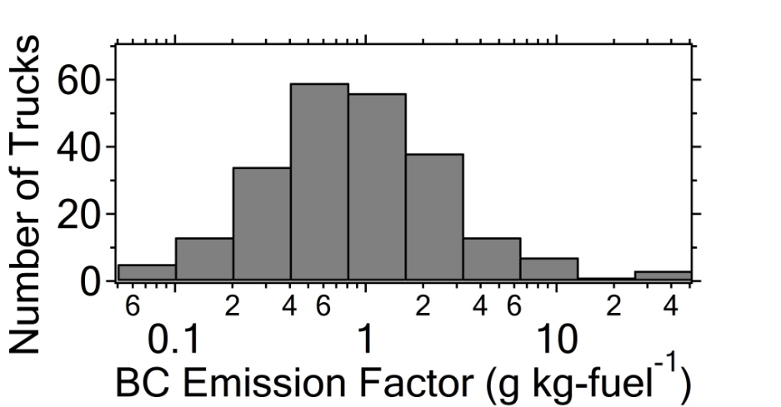
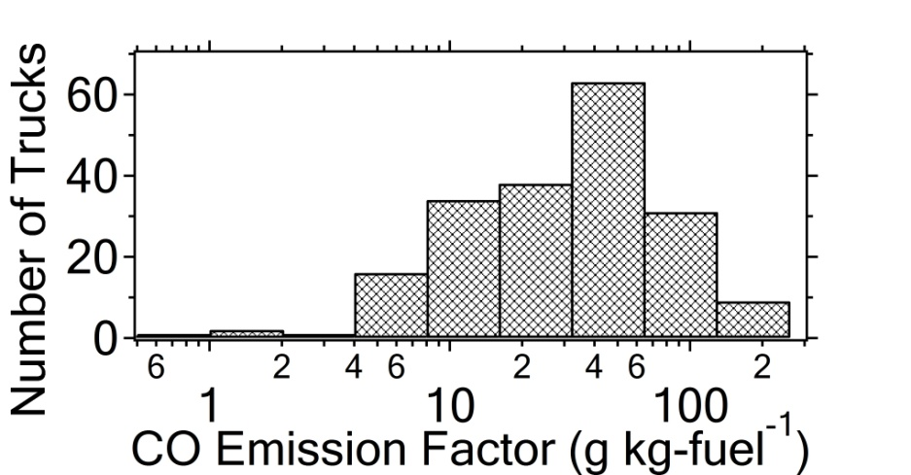
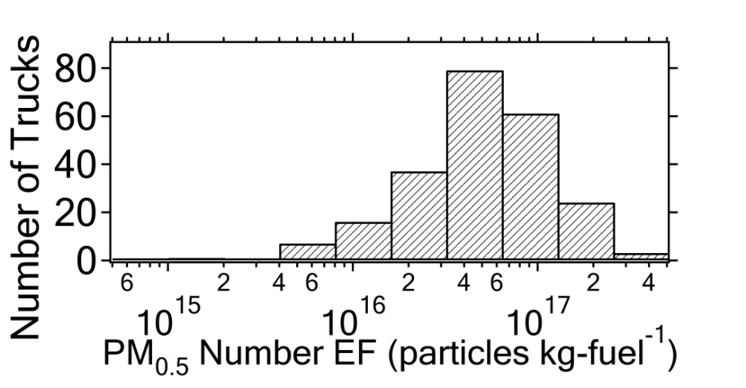
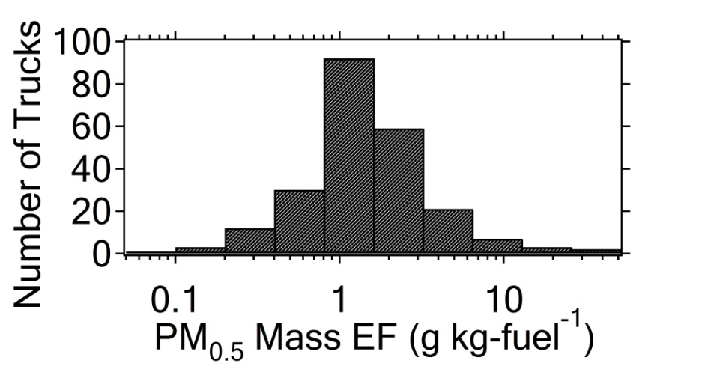
EF distributions: ~250 Diesel Trucks
Mean Value
Wang et al., (2010) Atmospheric Environment

Slide 15
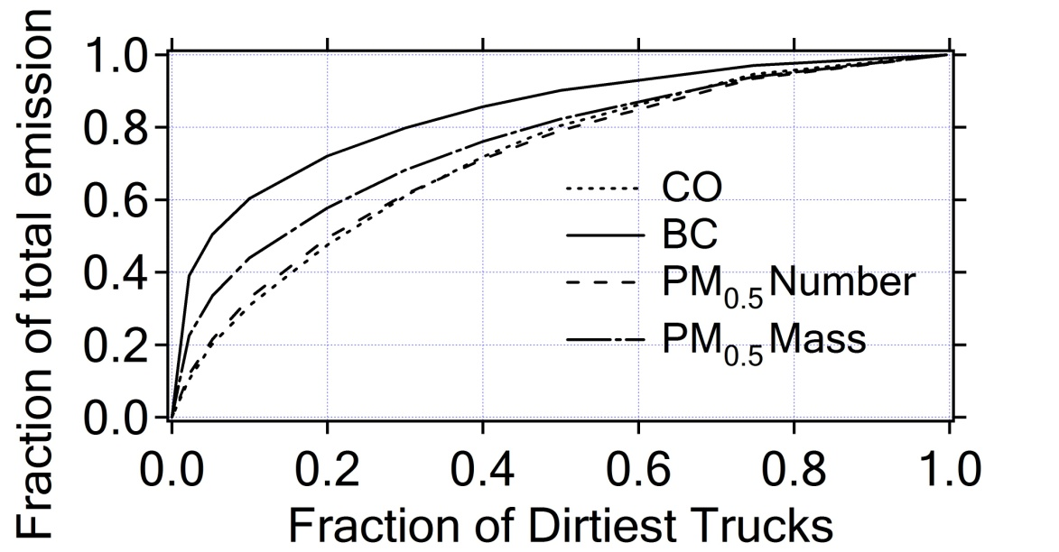
BC EF distribution--Diesel Trucks*
5%
20%
5% heavy emitters responsible for 50% BC emissions
20% of trucks were responsible for 50% CO and PM number, 60% PM mass and 70% BC emissions
Wang et al., (2010) Atmospheric Environment

Slide 16
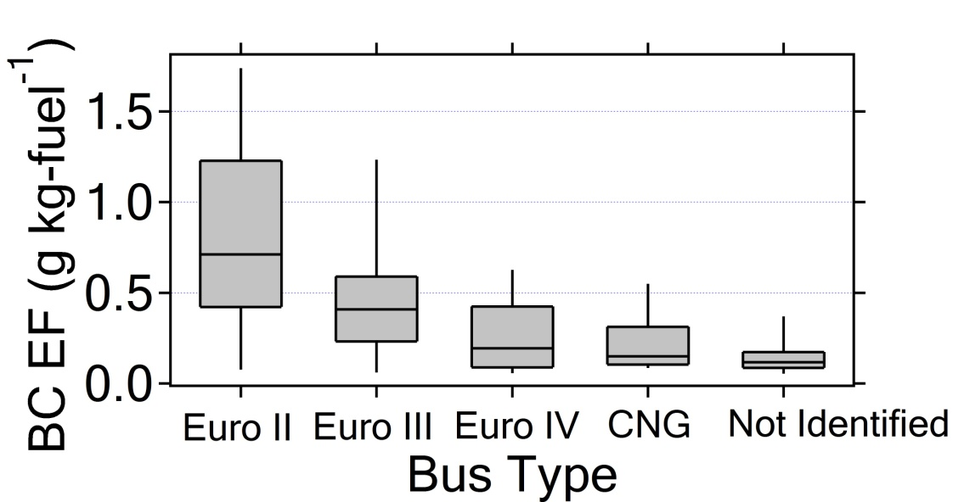
BC EF distribution: Buses by type
BC EF of Euro IV and CNG buses were 70% and 75% , respectively, lower than Euro II buses
Wang et al., (2010) Atmospheric Environment

Slide 17
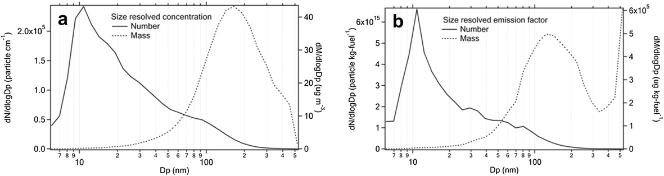
Particle size resolved PM concentration and emission factors for urban buses*

Slide 18
Objectives for December 2010 studies
Expansion of successful field studies of winter 2009 where we sampled the emissions from over 250 on-road vehicles in and around Beijing
The main objective was to add NOx measurement and emission factors to our protocol
A second objective was to compare our emission measurements using the on-road chasing method to Portable Emissions Measurement System (PEMS) observations
Third objective was to expand chase studies to include a second city for chase studies

Slide 19
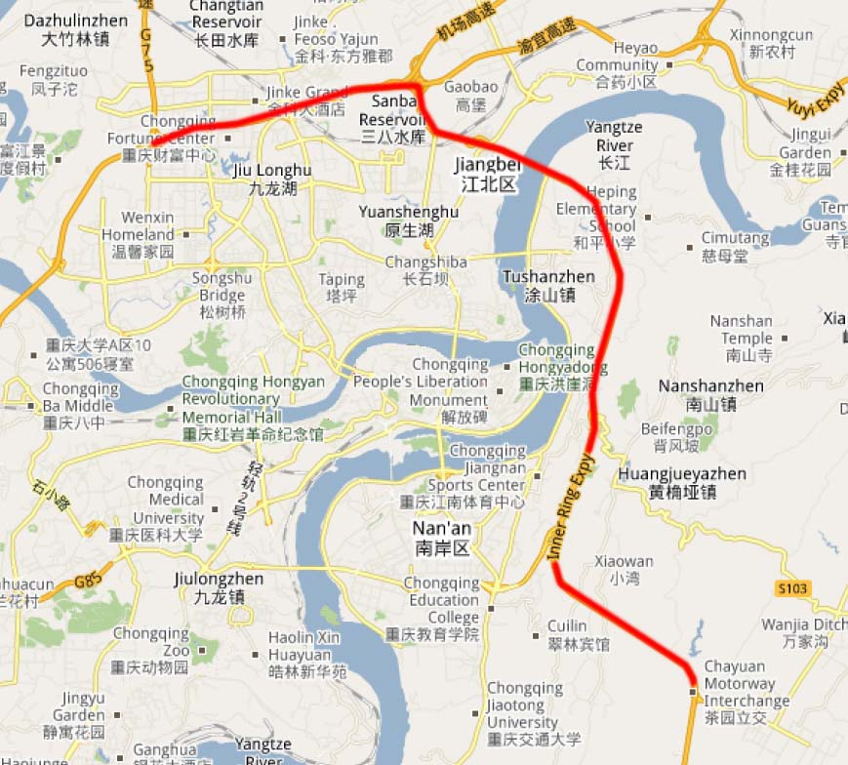
Routes-Chongqing
A
Inner Ring Expy
Downtown
B
A-B: On-road truck chasing route (25.1 km)

Slide 20
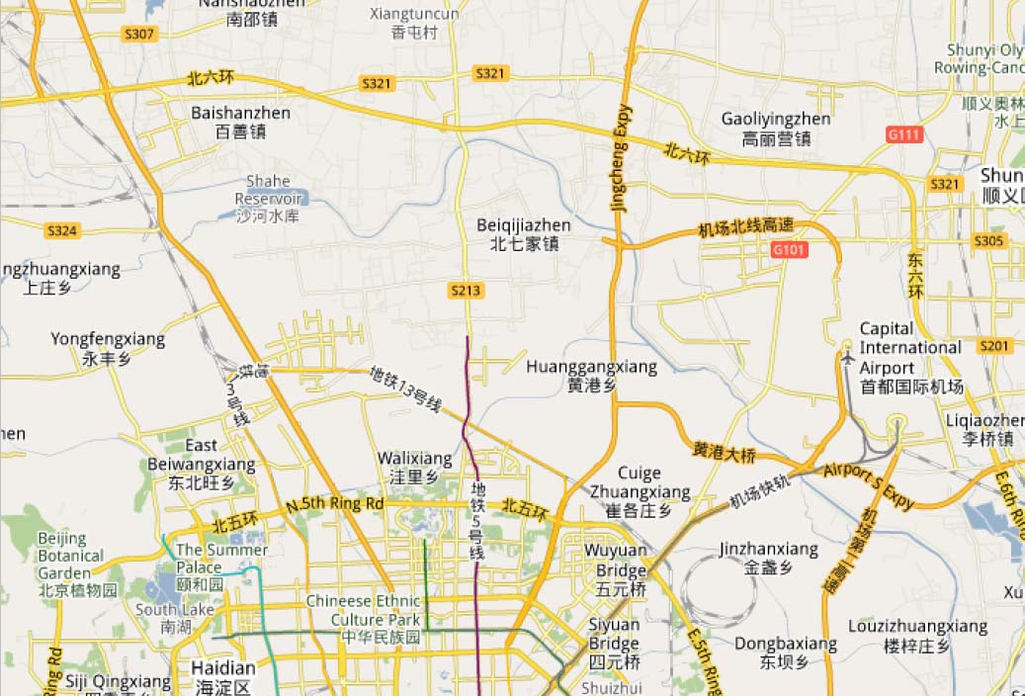
Routes-Beijing
A
D
6th Ring Rd.
Beijing-Chengde Expressway
Beijing-Tibet Expressway(G6)
C
5th Ring Rd.
B
4th Ring Rd.
A-B: On-road truck chasing route (48.1 km)
C-D: PEMS comparison chasing route (19.7km Expy+11.4 Urban Road)

Slide 21
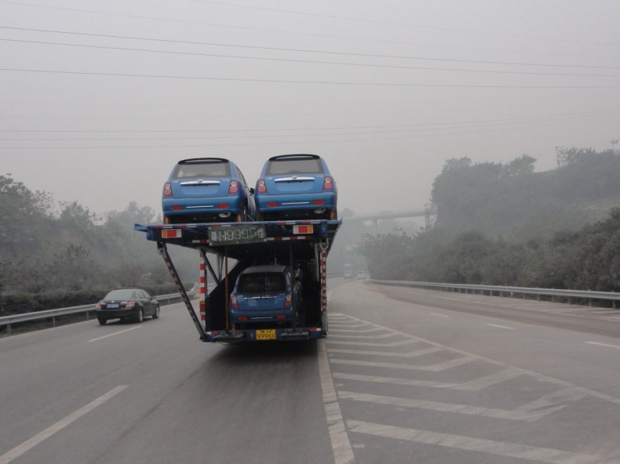
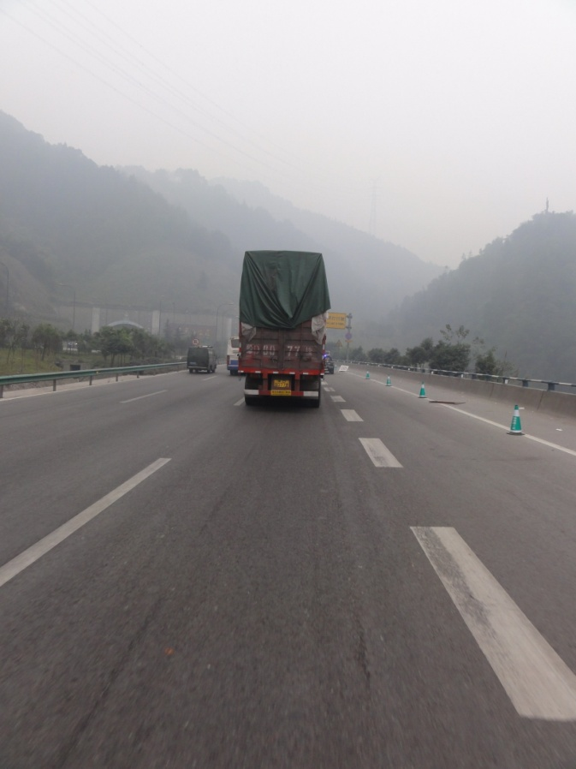
December 2010 activities - Chongqing
On-road chasing study in Chongqing
  Dec 21-Dec 27, 2010
  Truck chased: 267
Date | Route | Trucks Chased
Dec 21 | Inner Ring Rd. | 38
Dec 22 | Inner Ring Rd. | 60
Dec 23 | Inner Ring Rd. | 61
Dec 24 | Inner Ring Rd. | 11
Dec 26 | Inner Ring Rd. | 56
Dec 27 | Inner Ring Rd. | 41

Slide 22
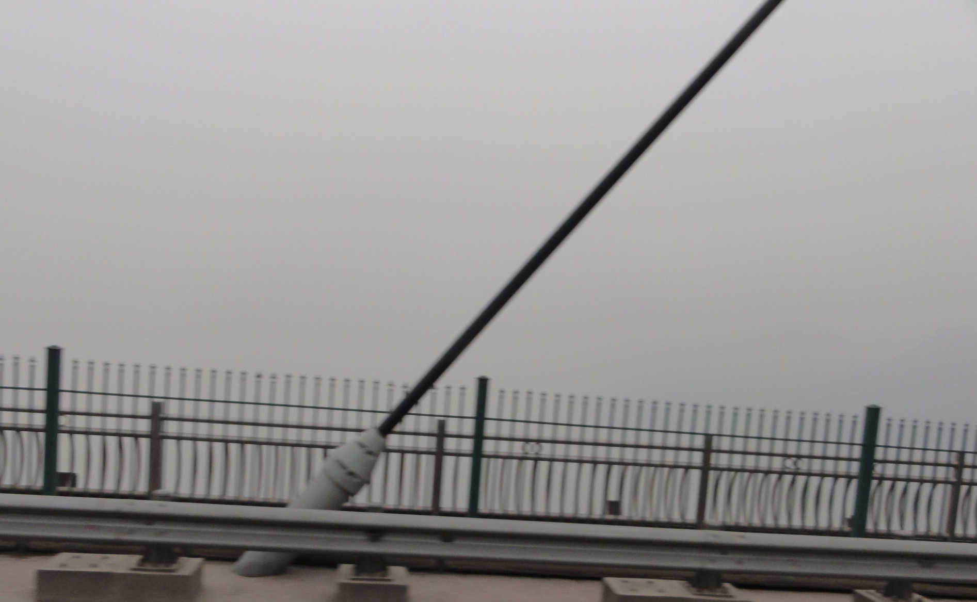
Beautiful Chongqing
Yangtze River and city skyline

Slide 23
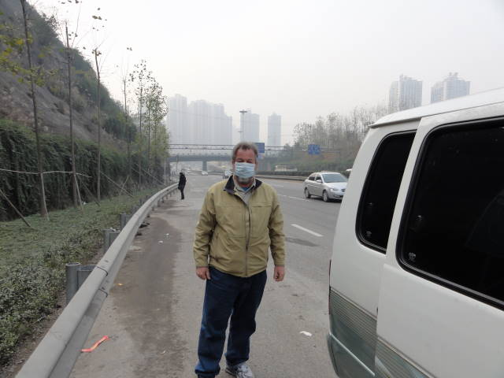

Slide 24
December 2010 Activities - Beijing
On-road chasing study in Beijing
  Dec 9-Dec 14, 2010
  Trucks sampled: 195
PEMS vs on-road chasing comparison study in Beijing
  Dec 15-Dec 17, 2010
  Three trucks
Date | Route | Trucks Chased
Dec 9 | 6th Ring Rd. | 26
Dec 11 | 6th Ring Rd. | 55
Dec 12 | 6th Ring Rd. | NOx Test
Dec 13 | 6th Ring Rd. | 55
Dec 14 | 6th Ring Rd. | 47
Dec 17 | 6th Ring Rd. | 12
Date | Route
Dec 15 | Beijing-Chengdu Expy, 6th Ring Road
Dec 16 | Beijing-Chengdu Expy, Urban Road
Dec 17 | Beijing-Chengdu Expy, Urban Road

Slide 25
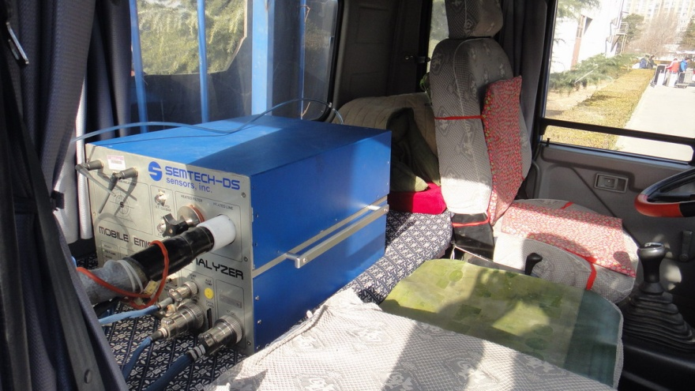
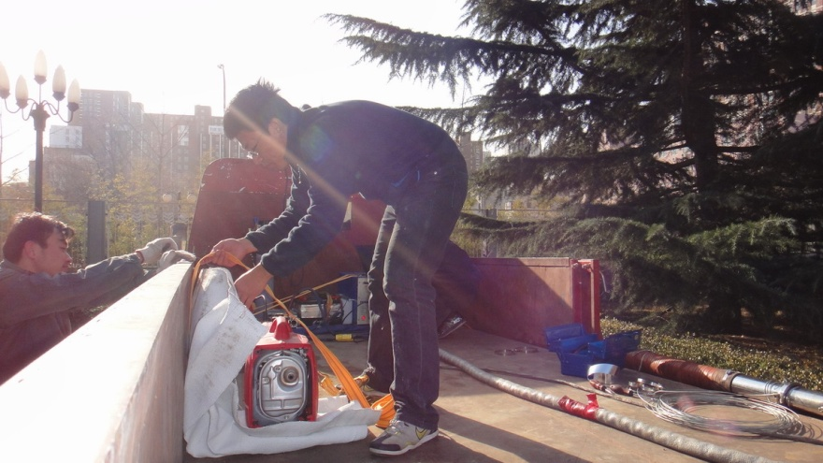
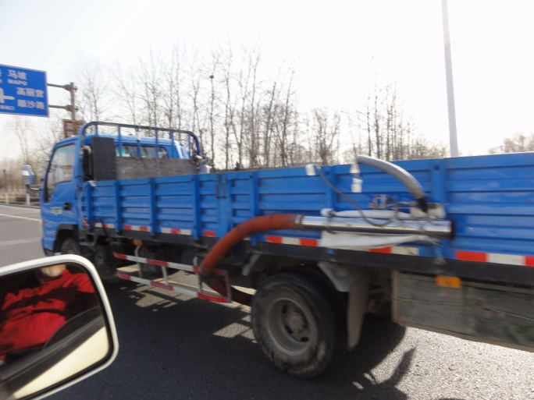
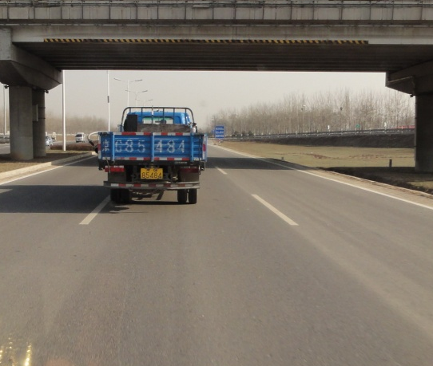
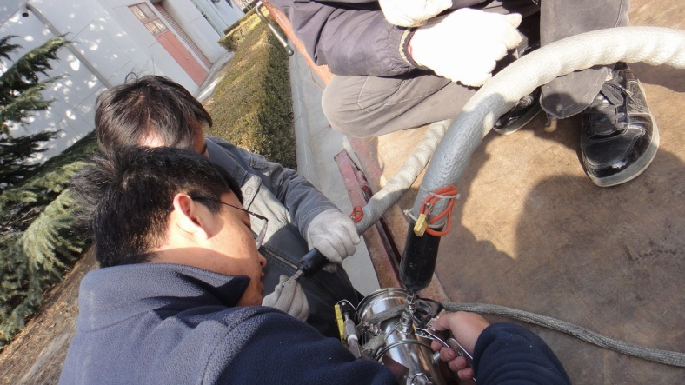
PEMS vs. on-road chasing comparison study
Beijing—Initial focus on NOx data

Slide 26
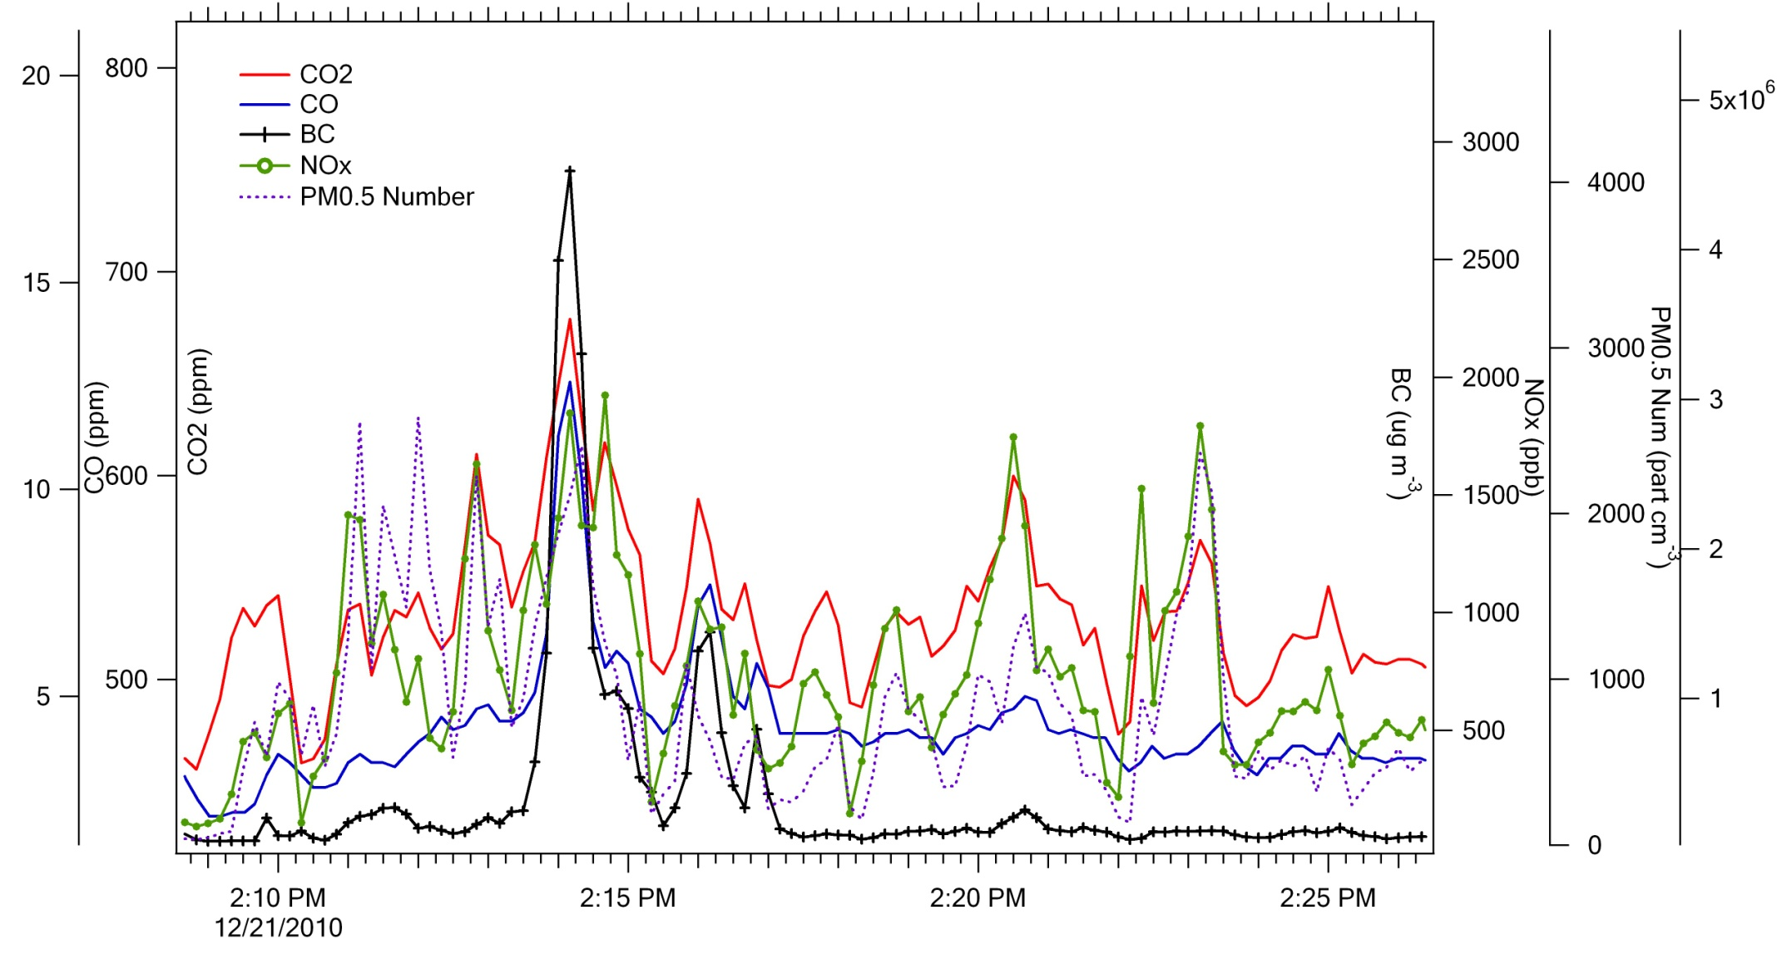
Preliminary Results
A high emitting truck in Chongqing

Slide 27
Preliminary Results

Slide 28
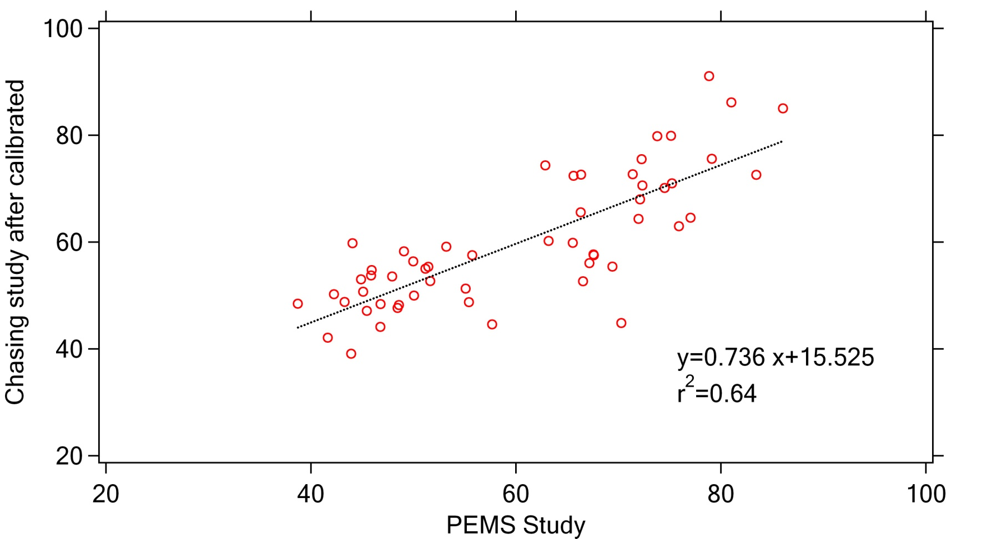
Very Preliminary Results
NOx emission factors
PEMS vs. Chasing method (g/kg fuel)
.

Slide 29
2010 Summary
On-road chasing methods were successfully implemented in Beijing and Chongqing.
On-road NOx, BC, CO, CO₂, UFP data were collected for more than 400 diesel trucks.
The NOx emission factors derived from the on-road chasing method with speed calibration appear to be in good correlation with those from PEMS—still under construction.
On-going data analysis aims to add NOx emission factor distributions for on-road Chinese trucks.

Slide 30
Conclusions from On Road Studies
A time- and cost- effective approach allows us to sample a large number of trucks and buses
  Real-world on-road emissions of areal-world vehicle population
Useful support for air pollution control measures:
  Identify heavy emitters and implement emission reduction programs to control them
  Need to improve fuel quality in entire region rather than specific cities*
  Clean –burning buses work

Slide 31
Will Chase methods replace PEMS?
NO—but
Allows consideration of real world PM
  UFP size and numbers down to 5.6 nm
  Black carbon
Allows testing of many vehicles—40 or 50 a day
  Produces a better representation of on road fleet
Easy to set up and operate
  But labor intensive to analyze
Ideal for use in developing world

Slide 32
Can Chase methods compliment PEMS?
Yes
Quick means to generate emissions hypotheses
Screening tool for finding high emitters
  Follow up with PEMS
Can be applied in areas far from lab support
New metrics/compounds can be added
Methods could be used together to generate better PM and black carbon emissions data

Slide 33
Acknowledgements
Dr. Zhenghua Li and Prof. Wu Ye at Tsinghua University
Prof. Xiaochuan Pan at Peking University School of Public Health
Dr. Jingnan Hu at Chinese Research Academy of Environmental Sciences
Mr. Jianjun Zheng at Chongqing Research Academy of Environmental Sciences
Although the research described has been funded wholly or in part by the USEPA contract EP-C-06-003 to SRA International, it has not been subject to the Agency’s review and therefore does not necessarily reflect the views of the Agency, and no official endorsement should be inferred.

Slide 34
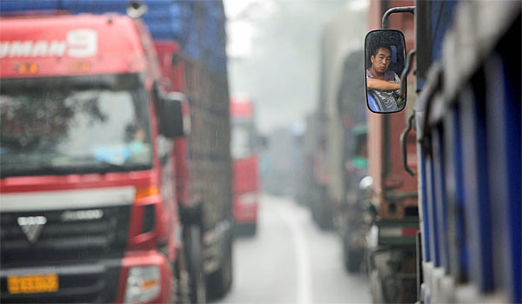
A better future for Beijing?
Maybe, but traffic and traffic growth will remain a serious challenge for rest of China

Slide 35
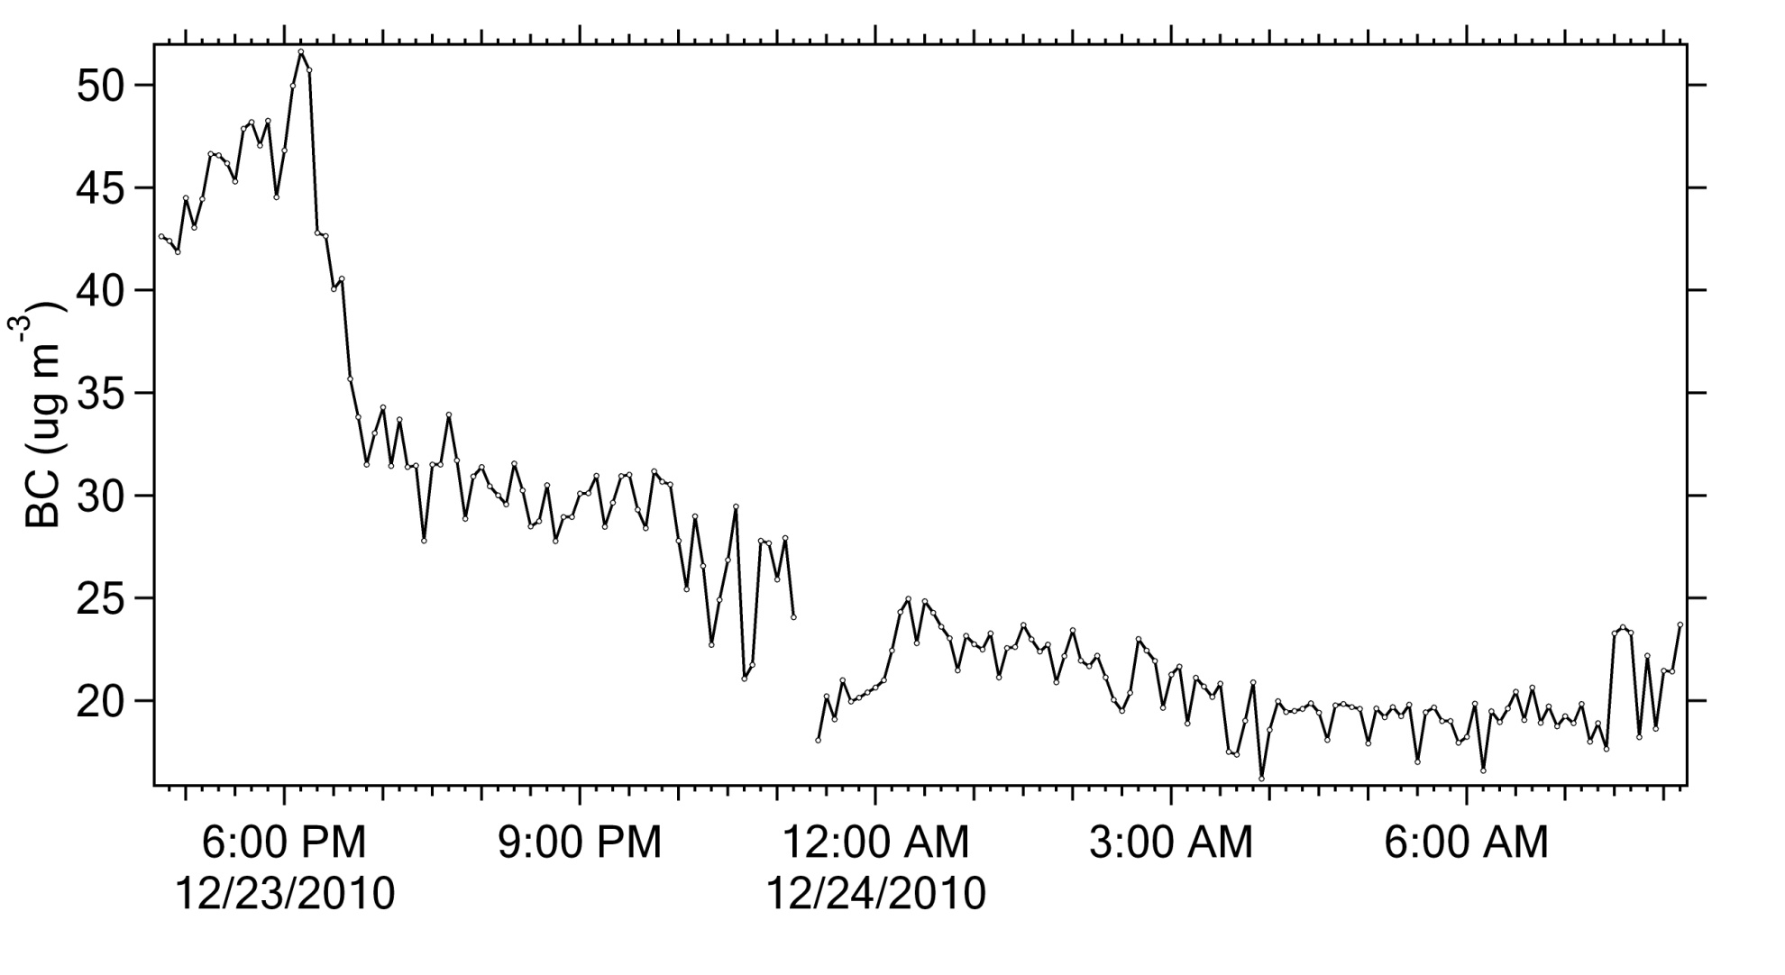
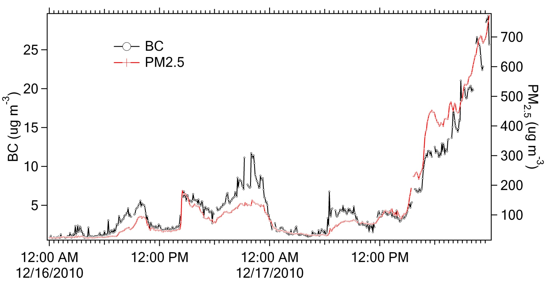
Ambient Black Carbon
A tale of 2 cities
Chongqing
Daytime truck traffic strongly reflected in Chongqing ambient air
Beijing

