Slide 1
In-Use Emissions Testing – Engine Manufacturer’s Perspective
Shirish A Shimpi
Portable Emissions Measurement Systems Workshop
March 24, 2011

Slide 2
In-Use Emissions testing using PEMS - History
Heavy-Duty in-use testing came into the regulatory arena in the US as a result of the 1998 EPA Consent Decree which included Not to Exceed (NTE) Standards
The manufacturer-run in-use testing program for Heavy-Duty On Highway Diesel Engines and Vehicles program was a result of a cooperative settlement agreement in 2003 between EPA, CARB and EMA on certain provisions of the Not to Exceed Standards
The final Rule on In-Use Testing Program for HDOH Diesel Engines and Vehicles program was announced in June 2005

Slide 3
One of the first PEMS – EPA’s ROVER
From an EPA presentation to GRPE’s Off-Cycle Working Group
September 13, 2005

Slide 4
In-Use Emissions testing using PEMS - History
The Final Rule stipulated that:
Portable Emissions Measurement Systems (PEMS) will be used to monitor in-use emissions from diesel vehicles with measurement of NOx, HC, CO and PM
Measurement Accuracy Margins would be established to account for PEMS emissions measurement variability in-use
A pilot program for both gaseous and PM was established for EPA and engine manufacturers to gain experience using PEMS and generating/submitting data
EPA will select engine families for in-use testing
Engine Manufacturers will select vehicles based upon 7 EPA stipulated criteria and screening process – EPA has to approve selection
Vehicle and family pass/fail criteria need to be met

Slide 5
Engine Manufacturers Association’s response to EPA’s Final Rule on In-Use Emissions Testing
EMA’s president stated:
The voluntary agreement to develop, conduct and fund a new in-use testing program demonstrates the continued strong commitment of diesel engine manufacturers to produce heavy duty engine systems that reduce emissions and improve air quality in our cities and states
The agreement on an in-use testing program with EPA and CARB is truly a milestone for heavy-duty engine manufacturers and cleaner air because it moves emissions testing from the laboratory into real-world operating conditions
The program not only will verify that near zero emissions levels measured under laboratory certification conditions are achieved on our streets and highways, but will also provide valuable feedback to engine manufacturers on any need to further improve and enhance emissions control systems

Slide 6
Measurement Accuracy Margins a.k.a Measurement Allowance (MA)
Both EPA and EMA understood that in-use measurements were more difficult than Lab measurements and measurement accuracy margins would have to be provided for variability above Lab testing variability
EPA offered a flat 5% MA for all regulated emissions species which EMA rejected
EMA, EPA and CARB agreed to fund two programs at SwRI that would provide measurement allowances for gaseous and PM that were based on actual test results on PEMS units with verification using CE-CERT’s mobile emissions lab
The determination of gaseous emissions MA was initiated first since gaseous emissions PEMS were commercially available
PM PEMS were not readily available commercially and had issues even when they were used in determining the MA
Finally, after running the data based MA program for PM, EPA and EMA agreed to a MA for PM
Both the gaseous and PM MA programs were multi-year programs and cost several millions of dollars with costs shared between EPA, CARB and EMA

Slide 7
Pilot and Enforceable In-Use Programs
EPA instituted a 2 year pilot program prior to the enforceable program to provide time for engine manufacturers to become familiar with the program
5 vehicles are to be tested under the pilot and 5 to 10 vehicles to be tested in the enforceable parts of the program
Each pilot or enforceable period is 18 months long for obtaining and reporting in-use data
The start of the pilot program was based upon the completion of the MA determination per a predetermined schedule
Delays in the completion of the MA determination delayed the start of the pilot program and hence the start of the enforceable program
Gaseous emissions pilot program started in May 2006 and the in-use testing program is now in the enforceable part of the program
PM in-use testing program is still in the pilot phase. Instead of 2 years for a pilot program, due to delays in the PM MA determination, the pilot program covers a 4 year period starting in 2007 with engine manufacturers selecting two years out of the 4 to conduct pilot testing

Slide 8
In-Use Testing for Heavy Duty Non-Road Engines
So far, in-use testing programs have been established for Heavy Duty On-Highway Diesel Engines
EPA has been negotiating with EMA regarding in-use test program for non-road engines
The NPRM for the Non-Road Heavy Duty In-Use Testing has not yet been announced by EPA but is expected sometime soon
EPA’s GHG NPRM had caused the delay
EPA does not plan to rerun the Measurement Allowance program but will use information gathered through the HDIUT MA determination with some modifications

Slide 9
The Challenge of In-Use Testing
Engine design, mapping engine operating surfaces etc. could be challenging in order to satisfy NTE for in-use testing in the NTE zone for events as short as 30 seconds under a variety of engine driving operations and ambient conditions
Additionally, actually preparing for and conducting in-use test protocol with customer engines/vehicles and the PEMS is also challenging
Engine manufacturers have demonstrated that they are up to the challenge through the work carried out to date

Slide 10
Impact of In-Use Testing
Imposes additional burden on engine manufacturers
Significant additional cost for equipment, personnel and testing according to the edicts of Part 1065
It would be useful to determine if there are ways to reduce the impact
Do all emissions species need to be measured? Can we do away with not measuring some of the less important ones?
Could other regulatory programs be trimmed as being unnecessary with in-use testing in place?
Will the in-use testing program continue without end or will it sunset sometime in the future?

Slide 11
Customer Vehicle Testing Issues
Required to work around normal vehicle schedule
Results in long irregular work hours
Difficulty in locating customers
Fleet schedule variability
Vague departure and arrival times
Miscommunication common at larger fleets
First test at a given customer site is always the most difficult
Test equipment takes up a lot of room
Large quantities of equipment needed leads to problems – forgotten items
Must depend on driver to record some information – they just don’t always do it
Limited or no trouble shooting time

Slide 12
Some Gaseous Emissions PEMS Issues
Field maintenance and calibration of the analyzers
THC measurement is cumbersome and expensive. Not sure the benefit or use
Exhaust systems have been difficult to un-assemble
Leak checking heated emission line on vertical stack is problematic
Heated sample line is fragile and expensive to repair
CFR 1065 linearization requirement is probably too stringent for in-use equipment - esp. CO

Slide 13
Lessons Learned
Single MPS PPMD with remote dilution provides most versatility and ease of use for compliance testing
Weather too difficult to predict. Most installations require concern for rain. Remote dilution allows for PPMD to be installed in the cab.
Perform crystal greasing and sample flow and other checks the day before testing (reduces installation time).
Have adequate computing resources for on site data processing.
Carefully consider shipping options when shipping PPMD
13
3/24/2011

Slide 14
Lessons Learned
Start customer ID process as early as possible
Communicate regularly with field network to speed up customer location
Solicit multiple customers
Verify ESN, vehicle numbers and truck mileage early in the ID process
Carry spare parts
Visit customer before test date to develop installation plan

Slide 15
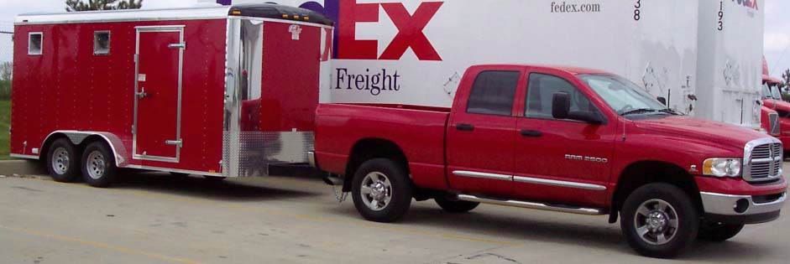

Slide 16
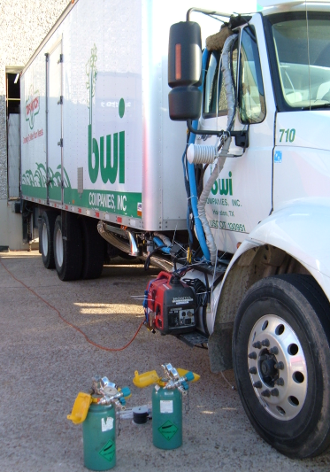
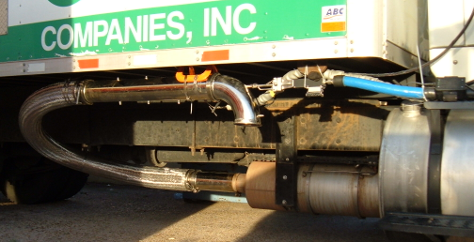
Class 8 Straight Truck
Gaseous and PM analyzers are in the cab in place of the passenger’s seat (removed for test).
Weather Station (Temp, RH)
Exhaust Flow Meter
PM sample line
Flexible Exhaust Transport
Remote Dilutor for PM sampling
16
3/24/2011

Slide 17
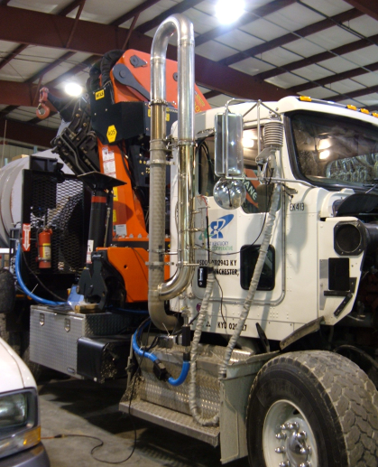
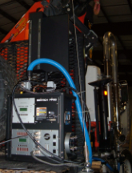
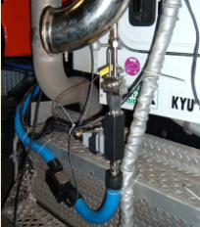
Custom Crane Chassis Single MPS PPMD with Remote Dilution
Rigid Exhaust Transport
PPMD
Remote Diluter
17
3/24/2011

Slide 18
Thank-you. Any Questions?

