Slide 1
Portable Emission Measurement
– U.S. EPA Perspective
1st Ever PEMS Conference
March 24, 2011
John Koupal
Director, Air Quality & Modeling Center
Assessment and Standards Division
EPA Office of Transportation & Air Quality

Slide 2
How PEMS is used at EPA
2
Compliance
  Field investigation
  New in-use rules
Smartway
  Assessing new technologies
Emission Inventory Modeling
  MOVES

Slide 3
Key Milestones & Drivers
“ROVER”
  Patent No. 685946 filed in October 2000
Technology advancements by industry
PM Regulations
  40 CFR 1065 - linking lab to “real-world” operations
  Harmonizing regulations with other countries
In-Use Rules
  HDIU standards established in 2007
    Establishing “Not-to-Exceed” (NTE)
    Multiple years of use by manufacturers
  NRIU standards being proposed in 2011
Development of MOVES

Slide 4
EPA PEMS Program Objectives
Improved methods and techniques
  How to use equipment in field, safety, SOPs, etc
Sample design and recruitment
  Testing broader population of vehicles
  Sampling population: RSD, random sampling, $, etc.
Improved regulations for PEMS usage
  (CFR 1065)
  PM measurements
Improved equipment
Efficient deployment & data production

Slide 5
Motivation for PEMS in Modeling
5
In “Modeling Mobile Source Emissions” (2000), National Research Council made several recommendations to EPA to improve modeling:
  Support for smaller-scale (project level) analysis
  Improved characterization of high emitters, heavy-duty vehicles and nonroad sources
  Improved characterization of particulate matter and toxics
  Improved model evaluation and uncertainty analysis
  Improved ability to interface with other models
These recommendations became the primary objectives for MOVES

Slide 6
What is MOVES2010?
Motor Vehicle Emission Simulator
EPA’s replacement for MOBILE
Estimates total emissions & energy use from all on-road sources at national, local or project levels
Official version released December 2009
  Replaces MOBILE6.2 as EPA’s official car & truck emissions model for SIPs and conformity determinations
Based on “modal” emissions
  Allows finer scale (e.g., project level) modeling
  No longer limited to data on specific test cycles - greatly broadens data sources to include lab, PEMS, I/M over any cycle

Slide 9
Why We Like PEMS
Supports modal emission rate development
The real world is where the action is
  Can measure emissions from real (not trace) driving
  Grades, temperatures, A/C etc. etc.
Labs are expensive – especially for engines
They don’t have labs in Denver… Texas… many areas
We can go to the vehicle – capture vehicle “in the wild”

Slide 10
Challenges with PEMS
Inherent variability of real world conditions
“Wild West”
  Easier access to emission measurement
  Many 1-2 vehicle test programs out there
  Different focus, quality standards, methods
Representing the entire fleet
Separating emissions and activity

Slide 11
Strengths and Weaknesses of Different Data Sources
 | Lab | I/M | PEMS | RSD
High Emitters |  | ☺ |  | ☺
Fuel, Temperature Effects | ☺
Sample Size |  | ☺ |  | ☺
Operating Range | ☺ |  | ☺
Deterioration Trends |  | ☺ |  | ☺

Slide 12
Pollutants covered in MOVES
HC (THC, NMHC, NMOG, TOG, VOC)
CO
NO_{x} (NO, NO₂)
NH₃
SO₂
PM_{10,2.5} (OC, EC, sulfate, brake, tire)
GHG (CO₂, CH₄, N₂O)
Toxics
Energy (total, petroleum, fossil)

Slide 13
Emissions Processes in MOVES
Running
Start
Extended Idle (“hoteling”)
Evaporative
  Permeation, Vapor Venting, Liquid Leaks
Refueling
  Vapor loss, Spillage
Crankcase
Tire Wear
Brake Wear

Slide 14
Where does MOVES data come from?
Depends on pollutant, process, vehicle class
Historical EPA emission factor testing program
  Conducted from 1970s through 1990s
Inspection/Maintenance programs in U.S.
EPA research studies
  e.g., Kansas City Gas PM Study
EPA compliance & in-use data
  PEMS data used for HDD NOx/CO/HC data for MOVES; only use of PEMS in MOVES2010
Industry/academic research programs
  Many CRC programs used in MOVES

Slide 15
EPA PEMS Programs
MOVES “Shootout” (2001)
Kansas City LD PM program (2005)
Diesel Construction “Pilot” program (2008)
Houston HD “Drayage” program (2010)
Evaporative Field Leak program (ongoing)
Tier 2 LD program (ongoing)

Slide 16
The Challenge of
Emission Factor Research
Need very large samples to reflect the tail
  If sampling fully at random
RSD and I/M provide these samples, but are a limited snapshot of the total emissions
PEMS provides on-road emissions, but sample sizes are limited
Emerging “hybrid” approach:
  Screen vehicles using RSD
  Develop stratified samples based on RSD score
  Test vehicles in each strata with PEMS for on-road emissions
  Reweight PEMS results according to strata RSD weighting
Enables much smaller sample sizes

Slide 17
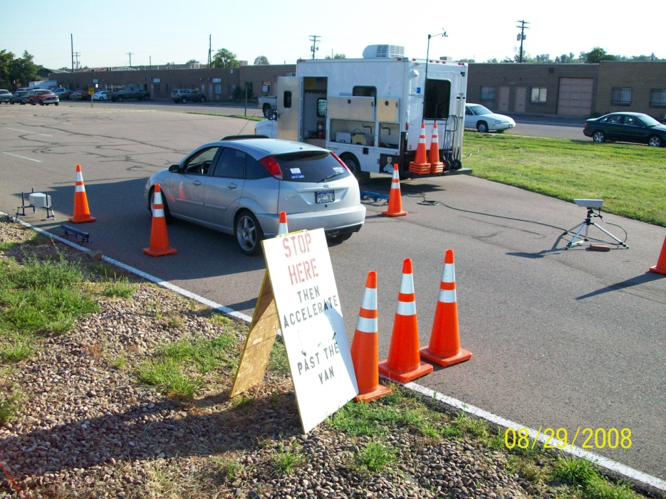
Evaporative “Leaker” Field Study
Evaporative vapor emissions either contained, or leaking
Developing groundbreaking approach to quantifying frequency of evap leakers
Developed method to find evap leakers using roadside remote sensing
Verified using portable SHED – with PEMS as the analyzer!
Collaborators: CRC, ERG, Colorado

Slide 18
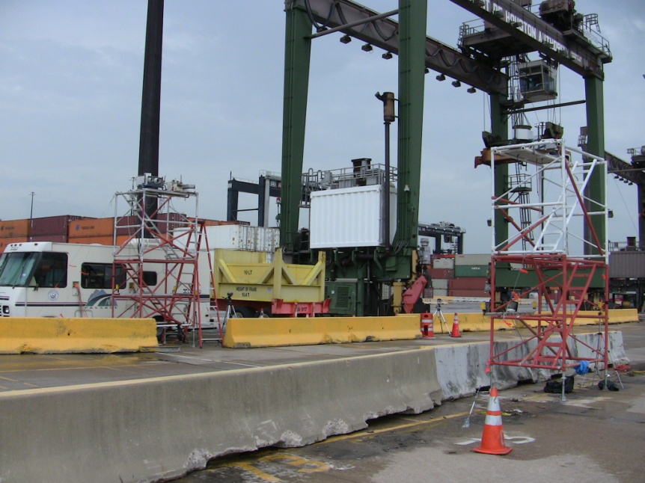
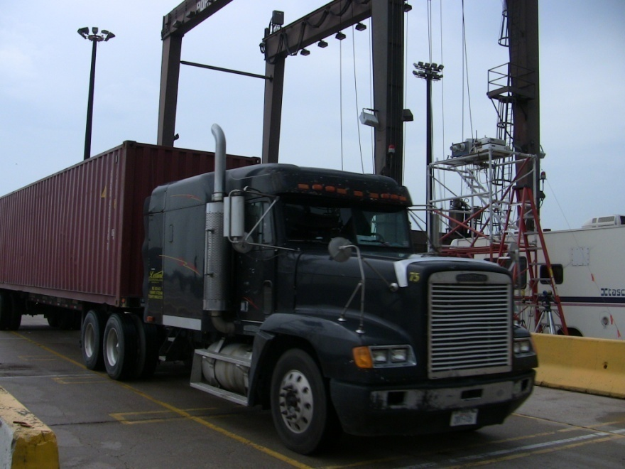
Houston Port HD Drayage Study
  ~ 4,000 RSD hits on 1,900 trucks entering port
  PEMS testing on sample of these, stratified by emission level
RSD equipment
Collaborators: TCEQ, ERG, HGAC, PHA
18

Slide 19
Population and Sample Sizes
Developed Model Year and Nox Bins for Field Set and Desired Stratified Sample
19

Slide 20
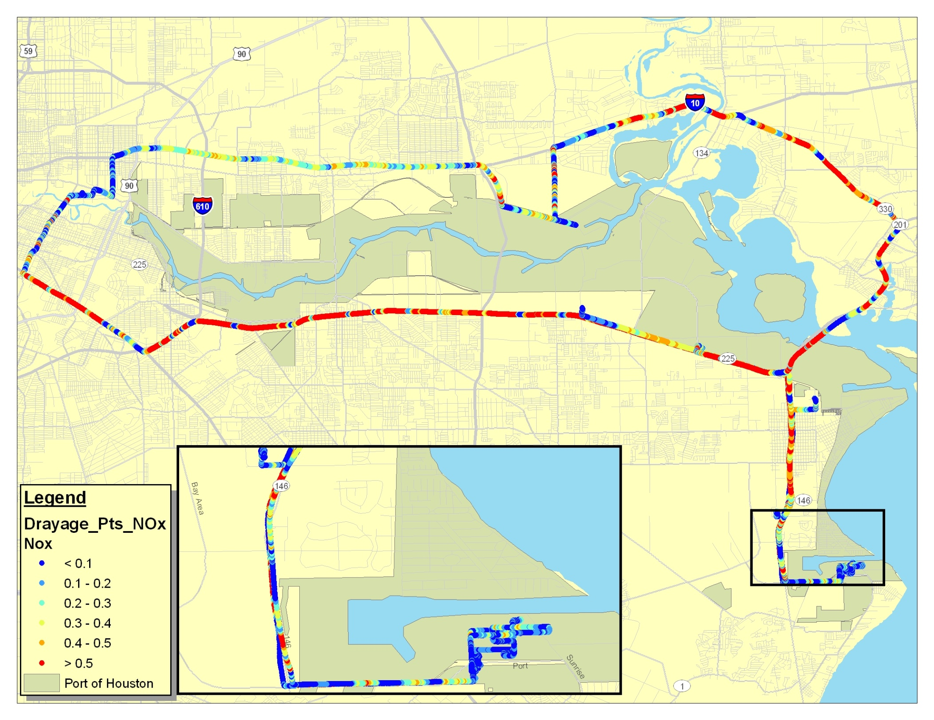
20

Slide 21
Summary
PEMS has been a game changer for compliance and modeling activities
EPA developed MOVES in anticipation of PEMS
However, much work needed to make best use of the data PEMS provides
EPA research focused on capturing in-use emission distribution, by capitalizing on strong points of RSD and PEMS
  Cost effective, efficient, robust

