Slide 1
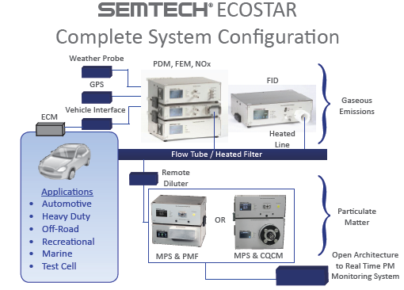
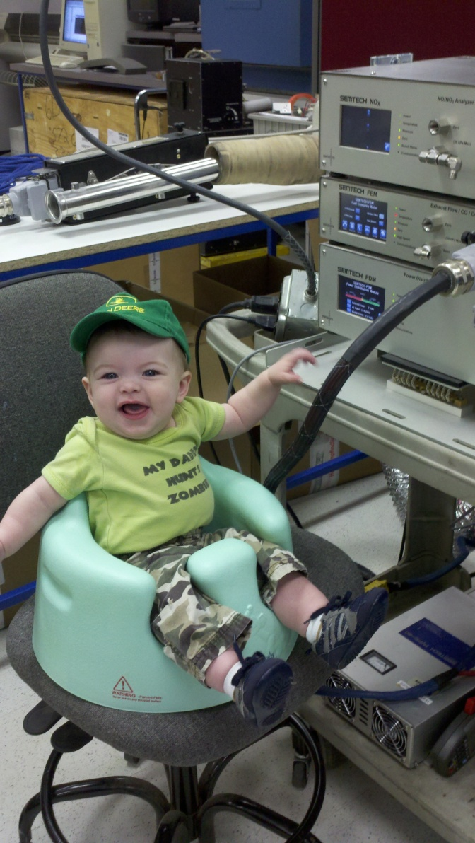
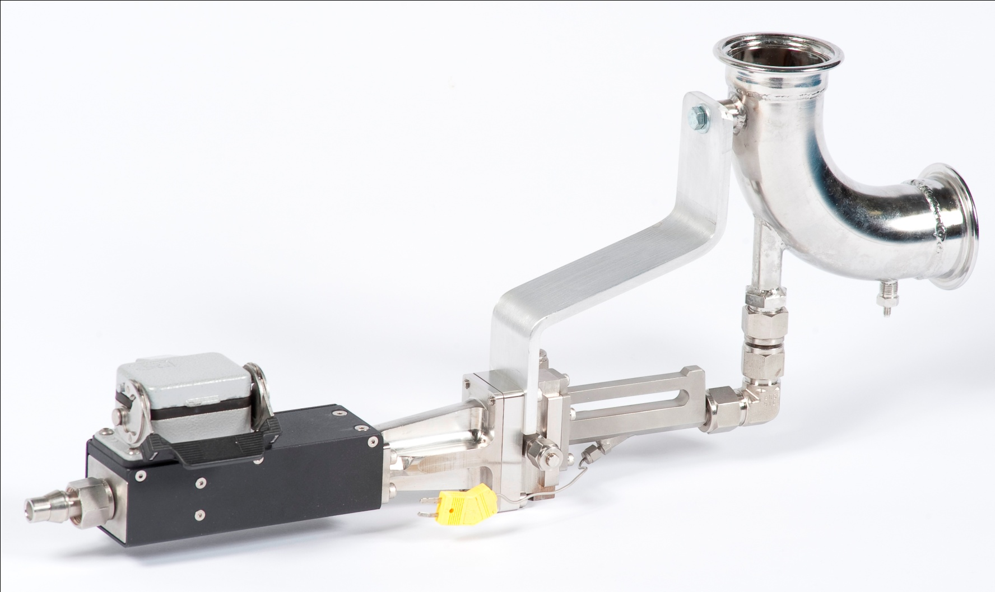
Complete Gaseous and PM System
David Booker, Sensors-Inc
SEMTECH ECOSTAR
PART 1 Gaseous

Slide 2
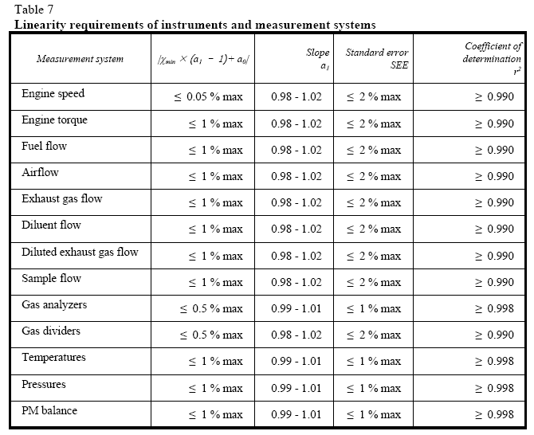

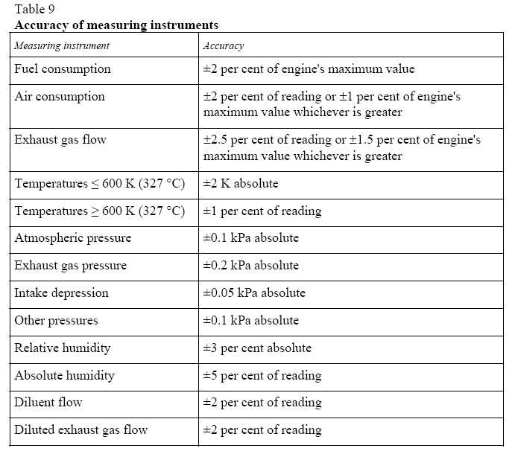
Regulatory Performance Requirements are Changing
  REG 49 (EURO IV) - PEMS and “Lab Grade / Certification equipment” same specifications.
  NDUV for NO / NO2 included.
  Additional criteria to meet, including;
    2.5 / 3.5s time response
    Sample dew point < 7C
    NO2 Loss performance requirements

Slide 3
Instrument Performance
ACCURACY: EU Reg 49 3.1.1: The analyzer shall not deviate from the nominal calibration point by more than ±2 per cent of the reading over the whole measurement range except zero, or ±0.3 per cent of full scale whichever is larger.
Precision EU Reg 49 3.1.2: The precision, defined as 2.5 times the standard deviation of 10 repetitive responses to a given calibration or span gas, has to be not greater than ±1 per cent of full scale concentration for each range used above 155 ppm (or ppmC) or ±2 per cent of each range used below 155 ppm (or ppmC).
Noise EU Reg 49 3.1.3: The analyzer peak-to-peak response to zero and calibration or span gases over any 10 second period shall not exceed 2 per cent of full scale on all ranges used.
Zero Drift EU Reg 49 3.1.4: Zero response is defined as the mean response, including noise, to a zero gas during a 30 seconds time interval. The drift of the zero response during a one hour period shall be less than 2 per cent of full scale on the lowest range used.
Span Drift EU Reg 49 - 3.1.5: Span response is defined as the mean response, including noise, to a span gas during a 30 seconds time interval. The drift of the span response during a one hour period shall be less than 2 per cent of full scale on the lowest range used.

Slide 4
Instrument Performance
RISE Time EU Reg 49 3.1.6:The rise time of the analyzer installed in the measurement system shall not exceed 3.5 seconds. Note: Only evaluating the response time of the analyzer alone will not clearly define the suitability of the total system for transient testing. Volumes and especially dead volumes through out the system will not only effect the transportation time from the probe to the analyzer, but also effect the rise time.
Response Time EU Reg 49 – 1.5: The system settings for the response time evaluation shall be exactly the same as during measurement of the test run (i.e. pressure, flow rates, filter settings on the analyzers and all other response time influences). The response time determination shall be done with gas switching directly at the inlet of the sample probe. The gas switching shall be done in less than 0.1 second. The gases used for the test shall cause a concentration change of at least 60 per cent FS. The concentration trace of each single gas component shall be recorded. The response time is defined to be the difference in time between the gas switching and the appropriate change of the recorded concentration.
Leak Check EU Annex 4B 9.3.4. ……Another method is the introduction of a concentration step change at the beginning of the sampling line by switching from zero to span gas. If for a correctly calibrated analyzer after an adequate period of time the reading is ≤ 99 per cent compared to the introduced concentration, this points to a leakage problem that shall be corrected.

Slide 5
Design / Performance Targets
4th Generation PEMS within Sensors
In a like-for-like comparison to the SEMTECH DS the ECOSTAR design criteria included (August 2010):
  Reduce size and weight by by >20-40%
  Reduce power by >30%
  Improve analytical performance to meet “Laboratory Grade” requirements
  Improve serviceability
  Extend Mean Time Before Failure
  Meet all CE / UL requirements for safety
  Meet IP 54 standards for dust and moisture protection

Slide 6
Design Approach
A Modular Design Approach was adopted (August 2010)
RULES
All interaction with other modules should be explicit.
Each module should be small and simple.
Decisions subject to change should be confined to a single module.
Each module should have a clear relation to the functional specifications.
Each module should be easy to test.
Hardware and Application dependencies should be confined to a small number of modules.
Benefits
Flexibility for configuration
Each module USEAP 1065 / EU Reg 49 Compliant
Common Module-to-Module features
Duplication of parameters (back-up)

Slide 7
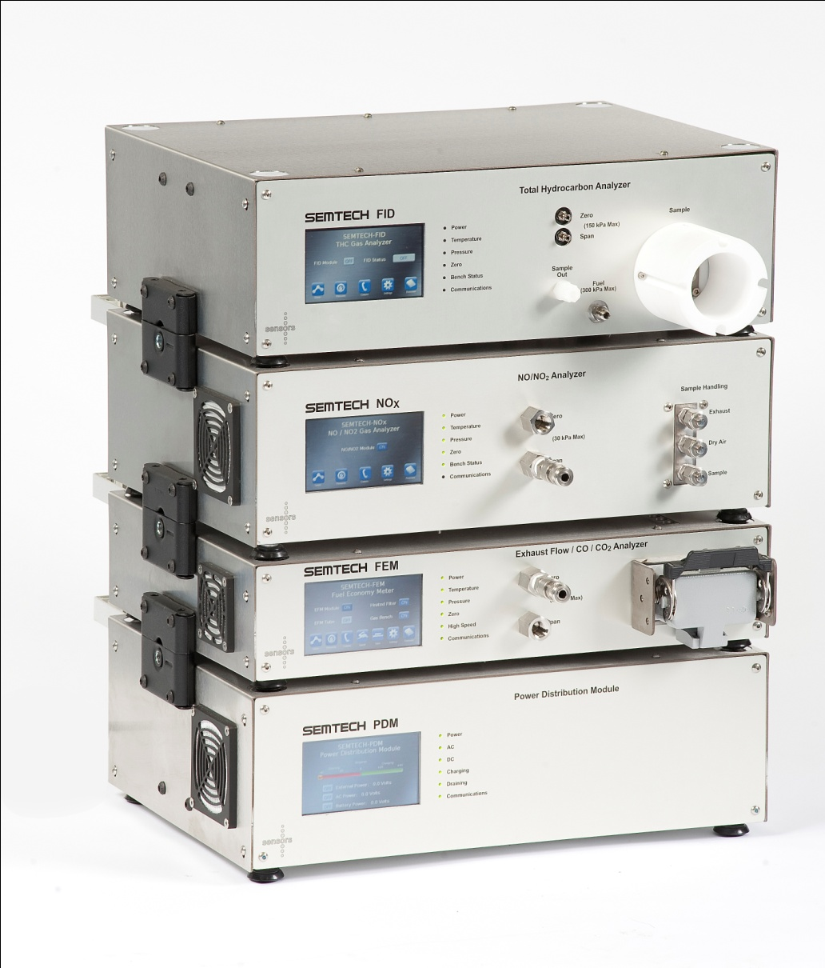
Modules
FID (Vacuum - THC analyzer)
NOX (NO / NO2 Analyzer)
FEM (Fuel Economy Meter)
PDM (Power Distribution)

Slide 8
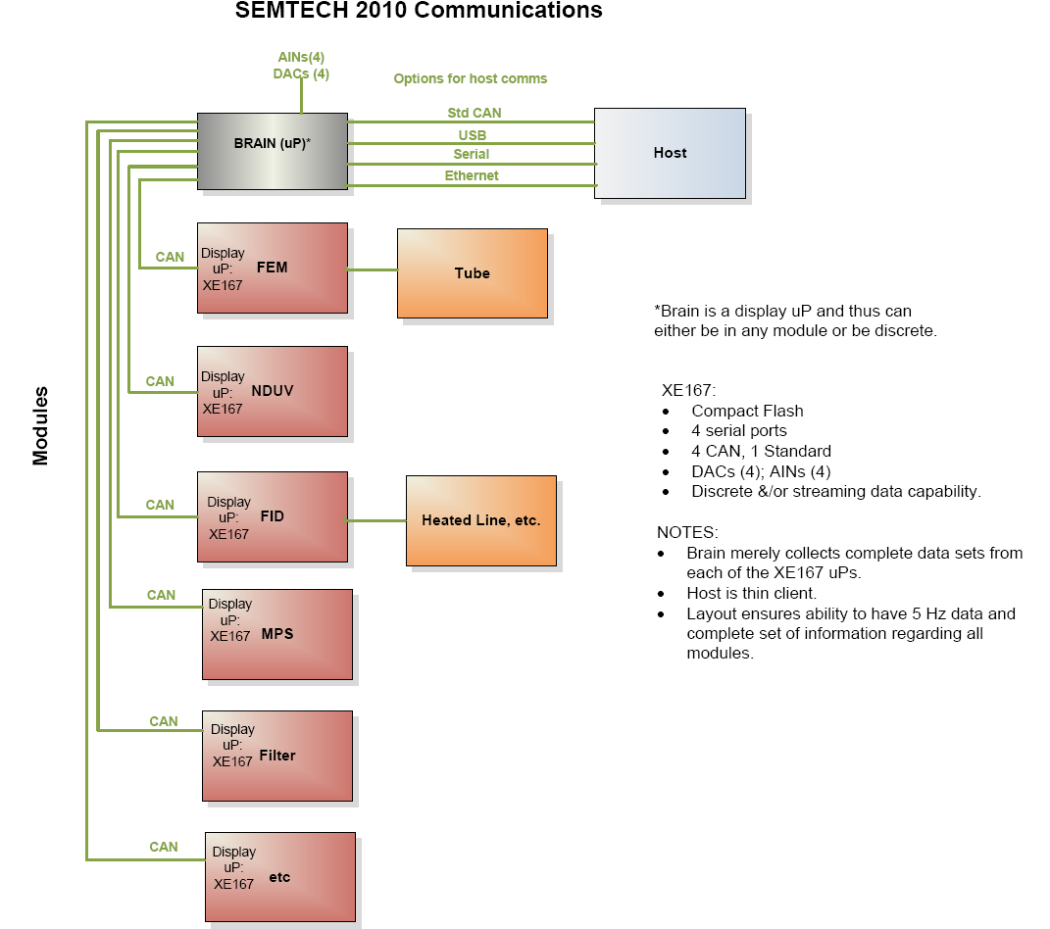
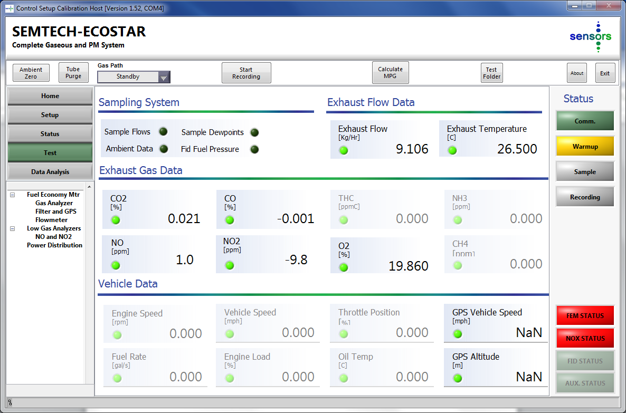
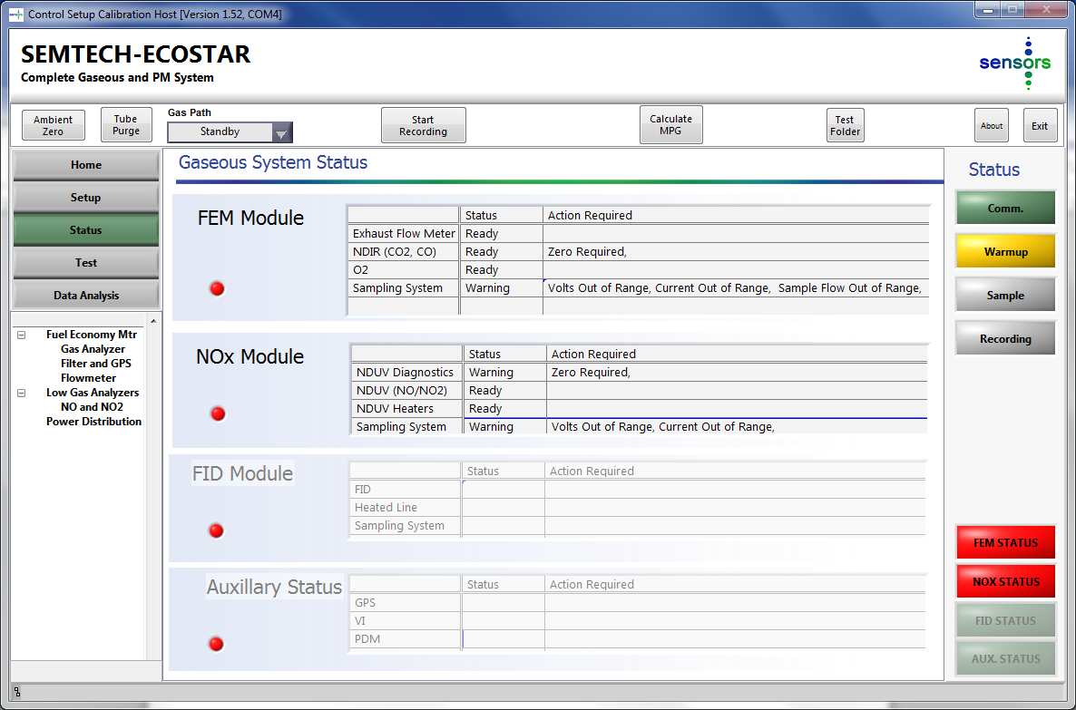
Architecture
Display Modules are the “Brain”
  Data Management / Storage (CF Card, 32 bit)
  DAC’ s (4)
  4 CAN ports (1 reserved for CAN Open Std)
  Serial (VI, Reference flow meter etc), Ethernet, USB connectivity
  PCB Design Layout
  Firmware
Host (Thin Client)

Slide 9
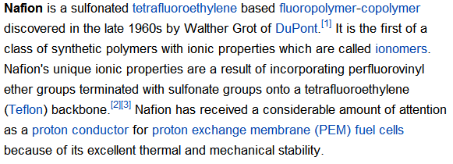
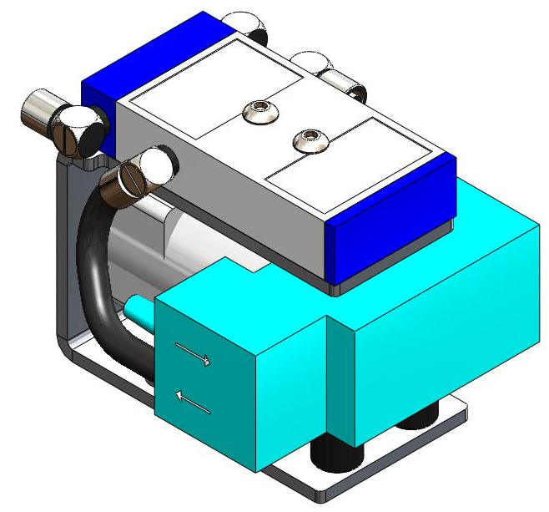
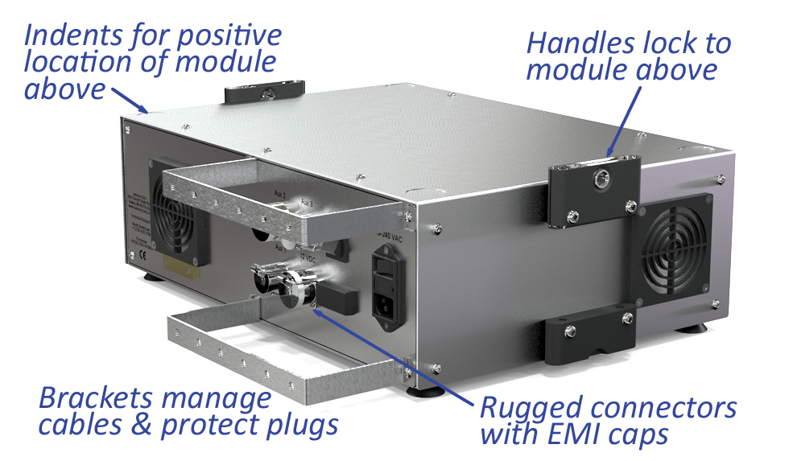
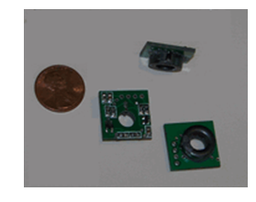
Module – Module Integration

Slide 10
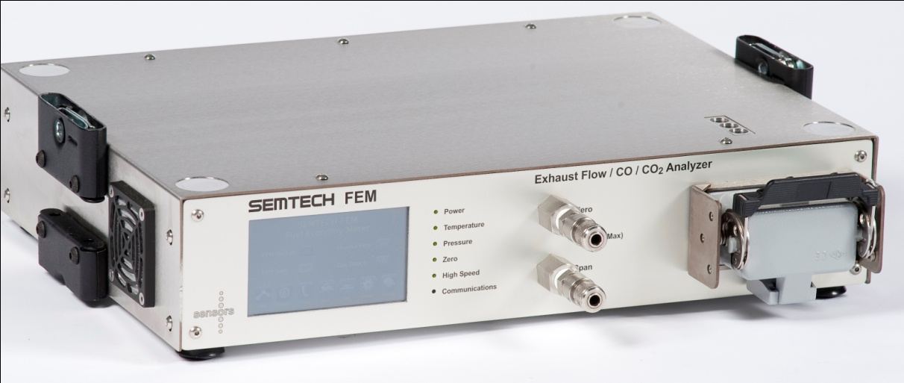
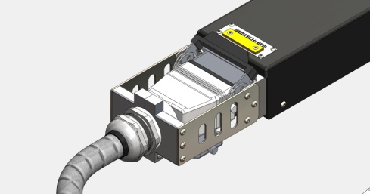
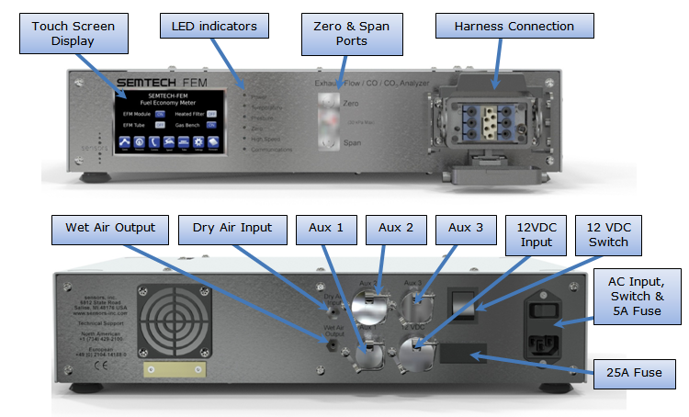
FEM Module
Electronics Box
CO, CO2, O2 (electrochemical and Paramagnetic)
Exhaust Flow
Sampling System
VI Interface
GPS / Weather Probe

Slide 11
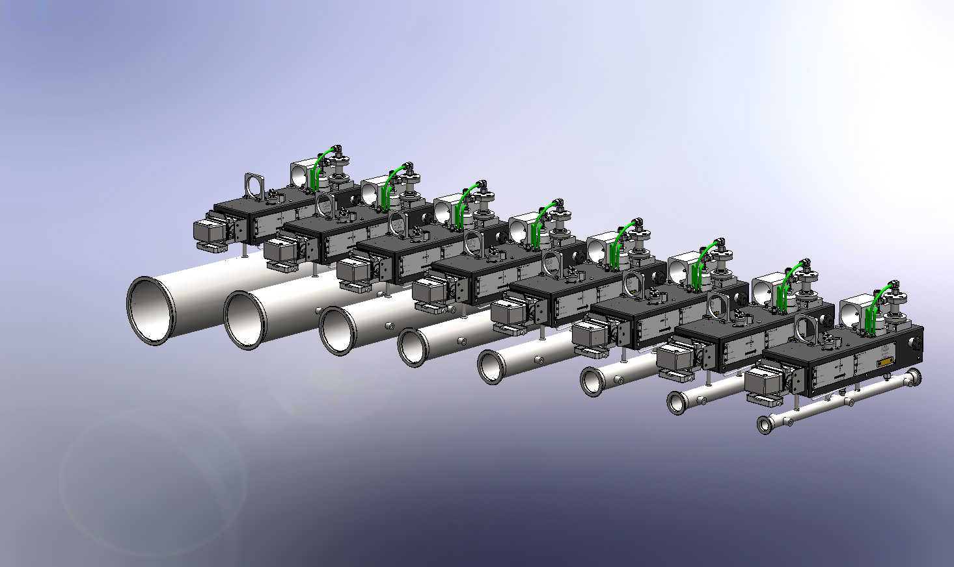
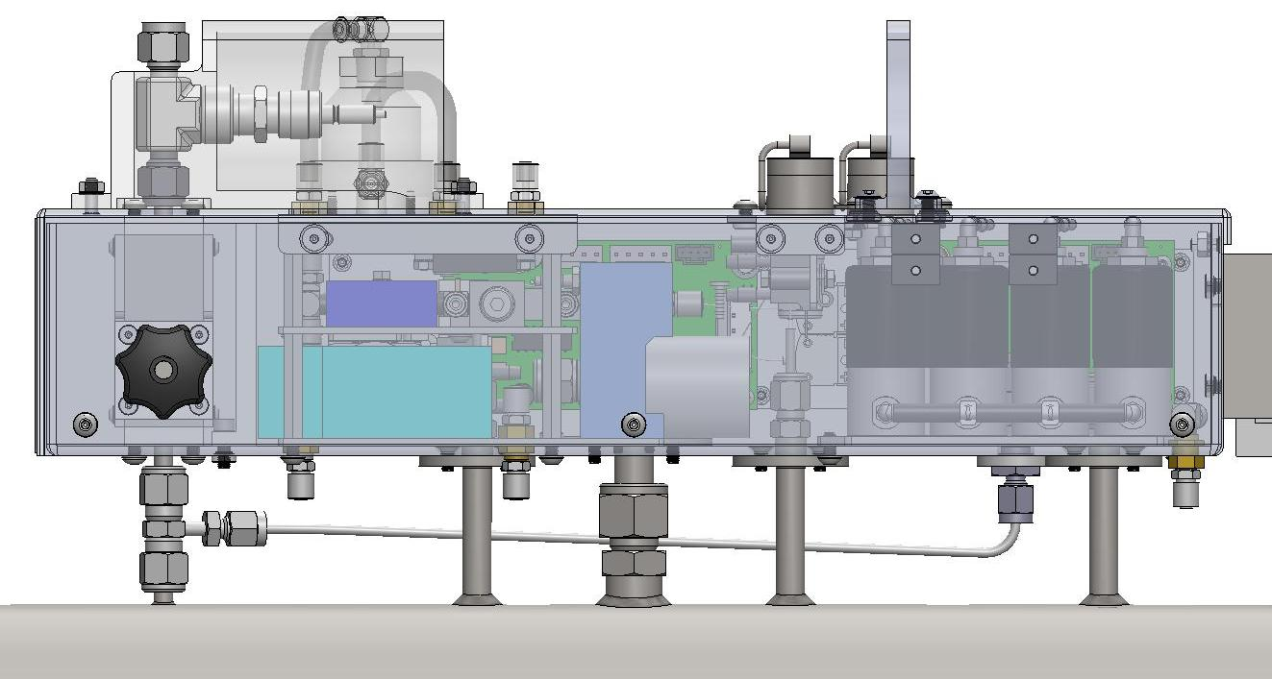
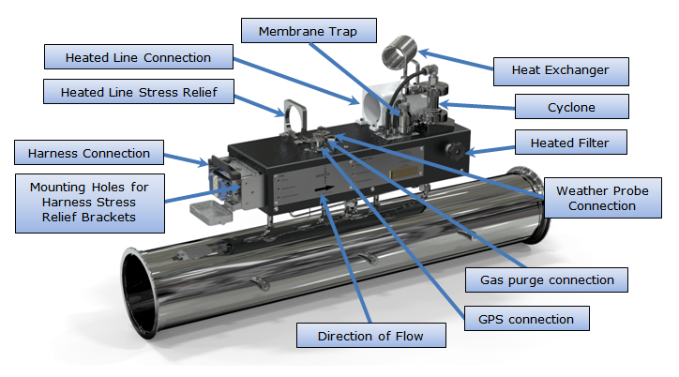
EFM Flow / Sample conditioning
Engine Sizes from small gasoline to HD diesel

Slide 12
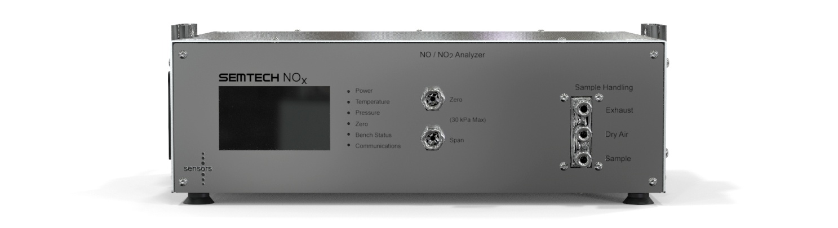
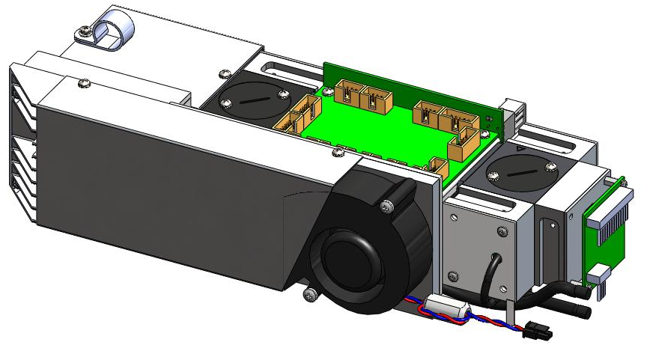
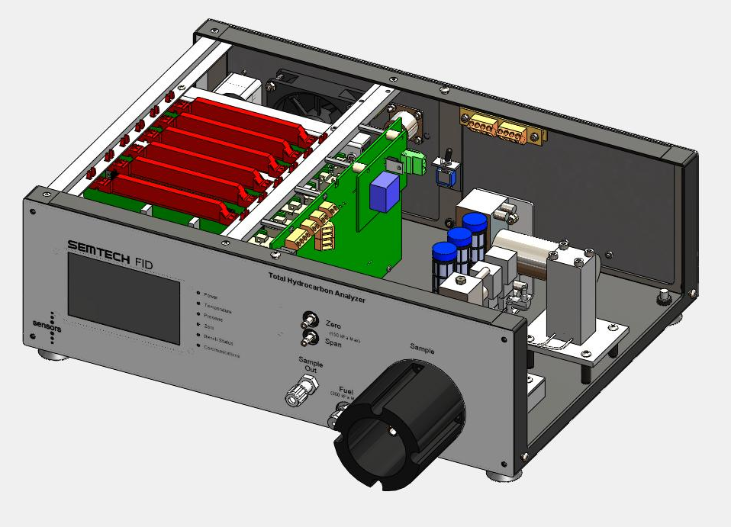
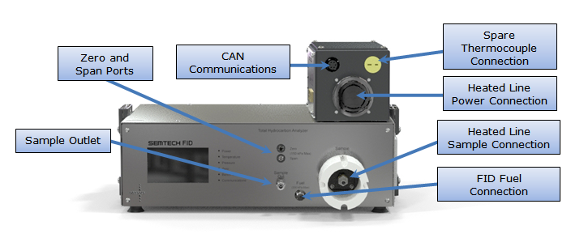
NDUV(NO and NO2)
FID (THC)

Slide 13
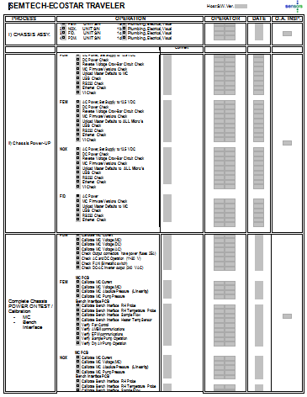
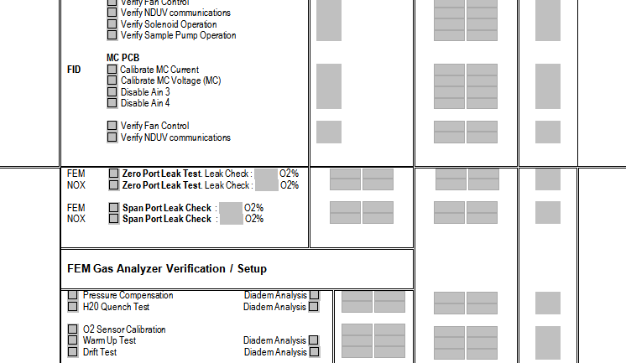
USEPA 1065 / EU Reg 49 Performance Verifications – Manufacturing Traveler (3 pages)

Slide 14
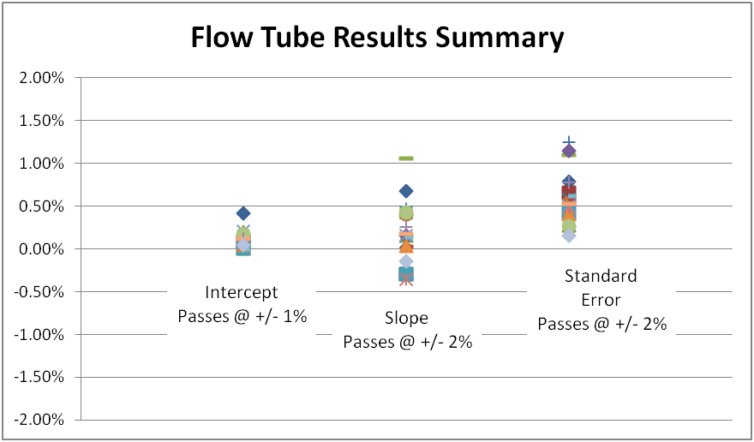
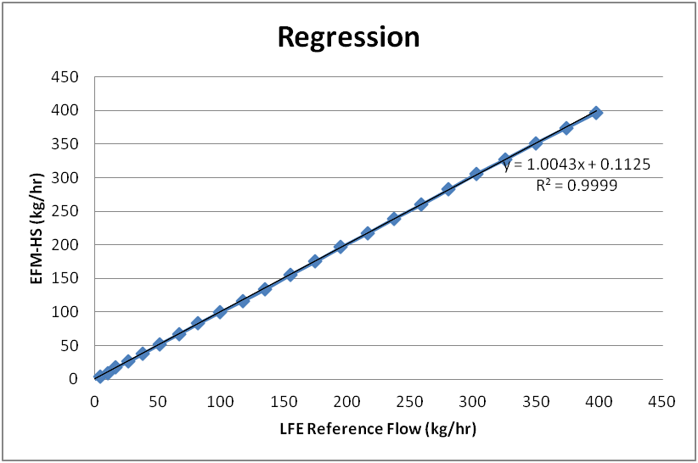
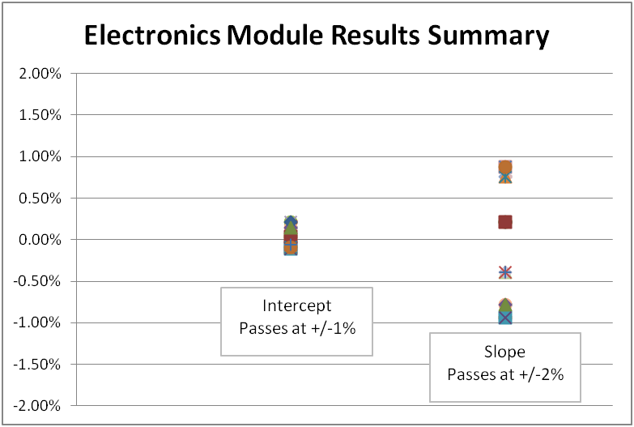
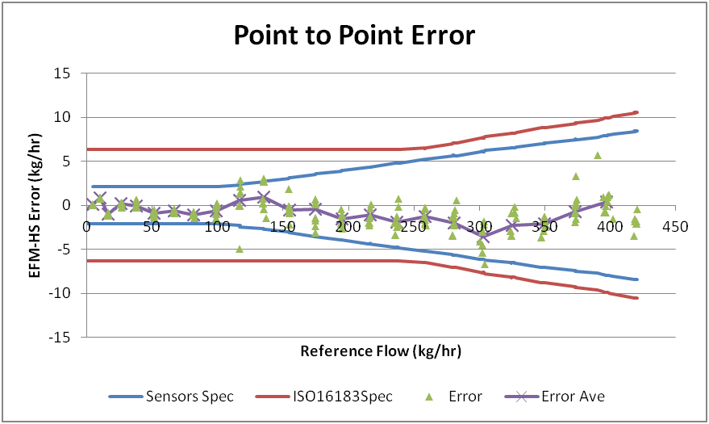
Example Data – Exhaust Flow

Slide 15
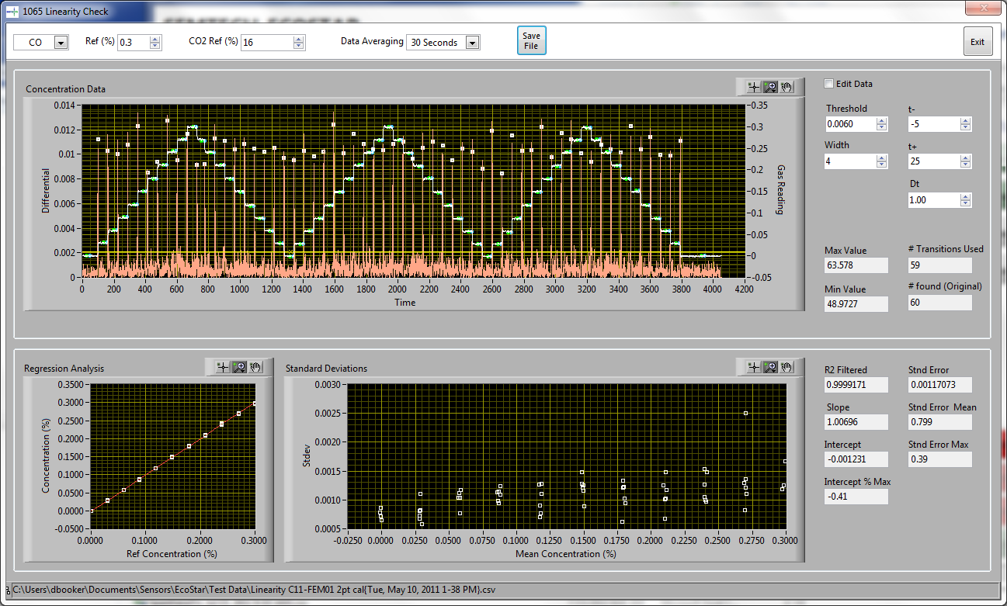
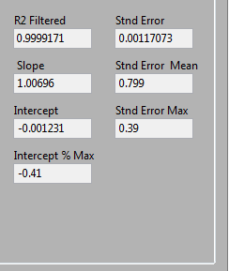
Performance Check Automation
1065 and ISO Linearity Calculations performed automatically

Slide 16
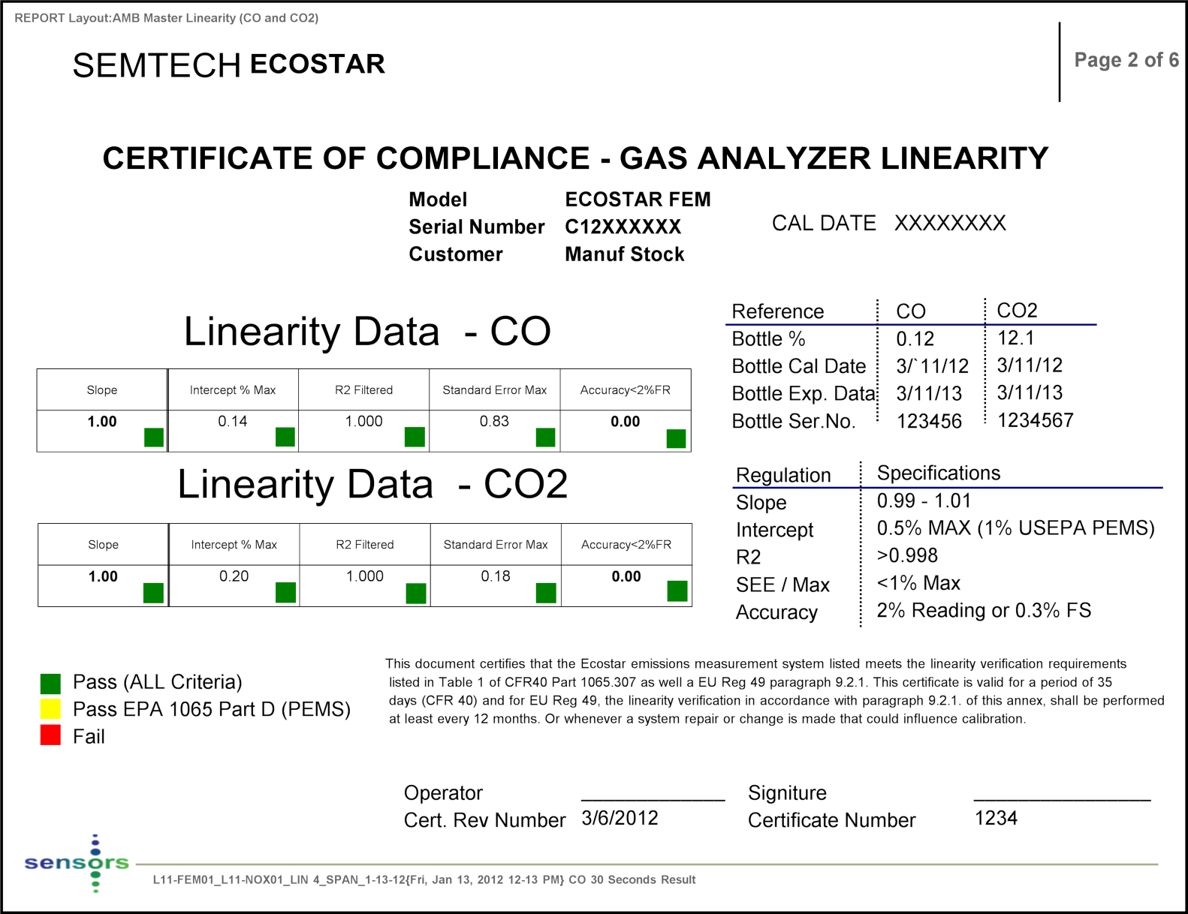
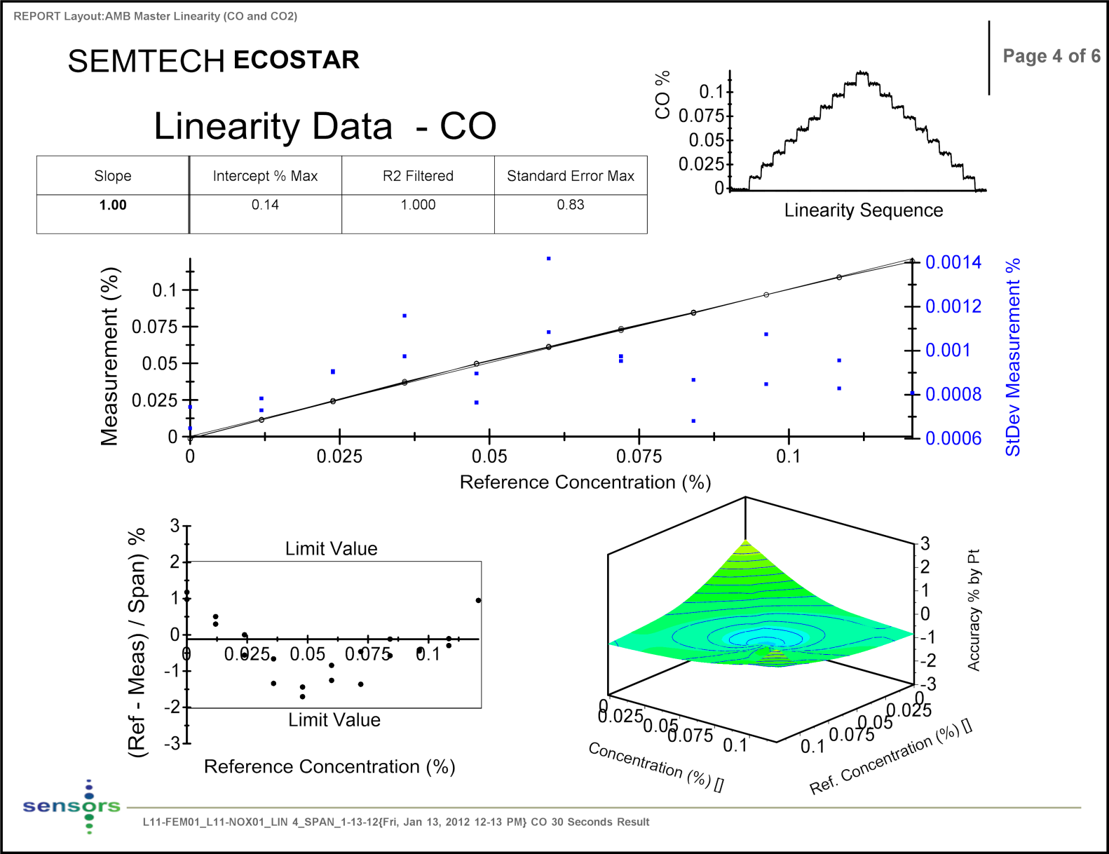
^{Example Data -Linearity} (CO / C02)

Slide 17
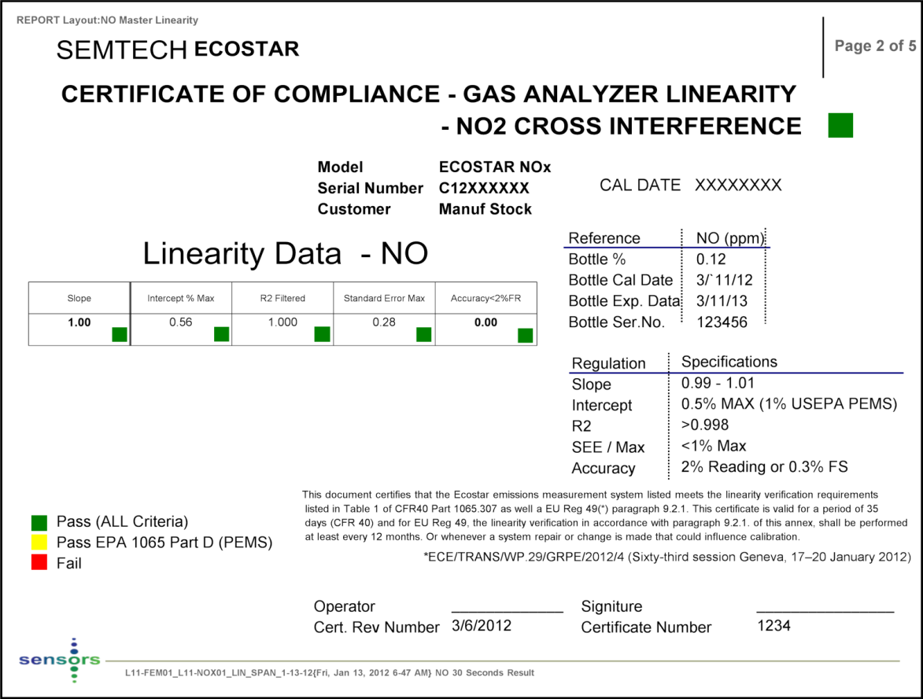
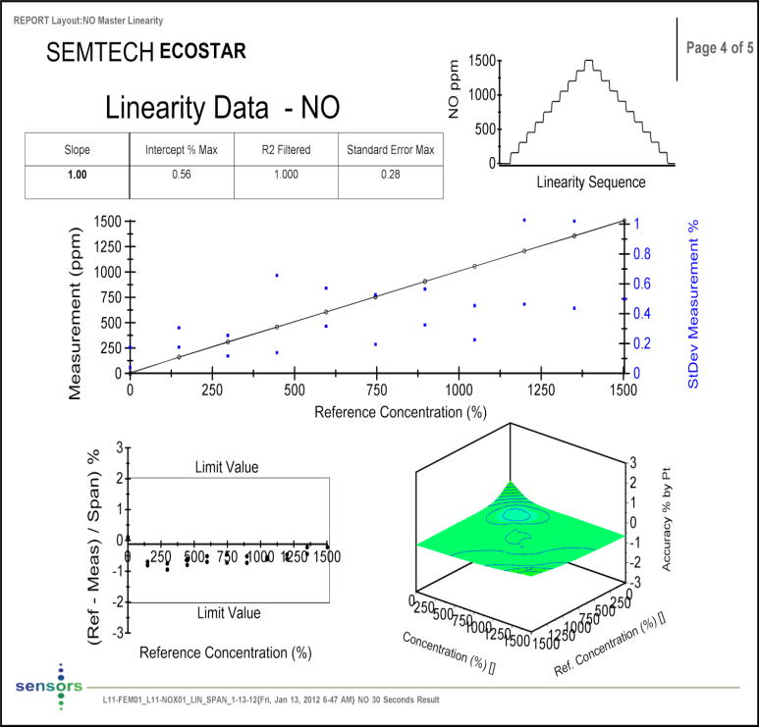
Linearity (NO)

Slide 18
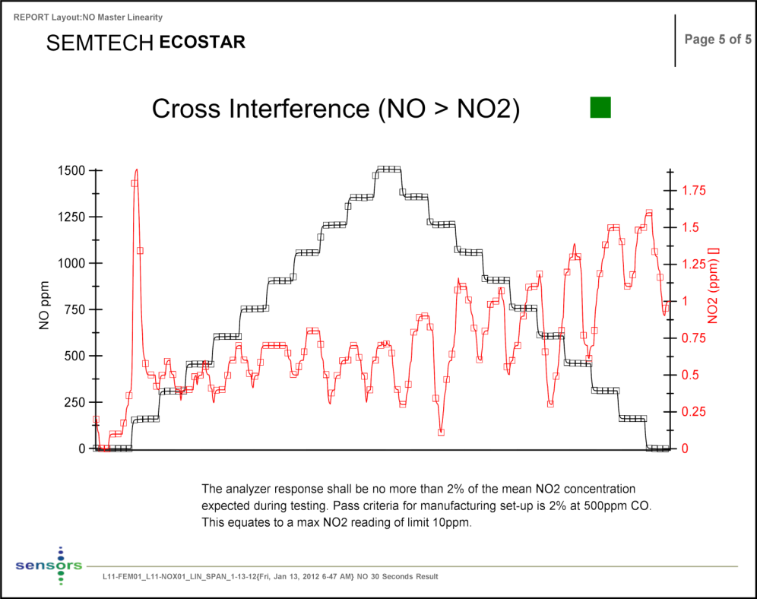
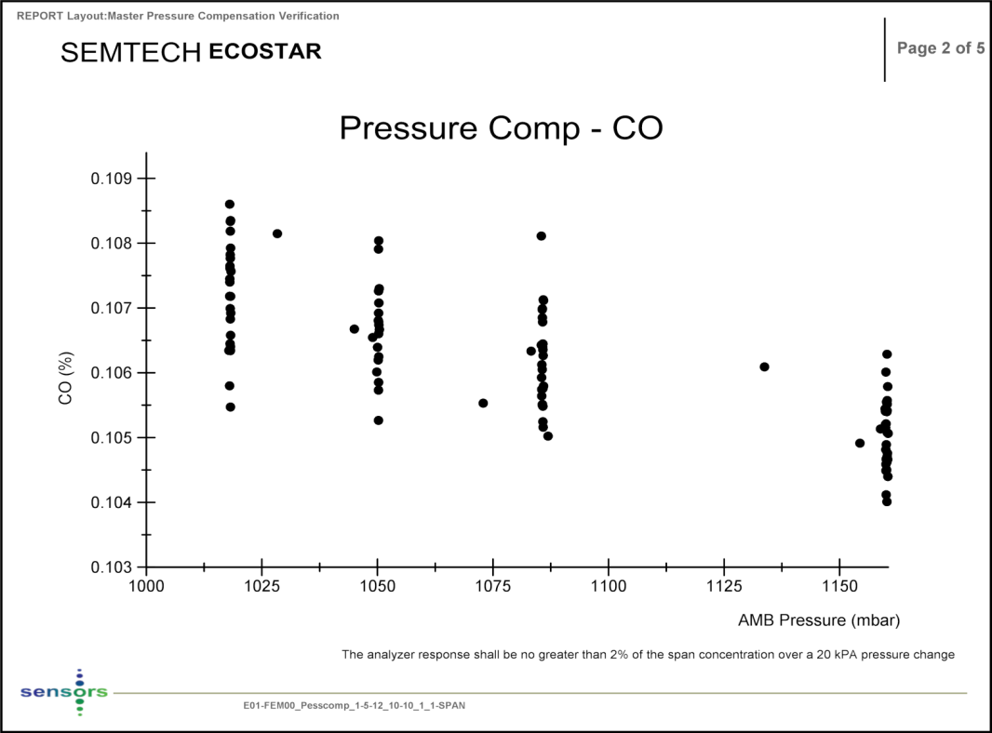
^{Example Data} – Cross Interference / Pressure Compensation

Slide 19
Example Data – Time alignment(1)

Slide 20
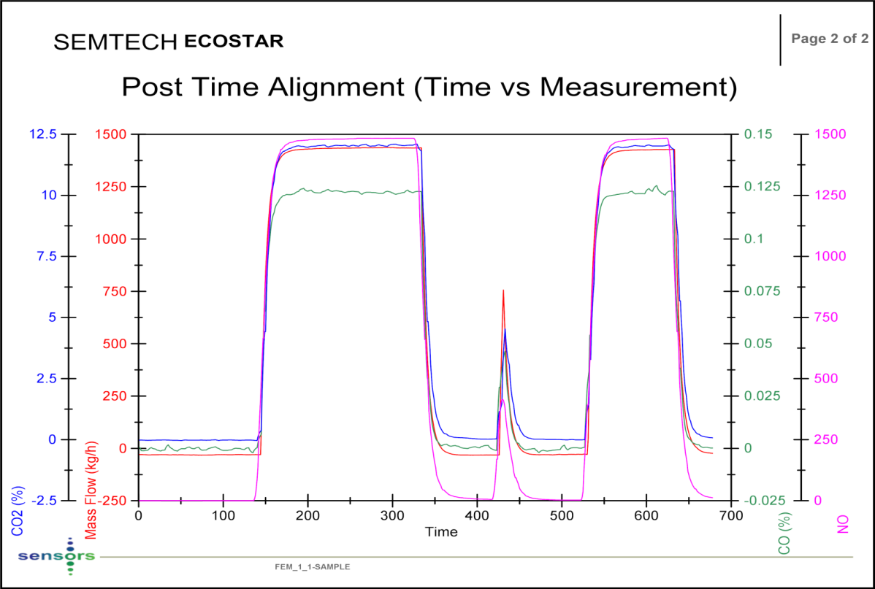
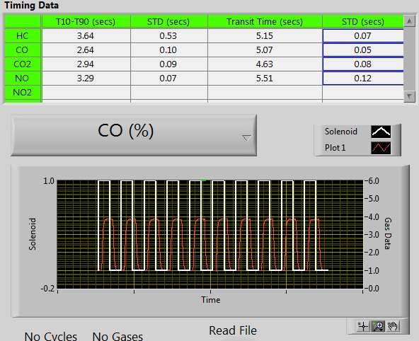
Time Alignment Automation
Controlled Span gas injection at sample probe allows:
Fully automated time alignment of Exhaust Flow and Gases
Fully automated T10 – T90 time response verification
Zero and Span Check
250 ms resolution

Slide 21
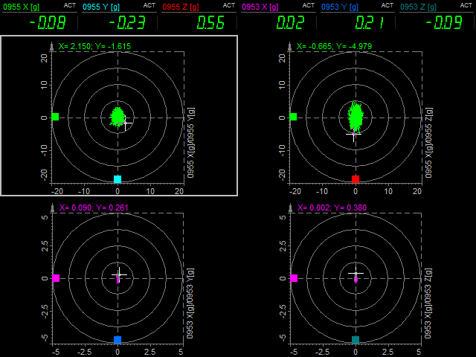
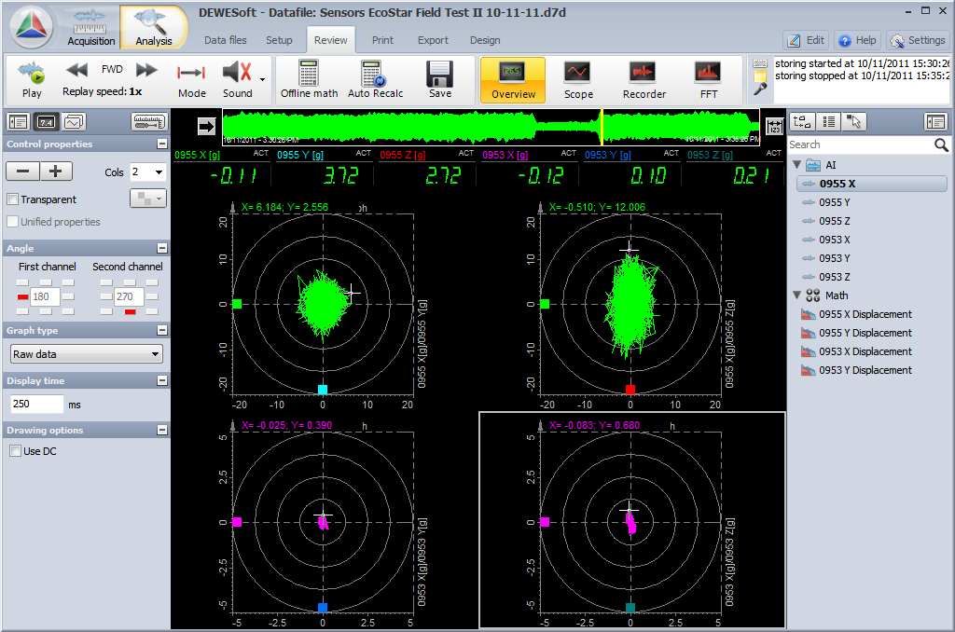
Emission Tests
CVS Correlation studies, On road validation DS / Ecostar comparison studies, vibration, altitude etc

Slide 22
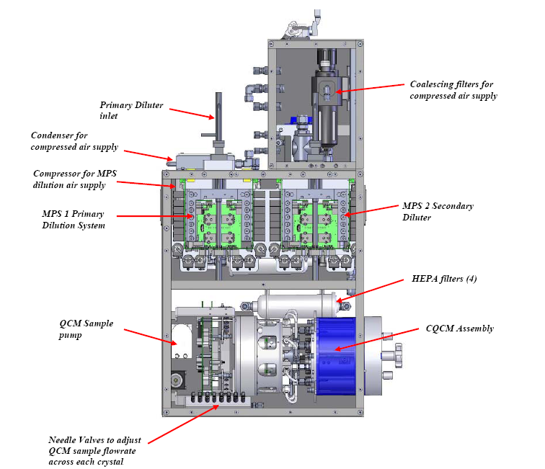
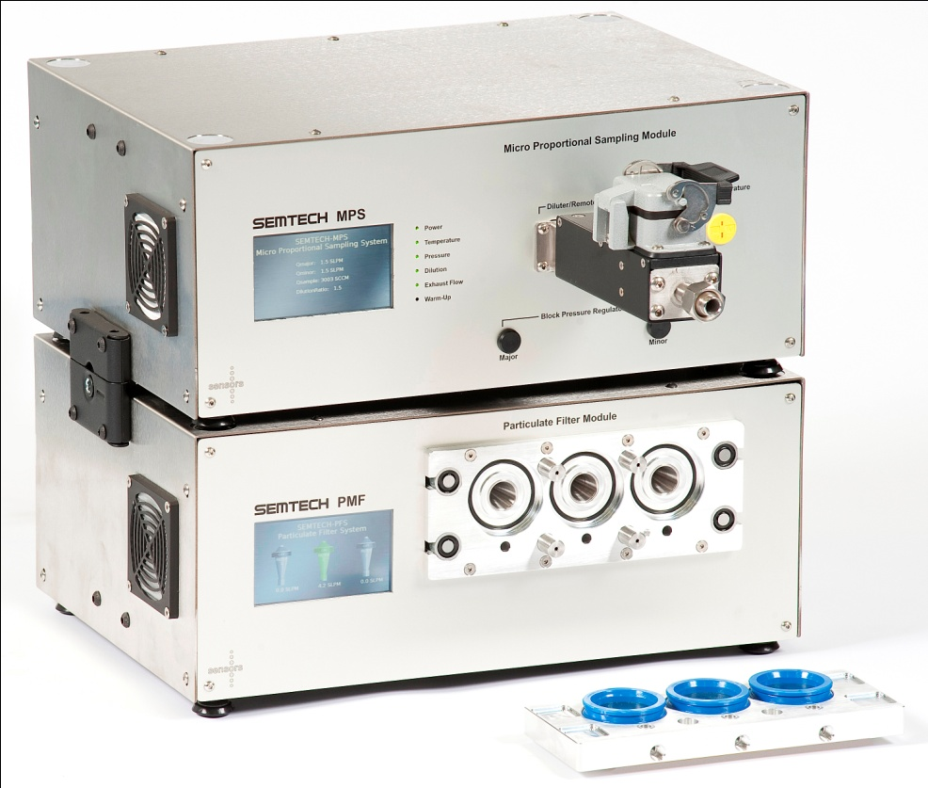
Complete Gaseous and PM System
SEMTECH ECOSTAR
PPMD > ECOSTAR MPS & CQCM
USEPA “NTE”
ECOSTAR “Real Time” PFDS / Filter
“Work-Based Window” & USEPA “NTE”
PART 2 - PM

Slide 23
^{SEMTECH PPMD MPS}
Primary Mixing
Chamber (vacuum)
Secondary Mixing
Laminar flow Sample Capillary
Secondary Transport Tube
Qsample
0 - 2 lpm
Total Dilute Flow,
QMajor + QMinor + QSample
= 8 lpm (constant)
Raw Exhaust
Venturi creates vacuum
from Major Flow, Drawing Sample
Sample
Bypass
Qminor
0 - 4 lpm
Qmajor
4 - 8 lpm
Sample ΔP
Qminor adjusts vacuum
Adjust Sample from 0 – 2 lpm
In proportion to Exhaust Flow
*Sample taken from the exhaust MUST be proportional to the Exhaust Flow
All rights reserved 2010© Sensors, Inc.
Notes:
The MPS dilution system works under both Bernoulli equation and the equations for laminar flow in capillaries. These equations describe the analytical relationship between the sample flow, dilution flows (major and minor) as a function of the inlet temperature and pressure of the sample (exhaust) gas.
Bernoullis equation states that the pressure drop between the inlet and outlet of the diluter must equal the pressure drops across the sample capillary + second transport capillary and the venturi. Each of these pressure drops can be calculated from theory and the equations can be re-arranged to calculate the dilution flows (for an assumed total flowrate) for ANY sample flowrate at ANY temperature or Pressure.
For example, for a given major flowrate, the sample flow rate can be changed over a wide range by changing the minor flow rate. This is due to the change in pressure in the primary mixing chamber.
An example would be as follows: The major flowrate is set to 6 SLPM with generates a “suction pressure” in the venturi of 3 kPA (0.5rhov2). If Qminor is zero then the pressure in the primary mixing chamber will be equal to the balance 3kPa minus the pressure dropped across the secondary capillary

Slide 24
Sampling Requirements MPS - PFDS
Sample taken from the exhaust MUST be proportional to the Exhaust Flow
  Particle Formation, CVS equivalent Sampler, harmonization with International Stds etc
Diluted sample at a constant total flow rate

Slide 25
PPMD Conversion to Ecostar Format
EFM
Three main sub-systems:
Exhaust Flow Meter (EFM)
Micro Proportional Dilution System (MPS)
Carousel Quartz Crystal Microbalance (CQCM)
MPS
CQCM
All rights reserved 2010© Sensors, Inc.

Slide 26
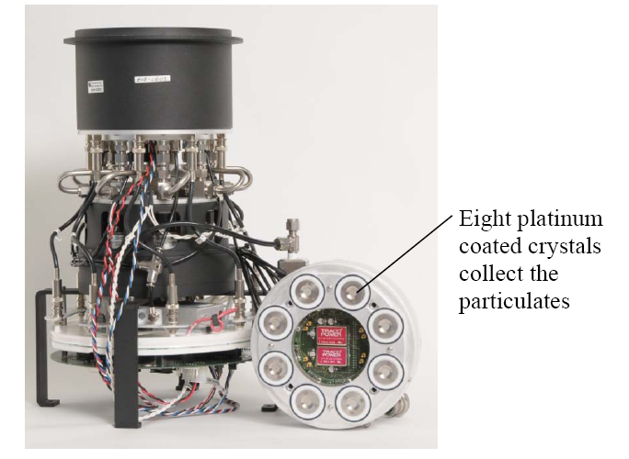
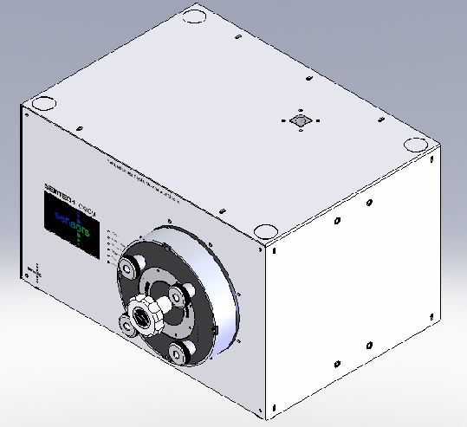
ECOSTAR CQCM

Slide 27
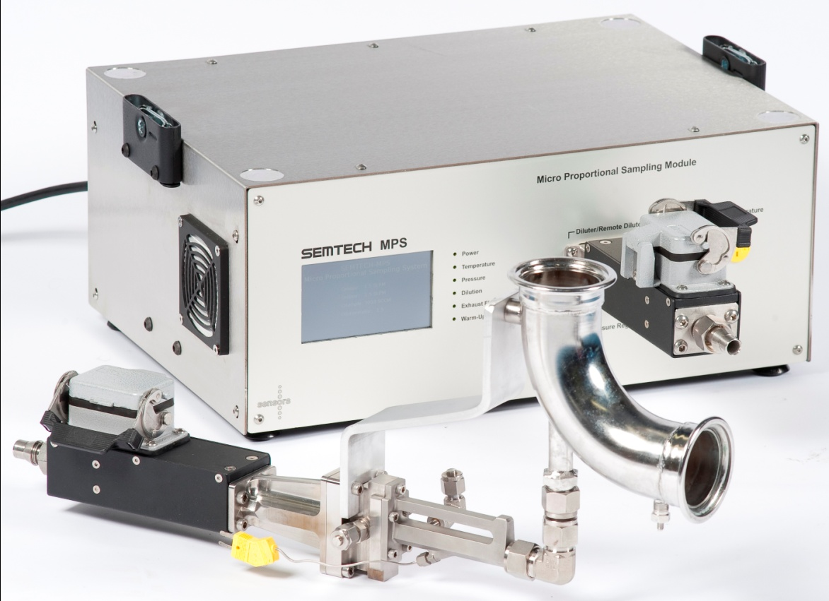
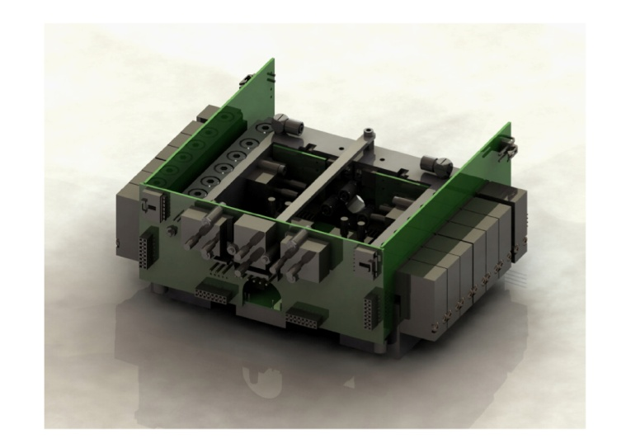
ECOSTAR MPS

Slide 28
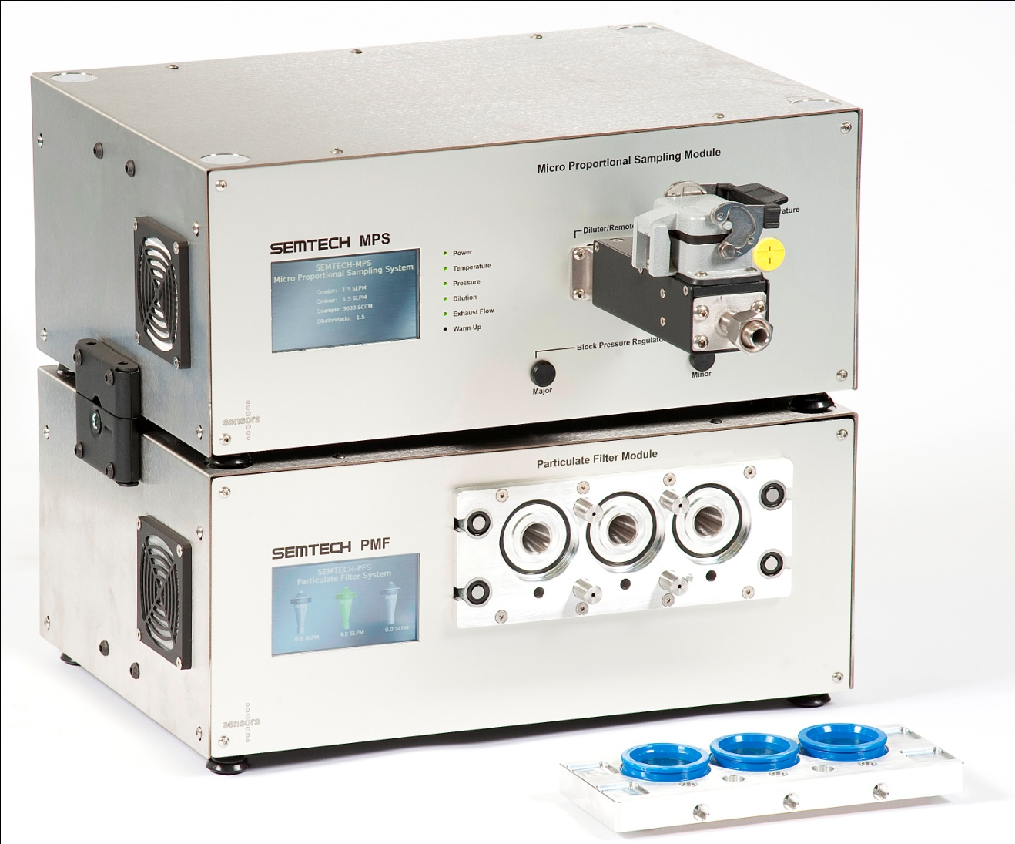
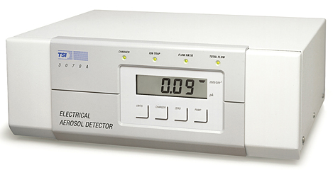
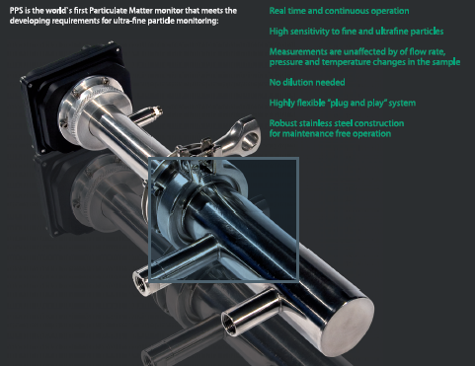
ECOSTAR PM MPS + PFS + “real Time”
Real time candidates include the TSI EAD, HPO and the Pegasor

Slide 29
Data Processing Methodology
Methodologies
  USEPA 1065
    NTE PM sampling onto the filter
    Filter Mass results used to “Span” the Real time analyzer
  EU Work-Based Windows
    Filter used to “Span” the Real Time device
    Filters used to Collect PM
      3 filters extend the operational time

Slide 30

ECOSTAR PMF (Filter Module)

Slide 31



Filter Module
At the heart of the PM filter system is a novel 3 x 47mm filter holder design that can maintain high filter face velocities at much reduced flow-rates by correspondingly reducing the stain area.

Slide 32

ECOSTAR – Real Time PM Solution
The PM solution being developed for the SEMTECH ECOSTAR Product comprises a partial flow dilution system, a gravimetric filter system and a real-time 3rd party PM device (TSI EAD, Pegassor). The complete system including candidate “real time devices” are currently being evaluated prior to Sensors Inc proceeding with the USEPA 1065 Alternative System Approval and JRC system validation
NOTE that the ECOSTAR MPS / CQCM system is already under USEPA 1065 Part J approved.

Slide 33
SEMTECH ECOSTAR Development Summary
  Physical – Significantly Smaller
  Electrical Power Reduced significantly
  Analytical Performance Improvements
  Serviceability
    Reduced Mean Time to Repair - “High expectation”
    Modular design significant Benefits
  Mean Time Before Failure (MTBF)
    “High Expectation”
  IP 54
    Dust and water ingression significantly improved
    “Ballistic Nylon” filtered-enclosure cover will add further protection

