Slide 1
SEMTECH® LASAR Trace Gas Analyzer
2012 PEMS Conference and Workshop – UCR/CE-CERT
SEMTECH® LASAR:
High Speed Tools for The In-use Measurements of Nitrogen-Containing Species.
Bertrand S. Lanher, PhD.
Sensors, Inc.
www.sensors-inc.com

Slide 2
SEMTECH® LASAR Trace Gas Analyzer
2012 PEMS Conference and Workshop – UCR/CE-CERT
SEMTECH® LASAR:
Improving upon TDLAS for
ppb-level, interference-free
in-use measurements of nitrogen-containing (and other) species.

Slide 3
SEMTECH® LASAR Trace Gas Analyzer
Part 1 - Spectroscopy

Slide 4
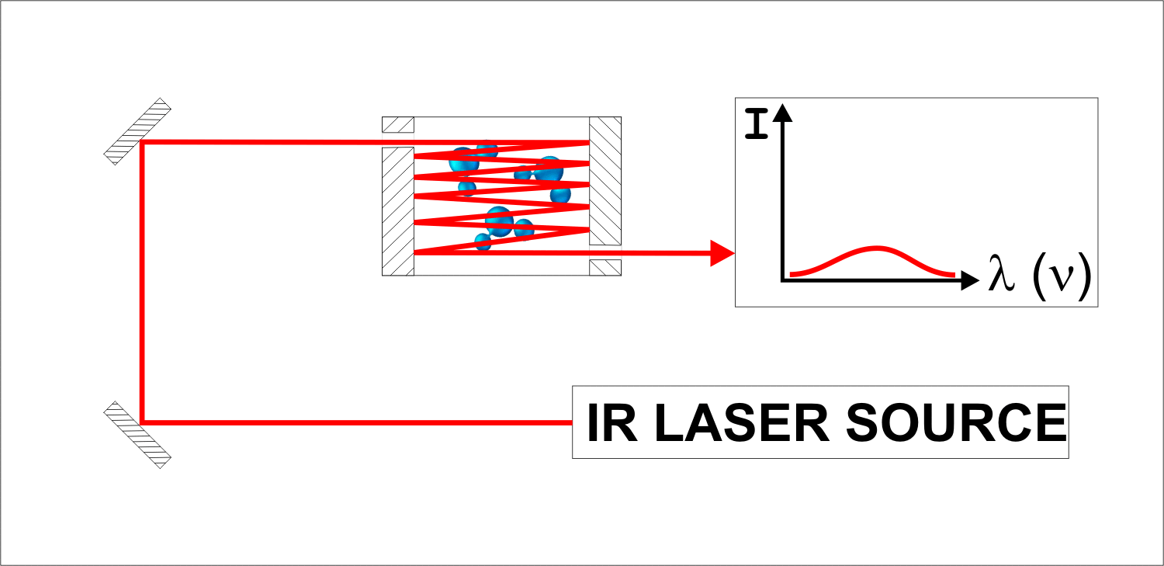
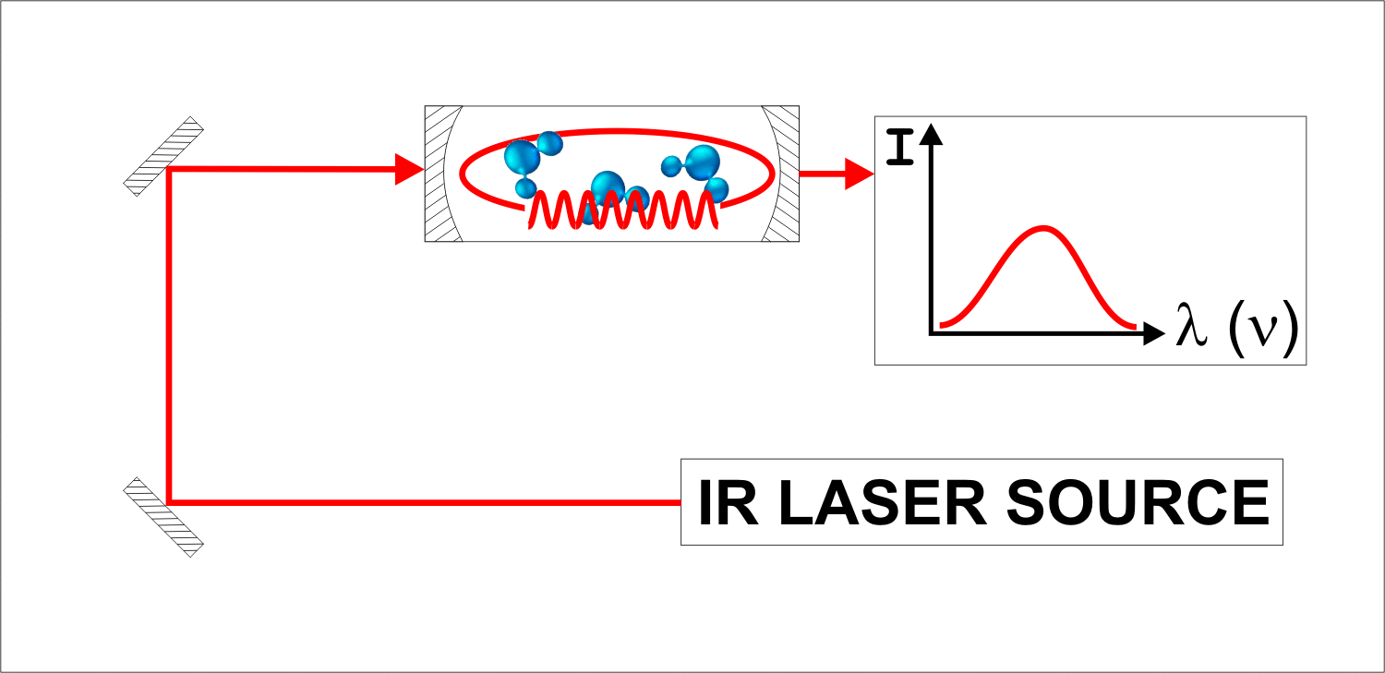
SEMTECH® LASAR Trace Gas Analyzer
STEP 1
Replace the Herriot (multipass) gas cell with a Fabry-Perot ring resonator.
Advantage:
Increase pathlength from a few meters to up to 20 km.
Benefit:
Increase signal (and sensitivity) by 1,000x

Slide 5
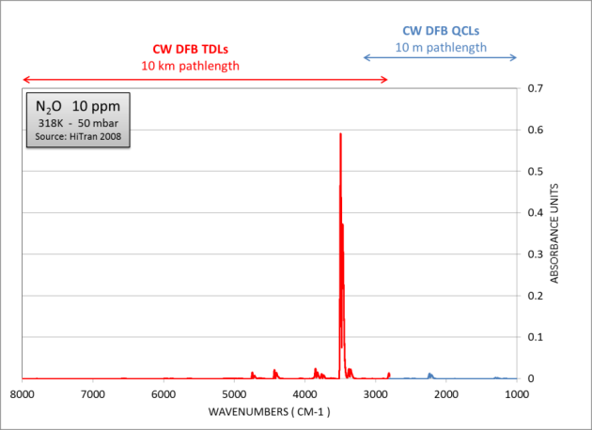
SEMTECH® LASAR Trace Gas Analyzer
STEP 1
Replace the Herriot (multipass) gas cell with a Fabry-Perot ring resonator.
Advantage:
Increase pathlength from a few meters to up to 20 km.
Benefit:
Increase signal (and sensitivity) by 1,000x
TDL’s used with hyper-reflective gas cells outperform QCL with multipass gas cells.

Slide 6
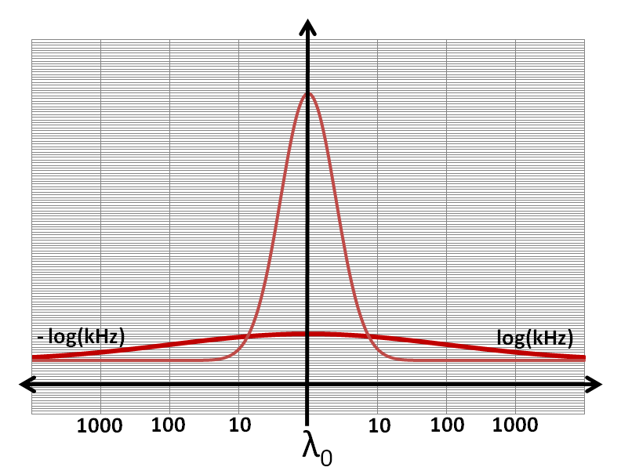
SEMTECH® LASAR Trace Gas Analyzer
STEP 2
Reduce laser light source emission bandwidth from
1 MHz to 10 KHz
by means of optical feedback.
Advantage:
Improves laser light emission purity.
Benefits:
Reduces noise (and improves sensitivity) by 100x.
Improves instrument response linearity.
0.1 pm WL accuracy.
0.005 cm-1 optical resolution
Feedback
Mode Locking
No Feedback
No Mode Locking

Slide 7
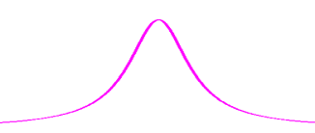
SEMTECH® LASAR Trace Gas Analyzer
Laser
Intensity
(mA)
STEP 3
Apply current ramp to laser light source to change very quickly emission wavelength.
Advantage:
Collects broad spectrum information.
Benefits:
Measures more than 1 gas with a single laser light source.
Zero absorbance region provide auto-zero of the analyzer.
λ (nm)
80
λ_{T} + dλ_{I}
20
λ_{T}
λ₁
λ₂
λ₃
λ₁₉₉
λ₂₀₀
t(s)
0.5 ms
100 ms

Slide 8
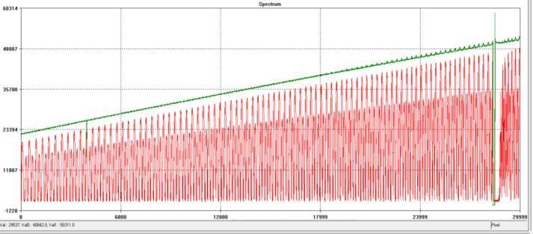
SEMTECH® LASAR Trace Gas Analyzer
STEP 4
Apply phase modulation to the laser light emission.
Advantage:
Widens spectral range.
Benefit:
Measure more than 1 gas with a single laser light source.
Zero absorbance region provide auto-zero of the analyzer.

Slide 9
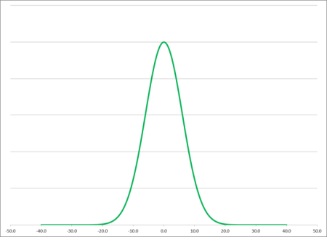
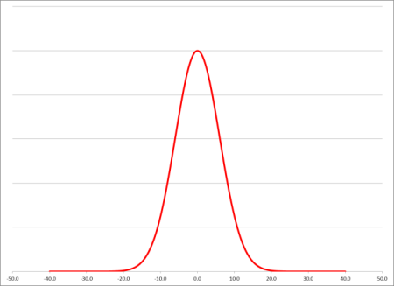
SEMTECH® LASAR Trace Gas Analyzer
STEP 5
Real-time calibration against primary, traceable standards
Advantage:
Primary measurement method.
Benefit:
Improves accuracy.
Full traceability of data/results.
REFERENCE (HiTran, GEISA, etc.)
Gauss Coefficient
(Concentration)
Lorenz Coefficient
(symmetry for ID & conc.)
Center Wavelength
(identification)
FIT
GAS
concentration
EXPERIMENTAL (Direct Absorbance)
Gauss Coefficient
(Concentration)
Lorenz Coefficient
(symmetry for ID & conc.)
Center Wavelength
(identification)

Slide 10
SEMTECH® LASAR Trace Gas Analyzer
SPECTROSCOPY – SUMMARY OF IMPROVEMENTS
5 Orders of Magnitude Sensitivity Improvement
0.005 cm-1 Optical Resolution
Up To 400 Wavelengths scanned every 100 milliseconds
Built-in Zero Information (analyzer auto-zeroed @ 10Hz)
Multiple Gases Measured with a Single Laser.
Wider Dynamic Range (> 1:5,000 @ 1 Hz; 1:50,000 @ 0.03 Hz)
Primary Measurement Method (improved accuracy + traceability)

Slide 11
SEMTECH® LASAR Trace Gas Analyzer
Part 2 - Sampling

Slide 12
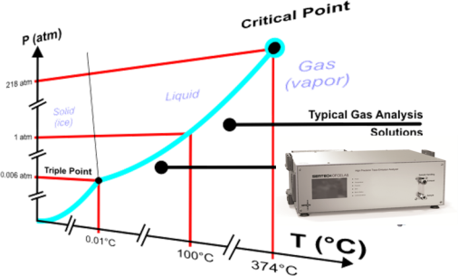
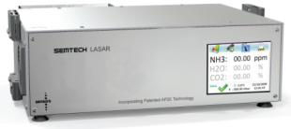
SEMTECH® LASAR Trace Gas Analyzer
Low Pressure Sampling
Operate the sampling line and gas analyzer between 50-100 mbar absolute.
Advantage 1:
Lowers dew point.
Benefit 1:
Operates sampling lines and analyzer at room temperature.
H₂O_{(g)} % vol.
Dew Point T°C
@ 50 mbar
10 % vol.
- 2.73°C (27.1F)
20 % vol.
+ 6.96°C (44.5F)
30 % vol.
+13.01°C (55.4F)

Slide 13
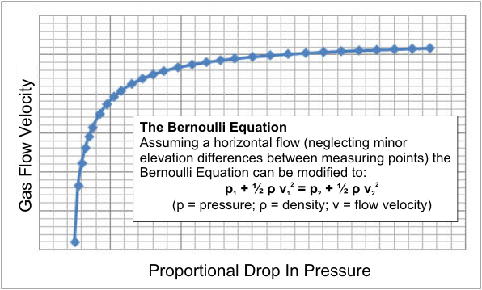
SEMTECH® LASAR Trace Gas Analyzer
Low Pressure Sampling
Operate the sampling line and gas analyzer between 50-100 mbar absolute.
Advantage 2:
Operates at low intake flow rate (<0.33 L/min), yet improves sample transfer speed.
Benefit 2:
Reduces overall analyzer response time.
Sample Transfer Speed between 1 and 4 m/sec. when using ¼” tubing (4/6 mm) and for flow rates of 5 to 20 L/hour, respectively.

Slide 14
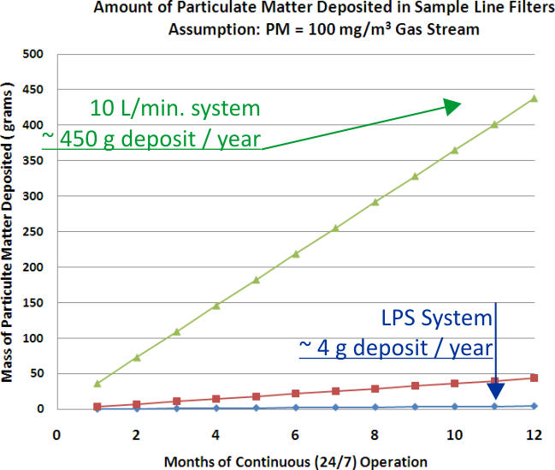
SEMTECH® LASAR Trace Gas Analyzer
Low Pressure Sampling
Operate the sampling line and gas analyzer between 50-100 mbar absolute.
Advantage 3:
Very low intake flow rate (<0.33 L/min) reduces fouling as a function of time.
Benefit 3:
Reduces fouling and optics maintenance.

Slide 15
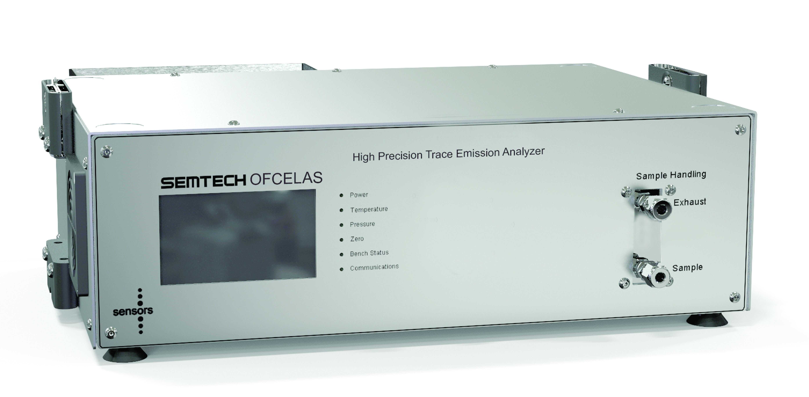
SEMTECH® LASAR Trace Gas Analyzer
Sample
Low Pressure Sampling
Operate the sampling line and gas analyzer between 50-100 mbar absolute.
Advantage 4:
Allows low temperature operation and reduces collision rate, therefore reducing chemical reaction rate in the sampling line.
Benefit 4:
Improved accuracy.
sample
Chemical Reactions
[NH₃] = x
[NH₃] = y (>< x)
Reaction Coef. Rate
a.k.a. Rate Constant
Reaction activation energy
Temperature
k(T) = Zρ.e^{Ea/RT}
Collision frequency
Gas constant
Steric factor
Collision frequency
Number of molecules / volume
Reaction cross section
Z = N_{A}σ_{AB}.(8k_{B}T/πµ_{AB})^{1/2}
Boltzmann’s constant
Reduced mass of the
reactants (A and B)
Temperature

Slide 16
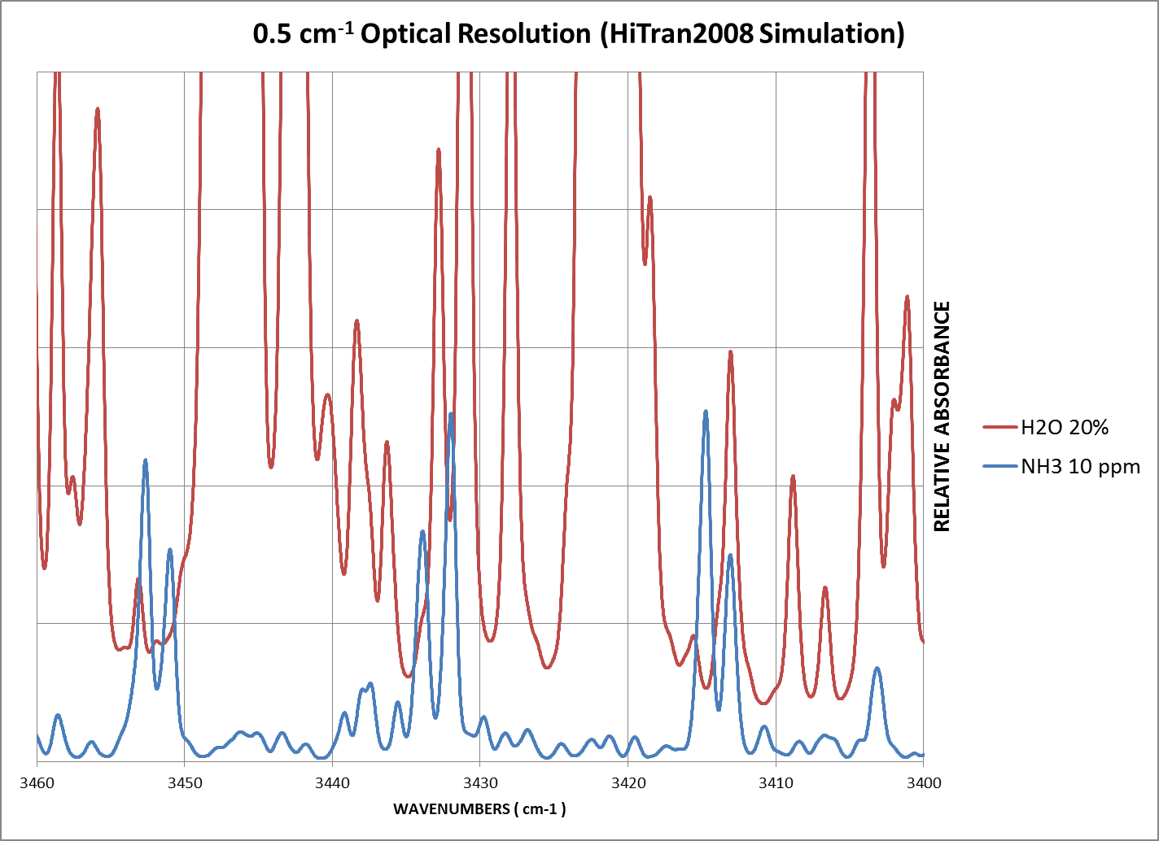
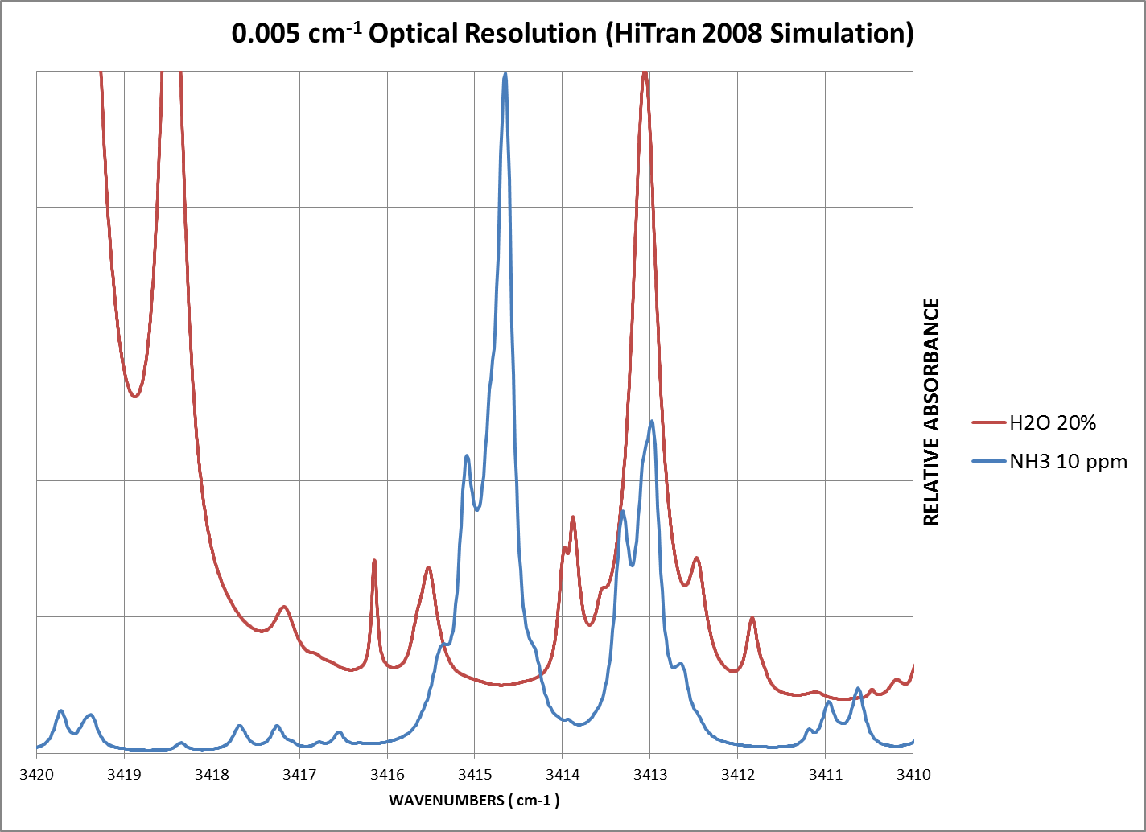
SEMTECH® LASAR Trace Gas Analyzer
Low Pressure Sampling
Operate the sampling line and gas analyzer between 50-100 mbar absolute.
Advantage 5:
Reduces bandwidth of absorption bands to the point of removing spectral overlapping.
Benefit 5:
Removes interferences.

Slide 17
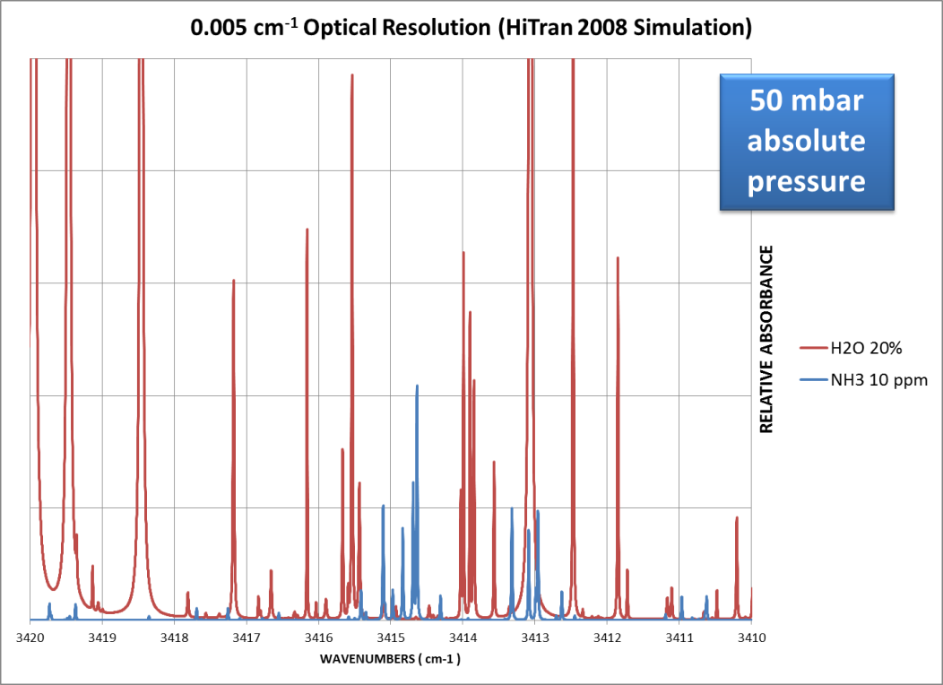
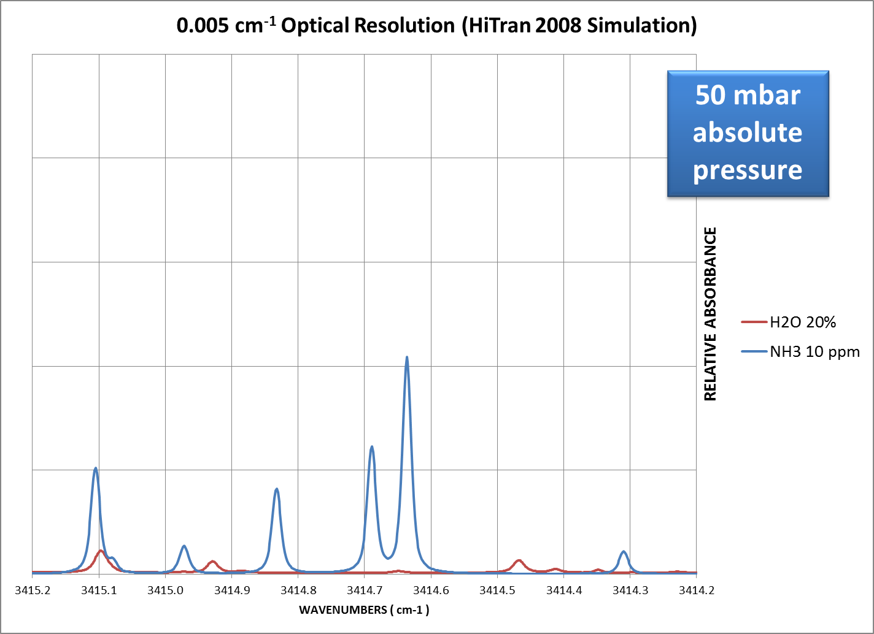
SEMTECH® LASAR Trace Gas Analyzer
Low Pressure Sampling
Operate the sampling line and gas analyzer between 50-100 mbar absolute.
Advantage 5:
Reduces bandwidth of absorption bands to the point of removing spectral overlapping.
Benefit 5:
Removes interferences.

Slide 18
SEMTECH® LASAR Trace Gas Analyzer
SAMPLING – SUMMARY OF IMPROVEMENTS
Room temperature operation (no heated lines required)
Very low flow rate (0.33 L/min.) for low fouling
Faster sample transfer rate (up to 4 m/sec.)
Improved accuracy (lower chemical reaction rate in sampling line)
Removes spectral interferences.

Slide 19
SEMTECH® LASAR Trace Gas Analyzer
Part 3 - Results

Slide 20
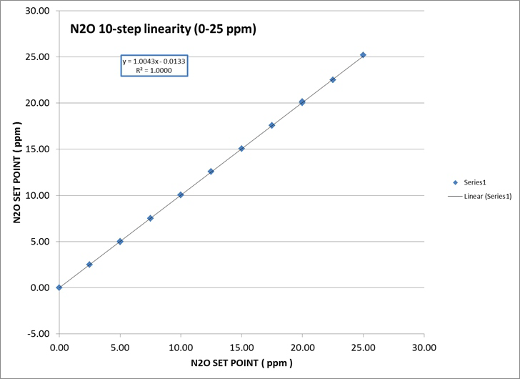
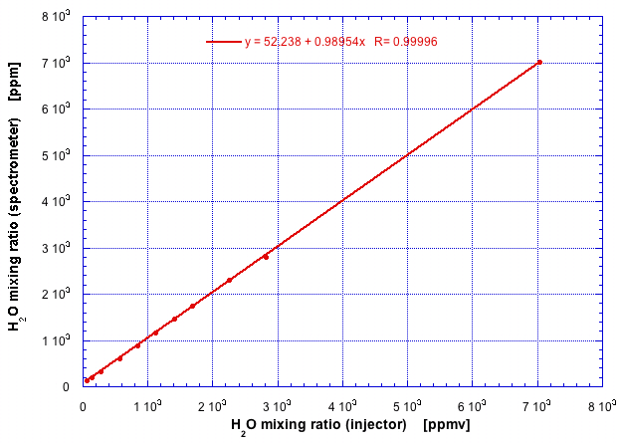
SEMTECH® LASAR Trace Gas Analyzer
Linearity
0 – 25 ppm N₂O
Slope = 1.004;
Intercept = 0.013 ppm
R^2 = 1.000
R^2 = 0.99996
0 – 8,000 ppm H₂O_{(g)}

Slide 21
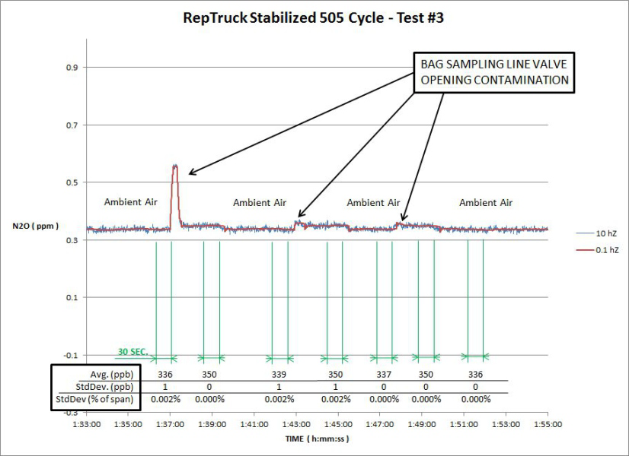
SEMTECH® LASAR Trace Gas Analyzer
Dynamic Range
0 – 50 ppm N₂O calibration
30-sec. Std. Dev.< 1 ppb

Slide 22
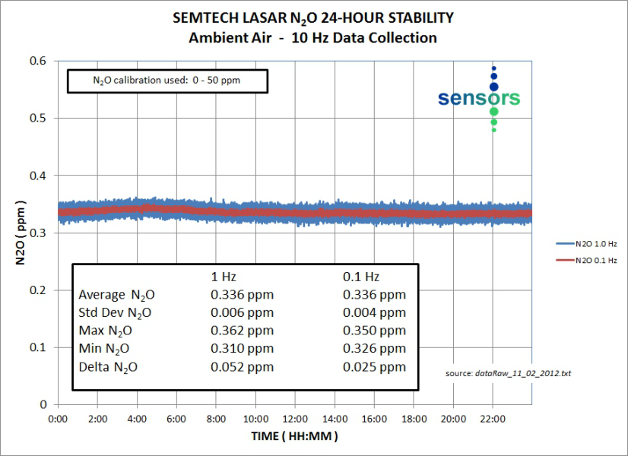
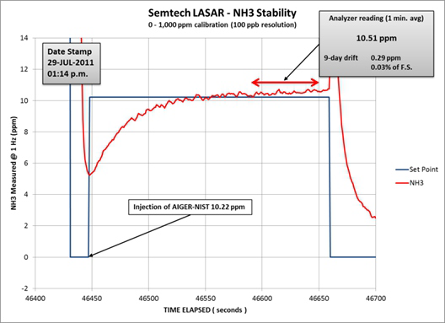
SEMTECH® LASAR Trace Gas Analyzer
Stability
50 ppm span N₂O
24-hour ‘zero’ stability
Std. Dev. = 4 ppb
1,000 ppm span NH₃.
9-day drift test (no re-zero / no re-span)
Drift = 290 ppb

Slide 23
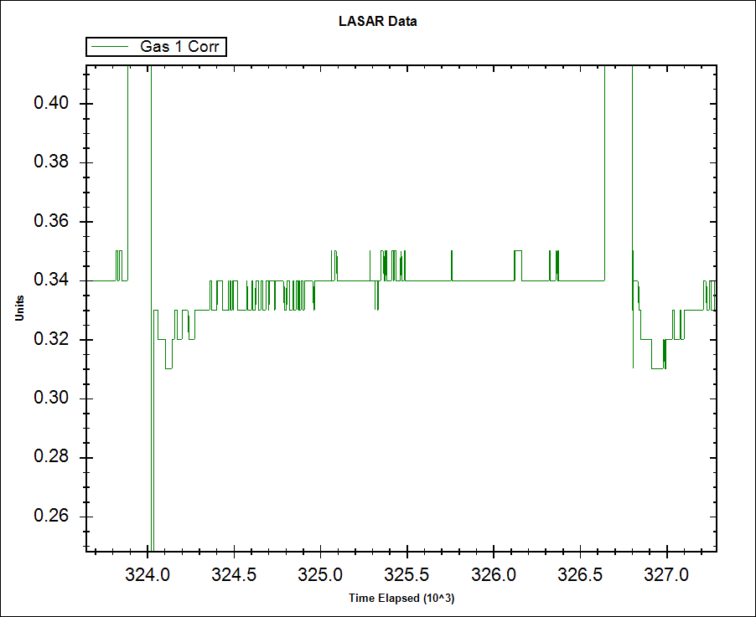
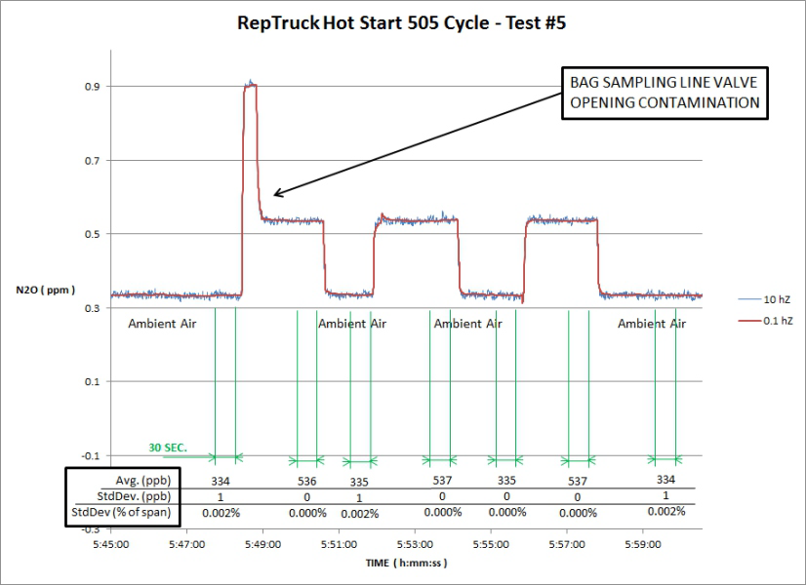
SEMTECH® LASAR Trace Gas Analyzer
Accuracy,
Precision,
Reproducibility
+/- 10 ppb
(@ 1 Hz without averaging)
± 3 σ noise = ± 10 ppb @ 1 Hz
using 50 ppm N2O span calibration
1 σ repeatability < 1 ppb
1 σ reproducibility < 1 ppb
@ 30 seconds integration using 50 ppm N2O span calibration

Slide 24
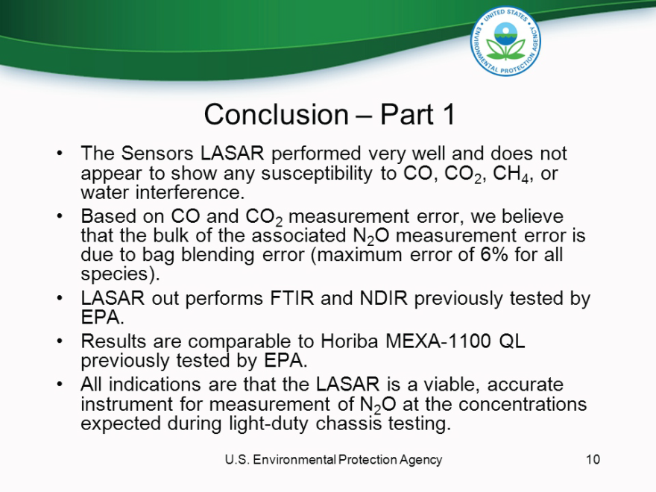
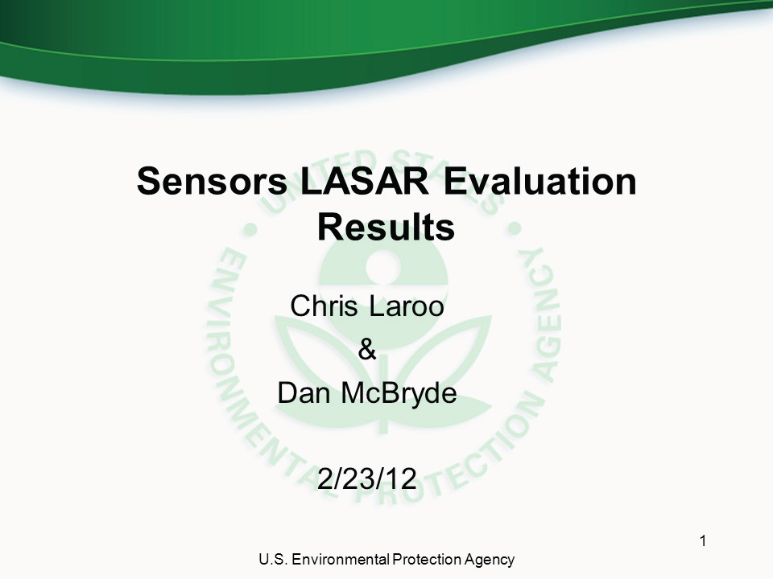
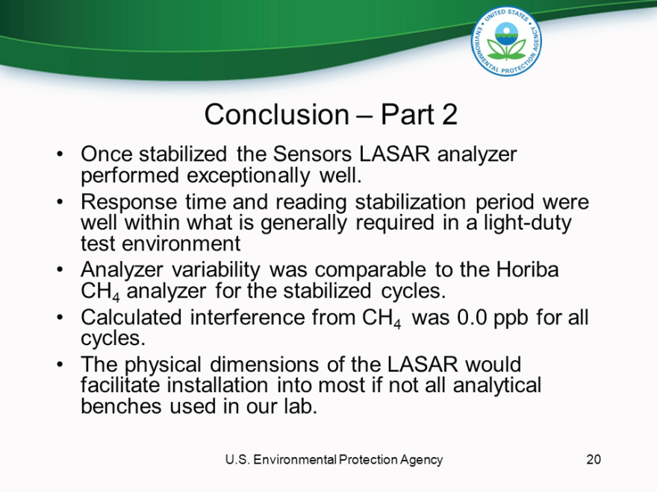
SEMTECH® LASAR Trace Gas Analyzer
No Interference

Slide 25
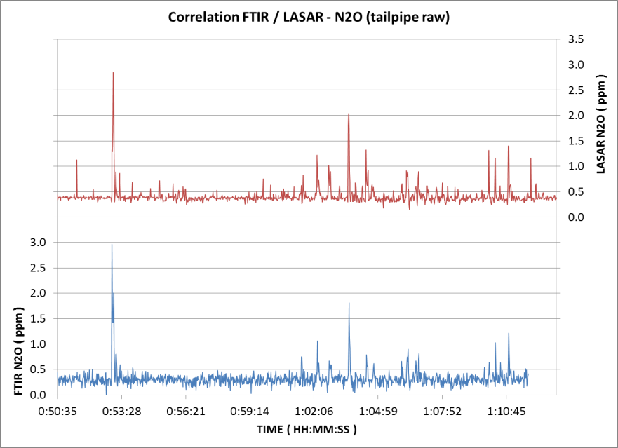
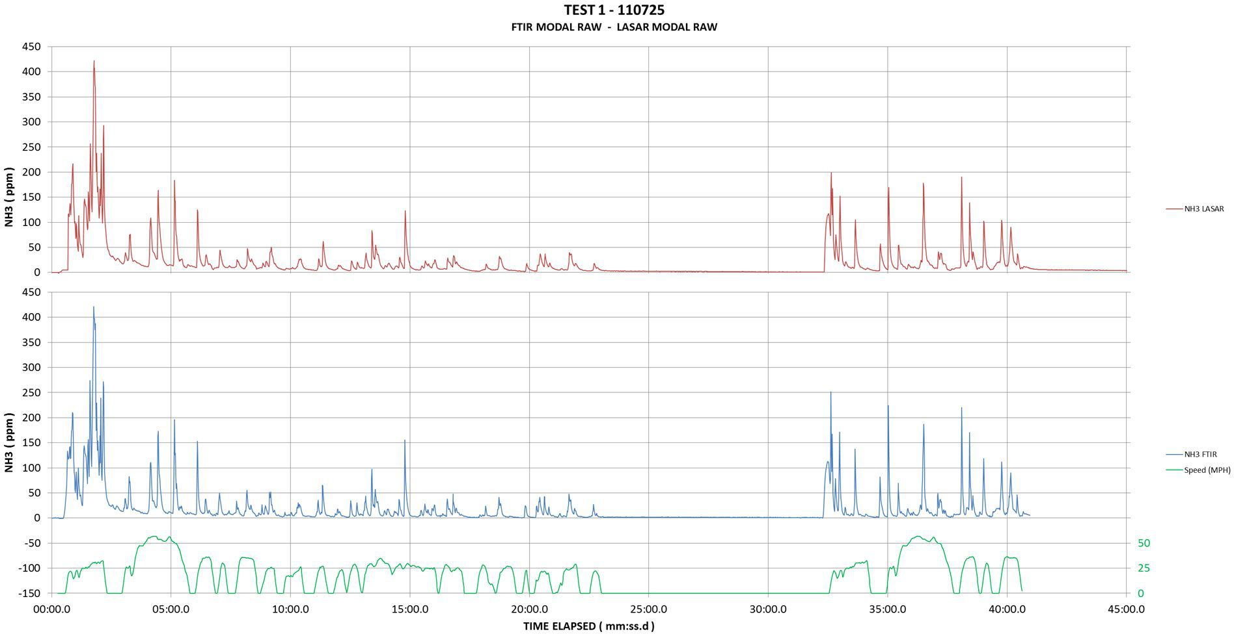
SEMTECH® LASAR Trace Gas Analyzer
Fast Response
N₂O LASAR
LASAR 10 Hz / 1 Hz 0.33 L/min.
FTIR 5 Hz / 1 Hz 15 L/min.
N₂O FTIR
LASAR 10 Hz / 1 Hz 0.33 L/min.
FTIR 5 Hz / 1 Hz 40 L/min.
NH₃ LASAR
NH₃ FTIR

Slide 26
LASAR – Spectroscopy Improvements
LASAR
FTIR
TDL
CRDS
Optical Resolution ⁽¹⁾
0.005 cm⁻¹
0.5-8.0 cm⁻¹
0.01 cm⁻¹
0.01 cm⁻¹
Wavelength precision ⁽²⁾
(Laser Purity)
10 kHz
1.5 GHz
1 MHz
1 MHz
Wavelength Accuracy ⁽³⁾
(Temperature stabilization)
± 0.01 pm
Drift of 1 pm / °C
Instrumental Noise ⁽⁴⁾
(single scan peak-to-peak)
4.10⁻¹⁰ A.U.
~ 10⁻⁵ A.U.
~ 10⁻⁵ A.U.
~ 10⁻⁶ A.U.
Pathlength ⁽⁵⁾
1-20 km
1-25 m
1-25 m
1-10 km
Multi-component capable ⁽⁶⁾
yes
yes
no
no
Zero (background) ⁽⁷⁾
Auto-zero
Requires regular re-zero
Instrument Drift ⁽⁸⁾
none
Yes (requires regular re-calibration)
⁽¹⁾
Distance between 2 consecutive data points
⁽⁵⁾
Practical pathlength; affects sensitivity
⁽²⁾
Laser bandwidth (width at mid-height)
⁽⁶⁾
Using a single IR source / Laser
⁽³⁾
Laser temperature regulation dependent
⁽⁷⁾
Re-zero requirement using zero gas
⁽⁴⁾
Single scan peak-to-peak noise (± 3σ)
Drift of zero and span as a function of time

Slide 27
LASAR – Sampling Improvements
LASAR
FTIR
TDL
CRDS
Sample conditioning ⁽¹⁾
none
Required to avoid condensable
Remove H2O(g) or heat sampling line
Spectral overlapping ⁽²⁾
none
Yes in most cases.
Use Multivariate Chemometrics to model
Gas cell volume ⁽³⁾
< 25 cm³
> 250 cm³
> 250 cm³
25-50 cm³
Intake flow rate ⁽⁴⁾
< 0.33 L/min
Up to 60 l/min.
> 1 l/min
Sample transfer speed ⁽⁵⁾
1-4 m.sec⁻¹
Dependent on line ID @ flow rate
T₁₀₋₉₀ ⁽⁶⁾
< 1 sec. @ 20 L/hr
2.5 sec. for NH₃
< 1sec. @ 60 l/min.
<3 sec.
Fouling rate ⁽⁷⁾
Negligible g/hr.
3.6 g/hr
60 mg/hr
⁽¹⁾
Potential for formation of condensates
⁽⁵⁾
Actual sample transfer speed (overall response time)
⁽²⁾
Potential for cross response
⁽⁶⁾
Actual T₁₀₋₉₀ based on reported flow rates
& gas cell dead volume.
⁽³⁾
Dead volume affecting true response rate
⁽⁴⁾
Actual sample intake flow rate
⁽⁷⁾
Hourly fouling rate based on 1000 mg/m3 particulate
matter concentration and reported flow rates

Slide 28
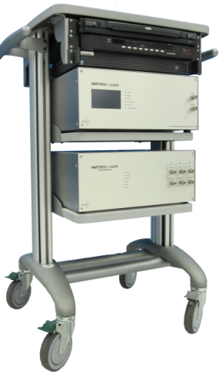
SEMTECH® LASAR Trace Gas Analyzer
CONFIGURATIONS
Released (for ICE applications):
NH₃ ( + CO₂ + H₂0 )
N₂O ( + NH₃ + CH₄ )
NO ( + CO₂ + H₂O )
NO₂ ( + CO₂ + H₂ )
H₂ ( + CH₄ + CO₂ )
H₂S ( + CO₂ + CH₄ )
HCN ( + CO₂ + H₂O )
CO
O₂
SO₂
SO₃
Custom configurations available.

Slide 29

LASAR – Conclusion

Slide 30





Contact Information
Sensors, Inc.
6812 State Road
Saline, MI 48176
Phone: 734-429-2100
Fax: 734-429-4080
Sensors Europe GmbH
Feldheider Str. 60
40699 Erkrath, Germany
Phone: +49 (0) 2104-14188-0
Fax: +49 (0) 2104-14188-14
www.Sensors-Inc.com
On Board Emissions Analyzers
Test Cell Emissions Analyzers
I / M Emissions Analyzers
Emission Testing Services
Environmental Applications

