Slide 1
Development of a Mobile
Energy and Emissions
Telematic System (MEETS)
George Scora
University of California-Riverside
College of Engineering-
Center for Environmental Research and Technology
PEMS Conference
March 29, 2012

Slide 2
Mobile Energy/Emissions Telematic System (MEETS) Concept

Slide 3
Comprehensive Modal Emissions Model (CMEM)
Microscale emission model
  Developed at UCR CE-CERT
  Initially developed in the 1990’s
Sponsorship
  National Cooperative Highway Research Program (NCHRP)
  U.S. Environmental Protection Agency (EPA)
Developed to model vehicle emissions
  project level ( sec-by-sec)
Accurately reflect impacts of :
  Vehicle speed, acceleration, road grade, starting conditions, and secondary engine load

Slide 4
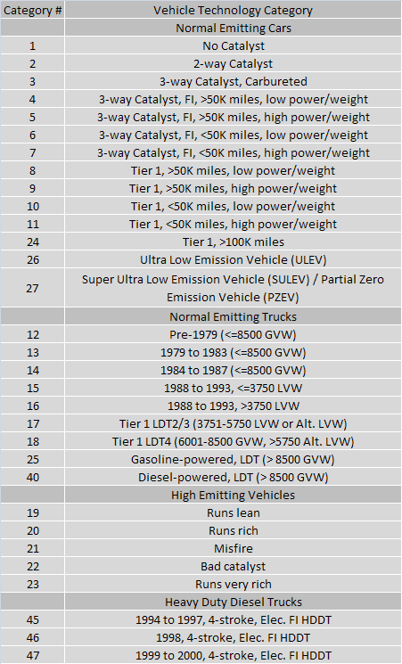
vehicle activity (velocity trajectory)
grade (optional)
calibration vehicle parameters
general vehicle parameters
CMEM
28 LDV
emissions
fuel consumption
3 HDDV

Slide 5
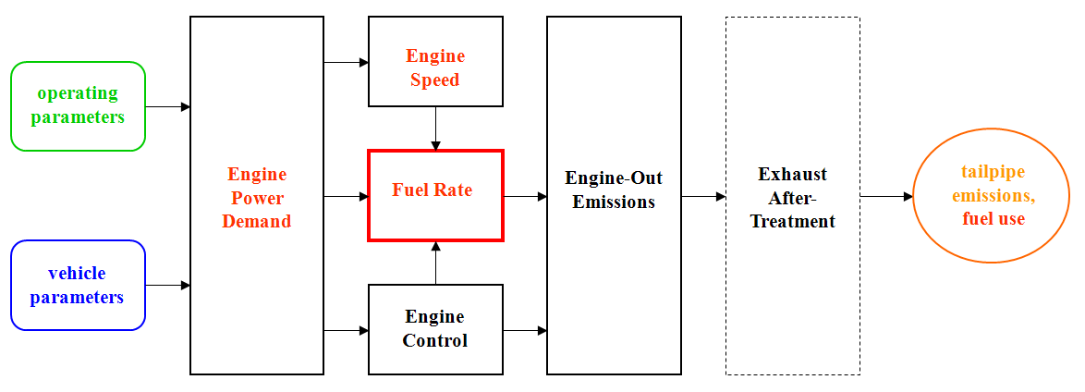
CMEM Emission Model Structure
Fuel is a function of Engine Power Demand and Engine Speed
Fuel rate is related to emissions through analysis based on measured data
Model Inputs
  Operating parameters - vehicle speed, road grade, accessory power, etc.
  Vehicle parameters – weight, gear ratios, calibrated emission parameters, etc.
Model Outputs
  Second–by–second emission data and fuel use

Slide 6
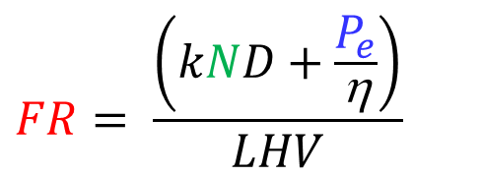
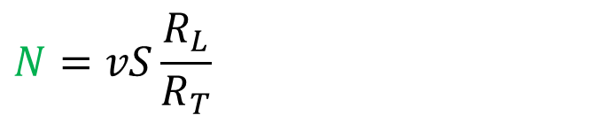
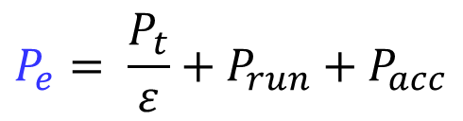
Fuel Rate Calculation
k = engine friction term
N = engine speed
D = engine displacement
$$FR= \frac{\left(kND+\frac{P_{e}}{\text{η}}\right)}{LHV}$$
P_{e} = engine power
η = engine indicated efficiency
LHV = lower heating value of fuel
P_{t} = tractive power demand
ε = drivetrain efficiency
P_{run} = running losses
P_{acc} = accessory power demand
$$P_{e}= \frac{P_{t}}{ε}+P_{run}+P_{acc}$$
S = engine-speed/vehicle-speed in top gear
R_{L} = gear ratio in Lth gear
R_{T} = gear ratio in top gear
v = vehicle speed
$$N=vS\frac{R_{L}}{R_{T}}$$

Slide 7

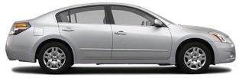
Real-time Emission Modeling
Engine
Operating
speed
variables
Power
demand
Exhaust
Tailpipe
Fuel
Engine
-
out
after
-
emissions,
rate
emissions
treatment
f
uel use
Vehicle
parameters
Engine Control and Operating Conditions

Slide 8
On-board Diagnostics (OBD)
Engine Control Unit (ECU)
Parameter Identification Data (PID)
  PID 05 = Engine Coolant Temperature (ºC)
  PID 10 = Mass Air Flow Rate (g/s)
  PID 44 = Commanded Equivalence Ratio
  PID 3C = Catalyst Temperature Bank 1 Sensor 1 (ºC)
  PID 0D = Vehicle Speed (km/h)

Slide 9
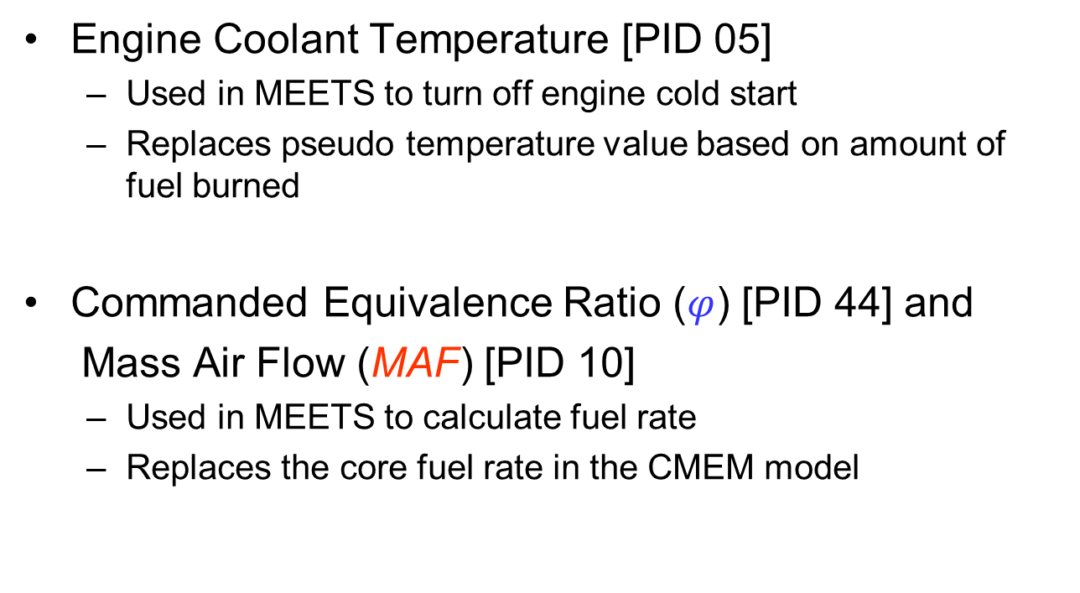
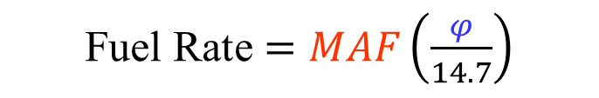
OBD Parameters
Engine Coolant Temperature [PID 05]
  Used in MEETS to turn off engine cold start
  Replaces pseudo temperature value based on amount of fuel burned
Commanded Equivalence Ratio ($φ$) [PID 44] and
Mass Air Flow (MAF) [PID 10]
  Used in MEETS to calculate fuel rate
  Replaces the core fuel rate in the CMEM model
Fuel Rate $=MAF\left(\frac{φ}{14.7}\right)$

Slide 10
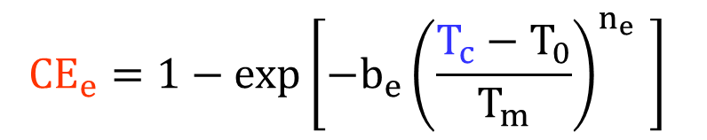
OBD Parameters
Catalyst Temperature
  Used in MEETS to approximate catalyst efficiency (CE_{e}) for each criteria emission
  Replaces catalyst light off time parameters
where
T_{c} = current catalyst temperature
T₀ = initial temperature
T_{m} = max/stable temperature
b_{e} = calibrated parameter for emission e
n_{e} = calibrated parameters for criteria emission e
$${CE}_{e}=1−exp⁡\left[{−b_{e}\left(\frac{T_{c}−T_{0}}{T_{m}}\right)}^{n_{e}} \right]$$

Slide 11
Sources of Modeling Errors Bypassed
Second-by-second grade data
Meteorological conditions
  Wind*
Vehicle weight
  Fuel level, payload, passengers
Road conditions
Losses in drivetrain and engine
Accessory load
Driver gear shift behavior
Engine and catalyst warm-up characteristics

Slide 12
UC Riverside ECO-Friendly Intelligent Transportation System (ECO-ITS) Test Bed Vehicle

Slide 13
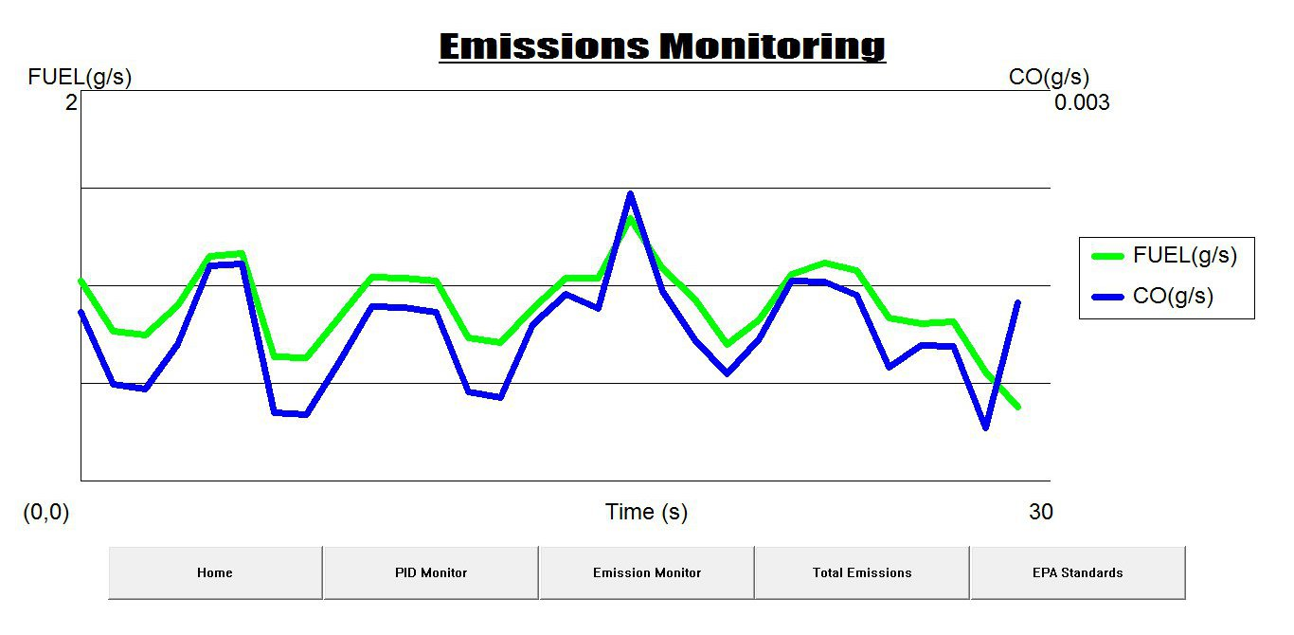
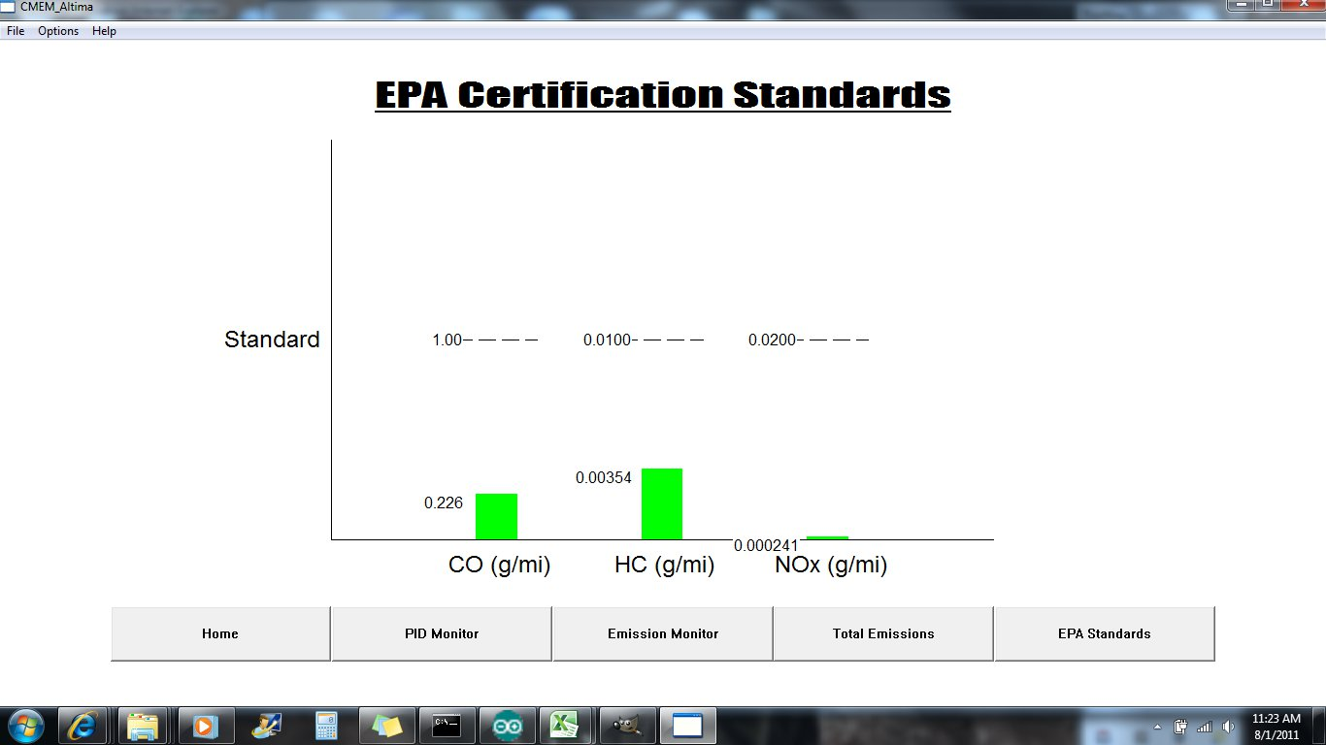
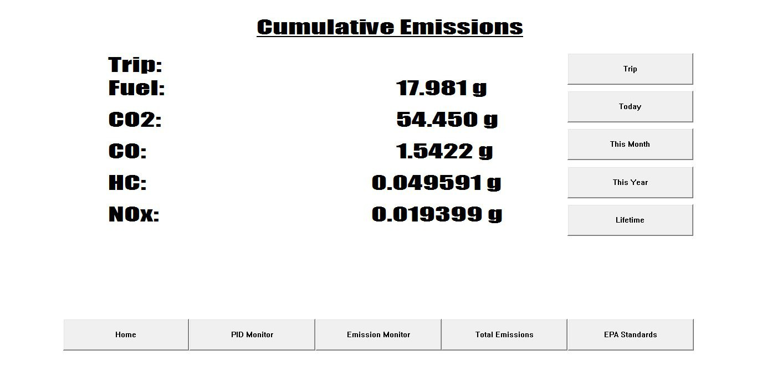
Example screenshots of MEETS on-board application

Slide 14
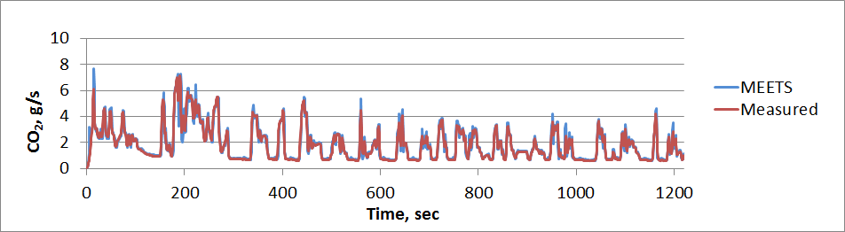
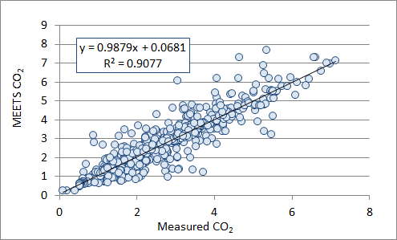
MEETS Emission Outputs CO₂
CO2 (g/s)
Measured | 2408.103
MEETS | 2472.424
% Difference | 2.7

Slide 15
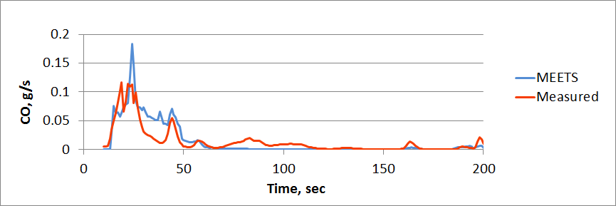
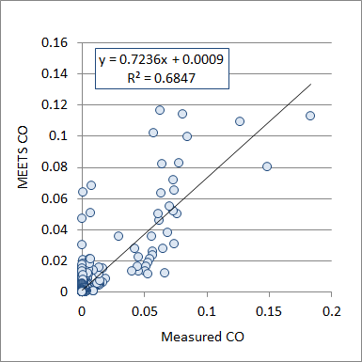
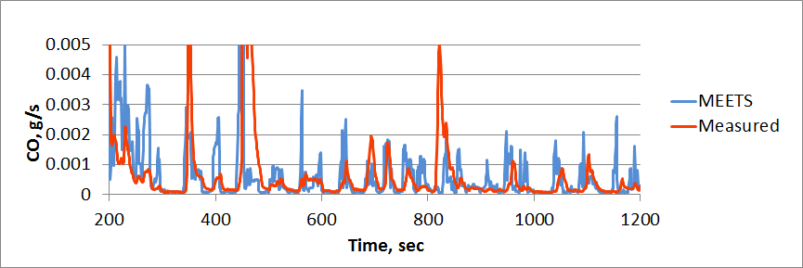
MEETS Emission Outputs CO
Cold Start
CO (g/s)
Measured | 3.927
MEETS | 3.388
% Difference | 2.8
Hot Stabilized

Slide 16
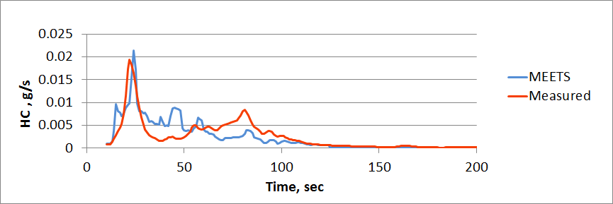
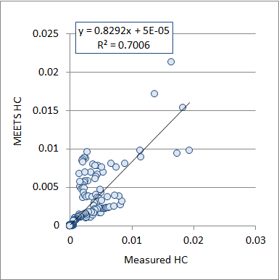
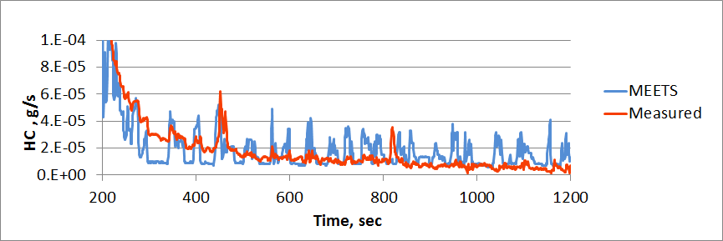
MEETS Emission Outputs HC
Cold Start
HC (g/s)
Measured | 0.514
MEETS | 0.483
% Difference | -5.9
Hot Stabilized

Slide 17
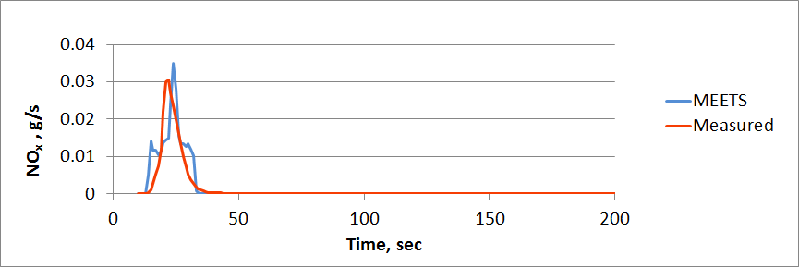
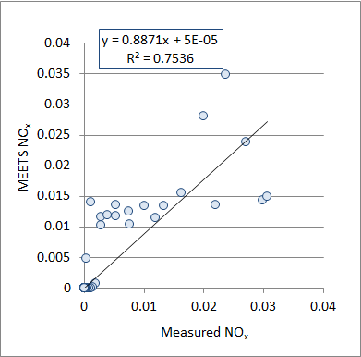
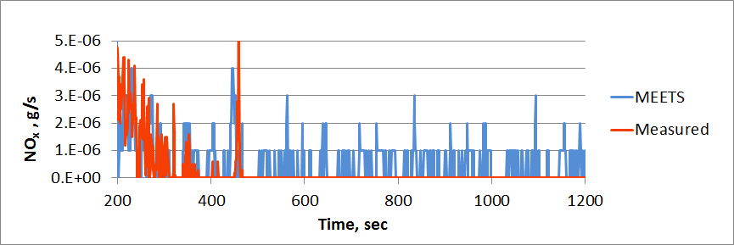
MEETS Emission Outputs NO_{x}
Cold Start
NO_{x} (g/s)
Measured | 0.250
MEETS | 0.287
% Difference | 14.6
Hot Stabilized

Slide 18
Trade-offs
PEMS
Performance
MEETS
Cost
Ease of implementation
Modeled data not measured

Slide 19
Conclusions
A mobile based emission estimation and reporting system can provide a unique set of real-time data which is valuable for traffic emission characterization
Improved emission estimations
  Bypass assumptions previously made to estimate fuel rate and engine operating conditions.
Various applications
  Low cost, easily implemented
  On-board driver feedback
  Broadcast energy/emissions from traffic for ITS
  Applicable to other platforms (i.e. Heavy Duty Diesel)
USDOT’s AERIS (Applications for the Environment: Real-time Information Synthesis) research program
  Real-time transportation data for environmental benefits

Slide 20
Questions?

