Slide 1
Update on EPA’s use of PEMS data for emissions modeling and inventory development
John Koupal, Carl Fulper
U.S. EPA Office of Transportation & Air Quality
UCR CE-CERT PEMS Conference
March 29, 2012

Slide 2
EPA PEMS Emission Factor Programs
MOVES “Shootout” (2001)
Kansas City LD PM program (2005)
Diesel Construction “Pilot” program (2008)
Evaporative Field Leak program (2009-11)
Houston HD “Drayage” program (2010)
Tier 2 LD program (2012)

Slide 3
Houston Port Dray Truck Study
Collected emissions and activity data on HD drayage trucks using PEMS and PAMS in 2009-10
Trucks selected for PEMS testing based on RSD scores
Generally higher mileage (> useful life)
Model Year | Number of Trucks w/ PEMS
1989 and prior | 1
1990 | -
1991-1997 | 10
1998 | 3
1999-2002 | 13
2003-2006 | 10

Slide 4
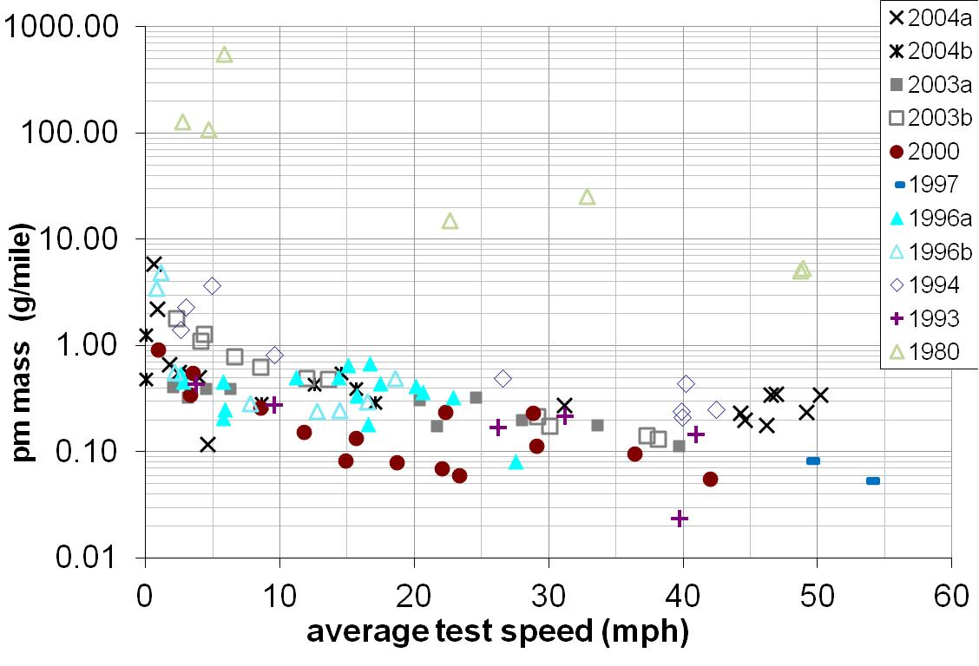
Prelim Houston Drayage PM Results
Individual Trucks by Model Year

Slide 5
In-use compliance data & MOVES
Heavy-duty in-use compliance data collected by manufacturers is also being analyzed to help update MOVES heavy-duty emission estimates
Number of Trucks Analyzed
MY | HHD | MHD | LHD
2005 | 35 | 15 | 10
2006 | 25 | 18 | 5
2007 | 21 | 27 | 21
2008† | 16 | 10 | -
2009 | 22 | 36 | 4
† excludes vehicles using AB & T for HHD

Slide 7
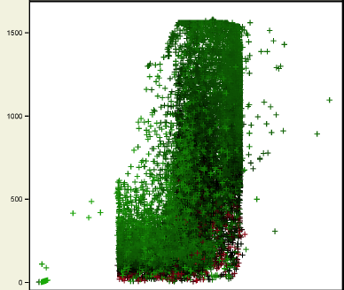
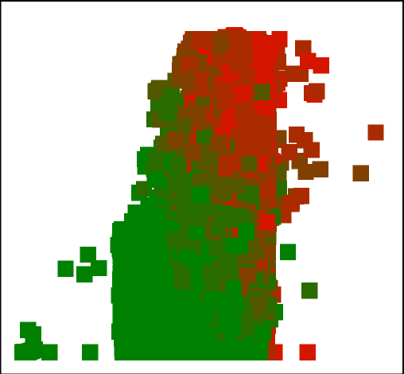
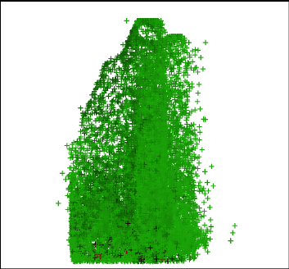
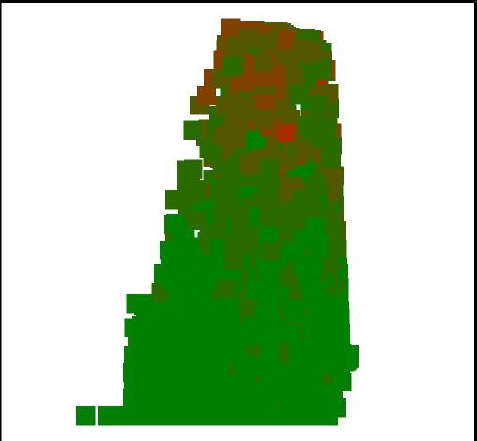

NOx Maps for Common Engine Family
Houston Drayage
5 yrs old, 750K miles
Compliance Program
2 yrs old, 350K miles

Slide 8
Tier 2 Light Duty Program
Objective: emission factors for Tier 2 vehicles
  Long term goal is longitudinal study, multiple cities
Screening component (RSD)
  Facilitating representative recruitment
    Capturing “dirty vehicles”
  Serves as independent measure
Measurement component
  Portable emissions measurement systems
Pilot Study
  RSD conducted in 2010; PEMS component 2012
  Detroit metro statistical area
  Develop, test and refine screening indices
  Develop and field-test methods

Slide 9
In-Use Deterioration over Ten Year Period
LDV Data Source from AZ I/M & Aggregate IM147
Need to characterize
for newer vehicles

Slide 10
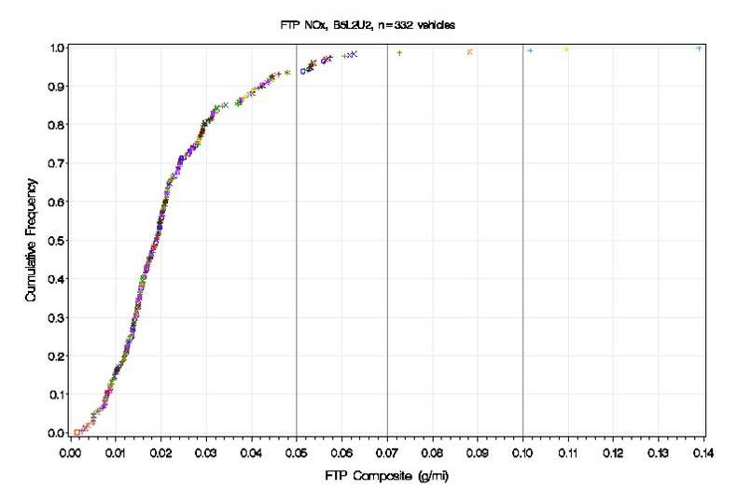
Why Screen?
Attempting to capture the entire distribution

Slide 11
Pilot: Research Questions
Can we use Remote Sensing to
  screen emissions level for vehicles
  Ranging from clean to dirty
  With some degree of reliability?
How can we measure starts using PEMS?
How can we recruit/retain participants?
  Short term?
  Long term?
Can we compensate for non-response bias?
  Using the screening measurements?

Slide 12
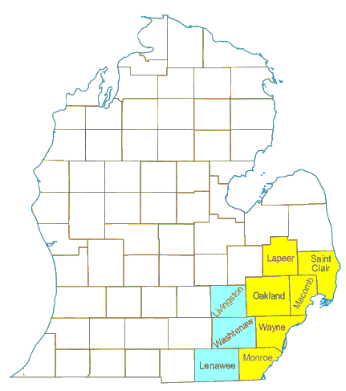
Study Population/Area
  Privately-owned light-duty vehicles
    Tier 2-Bin5 / LEV-II
  Study Area
    Detroit Metropolitan Statistical Area
      Primary
        Lapeer
        Macomb
        Monroe
        Oakland
        St. Clair
      Secondary
        Lenawee
        Livingston
        Washtenaw
Primary + Secondary = Consolidated MSA
“Primary”
MSA
“Secondary”
MSA

Slide 13
What to Measure?
Emissions: The usual suspects
Constituent Basis Technique
--------------------------------------------------------------------------------
CO₂ continuous EcoStar
HC/CO/NOx continuous EcoStar
PM aggregate 47 mm filters
PM continuous? Pressure Transducer?
May correlate to AVL Microsoot Sensor?

Slide 14
Activity Measurements
Parameter Basis Technique
--------------------------------------------------------------------------------
Basic
Diagnostic trouble codes
Fuel control status (closed, open loop)
Engine-coolant temperature
Intake air temperature
Manifold air temperature
Air flow rate
Engine speed
Calculated load
Vehicle speed
Other parameters (to be determined)
“Enhanced”
Air-conditioning code
O2 sensor(s)
Air/fuel ratio
Ambient temperature
GPS
Instruments:
HEM Data: OBD MiniLogger w/ GPS
Measurement Period:
~ two weeks

Slide 15
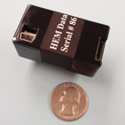
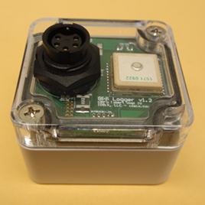
PAMS Devices
OBD Logger
Current HEM Data Devices
GPS Unit
New HEM Data Devices
w/ integrated GPS

Slide 16
What kind of Operation?
“put the vehicle thru its paces”
  On pre-arranged drive route
      Start (cold and warm)
      parking lot,
      residential,
      arterial,
      on-ramp,
      freeway,
      off-ramp,
      Idle,
      Grade (hills) – “load”
  Get starts (with PEMS)
      Run, soak, repeat
      In-use version of FTP Bag1, Bag3, etc.

Slide 17
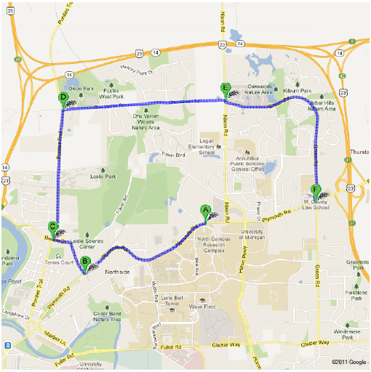
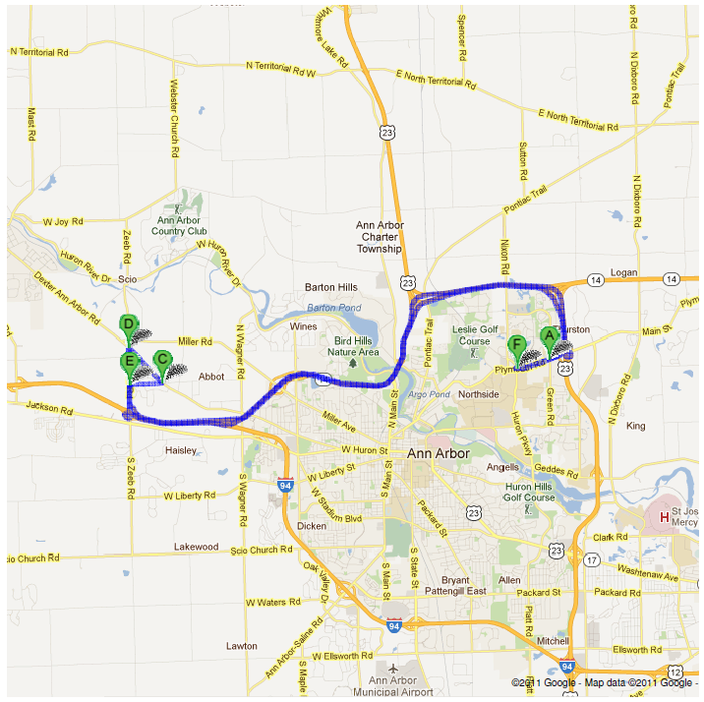
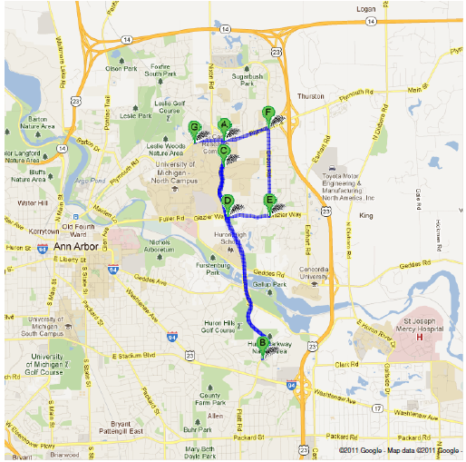
Driving Routes
“Cold” & “Hot” Start Filter #1
Driving Filter #2
includes hills “load”
Idle Filter #3

Slide 18
Logistics: Emissions
(“Quick vehicle turn around”)
URS
EPA
URS
URS
URS
EPA
EPA
URS

Slide 19
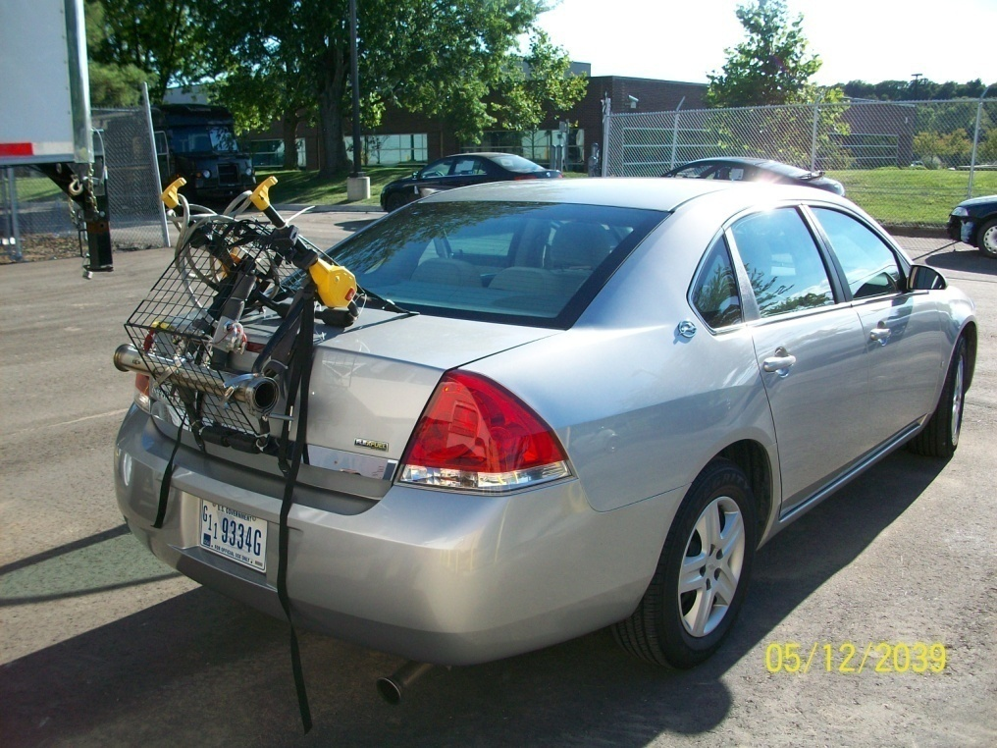
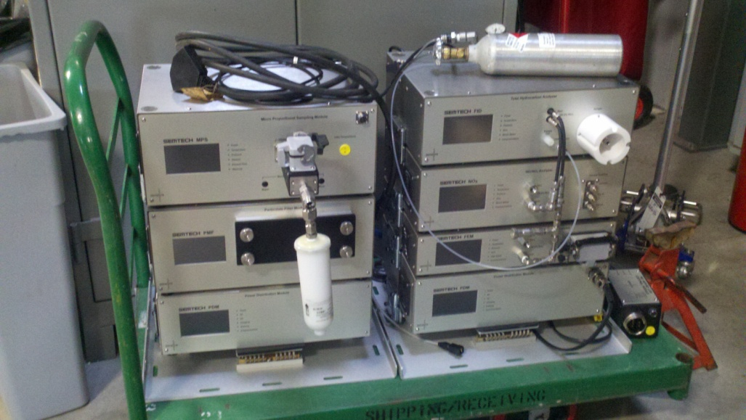
Vehicle Setup
Sensor’s EcoStar unit
3 PM filters
Proportional Sampling
2 Marine Deep Cell Batteries
GPS
Ambient Air Sensor
Flow Meter
Vehicle Interface
Laptop Computer
Equipment Weight: 150 lbs

Slide 20
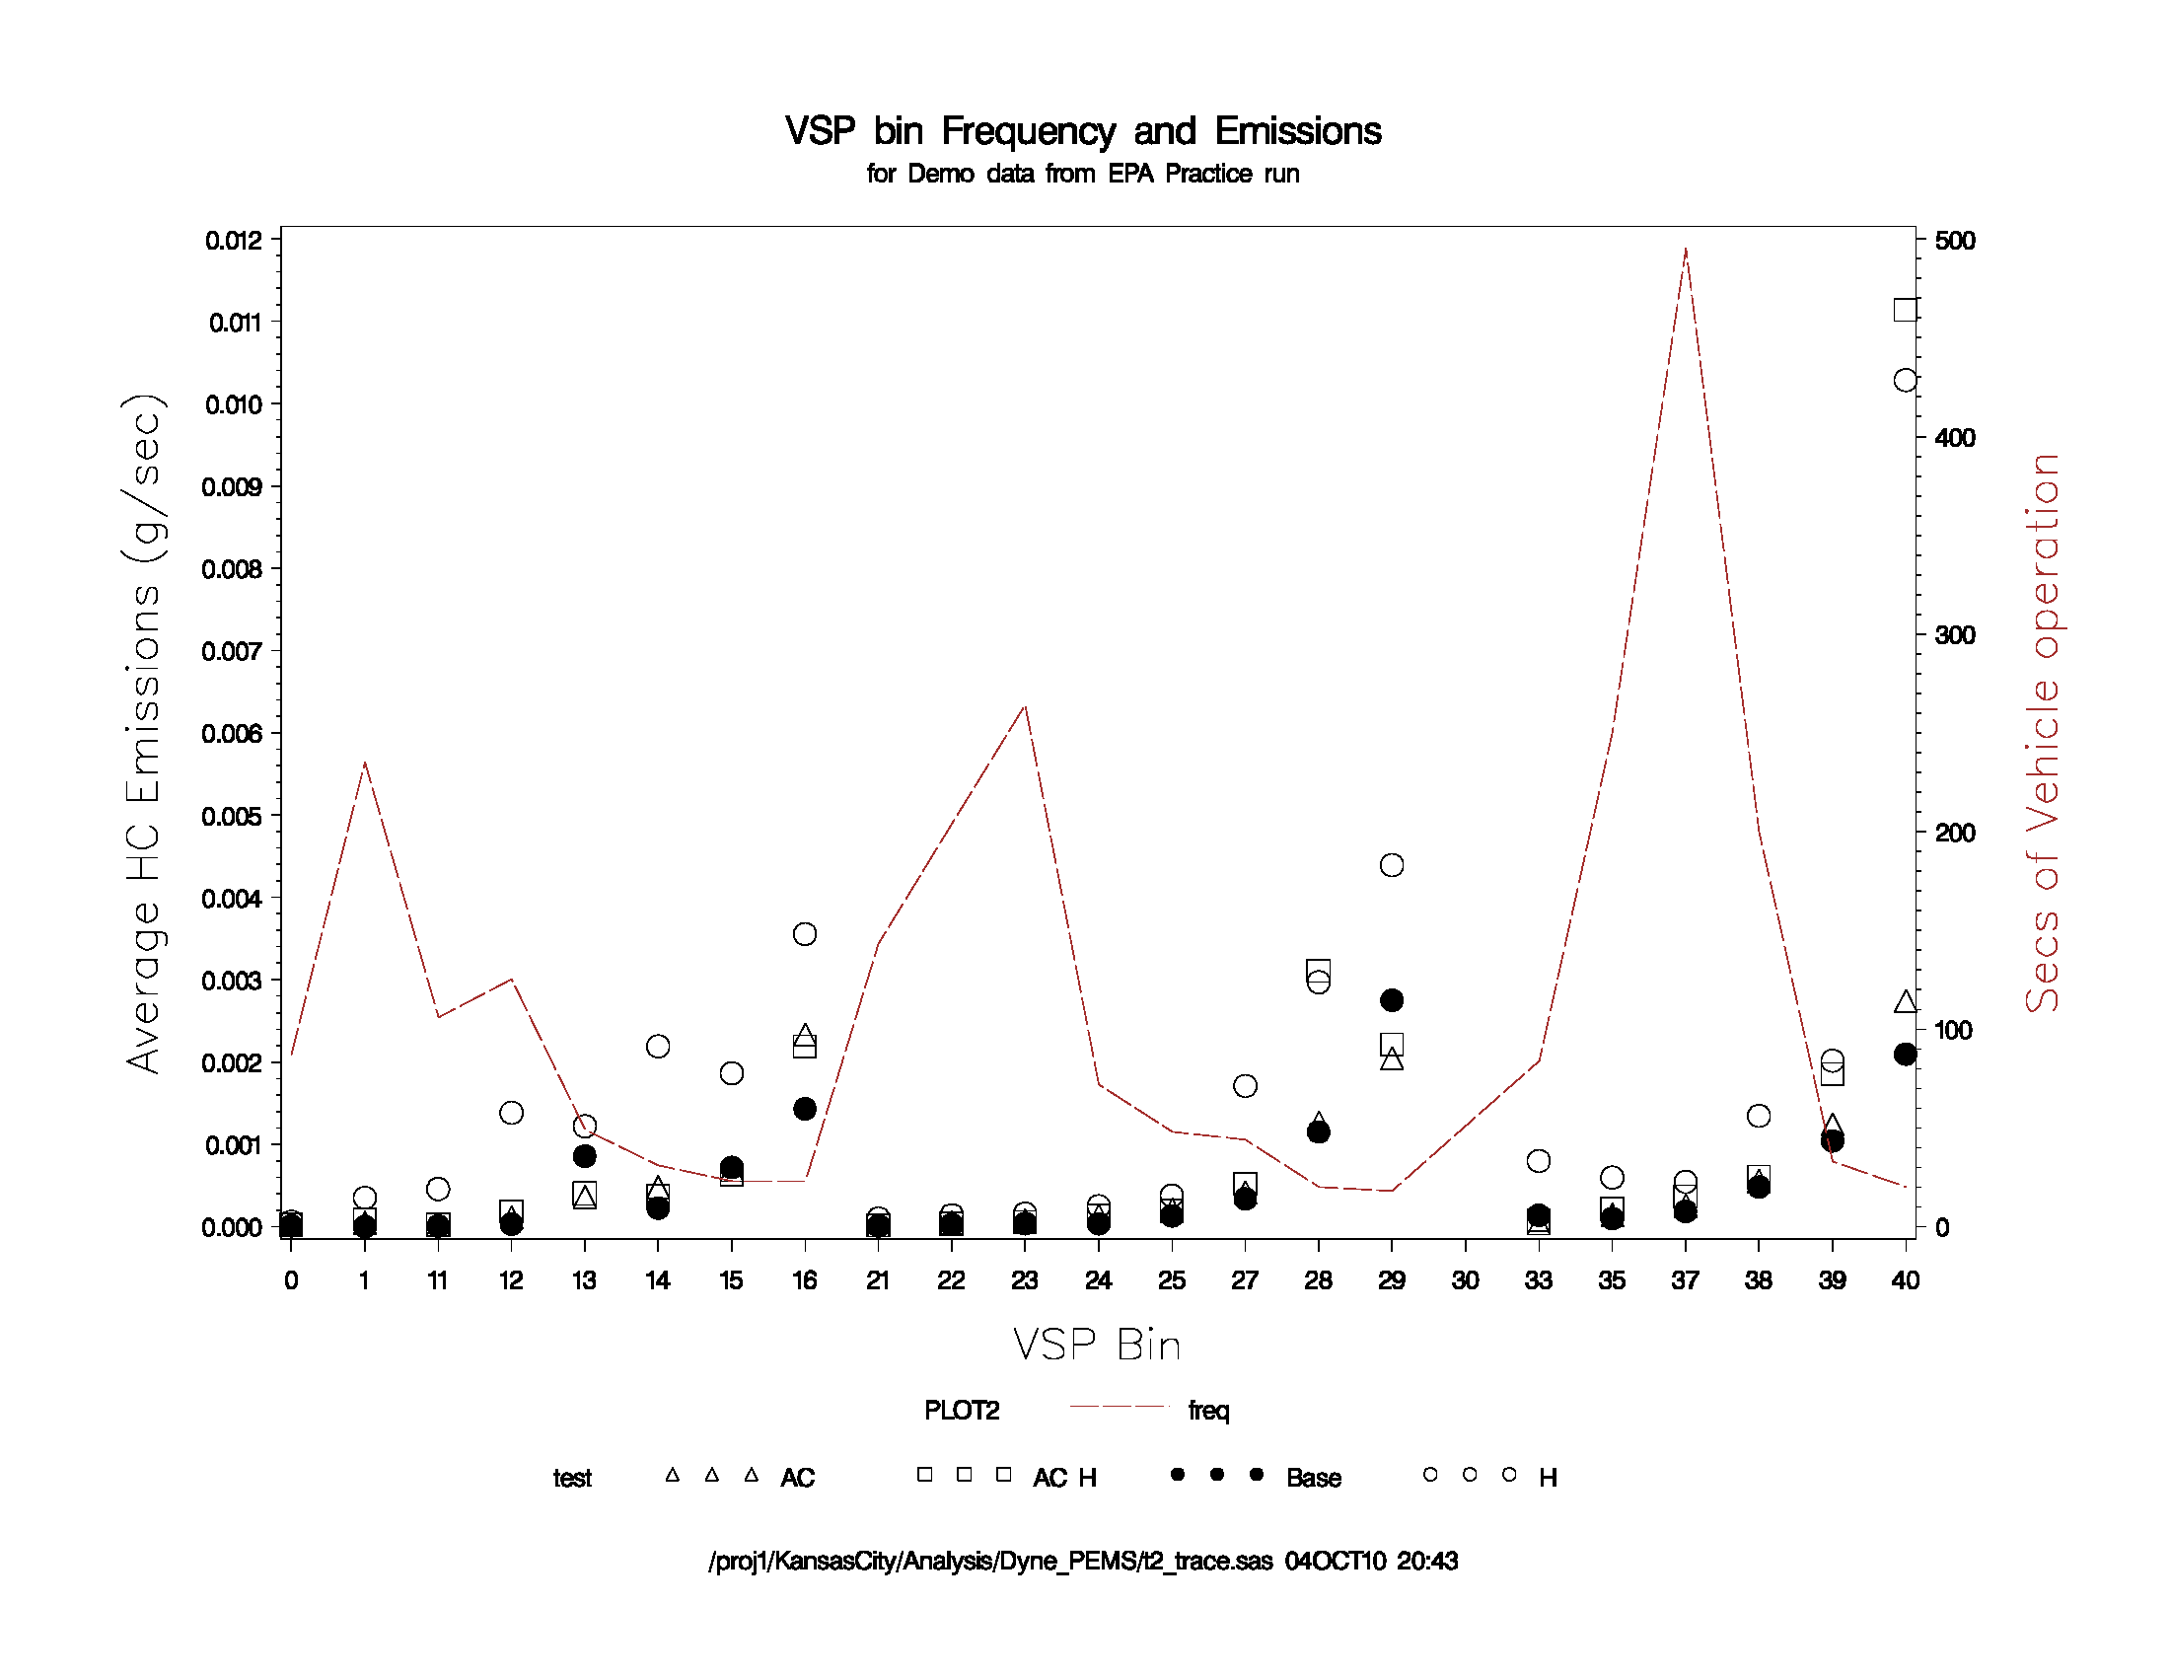
Change in HC can be seen at medium
to high Accels
> 50 mph
< 25 mph
25 - 50 mph

Slide 21
Summary
EPA is actively using PEMS to conduct emission factor testing
Data will inform EPA models and inventories
Have conducted program for LD, HD and Nonroad sectors
Have begun using RSD as selection device for PEMS testing
Piloting LD recruitment / testing methodology in Detroit area this year
  Using prescribed drive route approach for PEMS

