Slide 1
Comparative on-road testing of passenger cars in the UK: informing consumer choices
Nick Molden
11 April 2013

Slide 2
Overview
  Laboratory grade results on real roads
  Real-time MPG and CO₂ emissions from passive tailpipe monitoring
  PEMS equipment with post-test data analysis
  To create results comparable between different vehicles over time
  300+ vehicles so far tested

Slide 3
THE ISSUE

Slide 4
The issue
Users do not know true fuel consumption and emissions before purchase
“Green” vehicles are not necessarily lowest in consumption and emissions
The performance effect of driving patterns and styles is often unquantified
Choices are badly informed both individuals, companies and society
Better performance testing is required to enable the best choices

Slide 5
The questions
  For individuals: What vehicle should I choose?
  For consumer media: What vehicle should I recommend?
  For manufacturers: What is the optimal design and marketing?
  For dealers: What are the features and benefits?
  For government: What regulations, and tax and incentive structures should be set?

Slide 6
The context
  Results on the New European Drive Cycle are known to diverge from reality
  And the gap is believed to be growing
  Incentives for manufacturers are strong but misaligned
  Incentives for consumers are confusing: certain VED vs uncertain pump costs
  Trade-offs between reducing GHG and air pollutants are becoming vexatious
  Especially for diesels
  Trade-off between reducing emissions of new cars and making them cheaper
  Danger of leading owners to hold onto older, dirtier vehicles longer

Slide 7
METHOD

Slide 8
Method
Test cycles calibrated to real driving on real roads
    Exact trace kept confidential
Designed to build up dynamic performance map of each individual vehicle
    Speed, acceleration, gradients, etc
Endogenous factors to be controlled for
    Weather
    Air-conditioning, heating
Other elements kept constant, or recorded
    Driving style
    Vehicle weight
    Tyre pressure

Slide 9
EQUIPMENT

Slide 10
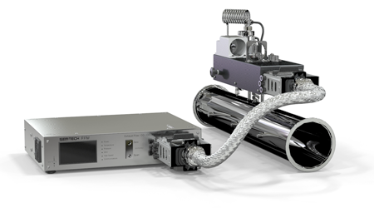
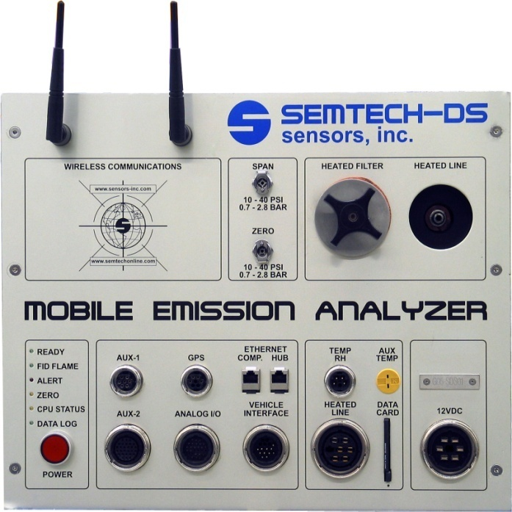
Raw data
Laboratory-grade equipment
Portable Emissions Measurement System connects to tailpipe
    Captures emissions for CO₂, CO, NO, NO₂, total hydrocarbons
    At 1 Hertz
  Air temperature, pressure, humidity
  GPS for speed and altitude
  Engine data via CANBUS
  DS weighs approximately 95kg including auxiliary batteries
  Proven robust over potholes, speed bumps

Slide 11
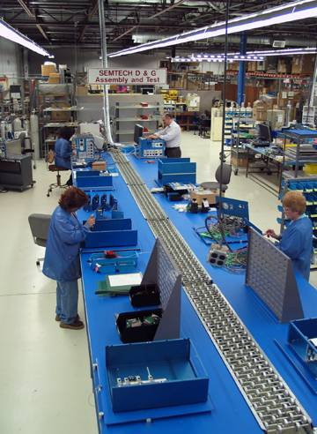
SEMTECH credentials
Development initiated in the 1990s
Established Joint Development Agreement with Ford Motor Company
Procured EPA Patent enabling mass emission calculation using exhaust flow meters
SEMTECH systems commercially available February, 2002
Awarded multiple contracts from USEPA, DG Joint Research Centre and Hong Kong EPA
Fully compliant with CFR 1065, Subpart J for Portable Emissions Measurement Systems (PEMS)

Slide 12
Operation
Minimise installation time
  Currently average one hour
  Including double and quad exhausts
Spot issues such as leaks rapidly
“Instant QA” of results
Avoid equipment downtime
1-3 vehicles tested per day
Working always to reduce “failure” rate of ~10%

Slide 13
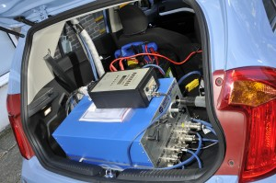
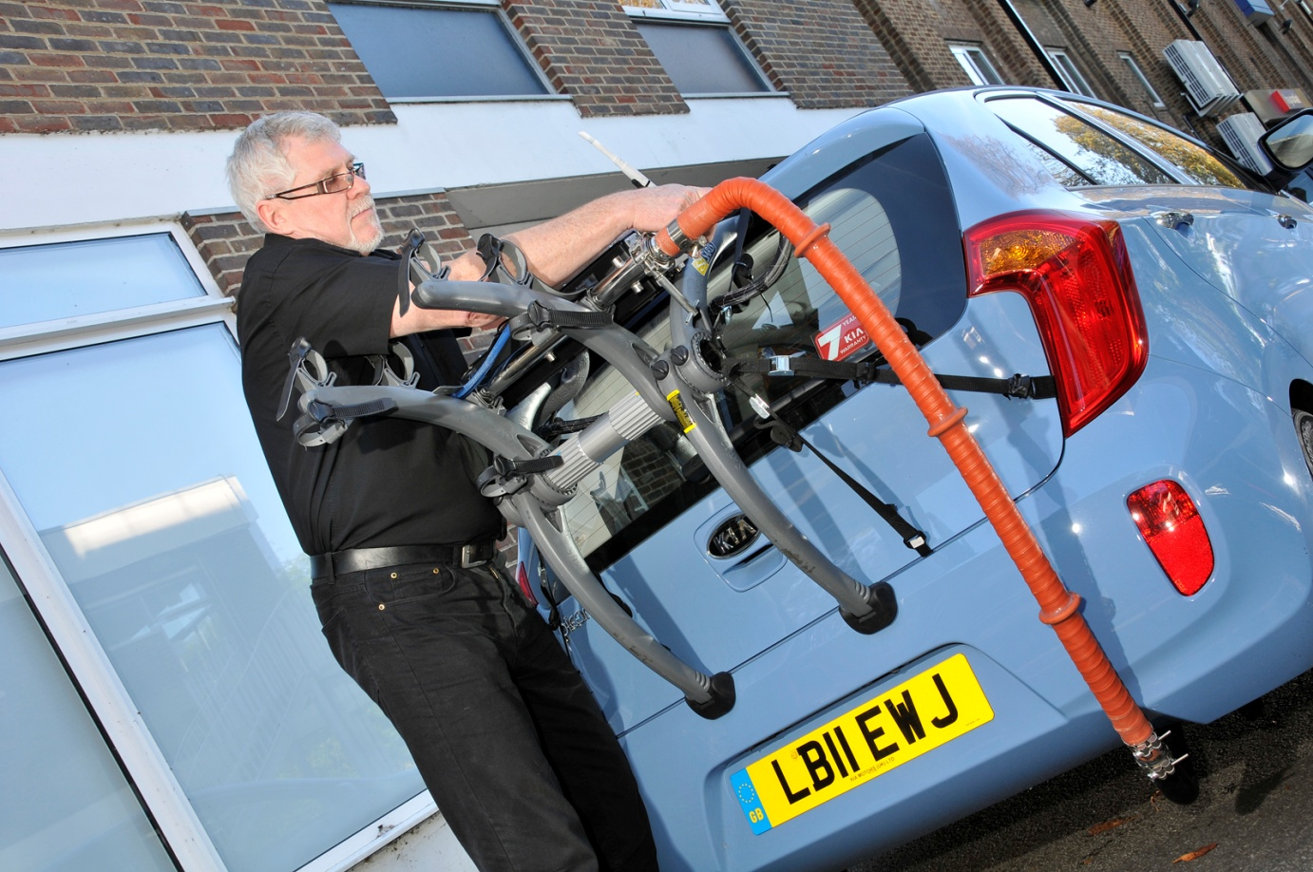
PEMS in action (1)

Slide 14
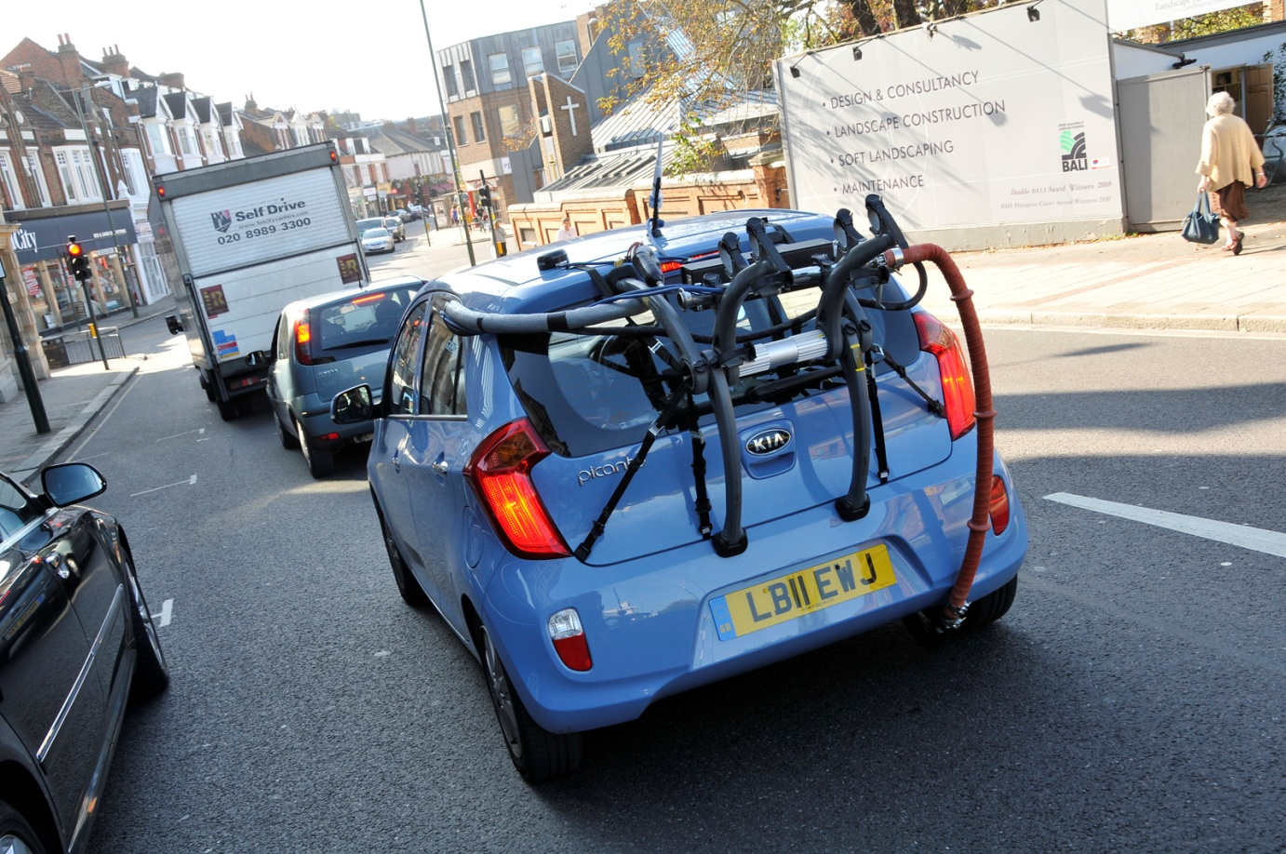
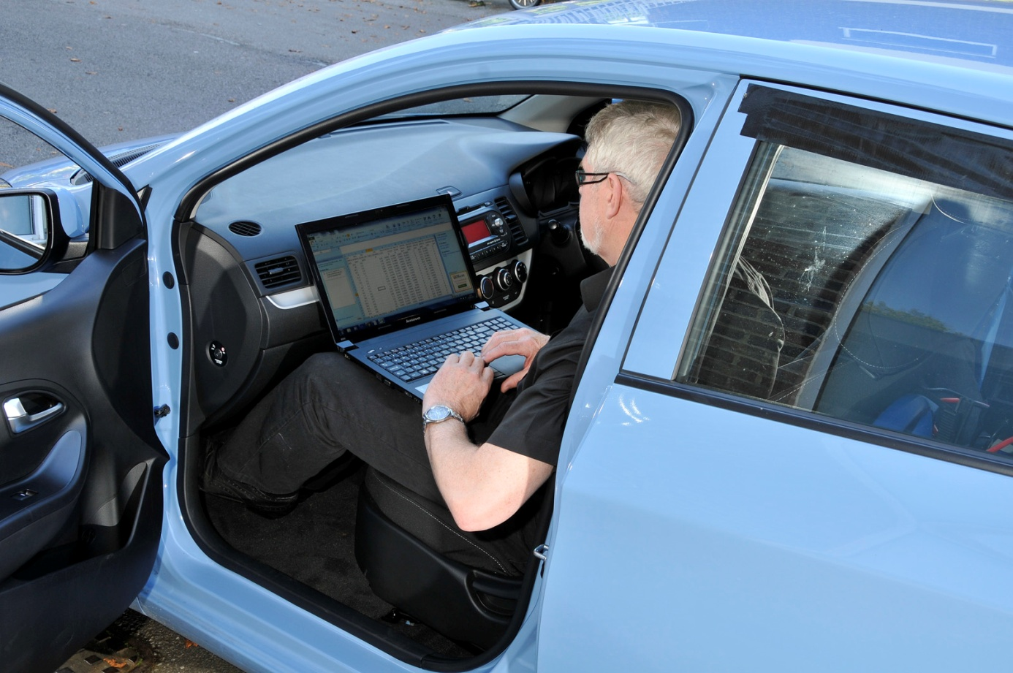
PEMS in action (2)
Portable Emissions Measurement System

Slide 15
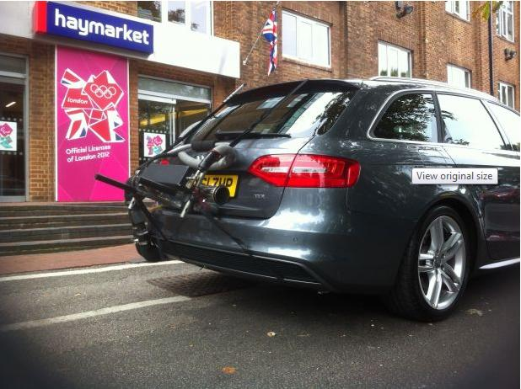
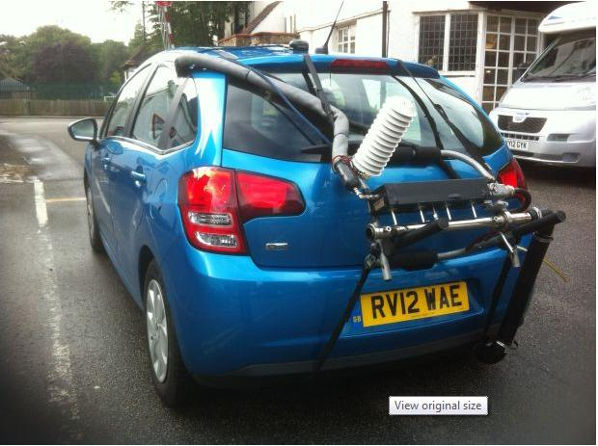
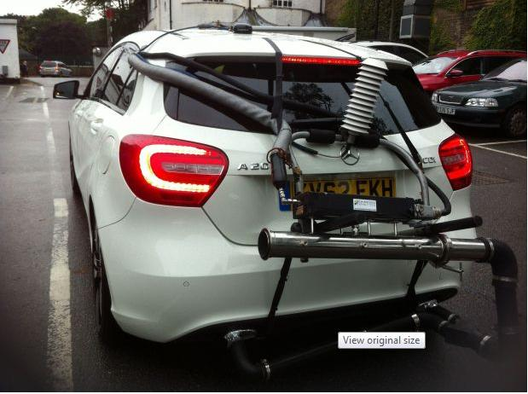
PEMS in action (3)

Slide 16
OUTPUTS

Slide 17
“TrueMPG” overview
Produced for What Car? (www.whatcar.com/truempg) in the UK since April
Real miles per gallon
Personalised to range of driver profiles, with different mixes of
  Road types
  Congestion
  Driving aggression
Post-test normalization to standard test cycle
  Off the official cycle – calibrated to real driving patterns
  Controls for variations in congestion
Estimated mileage to demonstrate monetary saving

Slide 18
“TrueMPG” process
Test every car road tested
Dovetail with existing test process
Published in every magazine issue and prominently on website
Relevant across EU
>600 model variants currently live
~500k unique users since launch
1m+ vehicles looked up

Slide 19
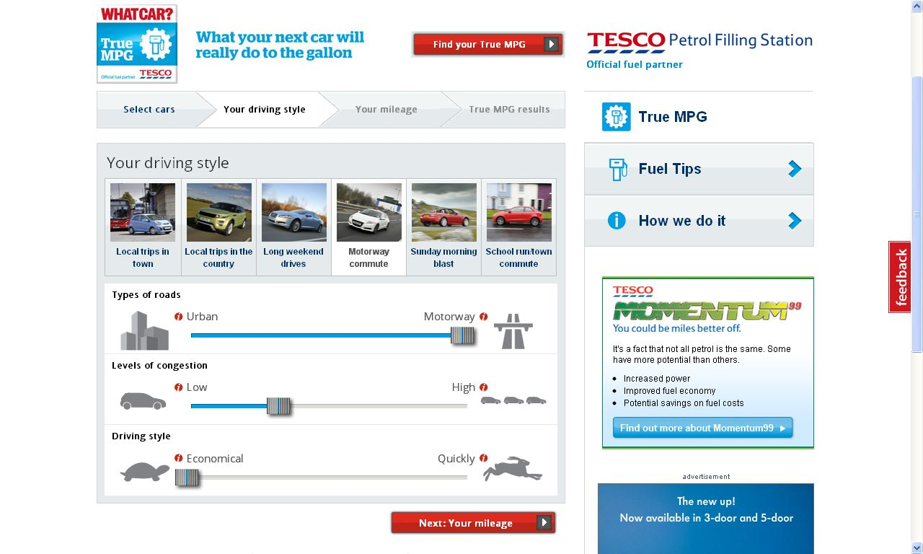
“TrueMPG” personalization

Slide 20
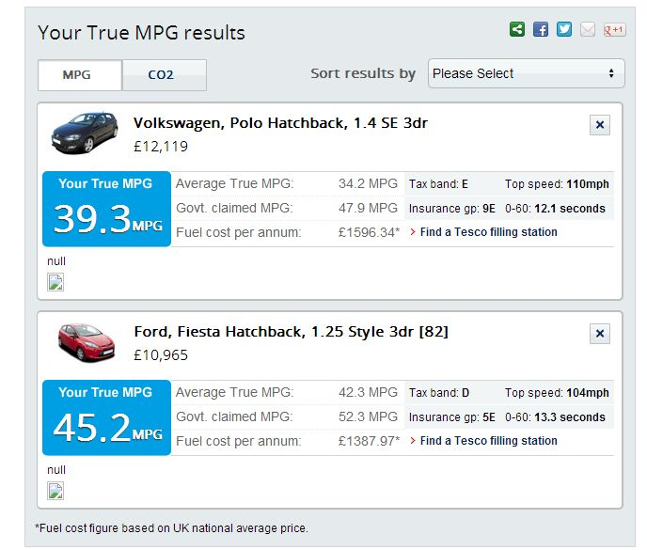
“TrueMPG” results

Slide 21
Headline results
Cumulatively 25% more CO₂ than official = 20% lower MPG
250 models
Sales weighted
Fluctuating mix
Gap growing
Official loopholes

Slide 22
Distribution of MPG variances
Variance between True MPG and official figures
Symmetric distribution
Only 7 models (3%) have exceeded official figures
Worst is 43.2% below

Slide 23
MPG by engine size
Official MPG falls with engine size, up to 3.0 litres
True MPG shows that mid-size engines (1.5-2.5 litre) are best performing
Gap between official and True MPG is 22% for 1.0-1.5 litres, but falls to just 5% for 2.5-3.0 litres
Simplistic downsizing is not the answer to better MPG

Slide 24
CO₂ variance by fuel/engine size
Gasoline and diesel vary in similar proportions
Early hybrids mixed picture
Generally: match engine to body
Large engines not sold on MPG?
 | Diesel | Diesel hybrid | Gasoline | Gasoline hybrid | Total
<1.00 |  |  | 66.8% |  | 66.8%
1.00-1.49 | 19.0% |  | 29.2% |  | 28.2%
1.50-1.99 | 27.9% |  | 23.6% | 11.2% | 25.7%
2.00-2.49 | 13.7% | 20.2% | 12.3% |  | 13.7%
2.50-2.99 | 0.8% |  | 7.3% |  | 5.0%
3.00+ | 11.7% |  | 2.7% | 28.4% | 10.1%

Slide 25
Consumer choices
Top ten vehicles by MPG change if ranked by True MPG rather than official data
6 of the Top 10 in official rankings change
Make | Model | Engine
Kia | Rio | 1.1
Citroen | C3 | 1.4
Renault | Megane | 1.5
Ford | Fiesta | 1.6
Volvo | V40 | 1.6
Honda | Civic | 1.6
Hyundai | i30 | 1.6
Toyota | Yaris | 1.5
Mini | Cooper | 1.6
Volkswagen | Golf | 1.6
Make | Model | Engine
Kia | Rio | 1.1
Citroen | C3 | 1.4
Honda | Civic | 1.6
Ford | Fiesta | 1.6
Fiat | Panda | 1.25
Mercedes-Benz | A200 | 1.8
Audi | A4 | 2.0
Honda | Civic | 2.2
Kia | Cee'd | 1.6
Alfa Romeo | Giulietta | 2.0

Slide 26
Dashboard accuracy
Surprising variance between on-board dashboard readings and True MPG
Over-stating MPG by 3% on average
Significant number overstating by more than 10%
Fewer underestimating...

Slide 27
Future perspectives
The future is dynamic modelling, not static tests and averages
Understanding the causes of consumption and emissions
To be able to predict and optimise emissions performance
For each model, derive instantaneous outputs as a function of speed, acceleration, temperature, gradients, cabin load....
E_{t} = ƒ (v_{t}, a_{t}, θ_{t}, σ_{t}, W_{t}, ...)
How long a test do you need to build a full dynamic vehicle performance map?
How many variables is optimal?

Slide 28
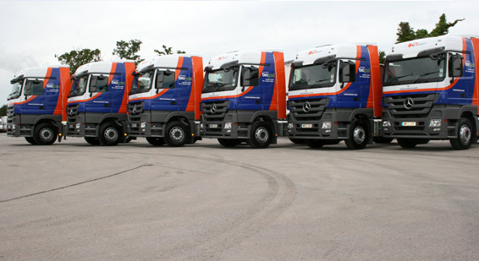
Low Carbon Truck Trial
Technology Strategy Board supported programme
Involving Howard Tenens and John Lewis
Three-year test on ~30 heavy-duty trucks
Testing diesel/CNG dual fuel system
For effect on
  MPG
  Gaseous air pollutants
  Particulates (in real-time)

Slide 29
Nick Molden, Managing Director
nick@emissionsanalytics.com
+44 (0) 20 7193 0489
+44 (0) 7765 105902

