Slide 1

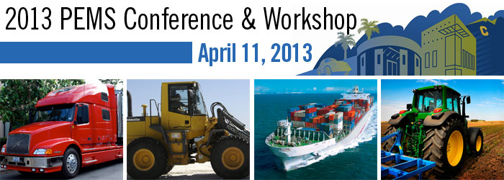
AUTOMOTIVE | BENCHMARKING | REPORTING | CONSULTING
An Overview of Vehicles, Resources & Regulation from the Land Down Under 2013
presented by
Natalie Roberts
Principal Engineer & Managing Director
www.abmarc.com.au

Slide 2

Contents
1. Overview ABMARC
2. About the Research
3. Australian Summary

Slide 3
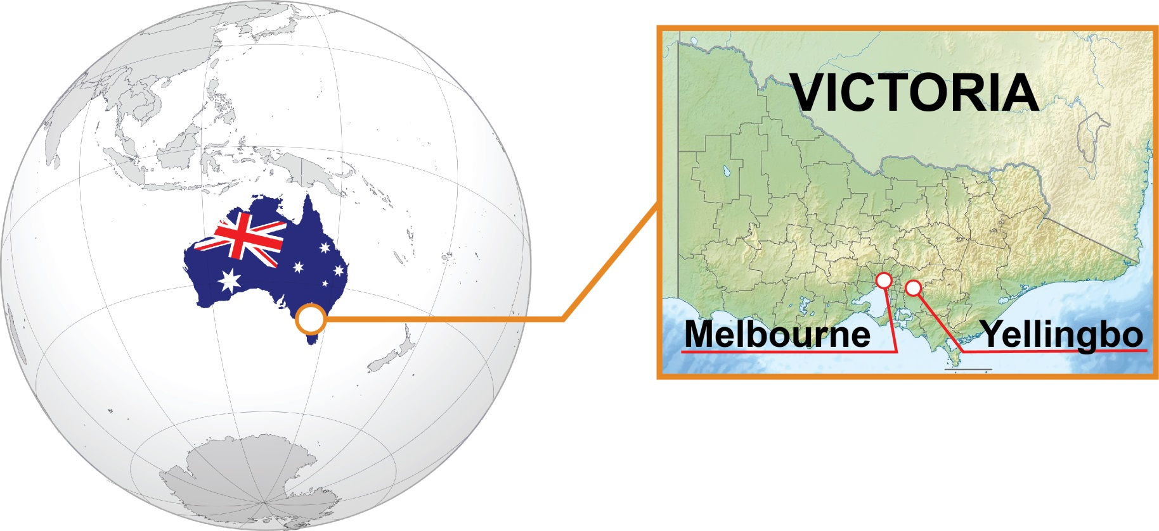
Overview ABMARC
Where in the World?
ABMARC is located in Yellingbo, Victoria, Australia – one hour East of Melbourne (the home of Australia’s automotive industry).

Slide 4




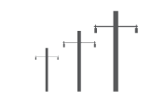

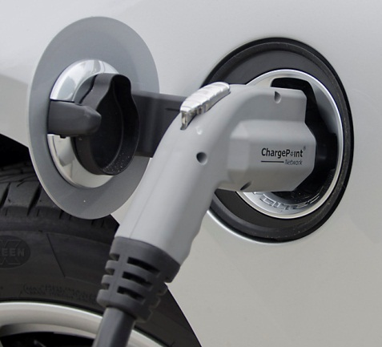
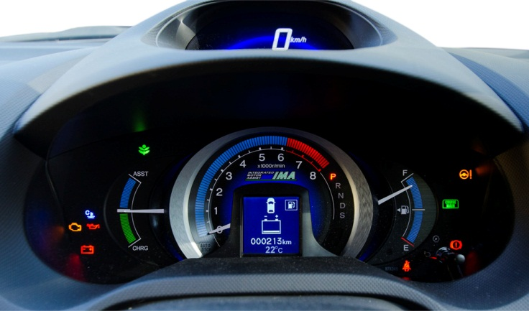

Overview ABMARC
About ABMARC
Overview
Established March 2011
Engineering, policy, business development & evidence based marketing
Automotive, transport, engines, fuels, technology
“Our aim is to challenge the status quo. We do this by providing our clients with best in industry reports and service”
Strategic planning tools
Empower business with fuels, energy and transport knowledge
Our Customers
Fuel Companies
Vehicle Manufacturers
Energy Companies
Government
Fleets

Slide 5
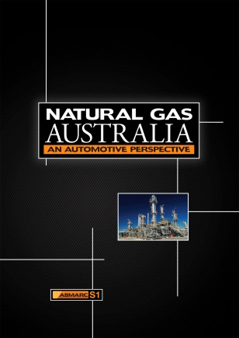
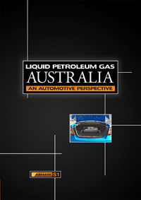
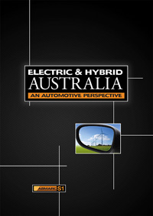
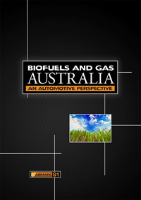






Overview ABMARC
Powertrain Series
Natural Gas
(CNG)
LPG
Electric & Hybrid Vehicles
Biofuels
“ABMARC is technology neutral, so our research and analysis is based on facts not opinion.”
ABMARC produces the Powertrain Series of reports. These reports provide a complete analysis of alternative vehicles and fuels, that is independent and unbiased, with global reviews and in-depth technology analysis.
Notes:
WHY? Lack of report material in Australia covering all of the pertinent issues surrounding alternative fuels and powertrains for automotive use.
With this in mind we set about creating a series of reports, The Powertrain Series, that will be invaluable to all levels of Business and Government and that can be relied upon to assist in making critical long-term planning, strategic or policy decisions.

Slide 6
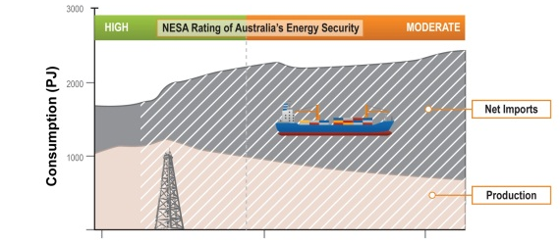
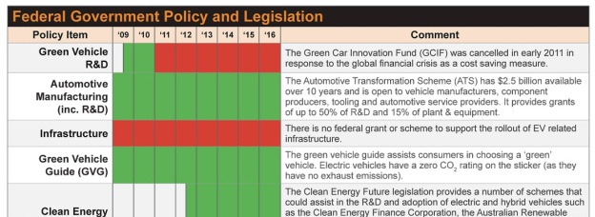

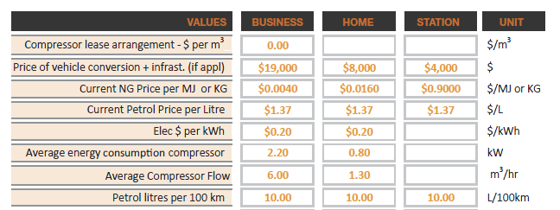
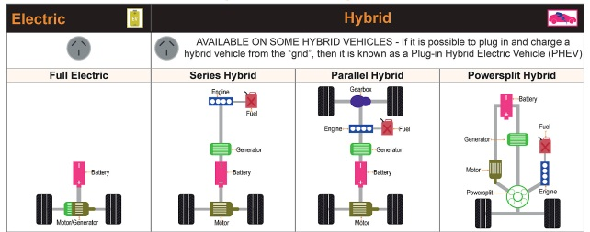
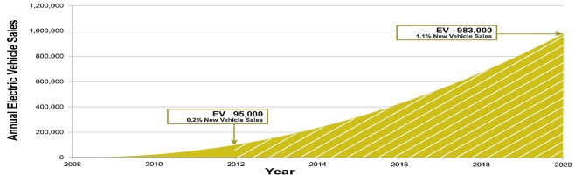
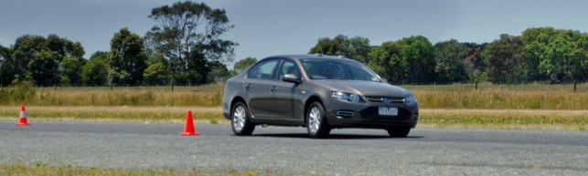
Overview ABMARC
ABMARC Capability
EXPERTISE Covers:
Resource/ Energy Analysis |  | Technical Market Research (surveys)
Government Policy Evaluation |  | Mapping of Infrastructure Availability & Trends (GIS)
Cost Analysis & Modelling (tool creation) |  | Desktop & in Field Technology Review & Forecasting
Emissions & Vehicle Forecasting |  | Vehicle or Technology Evaluations and Testing
ABMARC conducts a wide range of services in-house from desktop research to market research and in-field engineering test and evaluation.
Notes:
1. Understand resource life
2. It’s important to understand government policies to place products and trends in perspective
3. Excel based software tool creation
4. Our comprehensive knowledge of current technologies & legislation, state of the art and trends means that we can forecast across a wide range of areas – we have a bottom up approach
5. Complete end to end market insight conducted in-house to understand motorist trends or your customer base
6. “We can turn reams of data into powerful and usable information” with geospatial mapping
7. Literature reviews and Benchmarking of technologies
8. Test and reporting services – vehicle examples
Alternative fuel or vehicle fuel/power consumption
Fuel reduction devices/systems
Fit for purpose testing
Target setting for development
Testing of biofuels and gaseous fuels for power, fuel economy, CO₂ emissions and engine/component durability (including oil condition analysis)
Validation or confirmation of new technologies
Across industries:
Automotive – passenger, light commercial and heavy commercial vehicles
Stationary power generation – diesel and natural gas

Slide 7
Contents
1. Overview ABMARC
2. About the Research
3. Australian Summary

Slide 8
About the Research
About the Research
No PEMS in Australia
No regulation for PEMS under legislative consideration
Need for evidence based data for alternative fuels and vehicle technologies
Only one ETL in Australia capable of running large engines
Received an Ian Potter Foundation Fellowship to research PEMS in the USA and the EU (systems, regulation and test methodology)
Through our work we identified a need for evidence based decision making for alternative fuels and vehicle technologies – this led us to PEMS and the gap in Australia’s regulatory environment.

Slide 9
Contents
1. Overview ABMARC
2. About the Research
3. Australian Summary

Slide 10
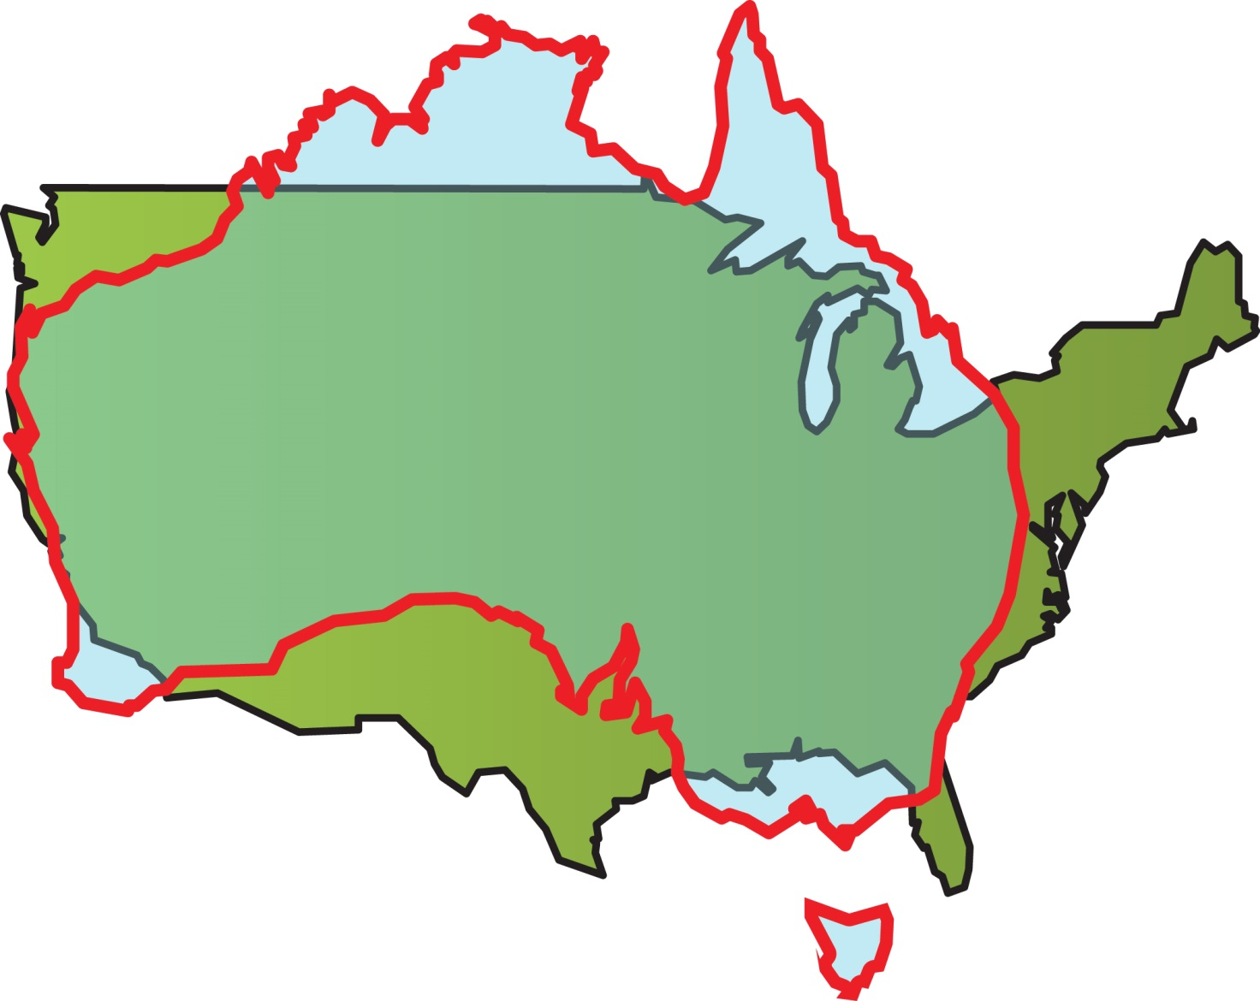
Australian Summary
Australia - Size Comparison with the USA
Australia is nearly the same size…
Notes:
If not in land mass then in personality!

Slide 11


Australian Summary
Key Statistics of Australia and America
 | AUSTRALIA | USA
Population | 22.7 million | 313 million
Number of Vehicles (passenger and LCV’s) | 15 million | 230.5 million
Vehicles per capita | 0.720 | 0.736
GDP per capita (USD) (2013) | $69,582 | $51,057
Anticipated GDP growth % (2012-2013) | 2.4% | 2.5%
The population (whilst small) is largely urbanised in sprawling cities. Public transport is generally of poor quality and Australian’s are very reliant on their cars.

Slide 12
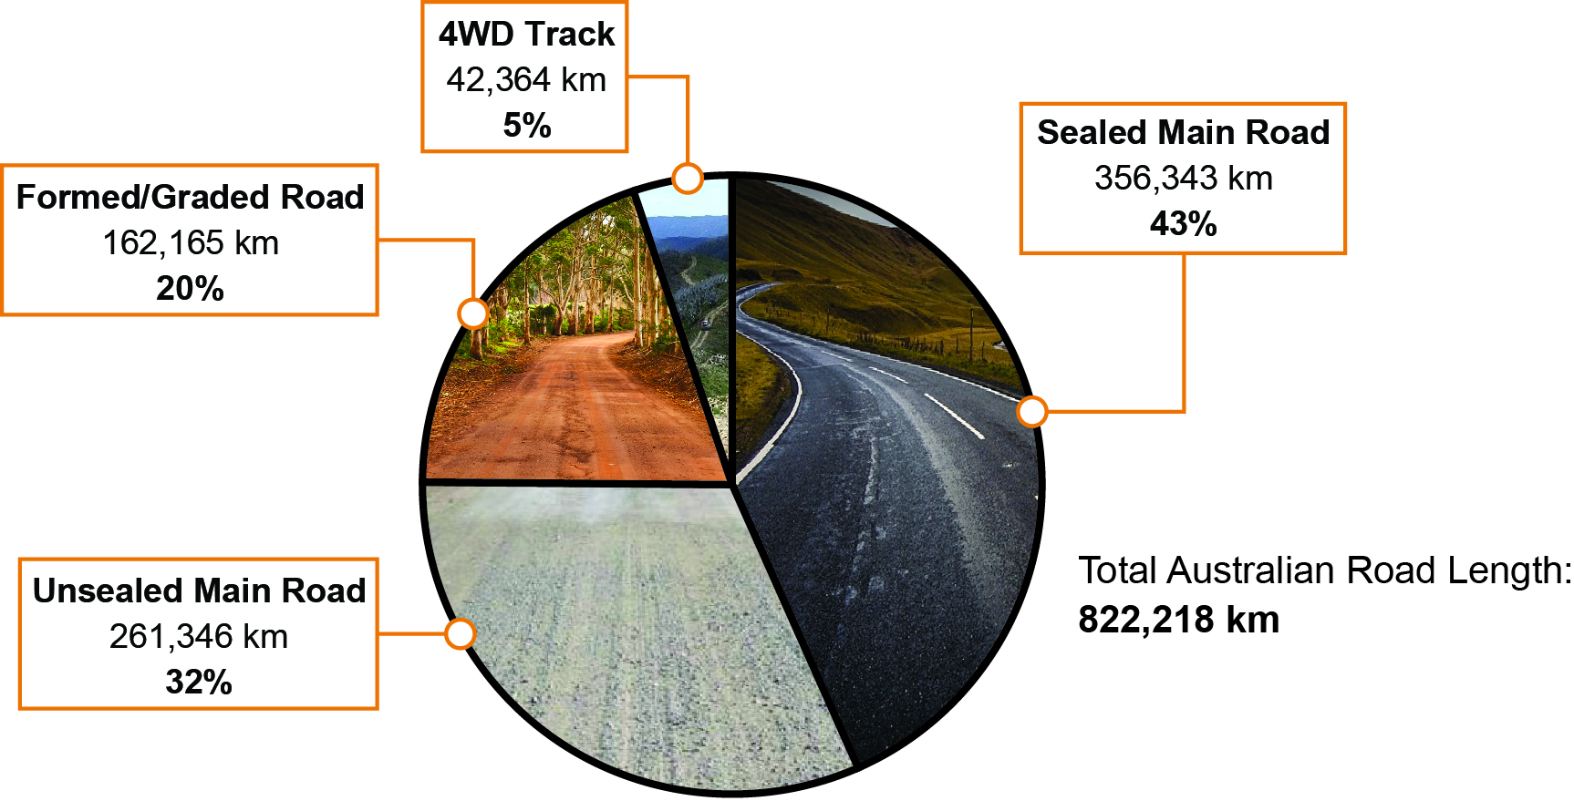
Australian Summary
Australian Road Types
v
Source: ABMARC based on BITRE data
Average Distance Travelled Per Year:
(Light Vehicles)
13,200 km
(8,202 miles)
Australia is a vast country with wide distances. There are more than 800,000 kilometres (500,000 miles) of road in Australia.
For definitions of the road types, go to: http://www.lockyervalley.qld.gov.au/images/PDF/about_council/policies/eo-003%20%20provision%20of%20access%20on%20designated%20roads%20unmade%20unformed%20or%20formed.pdf

Slide 13
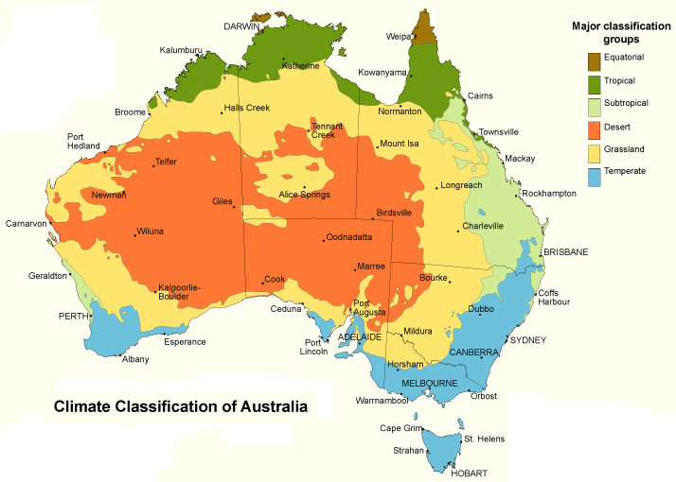
Australian Summary
Australian Environmental Conditions & Size Comparison
Australia’s climate extends from temperate to desert and tropical.
Notes:
About 9000’

Slide 14
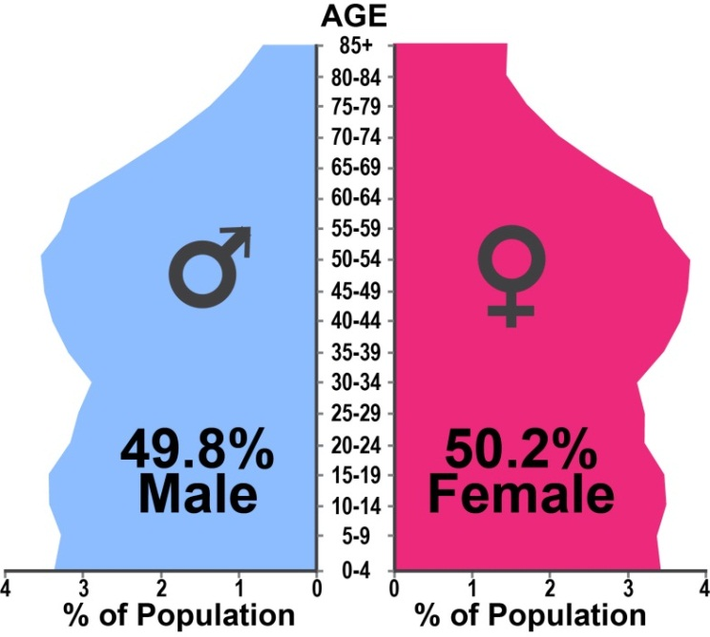
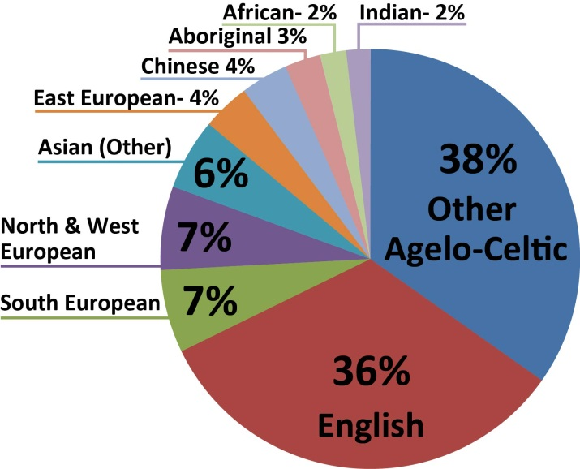
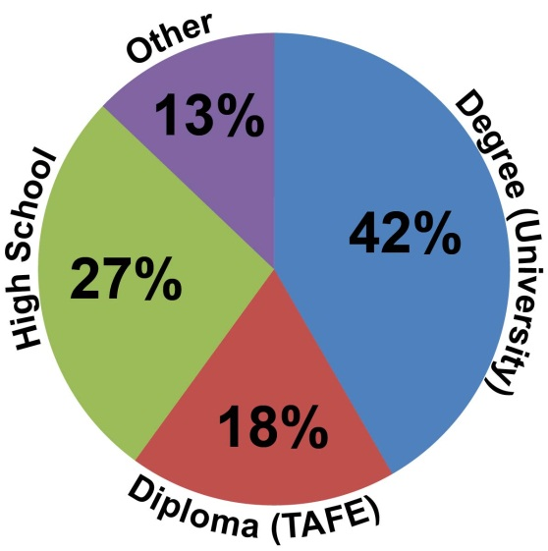
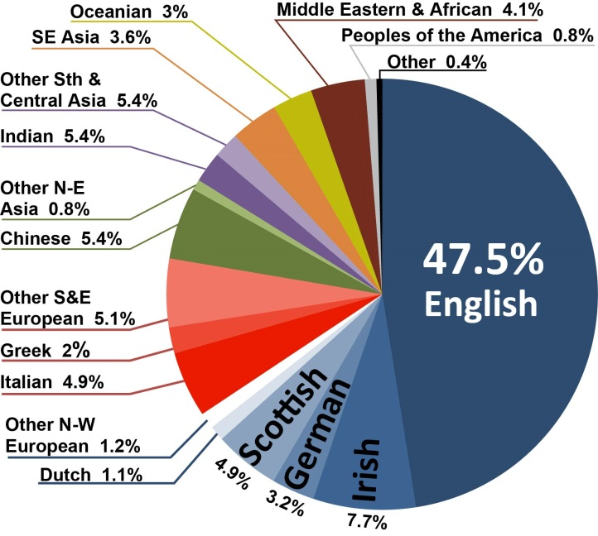
Australian Summary
Demographics
Most Identified Ancestry
Education
Age & Sex
Anglo-Celtic
Australia’s population is predominately Caucasian, but with a significant Asian and growing African influence. About 60% of people have a degree or diploma qualification. The population is aging.

Slide 15
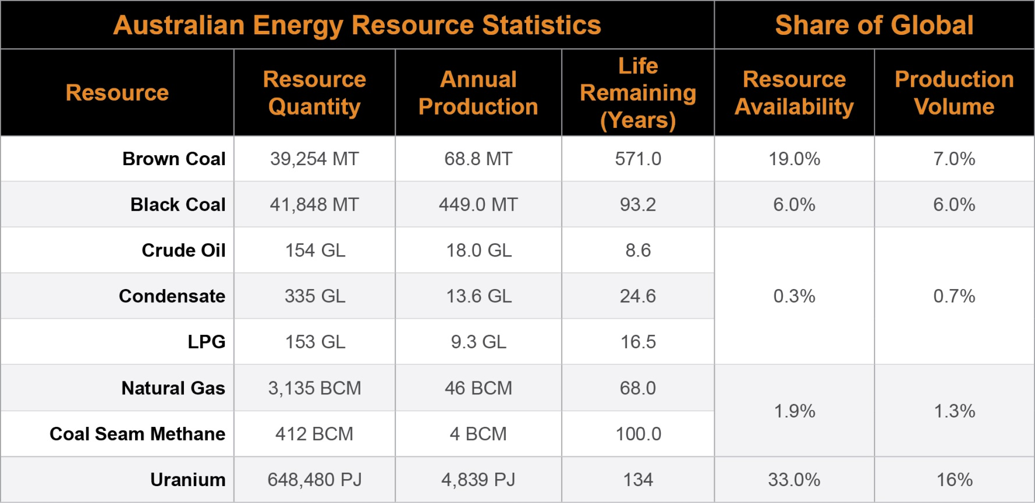
Australian Summary
Natural Resources - Summary
Australia has little oil, but has vast quantities of coal, gas and one third of the world’s known economic uranium resources. (Of note, Australia has no nuclear power generation)

Slide 16
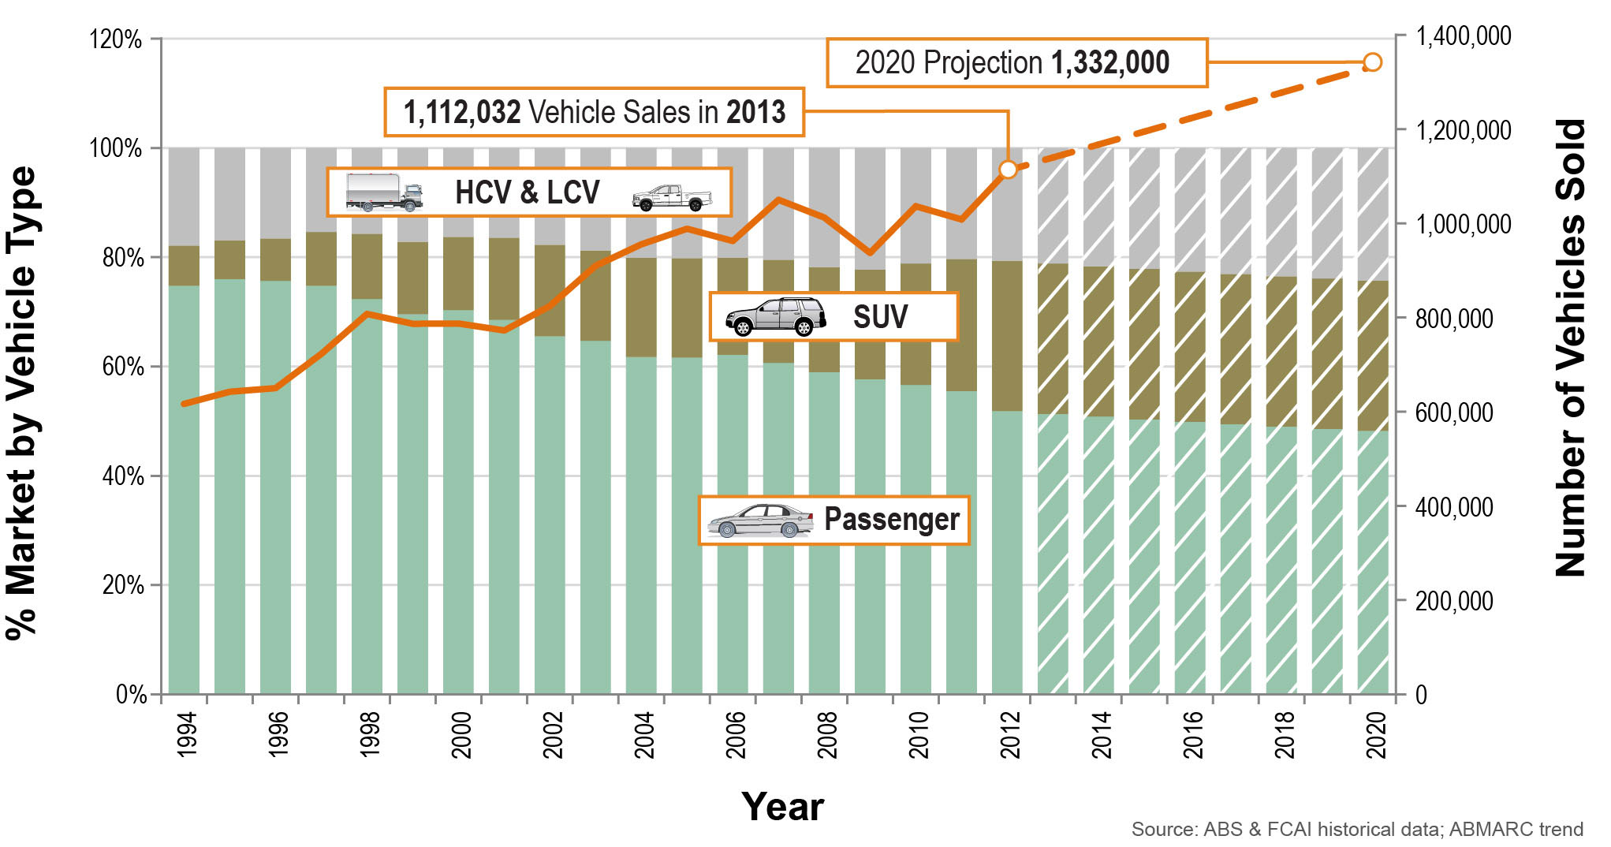
Australian Summary
Australian New Vehicle Sales
2012
Australian new vehicle sales continue to grow. SUV and LCV segments are increasing in share.

Slide 17
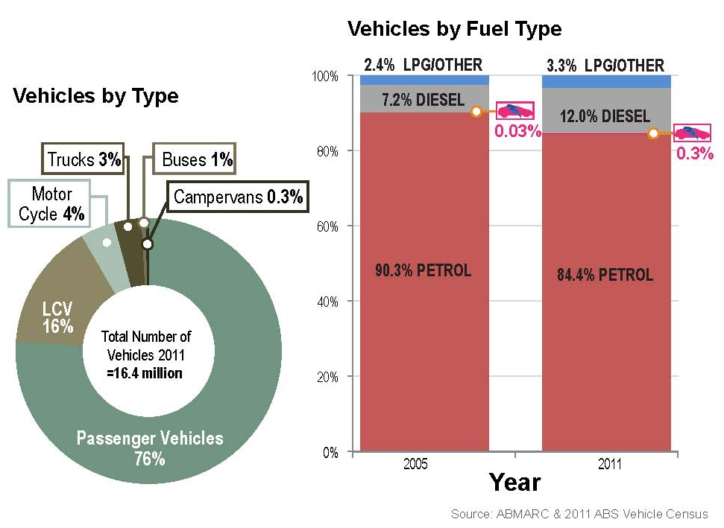
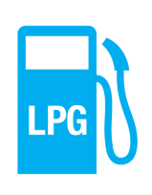


Australian Summary
Australian Vehicle Fleet
Vehicles #’s by Powertrain
513,000
45,000
< ~ 3,100
< ~ 200
~ 200
Fleet consists of mostly passenger vehicles. Diesel and hybrid powertrain share is growing dramatically.

Slide 18
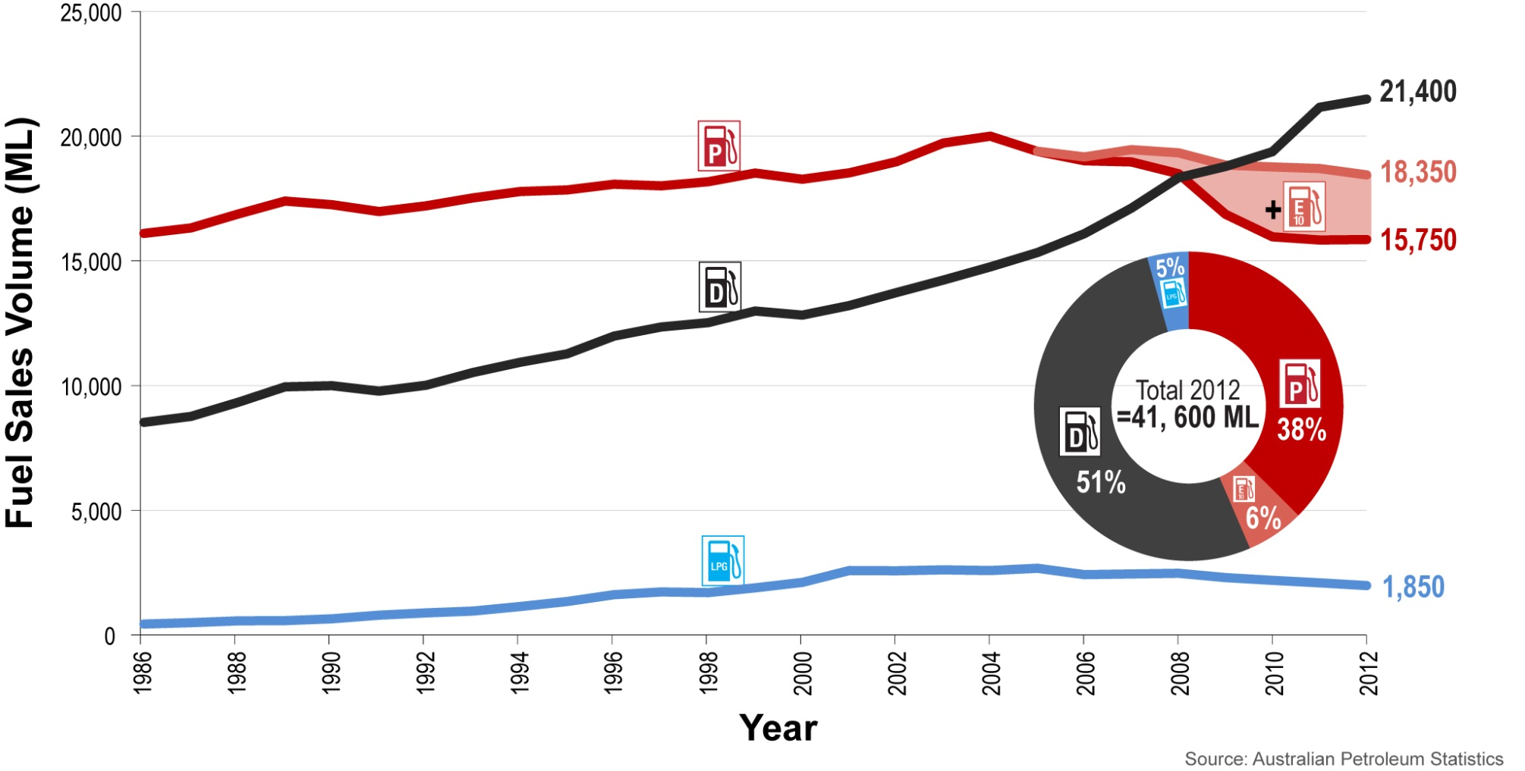
Australian Summary
Annual Fuel Sales Volume Trend
Diesel fuel sales increasing rapidly. Petrol (including E10) and LPG in slow decline.

Slide 19
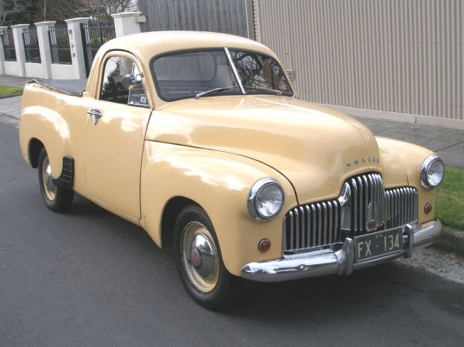
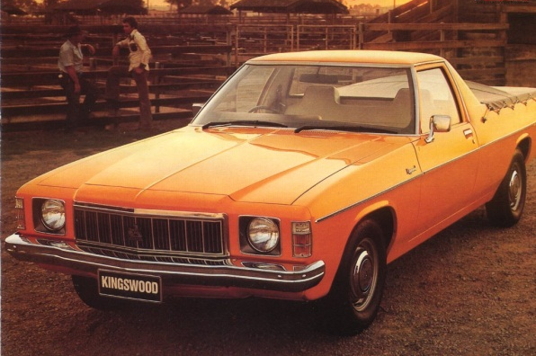
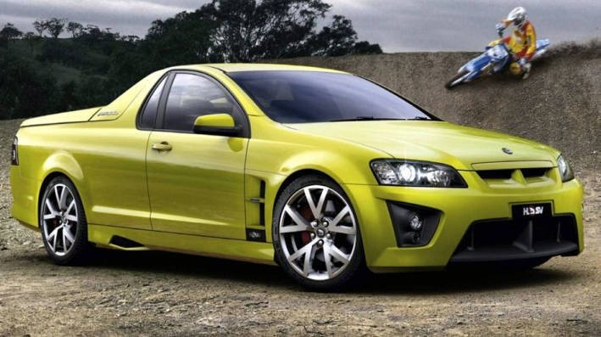
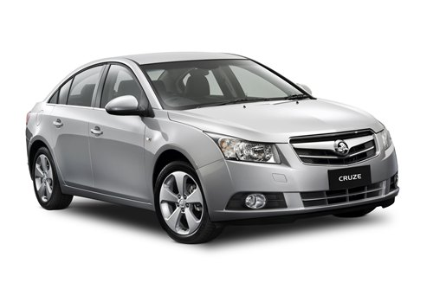
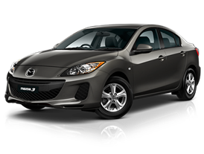
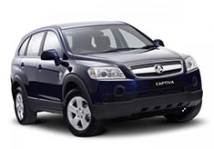
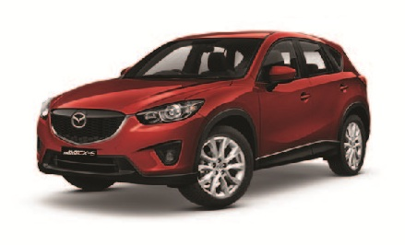



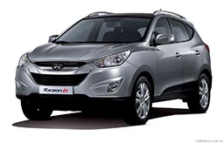
Australian Summary
Australian Vehicles – Light Segment
Unique Australian
Holden 48/215 ‘Ute’ (Utility)
Holden HX ‘Ute’
HSV Maloo ‘Ute’
Popular Small & Light
Small & Light Vehicle make up 35.7% of vehicle sales.
SUV’s (all) make up 32% of vehicle sales
Popular SUV’s
Holden Cruze
Mazda 3
Holden Captiva
Mazda CX-5
Ford Focus
Hyundai i20
Toyota Prado
Hyundai ix35
Big shift away from the ‘traditional’ large car. This plus high AUS $ and overseas control over planning is hurting local production.

Slide 20
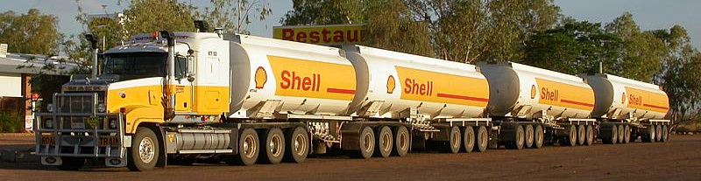
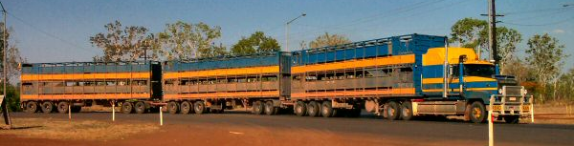
Australian Summary
Unique Australian Vehicles – Heavy Segment
Road trains, found in the Australian outback. B-double common around cities, B-triple on some freeway (motorway) routes.

Slide 21
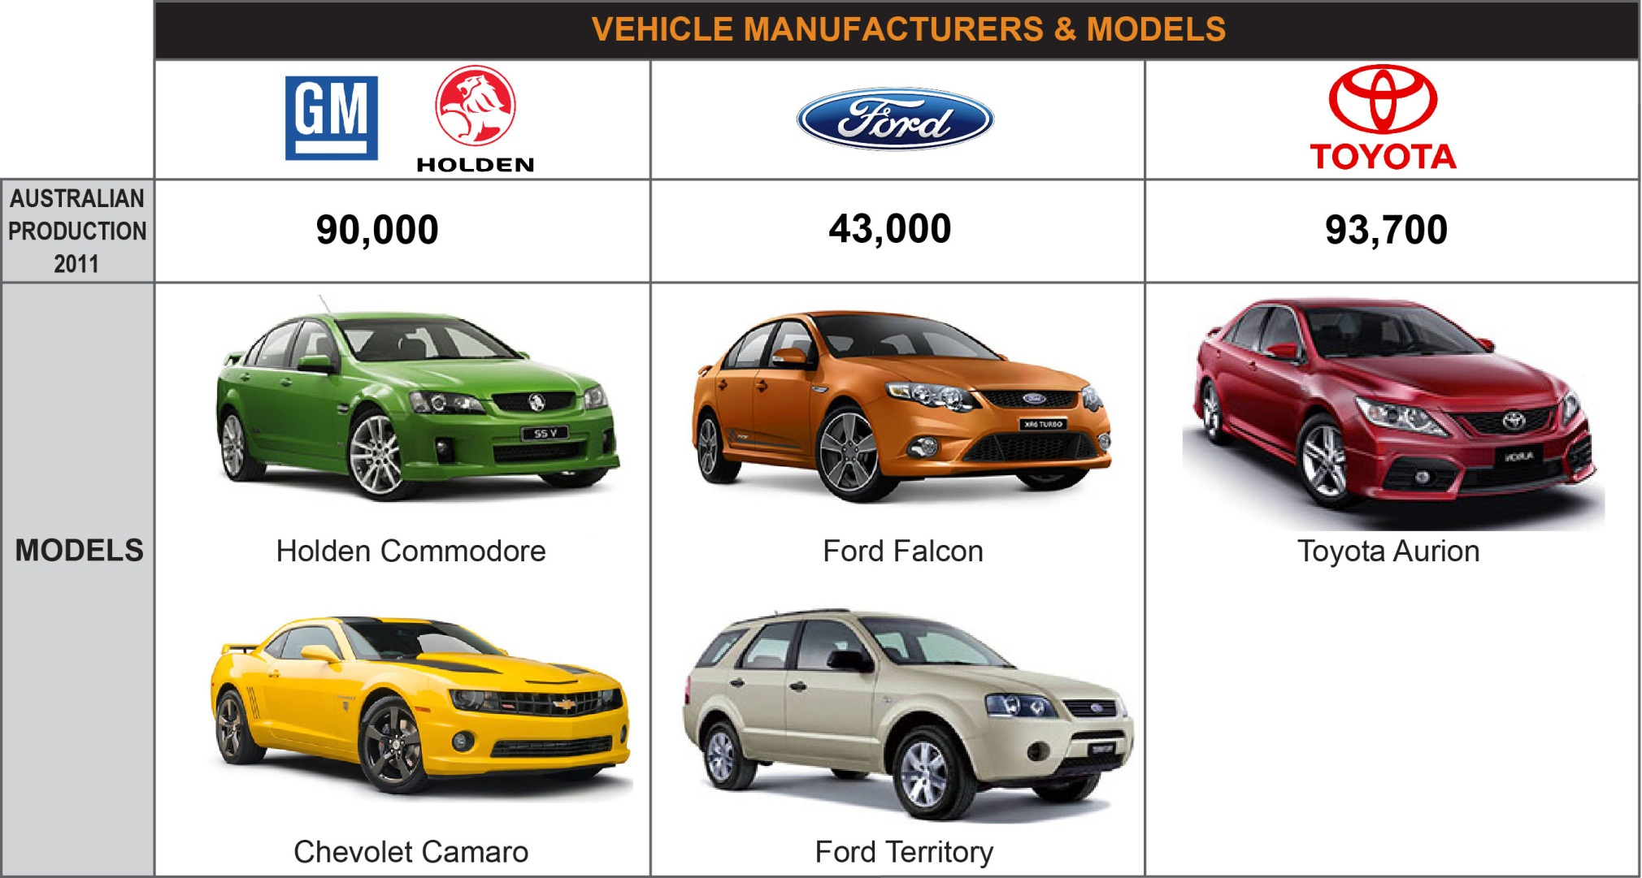
Australian Summary
Vehicle Manufacturing
Three vehicle manufacturers with two Australian developed platforms. Industry is under stress due to high Australian dollar.

Slide 22


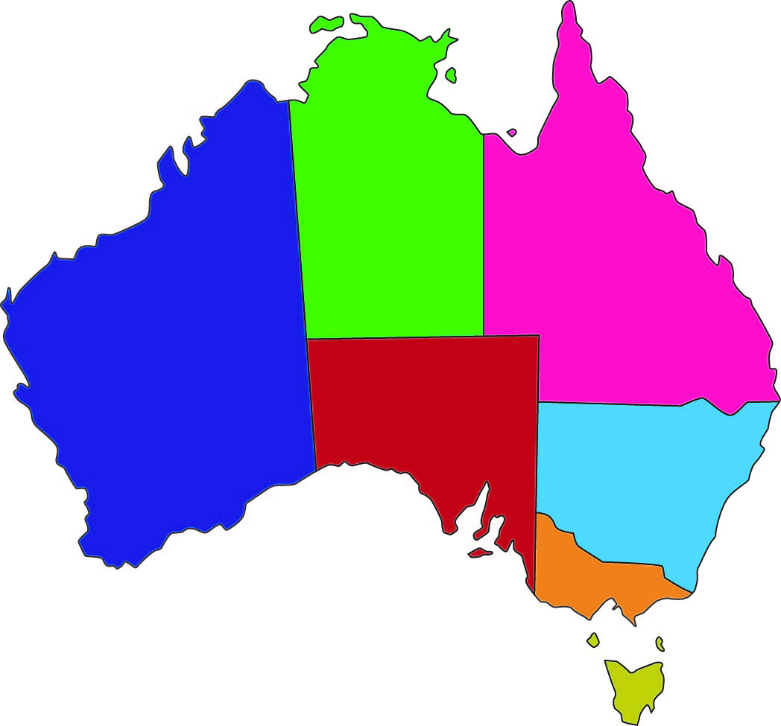
Australian Summary
System of Government
Federal
Vehicle Standards
Customs
Defence
State
(EPA) On road emissions
Education
Health
Local
Roads
Recreational
Waste
Westminster System
Prime Minister
Julia Gillard
NT
QLD
WA
Premiers
SA
NSW
VIC
TAS
Mayors
Minority Government hurting investment decisions due to lack of long term strategic policies. No thinking about PEMS.

Slide 23
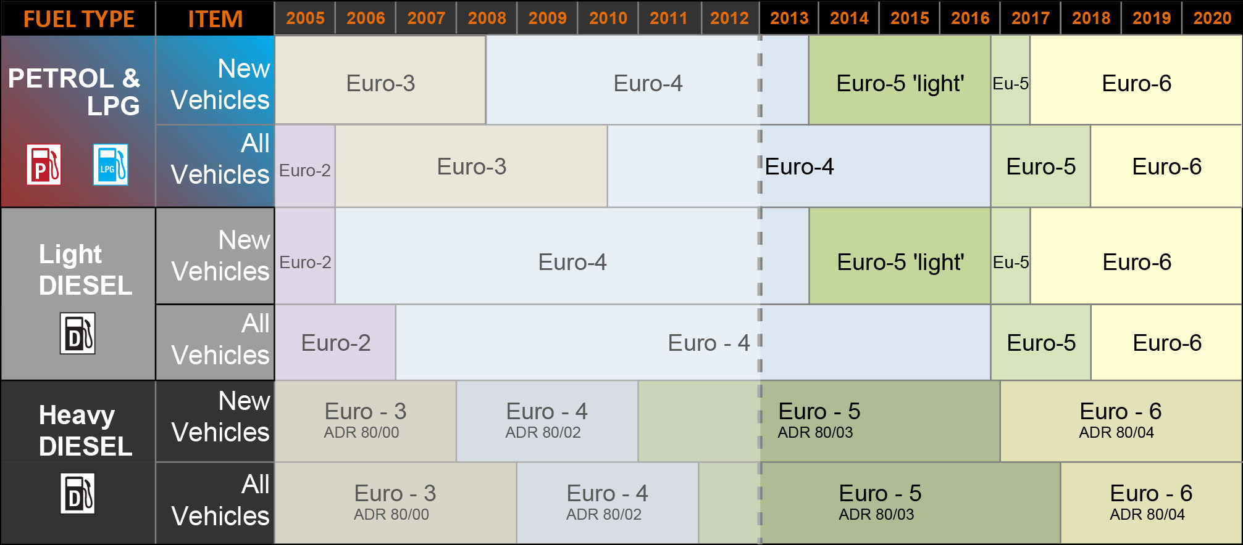
Australian Summary
Vehicle Emission Standards (Light)
Vehicle emissions regulation is based on European but lags by a few years.

Slide 24
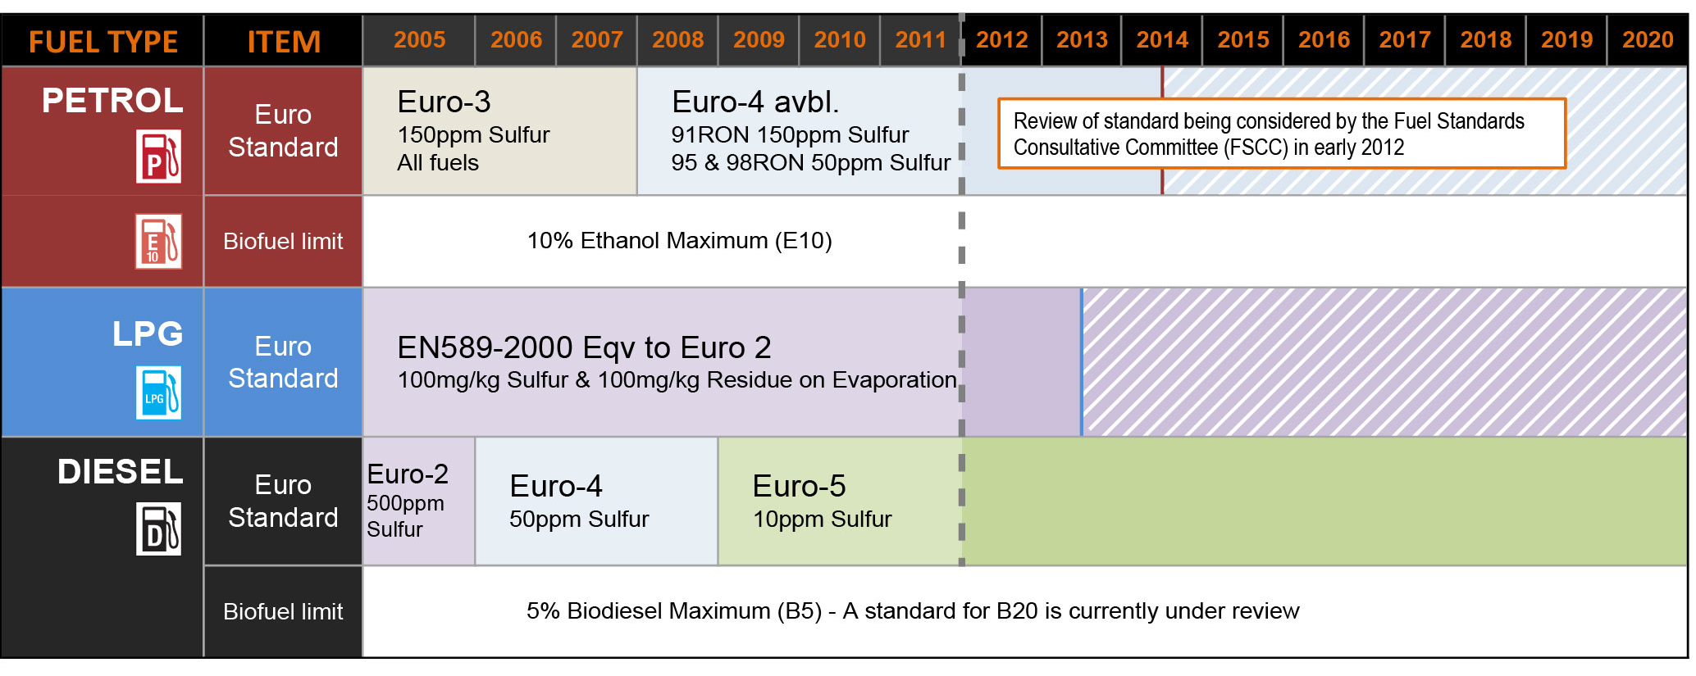
Australian Summary
Fuel Quality Standards
Gasoline fuel quality (regular) is still 150ppm sulfur. Diesel is equivalent to Euro 5 and 10ppm.

Slide 25
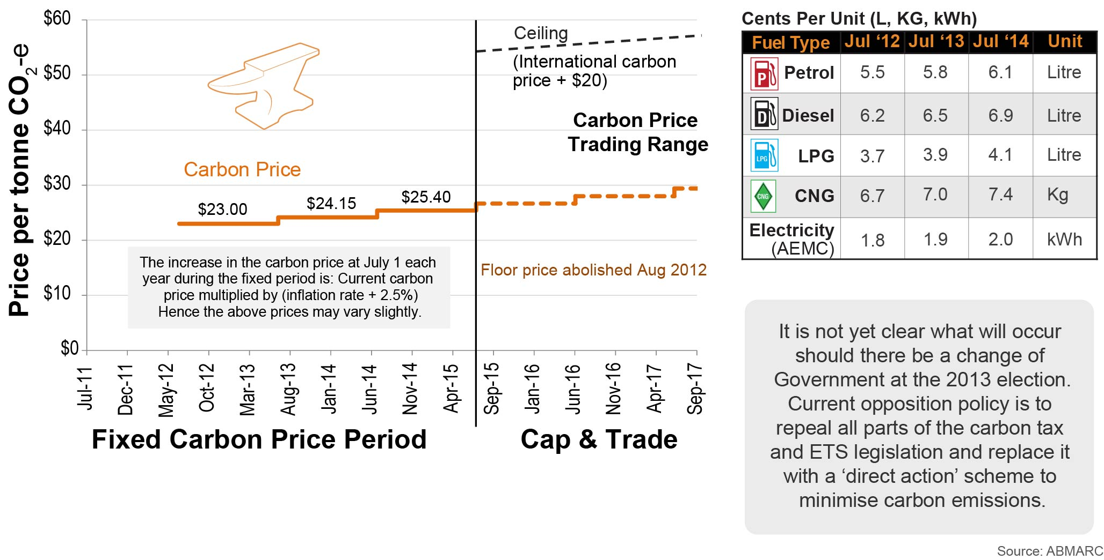
Australian Summary
Carbon Tax
Carbon tax was introduced in 2012 at AUD$23/tonne! It will be applied to heavy vehicle fuel usage only (private vehicles exempt.)
Notes:
What is price of EU carbon???

Slide 26
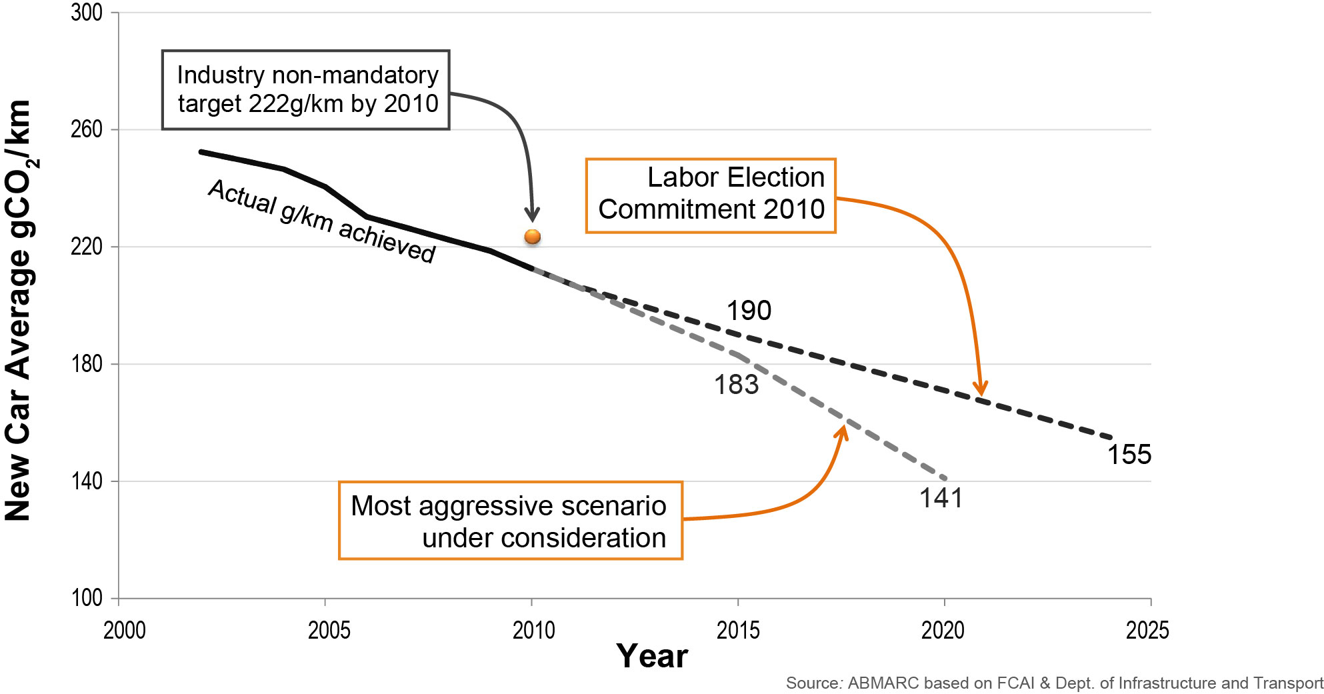
Australian Summary
Mandatory CO₂ Targets
Mandatory CO2 target under consideration – Federal government has been sitting on proposal for more than 12 months... Creating risk for investment.

Slide 27
Australian Summary
Future for PEMS in Australia?
?
Government currently not ‘thinking’ about PEMS. We believe there could be opportunities in certification of low volume, large engines with new technologies or alternative fuels.

Slide 28
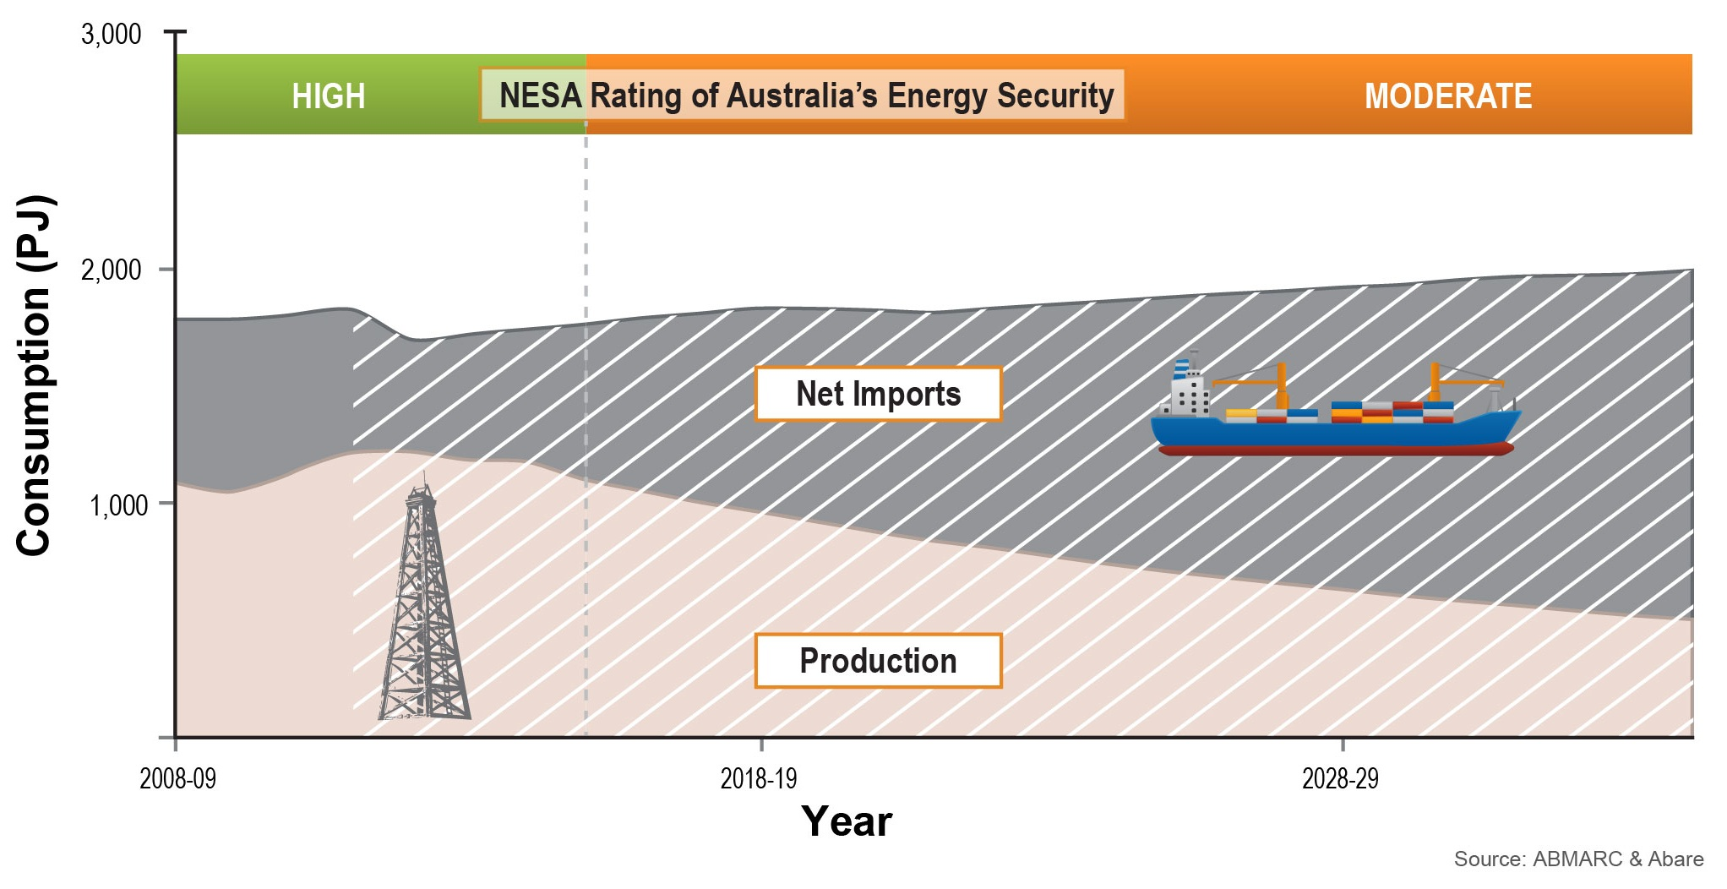
Australian Summary
Oil Consumption: Domestic Production and Imports
Australia’s reliance on imported oil is increasing due to decreasing domestic production and increasing consumption – consequently the energy security rating for liquid fuels is worsening.
Notes:
ASK GK

Slide 29
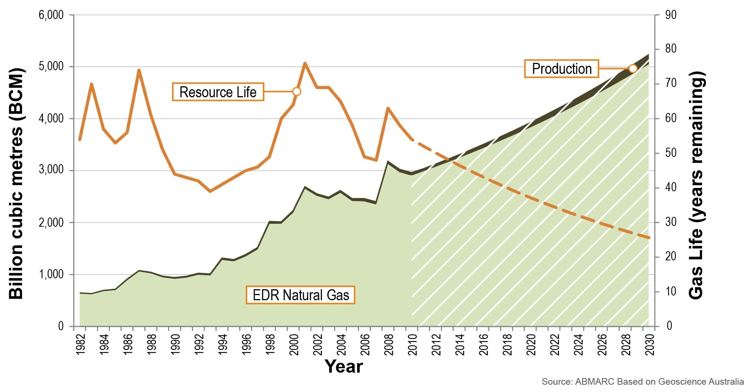
Australian Summary
Natural Gas EDR, Production, Life and Trend
In Australia, the known resources of natural gas have increased dramatically, tripling in the 16 years to 2009 – we forecast this trend to continue.
Notes:
-Growth of EDR in Australia is 2.8% over the last 28 years
-Over 5000 BCM of resources are expected to be discovered by 2030
-Production of NG is expected to grow at 6.7%
-Current production 60 BCM increasing to ~200BCM by 2030

Slide 30
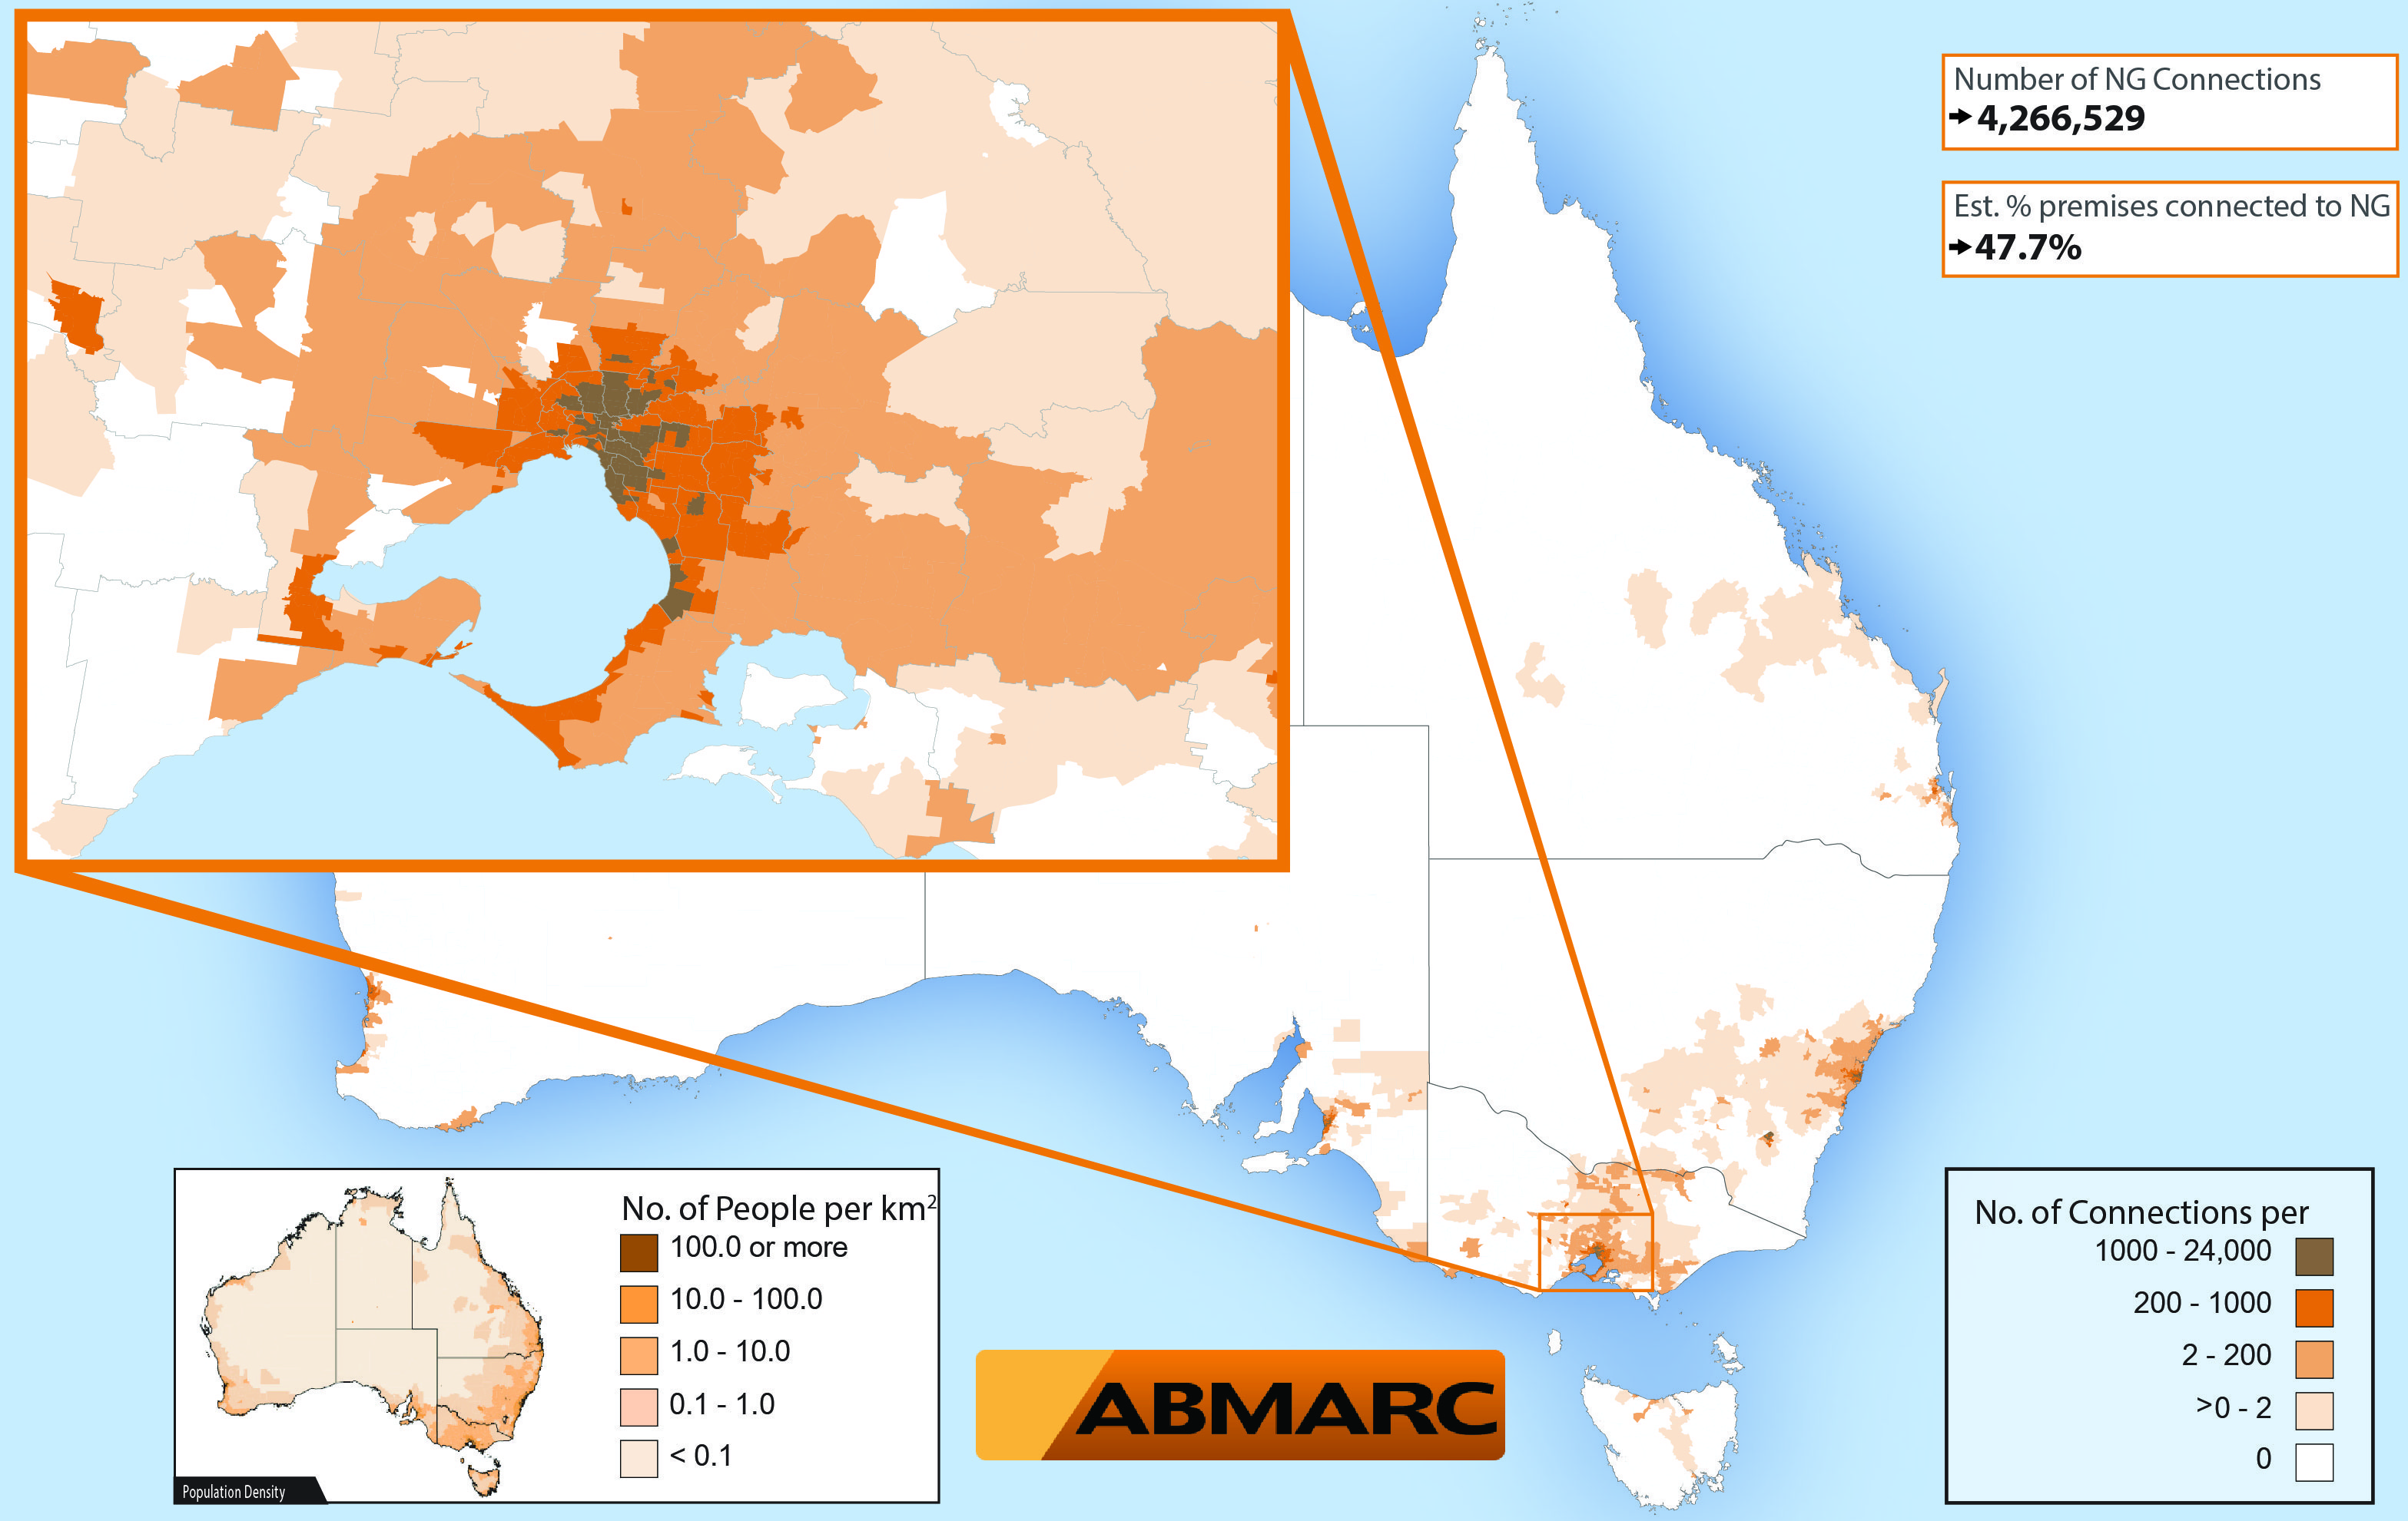
AUSTRALIA
Natural Gas Connection Density by Postcode

Slide 31
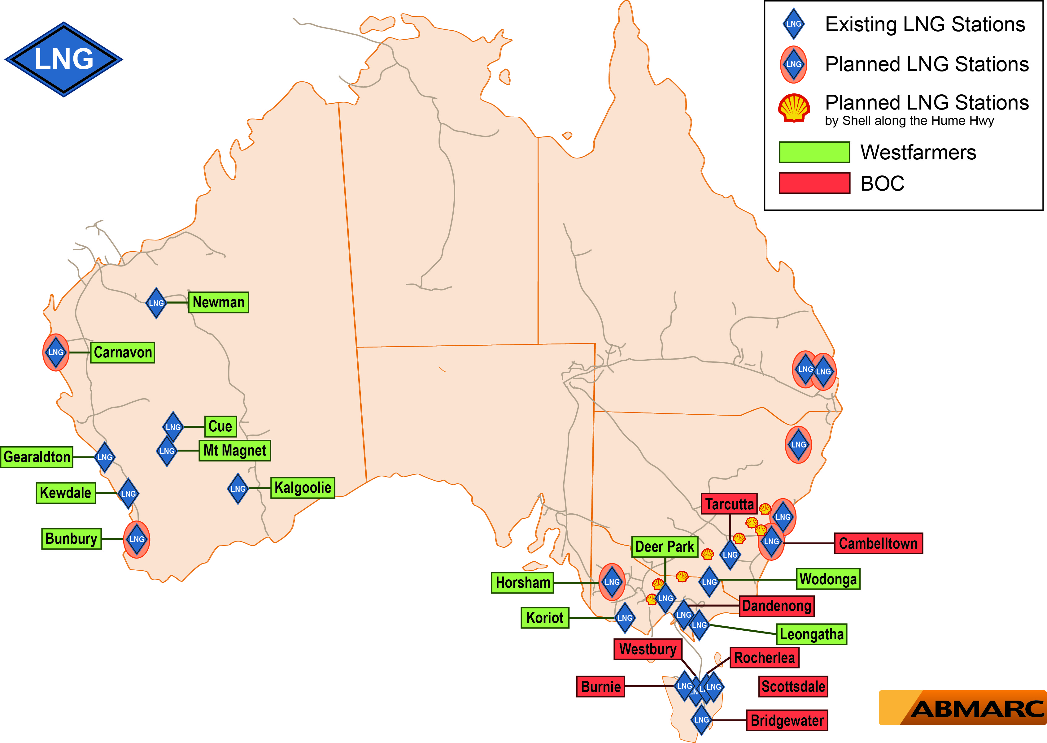
AUSTRALIA
LNG Infrastructure
17 Current LNG Stations
16 Planned LNG Stations

Slide 32
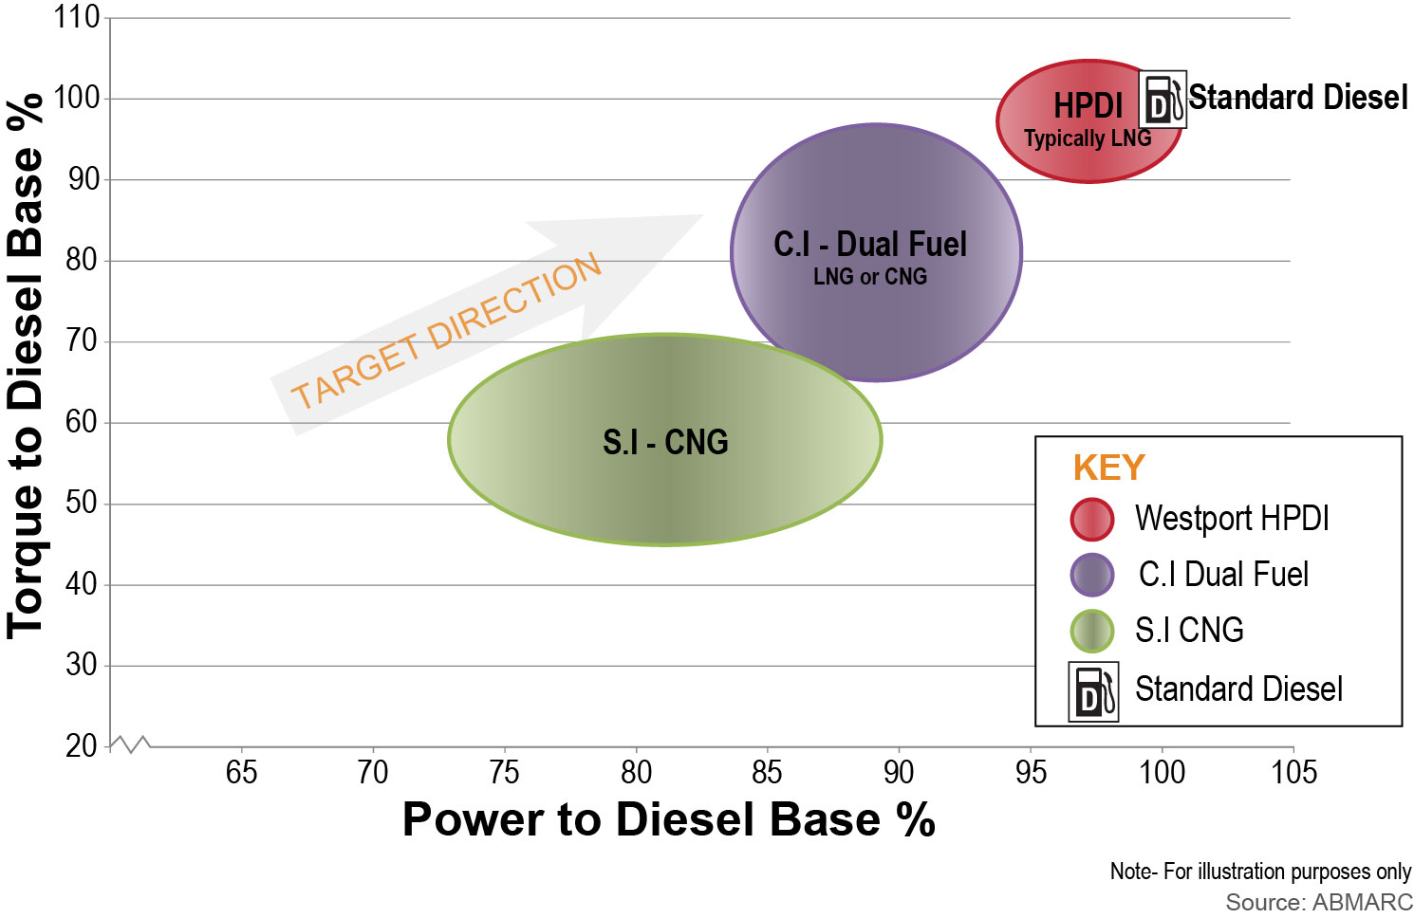
TECHNICAL
Power & Torque – Current Technology - CNG LNG HCV

Slide 33
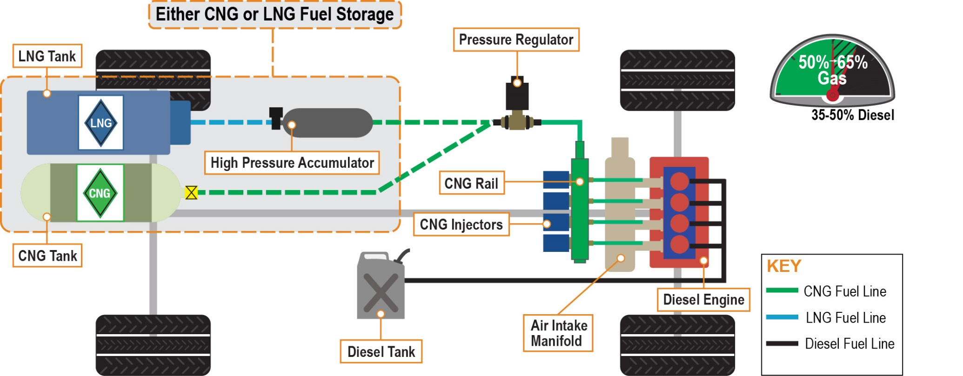
TECHNICAL
Dual Fuel System Overview (conversion or OEM fitted)
Natural gas is port fuel injected and compression ignited.
Gas can be stored as LNG or CNG.
Two fuels, typically 50-65% diesel substitution.

Slide 34
Conclusion…

Slide 35
TECHNICAL
Conclusion
Presently no plans by government for PEMS regulation in Australia
Industry needs a process that allows certification of large engine conversions to alternative fuels – maybe PEMS can fill this gap
Research covers PEMS systems, regulations and test methods in the USA & Europe
On completion, will brief both government and industry in Australia on our findings

Slide 36
AUTOMOTIVE | BENCHMARKING | REPORTING | CONSULTING
THANK-YOU. Questions?
For further information or discussion, please contact us.
Natalie Roberts
Principal Engineer & Managing Director
PH: +61 3 5964 8402
MB: +61 438 352 530
EM: nroberts@abmarc.com.au
An Overview of Vehicles, Resources & Regulation from the Land Downunder
www.abmarc.com.au

