Slide 1
Innovative PEMS Testing Approaches Used by TTI
Doh-Won Lee
The 3rd PEMS Workshop
<April 11, 2013>

Slide 2
ACKNOWLEDGEMENTS
Sponsors
  U.S. EPA
  Texas Department of Transportation (TxDOT)
  Texas Commission on Environmental Quality (TCEQ)
  Texas State Energy Conservation Office (SECO)
  Houston Advanced Research Center (HARC)
  Private sectors
Co-Authors (TTI)
  Dr. Josias Zietsman; Dr. Mohamadreza Farzaneh;
  Ms. Tara Ramani; Mr. Jeremy Johnson
TTI students – Mr. Nick & Ryan Olivieri & Others graduated

Slide 3
Outline
PEMS Testing at TTI
Innovative Approaches (Examples)
  Modification
  Drive/duty cycles
  Combinations
  MOVES-based data analysis
Summary/PEMS Future

Slide 4
PEMS Testing at TTI
First Testing – using a leased OEM-2100 Montana System in 2003
  A pilot testing for evaluation and implementation of PEMS emission data collection capabilities in order to implement MOVES in Texas
  Real-world/on-road heavy- and light-duty vehicle operations and idling
With TTI’s own PEMS (SEMTECH-DS in 2006 & Axion in 2008) – dozens of PEMS testing projects
  In-use real-world testing
  In-use on-road testing
  In-use off-road testing
  In-use idling testing

Slide 5
Innovative Approaches
Modification
Drive/Duty Cycles
Combinations
MOVES-Based Data Analysis

Slide 6
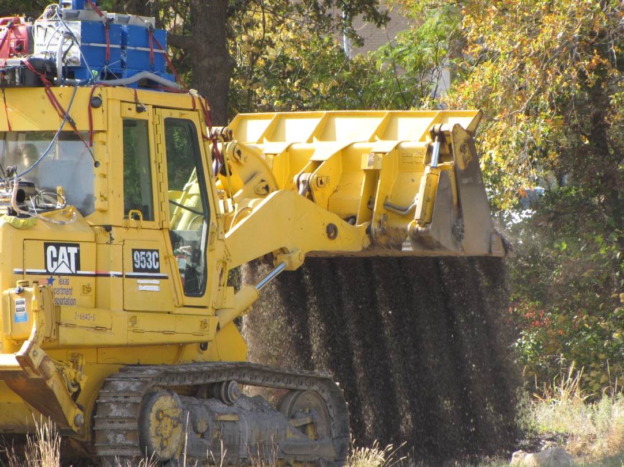
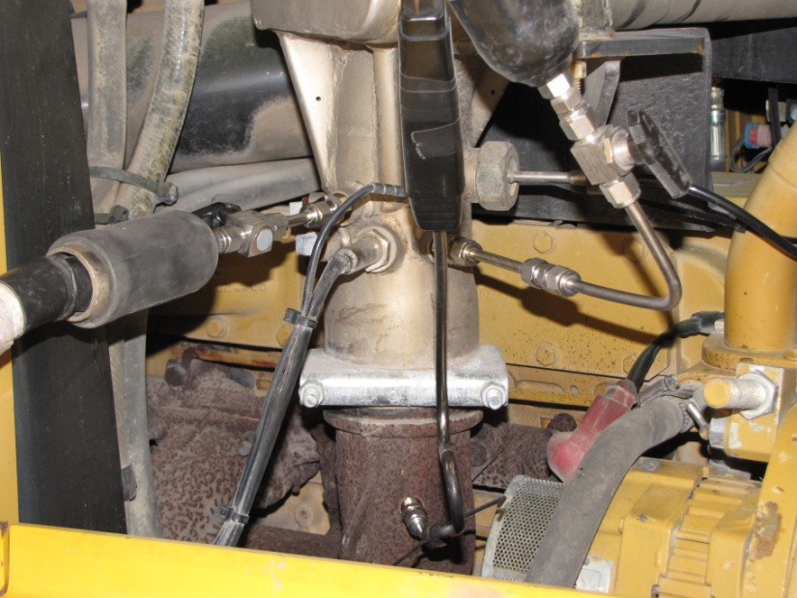
Innovative Approach – Modification
Project-specific modification
  Clean Diesel Emerging Technology Program (SCR efficacy testing)

Slide 7
Innovative Approach – Drive/Duty Cycles
Preparation
  GPS data collection
  Field observations
  Interviews
Considerations
  Driving characteristics
  Operations other than driving
  Other parameters
    Weight

Slide 8
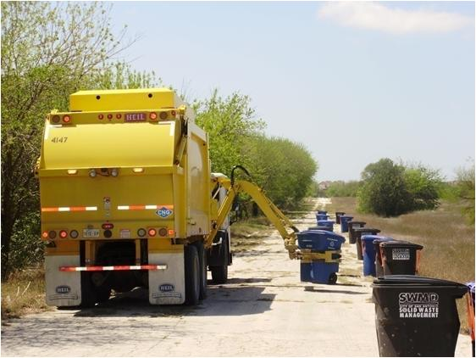
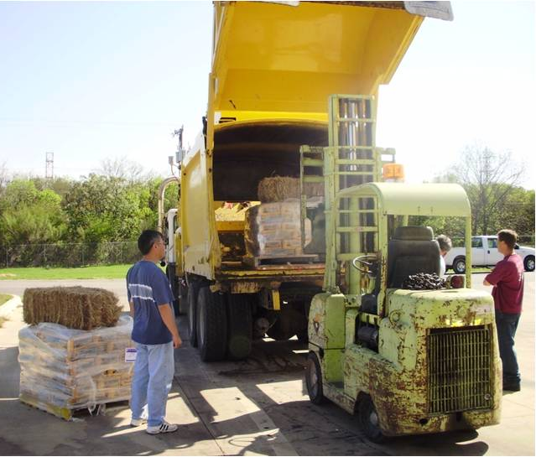
Innovative Approach – Drive/Duty Cycles
Preparation
  GPS data collection
  Field observations
  Interviews
Considerations
  Driving characteristics
  Operations other than driving
  Other parameters
    Weight

Slide 9
Innovative Approach – Combinations
Real-World & Simulated Testing
  Diesel & CNG refuse truck emission comparisons
Emissions & Air Quality Studies
  Onboard Idle Reduction Technologies (PEMS & ambient AQ analyzers with Modeling work)
Fuel Economy & Emissions Demands
  J-1321/SmartWay & …

Slide 10
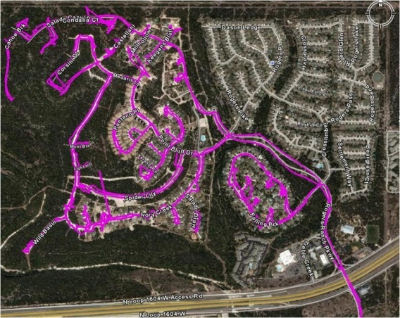
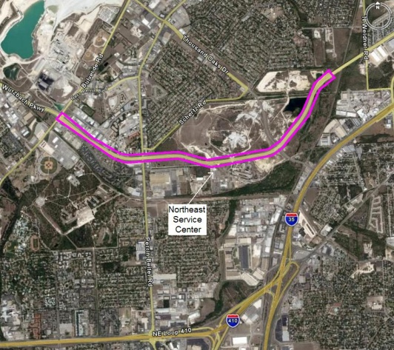
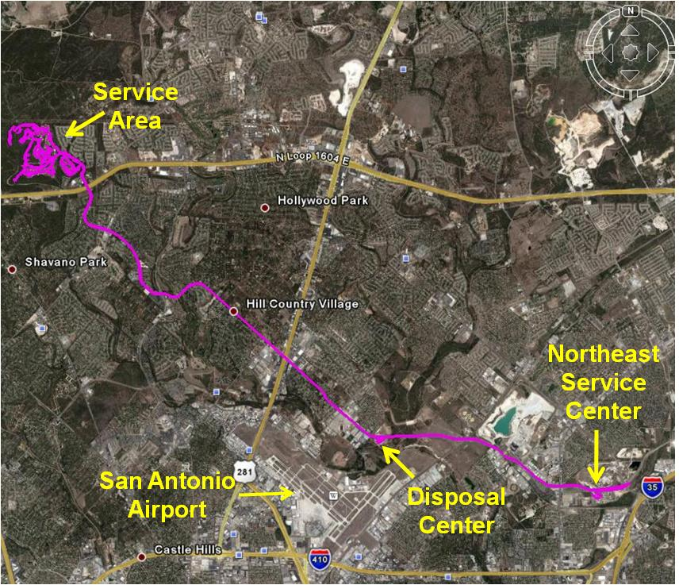
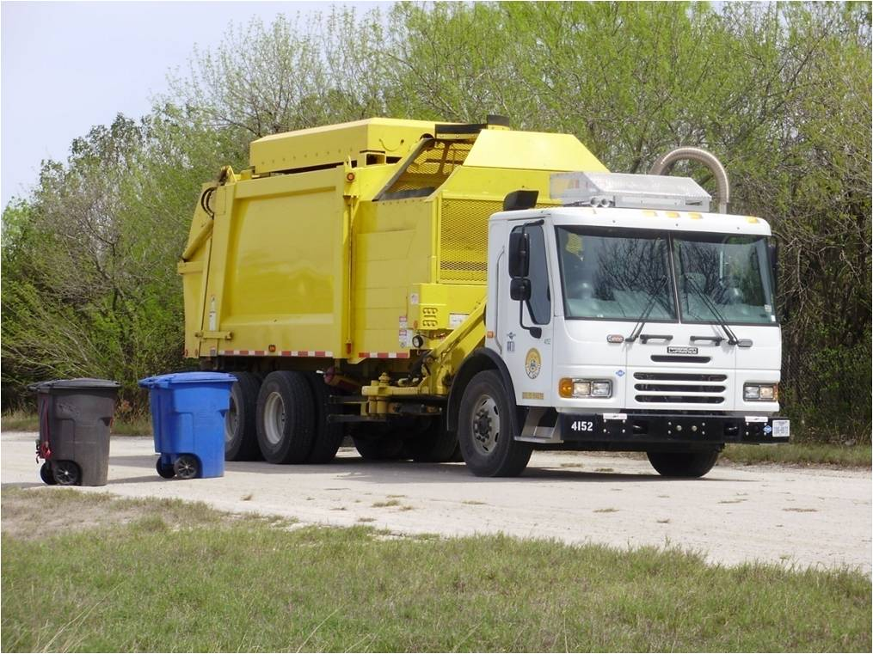
Real-World & Simulated Testing

Slide 11
Innovative Approach – Combinations
Real-World & Simulated Testing
  Diesel & CNG refuse truck emission comparisons
Emissions & Air Quality Studies
  Onboard Idle Reduction Technologies (PEMS & ambient AQ analyzers with Modeling work)
Fuel Economy & Emissions Demands
  J-1321/SmartWay & …

Slide 12
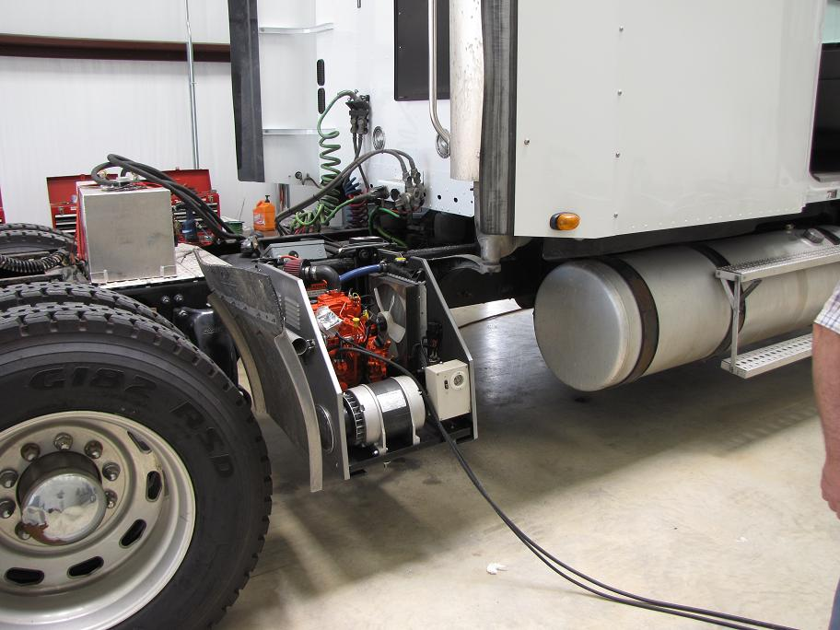
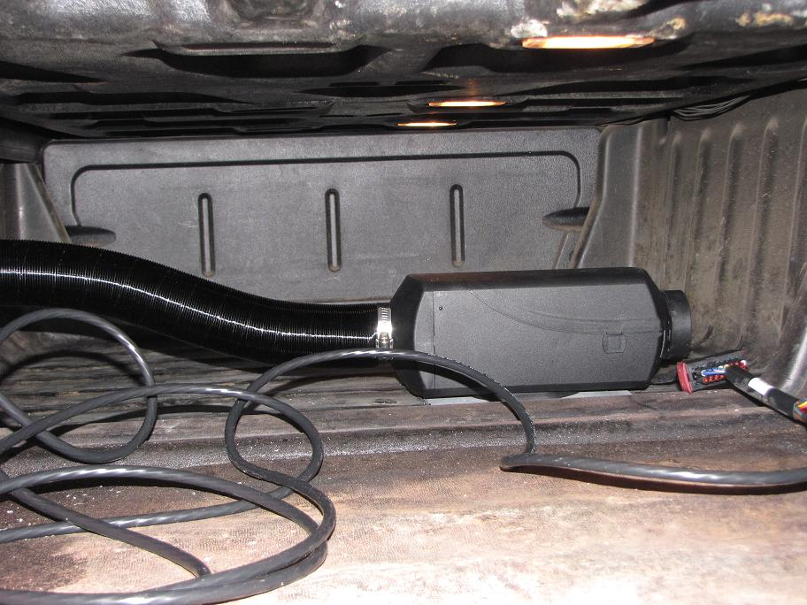
Emissions & Air Quality

Slide 13
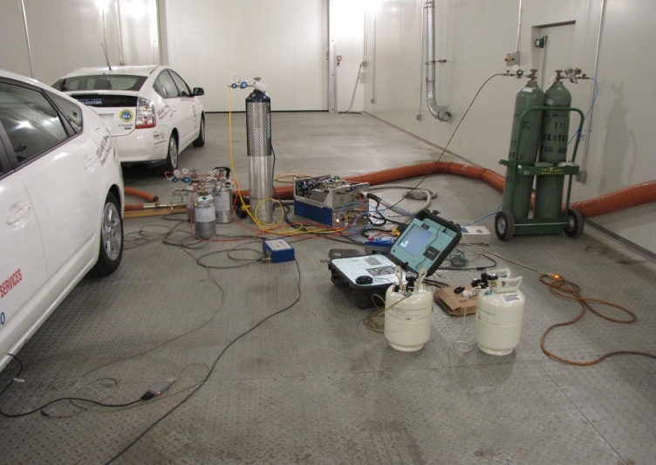
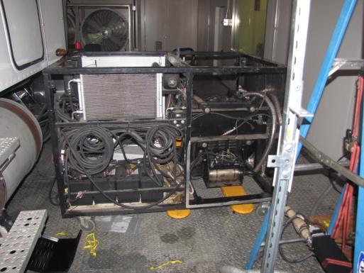
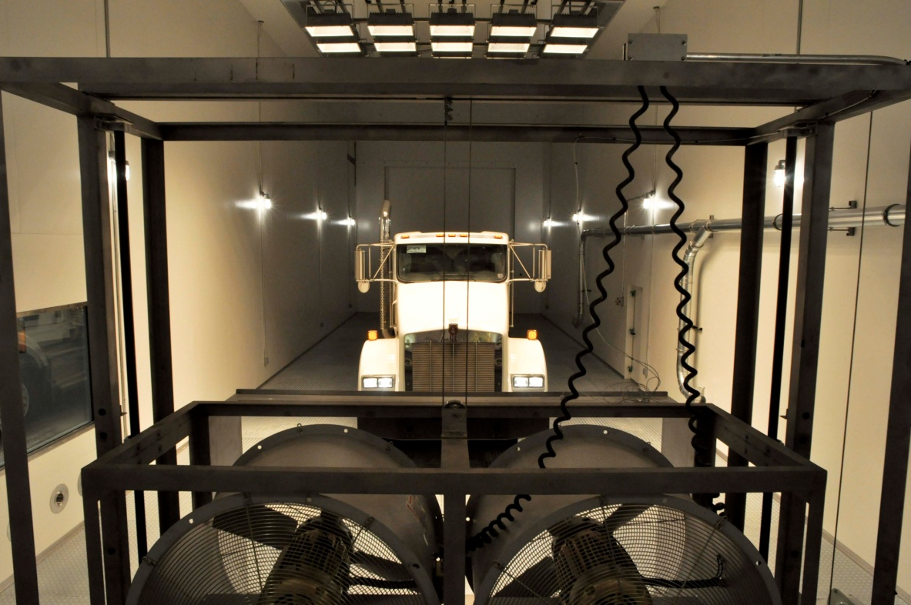
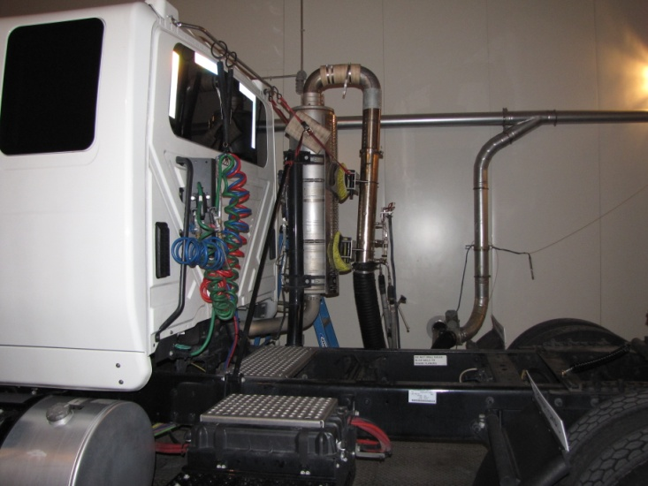
Testing (under controlled environment)
TTI’s Environmental Chamber Specs
  75′ X 23′ X 22′
  Temperature range (-40 ~ 130 ºF)
  RH (over 70% at 105 ºF)
  Solar load (up to 1100 watt/m²)
  Wind load (up to 35 mph)

Slide 14
Innovative Approach – Combinations
Real-World & Simulated Testing
  Diesel & CNG refuse truck emission comparisons
Emissions & Air Quality Studies
  Onboard Idle Reduction Technologies (PEMS & ambient AQ analyzers with Modeling work)
Fuel Economy & Emissions Demands
  J-1321/SmartWay & …

Slide 15
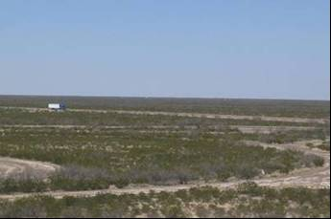
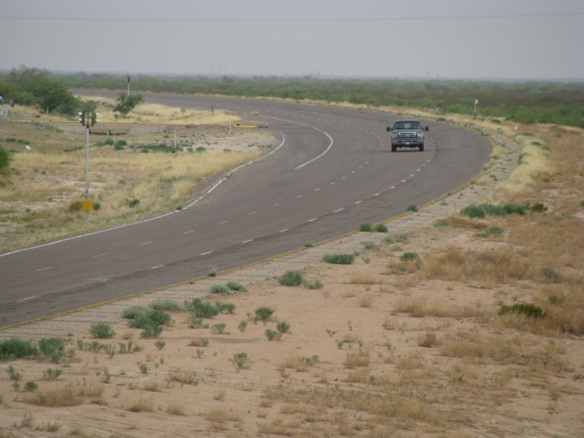
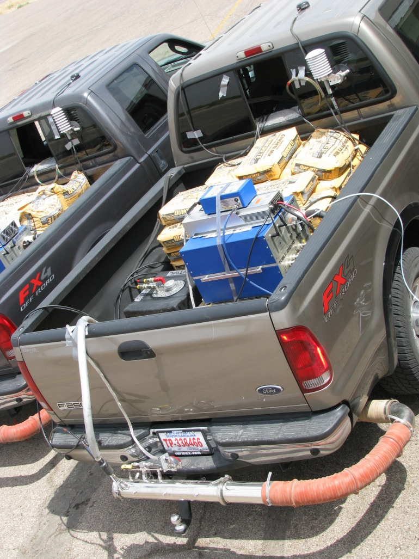
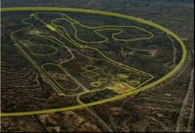
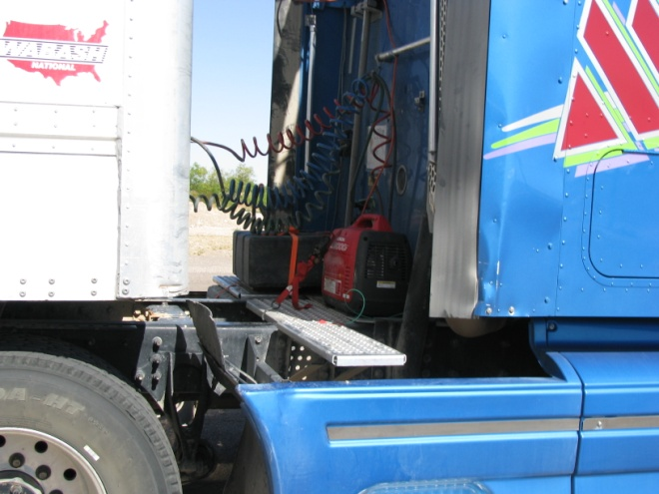
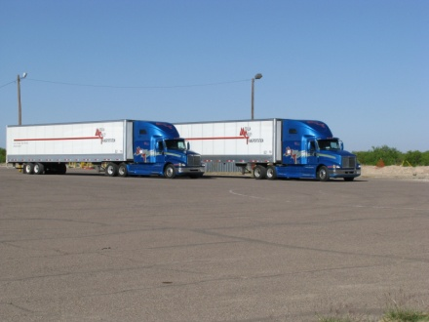
Fuel Economy & Emissions Testing

Slide 16
Innovative Approach – Using MOVES
Braking (Bin 0)
Idle (Bin 1)
 | Instantaneous Speed (mph)
Instantaneous VSP (kW/tonne) | 0-25 | 25-50 | > 50
< 0 | Bin 11 | Bin 21
0 to 3 | Bin 12 | Bin 22
3 to 6 | Bin 13 | Bin 23
6 to 9 | Bin 14 | Bin 24
9 to 12 | Bin 15 | Bin 25
12 and greater | Bin 16
12 to 18 |  | Bin 27 | Bin 37
18 to 24 |  | Bin 28 | Bin 38
24 to 30 |  | Bin 29 | Bin 39
30 and greater |  | Bin 30 | Bin 40
6 to 12 |  |  | Bin 35
< 6 |  |  | Bin 33
PEMS Feasible
  Second-by-second data
Needs for Air Quality Conformity
  MOVES Estimates in NA areas
Detailed Comparisons
  Disaggregated analysis

Slide 17
Summary/Future PEMS Testing
TTI’s Innovative Approaches
  Modification
  Drive/duty cycles
  Combinations
  MOVES-based data analysis
Future PEMS Testing
  More Sources: On-road, Off-road, Marine, Stationary, …
  Project Specifics: Modification, Drive/Duty Cycles, Real-World/Simulated, …
  Versatility: Combinations with ambient & indoor AQ, modeling, regulatory, and/or conformity work, …

Slide 18
Thank you!!!
Questions?

Slide 19
Idling Testing
OpmodeID Code | Operating Mode Description
101 | Soak Time < 6 minutes
102 | 6 minutes ≤ Soak Time < 30 minutes
103 | 30 minutes ≤ Soak Time < 60 minutes
104 | 60 minutes ≤ Soak Time < 90 minutes
105 | 90 minutes ≤ Soak Time < 120 minutes
106 | 120 minutes ≤ Soak Time < 360 minutes
108 | 720 minutes ≤ Soak Time (Cold-Start)

Slide 20
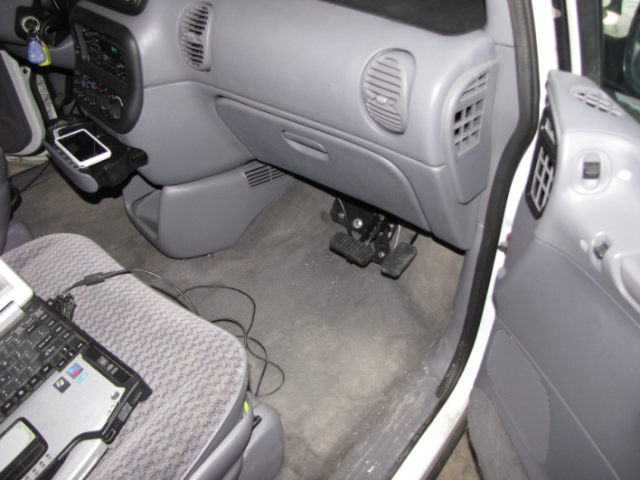
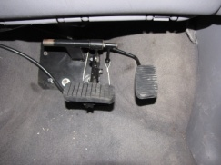
Innovative Approach – Modification
Project-specific modification
  In-use on-road FTP/SFTP testing – slave pedals for the second driver

Slide 21
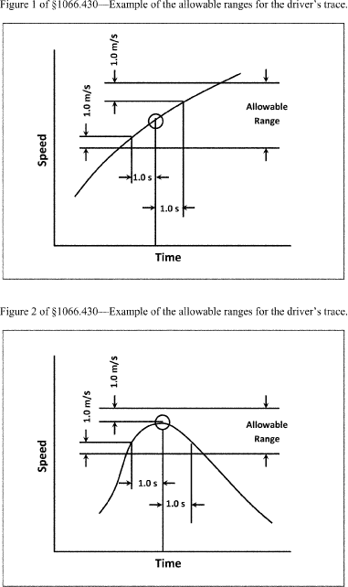
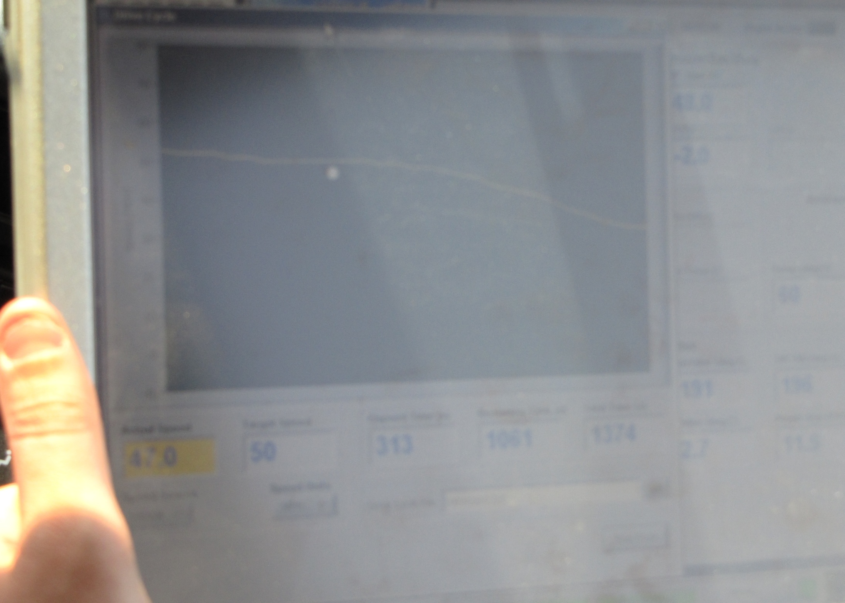
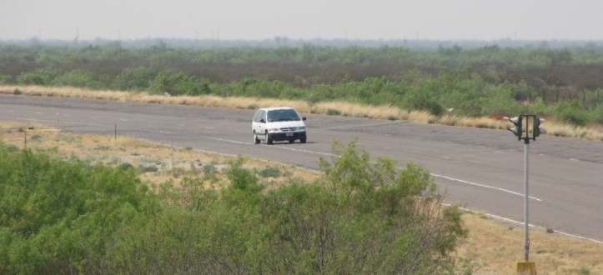
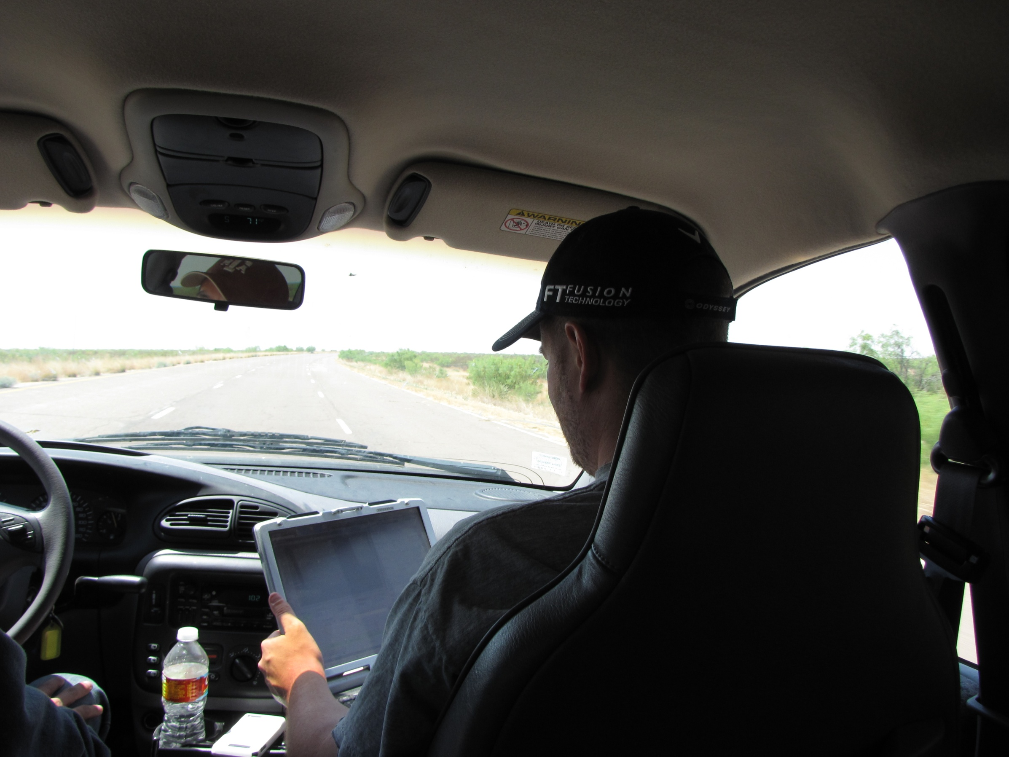
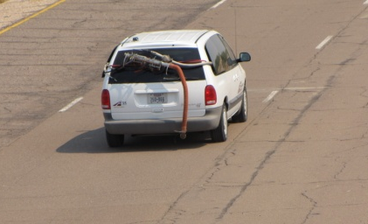
In-Use On-Road FTP/SFTP Testing
 | Ratio (Measure Emission Rates/MOVES Estimates)
 | CO₂ | CO | NOx | THC | PM
FTP (3-phase) | 116% | 29% | 40% | 72% | 23%
UDDS | 109% | 11% | 22% | 21% | N/A*
US06 | 105% | 263% | 22% | 105% | N/A*
SC03 | 126% | 18% | 26% | 14% | N/A*
HFET | 94% | 9% | 12% | 10% | N/A*

Slide 22
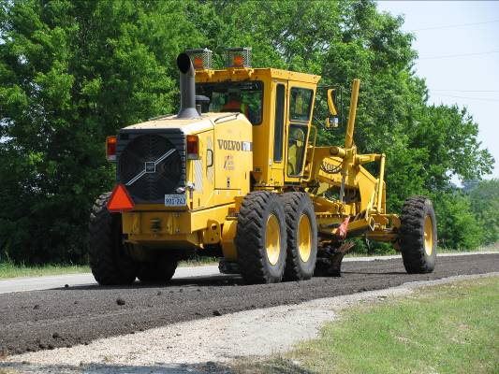
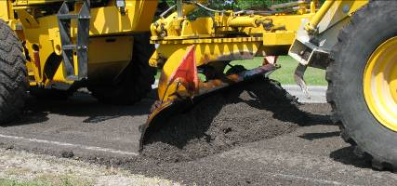
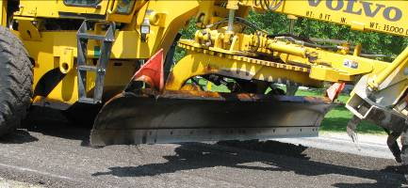
Grader Duty Cycle (Operations)
Leveling
Backup
Work Section
Notes:
Most TxDOT graders for maintaining public roads, spreading asphalts and other base materials.

Slide 23
Grader Duty Cycle (Operations)
Sub-run 2
Sub-run 3
Sub-run 1
Forward Leveling
Backup Movement

Slide 24
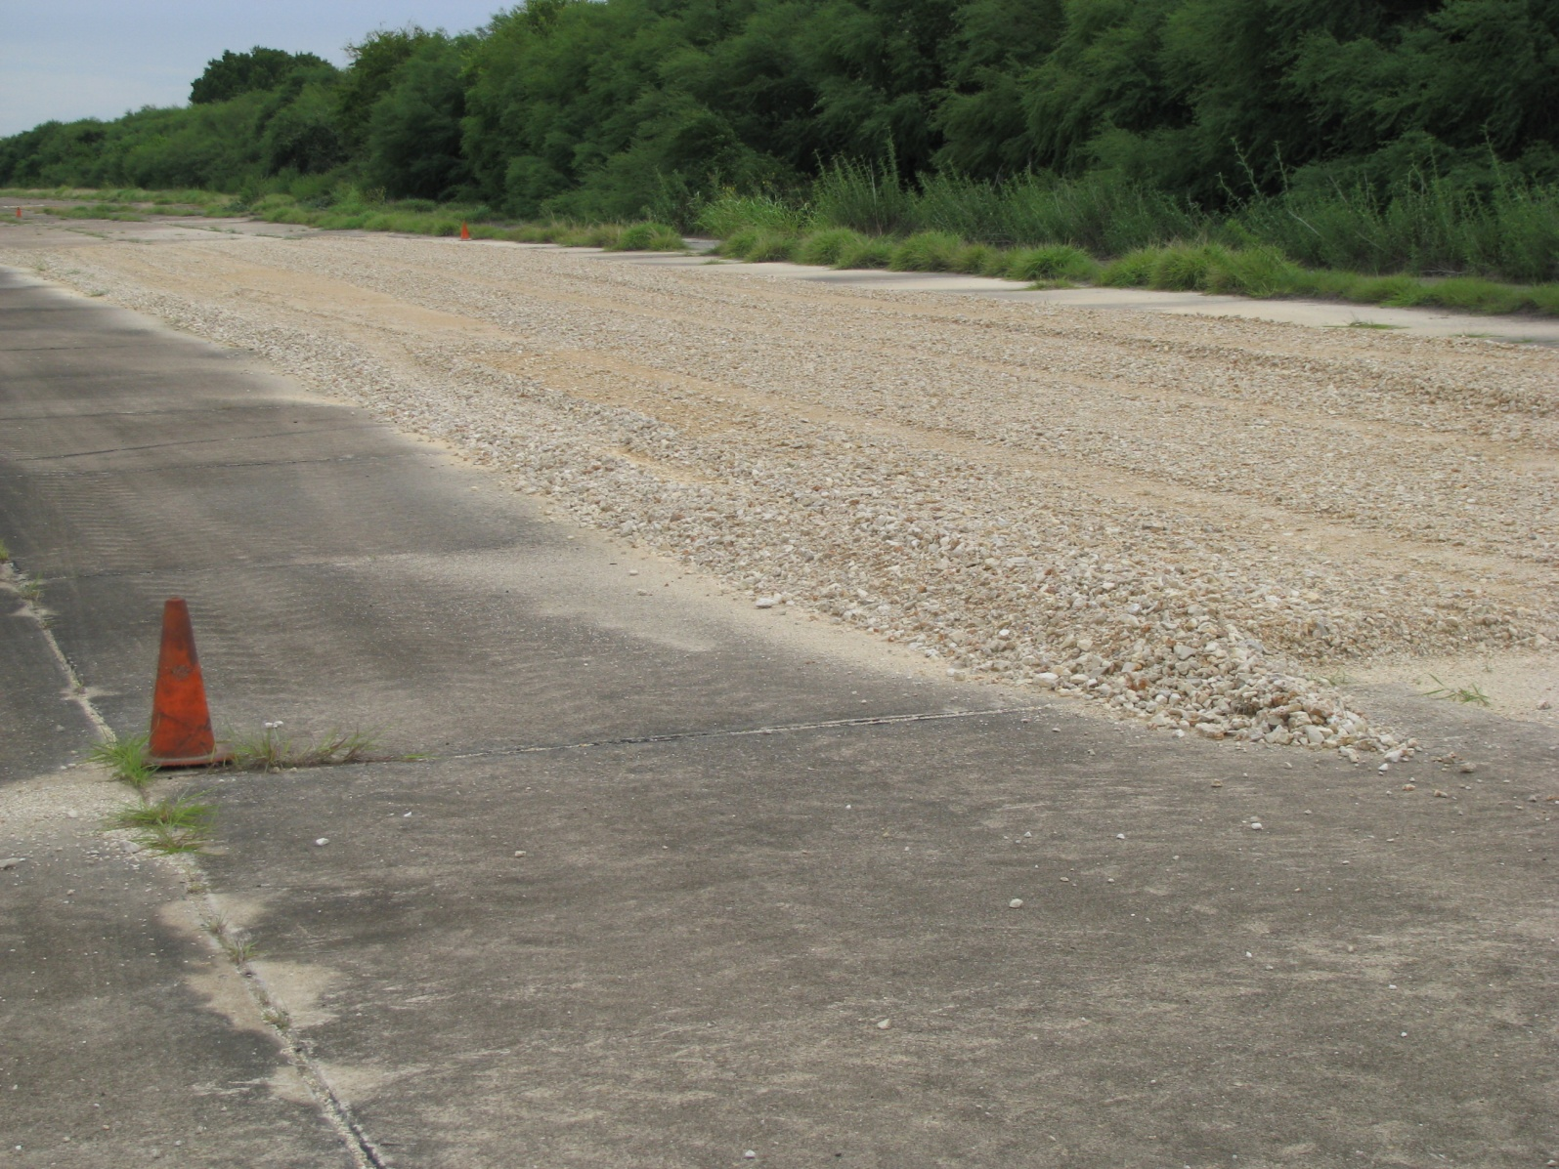
Test Bed for the Grader Duty Cycle
Notes:
70 yd X 10 yd w/ 10” depth (205 ton of Colorado Rocks)

Slide 25

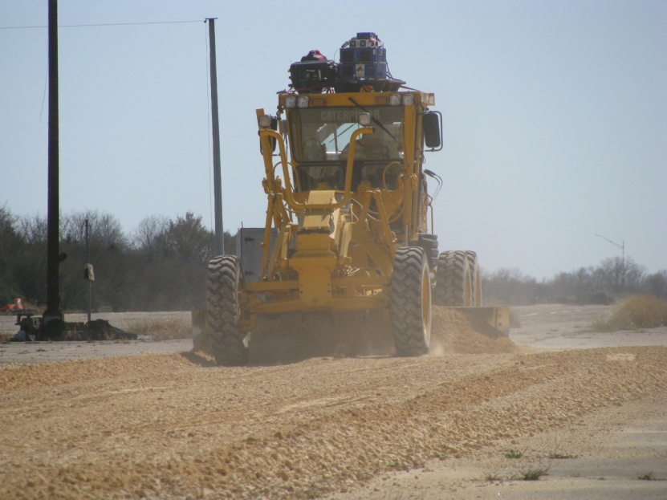
Testing on Test Bed (Duty Cycle Operations)
Sub-run 2
Sub-run 3
Sub-run 1

Slide 26
MOVES-Based Comparisons
0-25 mph
25-50 mph
> 50 mph
Braking
Idling

