Slide 1
Comparison of Experimental and First Principles
Modeling Results for the PMTrac®
Electrostatic Soot Sensor
Klaus Allmendinger¹, Brett Henderson, Jim Steppan,
Anthoniraj Lourdhusamy, Victor Wang, Joe Fitzpatrick
EmiSense Technologies, LLC
Matti Maricq, Dave Kubinski
Ford Motor Company
1. Presenter
Notes:
1
1

Slide 2
Presentation Outline
PMTrac® Sensor Design & Correlation Review
Sensor First Principles Model
Comparison to Experimental Results
Notes:
2
2

Slide 3
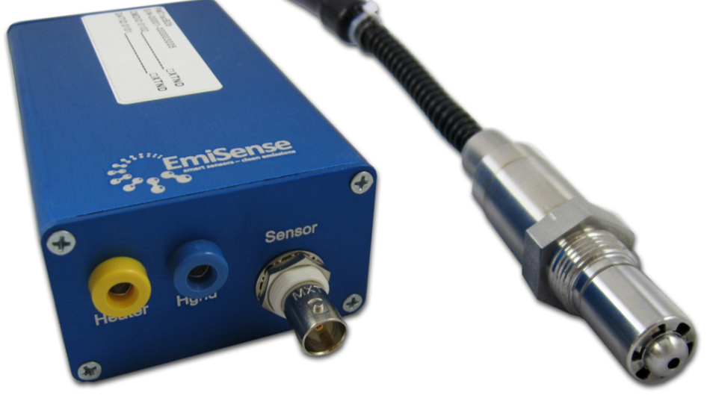
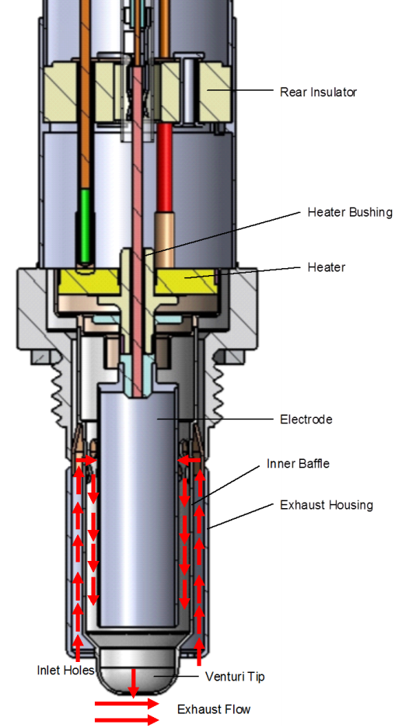
PMTrac Sensor Design
M-18
Venturi draws exhaust gas through sensor
Gas flows between electrodes at high electric field (~1KV)
Charged particles (+/-) are electrostatically collected on respective (-/+) electrode surfaces
Field-induced breakoff of charged soot agglomerates carries charge from one electrode to another generating an amplified current
Notes:
3
3

Slide 4
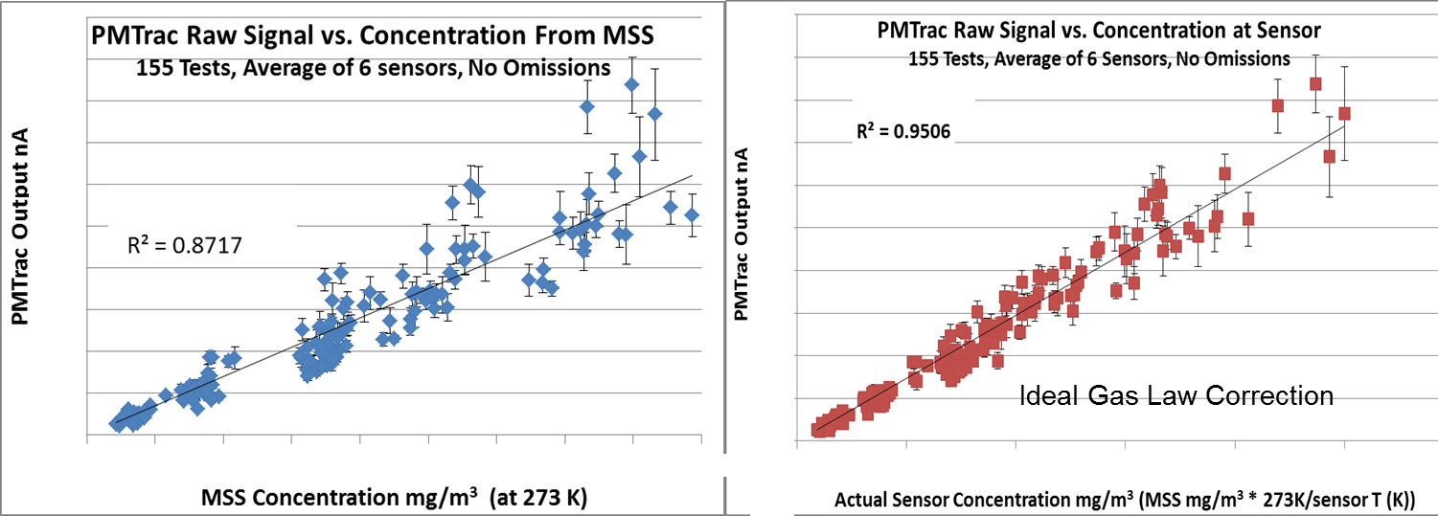
HD Engine Dynamometer Test Results:
PMTrac Sensors Correlate Well with AVL MSS
Notes:
4

Slide 5
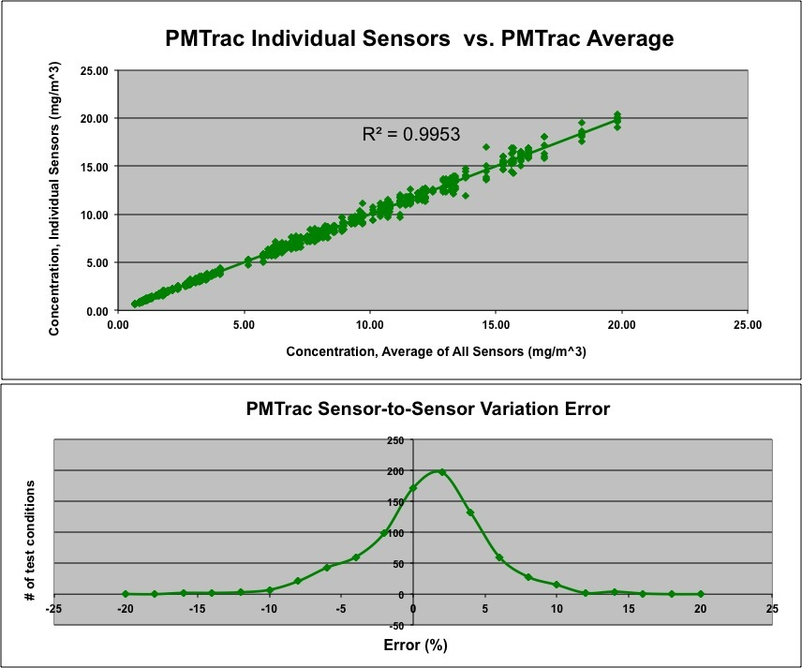
Sensor Variability
Multiple sensors in good agreement (R²=.99, 900+ Test Runs).
Divergence from MSS in unison, implying predictable variance in measurement principle.

Slide 6
PMTrac® Electrostatic and Particle Physics Model: Overview
Notes:
6
6

Slide 7
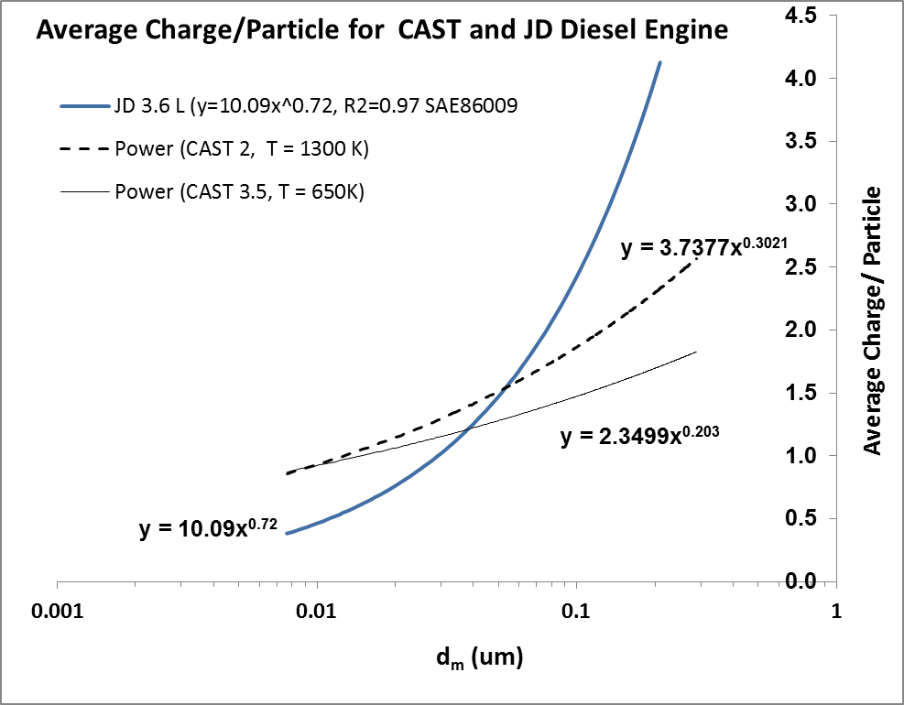
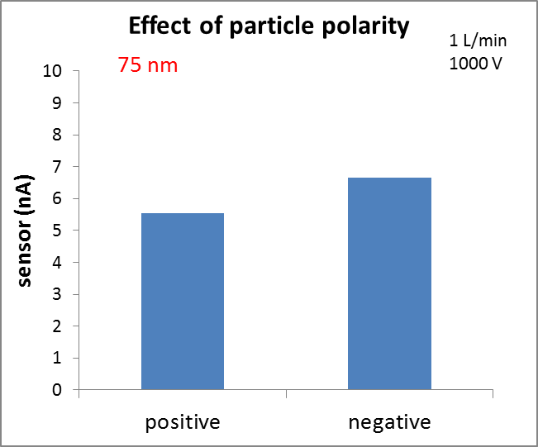
PMTrac® Electrostatic and Particle Physics Model: Inputs
Exhaust Gas Parameters
  Exhaust gas temperature (EGT (300 ºC))
  Exhaust gas velocity (EGV(30 m/s))
Exhaust Soot Parameters
a) Charge distribution (CHARGEA, CHARGEB)
b) Particle size distribution (MEAN, SIGMA)
c) Mass-mobility exponent (MASSEXP)
Break-off Agglomerate Parameters
  Charge distribution (AGGLCHARGE)
  Agglomerate size distribution (AGGLDP)
  Fraction of charged agglomerates from HVE (AGGLFRACT)
Sensor Parameters
  Current (ISENSE(nA))
  Gain (GSENSE (nA/(mg/m3) during calibration at 300 C, 30 m/s)
AGGLFRACT =
nA(-)/{(nA(-) + nA(+)} = 0.55
Notes:
7
7

Slide 8
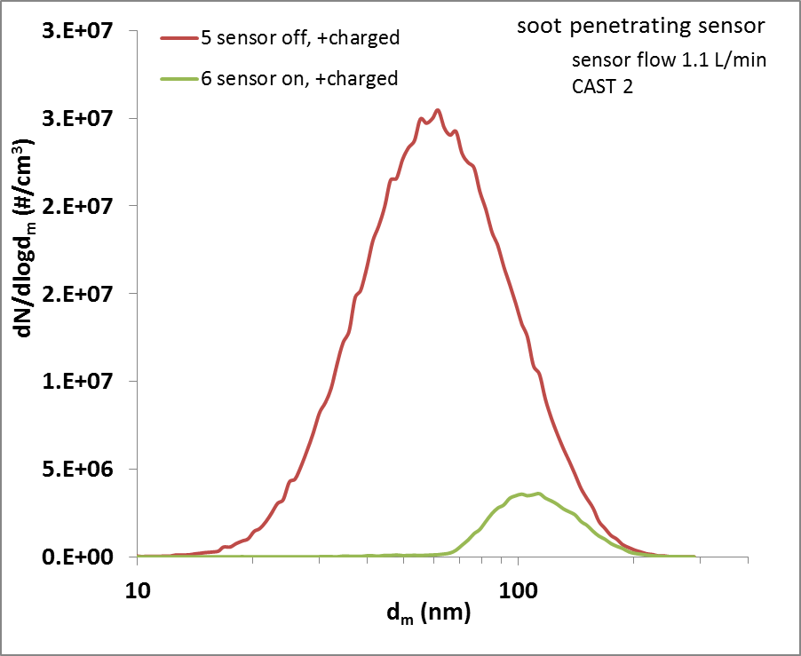
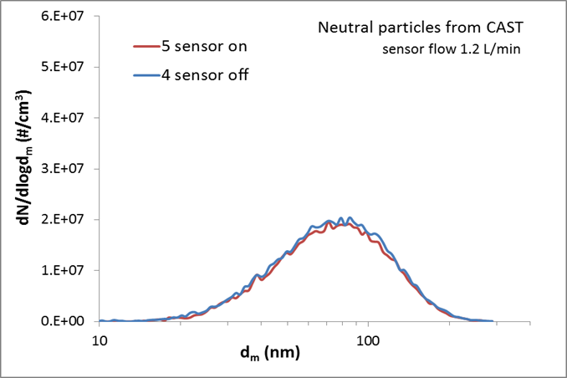
Sensor Measures Charged Particles, Not Neutral Particles
Notes:
8
8

Slide 9
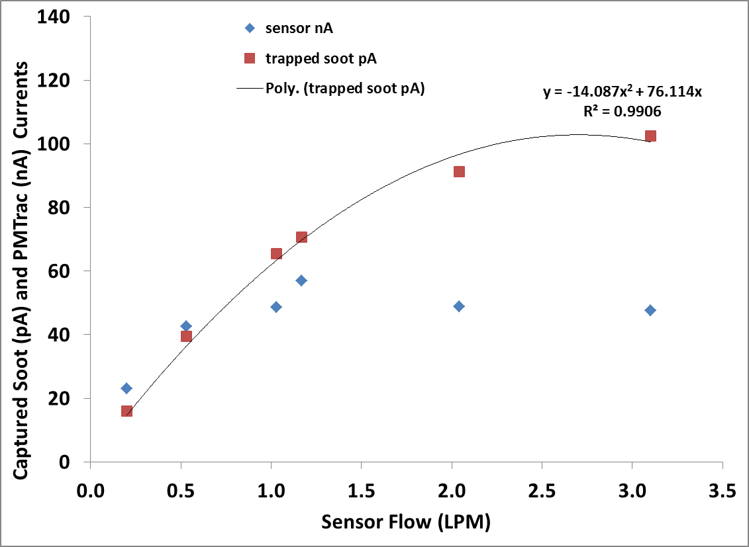
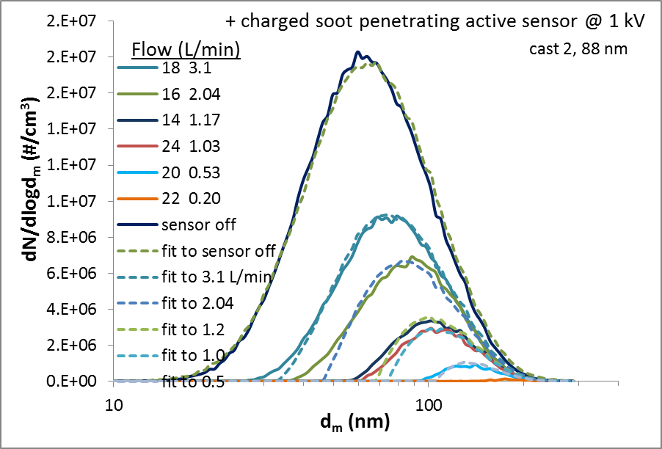
Flow Influence: Soot Flux Increase Offsets Capture Efficiency Decrease
At low flows, charged soot captured by sensor and sensor signal both increase linearly with flow
At higher flows, the increase in charged soot entering starts to be cancelled by the lower trapping efficiency of the sensor. Both the trapped soot current and the sensor response level off, but more rapidly in the sensor signal
Notes:
9

Slide 10
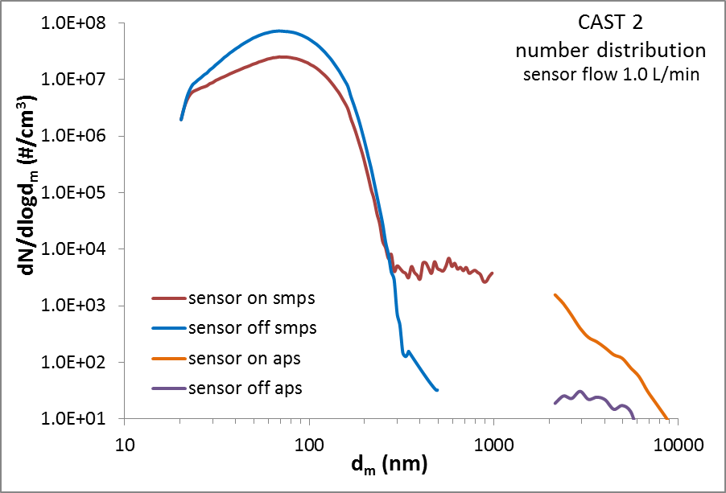
APS and SMPS Consistently Detect 0.3 to 10 um Break-off Agglomerates Exiting The PMTrac Sensor
Notes:
10
10

Slide 11
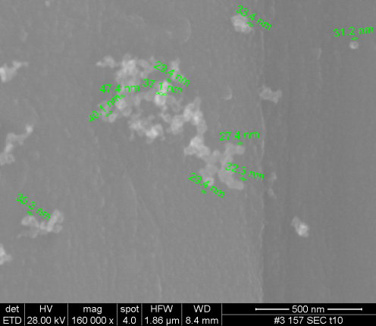
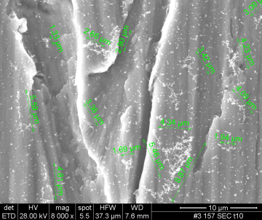
SEM Images Confirm Agglomerates Exiting the Sensor
30-50nm particles evident in early stages on new HV electrodes
2-5 micron agglomerates evident on HV electrode at later stages and exiting sensor via SMPS and APS
Consistent with electrostatic force directed assembly (ESFDA) and break-off agglomerates
Notes:
11
11

Slide 12
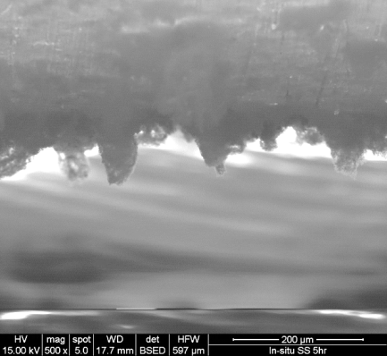
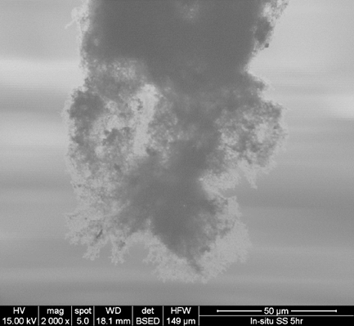
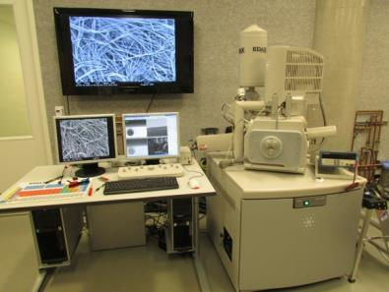
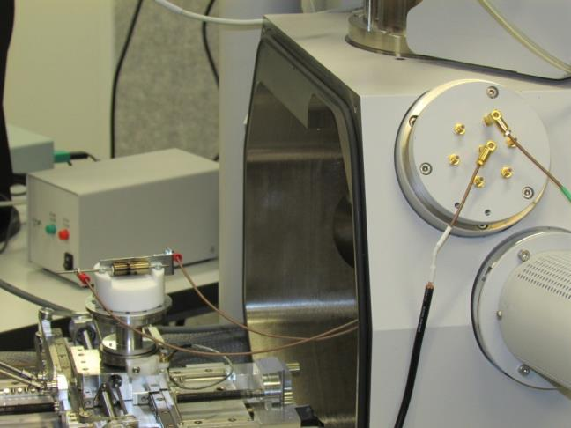
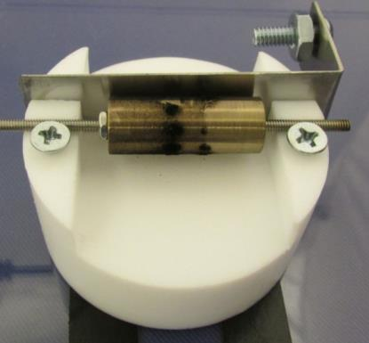
In Situ (Field Applied) SEM Imaging Work
Notes:
12

Slide 13
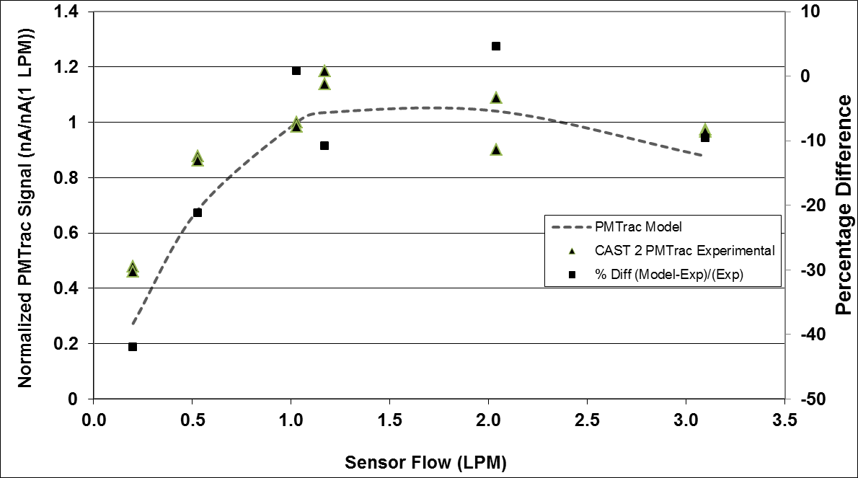
Comparison of First Principles Model with PMTrac Sensor Output
for mini-CAST Soot
Notes:
13

Slide 14
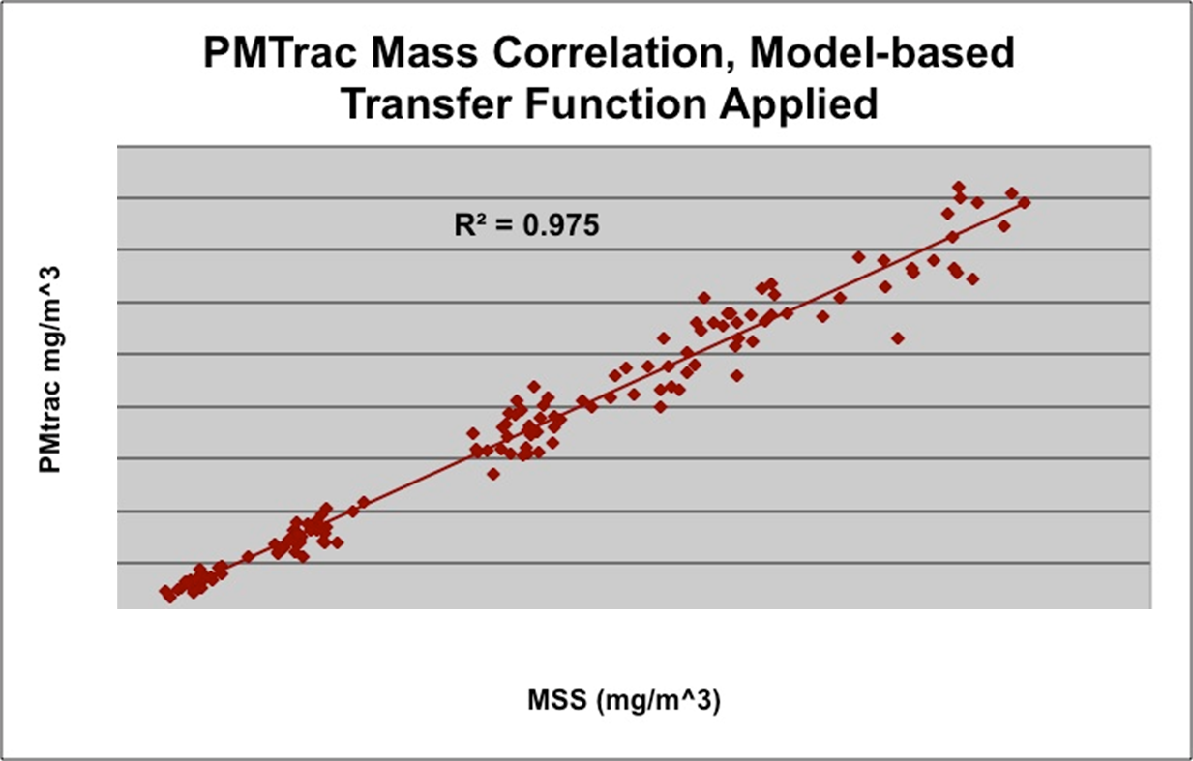
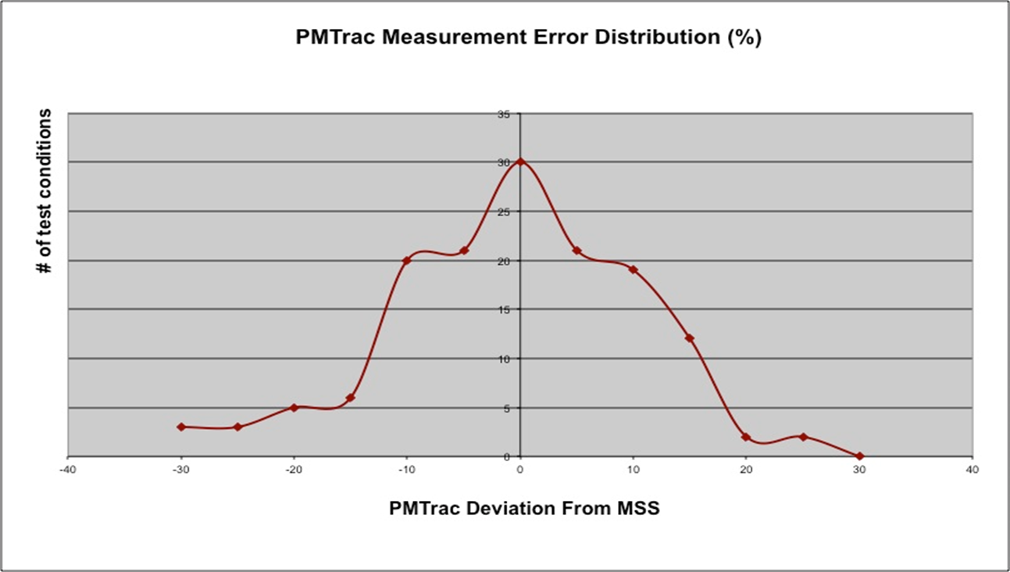
PMTrac Sensor Model Transfer Function

Slide 15
Summary
A first-principles-based model and transfer function that converts the PMTrac sensor’s signal (nA) to soot mass concentration (mg/m³) as a function of EGT, EGV, soot characteristics, and sensor characteristics has been developed.
SMPS was used to characterize particle size and charge distribution of soot entering and leaving the sensor. The influence of PSD, charge distribution, applied voltage, and sample flow rate on sensor output was characterized.
PMTrac sensor measures charged particles (and not neutral particles).
SMPS, APS, and SEM results confirm that larger (0.4 to 10 um) particles exit sensor and verifying ESFDA and signal amplification
The PMTrac sensor signal is amplified several orders of magnitude higher than expected if the observed current were solely caused by combustion-generated charged particles depositing their charge
These tests have enabled us to gain a better understanding of the sensor’s operating principle, validate our unified sensor model, and confirm our signal amplification mechanism
Notes:
15
15

