Slide 1
Particle Sensor Performance & Durability for OBD Applications & Beyond
Imad Khalek* & Vinay Premnath , SwRI
CE-CERT Workshop, April 11, 2013
Ikhalek@swri.org

Slide 2
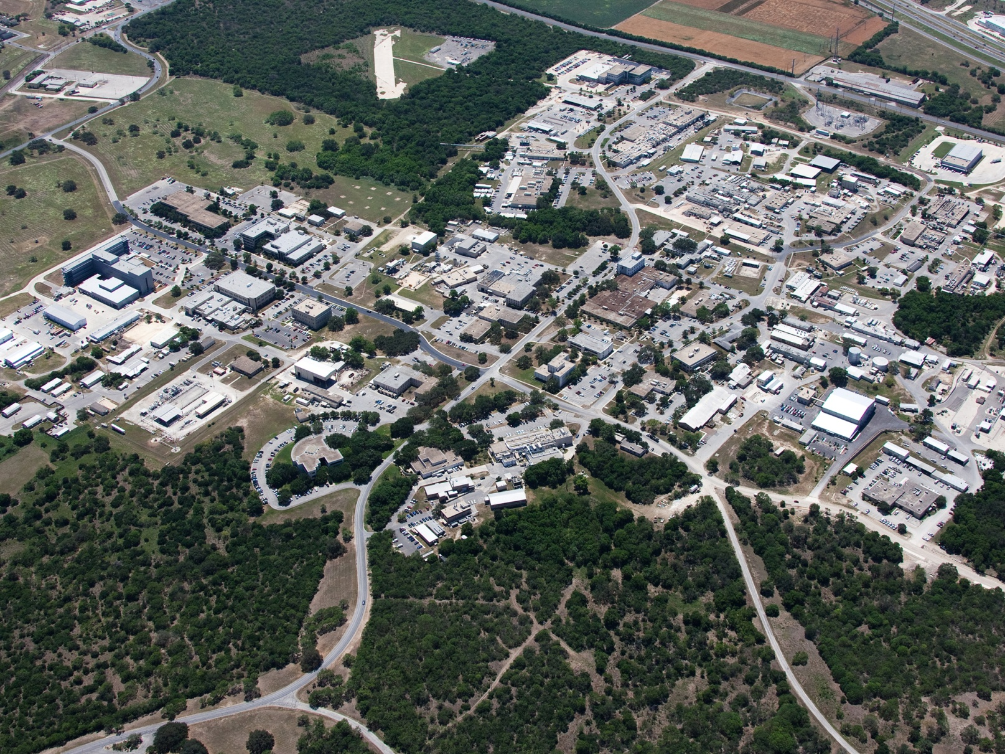
SwRI®

Slide 3
Acknowledgments
This work is funded by PSPD consortium members:

Slide 4
Brief
This work was developed in Year 1 of SwRI Particle Sensor & Durability (PSPD) Consortium
The focus of Year 1 was on performance
The focus of the upcoming Year 2 is on Performance & Durability

Slide 5
Particle Sensor Applications
Onboard vehicles downstream of exhaust particle filters for:
OBD Requirement (highway vehicles, potentially nonroad)
Filter leak detection and durability
QA/QC
In-use screening
Onboard vehicles engine out
Active particle emissions control
Engine mapping (Real World)
EGR cooler diagnostics through particle dynamics
Retrofit Applications
In-Use PEMS Testing (Very Simple System)
Can be applied to very difficult applications (e.g. nonroad)
Smoke meter replacement (laboratory use)
Replacement of expensive laboratory instruments

Slide 6
Objectives
To investigate exhaust particle sensor performance and durability using diesel engine platform
Compare sensor performance with that of laboratory particle instruments under different engine operating conditions:
Concentration, composition, temperature, velocity, pressure, etc…
Determine short and mid term (few days) variability using multiple sensors
To determine sensor short term survivability under:
DPF regeneration
Increased backpressure
Cold temperature environment
To determine long term durability under various engine operating conditions

Slide 7
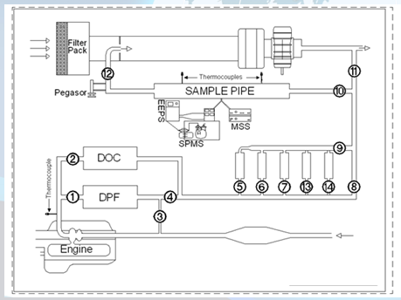
Engine Test Cell Setup

Slide 8
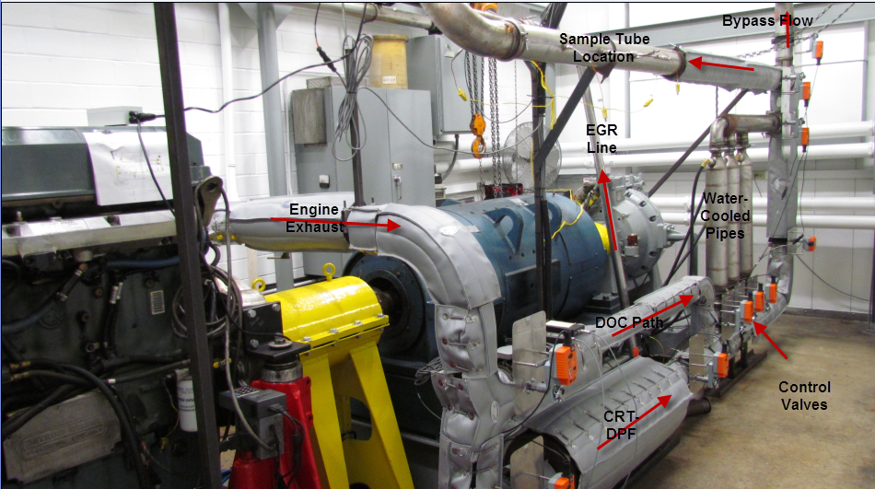
Engine Test Cell Setup

Slide 9
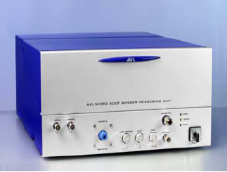
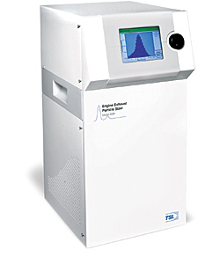
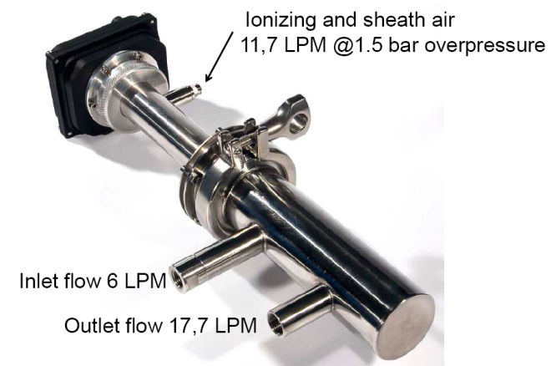
Particle Instruments
AVL MSS (Soot Mass)
TSI EEPS (Size, Number, Charge
Pegasor PPS
SwRI SPSS, Facilitate Solid Particle Measurement
(Used Upstream of EEPS)
Real Time Soot Mass

Slide 10
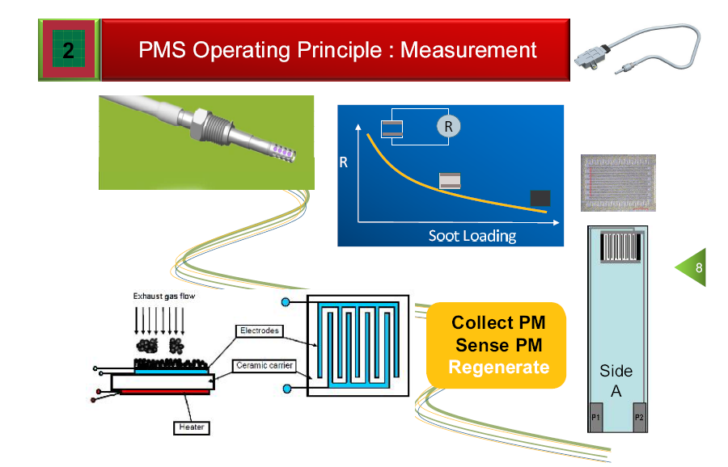
Electricfil Cumulative Sensor
Particles collect on an electrode with high electric resistor
Electric resistance decrease with soot loading
As resistance reaches a threshold, sensor is regenerated, and the process starts again
Change in resistance over time is determined between:
End of Regeneration and Beginning of Regeneration
This sensor provides integrated soot accumulation on the sensor surface over a period of time:
Time will be short if the concentration is high
Time will be long if the concentration is low
For an engine producing ~0.03 g/hp-hr, four regeneration events took place in 20 minutes
Even if the sensor is very accurate, particle deposition will have to be proportional to engine exhaust to get a proper weighting to exhaust emissions, especially under transient operation (a very challenging fluid dynamic problem)

Slide 11
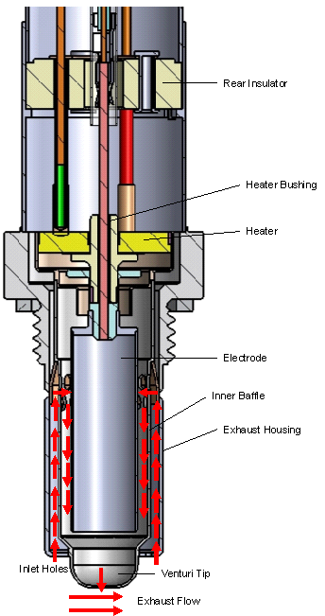
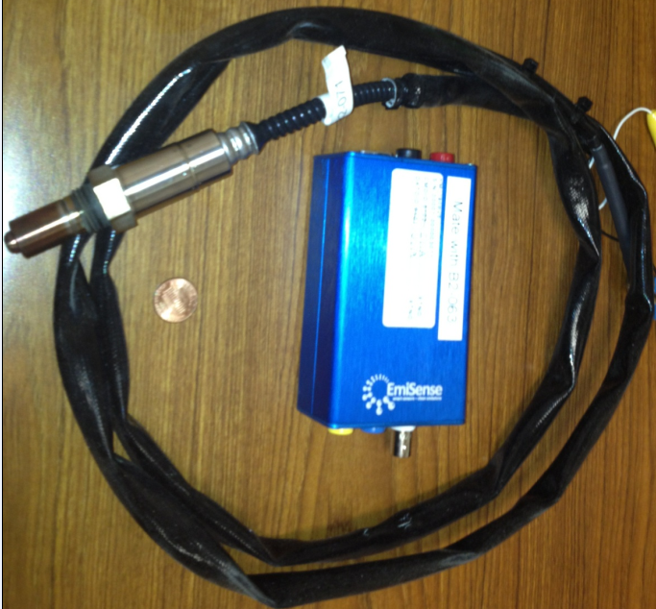
Emisense Real Time Sensor
A sample of exhaust is extracted into the sensor electrode region by a venturi using exhaust velocity
Naturally charged particles are captured between two electrodes in a electric field
Captured particles break away from the surface of the electrode due to high charge buildup
Electrometer current is an output associated with particle deposition and release from the electrode surface.
Better understanding of sensor fundamental performance is currently being developed by the sensor manufacturer

Slide 12
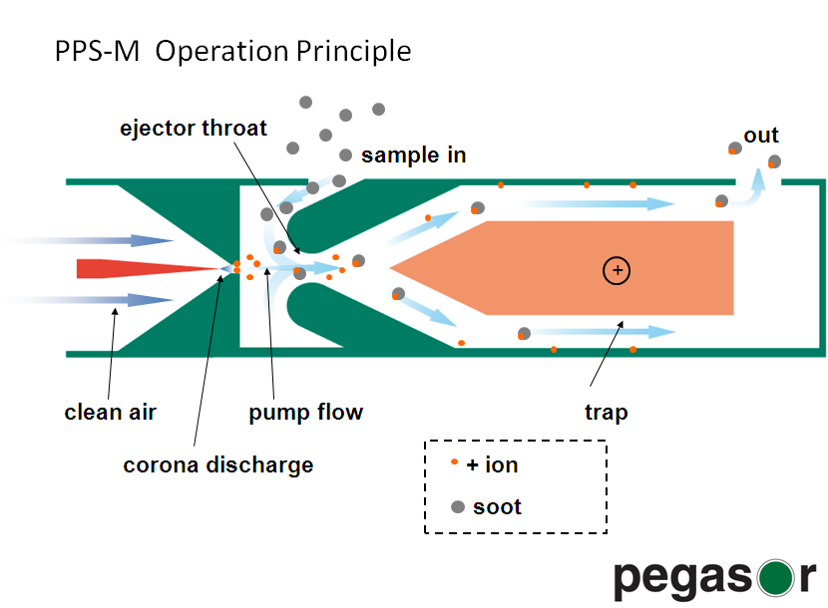
NGK-NTK Real Time Sensor
Air driven by an external pump is ionized via a positive corona needle to charge the particles
The high velocity ionized air creates a low pressure region where exhaust enters and mixes with it.
The excess ions are trapped
The positively charged particles enter and escape a Faraday cup creating a net total charge that is proportional to particle concentration
No trapping of particles is required for this method to work

Slide 13
Sensor Experiments Test Matrix
 | Nominal Sample Zone Temperature of 500 ºC
Nominal Velocity, m/sec | 10 | 30 | 50
 | Nominal Sample Zone Temperature of 390 ºC to 440ºC
Nominal Velocity, m/sec | 10 | 30 | 50 | 70 | 90
 | Nominal Sample Zone Temperature of 300 ºC
Nominal Velocity, m/sec | 10 | 30 | 50 | 70
 | Nominal Sample Zone Temperature of 200 ºC
Nominal Velocity, m/sec | 10 | 30

Slide 14
Other Sensor Exposures
Sensors were exposed to 8 hours of ammonia concentration of ~500 ppm
Same Engine used but with urea injection
FTIR was used to measure NH3 concentration
Sensors were exposed to 8 hours of 700C temperature
High gas temperature diesel burner with DPF was used for this work
Sensors were exposed to sub-atmospheric pressure (0.75 atm) and positive pressure of (1.25 atm), (1 hour for each)
This work was performed off-line

Slide 15
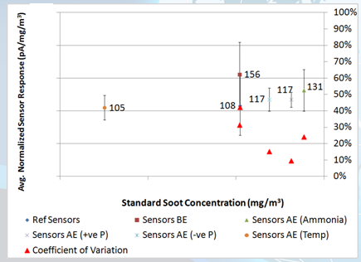
Results-Example of Sensor Sensitivity After Multiple Exposures

Slide 16
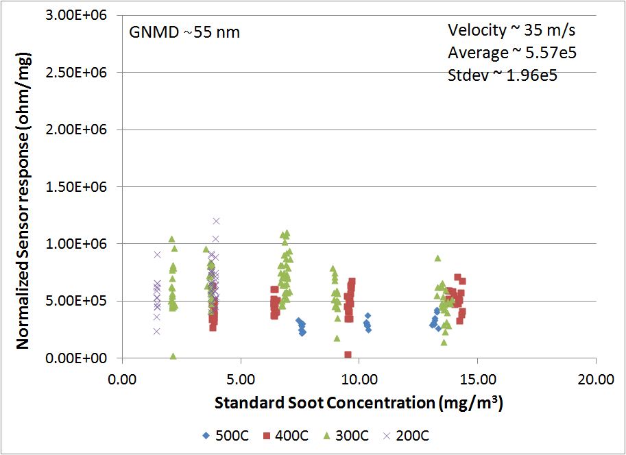
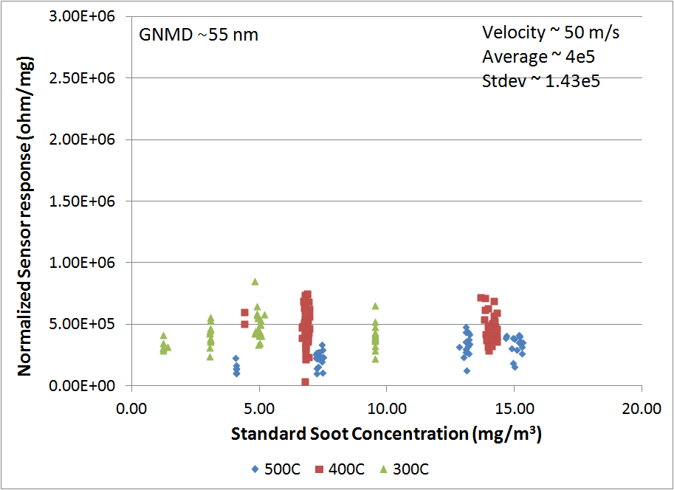
Results-Sensor Sensitivity Response at Different Velocities and different temperatures
35 m/sec 50 m/sec

Slide 17
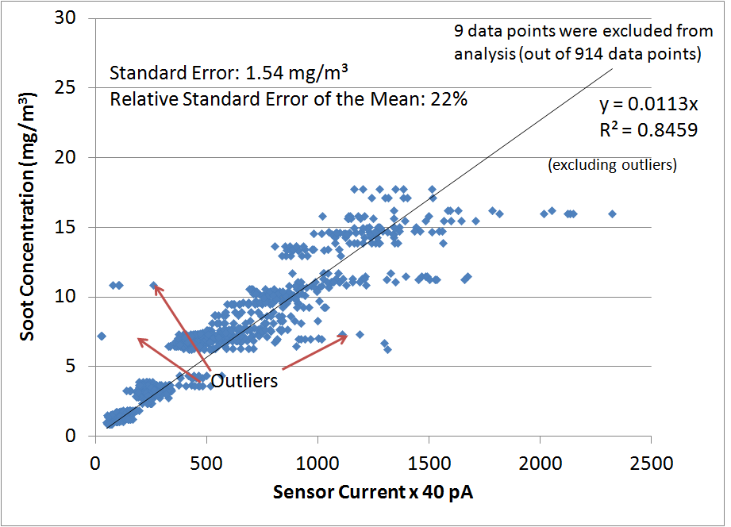
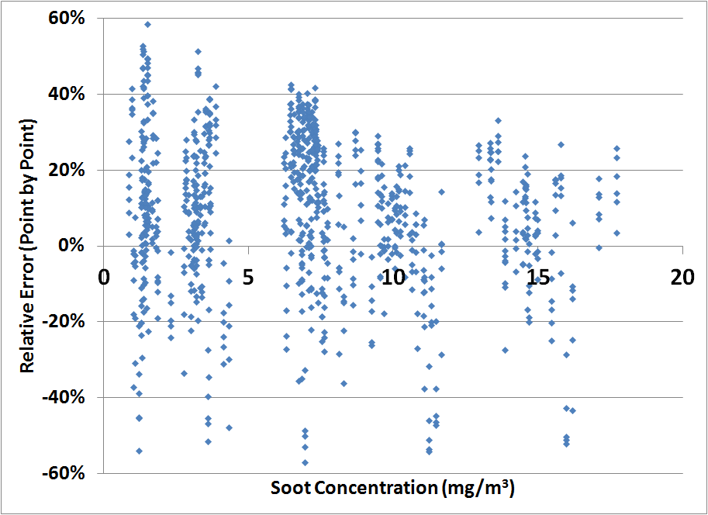
Correlation between Sensors and AVL MSS Soot Concentration (Steady-State (SS) Testing Only)
Steady-State Data
Steady-State Data

Slide 18
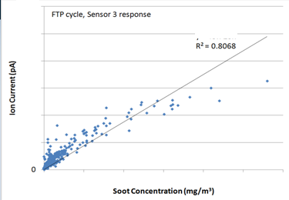
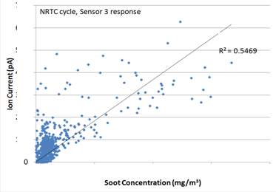
Transient Response
Best Correlation Plot for FTP and NRTC transient cycles between a Sensor and the MSS

Slide 19
Upcoming Year 2 of Consortium Activities
100,000 miles of durability using modern diesel engine (DOC+SCR+DPF+AMOX)
Cold Temperature Exposure -30°C
Shock & Vibration
RMI/RFI
Year 2 of the PSPD consortium provides excellent and cost-effective opportunity to evaluate spark-plug sized particle sensors for various applications

Slide 20
Summary
Our work is showing the birth of spark-plug sized technology for sensing particles in engine exhaust
It is critical to continue the development of this technology with the help of engine and sensor manufactures and other interested stakeholders

Slide 21
Southwest Research Institute®
For Questions, please contact Imad Khalek at Ikhalek@swri.org

