Slide 1
STANDARDIZATION OF ECU DATA George Gatt In-Use Retrofit Section / Heavy-Duty In-Use Strategies Branch California Air Resources Board CE-CERT / UCR
PEMS Conference Workshop
April 11, 2013

Slide 2
Background
What are On-Board Diagnostic (OBD) Systems?
Self-diagnostic systems incorporated into the engine ECU
Monitors virtually every component that can increase emissions
Alert the driver (MIL)
Provide information (data, DTCs) to assist repair technicians
Why OBD Systems?
Minimize in-use emissions by:
Identifying vehicles with emission-related malfunctions
Alerting operator to enable timely repair
Assisting repair technicians for effective diagnosis and repair
Encouraging durable emission controls

Slide 3
History of OBD
Light- and Medium-Duty Vehicles (<14,000 lbs)
1988: OBD I- minimal monitoring, no standardization
1996: OBD II- comprehensive monitoring, standardized information for scan tools
Ongoing updates every ~2 years
Heavy-Duty Engines
2010: HD OBD-initial phase-in, one engine model per manufacturer, no standardization
2013: HD OBD-required on all on-road engines, standardized information for scan tools
Ongoing updates every ~2 years

Slide 4
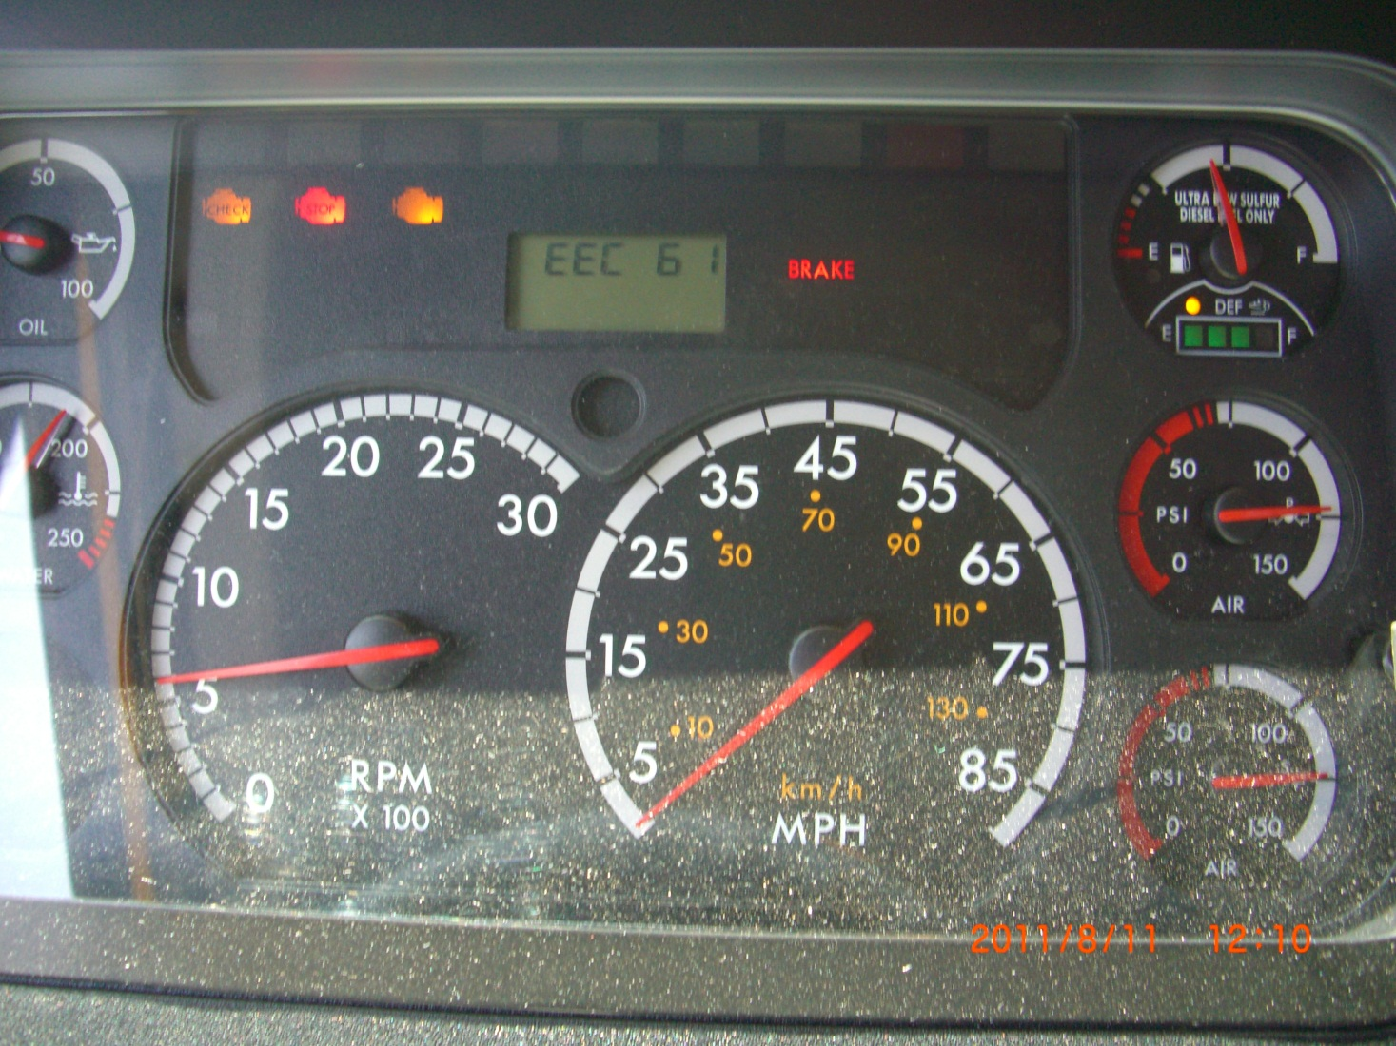
WHAT IS MY TRUCK TELLING ME?

Slide 5
Required Standardized Data
HD OBD is only CARB regulation that requires standardized data
Used to ensure easy access to data necessary for emission repairs
Also used to facilitate inspection or compliance testing
Vehicles/engines can be recalled for not complying
NTE and PEMS testing regulations do not require standardization of engine data needed for testing
Absent OBD requirements, manufacturers not required to adhere to any SAE standard or report any specific data

Slide 6
Standardization Details
Two “standards” to choose from for HD OBD:
SAE J1939
Defines connector, protocol, and messages
Baud rate: 500k required for 2016+MY, 250k or 500k allowed for 2013-2015MY
Used mostly by Cummins, DDC, Navistar, and Paccar
SAE J1979 & ISO 15765-4
Identical to connector, protocol, and messages used by light-duty vehicles since 2008 MY
Used mostly by GM, Ford, Hino, Volvo, Isuzu

Slide 7
Examples of Standardized Data
HD OBD regulation defines specific parameters that must be reported
Only requires a subset of the parameters defined in J1939
Defined in J1939 does not mean required by HD OBD
Data for emission-related troubleshooting and repair
E.g. engine speed, coolant temperature, exhaust temperature sensor readings, NOx sensor readings, fault codes, etc.
Data for facilitating inspections
E.g., MIL command status, chassis VIN, etc.
Data for facilitating compliance testing
E.g., frequency of operation of individual diagnostics, frequency of operation of some AECDs, etc.
Including data about NTE operation and data intended to make PEMS testing easier
Back-up slides at end of presentation provide a list of required parameters

Slide 8
NTE Status for NOx and PM
NTE ZONE
NOx NTE Control Area Status Parameter
Reports engine is currently:
inside NTE control area, or
outside NTE control area, or
in a manufacturer-specific carve-out area, or
in a NTE deficiency area
Can be used to confirm instantaneous data points are in the NTE region
Analogous parameter exists for PM

Slide 9
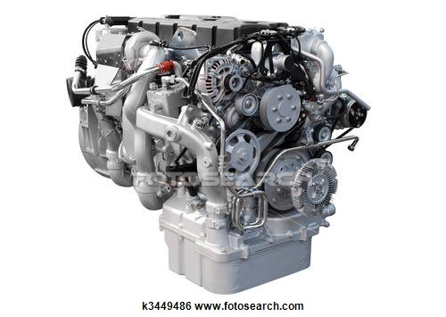
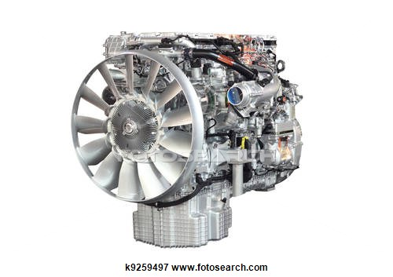
Torque Data
Consistency of Torque Implementation?
Torque Accuracy?

Slide 10
Torque Data Issues
Goal: All manufacturers report torque consistently so values can be relied upon for PEMS testing
Issue: As currently implemented, same torque parameter represents different values for different manufacturers
Example: SPN 514 ‘nominal friction torque’ generally includes torque to run base engine accessories (oil pump, internal engine friction, etc.) but sometimes includes non-base engine accessories (cooling fan, etc.)

Slide 11
Resolving Torque Data Issues
Plan: Working with SAE to revise definitions to ensure consistent implementation
Delineate what ‘frictions’ must be included and excluded
Appears that PEMS needs something that matches ‘Brake Power’ definition¹ in 40 CFR 1065.1001
But, could use some help from knowledgeable PEMS equipment manufacturers or others on this effort
Per HD OBD regulation, reported torque must be “most accurate values” calculated within the ECU
Cannot report a less accurate value over standardized data than available on proprietary data
¹CFR 40 1065.1001 defines Brake Power as: “The usable power output of the engine, not including power required to fuel, lubricate, or heat the engine, circulate coolant to the engine, or to operate after-treatment devices. If the engine does not power these accessories during a test, subtract the work required to perform these functions from the total work used in brake-specific emission calculations. Subtract engine fan work from total work only for air-cooled engines.”

Slide 12
Additional Relevant Data
For 2016+ MY engines, engines must report:
Fuel Rate (mg/stroke)
Modeled Exhaust Flow (mass/time)
Data can be helpful for PEMS testing
Time-aligning ECU data and other sampled data
Potential Method 3 usage

Slide 13
Summary
With implementation of HD OBD, manufacturers now required to adhere to standards and report specific data
First steps taken to standardize data needed for PEMS testing
Further refinement (especially for torque) still needed

Slide 14
Thank You for your attention

Slide 15
Back-Up Slides: OBD Required Data
Calculated Load
Driver’s Demand Engine Torque
Actual Engine Torque
Reference Engine Maximum Torque
Engine Coolant Temperature
Engine Oil Temperature*
Engine Speed
Time Elapsed since Engine Start
Fuel Level*
Vehicle Speed*
Barometric Pressure
ECU Voltage
Number of Fault Codes
Monitor Readiness Status
Distance Traveled since Fault Codes Cleared
Number of Warm-ups since Fault Codes Cleared
MIL status
NOx NTE control area status
PM NTE control area status
* If used as part of the OBD system on the engine

Slide 16
Back-Up Slides: OBD Required Data
PM filter inlet temperature**
PM filter inlet pressure**
PM filter outlet pressure**
PM filter outlet temperature**
PM filter delta pressure**
Exhaust gas temp sensor**
Turbo speed**
VGT position**
VGT commanded position
Turbo compressor inlet temperature**
Turbo compressor inlet pressure**
Turbo turbine inlet temperature**
Turbo turbine outlet temperature**
EGR Temperature**
Reductant (Urea) Tank Level*
NOx sensor output**
PM sensor output**
Distance traveled while SCR inducement active
* If used as part of OBD system ** If engine is actually equipped with this sensor

Slide 17
Back-Up Slides: OBD Required Data
Normalized trigger for PM filter regeneration (e.g., how close is it to triggering an active regen)
PM filter regeneration status (e.g., is it in an active regen)
Average distance between PM filter regenerations
Accelerator Pedal Position
Fuel Rail Pressure**
Commanded Fuel Rail Pressure
Fuel Injection Timing
Intake air Temperature**
Engine Intercooler Temperature**
Boost Pressure**
Mass Air Flow**
Ambient air temperature**
Commanded EGR valve position
Actual EGR valve position**
EGR error between actual and commanded**
Fuel rate
Turbo intake air temperature**
** If engine is actually equipped with this sensor

