Slide 1
Lessons Learned from Off-road Activity of 20 Units with PEMS, PAMS, and Video
2013 PEMS Workshop: The Latest Tools and Techniques for In-Use Measurements
April 11th 2013
Presented By: Tanfeng (Sam) Cao
Co-Authors: Kent Johnson
University of California, Riverside
Bourns College of Engineering
Center for Environmental Research and Technology
www.cert.ucr.edu
Notes:
1

Slide 2
Motivation and Background
Emission factors typically involve load (g/hp-h)
ECM broadcast messages are used for getting load information
Heavy duty OBDII and J1939 have most information available but reliability still needs investigation
Off-road ECMs are difficult to connect to
Summary of experiences dealing with ECM related issues

Slide 3
How to Obtain In-use Load
Torque J1939 (calculated from fuel usage)
  Actual Torque
  Friction Torque
  Reference Torque
Percent Load
  % load is percent of Lug Curve
  Obtain lug curves (actual, estimated, approximate, bsFC)
Manifold pressure
  Infer % load from pressure
  Obtain lug curves (actual, estimated, approximate, bsFC)

Slide 4
Accuracy on ECM Torque and Fuel Values
(on-road)

Slide 5
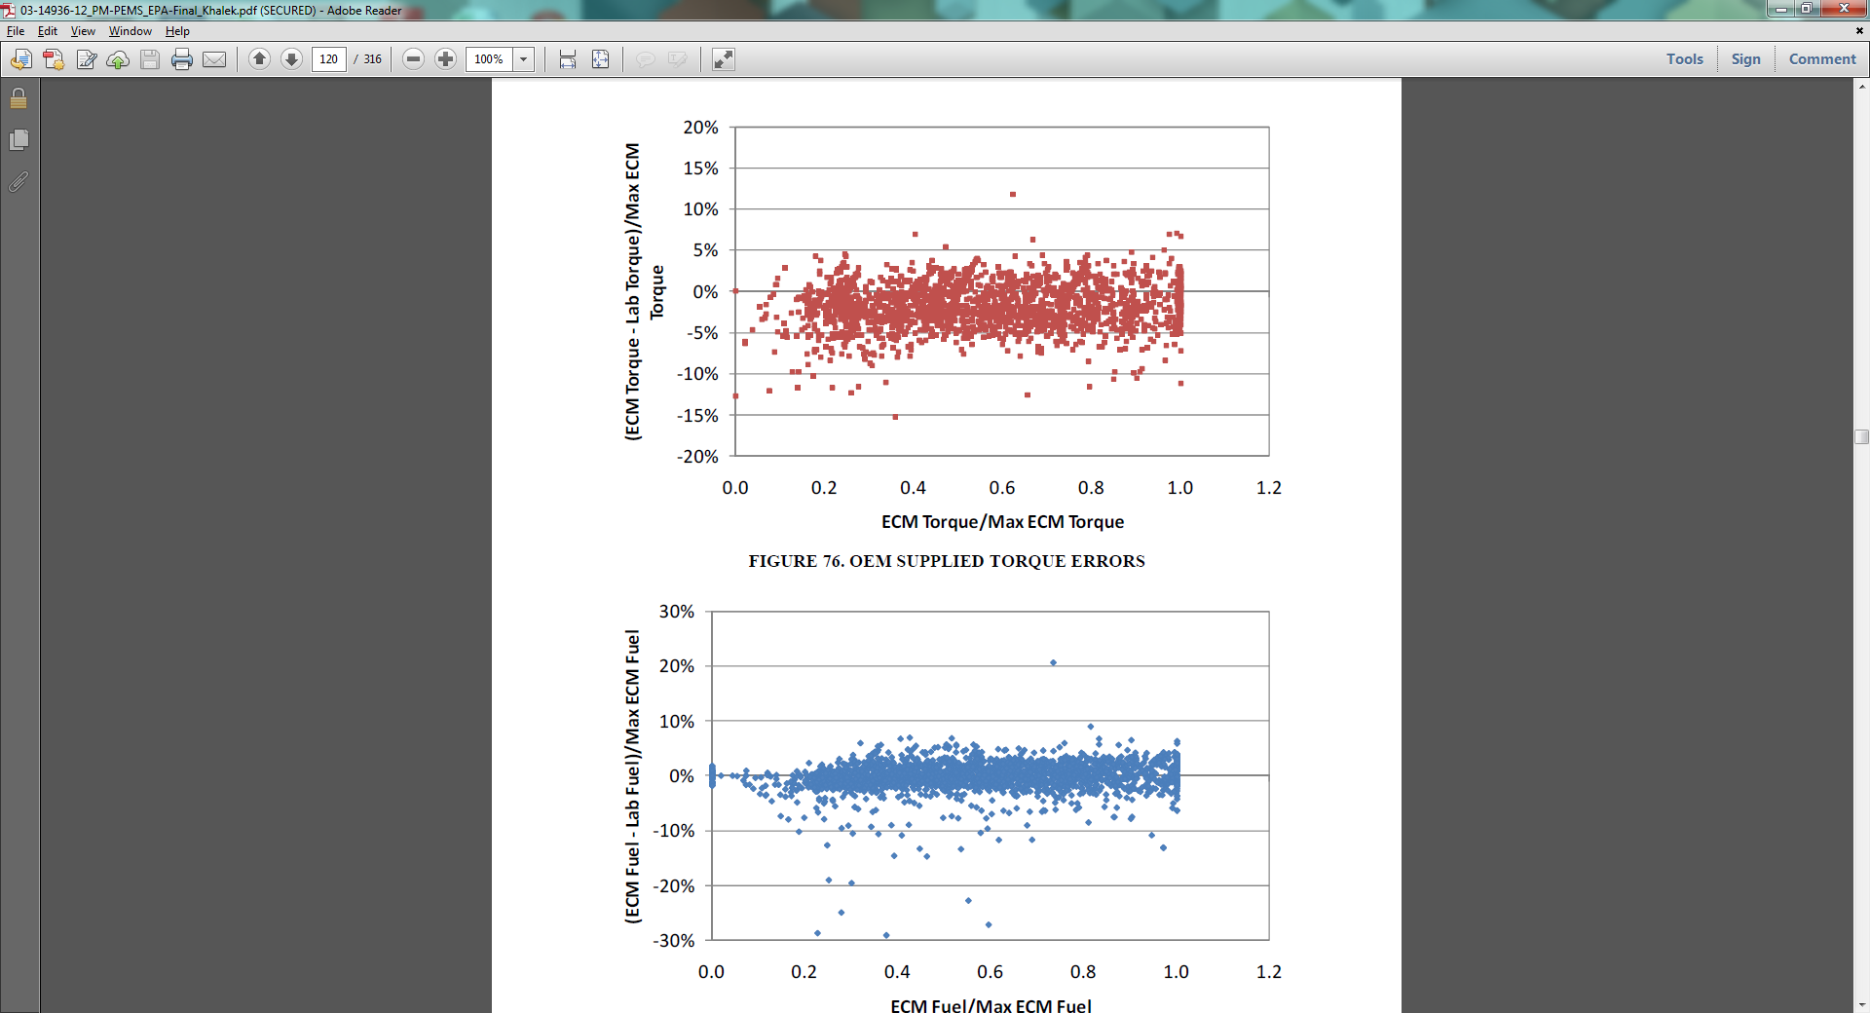
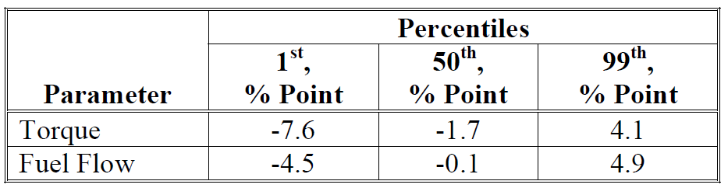
SwRI Error Surfaces for % Torque and Fuel
A
B
¹ Source SwRI PM PEMS Final Report
Notes:
5
OEM provided numbers

Slide 6
UCR Steady State Analysis
Intended for troubleshooting exhaust flow
2006 Cummins ISM w/ EGR on CE-CERT’s HDD
20 torque load point for 2 different RPM
www.cert.ucr.edu

Slide 7
UCR Error Surfaces for % Torque: Lug Curve
A
B
A: 0% - +150% of point error
B: 2% to 15% of max error
Notes:
7
OEM provided numbers

Slide 8
UCR Error Surfaces for % Torque: ECM Reference Torque
A
B
A: 0% to -75% of point error
B: 2% to 15% of max error
Notes:
8
OEM provided numbers

Slide 9
UCR Error Surfaces for Fuel Rate: ECM Fuel Rate
A
B
A: 0% to +10% of point error
B: <5% of max error
Notes:
9
OEM provided numbers

Slide 10
Low Duty Cycles show High Fuel Usage
A
B
C
¹ MAC 450 12.8 L engine
(A) All cycles carbon balance to ECM
(B) Port cycle carbon balance to ECM
(C) UDDS cycle carbon balance to ECM
30% fuel deviation at low duty cycle
Power and fuel should have similar errors?
Notes:
10

Slide 11
Accuracy on ECM % Load and Fuel Values
(off-road)
Notes:
Therefore, we need a comprehensive guide for verification and calibration of PEMS/and emission laborites.
40 CFR Part 1065 has many sections focused on applicability (what type of regulation to use for what type of engine being tested), laboratory and field testing methods; engine, measurement, fuel, and sample system requirements; verifications; calibrations and performance specifications; as well as many other details for emissions measurements and calculations.
Part 1065 is a comprehensive requirement to control the uncertainty of emission measurements. It can also be used as a guide to verify new products from an operation, performance, and applicability perspective. Thus, 1065 is an excellent tool for product development confirmation and product approval prior to production release.
Today, I am going share some experiences as well as some how-tos on doing one 1065 audit

Slide 12
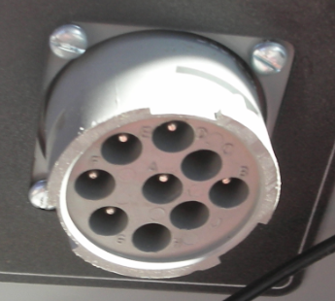
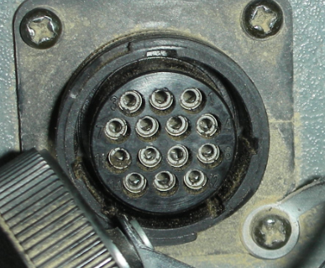
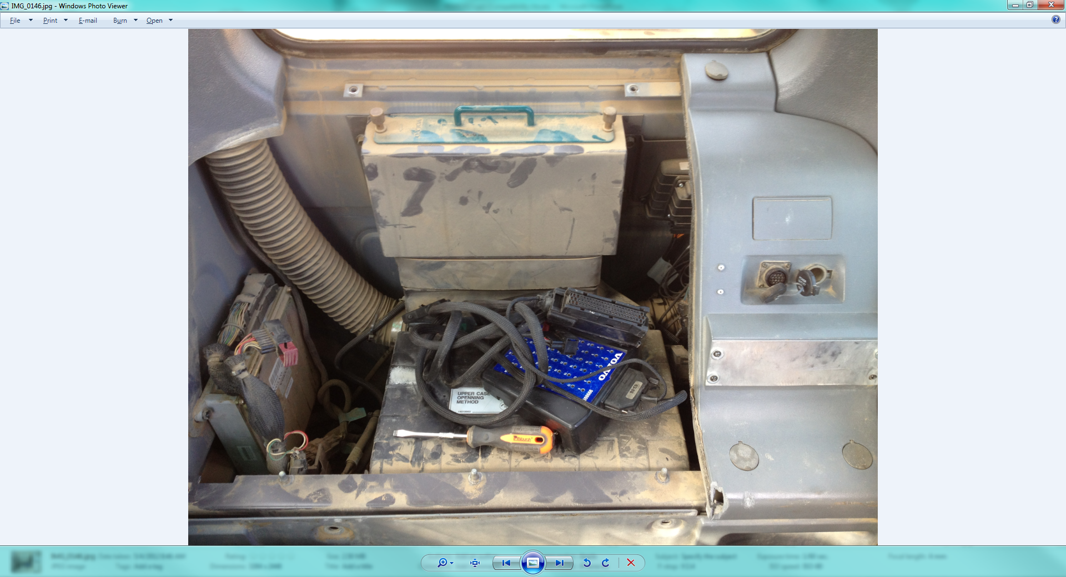
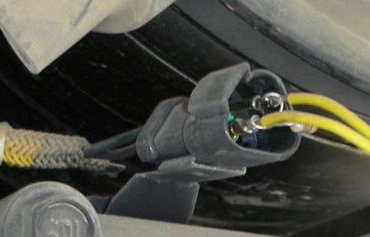
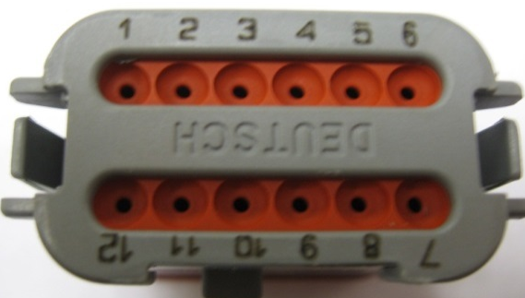
Off-Road ECMs are Hard to Connect
John Deere: 9 pin J1939
Caterpillar:
  Tier 2 and older : serialbus, CAT ET only
  Tier 3: canbus, J1939 w/proprietary channels, specialty CAN tool, CAT ET
  Tier 4i: CAT ET, J1939 w/ less proprietary channels, specialty CAN tool
Volvo:
  Tier 3: J1708 & J1939: canbus, needs dealer “hot box”, not all channel broadcasted
Komatsu:
  Tier 2: canbus? 3 pin connector, J1939/J1708?
  Tier 3: canbus, 12 pin connector, proprietary J1939, specialty CAN tool
Notes:
12
PM seems high for LPG_ln_OC test, but it could be from the vehicle

Slide 13
Off-Road ECM FC Show Similar % Error
As On-road data
A
B
% of Max
% of Point
PEMS carbon balance is the ref.
3 sec running average is applied for both data set
Trends looks similar to on-road
Notes:
13
PM seems high for LPG_ln_OC test, but it could be from the vehicle

Slide 14
Obtaining Lug Curves can be Difficult
UCR tested 27 pieces of off road equipment
Lug curve & % load = power for off-road machines
20 official lug curves from various sources (not easy)
  Gross power (SAE J1955, ISO14396, ISO14396 DIN)
  Net (SAE J1349, ISO 9249, ISO 9249 DIN)
5 estimated lug curves
1 modified official lug curves
1 estimated from BSFC
Notes:
14

Slide 15
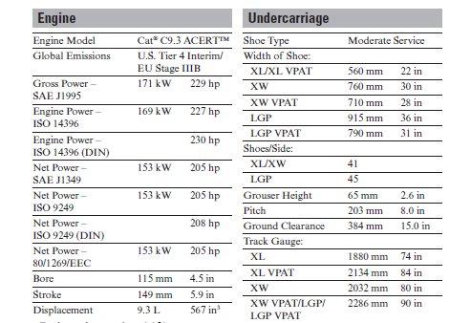
OEM Official Lug Curve Different Power Ratings Can be Misleading
Notes:
15
SAE J995 http://www.docin.com/p-120228875.html

Slide 16
OEM Official Lug Curve Different Ratings
Indicated – mean effective pressure or actual indication of torque produced by the cylinder
Gross power – flywheel power, “bare” engine.
  SAE J1995 (used by UCR for estimating brake specific emissions)
  ISO 14396
  ISO 14396 (DIN)
Net power – flywheel power, fully equipped.
  SAE J1349
  ISO 9249
  ISO 9249 (DIN)
Notes:
16
SAE J995 http://www.docin.com/p-120228875.html
SAE J1349 http://www.docin.com/p-338877787.html

Slide 17
Estimating Lug Curve When not Available
  Rated power/peak torque often easy to obtain
    ECM download using OEM tool (represents gross power)
    Engine Label (gross power)
    Product brochure (may be gross or net)
Notes:
17
PM seems high for LPG_ln_OC test, but it could be from the vehicle

Slide 18
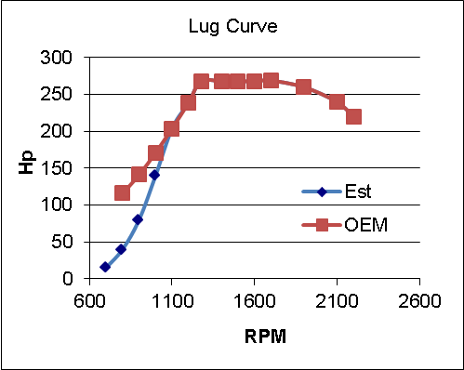
Percent Load can Vary for Off-Road
(ECM fuel rate not available)
OEM
Estimated
bsCO2 lower at idle than when working
% load at idle suspiciously high
Overall impact low for working emissions, but double near idle
¹ Source UCR off-road report
Notes:
18
PM seems high for LPG_ln_OC test, but it could be from the vehicle

Slide 19
Conclusions and Recommendations
J1939 % torque may be more accurate than % load over wider range
J1939 fuel rate can be off as much as 30% at light loads
Improve torque accuracy over full range (idle to max rated speed)
Standardize J1939 torque to be flywheel gross power J1995 for proper interpretation of in-use load and reference to engine dyno brake specific emissions
Standardize off-road ECM to J1939 similar to on-road
www.cert.ucr.edu
Notes:
19
Don’t know what to say yet/.

Slide 20
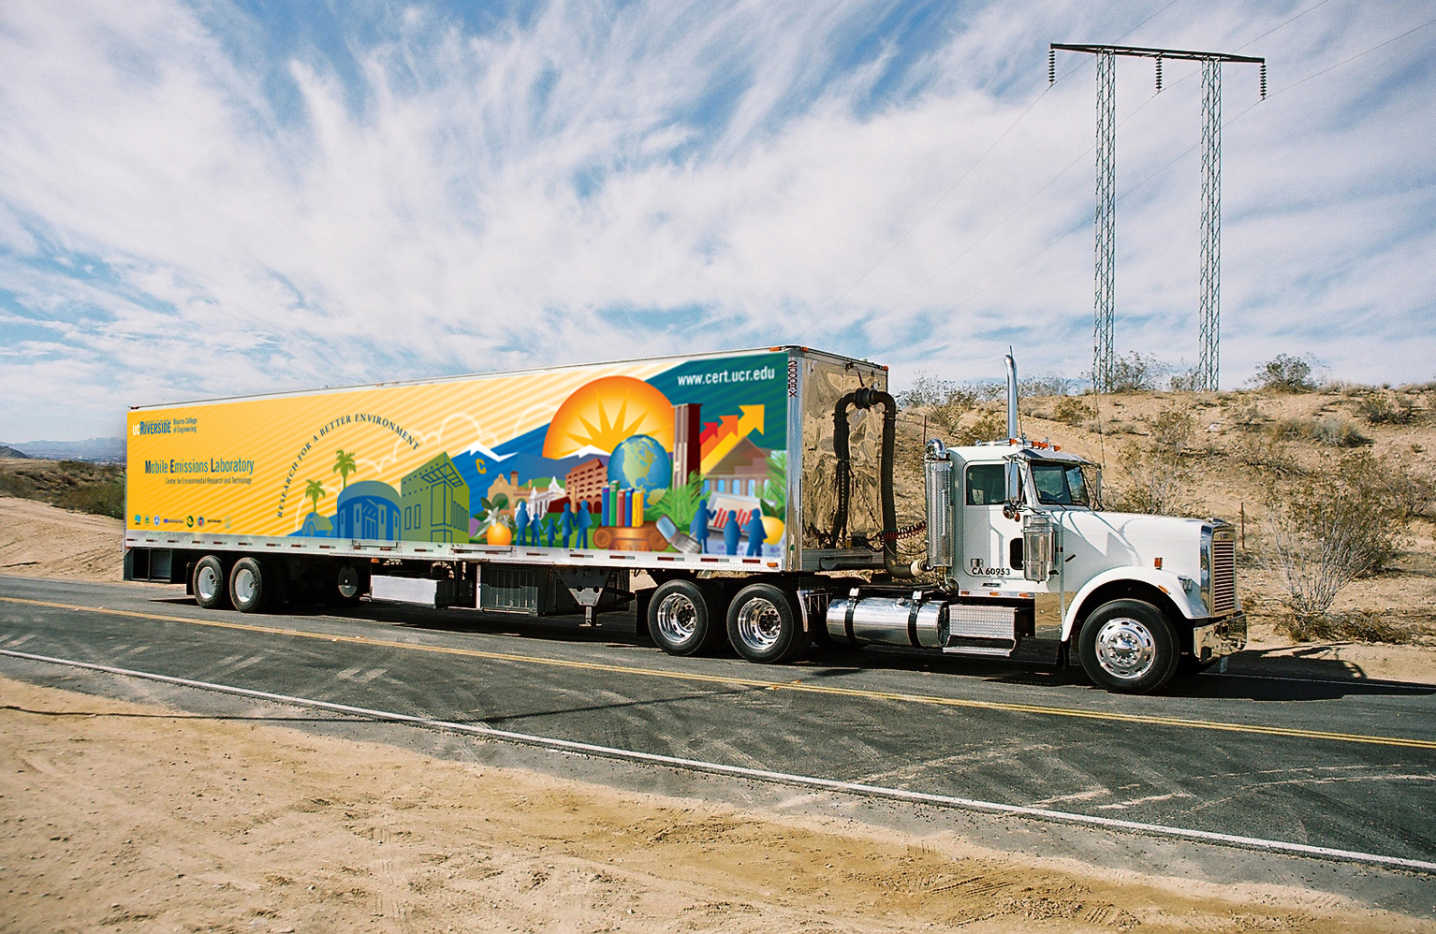
Questions?
www.cert.ucr.edu
Notes:
20
Needs to change this

Slide 21
ECM parameter critical for emissions calculation
Engine speed
Fuel rate
% load
% fiction torque/%acutal torque/reference torque (on-road)
Engine lug curve
Engine Inlet manifold temp/pressure (if calculation exhaust flow)
Barometric pressure, ambient temp
After treatment temp/pressure/status
Coolant/oil temperature
Notes:
This slide gets into the how to section.
This is obvious but it’s good to point out what’s the CFR looks like (for those of them don’t know)
Thus, the 1065 have clear instructions on when, why, how tos, and what’s needed to pass the verification.

Slide 22
Acronyms Support Slide
  PEMS Sensors portable emission measurement system
  OEM Original Equipment Manufacture
  DPF Diesel Particulate Filter
  DOC Diesel Oxidation Catalyst
  Regen Forced regenerations with OEM tools
  ECM Mods Recalibrated ECM to change NO_{x} emissions levels
  DPF Wall flow diesel particulate filter
www.cert.ucr.edu
Notes:
22

