Slide 1
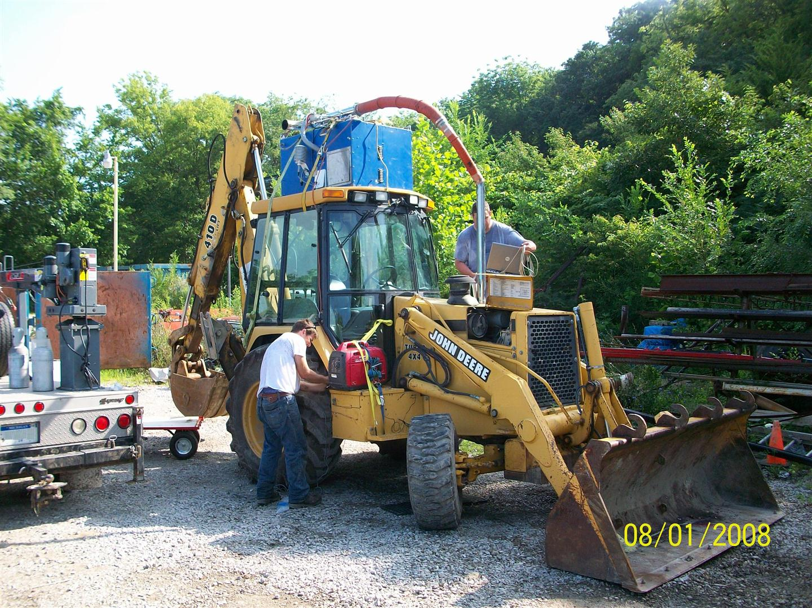

Development of Emission Factors, Load Factors, Duty Cycles and Activity Estimates from the Nonroad PEMS Study
Tim DeFries¹, Sandeep Kishan¹, Michael Sabisch¹
Carl Fulper² , Ed Glover², James Warila², David Hawkins²
Robert Giannelli², Connie Hart²,
¹ Eastern Research Group,
² US EPA National Vehicle and Fuel Emissions Laboratory
CE-CERT PEMS Conference, April 11, 2013, Riverside, California

Slide 2

Nonroad PEMS Study Objectives
For nonroad diesel equipment
  Develop methods to measure in-use gaseous & PM emissions
  Select equipment for measurement using a rigorous sample design, emphasizing selection of pieces that
      Are “large”
      Receive “high use” and
  Perform full site inventories to understand relation between sampled equipment and complete inventory
  Collect in-use emissions and activity data
  Develop new load factors, emission factors, duty cycles, and activity estimates based on real-world data

Slide 3
Scope of Field Study
EPA Region 7 (Iowa, Missouri, Kansas), fieldwork was conducted in five pre-selected counties
Diesel-powered equipment used in the commercial construction sector
Study was conducted between Summer 2007 and Fall 2008 in three fieldwork phases of 1 to 2 months each
Measurement Goals / Outcomes
  emissions goal of 25 pieces, ≅ 8 hours each (29 pieces tested)
  activity goal of 25 pieces, ≅ 1 month each (29 pieces tested)
Over 150 hours of emissions data and 1000 hours of activity data of was collected and analyzed

Slide 4
Recruiting and sampling

Slide 5
Sample Design
The objective was to collect a probability sample of nonroad equipment for purposes of emissions and activity measurement, meaning that each equipment piece in the sample has a known probability of selection. Equipment was selected for measurement through a four-stage sample design.
Stage 1 “County”: Five counties were selected in EPA Region 7 (Midwest US)
Stage 2 “Establishment”: Within each county, construction establishments were selected with the number of employees as measure of size.
  Comprehensive Business Samples (CBS) by Survey Sampling International (SSI) was initially used
  Later supplemented with Equipment Data Associates, Inc. (EDA) database
  Full census was necessary to accomplish testing goals
Stage 3 “Site”: For establishments with multiple work sites, simple random sampling was used to select one or two sites for inventory
Stage 4 “Equipment piece”: On each selected site, equipment was selected for emissions and activity measurement, using probability proportional to size and lifetime usage

Slide 6
Recruitment Procedure
“Ownership Interview” (1453 establishments)
1) Screening (878 screened)
- Verify identity of firm
- Verify business activity
2) Eligibility (123 establishments)
- Verify Equipment Use
verify role as prime contractor
“Equipment Inventory” (79 sites)
Inventory equipment on site: Type,
Manufacturer, MY, Size, lifetime usage
“Equipment Selection” (292 pieces
Inventoried, 179 PEMS testable)
Stratify by
Size
lifetime usage
“Instrumentation” (40 PEMS, 30 PAMS)
PEMS: measure emissions over 8 hours
AND/OR
PAMS: measure activity over one month
- Collect fuel and oil samples

Slide 7
Measurement equipment

Slide 8
Nonroad Methods & Equipment for Emissions & Activity Measurements
Constituent | Method
Continuous gaseous THC, CO_{2,} CO, NO_{x,} | SEMTECH-DS with 3”, 4” and 5” flowmeters
Aggregate PM | Gravimetric sampling via Sensors’ MPS (heated 47mm PTFE filters)
Fuel Properties | Onsite collection and in-house analysis
Metals in Oil | Onsite collection and in-house analysis
Engine Speed | Optical sensor or voltage collection from harness taps

Slide 9
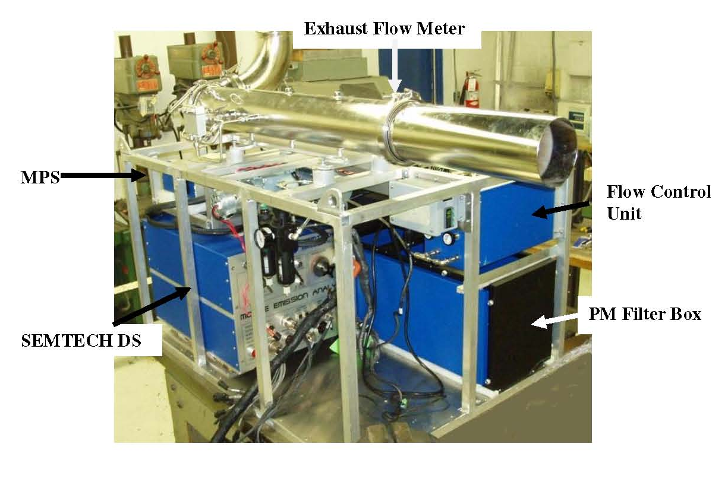
Nonroad PEMS Instrumentation

Slide 10
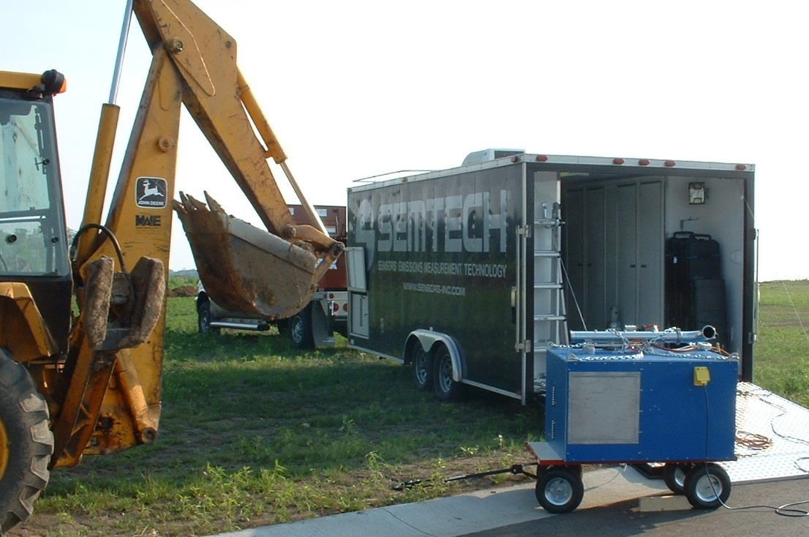
Nonroad PEMS use of Field Laboratory

Slide 11
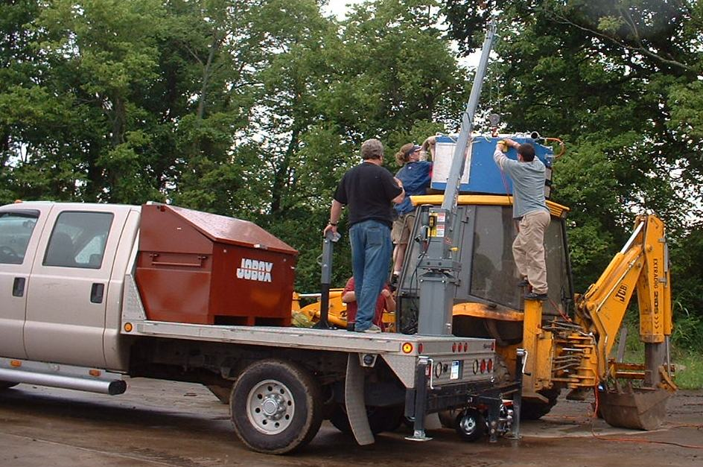
Nonroad PEMS Field Installation

Slide 12
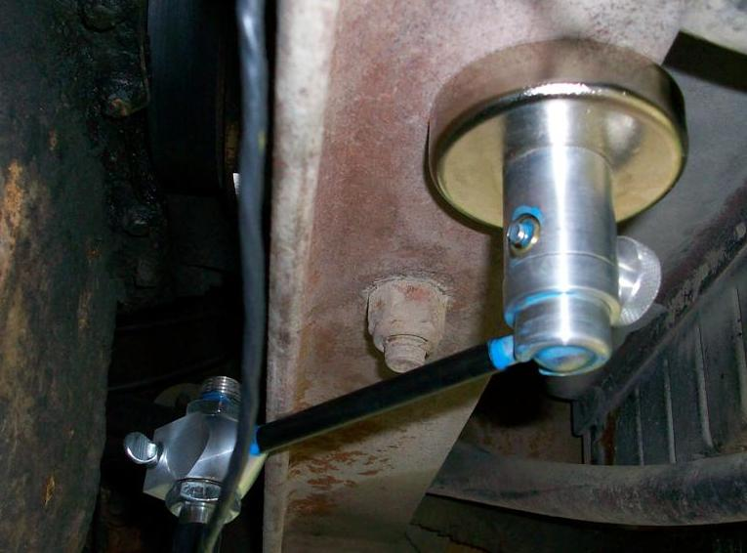
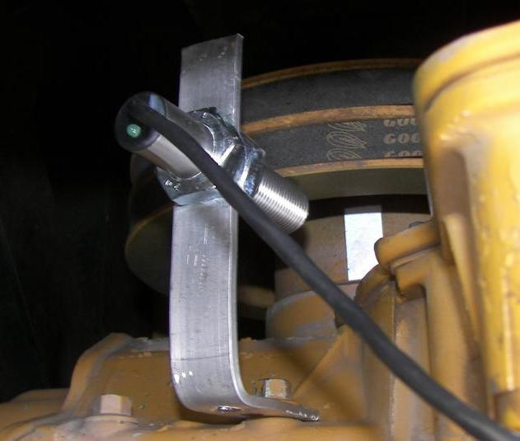
Example Optical Sensor Mountings

Slide 13
Fieldwork summary

Slide 14
Nonroad Data Collection Summary

Slide 15
Nonroad Equipment Tested
Equipment Type | # PEMS Tested | # PAMS Installs | Both PEMS & PAMS
Bulldozers | 2 | 1 | 1
Compact Excavator |  | 1
Compact Loaders |  | 7
Concrete Saw |  | 1
Crane |  | 1
Excavator | 5 |  | 2
Forklift |  | 2
Grader | 2
Horizontal Directional Drill |  | 2 | 1
Loader | 11 | 4 | 3
Road Compactor |  |  | 1
Telescopic Handler | 1 | 2
Well Driller | 1

Slide 16
PEMS examples

Slide 17
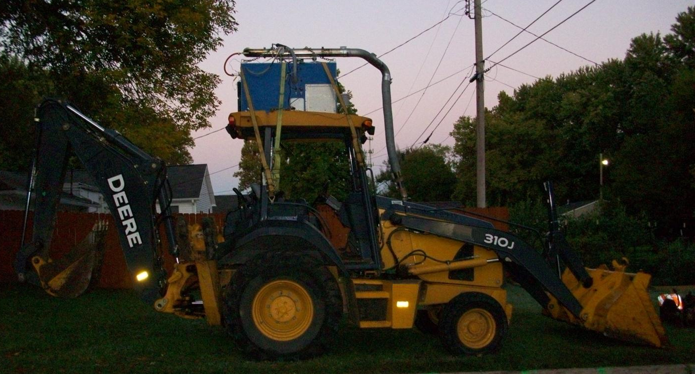
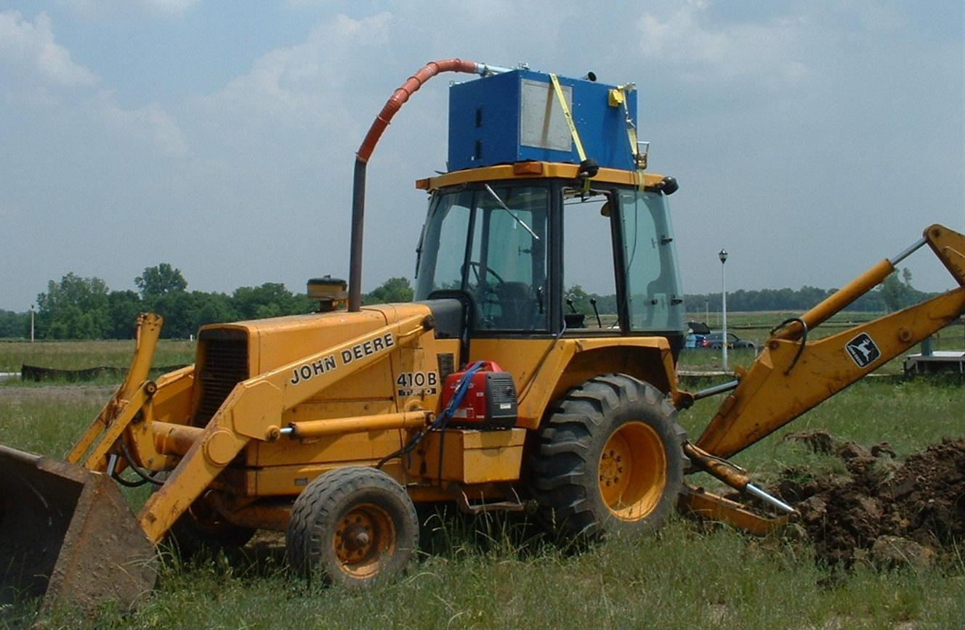
Backhoe Examples
(public utilities excavation and residential construction)

Slide 18
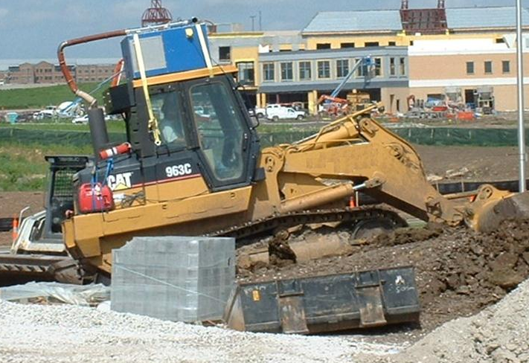
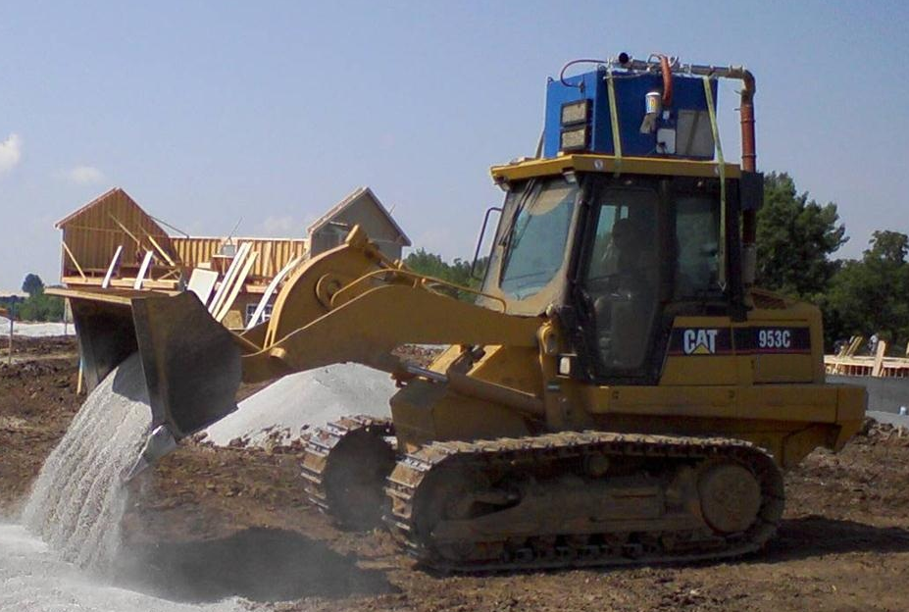
Loader Examples
(commercial construction and roadways)

Slide 19
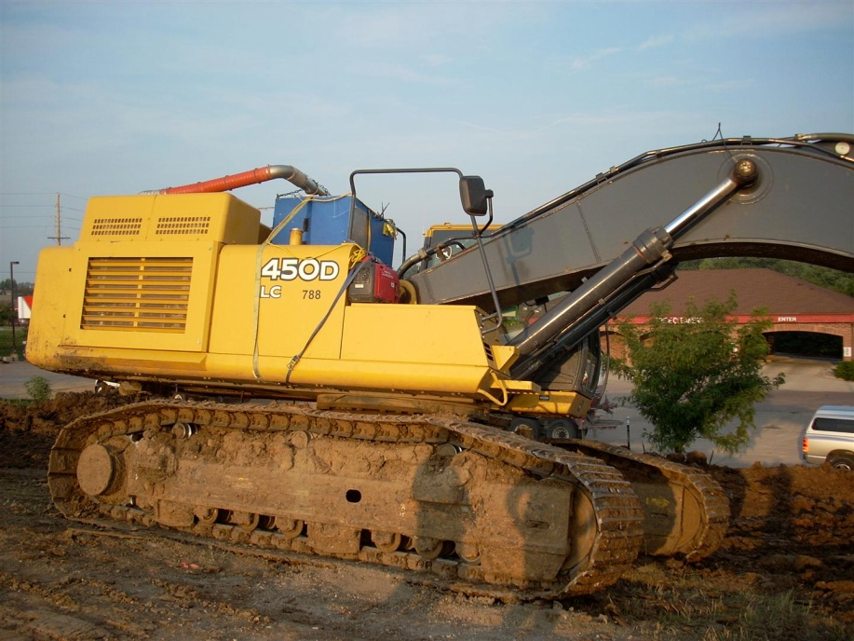
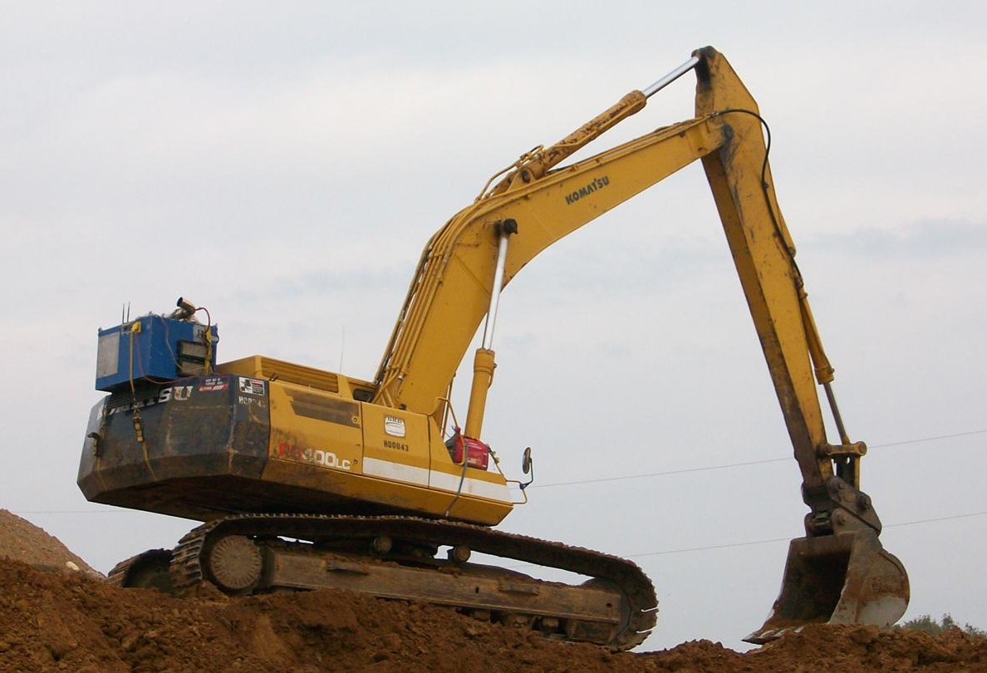
Excavators
(Road Construction)

Slide 20
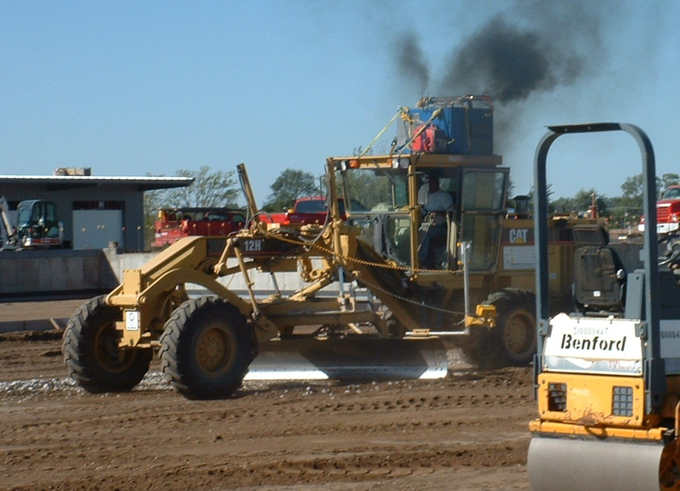
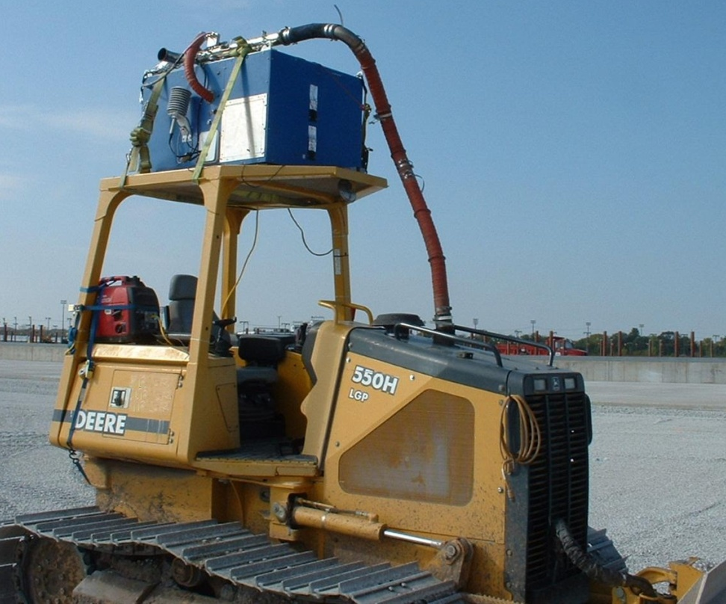
Grader and Dozer Examples
(Road Construction)

Slide 21
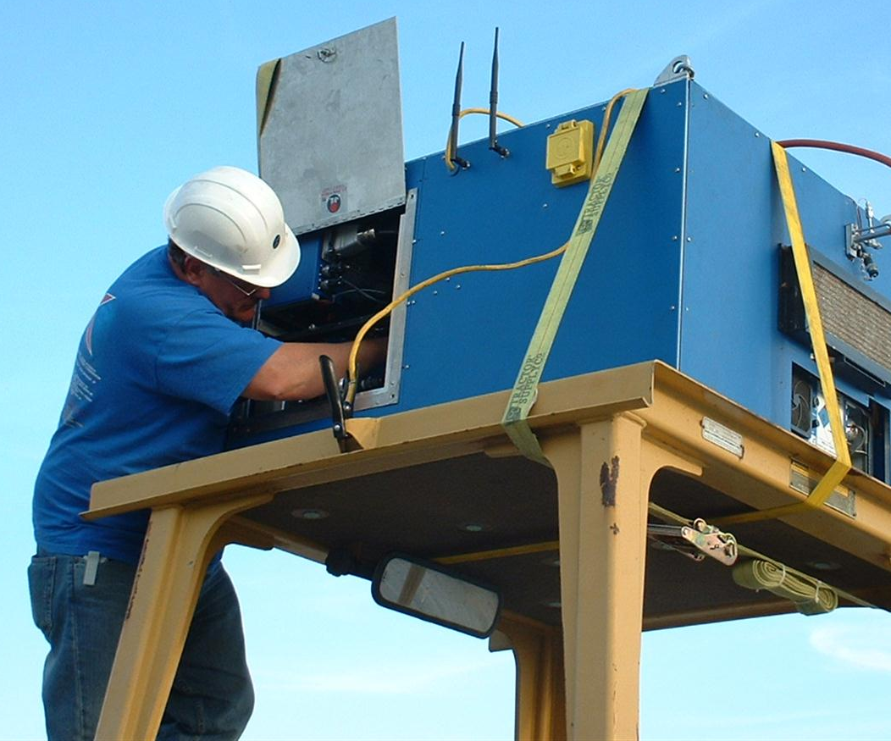
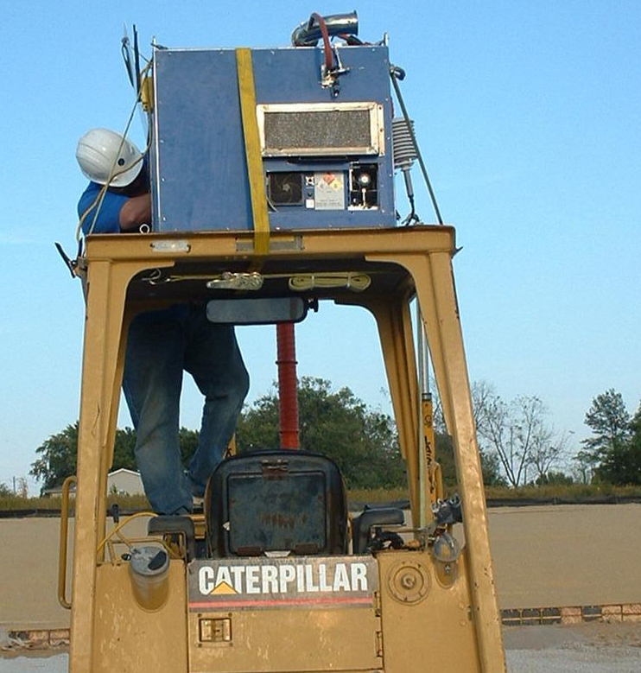
Servicing Installed Equipment
(Sensors’ Louie Moret digging in)

Slide 22
PAMS examples

Slide 23
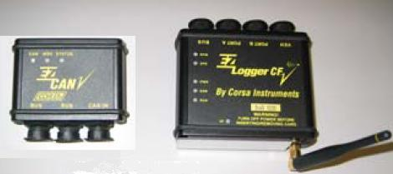
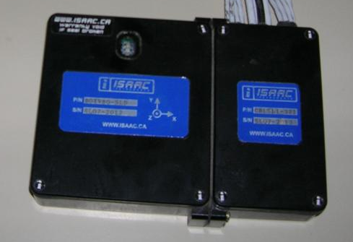
Nonroad PAMS Equipment
for Activity Measurement

Slide 24
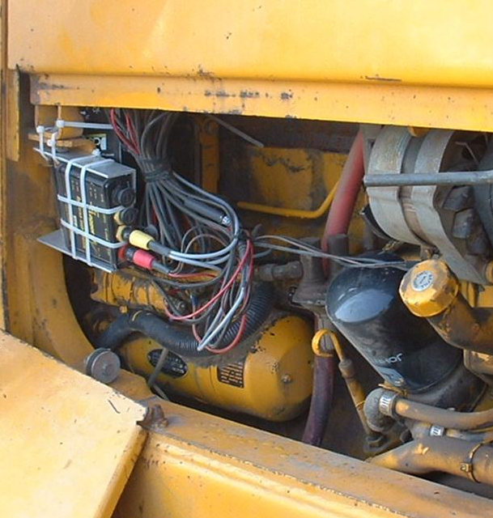
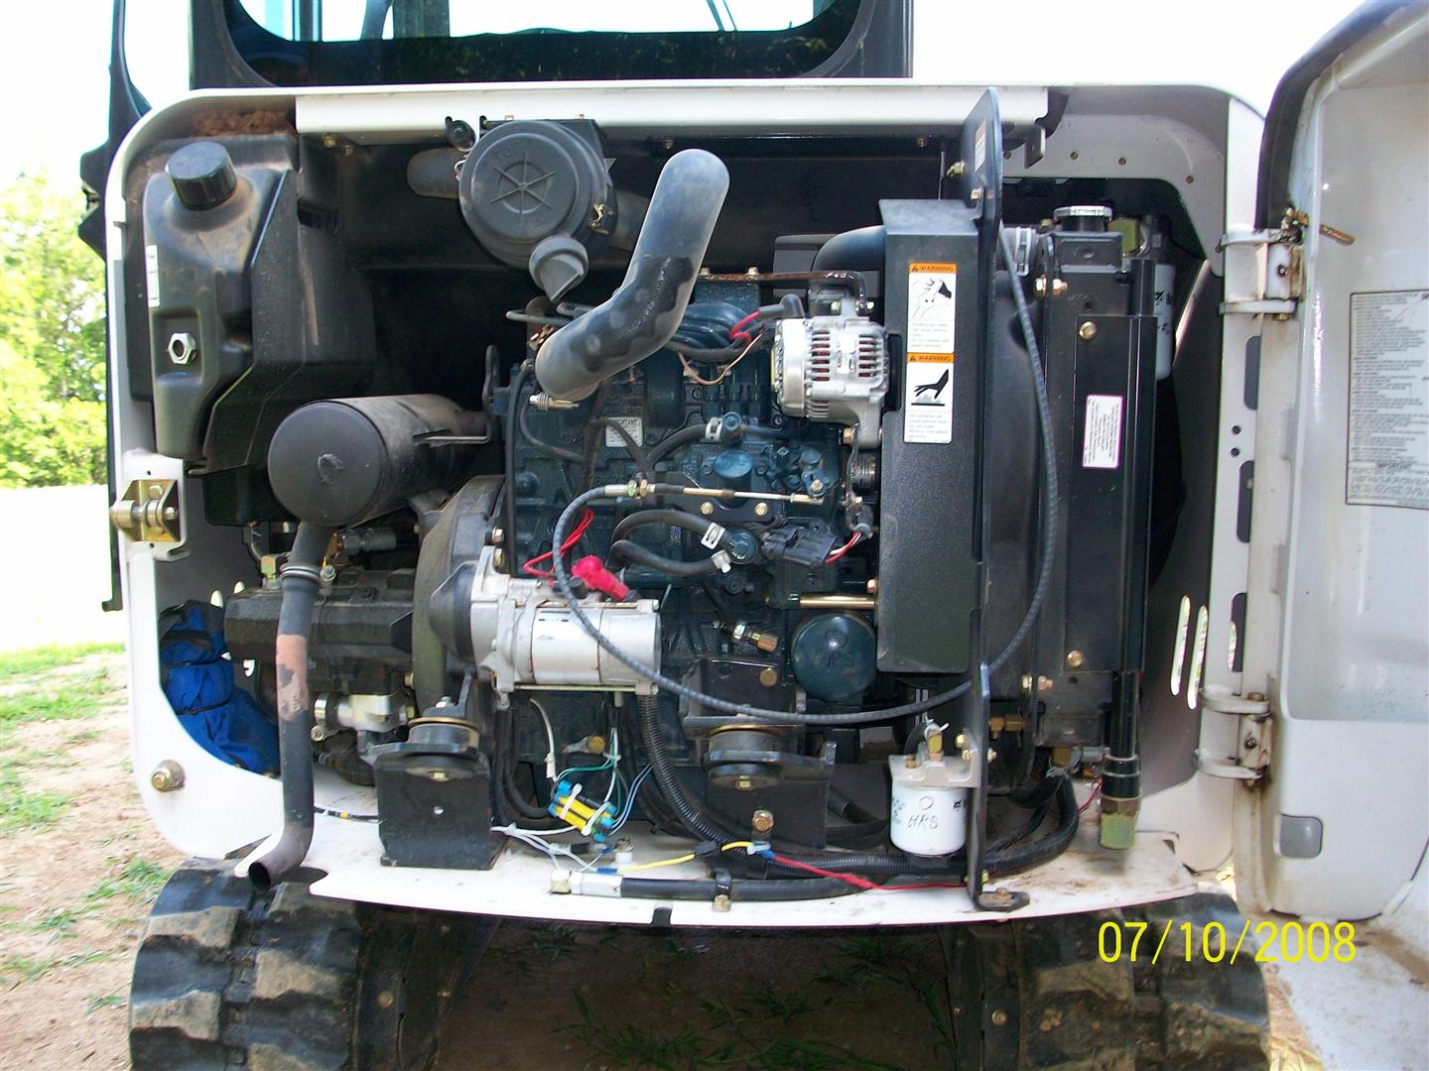
PAMS Examples

Slide 25
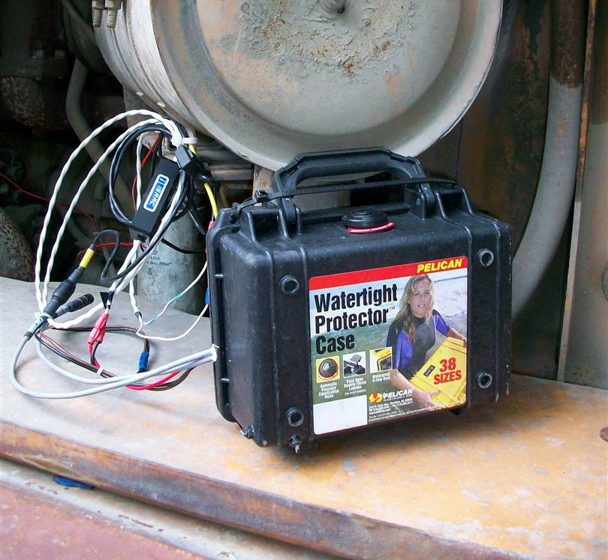
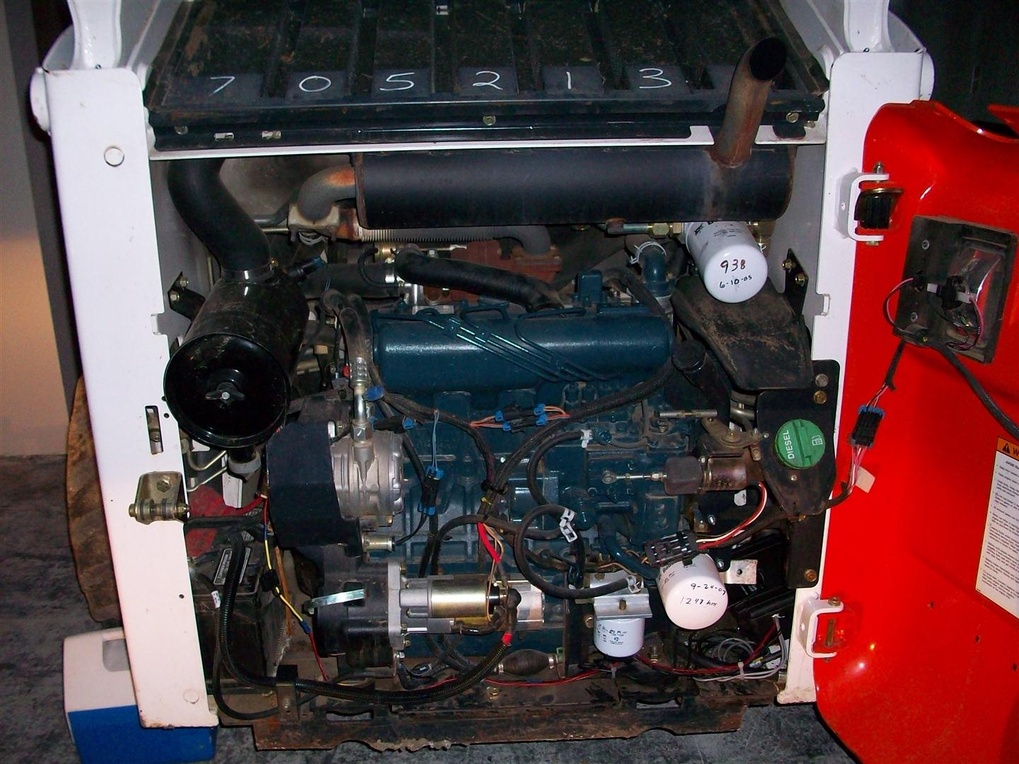
PAMS Sealing

Slide 26
Data validation and emission calculations

Slide 27
PEMS & PAMS Data QC
Time Alignment (RPM, pollutants, exhaust flow, GPS)
Review of all flows, temperatures, concentrations, MPS proportionality, flag and correct as necessary
RPM scaling, apply corrections as necessary
EPA performed QA/QC on PEMS operation compared with 40 CFR Part 1065 Requirements
    Flow meters
    Gaseous analyzers (drift and linearity checks)
    MPS proportionality validation

Slide 28
Emissions Calculations
Emissions were calculated on a time basis (i.e., g/sec), fuel basis (i.e., g/gal), or work basis (i.e., g/kW-hr)
Time-basis and fuel basis calculated directly from PEMS data, but work basis requires engine speed (measured) and power (not measured)
Equipment was either mechanically-controlled or electronically controlled but with non-standardized protocols, so ECU output of torque was not available
Work basis is advantageous because it “normalizes” emission in terms of work performed to evaluate and compare with standards

Slide 29
Brake-Specific Emissions :
Scale Engine Power to Fuel Consumption
To estimate instantaneous (second-by-second) power estimates, ERG and EPA:
- Gathered all available engine maps (BSFC and P_{max}) for equipment tested
- Used PEMS fuel rate with BSFC max fuel rate to estimate power output
Described in SAE 2010-01-10CV0060
Inputs are measured fuel rate, measured engine speed (N), published maximum fuel rate and published maximum power (both from lug curve)
Then, integrate emissions and work over test interval

Slide 30
Emission results

Slide 31
Brake-specific NO_{x} Emissions:
Excavators

Slide 32
Model development

Slide 33
Analysis of Results
Using data from the nonroad construction equipment field study, we:
Developed in-use load factors
Developed in-use emission factors
Developed operational duty cycles
Developed activity estimates

Slide 34
1. Load Factors: Use Mass Fuel Rate
Load factor is the ratio of total amount of work performed to the total amount of work that could have been performed over a defined period of time.
Used previously described assumption that power ratio is proportional to fuel ratio at same rpm
Described in SAE 2010-01-10CV0060 and validated in laboratory

Slide 35
1. Load Factors: Use Mass Fuel Rate
ERG developed two types of load factors based in in-use data for all types of equipment used in study
1a) Load Factor relative to Lug Curve:
Σ [Mass Fuel Rate over test (g/s)]
[Max. Mass Fuel Rate at observed RPM (g/s)]
1b) Load Factor relative to Rated Power:
Σ [Mass Fuel Rate over test (g/s)]
[231 g/kW-hr * Rated Power (kW) * Op Time (hr)]
Notes:
Top is simple, bottom is complex THD is usting the top eqn in his

Slide 36
Lug Curve (LC) & Rated Power (RP) Load Factors
Phase | TestID | Equipment Type | RP (kW) | 1a) LC LF | 1b) RP LF
1 | 0685-1214 | Grader - Wheeled | 147.0 | 0.555 | 0.221
2 | 3597-4734 | Loader - Wheeled | 50.7 | 0.432 | 0.158
2 | 3597-9706 | Bulldozer - Tracked | 62.7 | 0.466 | 0.463
2 | 3858-1482 | Bulldozer - Tracked | 64.9 | 0.504 | 0.452
2 | 3858-4862 | Telescopic Handler - Wheeled | 75.3 | 0.320 | 0.196
3 | 0062-0748 | Backhoe Loader - Wheeled | 63.0 | 0.392 | 0.316
3 | 0062-6092 | Backhoe Loader - Wheeled | 63.0 | 0.533 | 0.543
3 | 0229-0045 | Backhoe Loader - Wheeled | 56.0 | 0.394 | 0.322
3 | 0229-3781 | Excavator - Wheeled | 95.5 | 0.300 | 0.116
3 | 0349-1836 | Loader - Tracked | 90.3 | 0.473 | 0.536
3 | 0349-2422 | Excavator - Tracked | 95.5 | 0.745 | 0.702
3 | 8391-3333 | Excavator - Tracked | 260.0 | 0.498 | 0.345
3 | 8418-0097 | Loader - Tracked | 119.4 | 0.697 | 0.599
3 | 8418-0377 | Loader - Tracked | 111.9 | 0.831 | 0.920
3 | 8925-2466 | Loader - Tracked | 126.8 | 0.604 | 0.535
3 | 9272-0853 | Excavator - Tracked | 246.2 | 0.684 | 0.415
3 | 9272-2494 | Loader - Tracked | 164.1 | 0.553 | 0.288
3 | 9272-3481 | Excavator - Tracked | 239.5 | 0.561 | 0.436
3 | 9960-5674 | Excavator - Tracked | 190.2 | 0.467 | 0.304
3 | 9960-6086 | Articulated Loader - Wheeled | 92.5 | 0.393 | 0.178

Slide 37
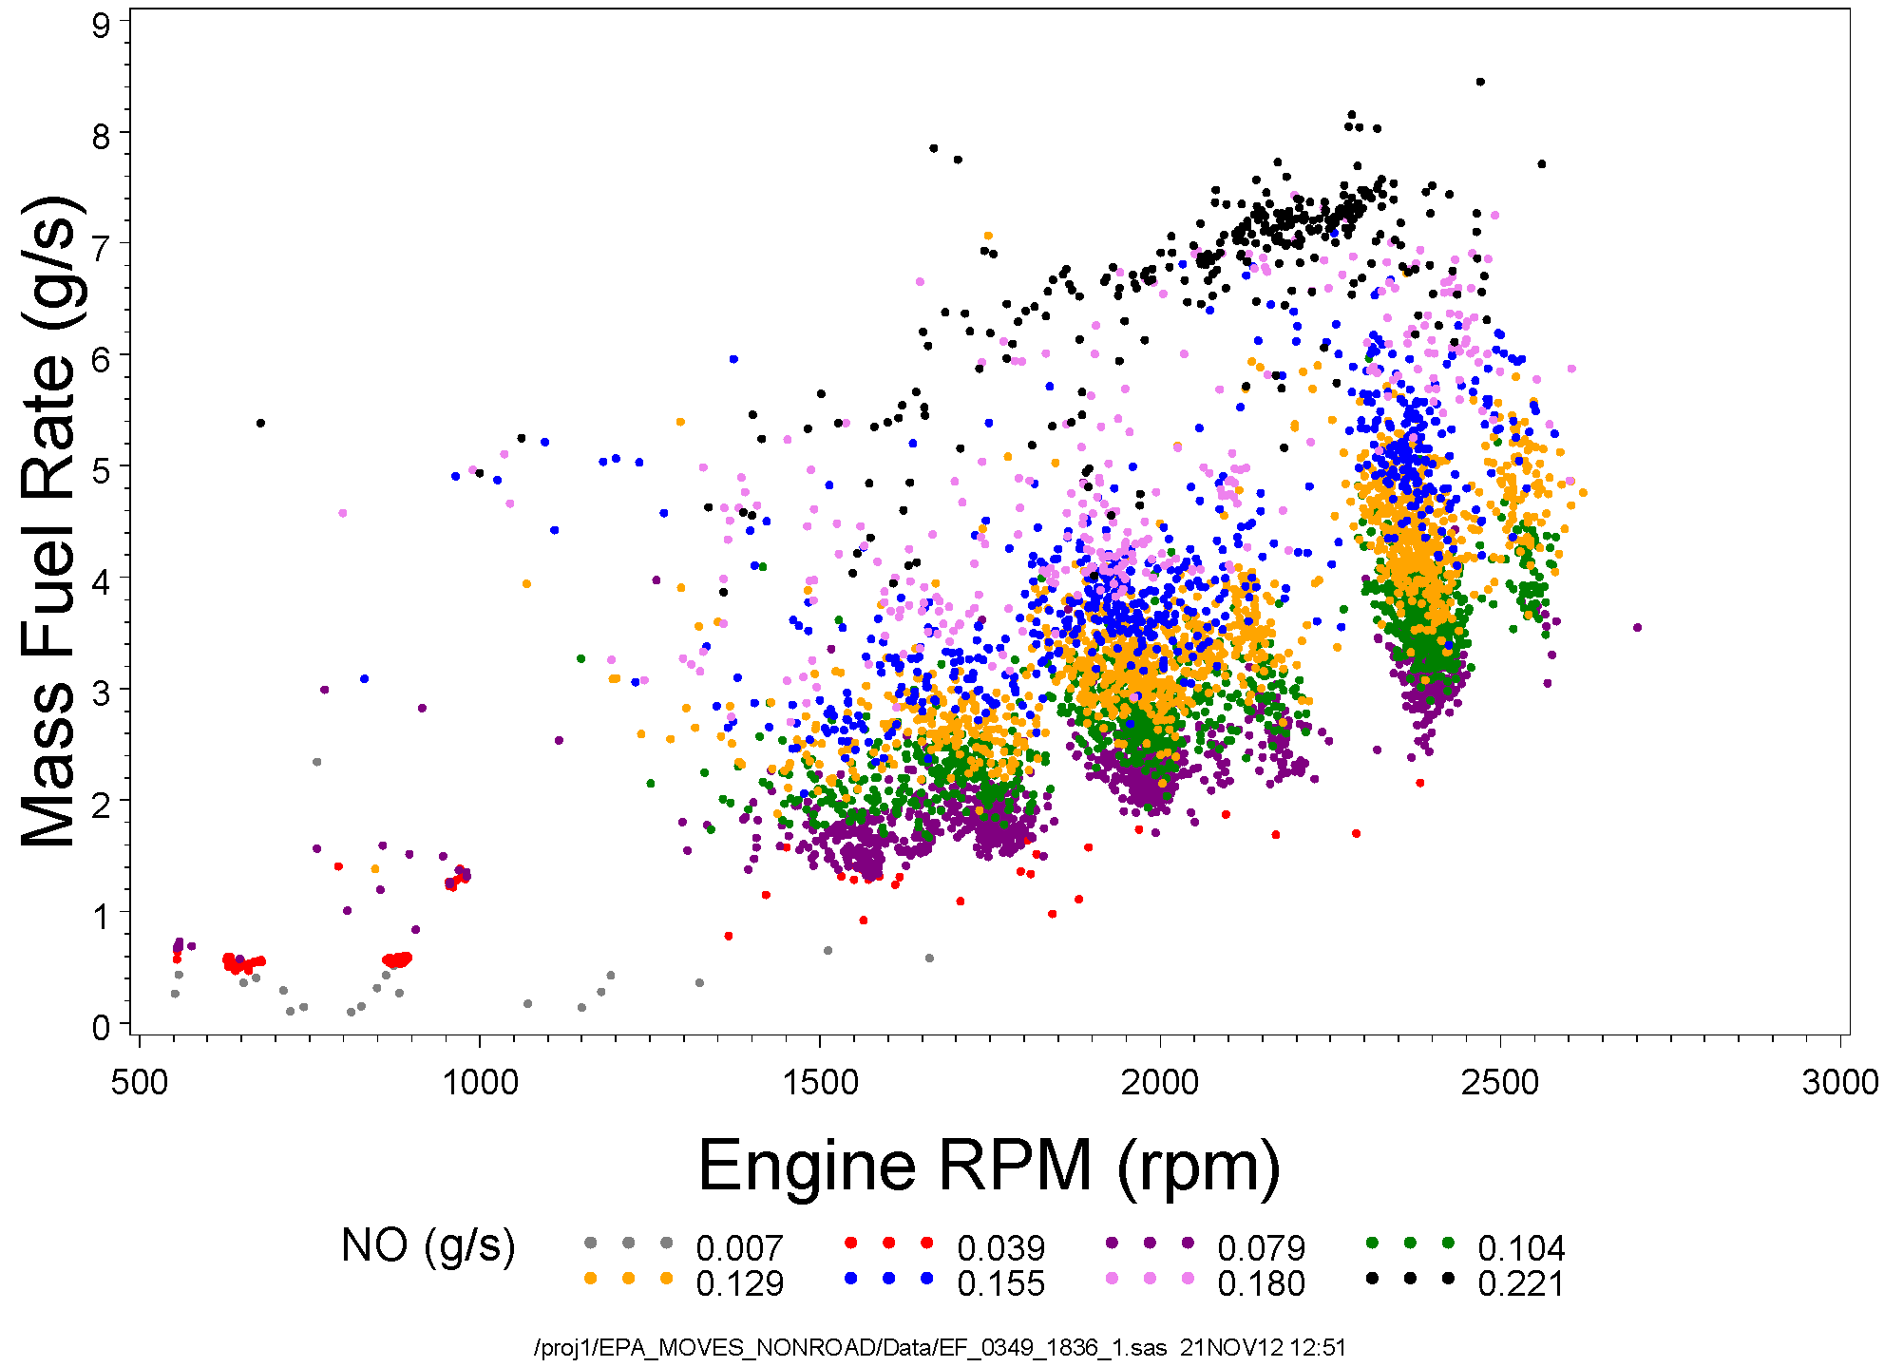
Tracked
Loader #1
2. Emission Factors: NO vs. Mass Fuel Rate and RPM

Slide 38
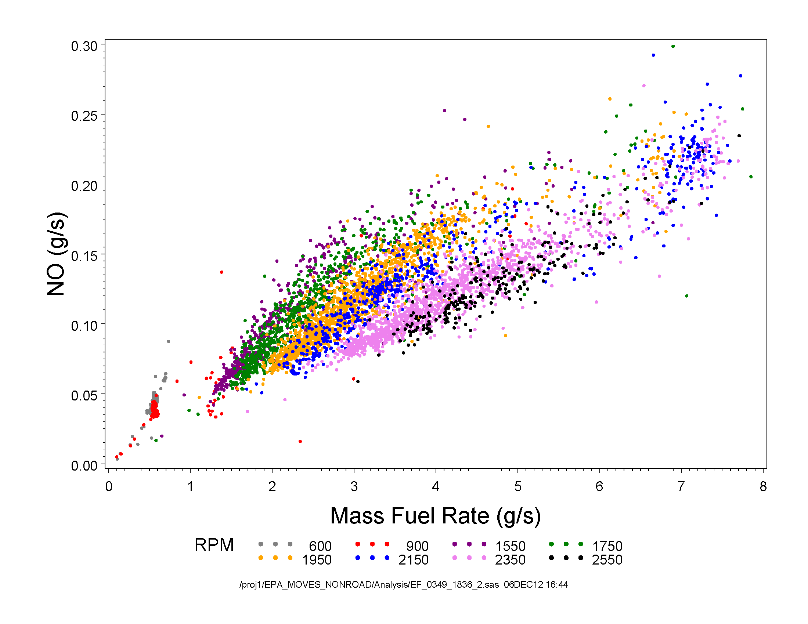
2. Emission Factors: NO vs. Mass Fuel Rate and RPM
Tracked
Loader #1

Slide 39
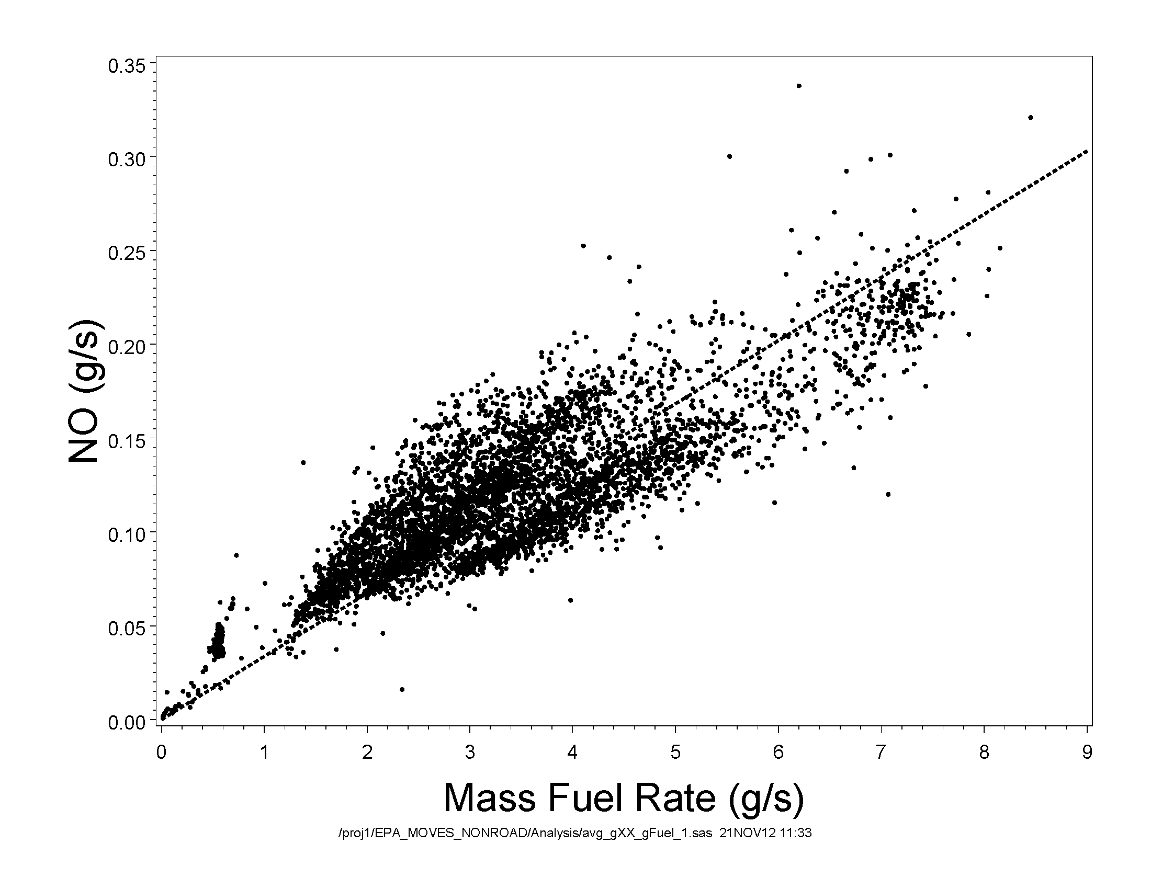
2. Emission Factors: MFR biggest effect
Tracked Loader
#1 with 1/1 line
Some scatter: due to diffusion / alignment?

Slide 40
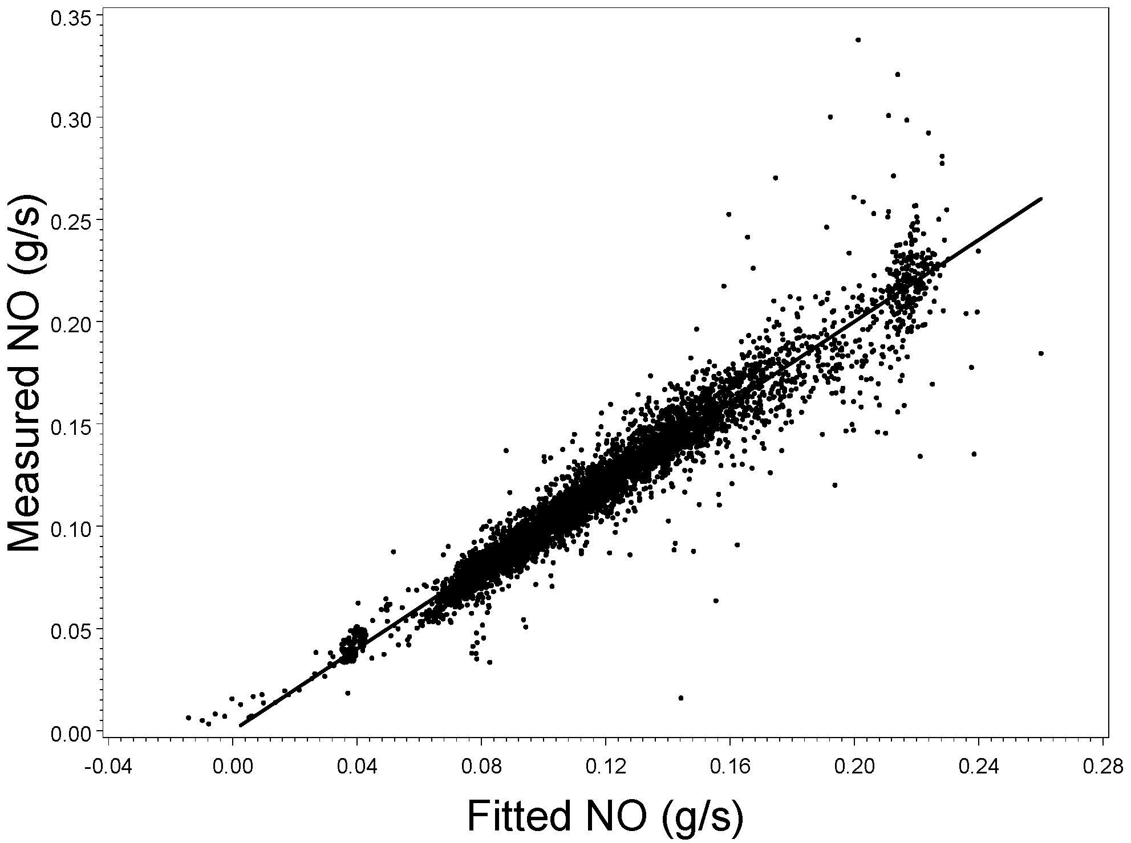
2. Emission Factors: f(MFR, RPM, MFR, RPM)
Tracked
Loader #1

Slide 41
4. Duty Cycles
A duty cycle is an engine power / speed vs. time operation cycle developed to represent actual operation
Built from snippets of actual in-use operation such that cycle matches characteristics of actual operation for that type of equipment
Scaled emission factors can then be applied to duty cycle in order to develop in-use emission estimates
Since power was not available in our data, mass fuel rate was again used as surrogate for load

Slide 42
4. Duty Cycles
Using nonroad construction equipment study data, ERG created duty cycles for:
Bulldozers (Tracked)
Backhoe Loaders (Wheeled)
Loaders (Tracked)
Telescopic Handlers (Wheeled)
Articulated Loaders (Wheeled)
Excavators (Tracked)

Slide 43
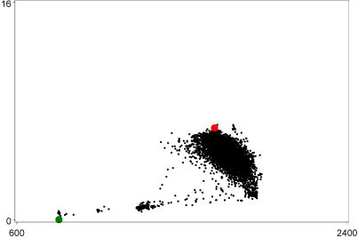
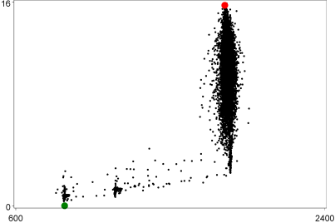
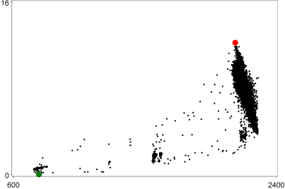
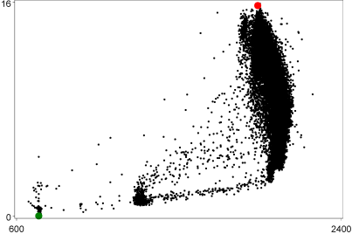
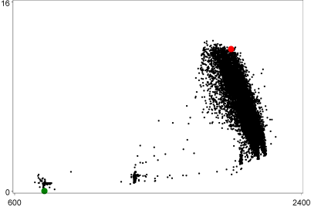
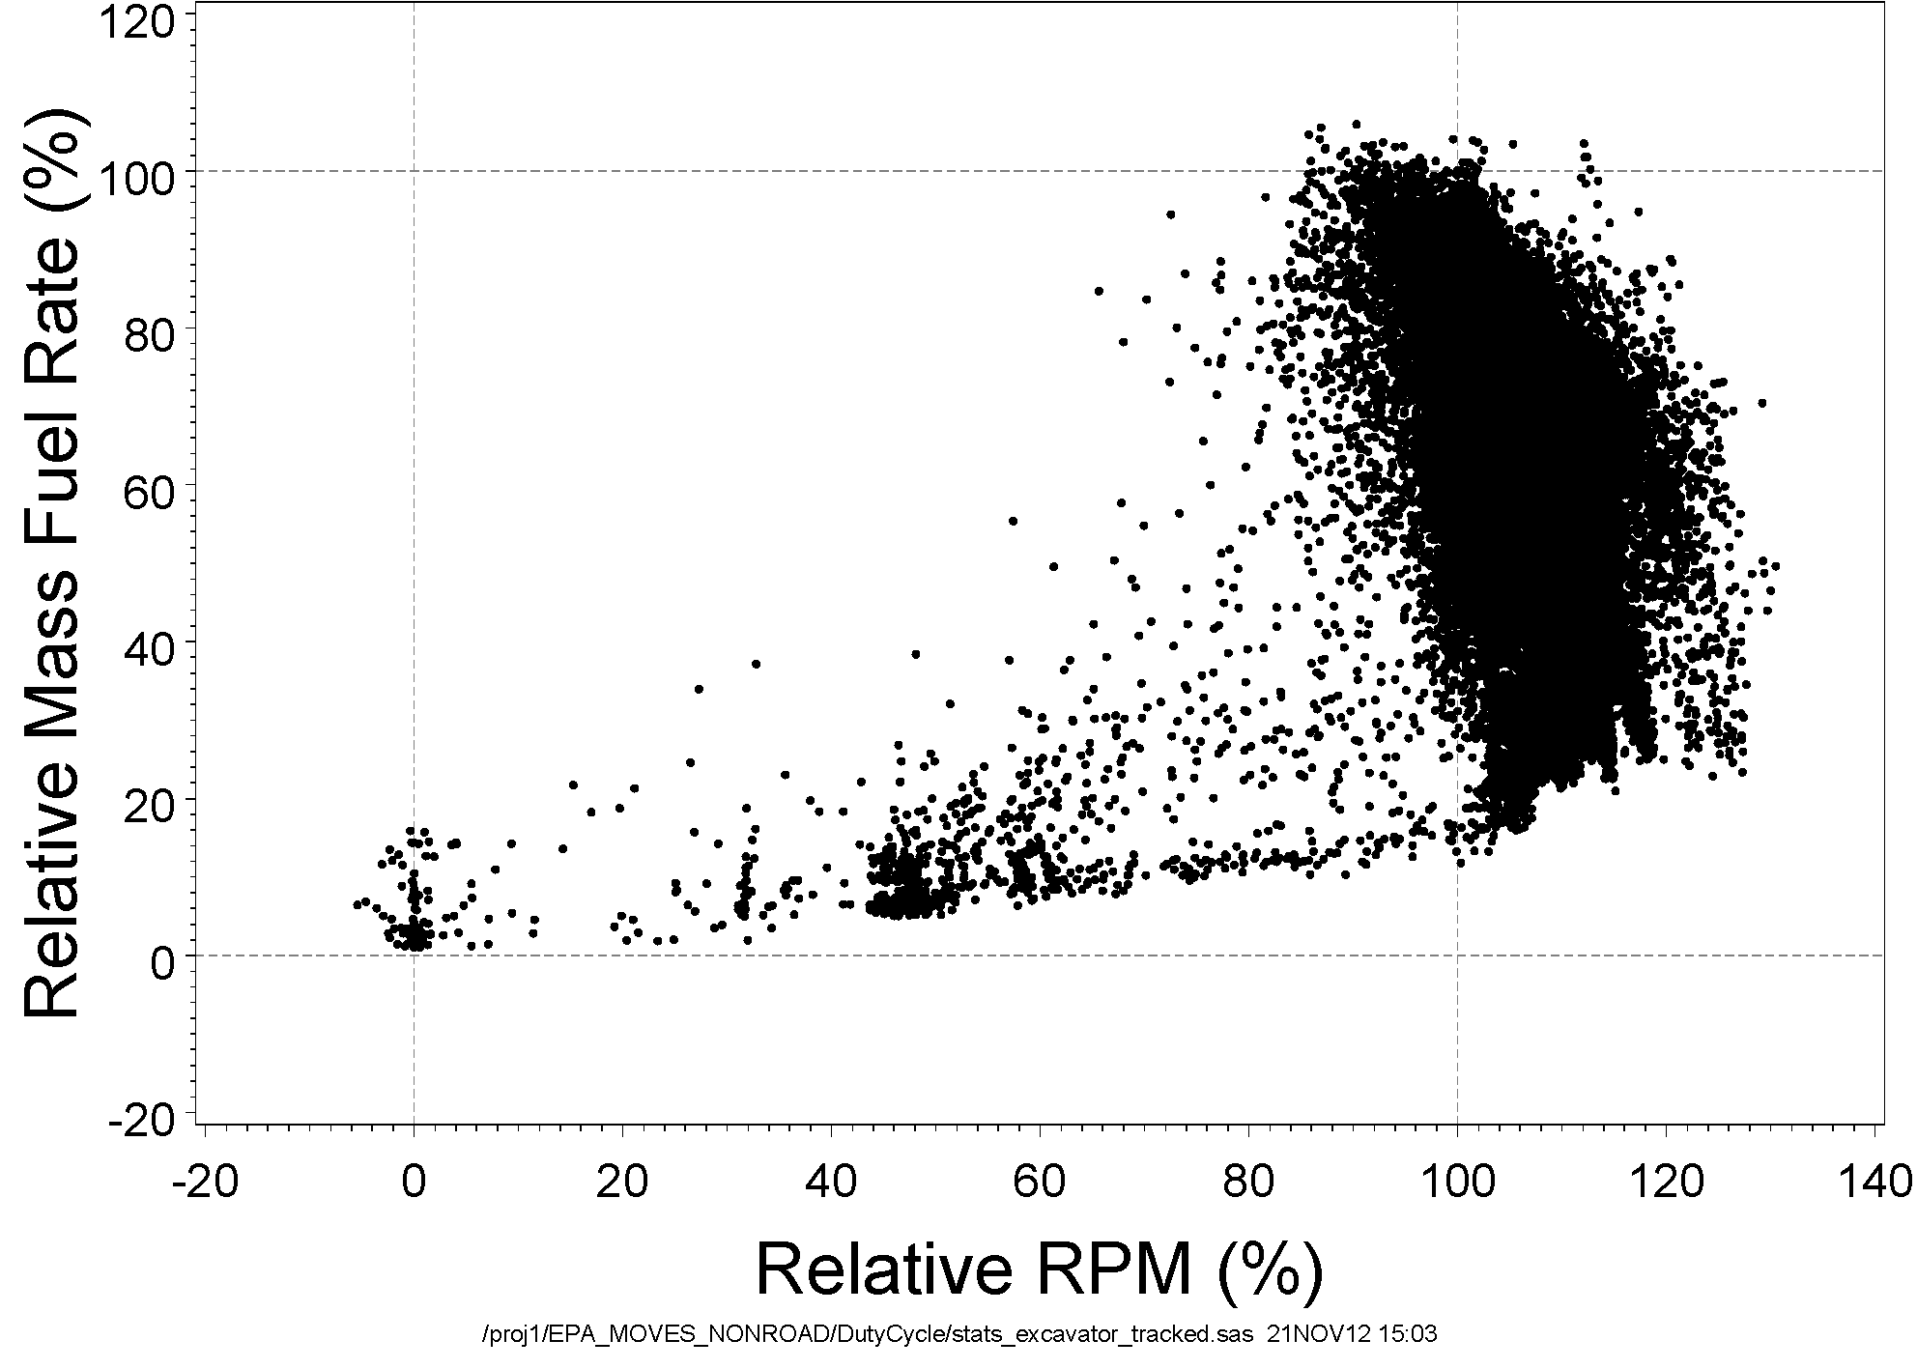
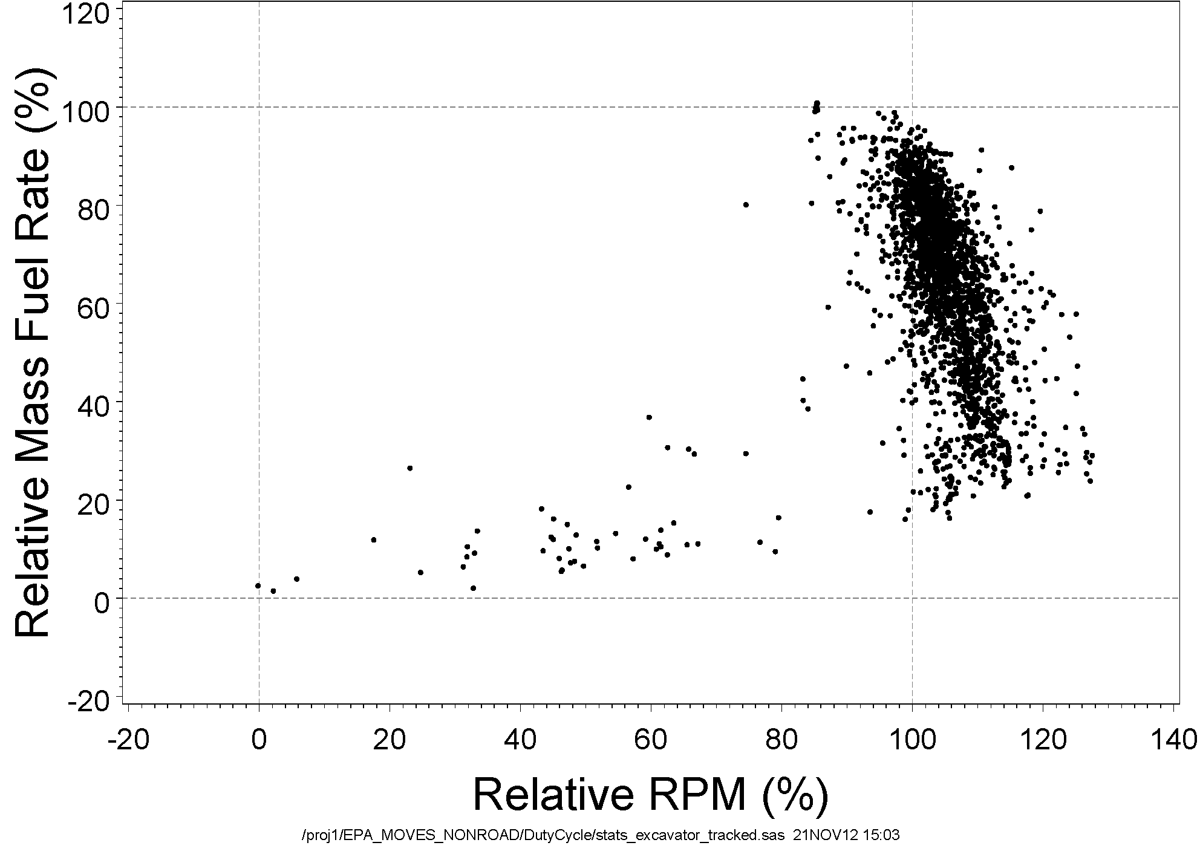
3. Duty Cycles: Scaling
Excavator
#1
Excavator
#2
Excavator
#3
Excavator
#4
Excavator
#4
Excavator
#5
Target
Cycle
Target
Cycle

Slide 44
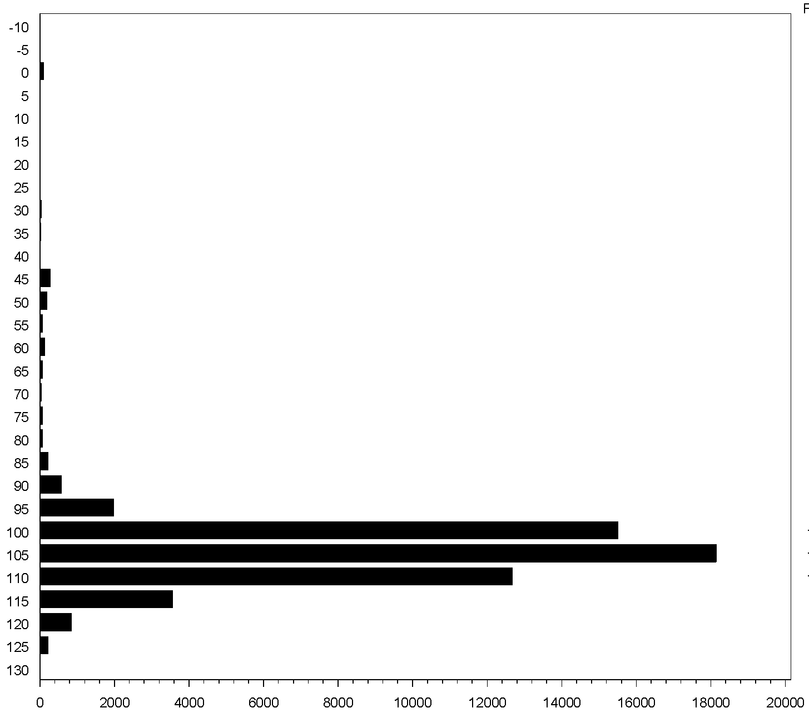
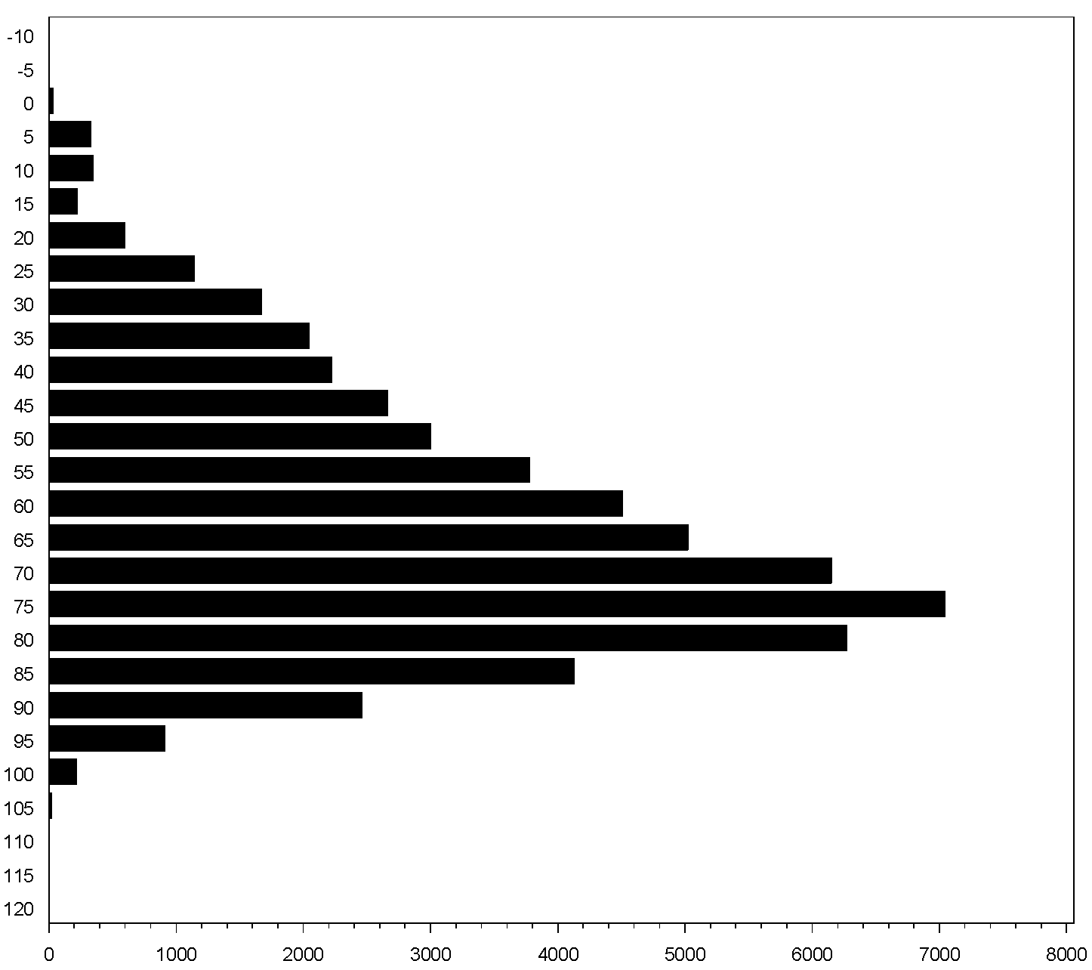
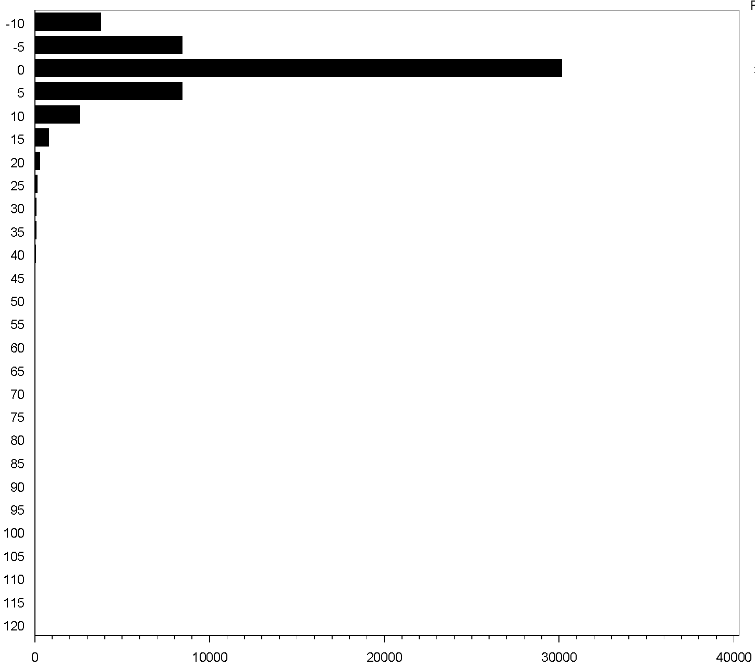
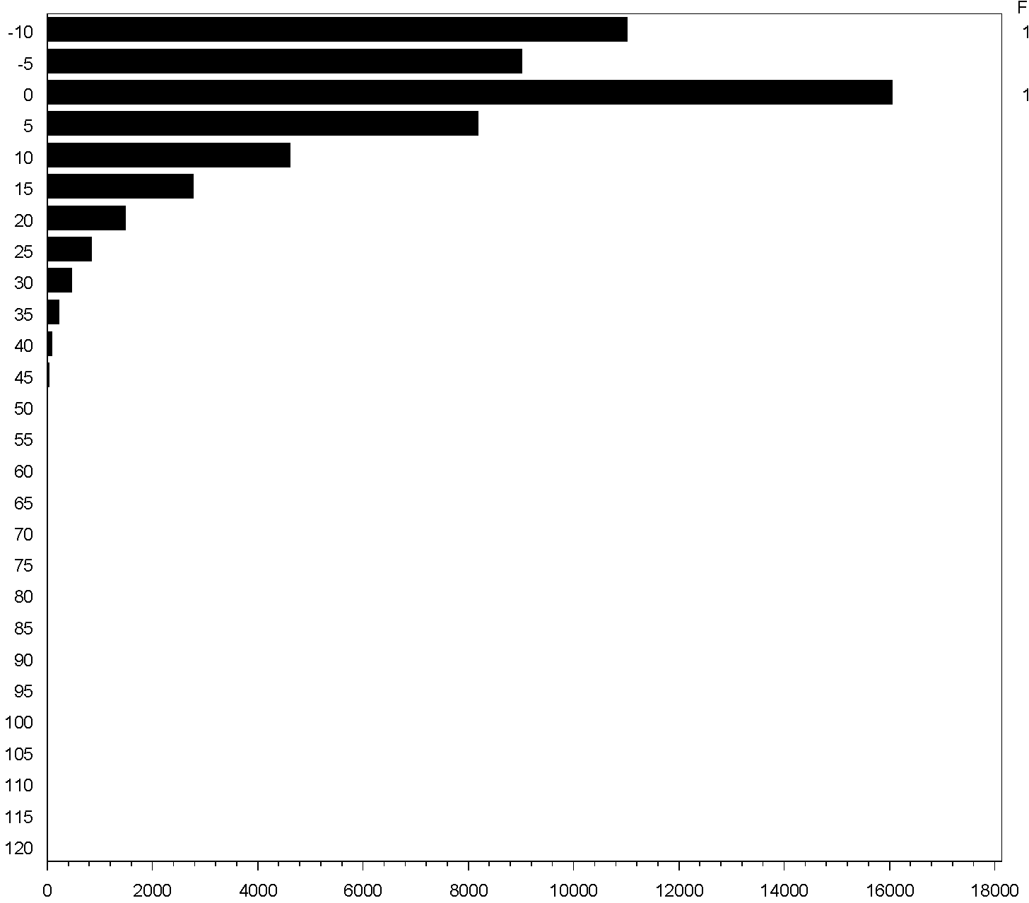
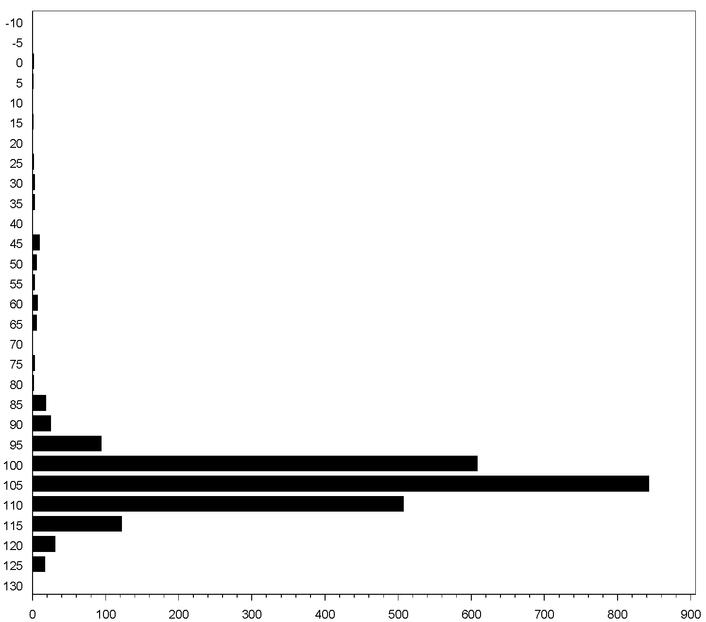
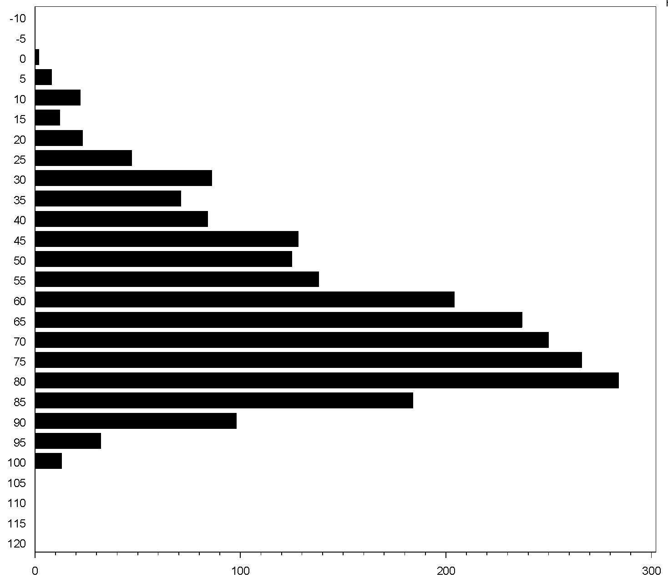
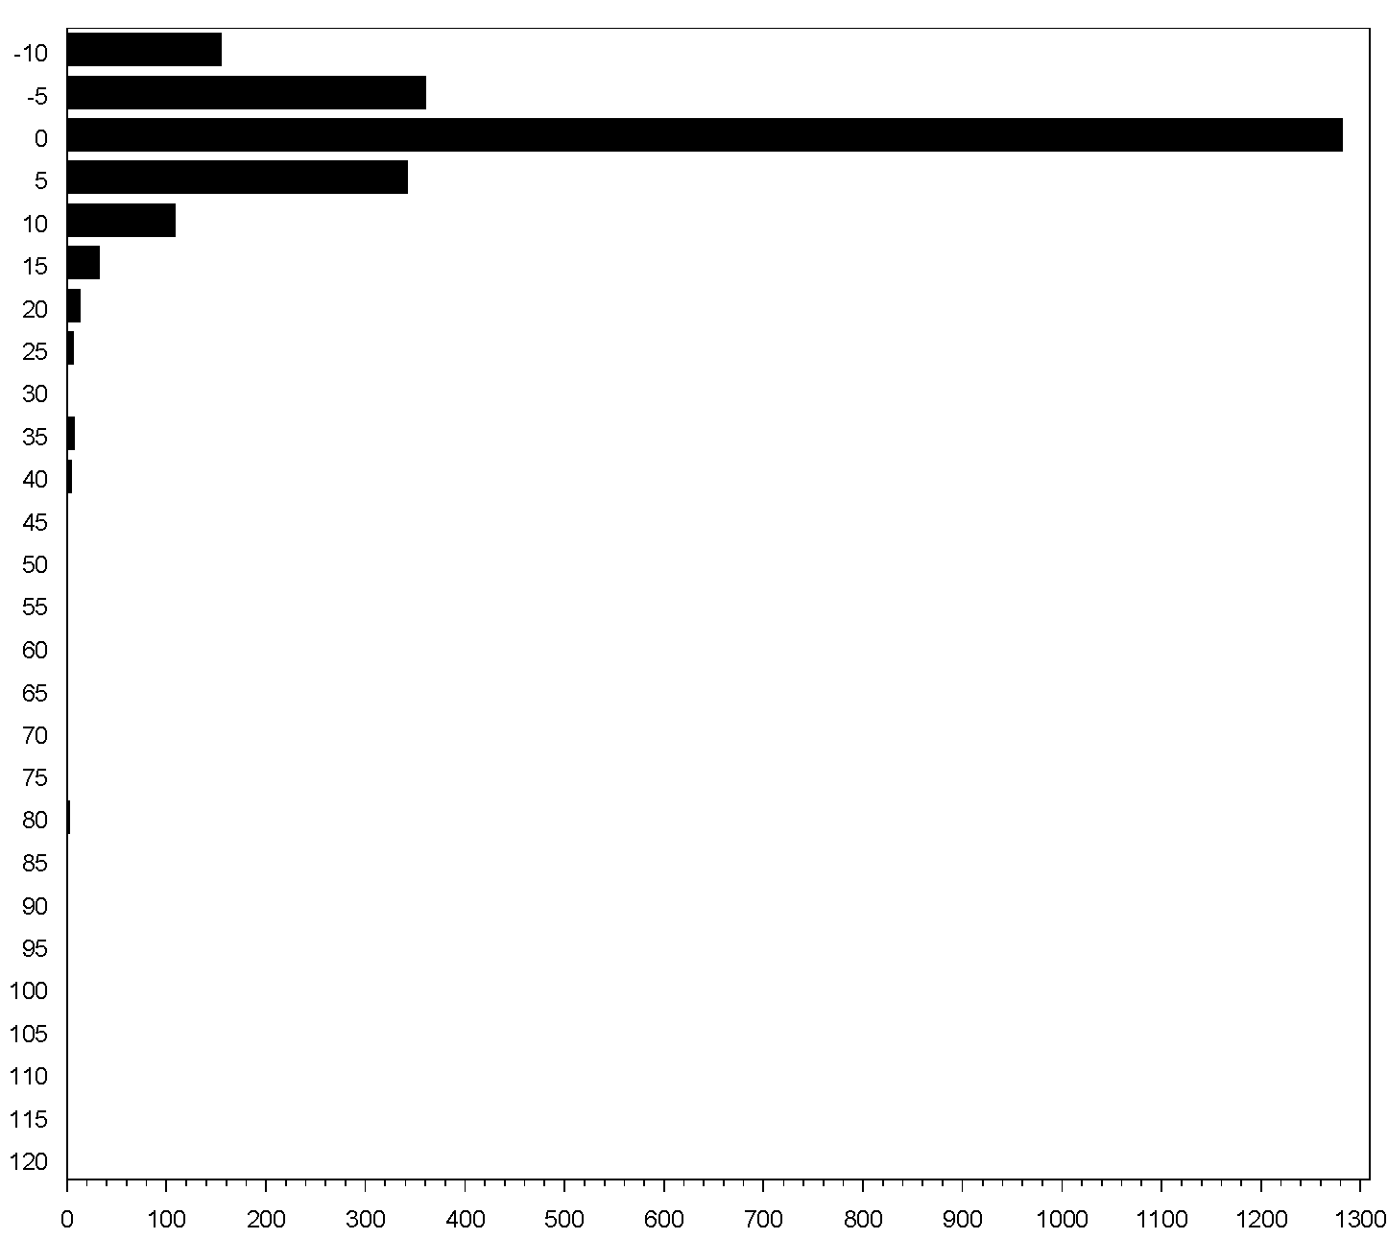
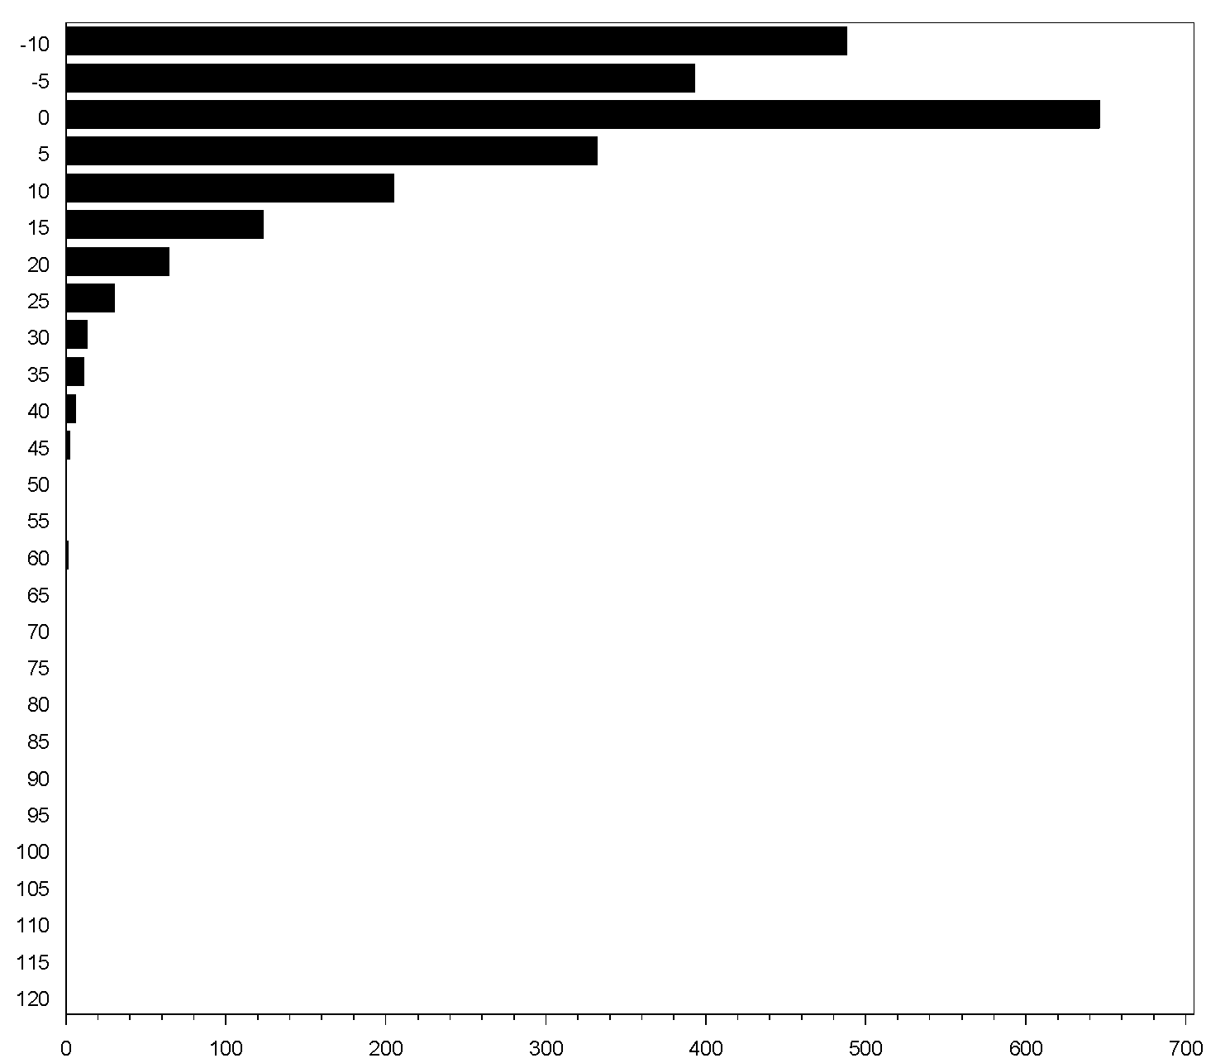
3. Duty Cycles: Evaluation
5 Tracked Excavators
MFR
RPM
ΔMFR/Δt
ΔRPM/Δt
Target
Cycle

Slide 45
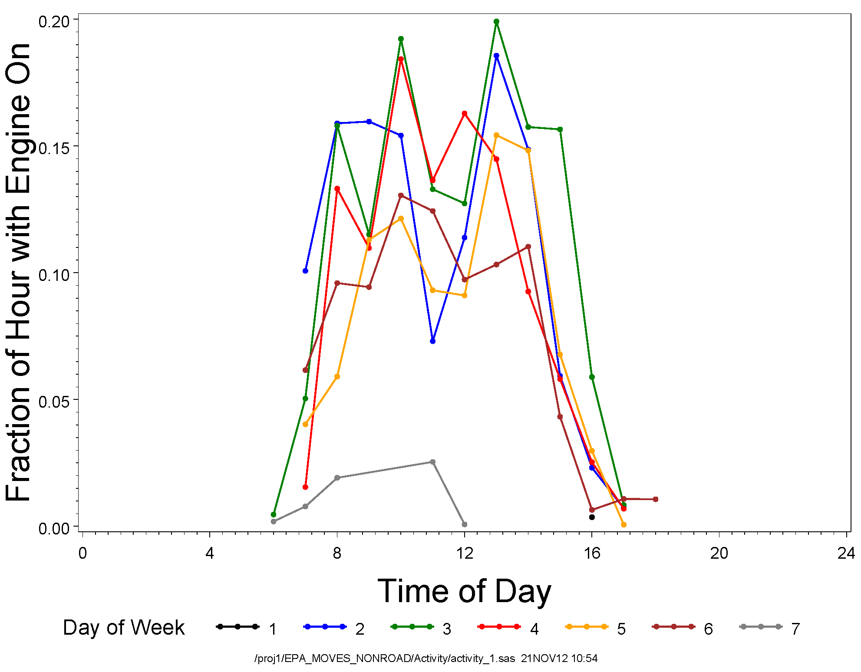
4. Activity Estimates: Day of Week, Time of Day
3
Backhoe Loaders

Slide 46
Summary and Conclusions
Focused on nonroad construction equipment
Used weighted stratified sampling
Conducted full site inventories to understand measured equipment in relation to overall equipment population
Developed fuel, time, and work-based PM and gaseous emissions estimates
Work-based emission estimates determined without ECU torque output:
  Appear reasonable, assuming BSFC linearity across range of load at every RPM and verified with lab engine correlation, BUT
  Could use more exact lug curves
  Deduced curves add about +/-5% variability (mainly at high and low engine speed)
  Potential for bias with deduced curves, especially beyond parameterized range
Developed load factors, emission factors, duty cycles and activity profiles for in-use non-road construction equipment

Slide 47
Acknowledgements
U S Environmental Protection Agency
Coordinating Research Council (E70)
Sensors, Inc.
Southern Research Institute
Infowedge (Andrew Burnette)
NuStats, Inc.
The Urban Institute
The Desert Research Institute

Slide 48
Thank you for your time!
Michael Sabisch, Eastern Research Group
michael.sabisch@erg.com
512-407-1828

Slide 49
Additional slides

Slide 50
Equipment Selection
Resulting combinations: “LgHi”, “LgLo”,
“SmHi”, “SmLo”, and “unknown” …
In sampling, we assign relative weights to
pieces by combination …
In selecting equipment, we want to:
(1) sample randomly, AND
(2) favor “large” equipment that is “used a lot”
Compromise solution: stratified sampling by size and usage
Size: “small” = rated at ≤100 hp
“large” = rated at >100 hp
“unknown”
Usage: “low” = 500 or fewer hr/yr
(lifetime average)
“high” = more than 500 hr/yr
“unknown”

Slide 51
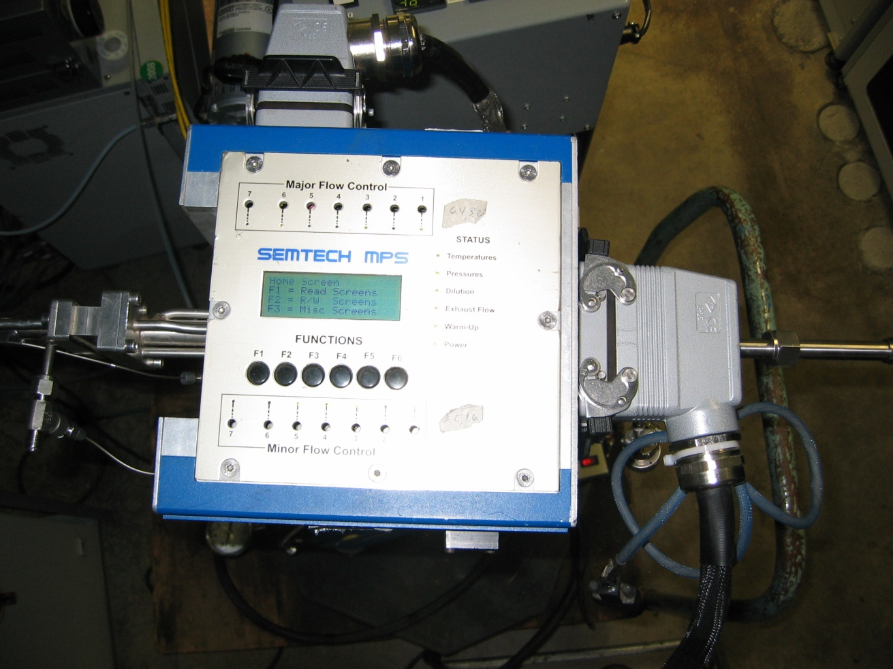
Micro Proportional Sampler (MPS) Unit

Slide 52
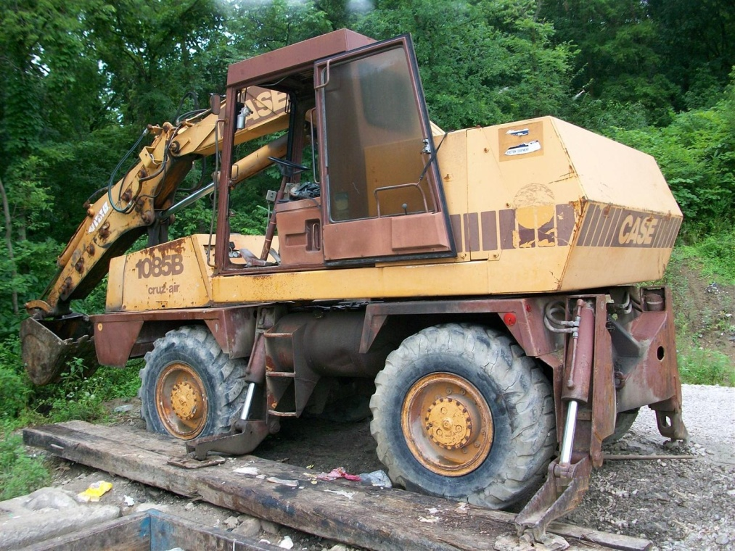
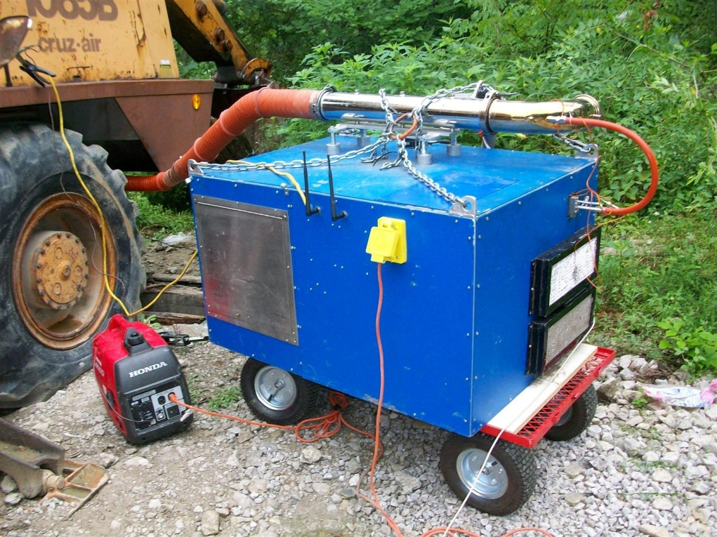
Excavator Example
(Stationary Trash Compactor)

Slide 53
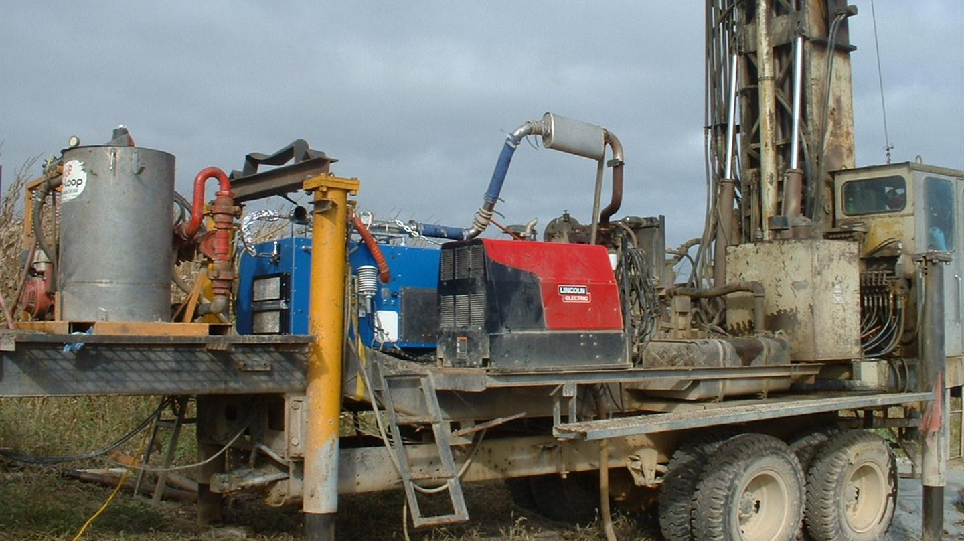
Well Driller Example

Slide 54
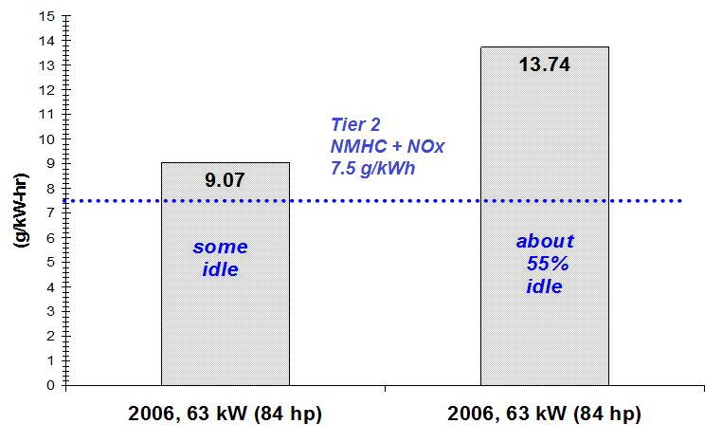
Brake-specific NO_{x} Emissions:
Backhoe Loaders

