Slide 1
Compliance Testing Applications: Installation Safety / Data Processing Tools
CeCERT 2013 PEMS Conference & Workshop
April 11, 2013
Steven S. Trevitz
Sr. Staff Engineer
Volvo Group Trucks Technology

Slide 2
Industry Developments (How Do PEMS Help Development and Compliance)
The Vehicle is a PEMS
Electronic Contols sensors, models
OBD legal requirement
Data Collection ECM
Service Tools
Engineering Tools
Development
Logging
Compliance-grade §1065 PEMS
Not used for development
Resource intensive
Different data of interest

Slide 3
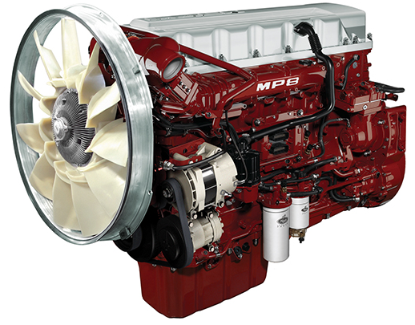
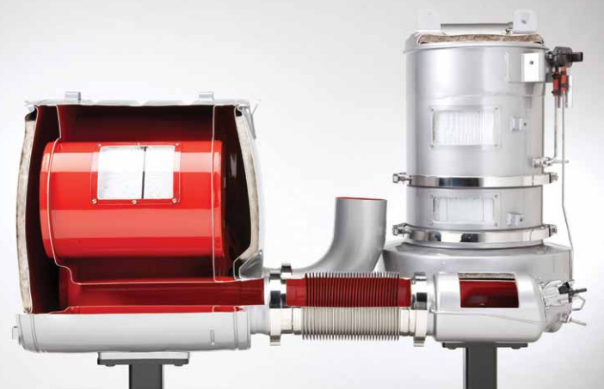
Product Development / Validation
Testing of Vehicle / Engine / EATS
Local
Expedition
Customer Field
Data Acquisition
ECM + Instrumentation
CSM UniCAN
Sensors
Lab Equipment
AVL Micro Soot Sensor engine-out soot

Slide 4
Compliance Test Equipment
Gas PEMS: Horiba OBS-2200
NOx, HC, CO, CO2
Exhaust Flow
Ambient Temp, Humidity, and Pressure
PM PEMS: AVL 494
Real-Time Soot
Gravimetric Filter Module
Central Controller: CSM UniCAN
ECM Data
Gas & PM PEMS synchronization
O2
GPS
EATS-out Exhaust Temp

Slide 5
Volvo-Designed Subsystems & Integration 18-hour unattended operation
Installation
In-Cab
Frame-side mount
Back-of-Cab to become primary installation method
Gassing System
Air, Quad-blend, FID fuel
Hourly zero and span calibrations
Power
Diesel generator
Alternator + inverters
Software
Analysis, Alignment, Computation, Reporting, and Validation

Slide 6
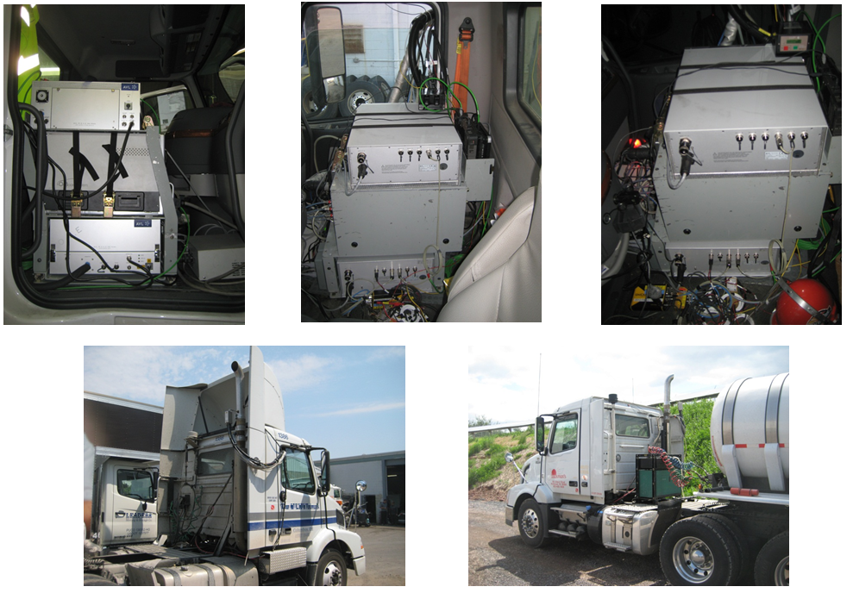

Slide 7
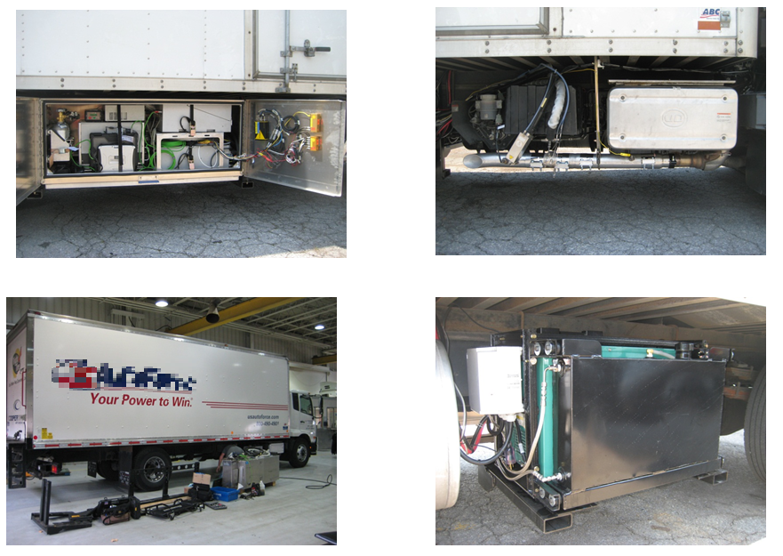

Slide 8
Generator Safety
Mounting DOT-legal
Secure
Fuel tank
Electrical
Grounding
Shore Power
Short-Circuit Prevention and Protection
Exhaust
Heat
Vehicle, Solar, Pavement
Safety Shutdown System

Slide 9
Synchronization and Control
PM PEMS requires [HC], exhaust flow, & exhaust temp from Gas PEMS
Gas PEMS undergoes hourly calibrations
UniCAN detects Gas PEMS calibration:
Signals PM PEMS to suspend filter loading during Gas PEMS calibration
PM PEMS filter loading will be terminated if FID extinguishes
Result Consistent hourly trigger for all 3 data loggers
Gas PEMS
Zero on/off
Span on/off
FID on/off
Uni-CAN
Control
Filter on/off
Filter on/off
State
PM PEMS

Slide 10
Data Management and Processing
All data logging at 10 Hz
3 systems combined generate 85 MB/hour of data
Typical test of 12 hours > 1 GB of data, 26 files
Specialized software
View data
Concatenation and continuity
Alignment and time correction
Gaseous and PM Mass calculations
Parse to 1 Hz
NTE calculations
Report preparation Engineering Analysis, Validation, EPA/CARB submissions

Slide 11
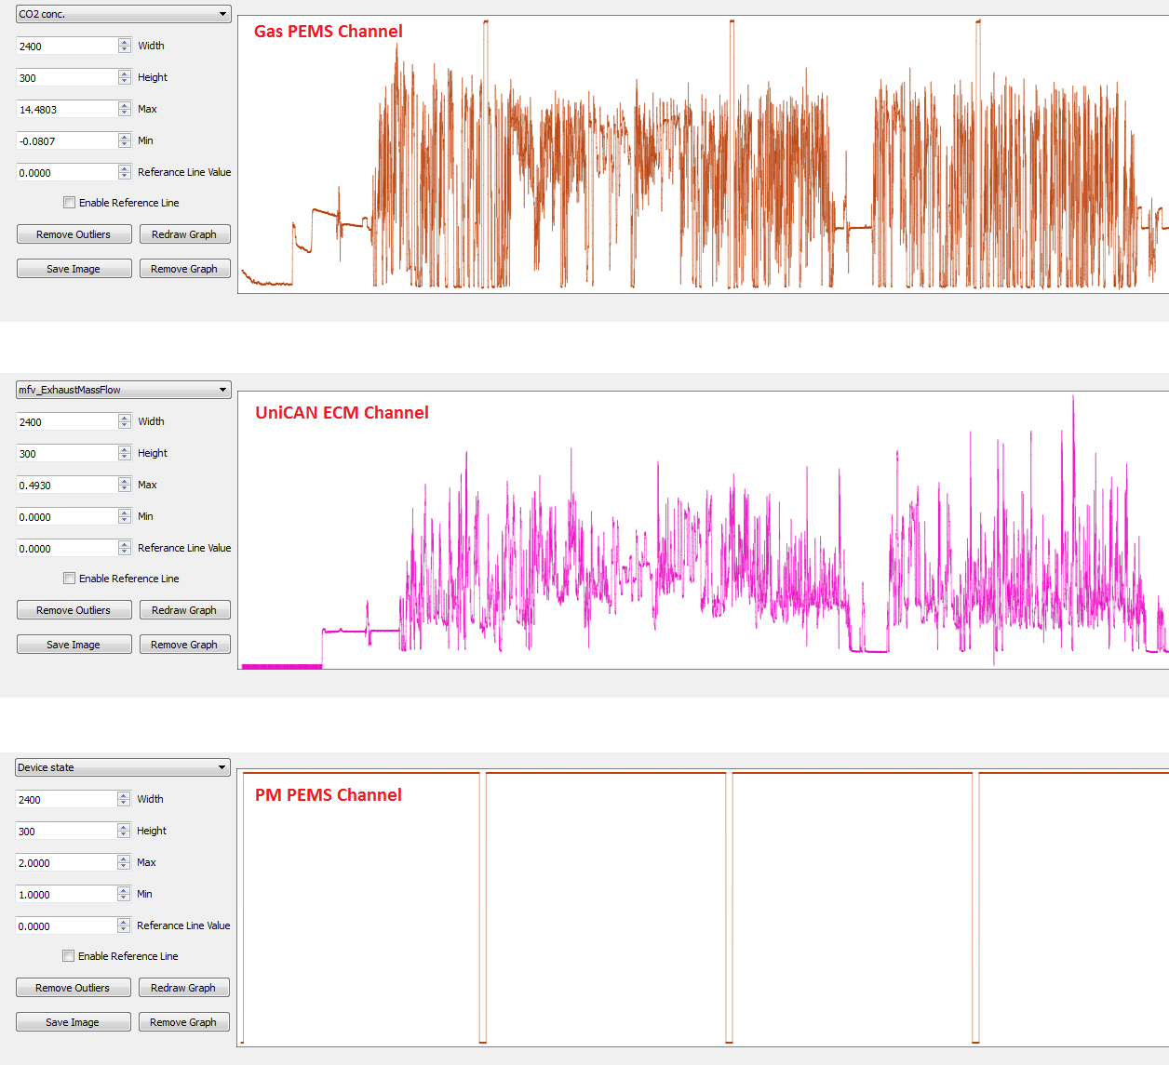
Graphical Viewer – Rapid Post Test Check

Slide 12
10 Hz Time Synchronization
UniCAN logs the time of record Continuous, Real-Time Operation
Clock time for Gas PEMS and PM PEMS are equalized at 1st hourly calibration (triggered by leading edge of Gas PEMS zero gas “ON”)
At subsequent hourly calibrations, the clock time gain/loss of Gas PEMS and PM PEMS is corrected by deleting or adding the appropriate time
Data row adjustment
Adjusted by 0.1 second increments
Adjustments < 1 second well within accepted alignment error
Correction applied to calibration period no emissions data logged
Result Coarse consistent alignment of all channels from all data loggers

Slide 13
10 Hz Alignment
Graphical alignment software allows visual expansion of 10 Hz data
Waveforms are aligned by superimposition and quickly checked from test beginning to end
Gaseous concentration data is inherently aligned by OBS procedure
Important feature as only CO2 has well-defined waveform on EATS-equipped, modern engine emissions
Exhaust flow is aligned to CO2 concentration.
Critical for mass calculations
ECM modeled exhaust flow is aligned to OBS measured exhaust flow
PM PEMS has an established lag from sample zone to detector
Empirical data necessary to establish alignment
Often, the soot concentration waveform lacks definition

Slide 14
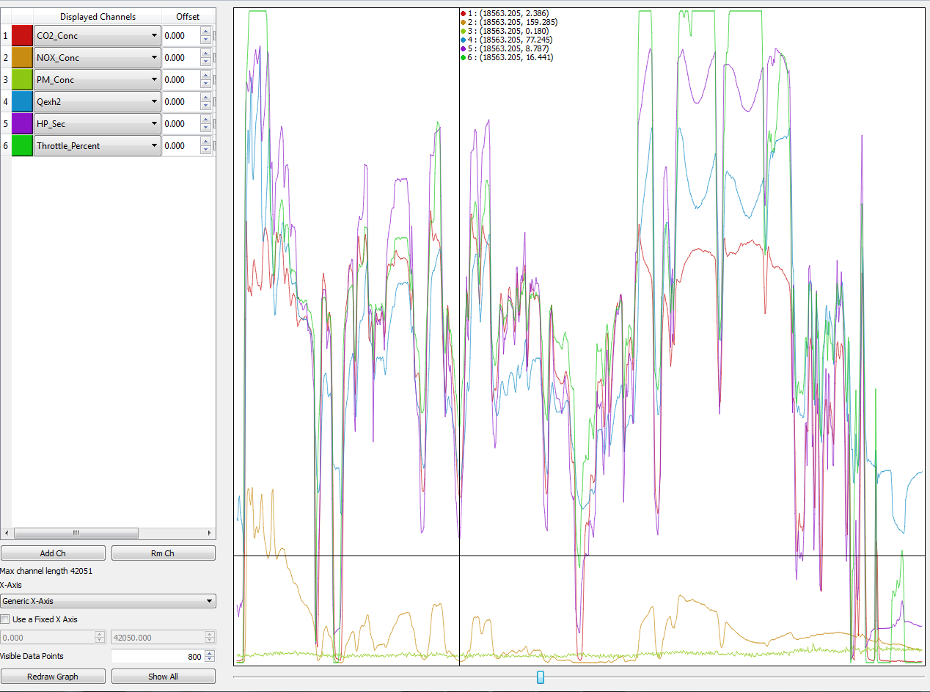
Process NTE & Report 1Hz Data

Slide 15
Validation
Real-time waveforms
NOx sensor vs analyzer
Exhaust flow ECM vs PEMS
Fuel CO2 vs PEMS
O2 sensor vs chemical balance
NTE calculation
BSCO2
Fuel Carbon Balance
Thermal Efficiency, expected value

Slide 16
Questions, Comments, Discussion

