Slide 1
On-Going Challenges for Off-Road/Nonroad Pilot In-Use Emissions Testing
2013 PEMS Conference and Workshop, Ce-Cert
April 11, 2013
John Bowman – Cummins Inc.

Slide 2
Content
Review of several Tier 4 applications tested summer of 2012
Installation overview and test observations
Front Loader
Excavator
Mobile Air Compressor
Summary of top Challenges
Going Forward
Q&A

Slide 3
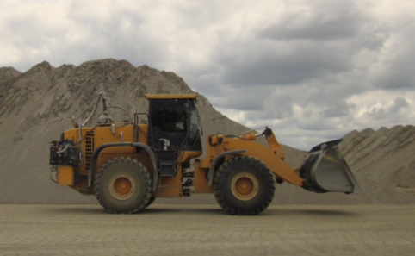
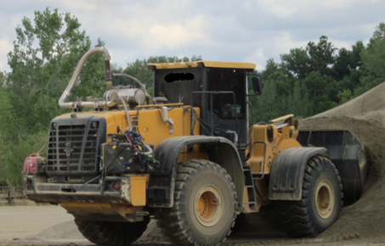
Wheel Loader Test
8.9L Tier 4 HDOH HDIUT test protocols including customer operated
Max Ambient Temp 98.6 deg F
Possibility of Rain

Slide 4
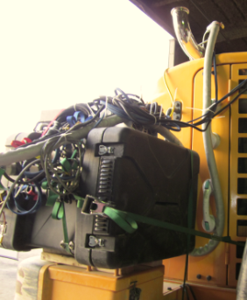
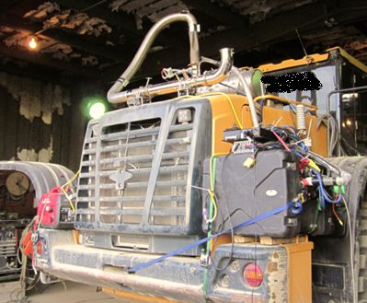
Wheel Loader PEMS Installation
Environment case used (chance of rain and better vibration isolation at the expense of greater heat retention on gaseous analyzer)
Honda 2k invertor generator for power
Ratchet straps for retention generator and environmental case
Specialized suction cups hold exhaust flow meter
No PM measurement for this test

Slide 5
Front Loader Test Observations
Very limited on installation space
PM measurement equipment was not possible unless equipment placed on Roll Over Protection
Duty Cycle not conducive to HDOH or WBW PEMS testing protocols
No NTE events observed over 4.7 hours of non-idle operation
Was not able to retain %50 of averaging windows at %15 minimum power threshold for Work Based Window methods

Slide 6
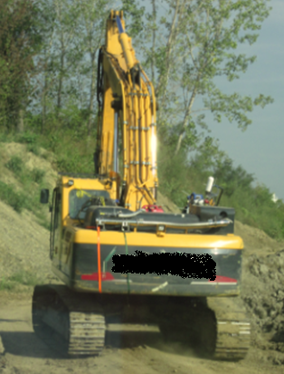
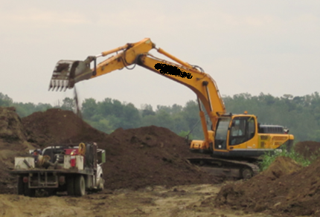
Excavator Test
6.7L Tier 4
HDOH HDIUT test protocols including customer operated
Maximum Ambient Temp 91.4 deg F
No rain in forecast

Slide 7
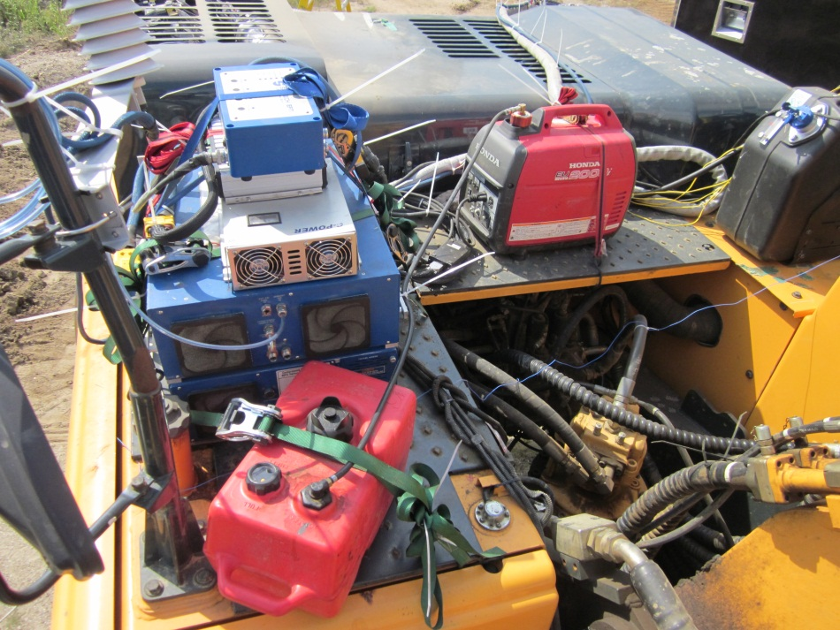
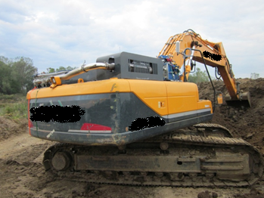
Excavator PEMS Installation Detail
Gaseous emissions only using SEMTECH-DS w/ EFMII
Testing preparation followed our on road process with respect to installation practices.
No special frames or mounts were fabricated.
Sensors vibration plate, ratchet straps, plastic strap ties, and suction cups
Honda 2k invertor generator for power

Slide 8
Excavator Test Observations
Excessive Vibration
Panels came loose on SEMTECH
Diffuser on weather probe came apart
Issues with data recorder (lost 80 minutes of data requiring a restart) are suspected to be vibration related
Lack of mounting locations
PM measurement equipment would be very difficult with most equipment configurations likely requiring custom frame mounts to be fabricated
Few options to relocate away from heat rejection
Good duty cycle for emissions testing
Suitable for NTE testing with 109 NTE events over 5+ hours of non-idle operation
Work Based Window analysis meets 20% minimum average power threshold

Slide 9
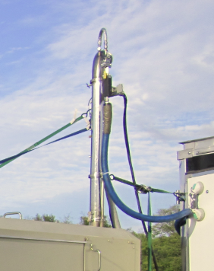
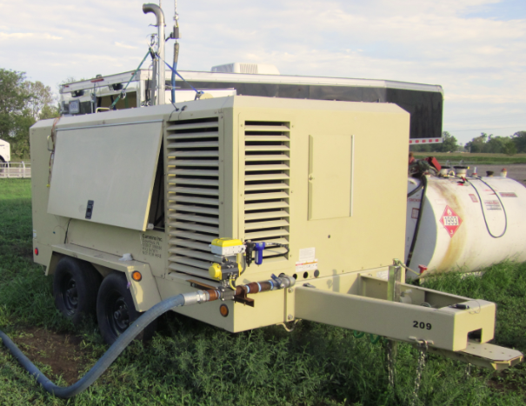
Air Compressor Test
8.9L Tier 4
Simulated Operation
Not customer operated
PEMS equipment kept in test trailer

Slide 10
Air Compressor Test Observations
Stationary application easy to PEMS test
Can keep equipment off to the side and easily keep the equipment protected from the conditions the mobile machine subject the equipment to
Relatively constant speed and load gives no issue to producing NTE events or high average power averaging windows for WBW methods
Duty Cycle presents some unique challenges
The machine always operates in NTE zone
Protocols currently do not allow equipment to start and auto zero if currently in an NTE. This will not allow equipment to zero and excessive drift was observed after 2+ hours of operation. Engine was stopped to allow a zero and restarted
Batch sampling devices may
Current protocols are such that one long NTE event would be limited by the 600 second NTE limit and thus only one NTE event would be evaluated over this
After manually time-aligning data, EMROAD shifted the data again during it’s time alignment by 77 seconds. Constant RPM applications may cause these issues with the EMROAD analysis tool.

Slide 11
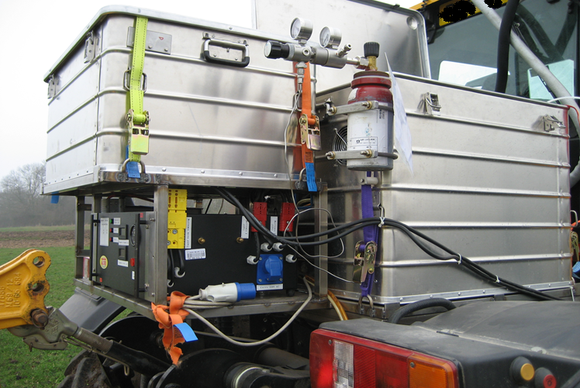
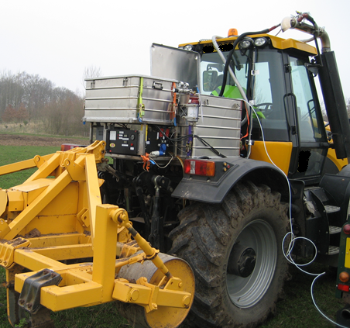
Summary of top Challenges
Application Diversity
Each application requires very specific installation requirements that may require customer rigging or frame work to appropriately constrain PEMS
Will require significantly increased pre-screening to be successful in procuring equipment that can be fully equipped with Gaseous and PM PEMS while also meeting necessary duty cycle requirements
Pre-fabricated frame
Installation by JCR

Slide 12
Summary of top Challenges (continued)
Working in customer operations much more difficult than HDOH applications in many situations
Environmental concerns
Vibration exposure continues to be a challenge
Extreme ambient temperatures especially at the hot end of the spectrum
Almost none of the applications have conditioned cab space available unlike on-road applications
Equipment space is very limited and may not be able to avoid engine waste heat rejection
Equipment starts exhibiting performance issues at approximately 100 Deg F
Dusty Conditions

Slide 13
Going Forward…
Rigorous pre-screening
Checking for installation feasibility and any necessary fabrication
Potentially monitor duty cycle
Improved vibration isolation
Smaller PEMS footprint
Supply environmental cases or cloth covers (tent) with ducted, filtered cooling air
Inlet air can be cyclone filtered for dust and drawn at locations away from excessive heat rejection from engine

Slide 14
Questions?

