Slide 1
Improving Flow Rate Exhaust Measurement when utilizing “Small” PEMS
John Karim
In-Use Retrofit Section
Mobile Source Control Division
California Air Resources Board
April 11,2013

Slide 2
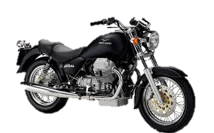
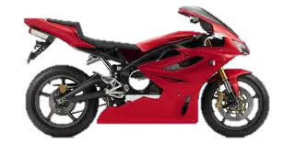
Objective
Evaluate the exhaust emissions of ON/OFF road Motorcycles under “real world” conditions

Slide 3
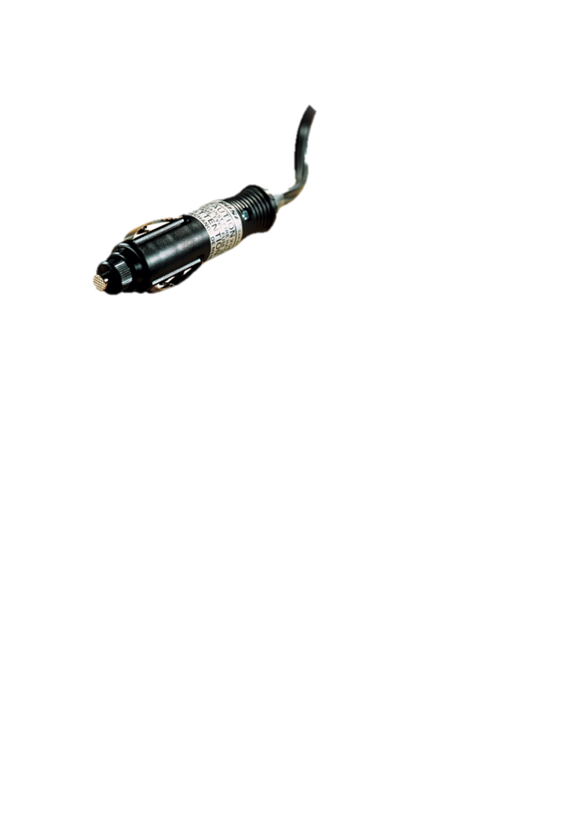
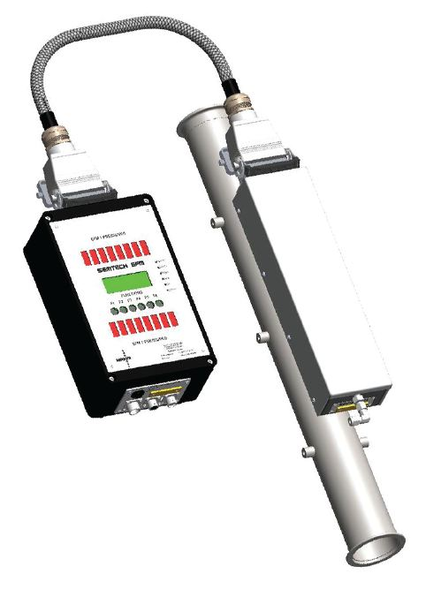
Challenges

Slide 4
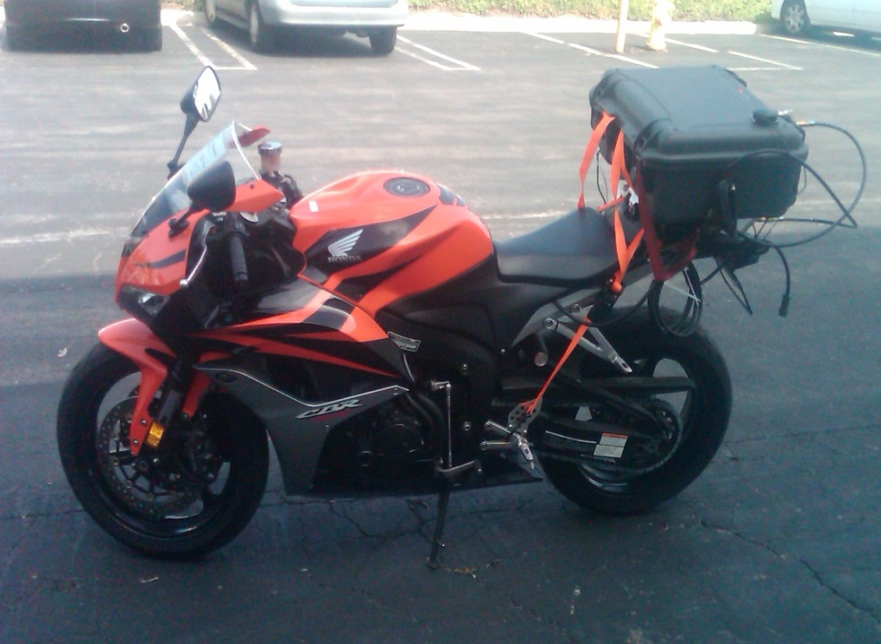
Requirements
Light Weight:
No significant change to center of gravity of the MC
No effect on MC’s maneuverability
Compact
Weather resistant
Safety concerns (FID fuel)
Measures THC, CO, CO2, NOx
PM
NH3
Power supply:
Own power (for short periods)
12V- 15A max (~5A)
Works on all types of engines:
Carburetors/Fuel Injection
2/4 stroke
Diesel, Gasoline, etc…
Exhaust flow rate measurement
ECU
No ECU
Minimize pulsation effect

Slide 5
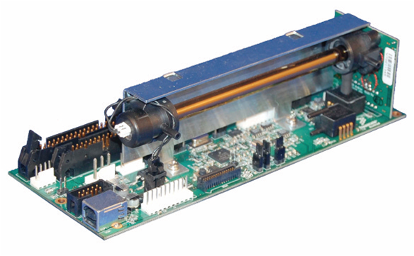
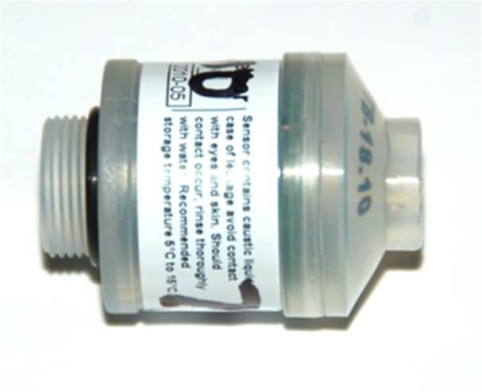
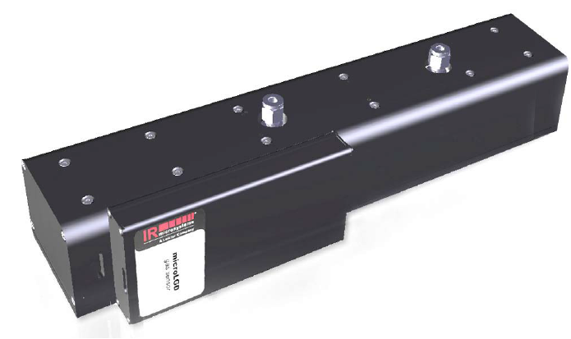
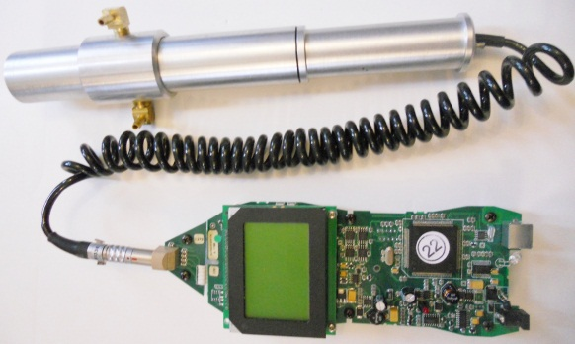
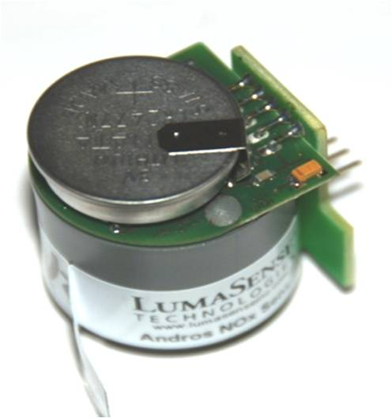
Small PEMS (AXION R/S System)
Continuous Gaseous Measurement (sec-by-sec) of CO₂, CO, NO_{X}, THC, PM, and NH₃ emissions
CO₂, CO, and THC by NDIR
NO_{X} by Electrochemical Cell
O₂ by Electrochemical Cell
PM by Laser Light Scattering
NH₃ by Tunable Diode Laser Spectrometry (TDLS)
NDIR
O2 Sensor
NOx Sensor
NH3 Module
PM Sensor

Slide 6
Small PEMS (AXION R/S System) Cont.
Other Continuous Measurement Components
Vehicle ECU Communication by OBD LDScanner and J1708/J1939 Scanner.
Intake Air Temperature (IAT) by Thermistor
Engine Speed (RPM) by Piezoelectric Tachometer, Optical Tachometer, or Inductive Tachometer
Manifold Absolute Pressure (MAP) by MAP Transducer
Global Positioning System (GPS) provide latitude, longitude, vehicle speed, and bearing.
Ambient Condition by Weather Envoy

Slide 7
Specifications of Small PEMS
Gas | Measurement Range | Accuracy | Repeatability | Noise | Resolution
CO₂ | 0 to 16 % | ±3% rel or ±0.3% abs | ±2% rel or ±0.1% abs | ±0.8% rel or ±0.1% abs | 0.01 vol %
CO | 0 to 10 % | ±3% rel or ±0.02% abs | ±2% rel or ±0.02% abs | ±0.8% rel or ±0.01% abs | 0.001 vol %
THC | 0 to 10,000 ppm | ±3% rel or ±4 ppm | ±2% rel or ±3 ppm | ±0.8% rel or ±2 ppm | 1 ppm
NO_{X} | 0 to 4,000 ppm | ±4% rel or ±25 ppm | ±3% rel or ±20 ppm | ±1% rel or ±10 ppm | 1 ppm
PM | 0 to 300 mg/m³ | NA | NA | NA | 0.01 mg/m³
O₂ | 0 to 25% | ±3% rel or ±0.1% abs | ±3% rel or ±0.1% abs | ±1.5% rel or ±0.1% abs | 0.01 vol %
NH₃ | 0 to 500 ppm | ±2% rel or ±2 ppm | NA | ±0.9 ppm | 0.1 ppm

Slide 8
Continuous Measurement
System 1
System 2
NDIR
NDIR
O2 Sensor
NOx Sensor
O2 Sensor
NOx Sensor
Notes:
Dual system to enable continuous measurement during zero checks which can be programed for a user-difined. interval

Slide 9
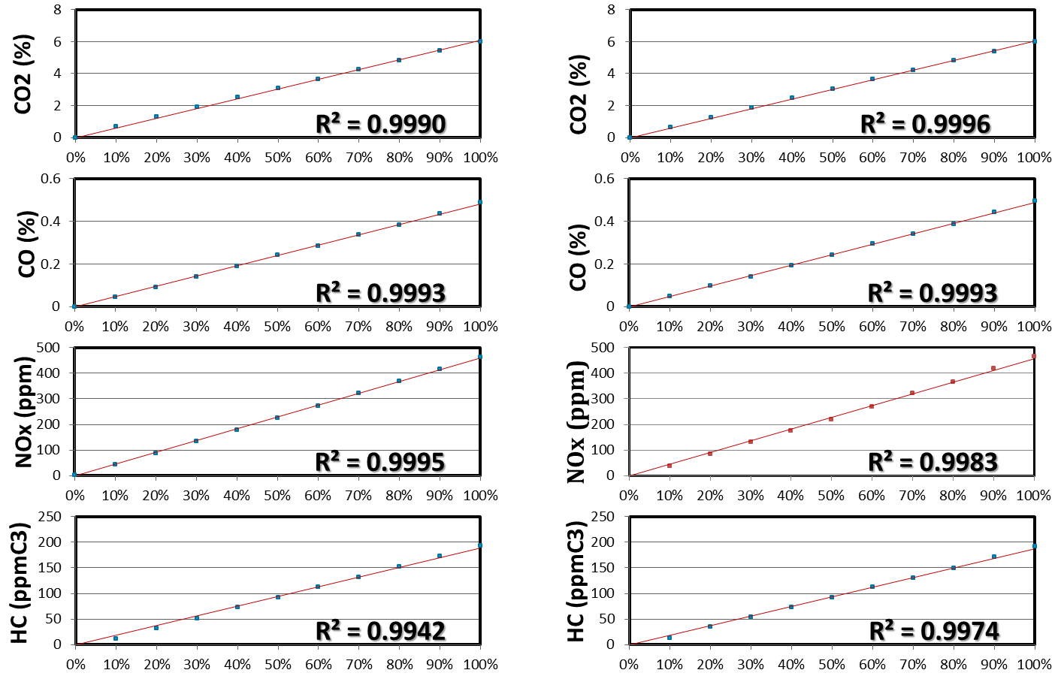
Linearity Check
Gas Analyzers #1
Gas Analyzers #2

Slide 10
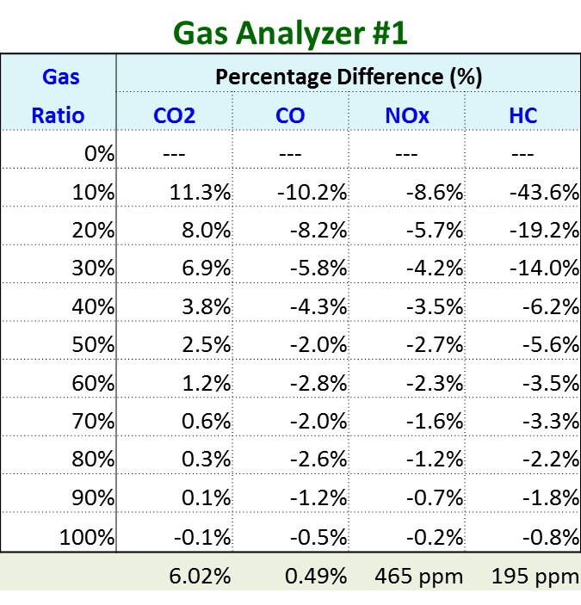
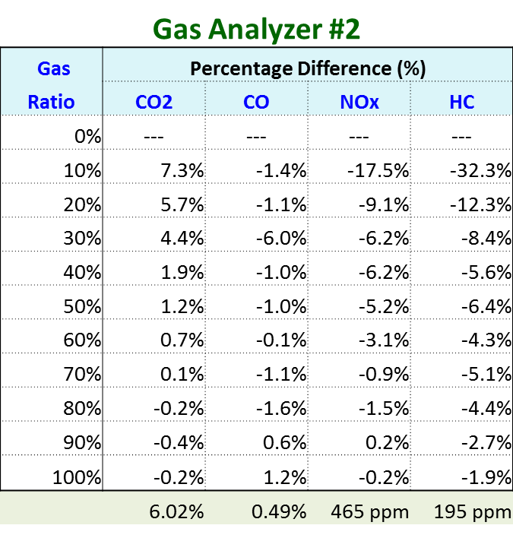
Gas Analyzer #1 and #2 (Linearity Check)
Instrument noise levels
Range
16
10
4,000
10,000

Slide 11
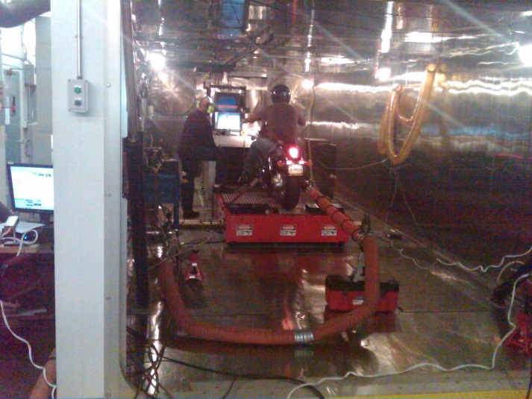
PEMS Testing on SS Dyno (cell6)
Dilution Air
CVS Tunnel
SEMTECH-EFM
SEMTECH-ECOSTAR
CVS Instrument Train
Bag #1
Bag #2
Bag #3
AXION R/S
Exhaust
Use Small PEMS (Axion-R/S system) and SEMTECH-ECOSTAR
Test 3 motorcycles in dyno lab with four-steady state cycle (idle, 15 mph, 30 mph, and 50 mph)
Check the real time concentration profiles and the emissions

Slide 12
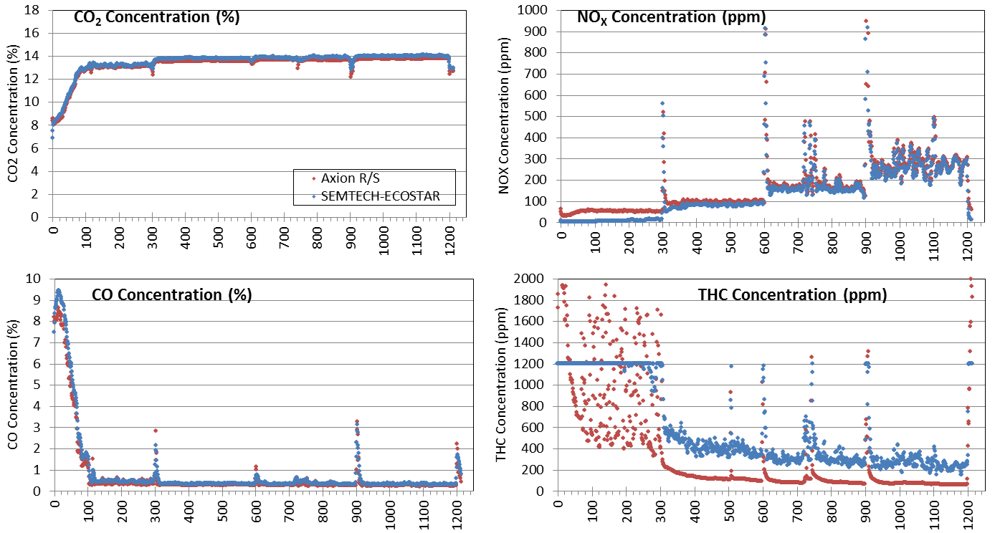
Concentration Profile Motorcycle 2008 Harley Davidson FXDWG 1584 c.c.
. Axion R/S
. SEMTECH-ECHOSTAR

Slide 13
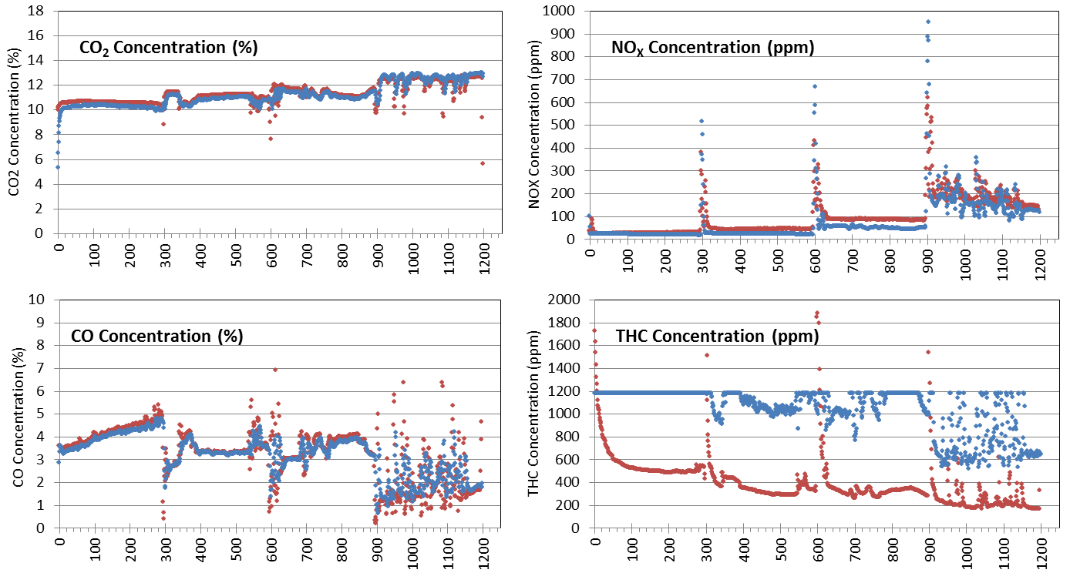
Concentration Profile Motorcycle 2006 Honda VTX 1300C 1312 c.c.
. Axion R/S
. SEMTECH-ECHOSTAR

Slide 14
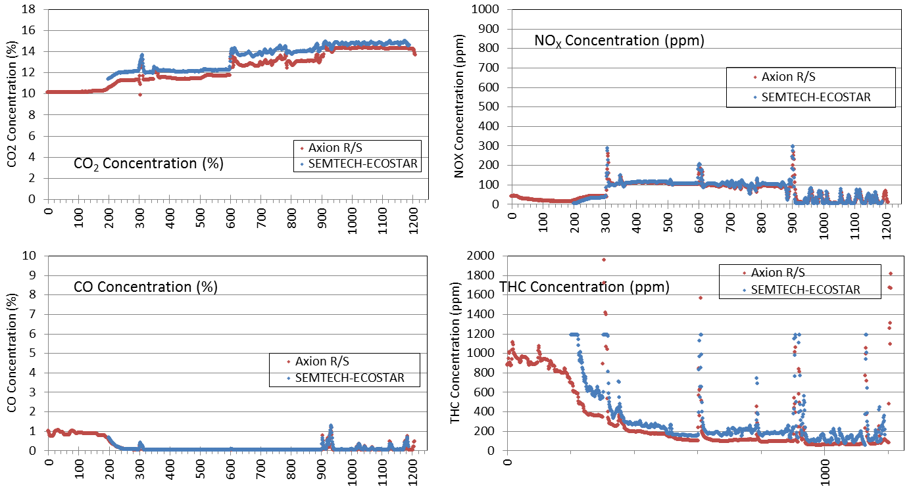
Concentration Profile Motorcycle 2008 Yamaha YZFR1XCR 1000 c.c.

Slide 15
Summary of Motorcycle Steady State Tests (Total Mass)

Slide 16
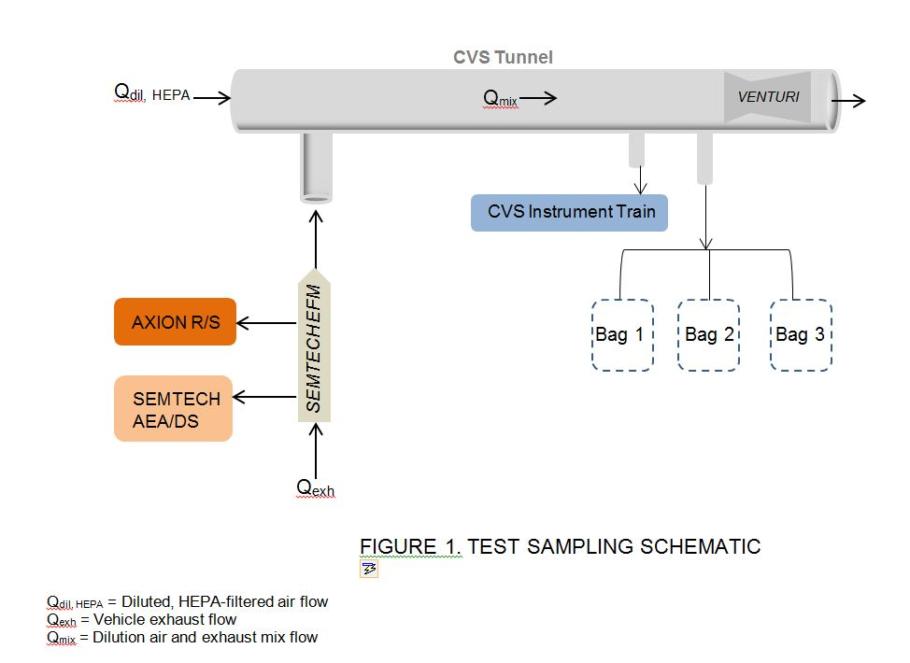
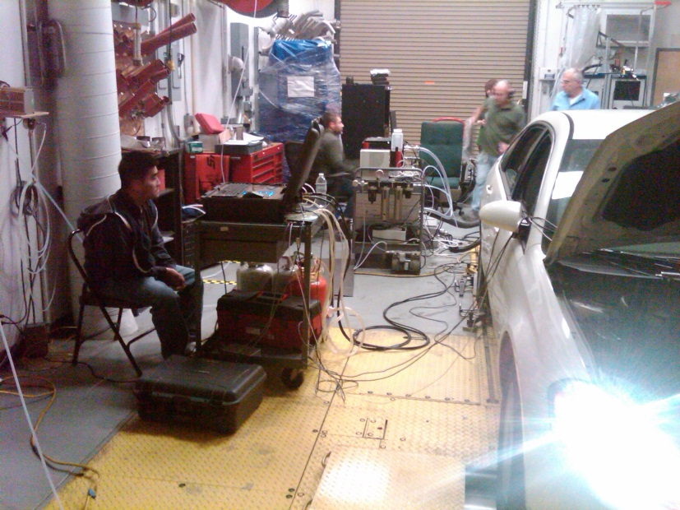
PEMS Testing on Gasoline Vehicle
Use Small PEMS (Axion-R/S system) and SEMTECH-AEA (including SEMTECH-DS)
Test in dyno lab with FTP-75 Cycle
Check the real time concentration profiles and the emissions

Slide 17
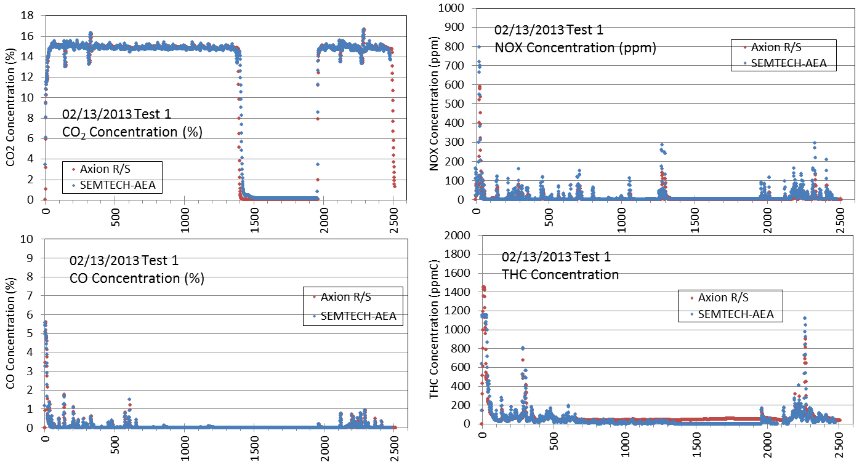
Concentration Profile Gasoline Vehicle 2008 Chevrolet Impala 3.5L Test: FTP-75 Cycle With Cold Start

Slide 18
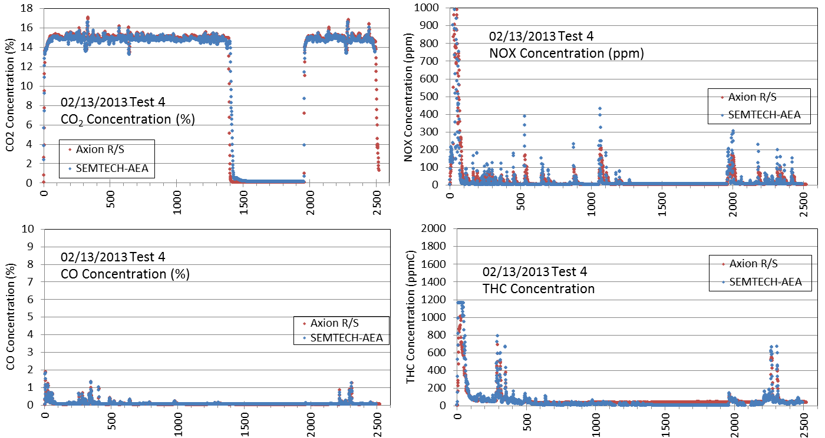
Concentration Profile Gasoline Vehicle 2008 Chevrolet Impala 3.5L Test: FTP-75 Cycle With Hot Start

Slide 19
Summary of the Gasoline Vehicle Tests (Total Mass) 2008 Chevrolet Impala 3.5L FTP-75 Cycle

Slide 20
Volumetric Efficiency Factor
Exhaust flow rate is dependent on IAT, MAP, and RPM
Volumetric Efficiency refers to the efficiency with which the engine can move the charge into and out of the cylinders.

Slide 21
Volumetric Efficiency Determination (Dyno 6)
Dilution Air
CVS Tunnel
SEMTECH-EFM
SEMTECH-AEA
CVS Instrument Train
Use Small PEMS (Axion-R/S system)
Test in Dyno 6 with FTP-72 Cycle
Bag #1
Bag #2
Bag #3
AXION R/S
Exhaust
Estimate the Volumetric Efficiency Factor (VEF) based on real time results from “dyno modal data” and “Axion R/S system”
Check the real time mass concentration profiles and the emissions

Slide 22
List of Motorcycles Tested for VE Correction
No | Model | Model Year | Engine Displacement
01 | Yamaha YZFR1 XCR | 2008 | 998 cc
02 | Kawasaki KLR650 | 2008 | 651 cc
03 | Suzuki SV650S | 2006 | 645 cc
04 | Honda VTX1300C | 2006 | 1312 cc
05 | Harley Davidson FXDWG | 2008 | 1584 cc
06 | Suzuki DRZ400SM | 2008 | 398 cc
07 | Harley Davidson Softail | 1995 | 1340 cc
08 | Honda CBR600RR | 2008 | 600 cc
09 | Honda CMX250C | 2006 | 234 cc
10 | Vespa GTS250 | 2007 | 244 cc
11 | Yamaha Vino 125 | 2007 | 125 cc

Slide 23
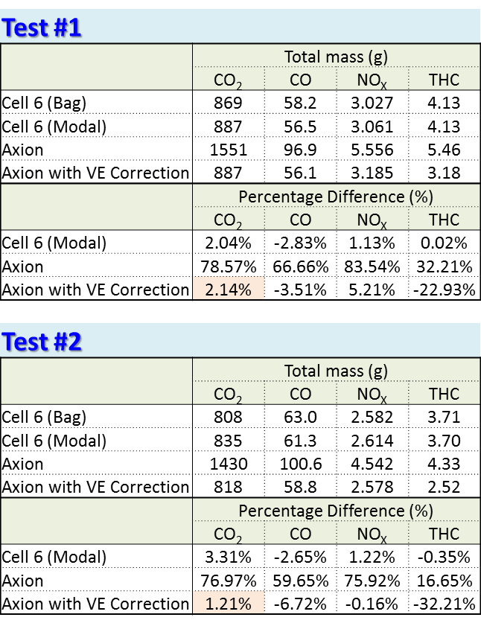
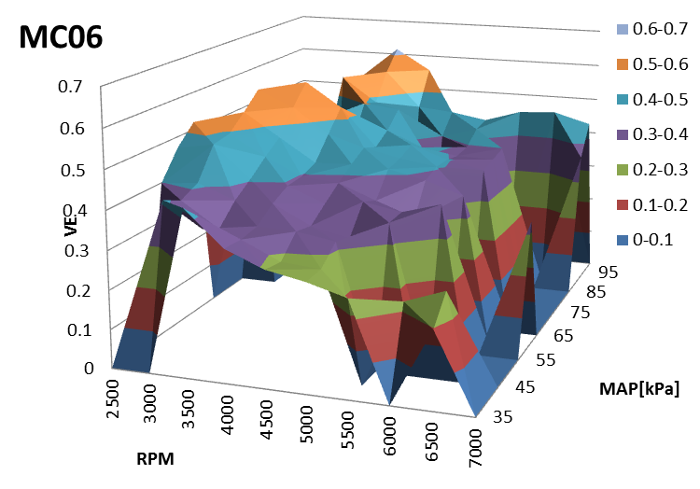
2008 Suzuki 398 cc

Slide 24
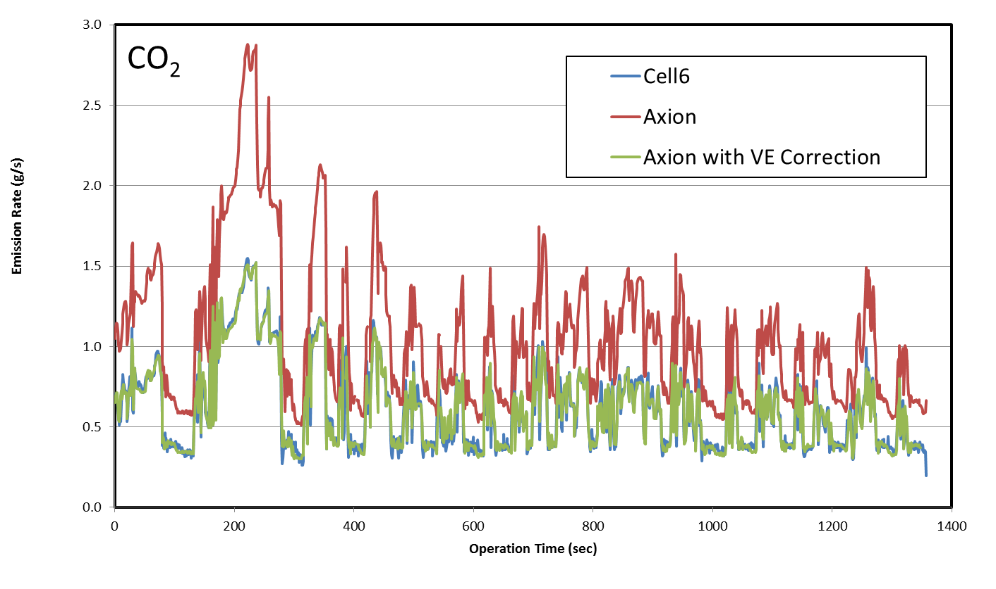
2008 Suzuki 398 cc

Slide 25
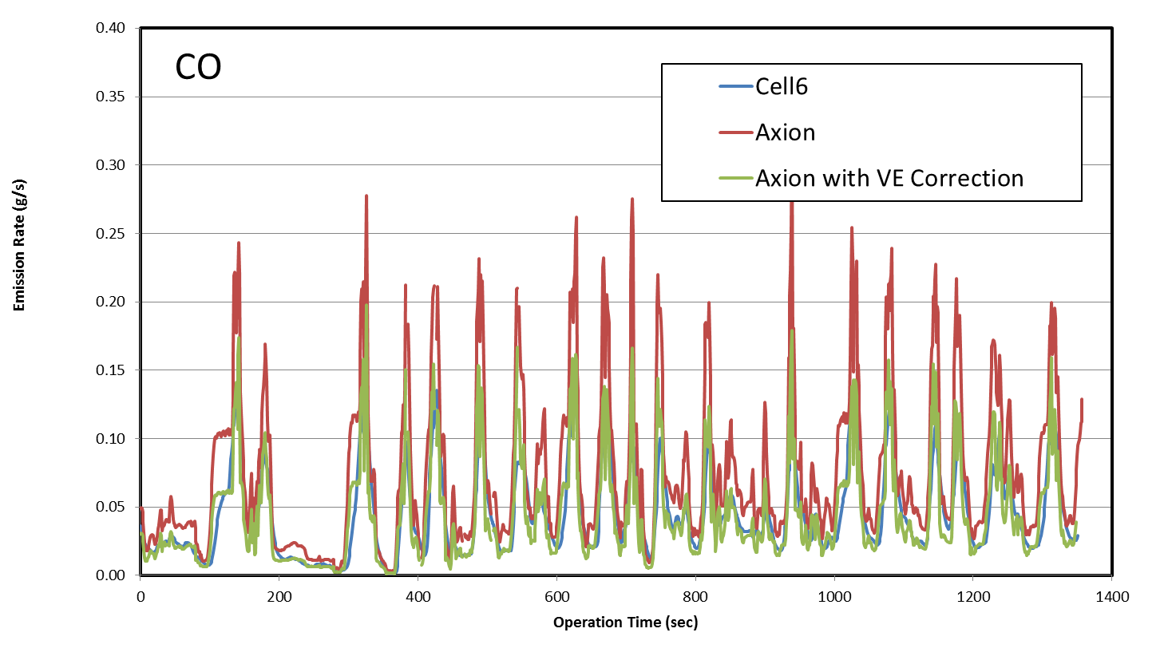
2008 Suzuki 398 cc

Slide 26
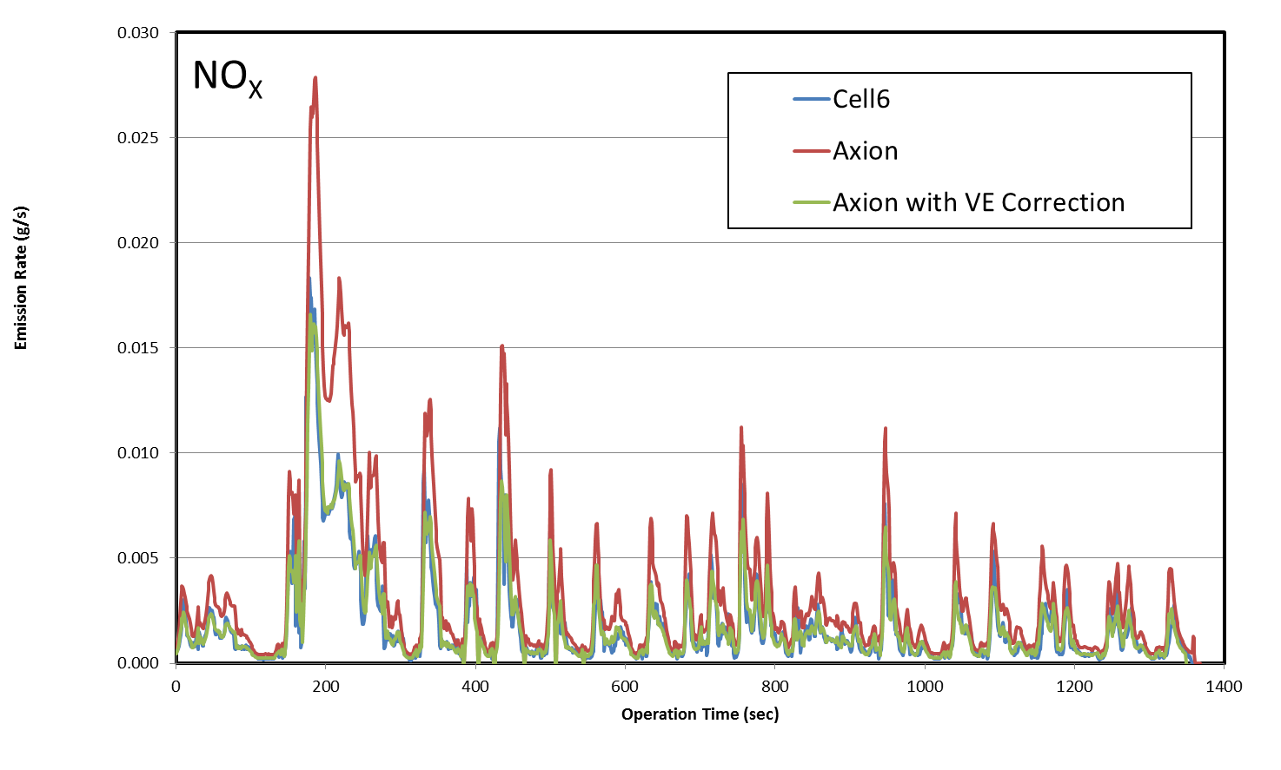
2008 Suzuki 398 cc

Slide 27
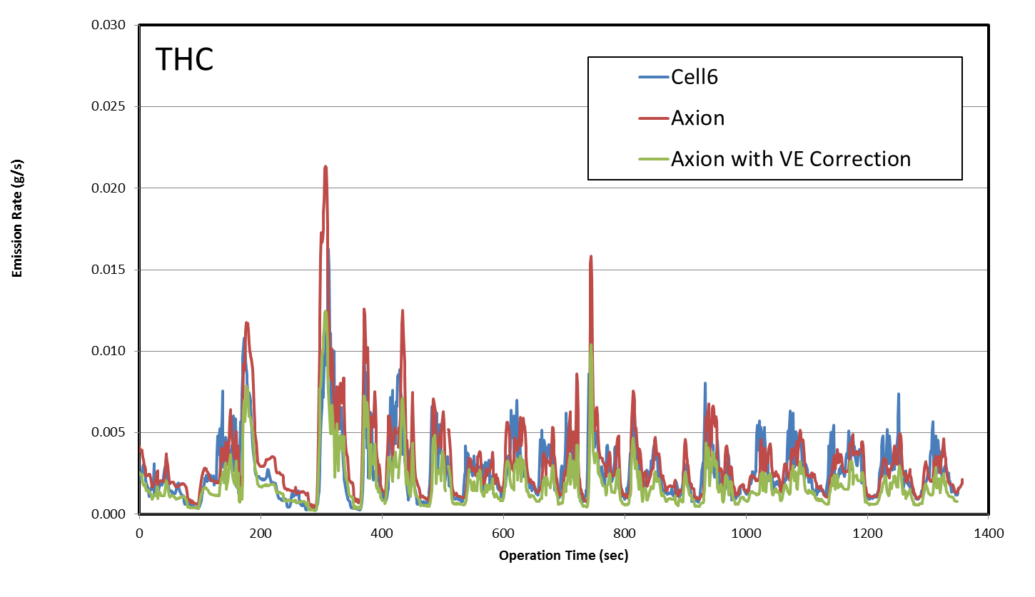
2008 Suzuki 398 cc

Slide 28
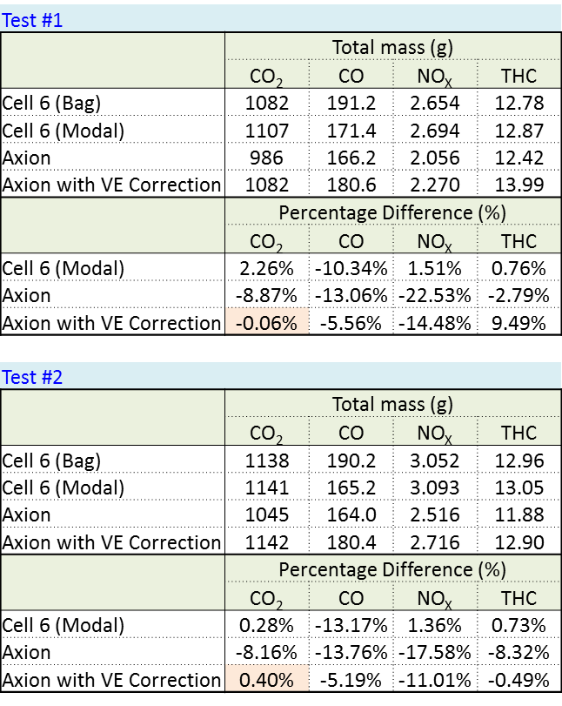
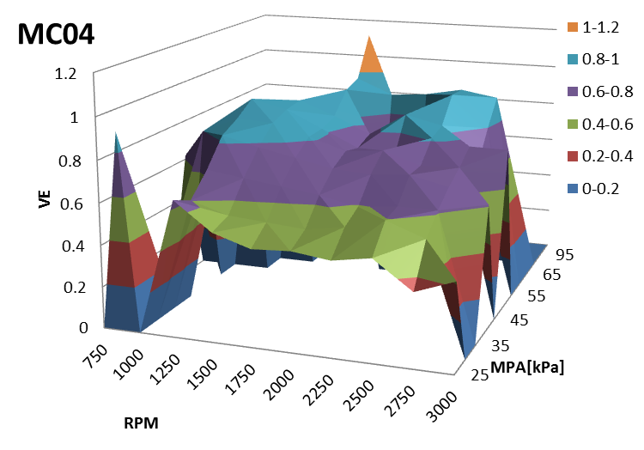
Honda 1312 cc

Slide 29
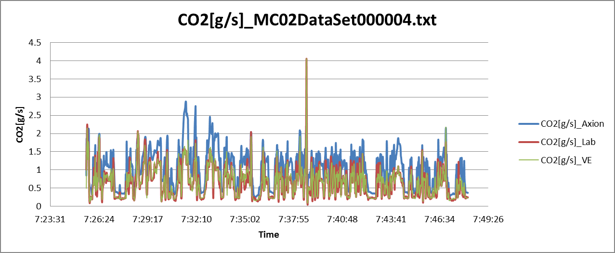
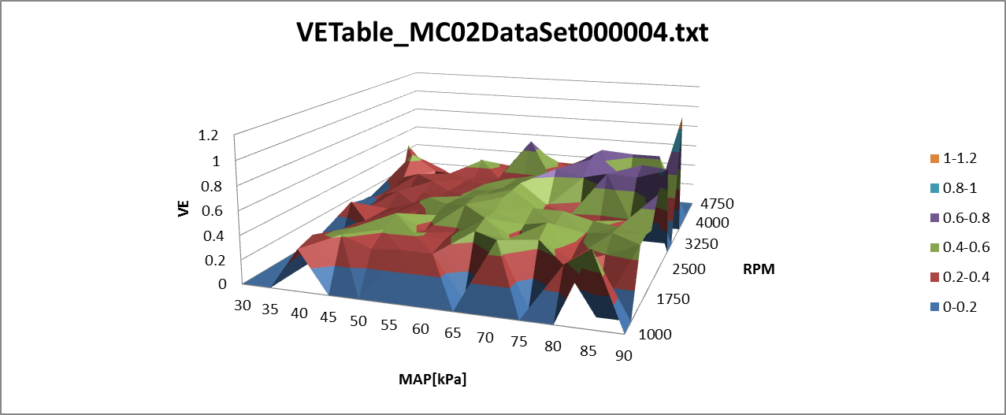
Kawasaki 651 cc

Slide 30
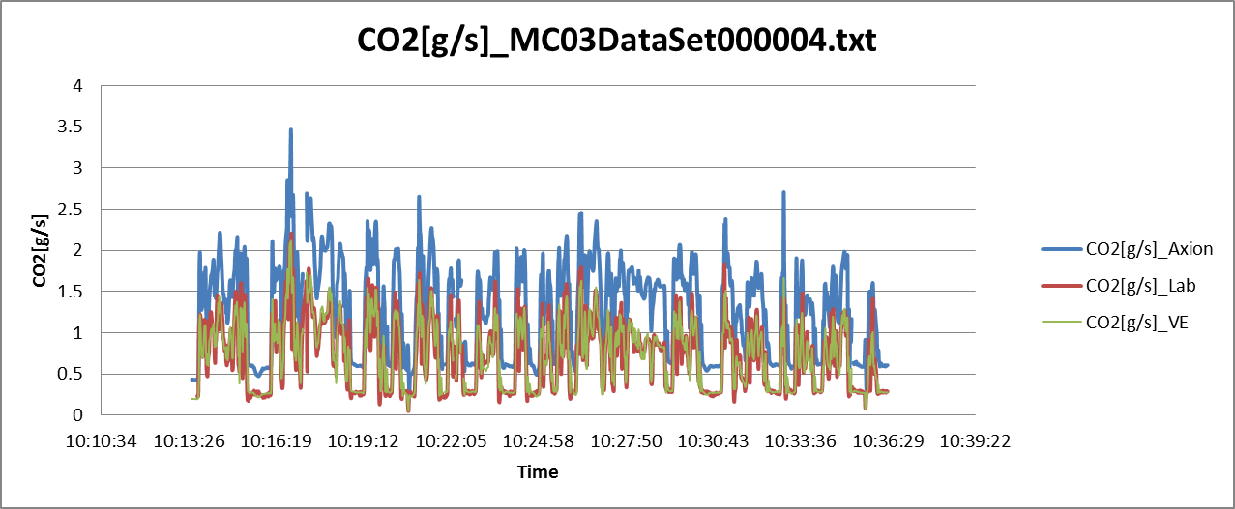
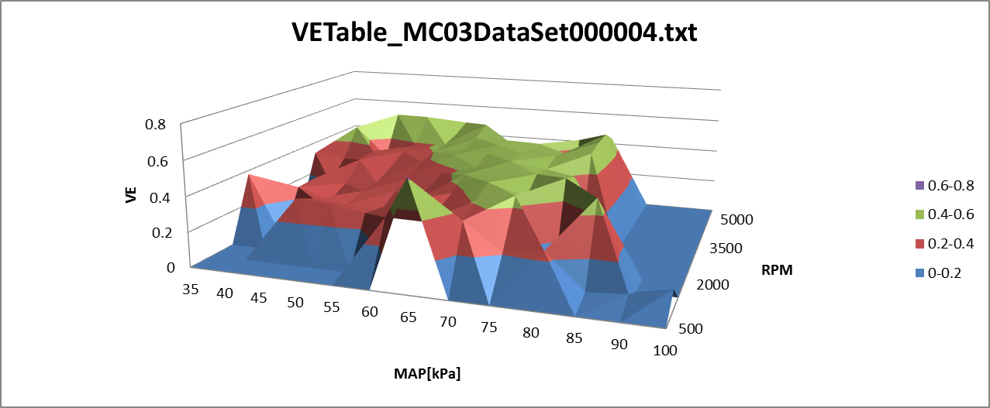
Suzuki 645 cc

Slide 31
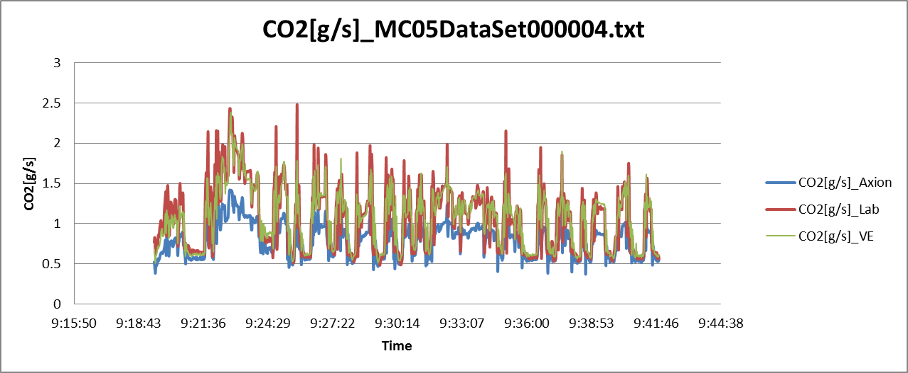
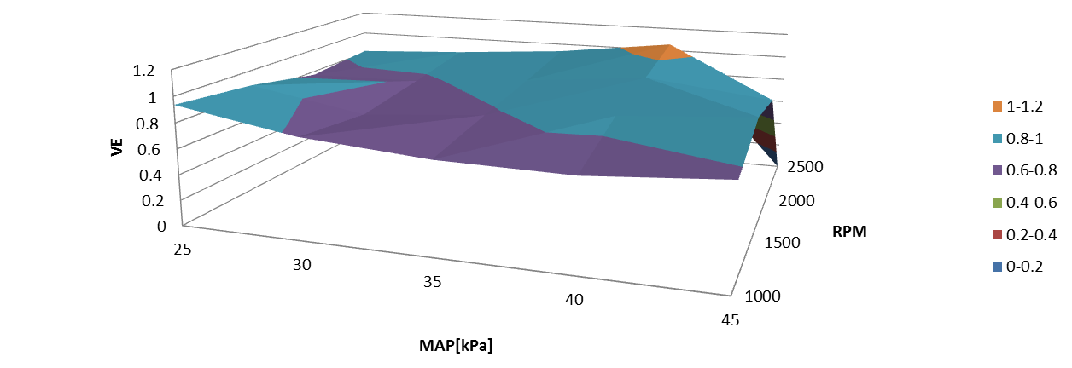
Harley Davidson 1584 cc

Slide 32
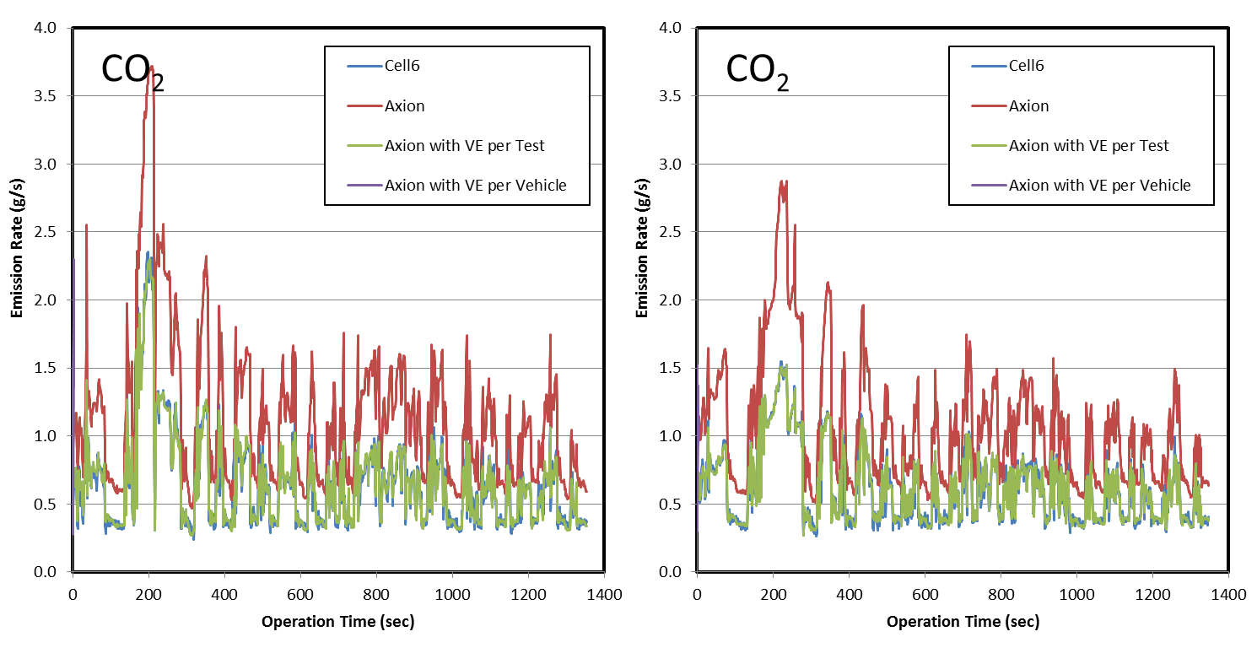
Suzuki 398 cc
Test 1
Test 2

Slide 33
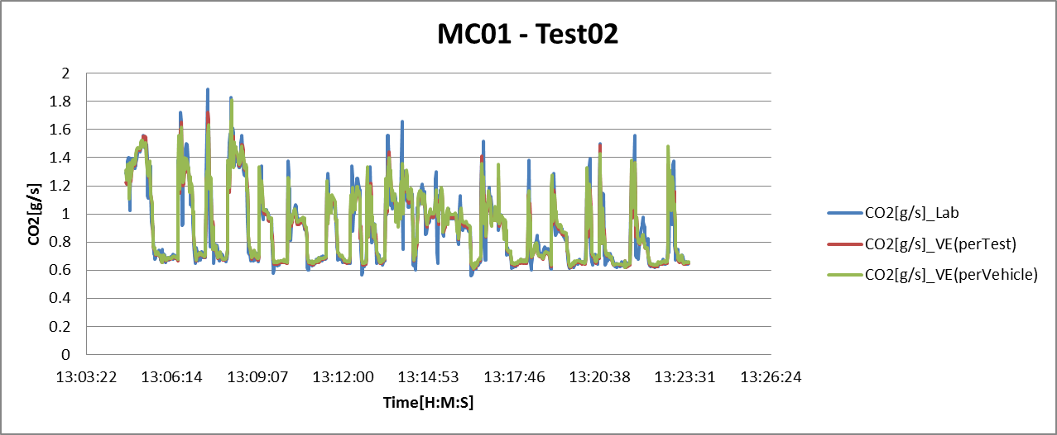
Yamaha 998 cc

Slide 34
Post-PEMS Testing Confirmation (Cell 5)
Dilution Air
CVS Tunnel
CVS Instrument Train
Bag #1
Bag #2
Bag #3
AXION R/S
Exhaust
Use Small PEMS (Axion-R/S system)
Test in dyno lab with FTP-75 Cycle
Evaluate the established volumetric efficiency (VEF) tables on the re-test in dyno lab
Check the real time mass concentration profiles and the emissions

Slide 35
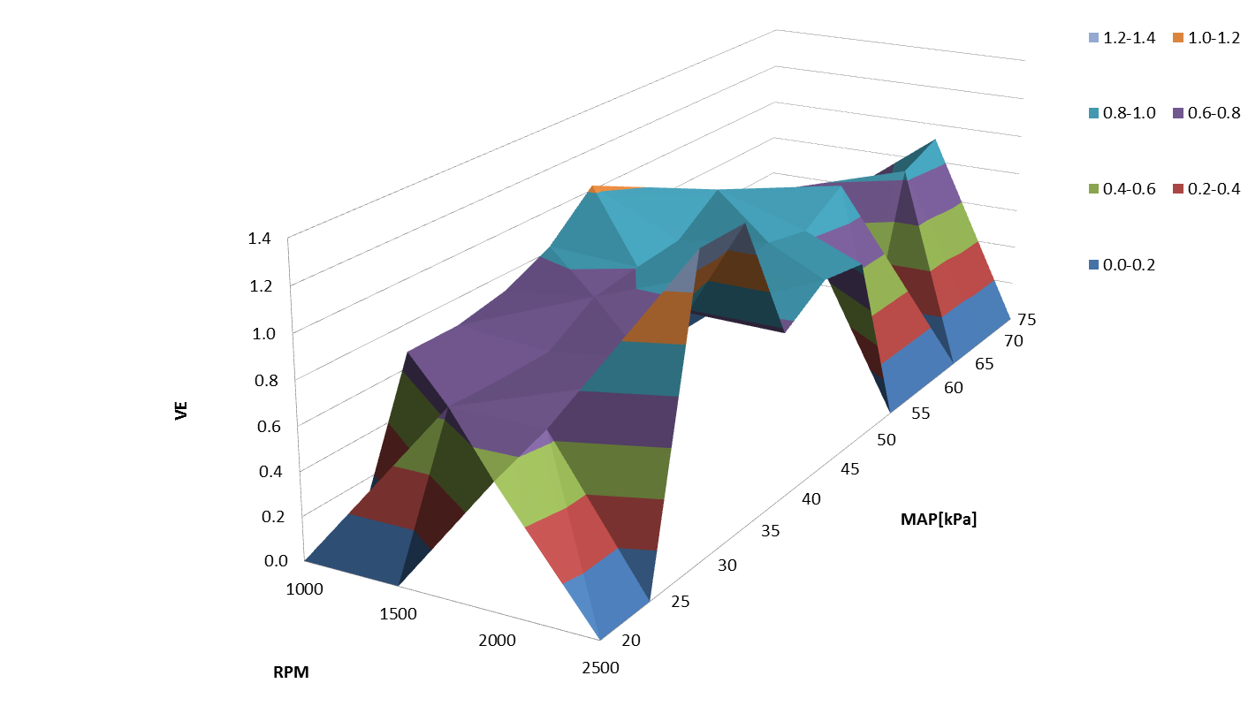
Harley Davidson 1584 cc

Slide 36
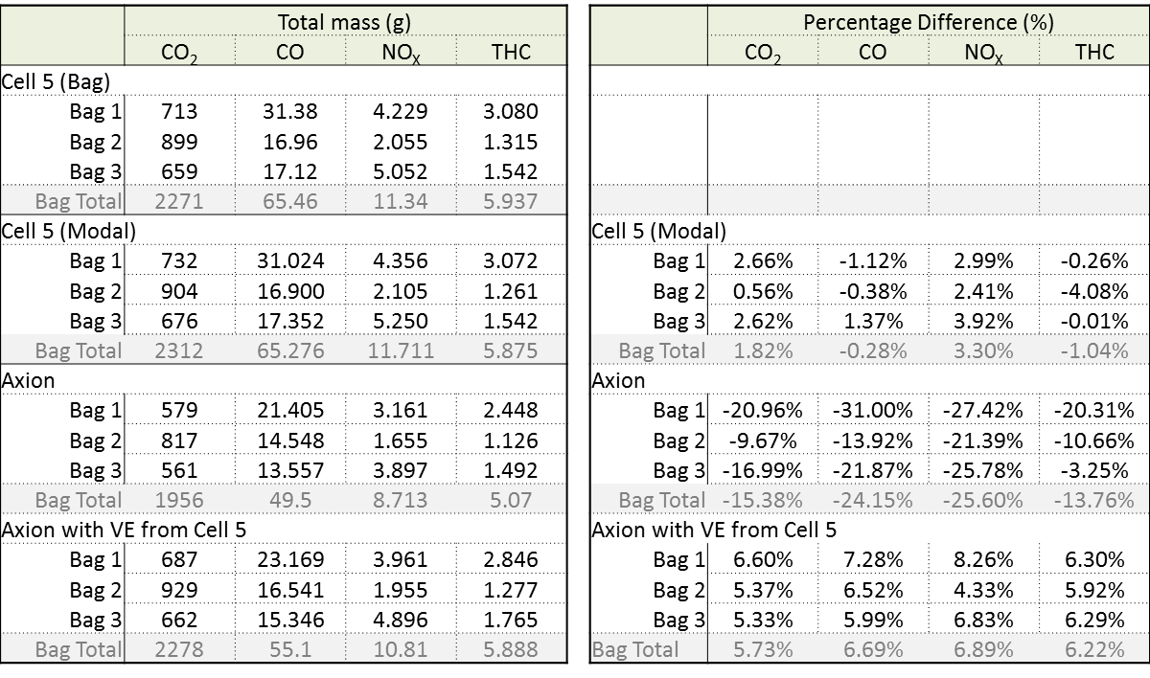
2008 Harley Davidson FXDWG 1584 cc (Test #1)

Slide 37
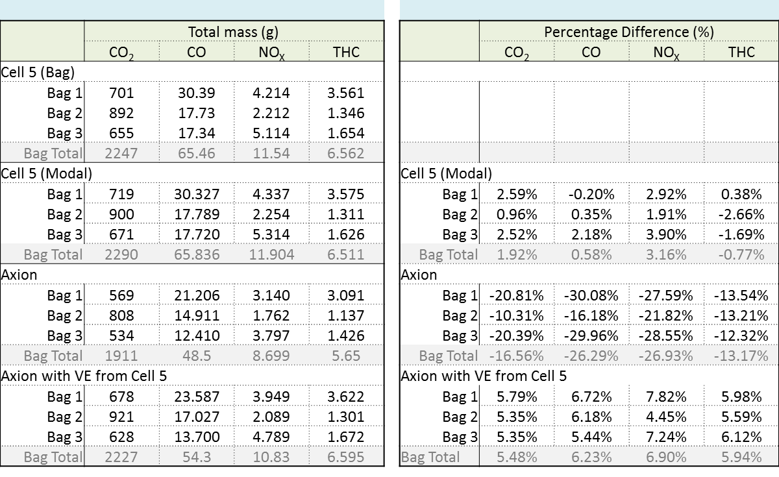
2008 Harley Davidson FXDWG 1584 cc (Test #2)

Slide 38
Summary and Conclusion
There is a need for a “small” PEMS
Small
Light weight
Easy hook-up
One person installation and operation
Low Energy Usage
Dual analyzers
Further enhancements are needed
Sample conditioning
Dual range analyzers (even for 1065 PEMS)
Better techniques to calculate VE (IAT, MAP, and RPM)
Better technology for HC
Include corrected NOx
Provide Post Processing software
Built from ground up
Adequate measurement can be achieved

Slide 39
Thank you
Special Thanks to
Mr. Brian Beckmann
Mechanical and Aerospace Engineer
GlobalMRV Inc.
Sharon Lemieux, Chief
Heavy-Duty Diesel In-Use Strategies Branch
In-Use Retrofit Section
Dr. Jesse Tu, Stephanie Maalouf, George Gatt, Gloria Pak, Tony Nassar, Svetlana Espinosa, Tung Tran, Robert Cabral, Anne Mackhampio, Patrick Chang, Nick Le

