Slide 1



Welcome to UC Riverside CE-CERT
PEMS Impacts/Hypermilling

Slide 2
Portable Emission Measurement Systems (PEMS): Impact
Marine fuel switching, hybrids, aftertreatment
On-road heavy duty SCR, drayage, fuels
Off-road heavy duty inventory and activity
Locomotive fuel, inventory
Light duty diesel vs gasoline (EU), my MPG!
Entertainment light duty emissions and MPG

Slide 3

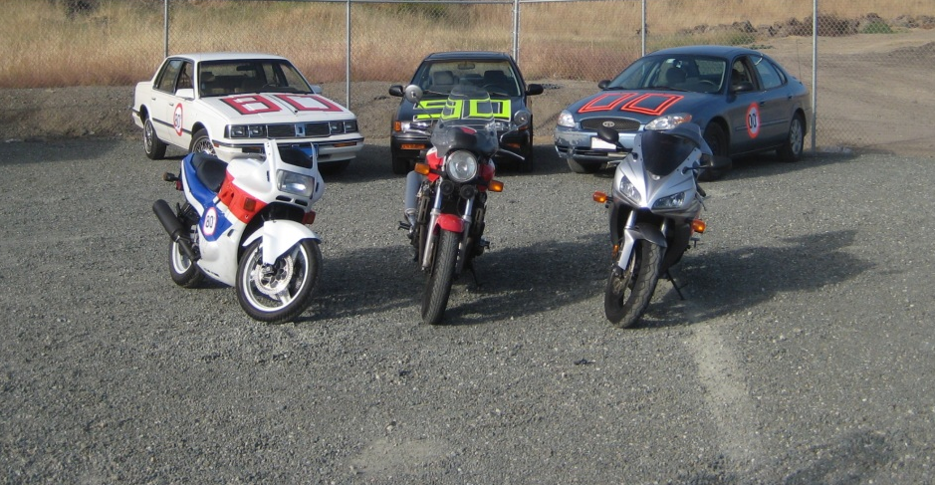
Mythbuster 2011
CARS versus Motorcycles

Slide 4
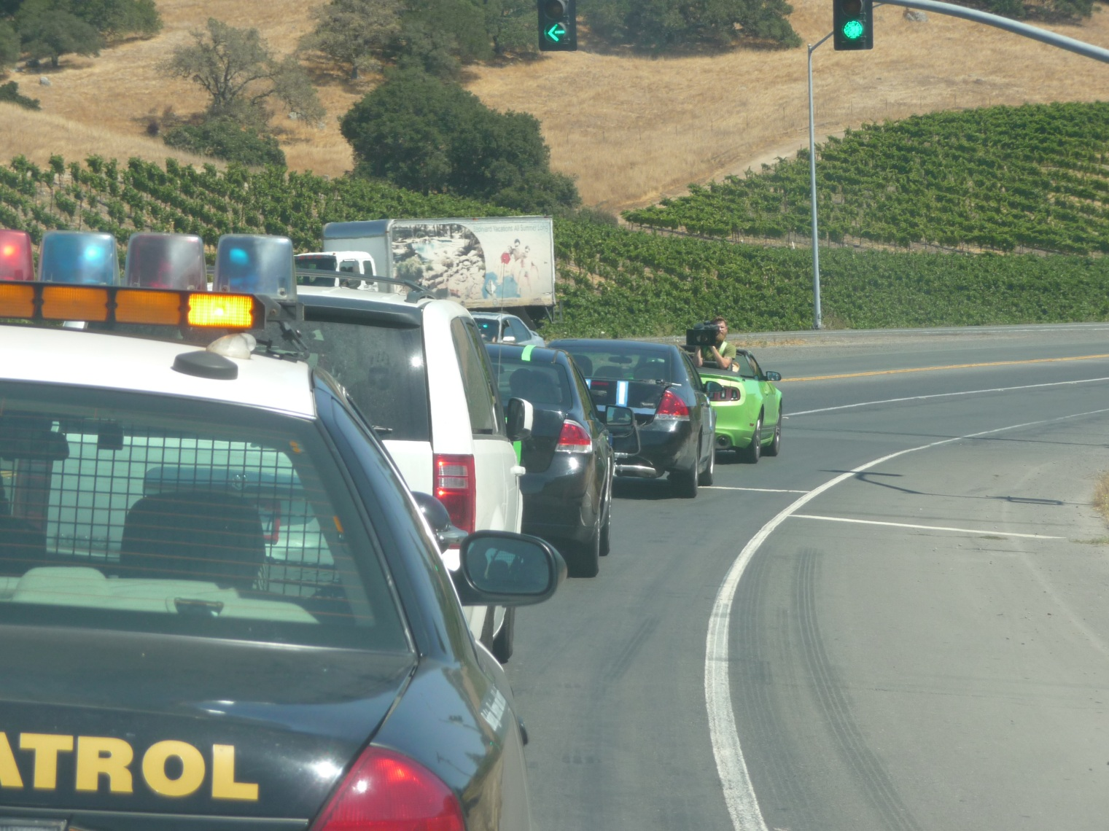


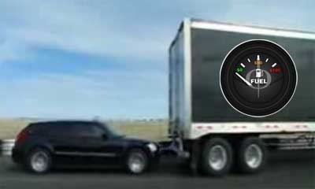

Mythbusters 2012

Slide 5

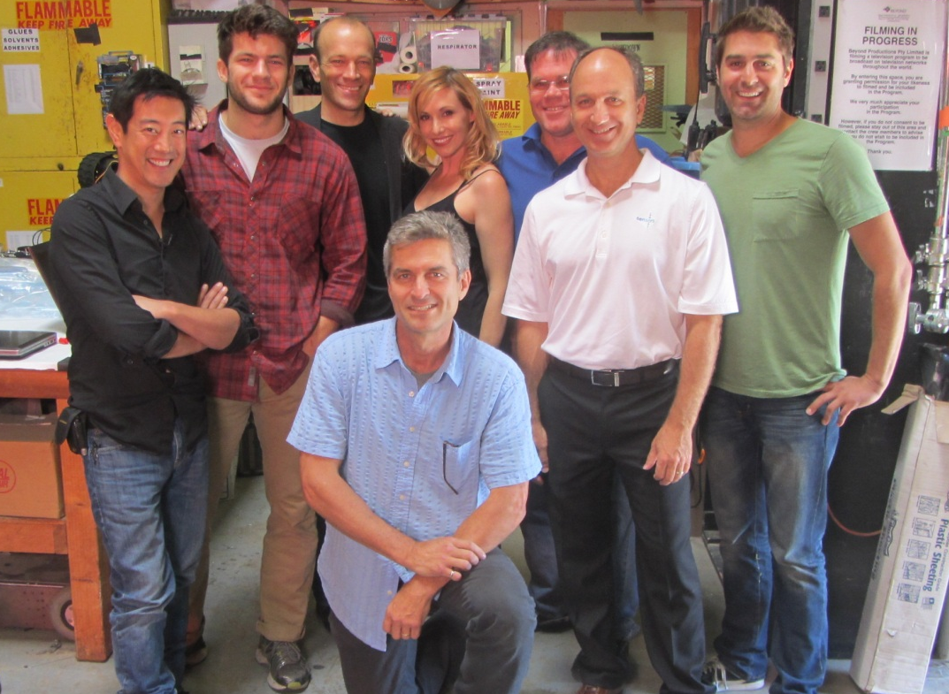
In-Use Testing For the Movies
Mythbusters 2012 On Air June 2013

Slide 6
Portable Emission Measurement Systems (PEMS)
2011 PEMS Workshop
  Golden Reference Data Set
  Recommend best practices (1065 or not?)
  THC 1065 necessary?
  How to evaluate new PEMS
  How low do we need to measure

Slide 7
Portable Emission Measurement Systems (PEMS)
2012 PEMS Workshop
  PM PEMS needs improvement
  Do we describe PEMS as reference PEMS when they are 1065 compliant?
  Moving to a work window approach. Agreement

Slide 8
Portable Emission Measurement Systems (PEMS)
2013 PEMS Workshop Questions
  NTE vs Work Based Window
  What are the PM PEMS development
  Standardize ECM signals on-road (add for off-road)
  PEMS and NOx at 0.02 g/hp-h

Slide 9
Portable Emission Measurement Systems (PEMS)
2013 PEMS House Keeping
  Printing/WiFi free and available
  15 minute talks
  5 minute Q & A
  Yellow with 2 min left (13 expired)
  Red with 2 min of Q & A left (18 expired)
  I’ll stand up at 20 minutes (no Q&A)

