Slide 1

Toward Clean Air in 2050:
Perspectives on
Portable Emissions Measurement Systems (PEMS)
Dr. Michael Benjamin, Chief
Monitoring and Laboratory Division
California Air Resources Board
2013 PEMS Conference & Workshop
University of California, Riverside
April 11, 2013
Notes:
Thank you for the warm welcome and introduction. It is an honor and a pleasure to be invited to speak before you all today.
I want to commend you, Dr. Barth, on organizing this conference and bringing together leading researchers in the area of portable emissions monitoring and measurement tools. Your efforts in catalyzing development of advanced measurement technologies is critical in helping regulatory agencies like the Air Resources Board develop effective strategies for achieving clean air.
With that in mind, I hope to share with you some perspectives on why the Air Resources Board is interested in the use of portable emissions measurement systems and how these fit into the broader challenges California is facing in meeting its air quality and climate goals over the next 35 to 40 years.

Slide 2
Outline
California’s Vision for Clean Air and the Transportation Sector
Measurement Needs for Road to 2050
Role of PEMS in Supporting 2050 Vision
Conclusion
2
Notes:
I’ll spend the first few minutes of my presentation discussing California’s Vision for Clean Air and specifically some scenarios for what we see as the evolution of the light- and heavy-duty transportation sectors in California.
I’ll then talk about the mix of tools that the Air Resources Board currently uses to measure on- and off-road emissions and how we envision that mix of tools potentially changing with the evolution of vehicle propulsion and emissions control systems.
Finally, I’ll conclude by talking specifically about the role of PEMS in helping the Air Resources Board meet its long-term air quality and climate goals.

Slide 3
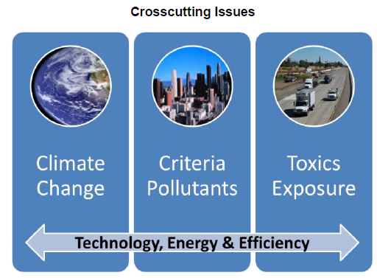
Vision for Clean Air: Framework for Air Quality and Climate Planning
Notes:
Last June, the Air Resources Board, along with our partners at the South Coast and San Joaquin Valley air pollution control districts, released a public document entitled “Vision for Clean Air: Framework for Air Quality and Climate Planning”. This joint agency effort describes the strategies that air quality agencies in California will need to consider in order to reach our air quality and climate goals over the next forty years or so. This document is an initial step in the direction of identifying key strategies and is intended to serve as a framework for future developments.
As shown in this slide, one of the key messages of the Vision for Clean Air is that strategies for reducing emissions of greenhouse gases, criteria pollutants, and toxics must be considered collectively. We recognize that now we need to explicitly account not just for the co-benefits of a specific regulation or strategy but need to think from the ground up about how we can develop holistic strategies that maximize the benefits of advanced technologies, clean energy, and greater system efficiencies to reduce emissions of all pollutants.

Slide 4
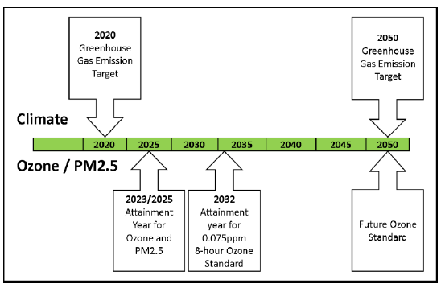
California’s Air Quality and Climate Goals
Climate Change Goal
Federal Ozone Standards
Notes:
One of the figures in the Vision for Clean Air document is this chart which shows on the same timeline critical milestones that California needs to meet to achieve both its climate change goals and the Federal ozone and fine particulate ambient air quality standards.
As many of you know, Assembly Bill 32 requires ARB to reduce its greenhouse gas emissions to 1990 levels by 2020. We are now well on the way to achieving those reductions through a combination of measures laid out in our original AB 32 Scoping Plan. ARB is now in the process of updating the Scoping Plan and considering various approaches for achieving additional greenhouse gas reductions to achieve longer term climate goals. As described in the Vision for Clean Air, we anticipate needing an approximately 80 percent reduction in greenhouse gases by 2050.
At the same time, California will need to meet an increasingly stringent set of ambient air quality standards for ozone and fine particulate. Key milestone dates in the near term are 2023 and 2025 for California’s nonattainment areas, namely the South Coast and San Joaquin Valley regions. Emissions of oxides of nitrogen, one of the precursors of ground level ozone, will need to be reduced by around 80% from 2010 levels by 2023. By 2032, nonattainment areas in California will need to reduce NOx emissions by about 90% relative to 2010 levels to attain the tighter 75 ppb eight hour ozone standard. By 2050, we anticipate needing to meet even tighter federal ozone standards.
These increasingly stringent climate and air quality goals will require holistic strategies for achieving reductions in both criteria and greenhouse pollutants. All of this will need to be achieved while also ensuring that community and near source risk is reduced.

Slide 5
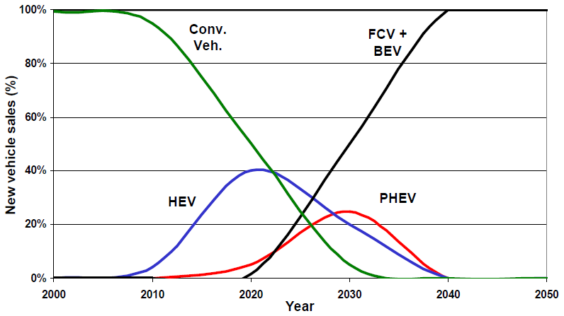
California Light-Duty Sector, 2010-2050
Auto Sales Scenario
Zero emission by 2040
5
Notes:
As part of this Visioning exercise, ARB staff developed a number of scenarios outlining what sorts of transformations in technology and fuels might be needed in different transportation sectors.
This slide shows the results of just one of those scenarios – this one for sales of new light duty vehicles in California between 2010 and 2050. As you can see, light duty auto sales in California are currently dominated by conventional internal combustion vehicles with a growing fraction of hybrid electric vehicles. In this scenario, we modeled a continued growth of hybrid electric vehicles through 2020 but then recognizing this as a transitional technology as we move towards fully electrified or zero emissions light duty vehicle sales. In the mid-term, that is 2020 through 2040, we modeled hybrid and partial hybrid vehicles displacing conventional internal combustion vehicle sales. Over the longer term, the 2040 to 2050 timeframe, we anticipate that light duty auto sales in California will need to transition almost entirely to battery electric and fuel cell vehicles.

Slide 6
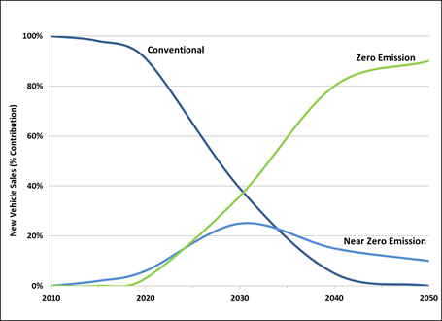
California Heavy-Duty Sector, 2010-2050
Heavy Duty Trucks Sales Scenario
Conventional
Zero Emission
Near Zero Emission
6
Notes:
We developed similar scenarios for sales of new heavy duty trucks in California, as shown in this slide. Currently, in 2013, heavy duty truck sales in California are dominated by conventional diesel and to some extent natural gas fueled trucks. We anticipate the introduction of more advanced technologies into the heavy duty fleet, including near-zero emissions vehicles such as hybrid trucks, and ultimately zero emission trucks including hydrogen and battery electric vehicles. For a number of reasons, this transition towards zero- and near-zero technologies in heavy-duty vehicles is expected to happen more slowly than in the light-duty fleet but will nonetheless be critical given the significant criteria and greenhouse gas emissions produced by this sector.

Slide 7
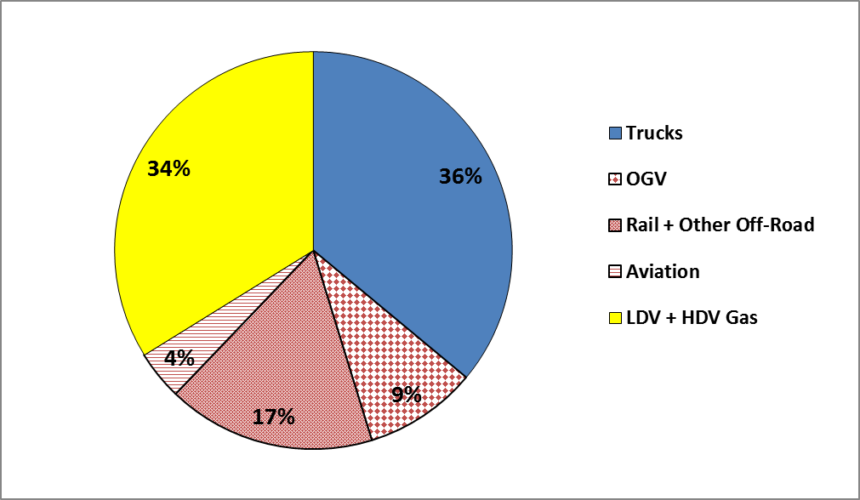
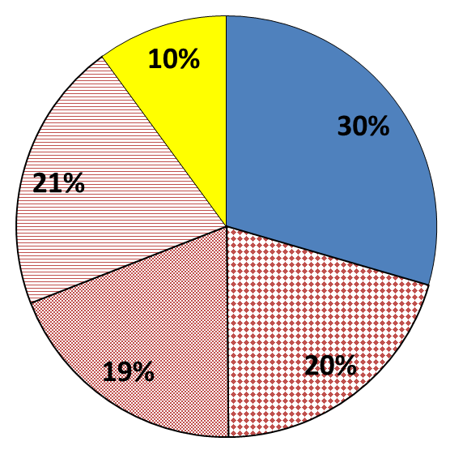
Mobile Source NOx Trend, 2010-2050
South Coast
2010
2050*
* 2050: total baseline emissions is expected to drop about 50% from 2010 levels.
7
Notes:
ARB’s existing control measures for mobile sources are expected to significantly reduce criteria pollutant emissions in California between now and 2050. This slide summarizes how we expect NOx emissions to be reduced for mobile sources in the South Coast between 2010 and 2050. Total baseline emissions are expected to drop by about 50% over this forty year period.
An important take home message from this slide is that we expect the relative contribution of NOx from the light-duty fleet to drop significantly due to the technological transformation I described earlier -- from about a third of the total NOx pie in 2010 to a tenth in 2050. The relative fraction of NOx emissions from the heavy duty fleet is expected to remain the same while the relative contribution from off-road sources is expected to grow from about a third of the total in 2010 to about two-thirds by 2050.

Slide 8
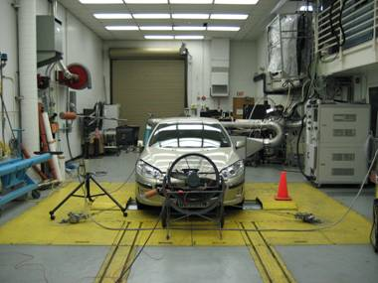
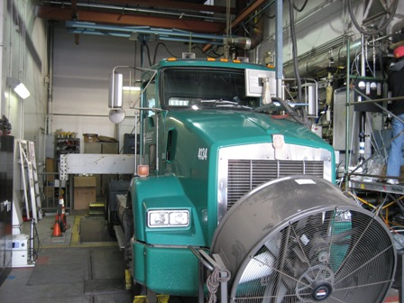
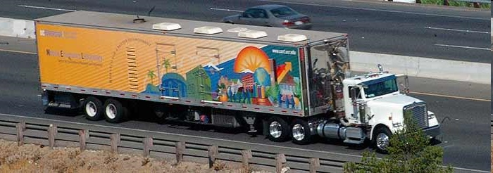
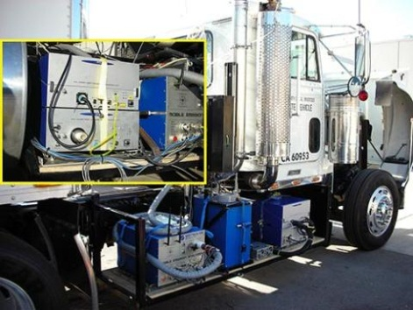
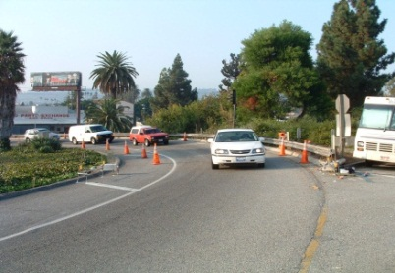
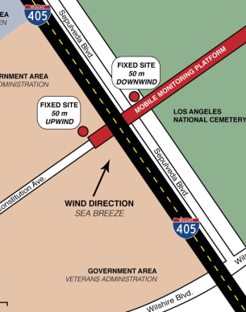
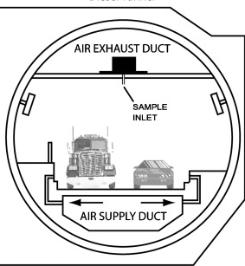
Vehicle Emissions Measurements
Dynamometer
ARB
ARB
UCR
Mobile
Emissions
Laboratory
PEMS
UCR
UCR/ARB
Remote
Sensing
Device
Near
Road
Tunnel
University of Denver
UCLA/USC
UCB
8
Notes:
ARB currently has access to a large and varied toolbox for measuring on- and off-road vehicle emissions, including light- and heavy-duty chassis dynamometers, engine dynamometers, mobile source emissions labs, PEMS devices, roadside remote sensing, near-road monitors, and tunnel studies. A number of these capabilities we have developed and maintain in-house but many of them we deploy through contracts with universities such as UC-Riverside, the University of Denver, UCLA, USC, and UC-Berkeley.

Slide 9
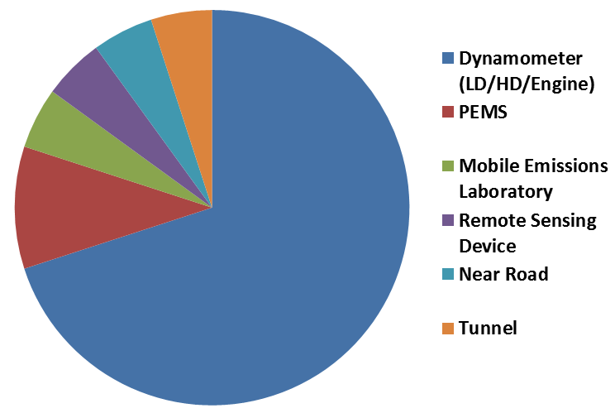
Emissions Measurement Road Map
ARB’s Current Capabilities
2050
?
9
Notes:
ARB currently dedicates most of its mobile source measurement resources to chassis and engine dynamometer testing – about two-thirds of the total pie as shown in this slide. As I discussed in the previous slide, we are exploring other measurement methods and tools such as PEMS and we estimate that the remaining one-third of our measurement resources are currently allocated to these emerging measurement methods.
What types and mix of tools we will be using in 2050 is unclear. It is likely that many of the existing tools will continue to be used but we may also deploy new measurement tools that have yet to be developed. What is clear is that the mix of tools ARB uses will need to change to match the emissions sources that we will be controlling in 2050. With this in mind, we will need to deploy more tools capable of measuring emissions from heavy duty trucks and off-road vehicles, especially those operating under real-world conditions.

Slide 10
Measurements to Support 2050 Vision
Applications
  Regulatory
  Implementation
  Research
Characteristics
  Lower detection limits
  Wide dynamic range
  Reduced size, weight, and cost
  Correlation to laboratory testing
Notes:
ARB’s new toolbox of measurement tools will need to support a variety of applications, including regulatory development, implementation of control strategies, and emissions research.
This new suite of tools will need to be characterized by lower detection limits to support development of ever cleaner vehicles. These instruments will need to have wider dynamic range. Their size will need to be reduced, as well as their weight and cost, in order for it to be practical to collect the large amounts of data needed to support new regulations and enforce existing ones. And finally, we will need to be able to do robust correlations with laboratory testing to provide confidence to stakeholders and the public that our results are trustworthy.

Slide 11
PEMS as a Tool on the Road to 2050
Proper characterization of real-world emissions
Evaluation of bridging technologies
Ensure low emissions remain for full useful life
Wide dynamic ranges, very accurate exhaust flow meters
Affordable equipment for ubiquitous use
Notes:
PEMS are already an important tool in ARB’s vehicle emissions measurement portfolio and may play a larger role in the future. For example, we expect PEMS to help us to better characterize real-world emissions from the on-road fleet and develop more robust emissions inventories. We believe that PEMS can also measure the actual benefits associated with bridging technologies through for example supporting development of quantitative test procedures for hybrid heavy duty vehicles and helping to certify these vehicles to much lower standards. Additionally, we expect PEMS will help us to ensure that new advanced engines stay clean for their full useful life.
As mentioned in the last slide, for PEMS to be more widely used by regulatory agencies like ARB, they will need to continue to be refined to have wider dynamic ranges with accurate exhaust flow meters. And their cost will need to come down significantly for them to be used more widely.

Slide 12
Conclusions
California needs a much lower-emission transportation system to attain its air quality and climate goals.
ARB’s mix of measurement methods will continue to evolve to match changing emissions sources.
PEMS may play a supporting role in moving California toward its 2050 goals.
Notes:
In conclusion, California will need to develop a much lower-emission transportation system to achieve its ambitious air quality and climate goals, particularly with regard to emissions of greenhouse gases and precursors of ozone and fine particulate.
To meet this challenge, ARB has invested significant resources in developing its current emissions measurement capabilities; however, as vehicles become cleaner and the relative importance of the light-duty, heavy-duty, and off-road sectors change, ARB’s measurement capacities will need to continue to evolve to match our changing needs.
We believe that PEMS has the potential to play a significant role in helping ARB attain its long-term vision for clean air. But in order to do so, researchers and PEMS manufacturers will need to continue to refine and demonstrate PEMS capabilities relative to the other existing and emerging emissions measurement technologies.

