Slide 1
PEMS Conference
Acquiring Data
from
In-Vehicle Networks
Rick Walter, P.E.
HEM Data Corporation

Slide 2
Acquiring Data from In-Vehicle Networks
Topics
  Overview/Benefits
  Heavy Duty J1939 protocol
  Available J1939 Parameters
  OBD-II for Light Duty
  CAN and OBD-II relationship
  OBD Test Modes / Service IDs

Slide 3
More Topics
  Required elements to acquire data from the
  in-vehicle network
  Database relating parameters to messages
  Available parameters on your vehicle
  Sample Rate & Timing
  Applications
  Pitfalls / Issues

Slide 4
Overview / Benefits

Slide 5

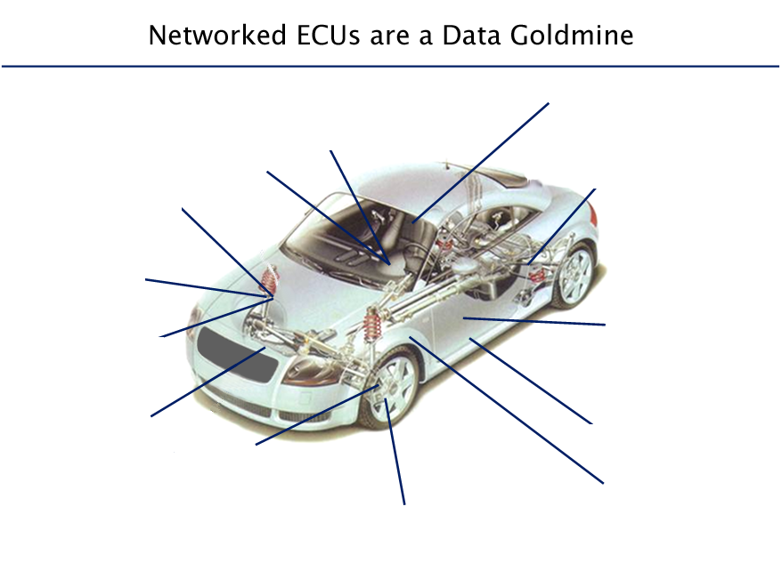
Data Goldmine
Air Bags, HVAC, Power Seats, Power Windows
Navigation, Telematics
Electronic Power Steering,
Anti-Theft
Anti-lock braking /
Traction Control
Transmission /
4 Wheel Drive
Emissions
Engine
Body, Climate,
Audio, Keyless Entry
Cruise Control
Hybrid Powertrain
Diagnostics (OBD-II)
Active Suspension
Traction
Smart Junction Box

Slide 6
Benefits of in-vehicle network
Wealth of information on the vehicle
Sensors, signal conditioning and A/D are standard on the vehicle
Controllers share digital data over the network
Easy to acquire many parameters without adding hardware
Only need to add missing sensors, or none at all!

Slide 7
Heavy Duty Vehicles

Slide 8
Heavy Duty Protocols
Older in-vehicle network standards:
  J1708 for hardware – 6 pin adapter
  J1587 for software
Newer / current standard is J1939
  Has many subset standards
  J1939-71 defines J1939 database
  9 pin adapter; also includes J1708/1587 protocol
  Available since year 2000 with CAN protocol
  More common after 2004

Slide 9
Heavy Duty J939 Database
J1939 spec defines almost 2000 possible parameters!
HD industry shares information better than LD.
Compare messages in file to the master J1939 database and remove messages and parameters (FF or FFFF) that are not there.
Vast majority of the parameters we need are broadcast due to normal operation of the vehicle.

Slide 10
Three Components defined in
J1939 Message ID
Message Priority (first part of 1st byte)
  1st byte is not really important for data acquisition
Parameter Group Number (middle 2 bytes)
  Critical to know this for data acquisition
Source Address (last byte)
  Always know which controller sent the data

Slide 11
CAN Protocols
CAN protocol developed by Bosch in 1980s
CAN defines both hardware and software standards.
Lowest number CAN ID has highest priority
J1939 defines the software and hardware standards
J1979 & ISO15765 defines OBD-II
ISO14229 defines EOBD

Slide 12
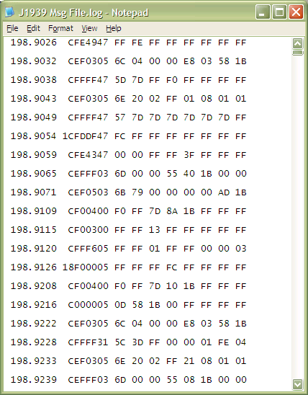
Sample J1939 Message File
Notes:
01 = eng; 03=trans; 05=shift console; 31=starter system 47=suspension

Slide 13
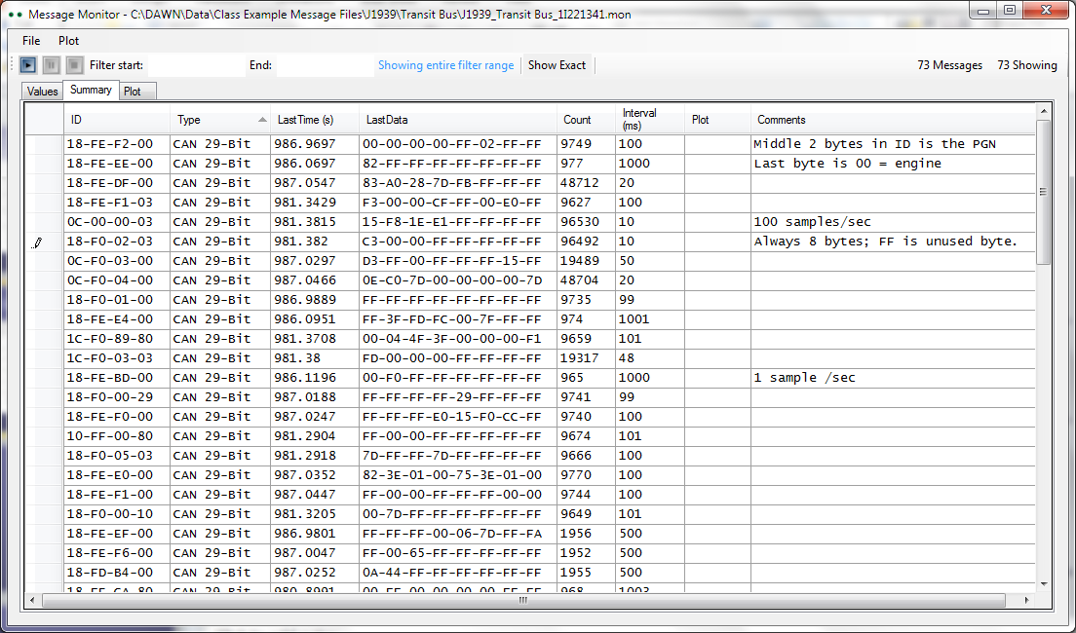
J1939 Messages Summary
Notes:
29=Vehicle Security; 80=Parking Brake 11 to 14 are brake systems

Slide 14
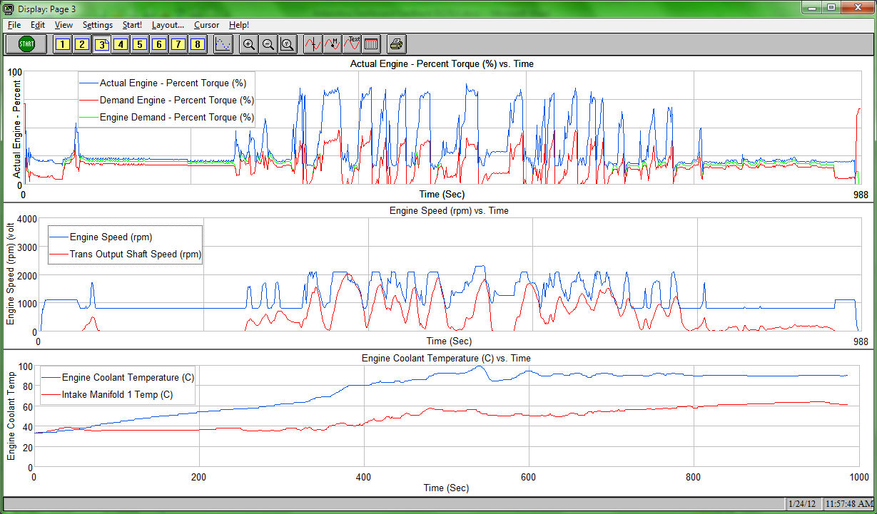
J1939 Heavy Duty Data

Slide 15
Light Duty Vehicles

Slide 16
OBD Compliant Controller
OBD Compliant controllers are:
  Engine
  Transmission
  Hybrid
  Hybrid Battery
All others are non-OBD compliant – harder to acquire data from non–OBD controllers
Some non-OBD controllers use CAN protocol.
Multiple protocols are on a vehicle.

Slide 17
Sample OBD-II (J1979) Parameters
From Engine Controller
  Engine speed, load (absolute & calculated)
  Vehicle speed
  Mass Air Flow (MAF) Rate to engine
  Manifold Air Pressure (MAP)
  Temperatures: coolant, ambient, catalyst
  Accelerator pedal and throttle position
  O₂ sensor data, Lambda (A/F)
  Fuel trims (long and short term)
  Diagnostic Trouble Codes (DTCs)
  Available parameters on a vehicle vary

Slide 18
Data You Can’t Get from Standard OBD-II
Odometer, Torque
ABS, Safety
Ride and handling
Air bag parameters
Hybrid operating parameters (SOC, motor speed/torque)
Fuel Consumption from injectors in most cases

Slide 19
OBD-II and CAN Relationship
OBD-II is the information – the data
CAN is one of many protocols to transmit OBD-II data
  Protocol is like a language
  Same information can be said in different languages
  Older LD protocols are J1850, ISO 9141, ISO 14230
  Since 2008, CAN must be used for OBD-II data
  2004 to 2008 was the transition period to CAN

Slide 20
Acquiring Parameters
From the Network
To Acquire
  request
  filter mask
  device ID
  data length
  acquisition rate
  data type
  test mode
To Scale and Plot
  units
  labels
  zero offset
  scaling factor
  min. value
  max. value

Slide 21
Automotive OBD-II
Test Modes

Slide 22
OBD Test Mode
(Mode or Service Request)
Test Mode = Service Request = Service ID (SID)
Information exchange initiated by the client (test tool) to require diagnostic info from a server (ECU),
Or to modify the ECUs behavior for diagnostic purposes.

Slide 23
Test Mode
Defines for each test:
  Purpose (Why)
  Information (What)
  Procedure (How)
  Rate & Priority (When)
  Controllers Involved (Who)

Slide 24
OBD-II Test Modes
(a.k.a. Service Requests)
Mode No. (Hex) | Description of Test Mode (Service ID)
01 | Request Current Powertrain Diagnostic Data (Data Acquisition Mode)
02 | Request Current Powertrain Freeze Frame Data
03 | Request Emission Related Diagnostic Trouble Codes (DTCs)
04 | Clear/Reset Emission DTCs
05 | Request Oxygen Sensor Monitoring Test Results
06 | Request On-Board Monitoring for Specific Systems
07 | Request Emission-Related DTCs Detected
08 | Request Control of On-Board System, Test, or Component
09 | Request Vehicle Information

Slide 25
Enhanced Diagnostics
Purpose | OBD-II J1979 | Enhanced OBD J2190 ISO14229
Data Acquisition | 01 | 21, 22, 23, etc.
Freeze Frame | 02 | 12
Trouble Codes | 03 | 13, 17, 18
Clear Trouble Codes | 04 | 14

Slide 26
Automotive CAN Headers
Targeted
  REQUEST = 000007 E0 01
  RESPONSE = 000007 E8 41
  Priority 7 (low)
  E0 is a targeted request of the Engine Controller
  Engine Response is E8
  Test Mode $01
  Response offset by $40
  Broadcast
  REQUEST = 000007 DF 01
  RESPONSE = 000007 E8 41
  RESPONSE = 000007 E9 41
  DF is a broadcast request
  E8 is engine controller
  E9 is transmission controller

Slide 27
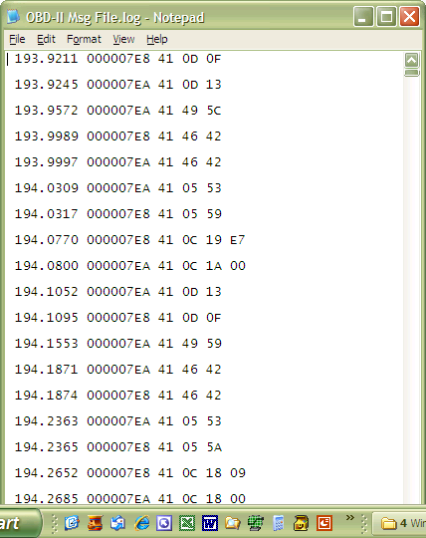
Sample OBD-II Message File

Slide 28
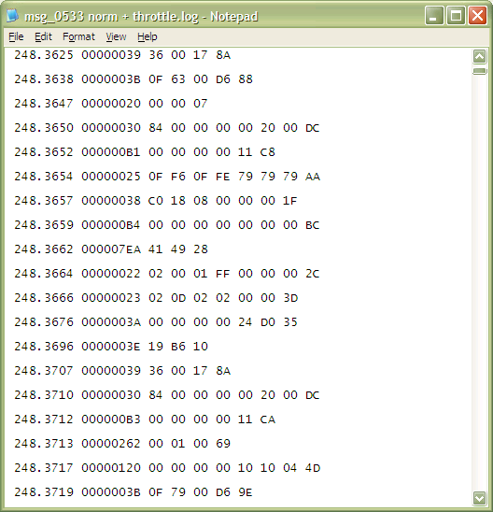
Sample Normal Message File

Slide 29
Requirements to Acquire Data
from an In-Vehicle Network

Slide 30
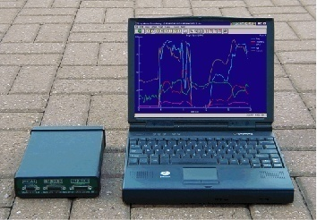
How Do I...
Acquire data from the in-vehicle network...
Store, retrieve, analyze, and display data on my computer?

Slide 31
Data Acquisition User Wants
Think in terms of engineering parameters (rpm, temp., etc.)
Isolate user from network message details
Acquire as easily as from direct sensors

Slide 32
How to Simplify In-Vehicle Network
Data Acquisition
Let user select parameters to acquire
Have a database for all of the details relating parameters to messages including scaling and message info
Let user define acquisition rate

Slide 33
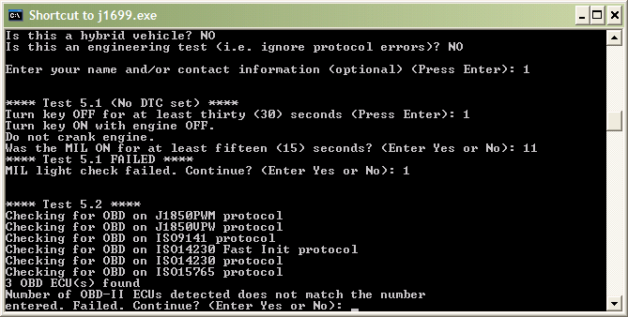
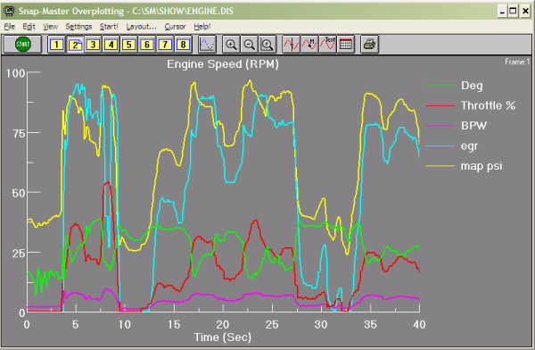
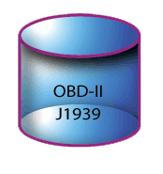


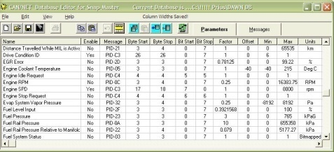
In-Vehicle Data Acquisition
SAE J1699
Determines
OBD-II Protocol
if unknown
Parameter/Message
DAWN Database
Vehicle Interface Tool
J2534
Pass-Thru
logger or
PC-based
Application Software
User Defined
CSV
DBC Database
Database Editor

Slide 34
Network Database
To reword a political expression:
It’s the database.
Database, database, database
The key is relating acquired hex messages to engineering parameters

Slide 35
EOBD Scan Tool Limitations
Why not use a scan tool?
Communicates with just one controller at a time
Typical limit is 20 samples/sec/message aggregate
Limited plotting and storage of data

Slide 36
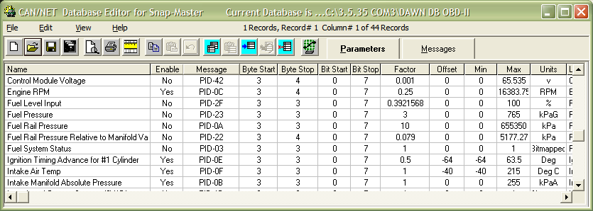
LDV OBD-II Parameter Database
Relates Messages & Parameters

Slide 37
Resolution
Scale Factor is in engineering units / bit
This is the best possible resolution
Resolution may not be even as good as the scale factor
Range of values
Is parameter measured or calculated (and what is it dependent on?)

Slide 38
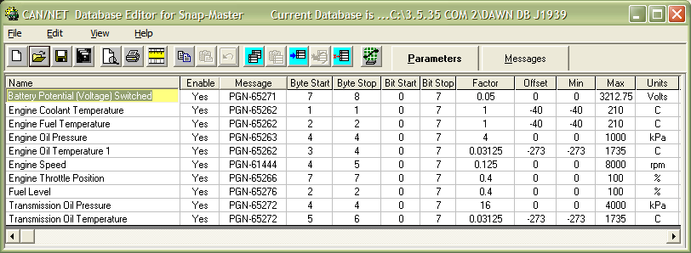
HDV J1939 Parameter Database
Relates Messages & Parameters

Slide 39
Sources of Automotive
Network Databases
1. OBD-II Diagnostics - (emission related only, around 100 parameter defined, but everyone has access). Must request these diagnostic messages. J1979 standard. (ISO 15031-5)
2. Enhanced Diagnostics (Service) – Used by service scan tools. Faster and more complete than OBD-II. Need to request. ISO 14229 standard. (J2190)
3. Normal / Functional - Need OEMs database or reverse engineer. Real-time. No request required.
4. Direct Memory Reads (DMRs) - OEM’s internal diagnostic messages. Most complete but hardest to get database. Need request messages. ISO 14229 standard.

Slide 40
Sources of Automotive
Network Databases
1, 2 & 4 are diagnostic data.

Slide 41
J1939 Messages
Normal Messages
  Most J1939 Messages we want are Normal broadcast messages
  No request message required
  Same messages used to operate the vehicle
Diagnostic Messages need request messages
  Tend to be slow changing parameters
  Proprietary messages

Slide 42
Non-OBD Controllers
Only engine, transmission and hybrid controllers conform to OBD-II
All other controllers are not
Less standards; more difficult. Very different procedure for each OEM.
Need to know controller ID; not standard
Ride and handling; odometer, etc.

Slide 43
Find Available Parameters
Just because we have a database of possible parameters doesn’t mean our test vehicle has them.
How do we know what is available?
Trial and error or is there a better way?

Slide 44
Find Available Parameters
For OBD-II vehicles only
Request PID $00 for a specific mode
Vehicle responds with available PIDs, MIDs, TIDs, etc. for the specific application.
Use for modes $01, 02, 06, 08, 09 and their enhanced versions

Slide 45
Overcoming Limitations for
Sample Rate
Maximum acquisition rate for a parameter is defined by the ECU. We can’t change this.
  Example: Vehicle speed is acquired at 1 sample/sec & is only 8 bits for resolution (1kph)
Typical transmit rate from an ECU is limited to 20 samples/sec/message aggregate
  Four OBD-II parameters yields 5 samples/sec for each

Slide 46
Improving Sample Rate
  Can pack two OBD-II PIDs and sometimes three, to more than double the rate for OBD-II messages
  Can pack many PIDs into an EOBD message to have all parameters update 20/sec
  Use a special EOBD high-speed mode defined by OEM, if available
  Find the equivalent “Normal” Message
  Request PIDs at different rates

Slide 47
Sample Data

Slide 48
Sample Engine Data from Network

Slide 49
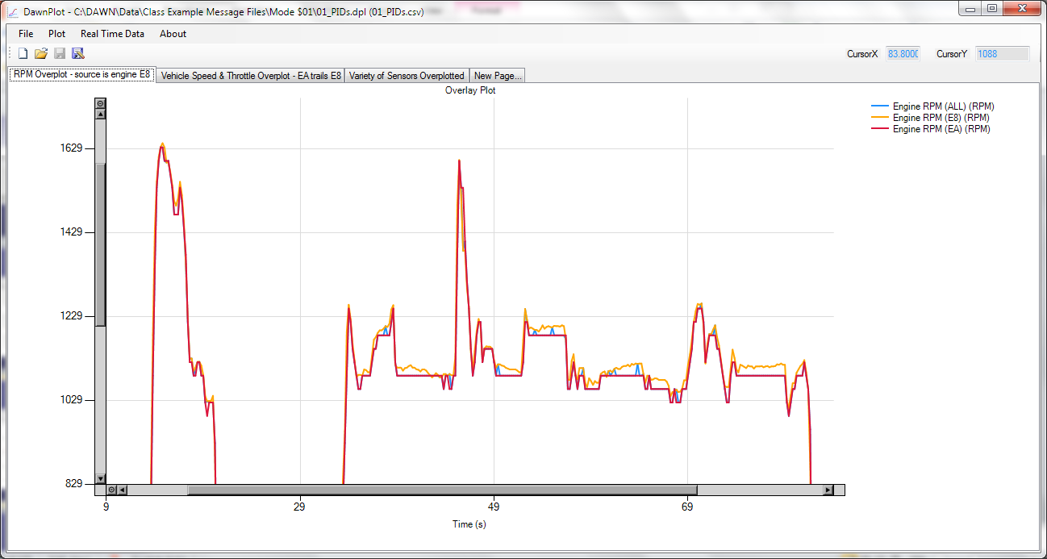
Shows RPM Source is the Engine Controller not Hybrid Controller

Slide 50
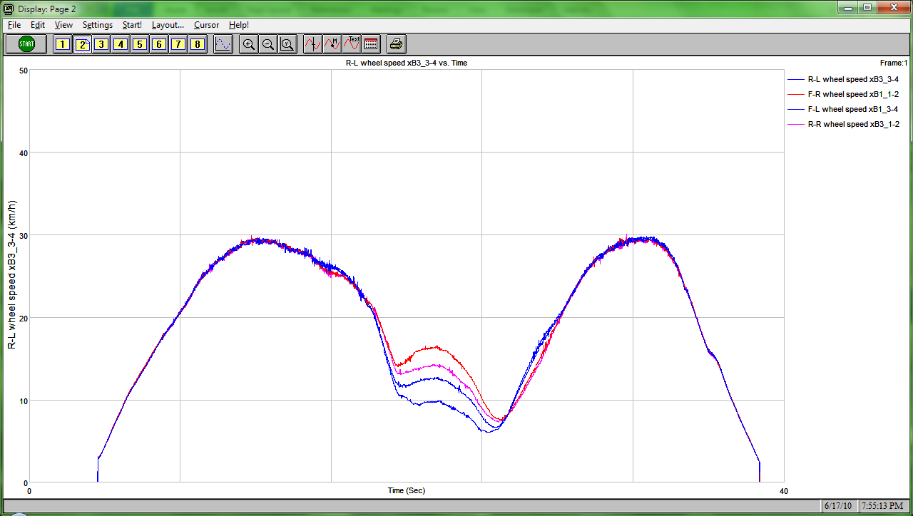
4 Wheels Speeds

Slide 51
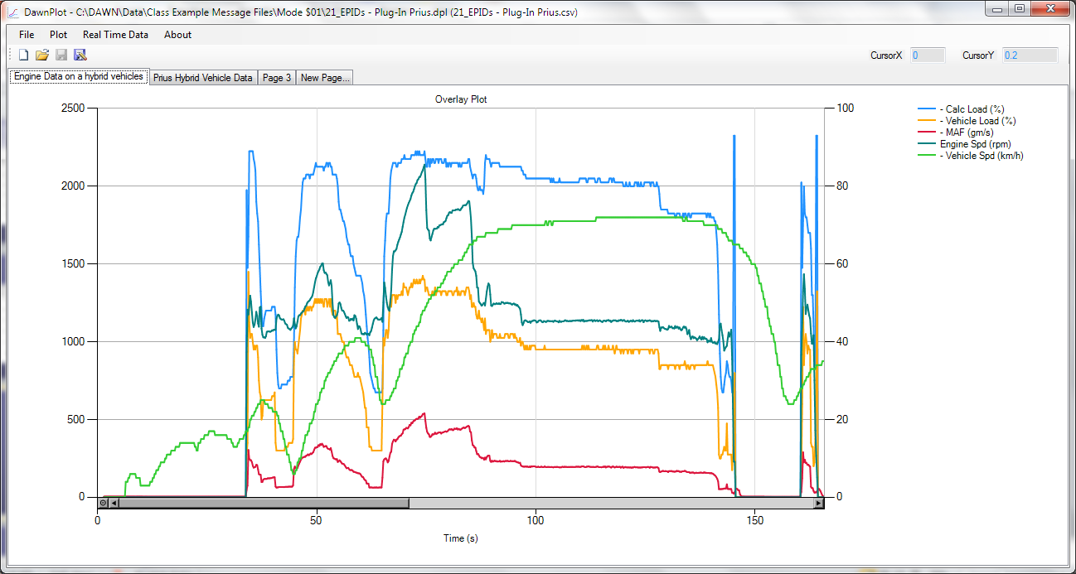
Hybrid Engine OBD-II Data

Slide 52
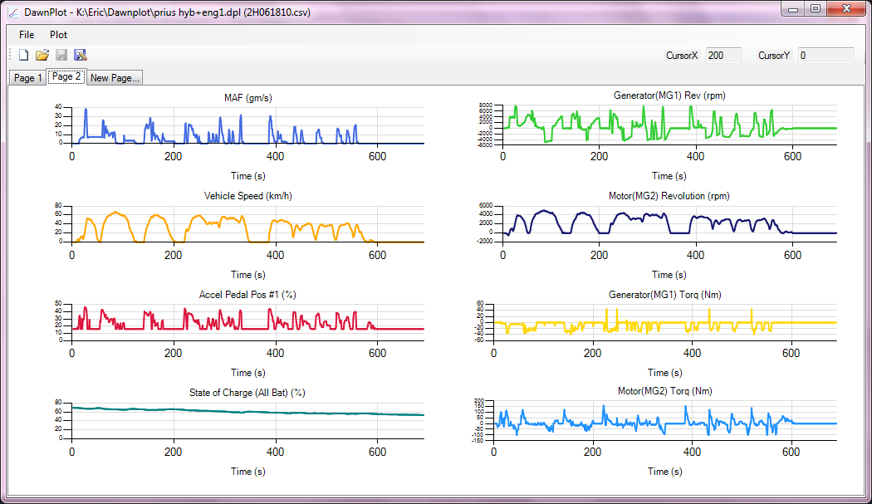
EOBD Hybrid Vehicle Data

Slide 53
Pitfalls from In-Vehicle Network
Data taken on faith / some assumptions
Parameter measured or derived (and how)?
Does it really measure what we need?
  The right parameter
  The right location and time
What is its amplitude accuracy?
What is its timing accuracy?
  Message sent fast enough?
  Unknown latency?

Slide 54
Biggest Issue
Can I get the database I need to convert the messages to scaled, engineering parameters?
What type of database will provide the information I need?
  OBD-II Diagnostics - J1979 standard.
  Enhanced Diagnostics (Service)
  Normal / Functional - Need OEMs database or reverse engineer. Real-time. No request required.
  Direct Memory Reads (DMRs) - OEM’s internal diagnostic messages.

Slide 55
PEMS Conference
This presentation is a subset of the SAE Seminar:
Acquiring & Analyzing Data
From Sensors & In-Vehicle Networks
May 1-2, 2014
Troy, MI
Rick Walter, P.E.
HEM Data Corporation
rickw@hemdata.com
248 559-5607 x111

