Slide 1

PAMS-based Light-Duty Vehicle Fuel Economy Pilot Study Overview
ERG:
Michael Sabisch
Timothy DeFries
Sandeep Kishan
ICCT:
John German
Francisco Posada Sanchez
Anup Bandivadekar
Presented at the UCR / Ce-CERT 4th Annual PEMS Conference
April 4, 2014

Slide 2
Project Overview
Because in-use loads and driving patterns differ from certification cycles, and real-world environmental conditions differ from lab conditions, in-use fuel economy deviates from vehicle mpg ratings
ICCT-funded a pilot study to investigate collecting second-by-second fuel economy on LD OBDII vehicles
  Sampling : Define sample size and structure for full-scale project
  Recruiting: Define a methodology and estimate cost
  Data logging: Identify or produce a data logger to conduct study
ICCT also contracted TUV Nord Mobilitat (TUV) for a similar European study

Slide 3
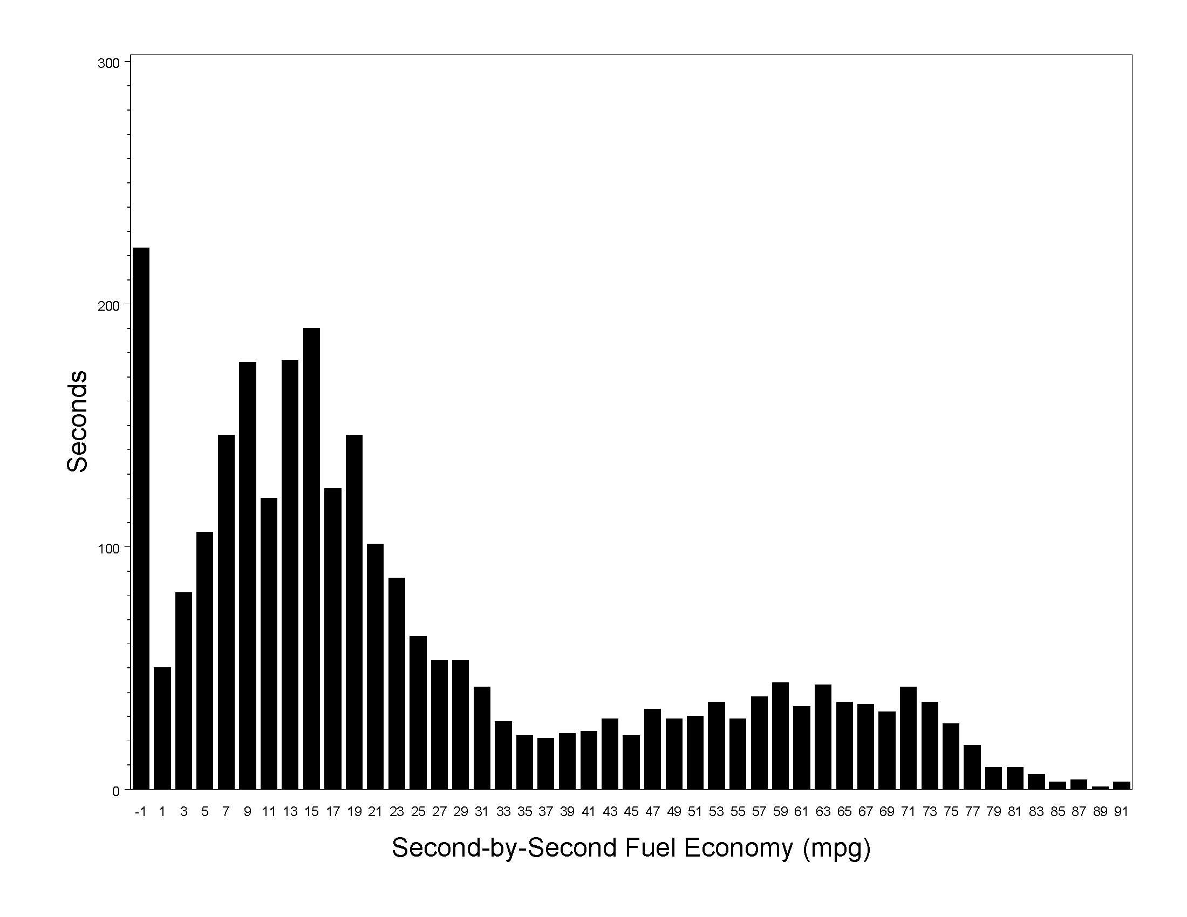
Why Second-by-Second?
PEMS FE Measurements of a 2003 Ford F150 4.6L
5
15
25
35
45
55
65
75
85

Slide 4
One Potential Study Vision
Select 1996+ LD vehicles from national household survey sample
Stratify sample by:
Propulsion system (PFI, GDI, Hybrid, Diesel)
Fuel Economy and Environment Label highway value
Fuel Economy and Environment Label City to Highway FE ratio
Adjust sample to be representative of US drivers, vehicles, geography
Record the following:
OBD parameters to calculate sxs FE (OBD datalogger)
Operating conditions that influence sxs FE (OBD datalogger)
Basic vehicle and driver info
Mail Dataloggers to vehicle owners to self-install for 1 year
Maintain program and collect data wirelessly over 1 year period
* sxs = second-by-second

Slide 5
Study Design Variables
Sample Design Variables*
Sample Measurement Variables
Stratification
FEEL Composite MPG
FEEL Highway MPG
FEEL City MPG
Propulsion System
Fleet Char.
Total Odometer
Home Altitude
Vehicle Age
Vehicle Type
Driver Age
SocioEconomics
Precipitation, climatic
Ambient Temp, climatic
Driver Gender
Transmission Type
Manufacturer
To Calculate FE
Standard OBD PIDs
and/or
Enhanced OBD PIDs (EPIDS)
Influencing FE
Acceleration
Road grade
Speed
Gear
A/C Compressor (EPID)
Engine warm-up
Aggressiveness
Altitude, inst.
Cargo Weight
Wind
Tire Pressure (EPID?)
% Ethanol
Precipitation, inst.
Aerodynamics, inst.
Ambient Temp, inst.
Alternator Load, inst.
*Must know before sample created
*Need population estimates

Slide 6
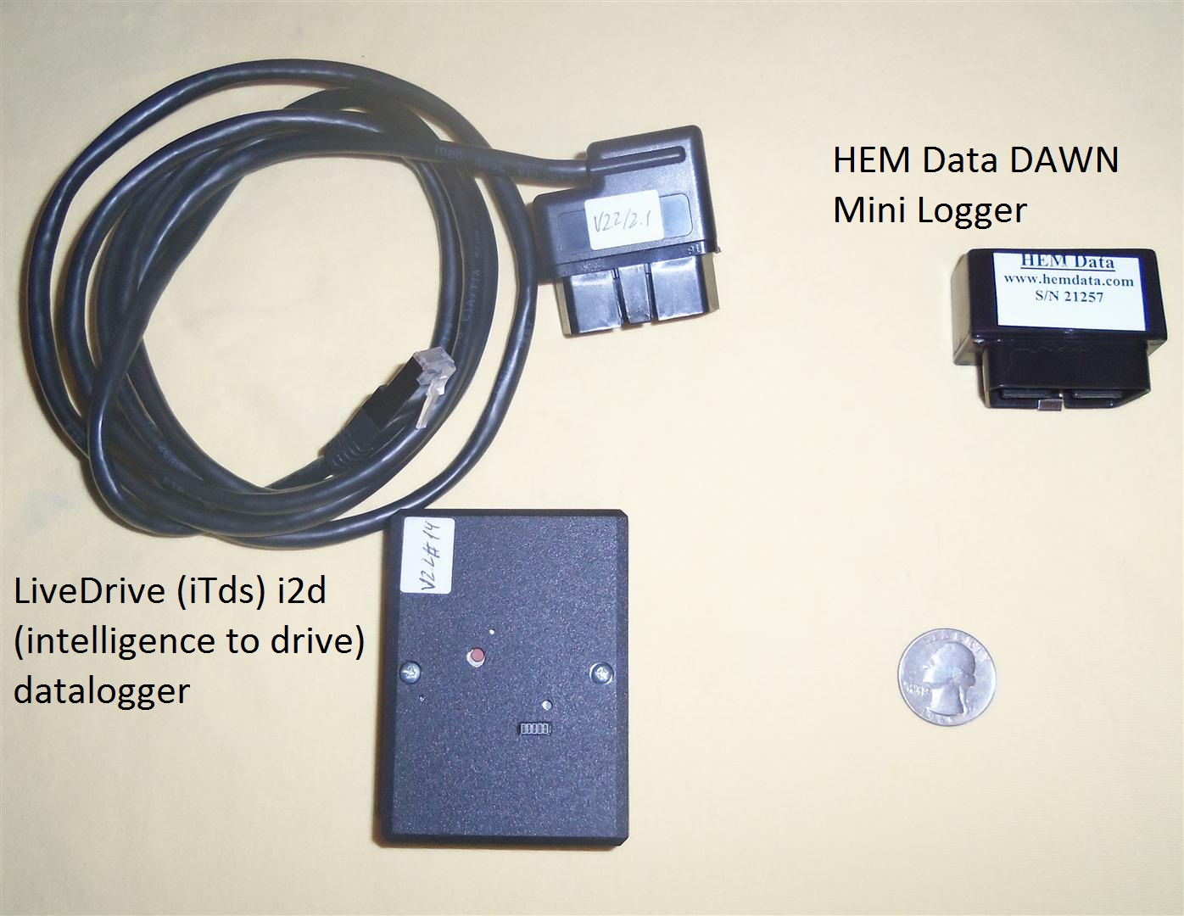
Data Logger Selection
More than 40 data loggers were screened
11 were carefully evaluated against study requirements
2 data loggers were acquired for hands-on evaluation
HEM Data DAWN OBD Mini Logger was selected for in-use testing

Slide 7
Technical Evaluation
Feature | LiveDrive i2d | HEM Data DAWN OBD Mini
auto sleep / power-up | Yes | Yes
adjustable data acquisition rate | Limited | Yes
Internal clock | No | Yes
auto-establish connection | Yes | Yes
Size and ease of installation | Fair | Good
GPS | Yes | Yes
accelerometer | Yes | Yes
Internal thermocouple | Not verified ¹ | Future²
on-board data storage | Yes, 2 GB internal | Yes, up to 32 GB card
CAN protocols | Yes | Yes
legacy protocols | Not verified¹ | Future²
Standard PID selection configurable | Planned | Yes
enhanced PIDs (powertrain / other) | No | May be added
Cellular data transmission | Yes | May be added
supplier accessibility | Fair | Good
FE calculations from standard PIDs | Not verified ¹ | MAF vehicles only
FE estimates for all vehicle types | Not verified ¹ | MAF gasoline only
barometric altimeter | Yes | No
Bluetooth | Yes | No
1 ITDS staff report the i2d does have this functionality, but this was not verified during ERG’s testing
2 HEMData is currently making this modification with an estimated completion of Spring 2014

Slide 8
Fuel Economy Validation
ERG evaluated fuel economy (FE) estimates using the following methods
  Comparison of FE estimates from OBD standard PIDS (MAF / wide-band O₂ sensor) vs. injector volume (enhanced PID) using data provided by HEM Data
  Comparison of dynamometer results and FE estimates from OBD standard PIDS (MAF / narrow-band O₂ sensor)
ERG focused on gasoline-powered vehicles that broadcast MAF (fuel rate or injector fuel rate the “target” approach for MAP & diesel vehicles)

Slide 9
FE Calculations using MAF
For gasoline vehicles which broadcast SAE J1979 PID Mode 01 PID 10 (Mass Air Flow) and λ (wide-band air/fuel ratio sensor)
Fuel Economy (distance per volume) = k₁ * Speed * λ * AFR_{stoich}
Mass Air Flow
Fuel Economy (volume per time) = k₂ * Mass Air Flow
λ * AFR_{stoich}
  (AFR_{actual}/AFR_{stoich}) from standard SAE J1979 on vehicles with wide-band O₂ sensors
  k₁, k₂ are constants that account for various unit conversions and the estimated fuel density and ethanol content

Slide 10
MAF vs. Injector Comparison
MY2012 conventional (non-hybrid) PFI gasoline
SAE J1979 MAF & wide-band O₂ λ vs. injector volume (enhanced PID)
MY2011 hybrid PFI gasoline
SAE J1979 MAF & wide-band O₂ λ vs. injector volume (Enhanced PID)

Slide 11
MAF vs. Injector Comparison (contd.)
MY2012 conventional (non-hybrid) PFI gasoline
MY2011 hybrid PFI gasoline

Slide 12
Types of Discrepancies Between MAF and Injector-Based Fuel Rates for Non-Hybrid (contd.)
Injector higher than MAF over multiple points
Most common (≈ 80% of discrepancies, 15% of data)
OBD load ≈ 12%, OBD throttle ≈17 %*, OBD λ = 1.2**, vehicle decelerating
Average injector fuel rate = 0.9915 mL/s, average MAF fuel rate = 0.3177 mL/s
Injector fuel rate appears to not accurately represent deceleration fuel cut
* 17% throttle represents closed throttle for this vehicle
** Max λ (reported air/fuel ratio) broadcast for this vehicle was 1.2, indicating fuel cut

Slide 13
Comparison of Cumulative MAF-Based and Injector-Based Fuel Rates
Vehicle | Duration (seconds) | Cumulative Fuel Volume (mL)
 |  | Injector-derived | MAF with λ correction (& % diff from injector) | MAF w/o λ correction (& % diff from injector)
2012 conventional (non-hybrid) | 3223 | 4324 | 3816 / (88.3%) | 3784 / (87.5%)
2011 hybrid | 849 | 753 | 729 / (96.8%) | 725 / (96.3%)

Slide 14
OBD MAF vs. Dynamometer
Vehicle
  2009 Saturn Outlook 3.6L V6 GDI
  MAF / narrow-band O₂ sensor
Test cycles (indoor lab temperature)
  HFET, US06, FTP75
Neural network (NN) computer modeling used to:
  Adjust for dyne / CVS delays (time alignment) for 1 Hz comparison
  Adjust for diffusion (mixing in CVS tunnel)
  Identify periods of non-stoichiometric operation
    Cold Starts, fuel cut, enrichment
NN modeling does not predict non-stoichiometric values
  Requires input of known parameters to calculate non-stoich operation

Slide 15
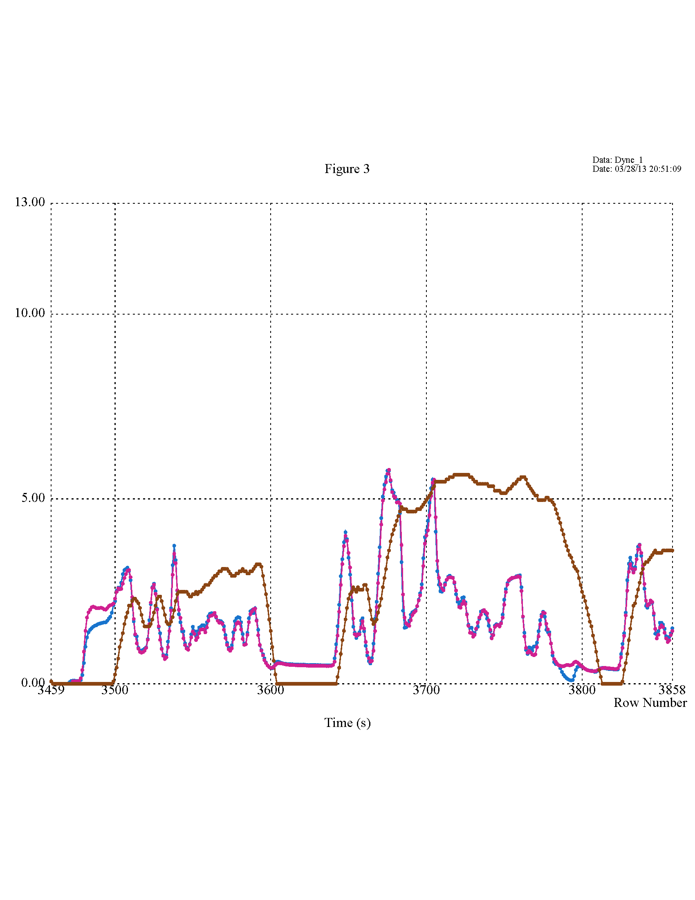
NN Modeling Before Input of Non-Stoich Corrections
NN Model Fuel Rate (mL/s)
Speed (mph/10)
Dyne Fuel Rate (mL/s)
OBD MassAirFlow → FuelRate (but only at stoich)
Discrepancies at cold starts
Discrepancies at fuel cut-offs

Slide 16
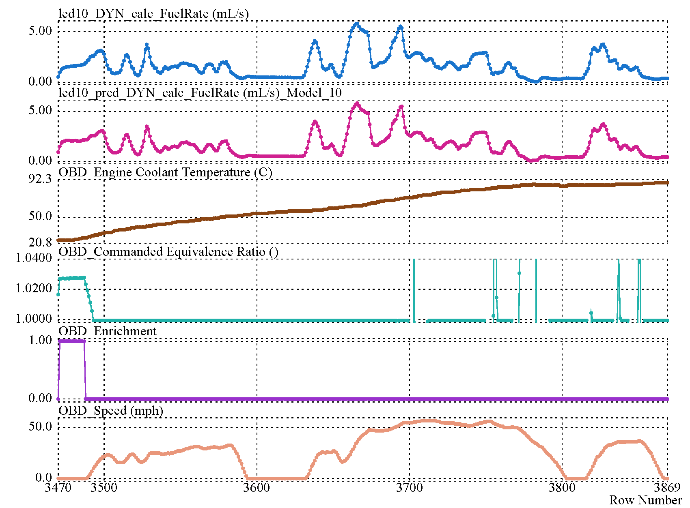
Non-Stoich Operation: Cold Start
NN Modeling Identified @ OBD Commanded Equiv Ratio ≈ 1 .025
FTP75 Bag1
ColdStart

Slide 17
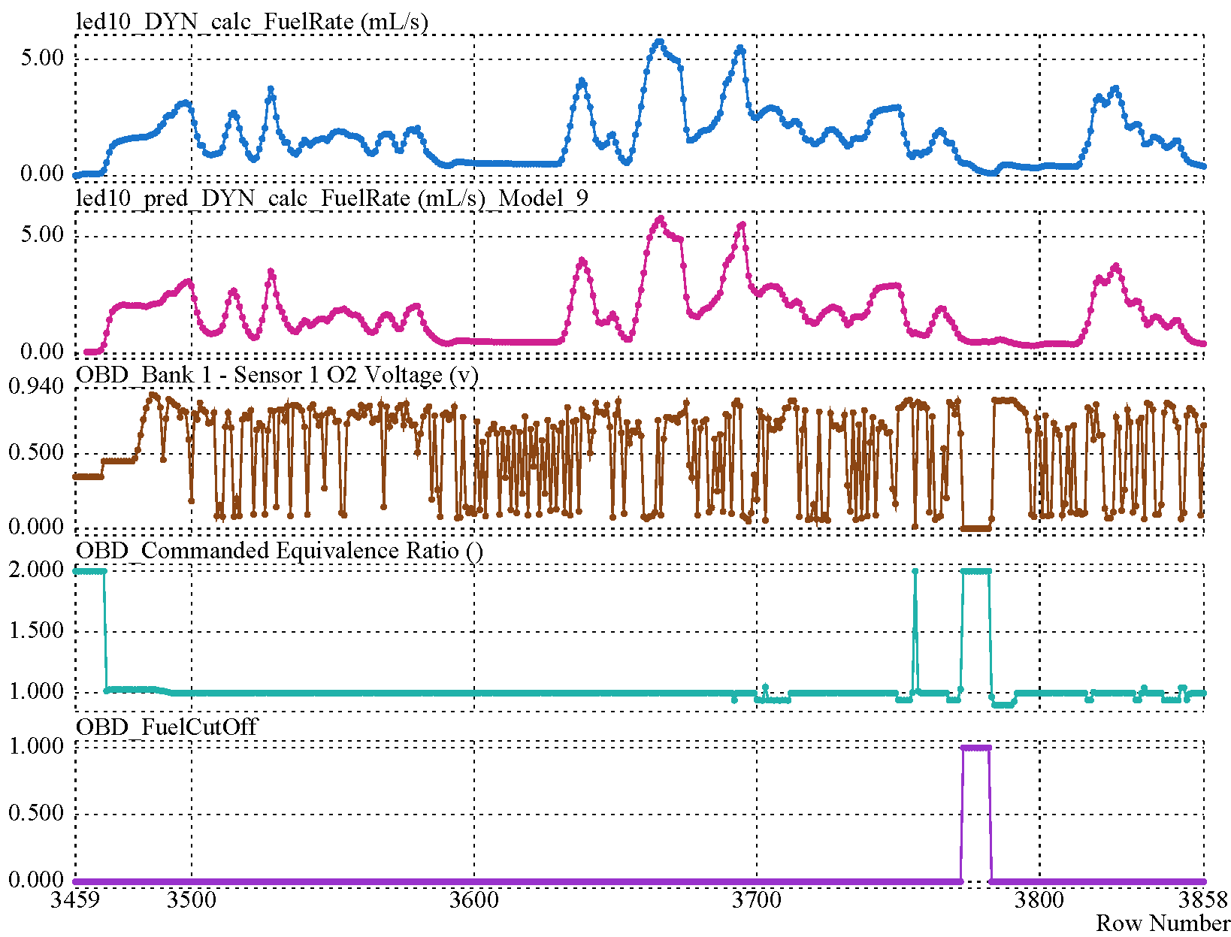
Non-Stoich Operation: Fuel Cut-Off
NN Modeling Identified @ 1.98 ≤ OBD_CommandedEquivRatio ≤ 2.00
FTP75 Bag1

Slide 18
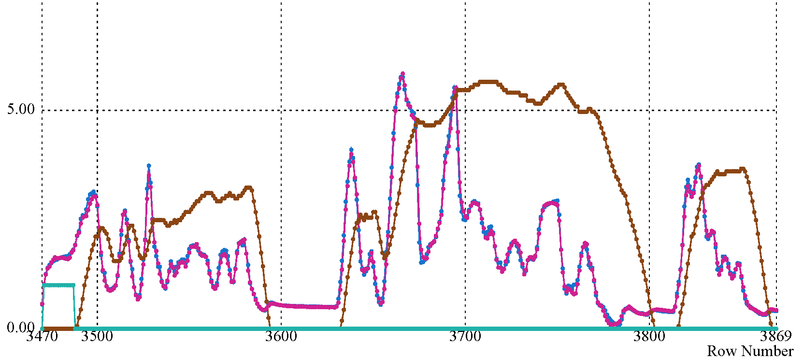
NN Modeling After Input of Non-Stoich Corrections
NN Model Fuel Rate (mL/s)
Speed (mph/10)
Dyne Fuel Rate (mL/s)
Cold Start Indicator
OBD_MassAirFlow → FuelRate (but only at Stoich)
OBD_FuelCutOff indicator → FuelRate (at fuel cut-offs)
OBD_ColdStart indicator → FuelRate (at one cold start)

Slide 19
Comparison of Cumulative MAF-Based and
Dyne-Based Fuel Rates
Cycle | Duration (seconds) | Cumulative Fuel Volume (mL)
 |  | Dyne Measured | OBD Modeled (& % diff from dyne) | OBD Uncorrected (& % diff from dyne)
HFET | 765 | 1392.8 | 1409.2 / (101.2%) | 1454.4 / (104.4%)
US06 | 600 | 1793.4 | 1841.3 / (102.7%) | 1856.9 / (103.5%)
FTP75 Bag1 | 505 | 810.0 | 816.8 / (100.8%) | 829.6 / (102.4%)
FTP75 Bag2 | 863 | 851.8 | 858.7 / (100.8%) | 888.9 / (104.4%)
FTP75 Bag3 | 505 | 667.7 | 681.9 / (102.1%) | 686.5 / (102.8%)

Slide 20
Pilot Study Conclusions on Data Logging
Straightforward to obtain OBD-based average fuel rate for gasoline vehicles that broadcast MAF
More challenging (and costly) to obtain moderately accurate instantaneous FE
  For non-stoich operation for vehicles that do not have wide-band O2S (cold starts, fuel cut, or enrichment operation)
  Injector fuel rate (an enhanced PID) appears inaccurate during deceleration fuel cut from one vehicle (this is correctable)
MAP Vehicles (Chrysler, Honda, others) and diesels pose additional challenges
Data validation is important, regardless of method of determining fuel rate

Slide 21
Acknowledgements
ERG gratefully acknowledges our partners:
  The Urban Institute
  NuStats
  Emerald Electronic Design
  SGS Environmental Testing Corporation
ERG would also like to thank Rick Walter of HEM Data for providing data and technical support throughout the study.

Slide 22
Additional Information :
Complete ERG (US) and TUV (Europe) study reports available at:
http://www.theicct.org/measuring-in-use-fuel-economy-summary-pilot-studies
Contact Information:
Michael Sabisch
ERG – Austin, Texas
michael.sabisch@erg.com
512-407-1828

