Slide 1
PEMS Testing to Assess Emissions
Implications of Electric Vehicles
Jeremy Johnson,
Josias Zietsman, Ph.D., P.E.
Reza Farzaneh, Ph.D., P.E.
Tara Ramani
Presented by
Yuche Chen, Ph.D.

Slide 2
Objective: Accounting for Electric Vehicles in Air Quality Conformity
State-of-art practice assessment
EV Market
Emission and Energy Implication
Implications for Air Quality and Conformity
Develop Texas-specific EV driving schedules
Develop Emission rates for EV
Tailpipe emissions
Emissions associated with electricity / charging
Develop EV Market Penetration Scenarios
Develop MOVES utility for emission estimation
Policy Implication and analysis

Slide 3
Approach
A total of 12 vehicles were tested, including:
4 HEVs (Camry, Fusion, Escape, Prius)
4 PHEVs (Prius, three Volts)
4 BEVs (Focus, three Leafs, Telsa??)
Emissions
Gaseous tailpipe emissions – HEV / PHEVs (charge sustaining mode, i.e. CS Mode)
Source emissions - BEV / PHEVs (charge depletion mode, i.e. CD Mode)
Calculated based on the EPA Power Profiler online tool and battery data from OBDII data loggers.
Test Procedure
Driving – One week for each vehicle at Environmental and Emissions Research Facility (EERF), College Station, TX
Idling (Warm Start & Cold Start, Hot & Cool temperature) – Environmentally Controlled Test Chamber at EERF

Slide 4
Test Protocol
In-use gaseous emissions - ECOSTAR system from Sensors Inc.
Each test included a GPS and an OBDII data logger to collect speed profile, battery profile (state of Charge, remaining battery power).
Pollutants: CO, CO₂, NO, NO₂, and THC

Slide 5
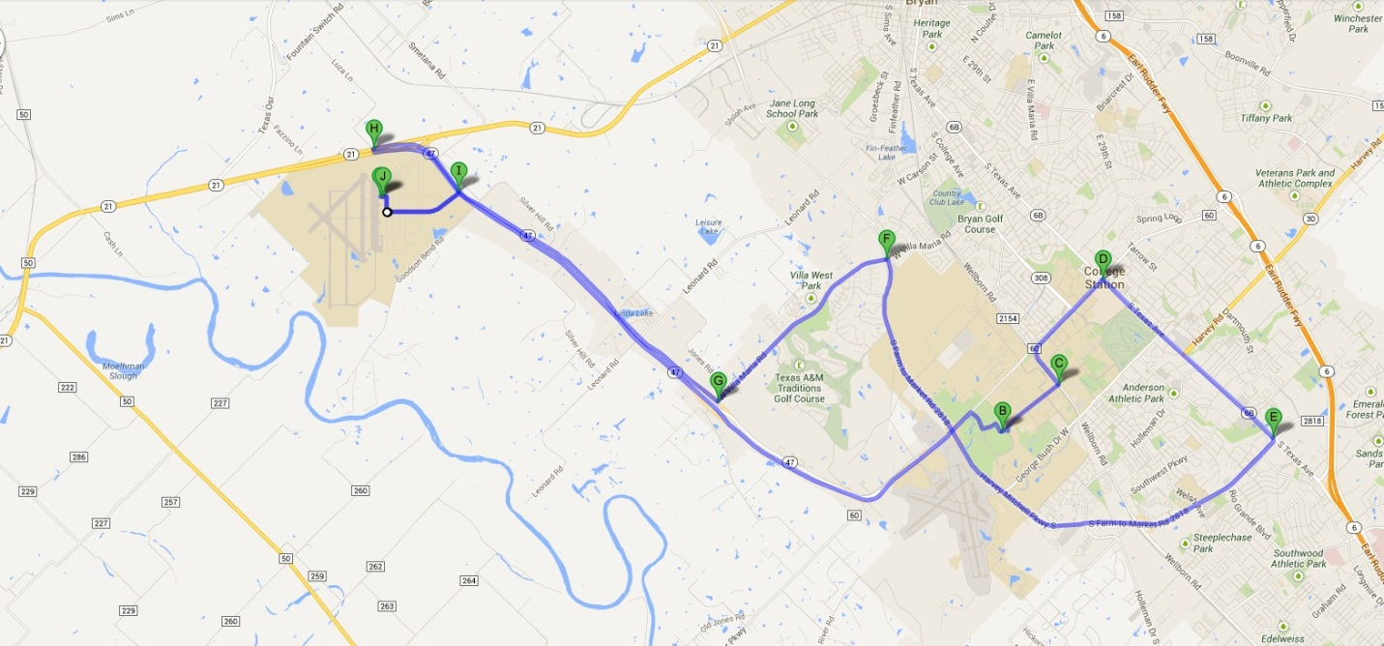
Test Route
Consisted of both highway and city driving - repeated multiple times per vehicle
Total distance was ~31 miles.

Slide 6
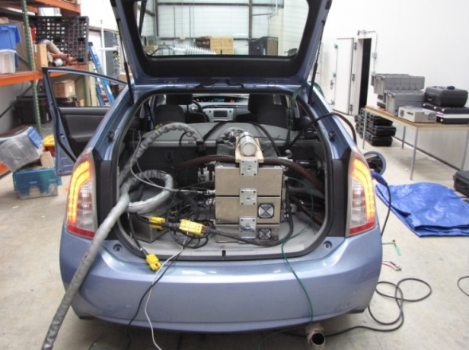
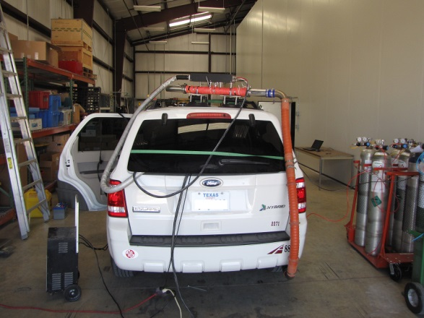
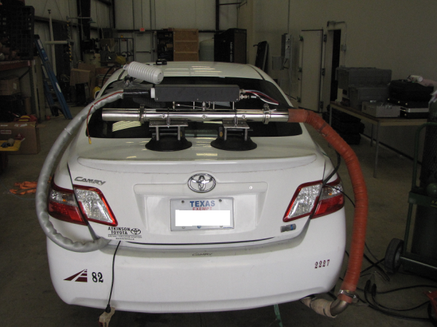
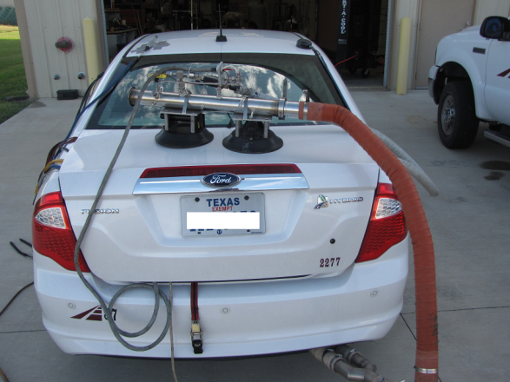
Vehicle Setup

Slide 7
Test Results
Results were tabulated for each vehicle based on MOVES OpMode bins using the GPS/OBDII data for second-by second speed profile.
The data was then averaged for each MOVES OpMode bin, resulting in emissions rates for each vehicle in each OpMode bin.

Slide 8
HEV-Running CO₂ Emissions

Slide 9
HEV-Running NO_{x} Emissions

Slide 10
HEV-Idling NO_{x} Emissions

Slide 11
PHEV CS Mode CO₂ Emissions

Slide 12
PHEV CS Mode NO_{x} Emissions

Slide 13
PHEV CD Mode Power Consumption
Notes:
The Prius had no CD mode data in the higher speed/acc bins

Slide 14
PHEV CS Mode Idling NO_{x} Emissions

Slide 15
PHEV CD Mode Idling NO_{x} Emissions

Slide 16
BEV Power Consumption

Slide 17
BEV Idling NO_{x} Emissions

Slide 18
Conclusions
Completed the testing of electric vehicles
Results will be used for emission estimation with uncertainties in EV market penetration, power generation emission, and energy policies.
Determine overall emission impacts / health impacts of EVs

Slide 19
Contact
Yuche Chen
Texas A&M Transportation Institute
Email: y-chen@tti.tamu.edu
979-862-2232

Slide 20
Supplemental Test Results

Slide 21
Test Results – HEV CO Emissions

Slide 22
Test Results – HEV THC Emissions

Slide 23
Test Results – PHEV CS Mode CO Emissions

Slide 24
Test Results – PHEV CS Mode THC Emissions

