Slide 1
COMPARISON OF pems, pAMS, AND DAILY lOGGED FUEL EFFICIENCY DATA FOR REFUSE HAULERS IN A MUNICIPAL FLEET
Andrew Burnette
infoWedge, El Dorado Hills, CA

Slide 2
Outline of Presentation
Summaries of main project and this exercise
Test vehicles and data methods
How the vehicles are used
Comparison of fuel efficiency results via different data methods
“Takeaway” lessons/conclusions

Slide 3
Summary of Main Project
Give SJAPCD an “apples-to-apples” comparison of new hydraulic-hybrid emissions & fuel use to conventional refuse hauler in the Manteca fleet
Many thanks to:
  Manteca fleet personnel for logistical/technical support and interviews
  SJAPCD for original project funding

Slide 4
Summary of this Exercise
Compare the accuracy and utility of fleet vehicle fuel efficiencies calculated via...
  “Low-cost” subscription service that uses automated daily data collection;
  “Medium-cost” method that requires 1-Hz ECU data, and;
  “High-cost” method that requires 1-Hz PEMS (or direct fuel flow) data collection.

Slide 5
Test Vehicle Description
Tier 3
Tier 4i

Slide 6
Data Collection Methods
Zonar (entire fleet)
  Automatic subscription service using RFID tags
  Daily CAN data (distance) and refueling volumes
UniCAN data logger (4 vehicles)
  CAN and GPS data at 1-Hz
SEMTECH-DS (2 vehicles)
  Emissions concentration and flow at 1-Hz
  CAN and GPS at 1-Hz

Slide 7
Fuel Efficiency Data
Distance Traveled
  Daily: Zonar computed from CAN data (rear wheels)
  1-Hz: Logged from GPS; logged from CAN data (rear wheels)
Fuel Flow Rate (per unit distance or time)
  Daily: Zonar measured refuel volumes
  1-Hz: Calculated from CO2+CO emission rates; imputed from injector pulse width

Slide 8
Typical Daily Work Flow

Slide 9
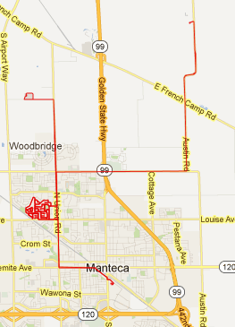
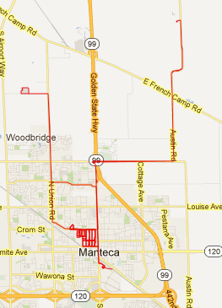

Single Vehicle Day-to-Day Routes
Feb 6, 2013
Feb 7, 2013
Feb 8, 2013

Slide 10
Zonar Data Alone
“We think they save some fuel, but are they worth it?”
What about driving differences
due to:
-Idling differences
Payload requirements?
Launch performance?

Slide 11
Driving Mode Assignment
Manually assigned modes
(Could be automated)
- Idle (with creep)
- Start/stop (sustained speed < 25 mph)
- Urban
- Highway (sustained speed > 40)

Slide 12
Comparison of CAN and PEMS results
“Hypothetical” daily duty-cycle is modal-average of conventional and hybrid on typical routes
ECM
(fuel injector)
& GPS data
PEMS
(carbon-balance)
& GPS data

Slide 13
“Takeaway” Lessons/Conclusions
Even automated commercial data collection has significant data “holes” and needs significant validation.
Daily average data can be misleading unless usage differences are accounted for, so...
  Modal Data is beneficial when comparing vehicles with different capacities, performance, features, duty cycles, etc.
  Modal Data enables more accurate assignment of specific refuse haulers to “best value” routes.
For non-idle data (low load?), CAN fuel use compares well to measured (carbon-balance) fuel use. But an injector calibration curve or more accurate CAN data would be nice.

Slide 14
Q? ➔ A!
Contact:
Andrew Burnette
andrew.burnette@infowedge.com
916.760.8474

