Slide 1

Real-World Activity and Fuel Use
of Diesel and CNG Refuse Trucks
¹
Gurdas Sandhu¹
H. Christopher Frey¹
Shannon Bartelt-Hunt²
Elizabeth Jones²
²
@ 2014 PEMS International Conference & Workshop » April 3-4 » Riverside, California

Slide 2
Waste Collection in U.S.
~ 250 million tons of municipal solid waste generated each year
~ 140,000 refuse trucks for collection and transportation
Trucks average 25,000 miles per year
Typical fuel economy of 2 to 3 mpg of diesel

Slide 3
Motivation
Very few studies that report real-world diesel or natural gas refuse truck duty cycles and fuel use rates.
No study that compares real-world duty cycles and fuel use rates between refuse truck configurations.

Slide 4
Study Overview
“Include refuse truck configurations, model years & emissions control devices, and fuels typical to the U.S. waste collection industry.”
24 Trucks (18 diesel, 6 CNG)
Roll-off, Front-loader, and Side-loader configurations
Model Years: 2003 to 2012
Fuels: Ultra Low Sulfur Diesel (ULSD) and Compressed Natural Gas (CNG)

Slide 5
Research Questions
What are the real-world duty cycles of roll-off, front-loader, and side-loader refuse trucks?
What are the real-world fuel use rates of diesel roll-off, front-loader, and side-loader refuse trucks?
What are the real-world fuel use rates of CNG front-loader and side-loader refuse trucks?

Slide 6
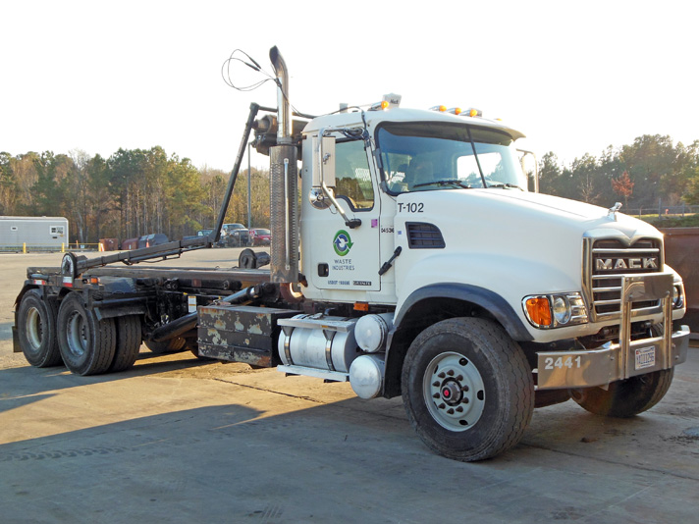
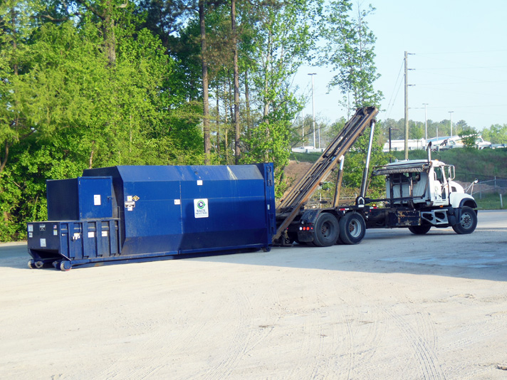
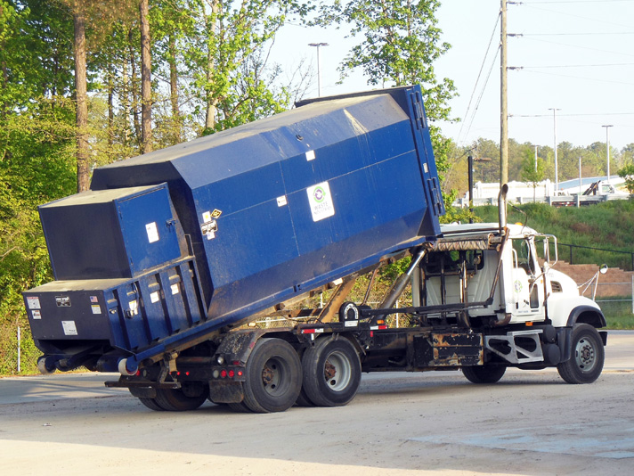
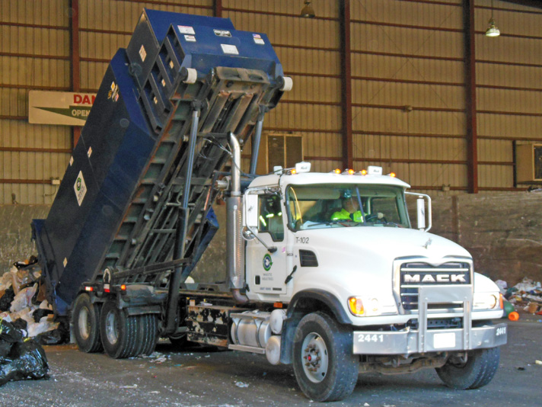
Roll-off Refuse Truck Activity
1
2
3
4

Slide 7
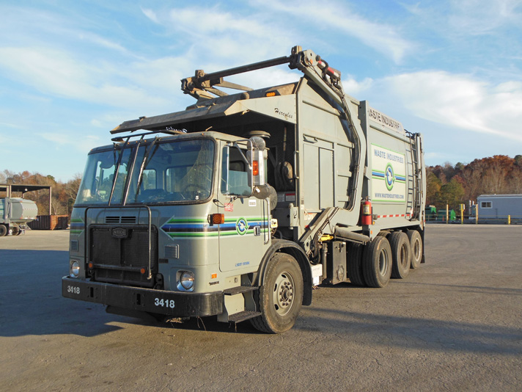
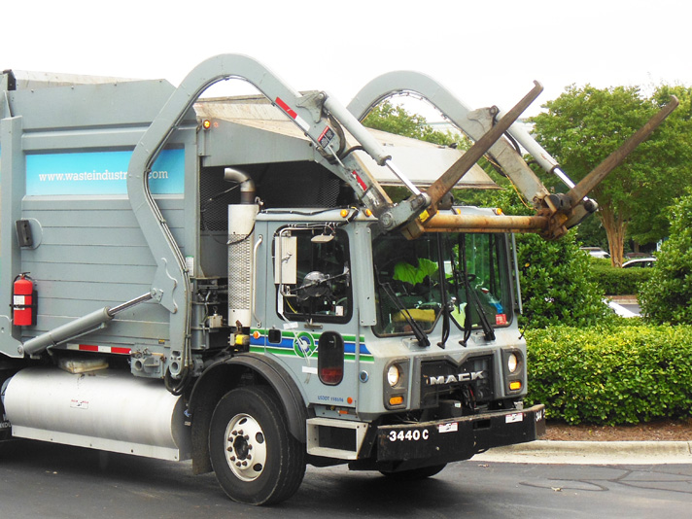
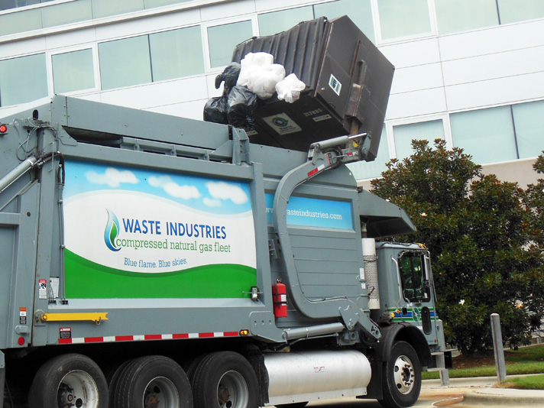
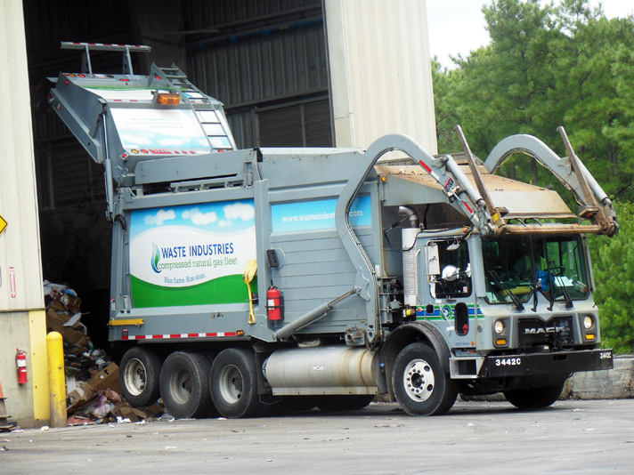
Front-loader Refuse Trucks Activity
1
2
3
4

Slide 8
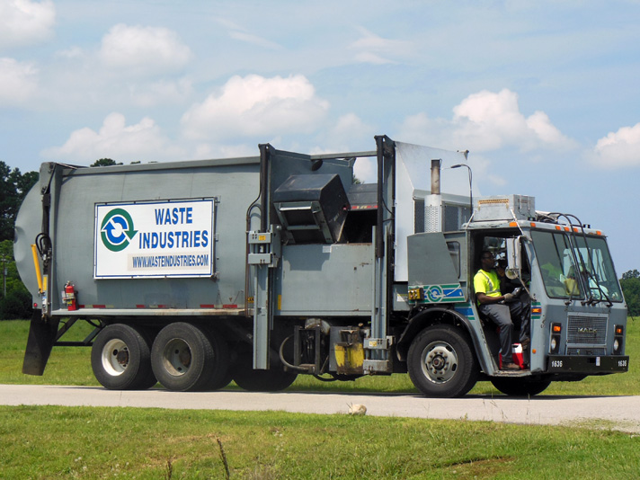
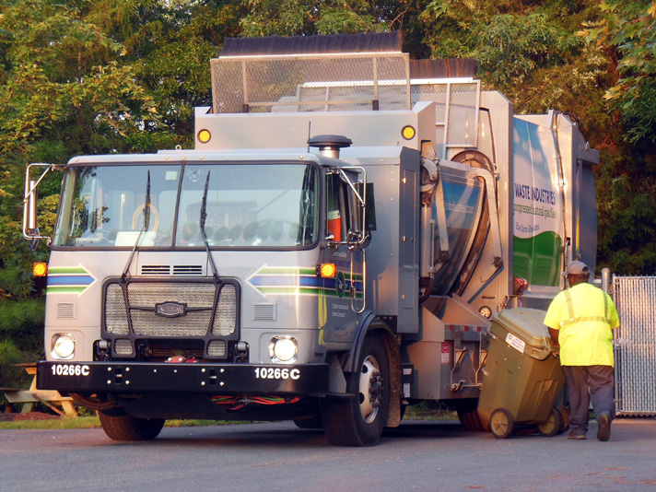
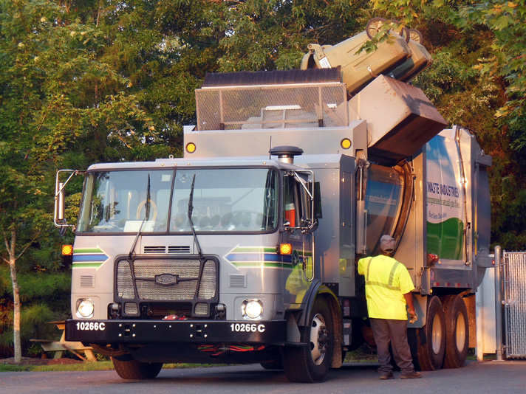
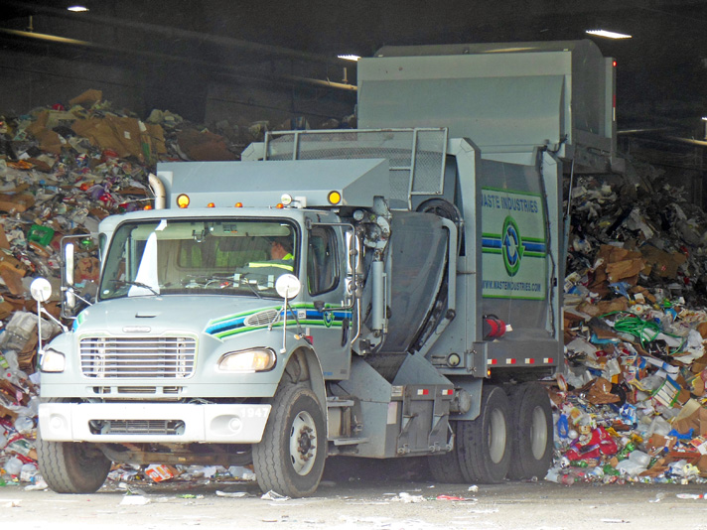
Side-loader Refuse Trucks Activity
1
2
3
4

Slide 9
Measured Diesel Roll-off Trucks

Slide 10
Measured Diesel Front-loader Trucks

Slide 11
Measured Diesel Side-loader Trucks

Slide 12
Measured CNG Trucks

Slide 13
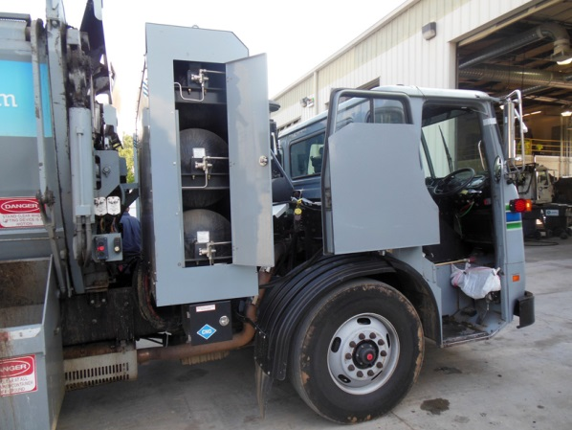
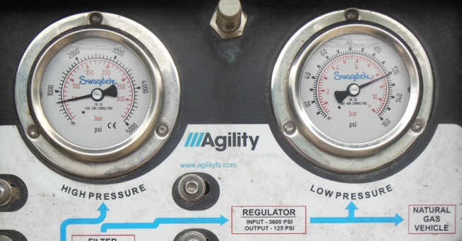
CNG Fuel System
1 diesel gallon equivalent (DGE) of CNG costs ~ $1.80
Full fuel tank: 3600 psi
At engine inlet: 70-150 psi
Inside engine: 40-70 psi

Slide 14
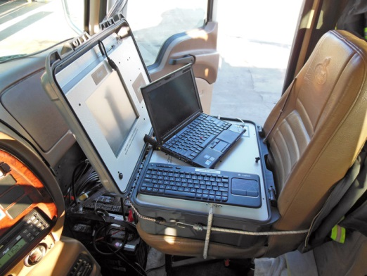

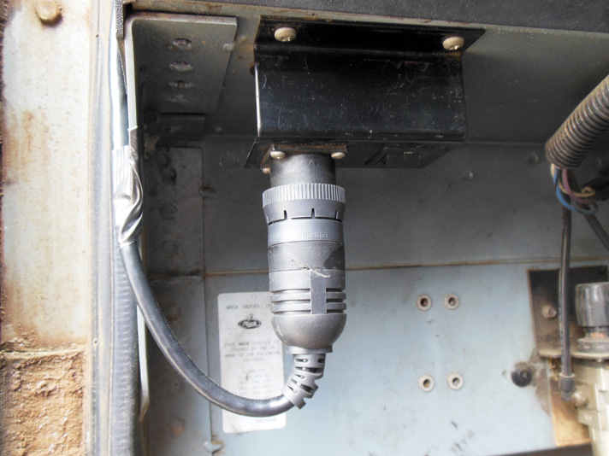
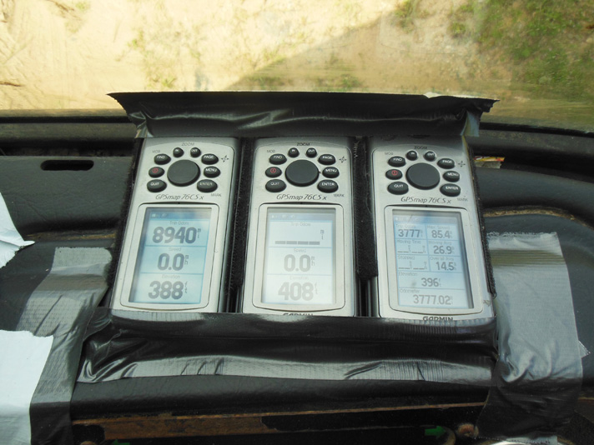
Instrumentation
PEMS: GlobalMRV Axion
Exhaust Probes
ECU Readout
GPS units: Garmin 76CSx

Slide 15
Data Collected
Exhaust pollutants: Carbon Dioxide (CO₂), Carbon Monoxide (CO), Hydrocarbons (HC), Nitric Oxide (NO), and Particulate Matter (PM).
Engine Data: Vehicle Speed (kph), Engine Speed (rpm), Intake Air Temperature (ºC), Intake Manifold Pressure (kPa), Fuel Use Rate (L/hr), Engine Load (%), Torque (%), and Exhaust Temperature (ºC).
Location Data: Latitude, Longitude, Elevation (m)

Slide 16
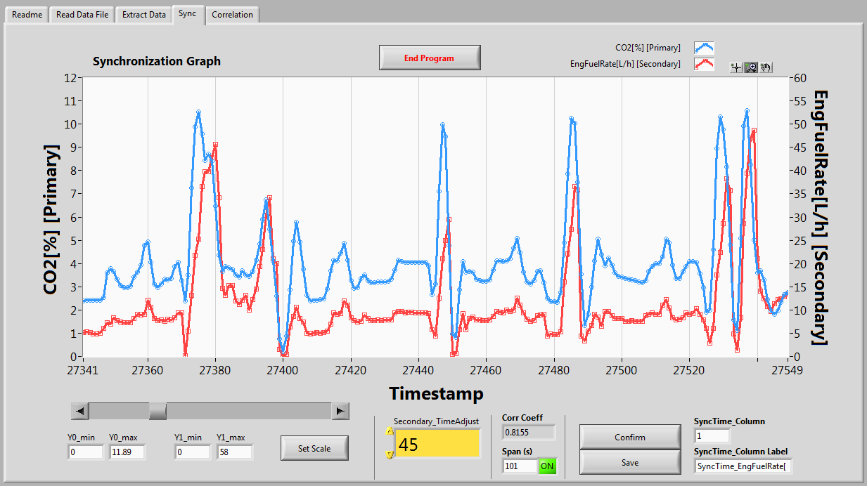
Time Alignment Example: CO₂ vs. Fuel Use

Slide 17
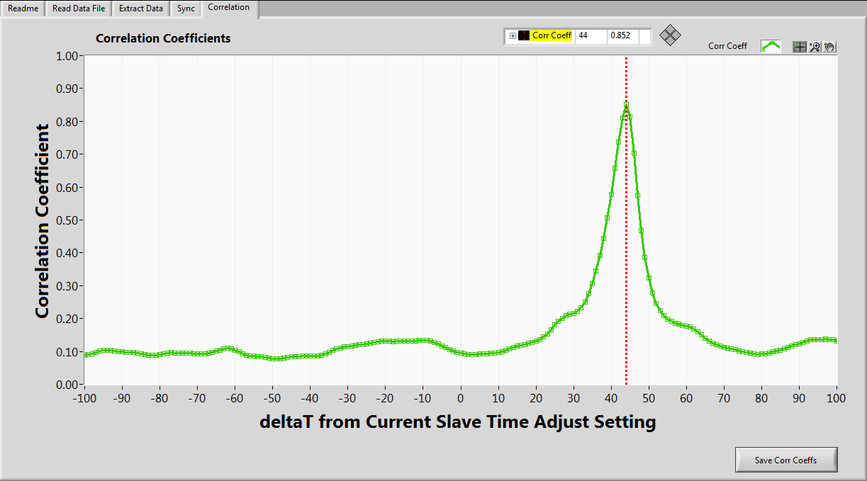
Correlation Coeff Example: CO₂ vs. Fuel Use

Slide 18
MOVES Scaled Tractive Power
STP_{t} = scaled tractive power at time t, skW
A = rolling resistance coefficient [kW-s/m] {1.41705}
B = rotational resistance coefficient [kW-s²/m²] {0}
C = aerodynamic drag coefficient [kW-s³/m³] {0.003572}
a_{t} = vehicle acceleration at time t [m/s²]
g = acceleration due to gravity [9.81 m/s²]
m = vehicle mass [metric ton] {20.6845}
r_{t} = road grade at time t [%]
v_{t} = vehicle speed at time t [m/s]
f_{scale} = scaling factor, 17.1 unitless

Slide 19
MOVES Operating Mode Definition

Slide 20
Activity Overview for Diesel Trucks
 | Roll-off | Front loader | Side loader | Total
1Hz QA Data (hours) | 50 | 48 | 46 | 144
Miles Driven | 870 | 780 | 555 | 2,205
Fuel Used (gal) | 199 | 285 | 210 | 694
Trash Cans Picked | 39 | 660 | 4,200 | 4,900
Trash Collected (tons) | 165 | 150 | 50 | 365

Slide 21
Activity Overview for CNG Trucks
 | Front loader | Side loader | Total
1Hz QA Data (hours) | 30 | 20 | 50
Miles Driven | 324 | 169 | 493
Fuel Used (DGE) | 145 | 116 | 261
Trash Cans Picked | 416 | 2110 | 2526
Trash Collected (tons) | 105 | 28 | 133

Slide 22
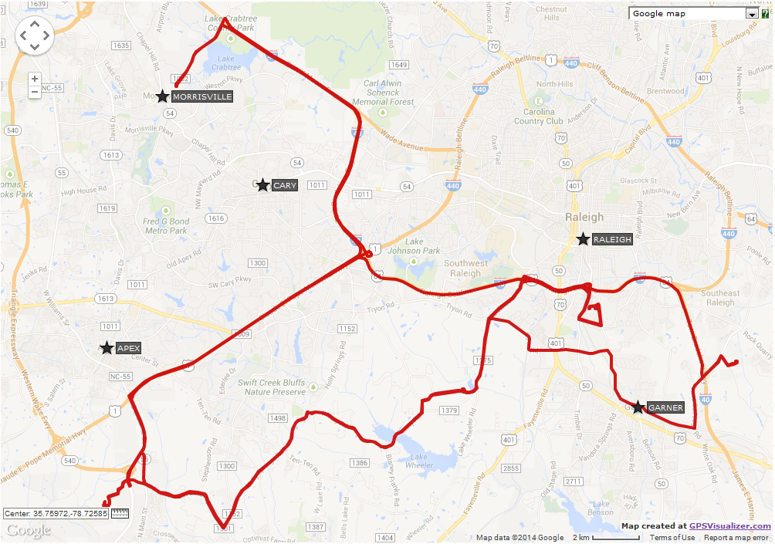
Route of Roll-off 3
170 miles
7 cans
52 tons

Slide 23
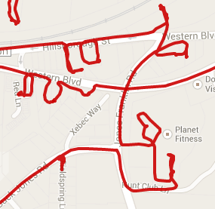
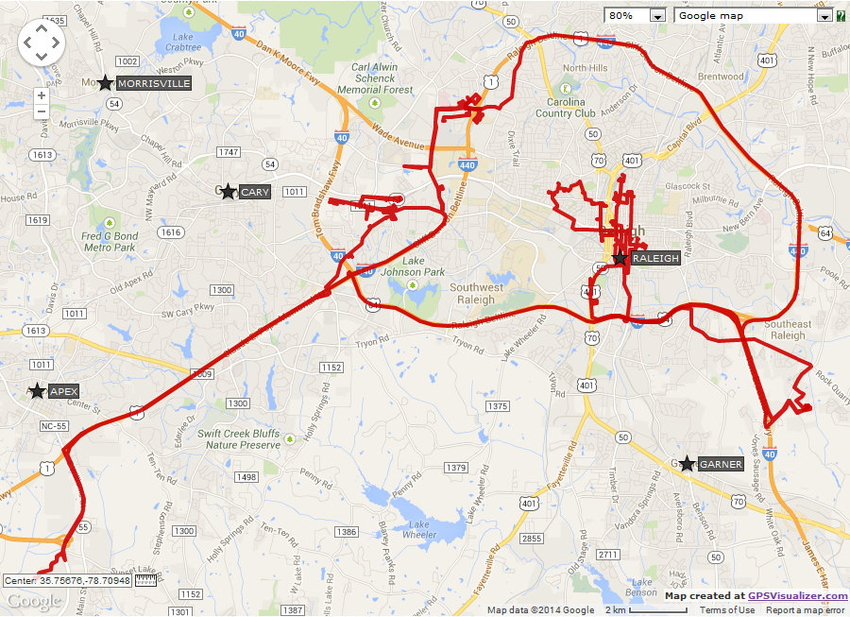
Route of Front-loader 2
157 miles
110 cans
28.3 tons

Slide 24
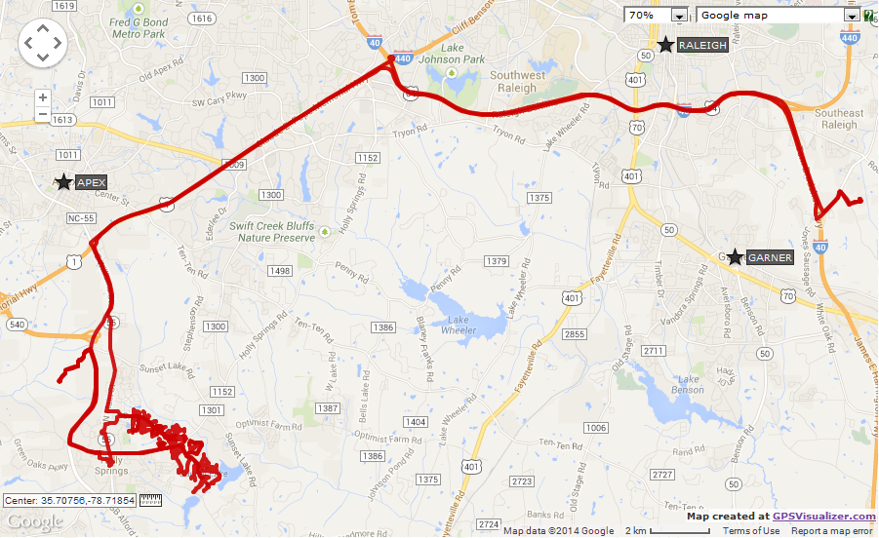
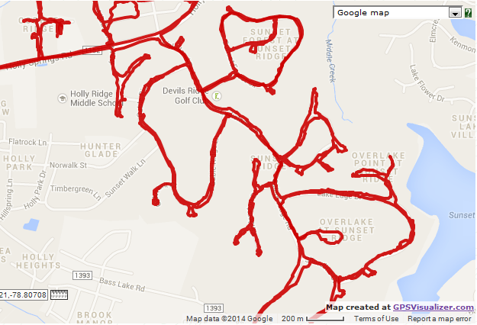
Route of Side-loader 4
88 miles
1100 cans
18.3 tons

Slide 25
Speed Trace for One Trip of Roll-off 3
U = Urban (arterial) driving, no trash collection; H = Highway driving; L = Landfill; TC = Trash Collection

Slide 26
Speed Trace for One Trip of Front-loader 2
U = Urban (arterial) driving, no trash collection; H = Highway driving; L = Landfill; TC = Trash Collection

Slide 27
Speed Trace for One Trip of Side-loader 4
U = Urban (arterial) driving, no trash collection; H = Highway driving; L = Landfill; TC = Trash Collection

Slide 28
Comparison of Duty Cycles: Diesel vs CNG

Slide 29
Comparison of Duty Cycles: NCSU vs Literature

Slide 30
Example: Modal Fuel Use Rates for RO-3

Slide 31
Diesel Fuel Use Rates for Observed Cycles
Roll-off
Front-loader
Side-loader
Average: 4.6
Max/Min: 1.5
Average: 2.6
Max/Min: 1.5
Average: 2.9
Max/Min: 2.1

Slide 32
Diesel Fuel Use Rates for Average Cycle
Roll-off
Front-loader
Side-loader
Max/Min: 1.4
Max/Min: 1.2
Max/Min: 2.0

Slide 33
CNG Fuel Use Rates for Observed Cycles
Front-loader
Side-loader
Average: 2.3
Max/Min: 1.2
Average: 1.5
Max/Min: 1.8
Diesel Avg: 2.6
Diesel Avg: 2.9
CNG fuel use rates are based on preliminary data analysis

Slide 34
CNG Fuel Use Rates for Average Cycle
Front-loader
Side-loader
Max/Min: 1.0
Max/Min: 1.3
CNG fuel use rates are based on preliminary data analysis

Slide 35
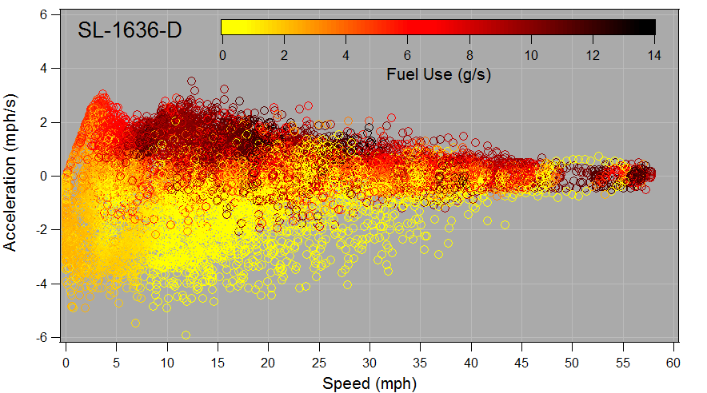
Exploratory Analysis: Diesel Fuel Use, SL-1

Slide 36
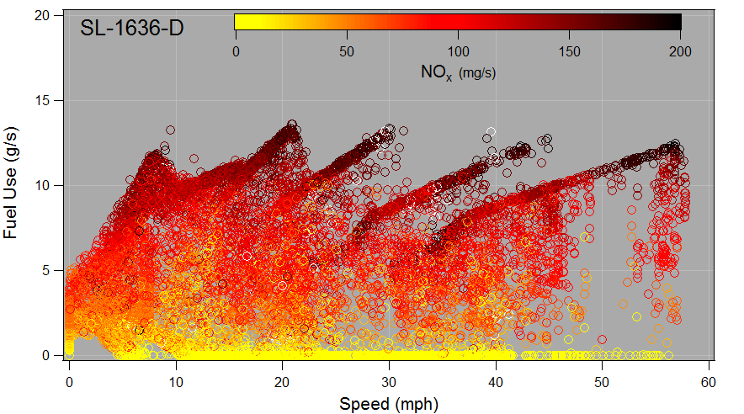
Exploratory Analysis: Diesel NO_{x} Rates, SL-1

Slide 37
Conclusions for Duty Cycles
Refuse truck duty cycles vary with configuration and are different from cycles used in previous studies.
EPA’s MOVES model should include at least one refuse truck duty cycle.

Slide 38
Conclusions for Fuel Use Rates
A higher value for fuel economy must be considered for roll-off configurations.
On average, compared to diesel, CNG trucks have lower fuel economy.
Overall fuel economy is not adversely affected by emissions controls; the adverse effect (if any) of only the emissions control device is offset by other efficiency measures.

Slide 39
Acknowledgements
This work is sponsored by the Environmental Research and Education Foundation (EREF).
Waste Industries (WI) provided refuse trucks for measurement at their Garner and Durham facilities in North Carolina, with extensive support from management staff, technical staff, and drivers.

Slide 40
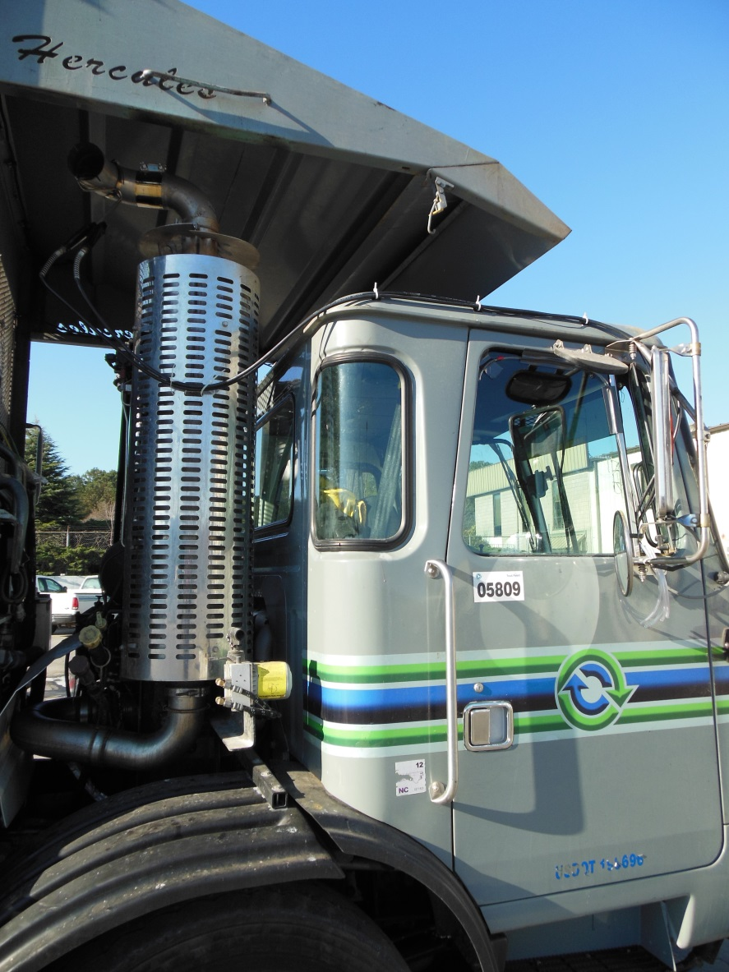
Questions Invited
Gurdas S. Sandhu
gssandhu@ncsu.edu

Slide 41
ADDITIONAL MATERIAL

Slide 42
MOVES STP References
Development of Emission Rates for Heavy-Duty Vehicles in the Motor Vehicle Emissions Simulator MOVES2010. US EPA; 420-B-12-049; August 2012.
Development of Emission Rates for Light-Duty Vehicles in the Motor Vehicle Emissions Simulator (MOVES2010). US EPA; 420-R-11-011; August 2011.
MOVES2010 Highway Vehicle: Population and Activity Data. US EPA; 420-R-10-026; November 2010.

