Slide 1
PEMS Conference 2014
Fuel Economy Data
Rick Walter, P.E.
HEM Data Corporation

Slide 2
Heavy Duty
Fuel Economy & Consumption
Notes:
What is going on here? Enhanced obd?

Slide 3
J1939 HD Engine Parameters
  Engine speed, load (absolute & calculated)
  Vehicle speed
  Injector Flow Rate to engine
  Temperatures: coolant, ambient, catalyst
  Accelerator pedal and throttle position
  Diagnostic Trouble Codes (DTCs)
  Many, many parameters are available on J1939.

Slide 4
Fuel Economy
Easy to Get on HD Vehicles
Engine Fuel Rate – Resolution is 0.050 L/H
Engine Total Average Fuel Rate
Trip Average Fuel Rate
High Resolution Total Vehicle Distance
– Resolutions is 0.005km
High Resolution Trip Distance
Engine Average Fuel Economy – Resolution is 0.0195 km/kg
Engine Instantaneous Fuel Economy
Engine Total Average Fuel Economy
Trip Drive Fuel Economy

Slide 5
How Accurate is Fuel Data
NREL stated J1939 reports 6% better fuel economy than their lab testing on a conventional vehicle (UPS truck).
And J1939 reports 11% better fuel economy than lab testing on a hybrid vehicle.
Two approaches measured simultaneously
Reported highly consistent results.
SAE paper 2012-01-2049, Measured Laboratory & In- Use Fuel Economy… by M.P. Lammert, et al.

Slide 6
How is Fuel Consumption
Determined on J1939?
Both torque and fuel consumption are calculated not measured. Based on proprietary messages.
Fuel rate is based on Command-Fuel-Quantity. This is based on the Injector-Command to Fuel-Quantity- Calibration curve.
Verified with fuel-rail-pressure and fly-wheel feedback.
Torque is based on Command-Torque relative to the Torque-Curve for the engine. Related to engine speed, boost, altitude, temperature, etc. % Load is reported on J1939.

Slide 7
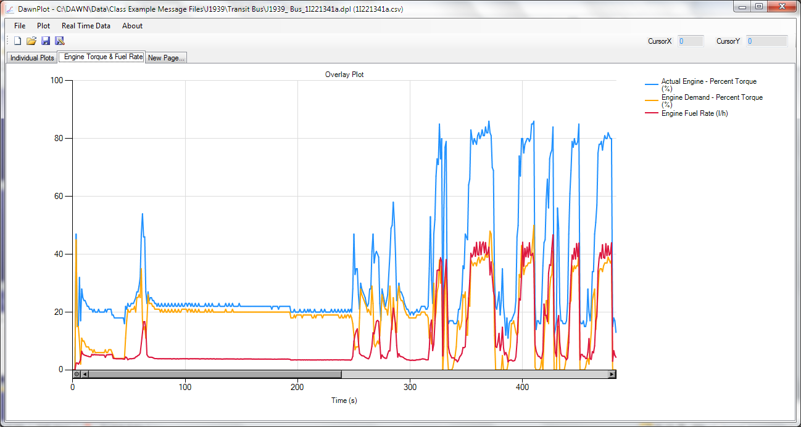
Engine Torque on J1939
Notes:
Question Demand Torque; other two are proportional

Slide 8
Today’s Focus:
Light Duty
Fuel Economy & Consumption

Slide 9
Sample OBD-II Parameters
From LD Engine Controller
  Engine speed, load (absolute & calculated)
  Vehicle speed
  Temperatures: coolant, ambient, catalyst
  Accelerator pedal and throttle position
  Diagnostic Trouble Codes (DTCs)
  Mass Air Flow (MAF) Rate to engine
  Manifold Air Pressure (MAP)
  O₂ sensor data, Lambda (A/F)
  Fuel trims (long and short term)

Slide 10
Fuel Economy from Injectors
Fuel economy (miles/gal)
= 784.05 x VSS (KM/HR) / (Injector Volume (mL) / N)
x Eng. Speed (rev/min) x No of cylinders)
Where N = number of injections summed before reporting a value for a given cylinder, e.g. Toyota sums 10 pulses before transmitting.
Using EOBD fuel injector data. Update rate is typically 1-2/sec

Slide 11
LD Injector Flow Rate
PID $5E in J1979 for OBD-II defines Injector Flow Rate –
but seldom used.
Injector Flow Rate as part of EOBD data
Some OEMs provide, but many do not.
Other key parameters are generally available
with OBD-II as defined in J1979.
So how to calculate fuel consumption and fuel economy without injector flow rate?

Slide 12
Fuel Economy Calculations
From MAF and A/F Ratio
Notes:
Header?

Slide 13
Fuel Economy
Most vehicles provide mass air flow (MAF) rate to calculate fuel consumption/economy
  Need: stoichiometric A/F ratio, vehicle speed, lambda, and fuel density
  Most commonly used, but Chrysler and some Honda vehicles don’t provide MAF.
If no injector data or MAF, then need to use MAP and ideal gas law. Helpful to model the engine. Least accurate.

Slide 14
Fuel Economy from MAF
Fuel Economy (MPG)
= lambda x 6.807 x VS (KPH) / (MAF(g/s)
or = lambda x 11.00 x VS(MPH) / (MAF(g/s )
Use either average or instantaneous values.
Lambda is a ratio that defines the deviation from stoichiometric
6.17 - Density of gasoline (lb/gal) 0.62137km/mile
454 - Conversion (g/lb) 3600 - Conversion (sec/hr)
gal (fuel) = (gal/6.17lb x lb/454g) / 14.08(A/F) = 1/39,440.6 gal/g
39,440.6 / 3600 = 11.00 g-hr/gal-sec

Slide 15
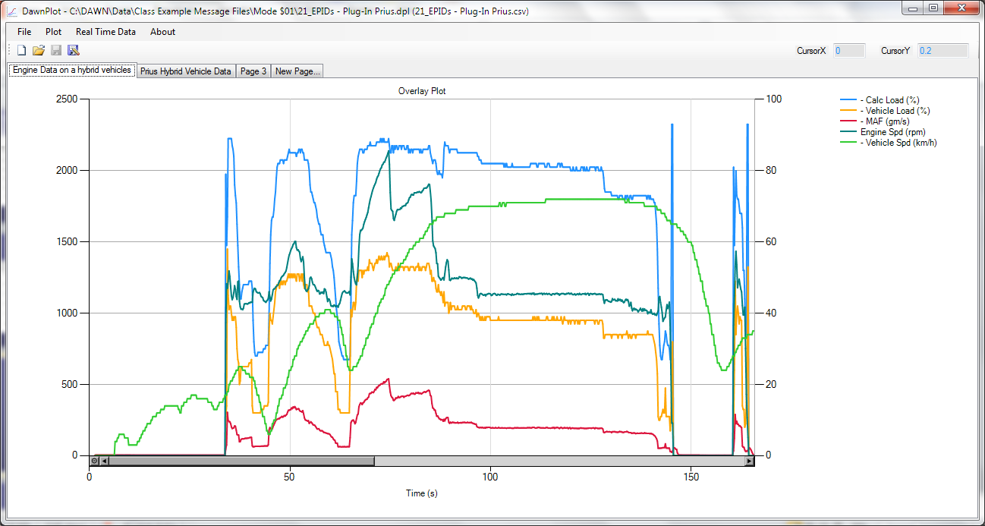
LD Engine Data

Slide 16
Two Studies Presented
First study is on the presenter's 2010 Prius HEV
Second study is from an OEMs fleet of
111 LD vehicles.
Assumes 10% ethanol

Slide 17
Fuel Economy MPG Calculations
2010 Prius HEV
Date | Miles | Fuel Tank | Injectors | MAF | Instr. Panel | % Difference (MAF to Inj) | % Difference (Instr to Inj)
25-Nov |  | - | 40.6 | 40.9 | 42.0 | 0.8% | 3.6%
2-Dec | 241.2 | - | 40.5 | 42.8 | 41.7 | 5.5% | 2.9%
10-Dec | 327.5 | 37.0 | 38.0 | 39.9 | 39.6 | 4.9% | 4.1%
20-Dec | 424 | 35.9 | 36.4 | 38.0 | 38.0 | 4.5% | 4.5%
13-Jan | 1260.4 | 40.1 | 40.1 | 42.9 | 42.8 | 7.2% | 6.9%
14-Mar | 239.1 | 34.8 | 35.1 | 37.0 | 37.1 | 5.3% | 5.6%
Summary | 2011.9 | 38.3 | 38.5 | 40.9 | 40.8 | 5.1% | 4.8%

Slide 18
Conclusions from Prius Testing
Fuel injector data agrees well with fuel tank after 30 gal of fuel added
MAF based results show 5% higher fuel economy than fuel tank & injectors
MAF based data correlates with instrument panel display
So instrument cluster MPG is 5% high

Slide 19
2nd Test Study
Fleet from one OEM
Fuel Economy calculations were made as part of their study by HEM Data
Tested in several states IL, CA, MO, NY, GA, LA, OH, MD, OR, TX, MA
Sorted by engine model
Test period from 12/11 to 1/13 – so over a year

Slide 20
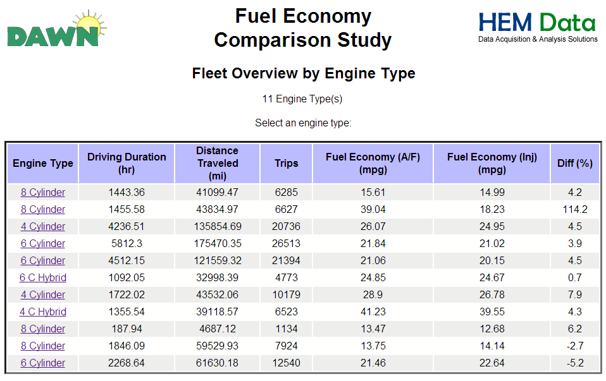
Overview of 111 LD Vehicles

Slide 21
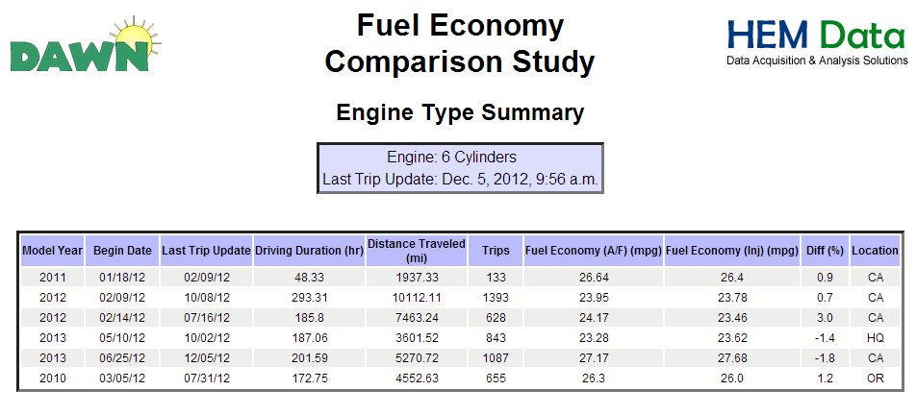
Shows Excellent Correlation

Slide 22
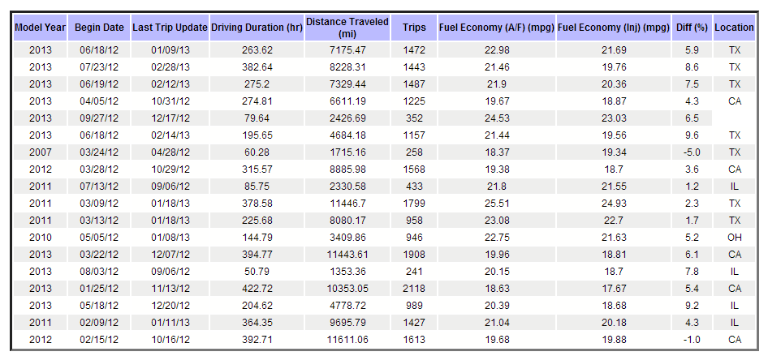
Correlation not as Good

Slide 23
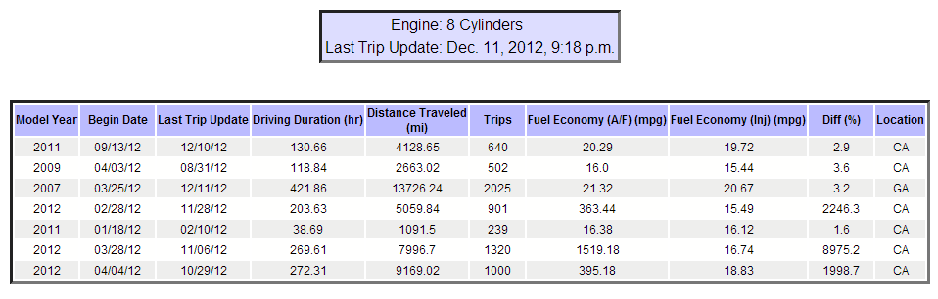
Some MAF Sensors Report
0 g/s some of the time

Slide 24
Summary of Differences
Fuel injector vs. MAF Based
Average = 2.8%
Std Dev = 5.1%
Mode = 1.2%
60 of the 111 vehicles were within +5%
32 of the 111 vehicles were within +3%
Summary chart % differences by model ranged from -5.2 to + 7.9%.

Slide 25
Conclusions from Fleet Study
Using MAF and A/F ratio is valid alternative to calculating fuel consumption and fuel economy if injector data is not available.
MAF approach generally shows lower fuel consumption and higher fuel economy.
25 of 111 vehicles showed the opposite result.
Consistent results with hybrid vehicles as the first study shows.
Injector data and > 30 gal of gasoline refueling give excellent results.

Slide 26
Conclusions from Fleet Study
Error could be 10% without noticing it on a single vehicle.
If injector data is not available, then to gain confidence compare MAF calculations to:
  Fuel tank additions of more than 30 gal, or
  Compare to a larger vehicle population
Could use this known difference to adjust the results to better match the injector results
Study is available at http://fuel.hemdata.com/

Slide 27
PEMS Conference 2014
Fuel Economy Data
Rick Walter, P.E.
HEM Data Corporation
rickw@hemdata.com
248 559-5607 x111

