Slide 1
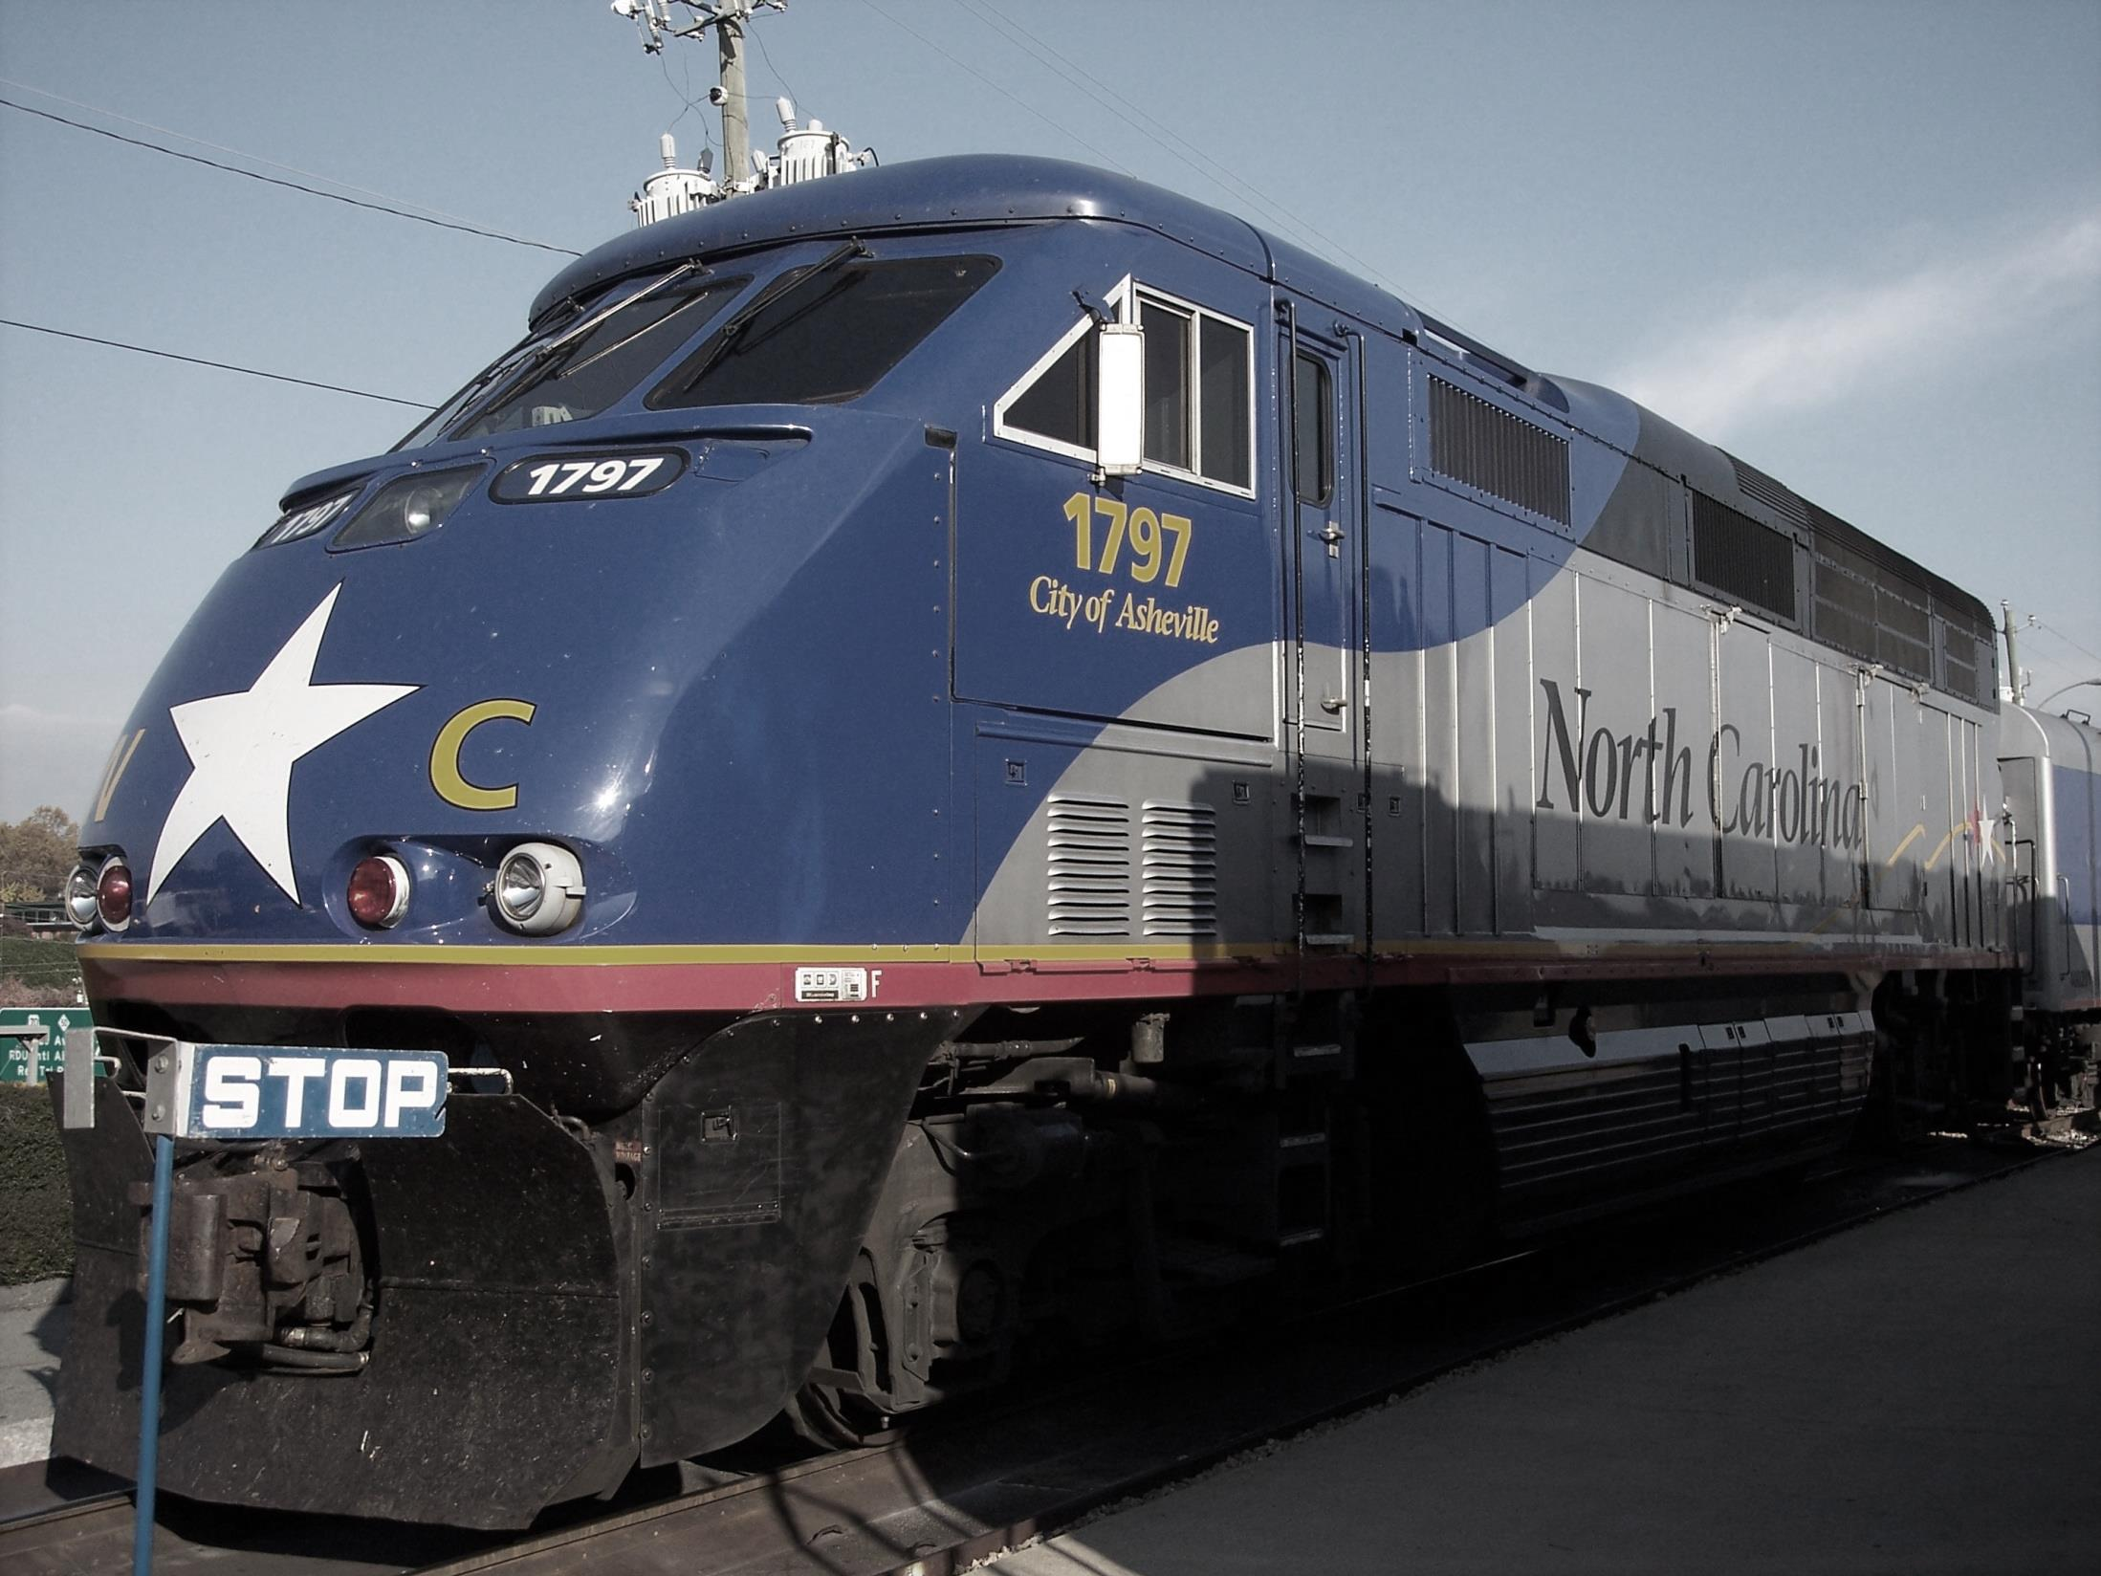
Measurement of Real-World Locomotive Engine Activity and Emissions using a Portable Emissions Measurement System
Brandon M. Graver, H. Christopher Frey, and Jiangchuan Hu
Mobile Air Pollution Engineering Laboratory
Dept. of Civil, Construction, and Environmental Engineering
North Carolina State University

Slide 2
RESEARCH MOTIVATION
Is there an easier, more cost effective way of measuring locomotive engine activity and emissions?
North Carolina Department of Transportation (NCDOT) is interested in assessing overall environmental performance of their locomotive fleet.
Locomotive engine emission measurements are conducted on a dynamometer or in the rail yard
Controlled test setting
Not representative of real-world operating conditions

Slide 3
RESEARCH QUESTIONS
What are the real-world duty cycles for passenger rail service in North Carolina?
What are the real-world emission rates for the locomotives that operate the passenger rail service?

Slide 4
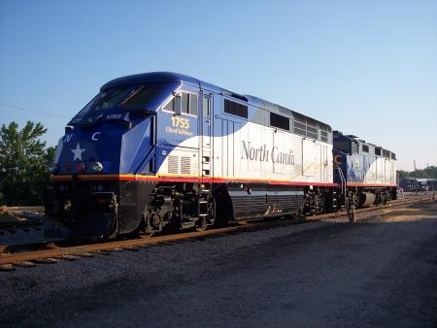
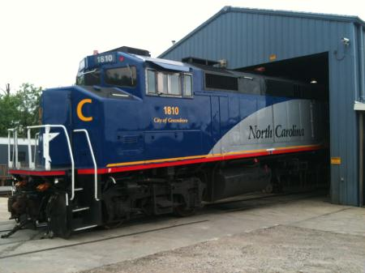
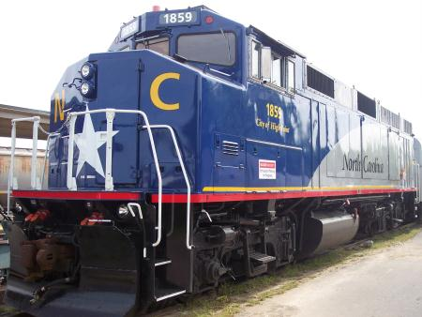
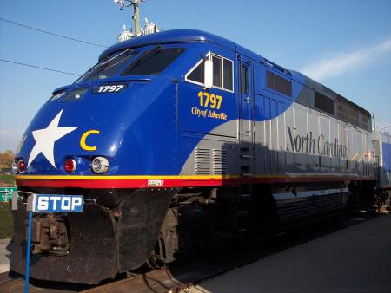
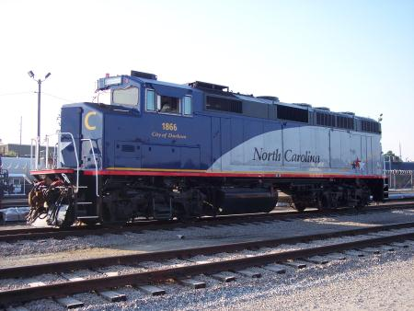
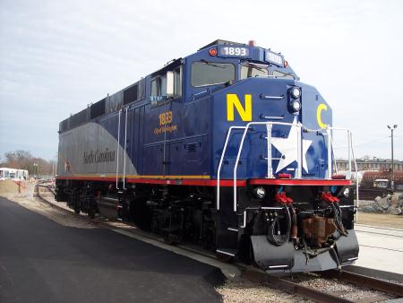
NCDOT LOCOMOTIVE FLEET
Two F59PHIs
Four F59PHs
Prime Mover Engine: 2-stroke, 12-cylinder, 140ℓ, 2240 kW
HEP Engine: 4-stroke, 6-cylinder, 18.1ℓ, 688 kW

Slide 5
LOCOMOTIVES
Dynamic Braking Grid
Gen.
Prime Mover Engine
HEP
Traction Motors
Prime Mover Engine – engine that powers traction motors via an electric generator
Head End Power (HEP) Engine – engine that provides electricity for passenger car hotel services

Slide 6
LOCOMOTIVES
Dynamic Braking Grid
Gen.
Prime Mover Engine
HEP
Traction Motors
Generator – powers the electric traction motors
Dynamic Braking (DB) Grid: “rheostatic braking” dissipates electricity generated by traction motors to slow the locomotive

Slide 7
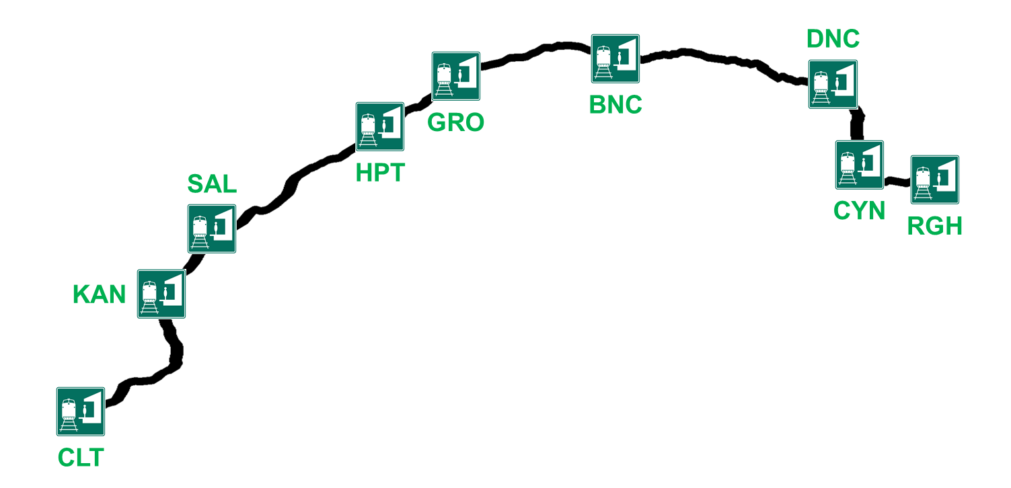
THE PIEDMONT TRAIN
Distance: 173 miles
Travel time (RGH→CLT): 3 hours, 15 minutes
Speed: 79 mph (maximum), 55 mph (average)

Slide 8
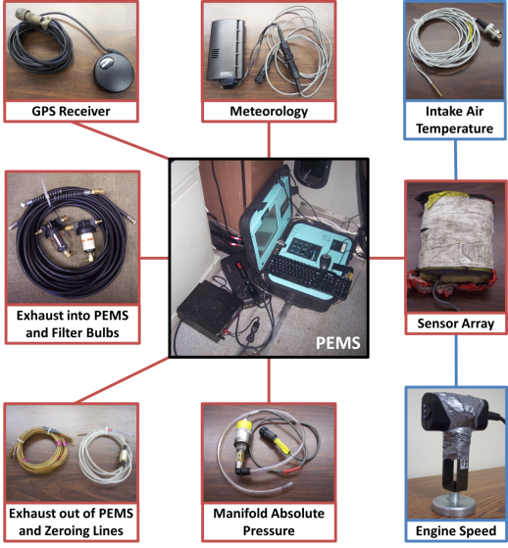
PORTABLE EMISSIONS MEASUREMENT SYSTEM
Montana and Axion systems by Clean Air Technologies International, Inc.
Non-dispersive infrared (NDIR) for CO₂, CO, HC
Electrochemical sensor for NO and O₂
Light scattering particulate matter measurement

Slide 9
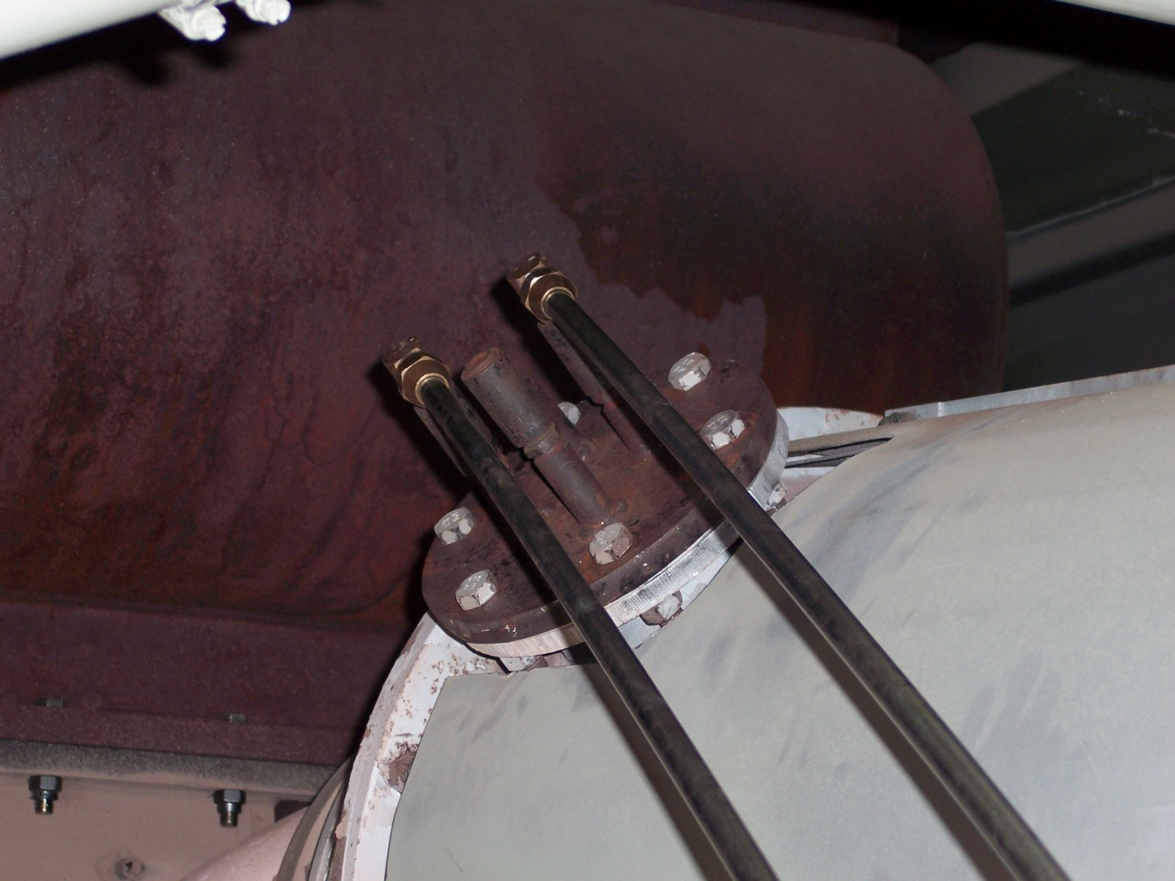
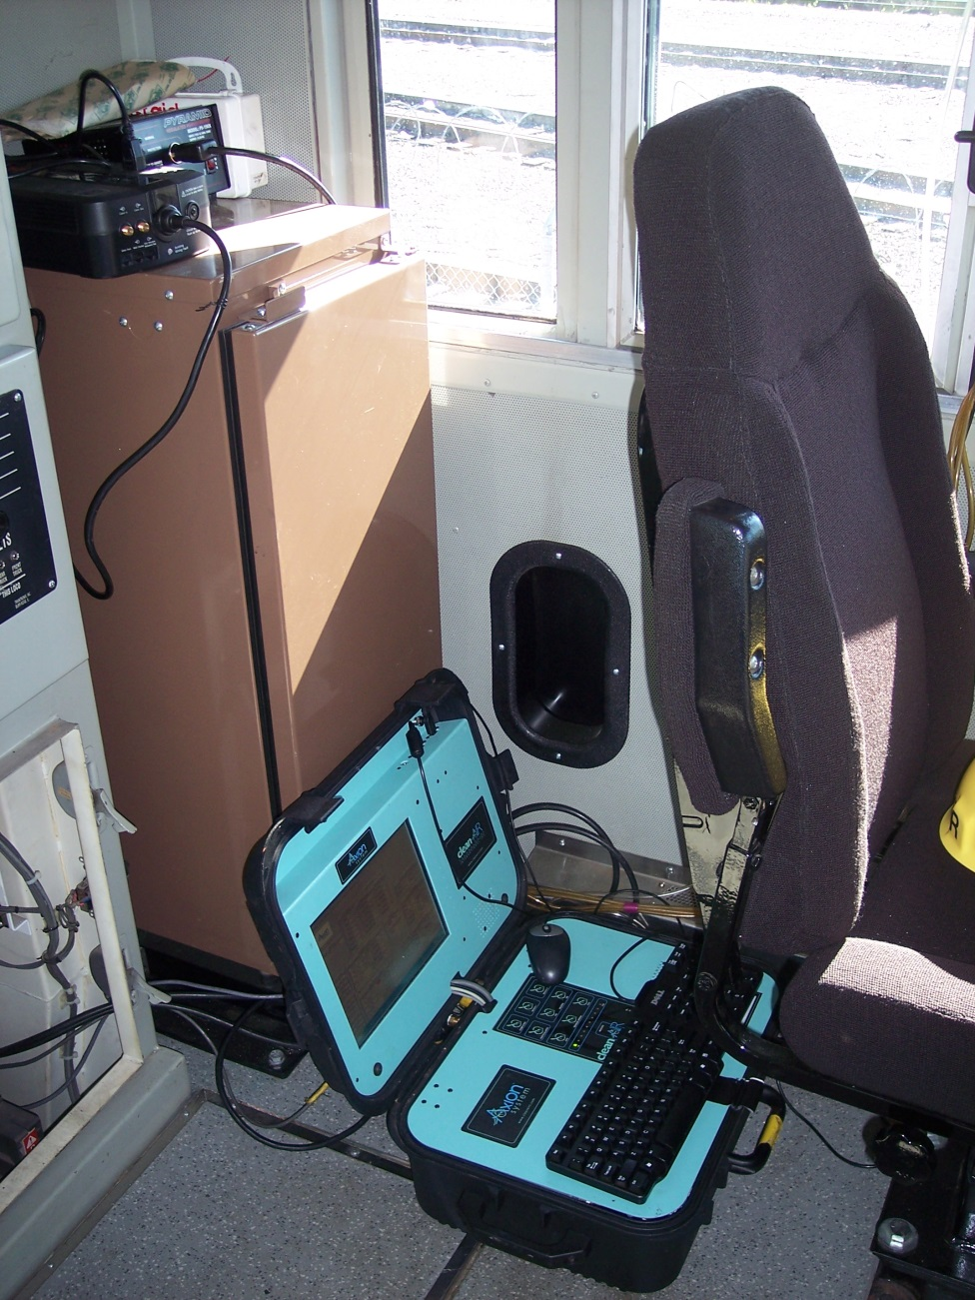
PORTABLE EMISSIONS MEASUREMENT SYSTEM
↑ Exhaust lines from engine to PEMS

Slide 10
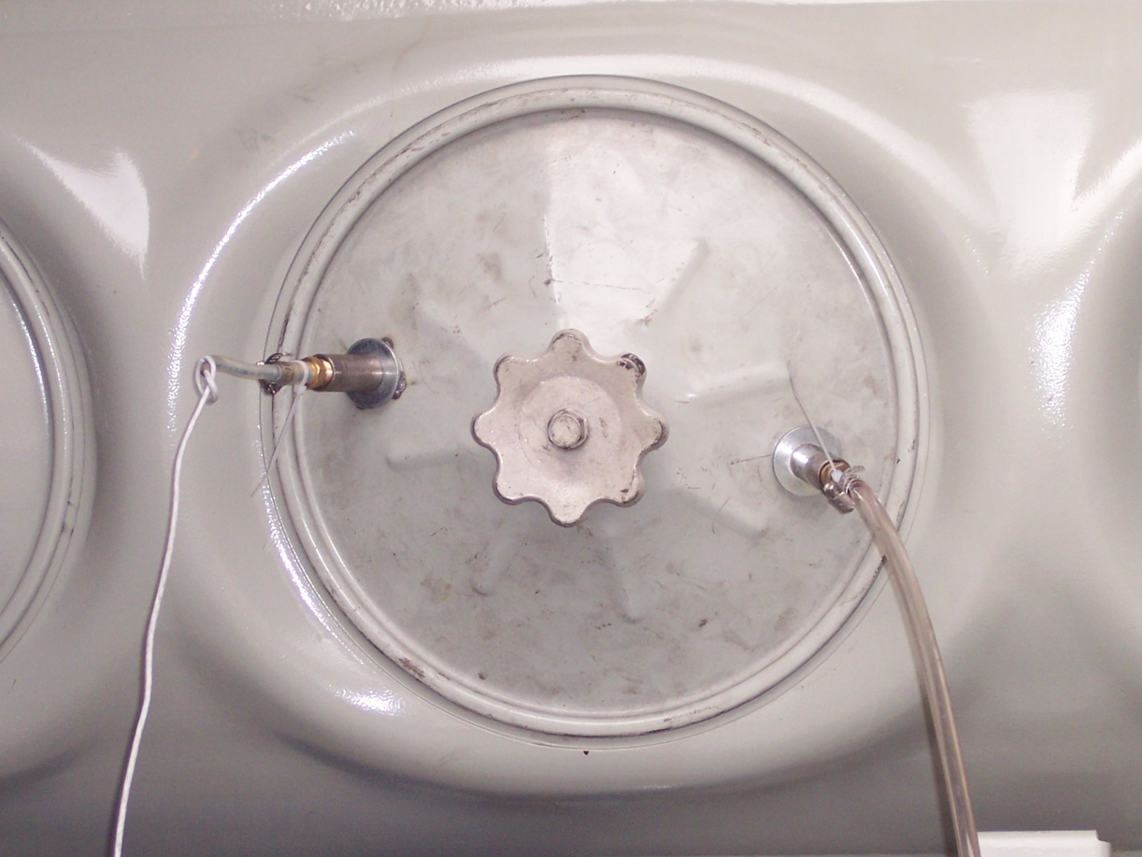
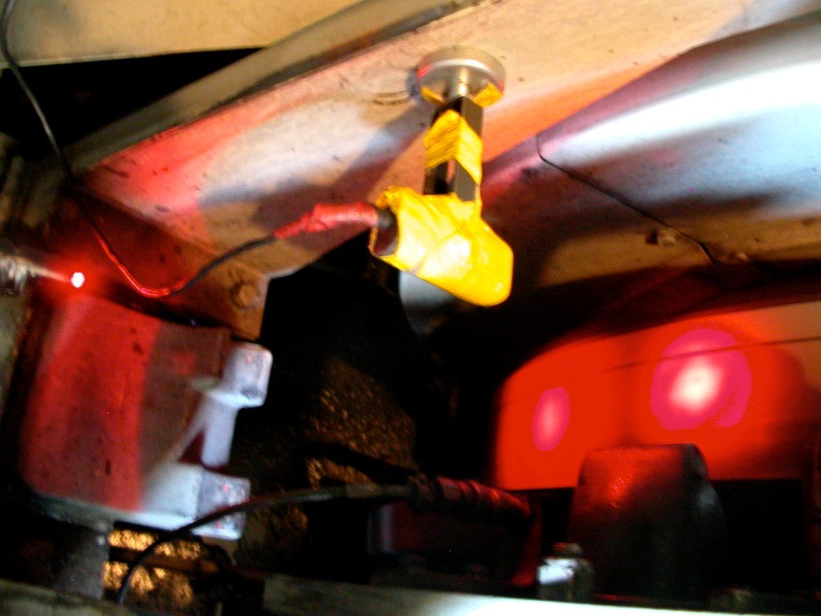
PORTABLE EMISSIONS MEASUREMENT SYSTEM
← MAP and IAT Sensors
RPM Sensor →

Slide 11
MEASUREMENT METHODS
Relatively inexpensive
Easily deployable for over-the-rail measurements
PM measurement uses a laser light scattering detection method that is useful for relative comparisons
Useful for comparative evaluations

Slide 12
LOCOMOTIVE ACTIVITY DATA RECORDER
Engine activity data shown on digital display in locomotive cab
Notch position, engine speed, and horsepower output displayed, but not archived
Engine solenoid operation data is archived, and notch position can be inferred from this data

Slide 13
FUEL USE ESTIMATION
Not feasible to accurately measure over-the-rail fuel use
Fuel is taken from a 900-1500 gallon onboard tank
Diesel engines return unspent fuel to the tank continuously
Exhaust flow rate is estimated based on calculation of mass air flow through the engine and inference of the air-to-fuel ratio from the measured exhaust composition

Slide 14
MASS AIR FLOW ESTIMATION
Mass air flow from “speed density” method:
EC = engine strokes per cycle (2)
ER = engine compression ratio (typically 15 to 18)
ES = engine speed (RPM)
EV = engine displacement (L)
M_{a} = intake air molar flow rate (mole/s)
P_{B} = barometric pressure (101 kPa)
P_{M} = engine manifold absolute pressure (kPa)
T_{int} = intake air temperature (degrees C)
VE = engine volumetric efficiency

Slide 15
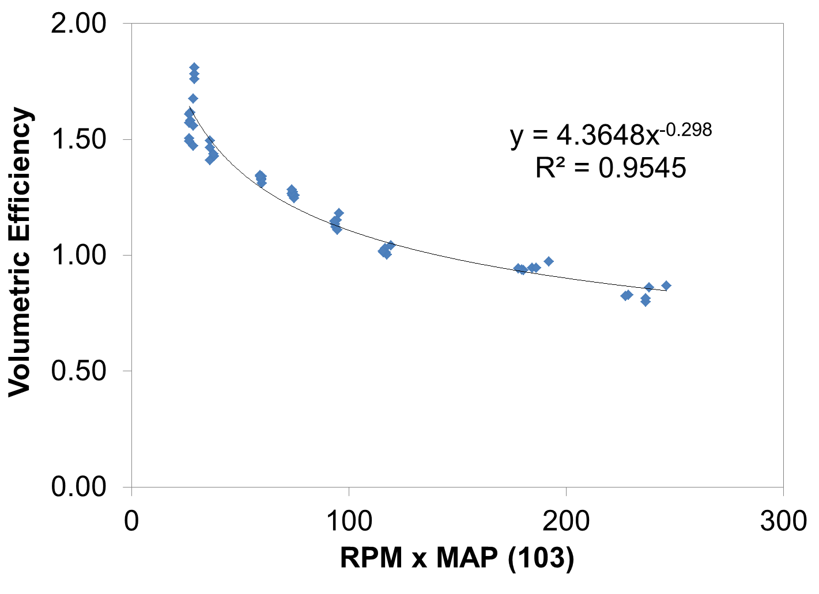
VOLUMETRIC EFFICIENCY
Values for VE are estimated based on dynamometer measurements of the same model prime mover engines

Slide 16
FIELD STUDY DESIGN
Six locomotives were instrumented and measured
Three days of over-the-rail (OTR) in-use measurements
Ultra-low sulfur diesel (ULSD)
This presentation – focus on NC 1797

Slide 17
EXAMPLE OVER-THE-RAIL RESULTS NC 1797
Duty Cycles
Notch | Percent Time in Each Notch
 | EPA Line- Haul | Measured Over-the-Rail
 |  | Average | 10/9/13 Train 75 | 10/9/13 Train 76 | 10/10/13 Train 75 | 10/10/13 Train 76 | 10/11/13 Train 75 | 10/11/13 Train 76
Idle | 38.0 | 35.0 | 39.2 | 40.6 | 30.4 | 23.2 | 38.7 | 37.8
DB | 12.5 | 4.0 | 2.8 | 4.5 | 3.0 | 3.4 | 3.1 | 7.0
1 | 6.5 | 3.0 | 2.2 | 3.3 | 1.0 | 7.9 | 1.9 | 1.7
2 | 6.5 | 4.6 | 1.9 | 2.0 | 9.3 | 9.9 | 1.9 | 2.5
3 | 5.2 | 2.7 | 2.5 | 1.9 | 3.0 | 5.1 | 0.7 | 2.7
4 | 4.4 | 3.0 | 2.4 | 3.0 | 5.6 | 4.4 | 1.6 | 1.2
5 | 3.8 | 2.1 | 2.6 | 3.1 | 1.8 | 2.1 | 1.7 | 1.0
6 | 3.9 | 2.1 | 2.1 | 3.2 | 2.0 | 1.6 | 1.5 | 2.1
7 | 3.0 | 1.2 | 1.1 | 3.7 | 0.1 | 0.2 | 0.9 | 1.4
8 | 16.2 | 42.4 | 43.2 | 34.7 | 43.8 | 42.1 | 48.0 | 42.6

Slide 18
VARIATIONS IN DUTY CYCLE
Engineer behavior
Weather conditions
Station delays
Rail traffic
Track maintenance

Slide 19
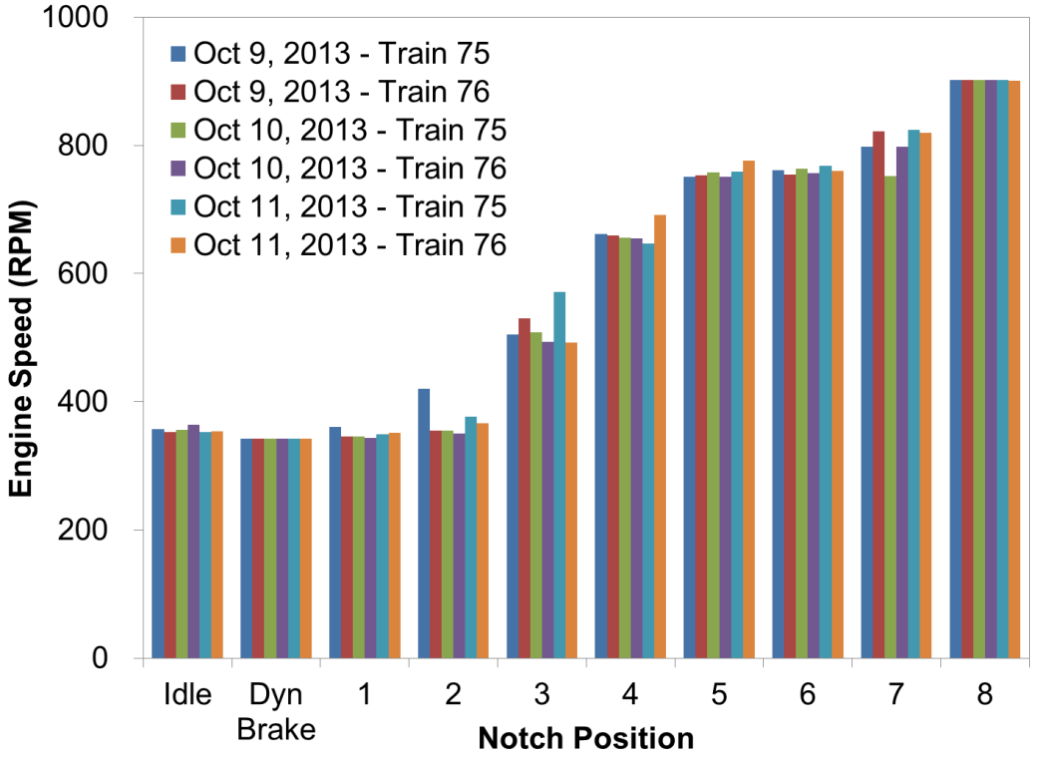
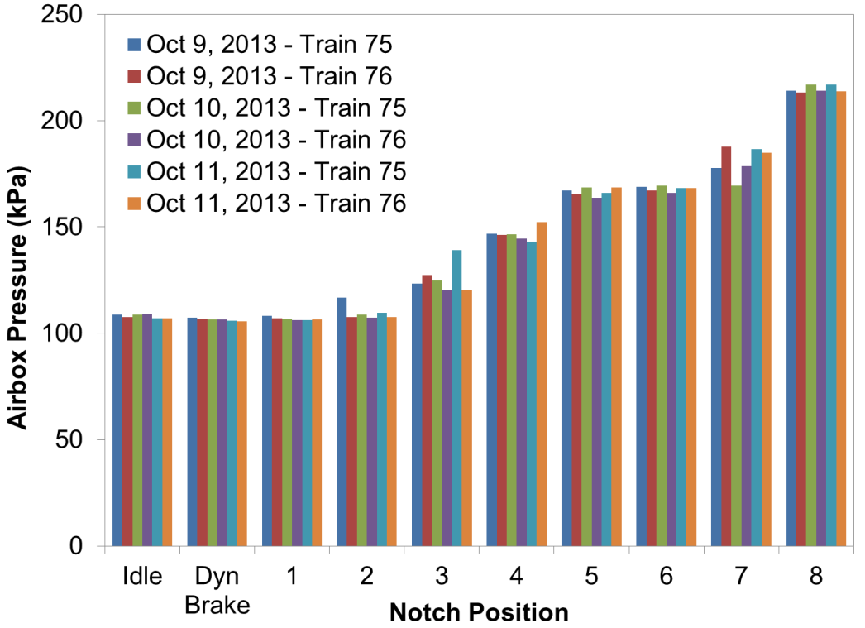
EXAMPLE OVER-THE-RAIL RESULTS NC 1797
Engine RPM
Airbox Pressure
Engine performance is highly repeatable from replicate to replicate
Relative Standard Deviation (RSD) = (standard deviation) / mean
Engine RPM RSD < 0.07; Airbox Pressure RSD ≤ 0.06

Slide 20
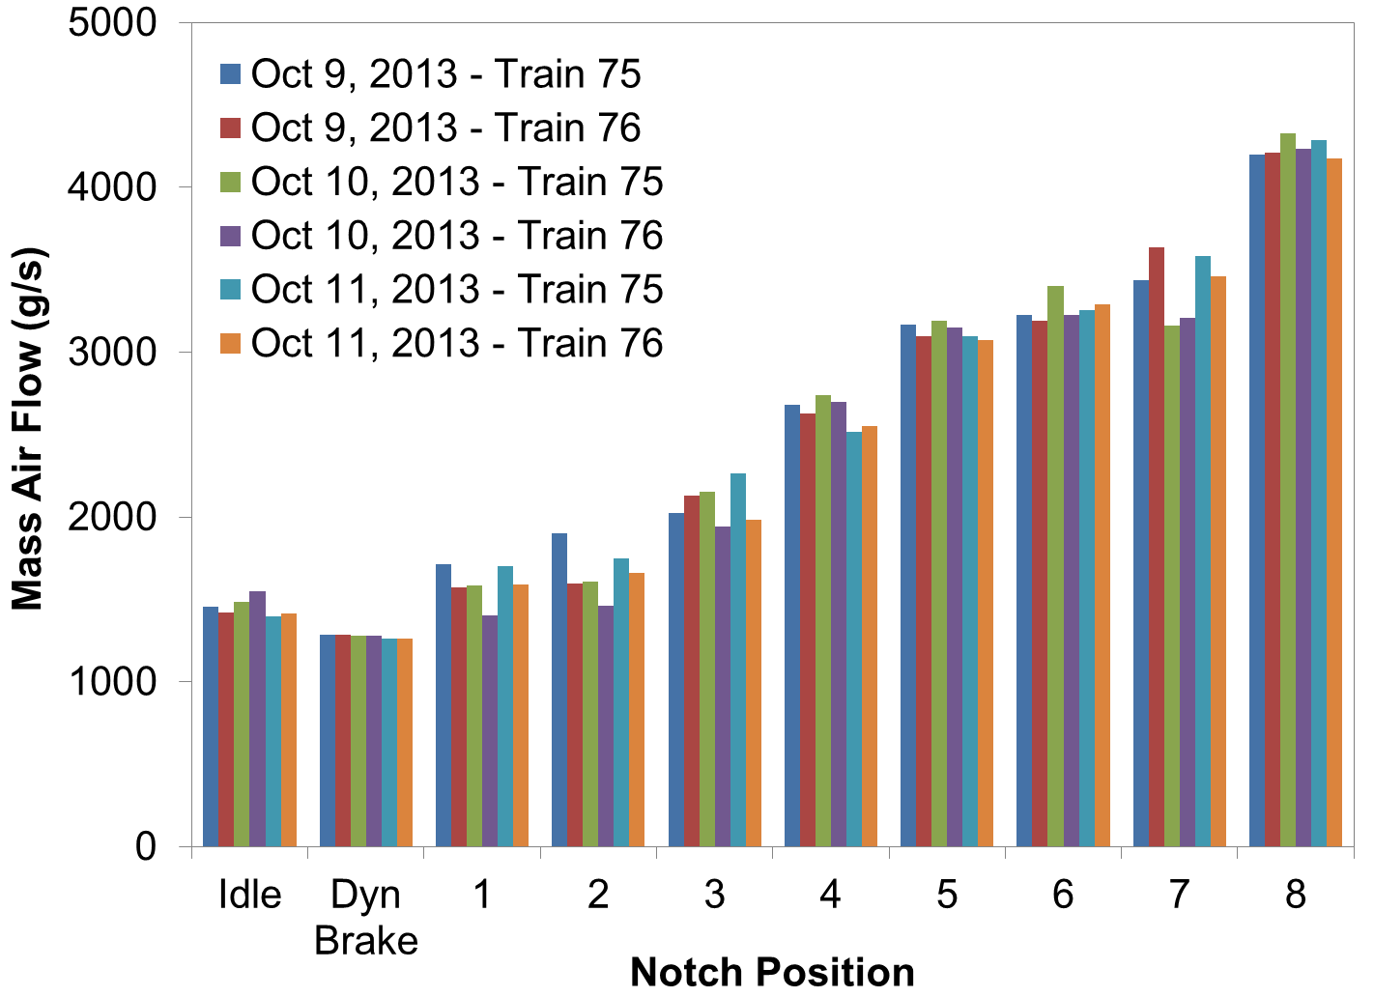
EXAMPLE OVER-THE-RAIL RESULTS NC 1797
Engine performance is highly repeatable from replicate to replicate
Mass Air Flow RSD ≤ 0.09

Slide 21
EXAMPLE OVER-THE-RAIL RESULTS NC 1797
Notch Position | Average NO Concentration (ppm) | Inter-Replicate Variability (Relative Standard Deviation)
Idle | 302 | 0.12
Dyn. Brake | 266 | 0.13
1 | 546 | 0.12
2 | 927 | 0.18
3 | 1302 | 0.03
4 | 1384 | 0.04
5 | 1371 | 0.07
6 | 1246 | 0.09
7 | 1282 | 0.21
8 | 1160 | 0.02

Slide 22
CYCLE AVERAGE EMISSION RATES
$${CAER}_{i}=\sum_{Idle}^{8}{\frac{{ER}_{ij}×{DC}_{j}×{hp}_{j}}{\sum_{Idle}^{8}{{DC}_{j}×{hp}_{j}}}}$$
CAER_{i} cycle average emission rate for pollutant i
ER_{ij} emission rate for pollutant i at notch position j
DC_{j} fractional time spent in notch j in duty cycle
hp_{j} engine horsepower at notch position j
Two duty cycles: EPA Line-Haul
Piedmont Measured

Slide 23
EXAMPLE OVER-THE-RAIL RESULTS NC 1797
Average Emission Rates: Actual Duty Cycle
 | NO_{x} (g/bhp-hr) | HC (g/bhp-hr) | CO (g/bhp-hr) | Opacity-based PM (g/bhp-hr)
Oct. 9, 2013 – Train 75 | 11.4 | 1.66 | 0.51 | 0.17
Oct. 9, 2013 – Train 76 | 11.7 | 3.59 | 0.92 | 0.15
Oct. 10, 2013 – Train 75 | 11.2 | 1.17 | 0.52 | 0.15
Oct. 10, 2013 – Train 76 | 11.9 | 2.79 | 0.87 | 0.13
Oct. 11, 2013 – Train 75 | 10.9 | 1.22 | 0.65 | 0.15
Oct. 11, 2013 – Train 76 | 11.2 | 2.88 | 0.88 | 0.14
Average | 11.4 | 2.22 | 0.72 | 0.15
Relative Std. Deviation | 0.03 | 0.45 | 0.26 | 0.10

Slide 24
EXAMPLE OVER-THE-RAIL RESULTS NC 1797
Cycle Average Emission Rates:
EPA Line Haul Duty Cycle
 | NO_{x} (g/bhp-hr) | HC (g/bhp-hr) | CO (g/bhp-hr) | Opacity-based PM (g/bhp-hr)
Oct. 9, 2013 – Train 75 | 13.9 | 2.79 | 0.59 | 0.19
Oct. 9, 2013 – Train 76 | 13.5 | 5.16 | 1.13 | 0.16
Oct. 10, 2013 – Train 75 | 14.0 | 1.80 | 0.51 | 0.16
Oct. 10, 2013 – Train 76 | 14.9 | 5.10 | 1.16 | 0.14
Oct. 11, 2013 – Train 75 | 14.3 | 1.84 | 0.61 | 0.16
Oct. 11, 2013 – Train 76 | 14.2 | 4.82 | 0.95 | 0.15
Average | 14.1 | 3.59 | 0.82 | 0.16
Relative Std. Deviation | 0.03 | 0.45 | 0.35 | 0.09
Line-Haul vs. Real-World | + 19% | + 38% | + 12% | + 6%

Slide 25
CONCLUSIONS
Differences in measured duty cycle compared to EPA line-haul duty cycle, especially at Idle and Notch 8
High repeatability in measured engine parameters
Little variability in NO_{x} and PM emission rates
Differences in duty cycle lead to differences in cycle average emission rates
Higher cycle average emission rates were estimated for the EPA line-haul duty cycle compared to the actual duty cycle

Slide 26
ACKNOWLEDGEMENTS
Allan Paul of the North Carolina Department of Transportation Rail Division
Herzog Transit Services and RailPlan International, Inc.
Lynn Harris and Curtis McDowell of McDowell Engineers
AMTRAK Southern Division Engineers and Conductors, Raleigh Station Staff
Federal Railroad Administration of the U.S. Department of Transportation

Slide 27
Brandon M. Graver
Department of Civil, Construction, and Environmental Engineering
North Carolina State University
Office: 919-515-4465
Email: bmgraver@ncsu.edu
Website: www4.ncsu.edu/~bmgraver

