Slide 1

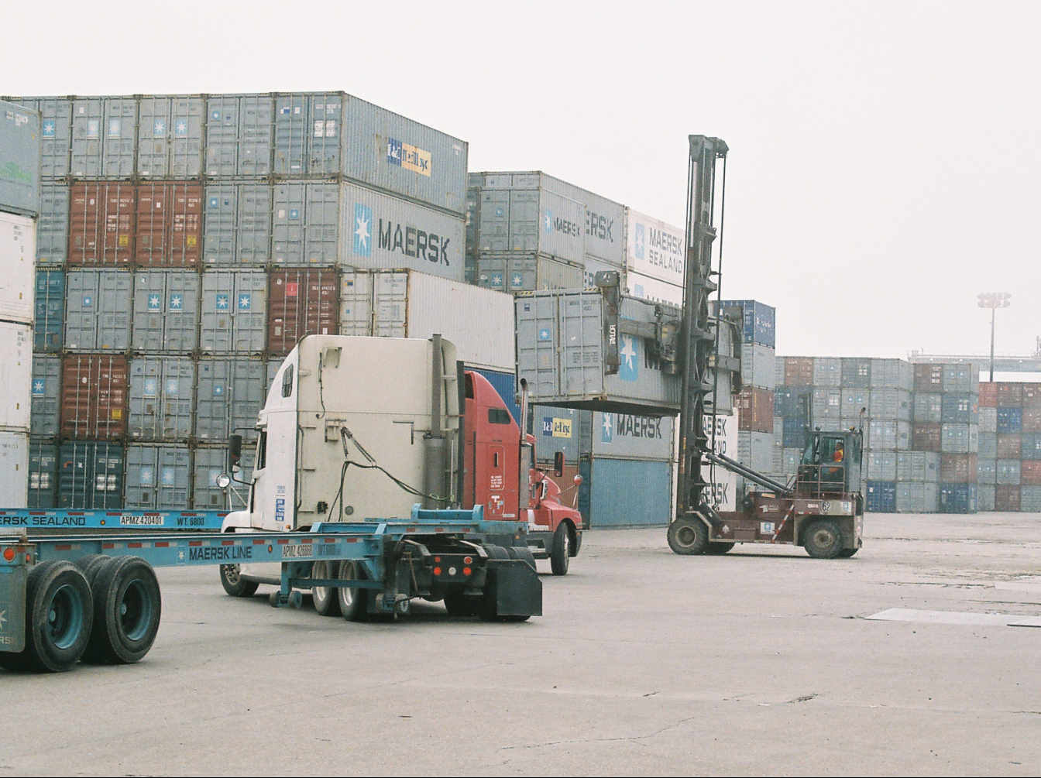
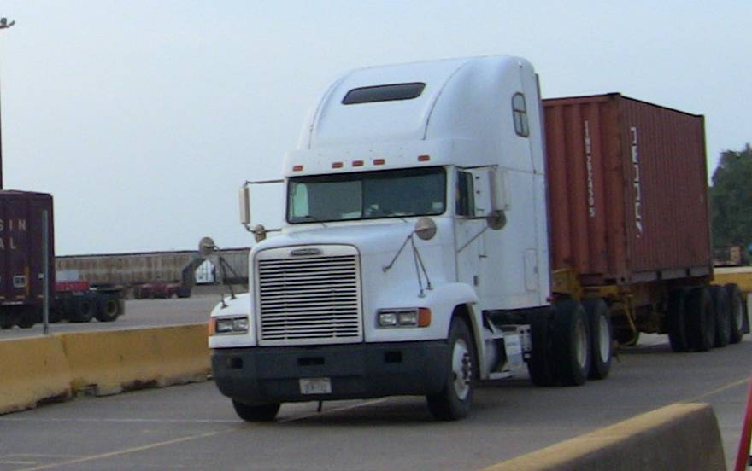
HD “Drayage” Real World
Emissions & Activity
PEMS Conference & Workshop
April 3 & 4, 2014

Slide 2
Outline
Overall Test Program
  Objectives/Scope
  CRADA (HGAC) and State of Texas: Texas Commission on Environmental Quality (TCEQ)
Remote Sensing (RSD) screening study
PEMS Equipment Improvements
Emissions Analyses (EPA)
Activity Analyses (Joint EPA/HGAC thru 2nd CRADA)
Future Modeling & Data Efforts

Slide 3
Sponsors & Project Team
U.S. EPA’s Office of Transportation & Air Quality (OTAQ)
Houston-Galveston Area Council (HGAC) (CRADA)
Texas Commission on Environmental Quality (TCEQ) (partner)
Port of Houston Authority (partner)
Contractors:
  Eastern Research Group
  Sensors Inc.
  University of Denver

Slide 4
Houston Port Study
Objective: Characterize activity and emissions of HD “drayage” trucks in Houston
  Differences in activity and emissions between off-network within the port and on-road were previously unknown
  Provides a new source of data for validating and potentially improving MOVES Heavy-Duty emission rates
  Allows improvement in inventory/transportation modeling by providing activity information, such as VMT, age distribution, speed distribution, to better reflect local situations
Logistics:
  CRADA formed with HGAC in 2009 providing $430K for emissions testing and $85K for activity analyses
  EPA contributed equipment, staffing, and expertise to the project
    Over $2 million in support to program

Slide 5
Major Activities Conducted
Preliminary analysis on Terminal Port Entry data (June ’09)
RSD screening study (July ‘09)
  Analyses of RSD data (August - December ‘09)
  Develop sampling and vehicle recruitment methodology using RSD (December ‘09)
Mockup & develop testing procedures (Nov ‘09)
Field testing (December ‘09 – March ‘10)
  Portable Emissions: ≅ 8 hours, 36 unique trucks (46 PEMS tests)
  Portable Activity: ≅ 7 days, 23 trucks
Further Analyzed Port of Houston Gate Entry Data (Bayport and Barbour Cut) (September 2012 – February 2013)

Slide 6
Number of trucks recruited for field testing
Model Year | PEMS | PAMS
1989 and prior | 1 | 1
1990 | -
1991-1997 | 10 | 3
1998 | 3 | 1
1999-2002 | 12 | 7
2003-2006 | 10 | 10
TOTAL | 36 | 23

Slide 7
RSD Screening Study
To gather preliminary emissions information on the Houston drayage fleet
Used to develop sampling methodology for PEMS and PAMS testing
  Conducted by University of Denver (July 2009)
  At entry gate of Barbour’s Cut Port
  Collected gaseous pollutants (NOx, THC, CO and CO₂ , SO₂ ,NH₃ and PM by opacity)
  Matched license plates to TX DOT database
  RSD valid readings: 4,032
  Number of unique vehicles: 1,877

Slide 8
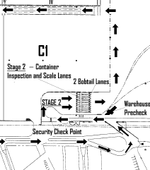
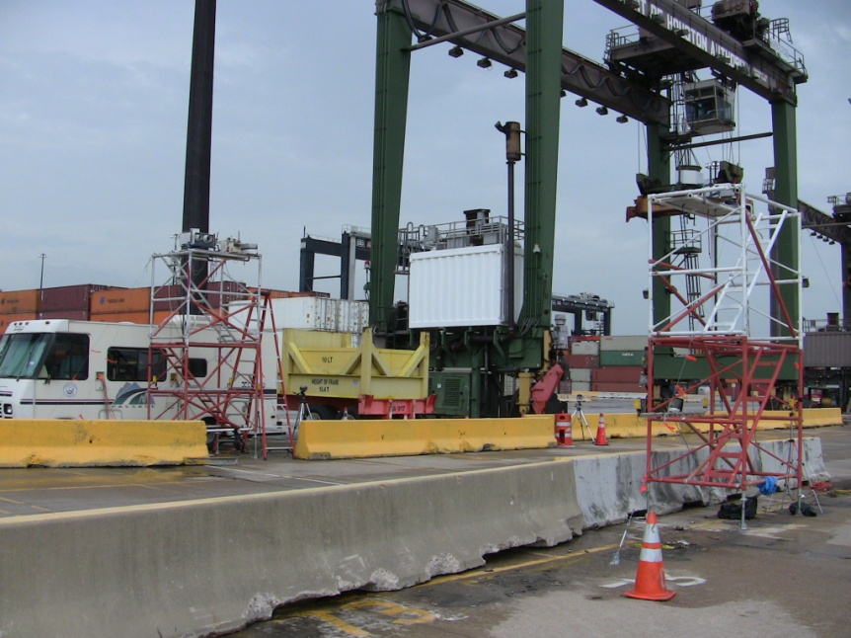
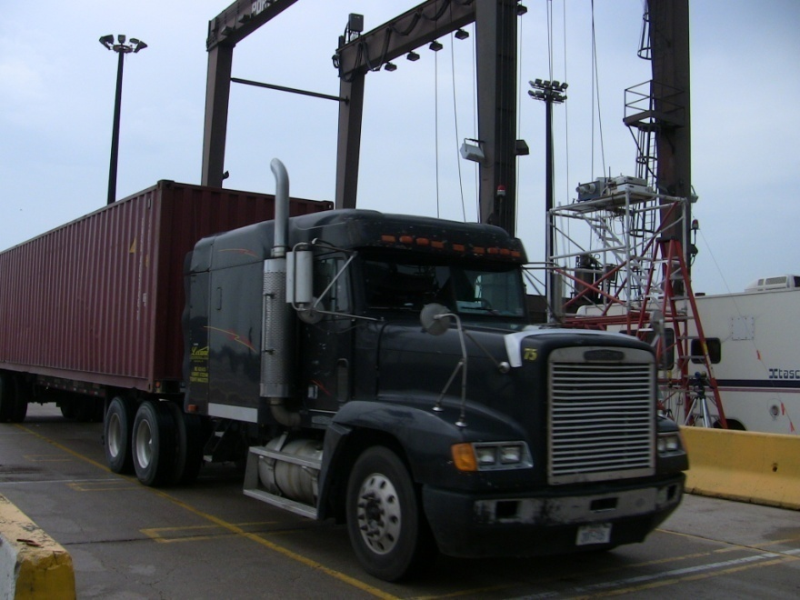
Location of RSD
equipment
RSD equipment

Slide 9
Sampling methodology
Classification
  “Stratified sampling”
  Population divided into separate ‘classes’ based on RSD NOx emissions and model year groups
  Each class sampled as an independent sub-population
Quota sampling within each class based on
  Probability that a vehicle is actually in the assigned NOx Bin
  Frequency that the vehicle will drive in the Port of Houston during PEMS & PAMS instrumentation

Slide 10
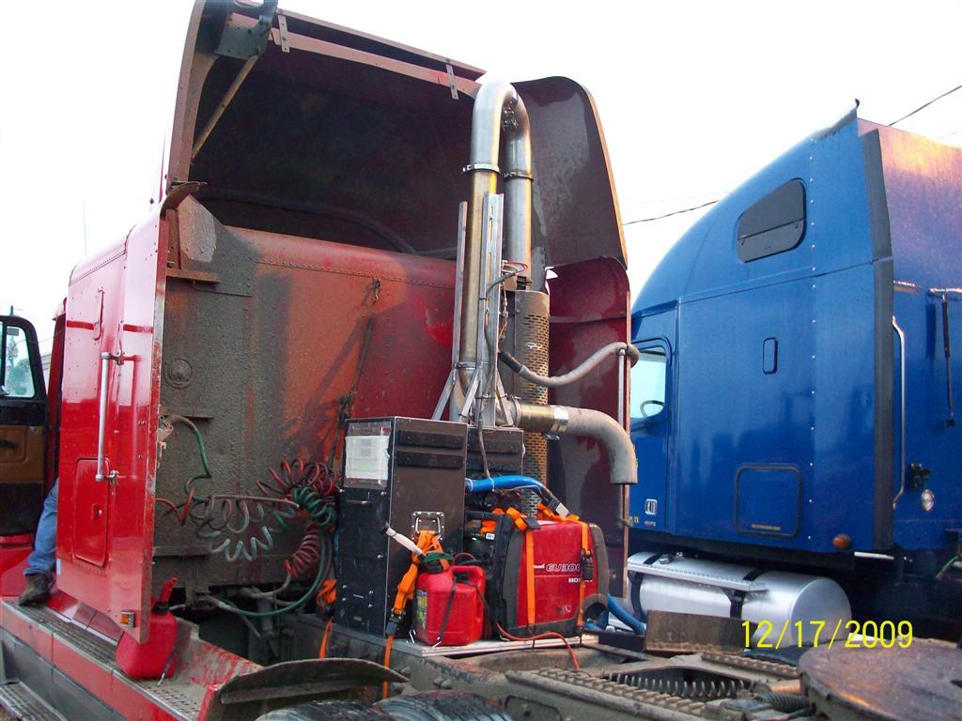
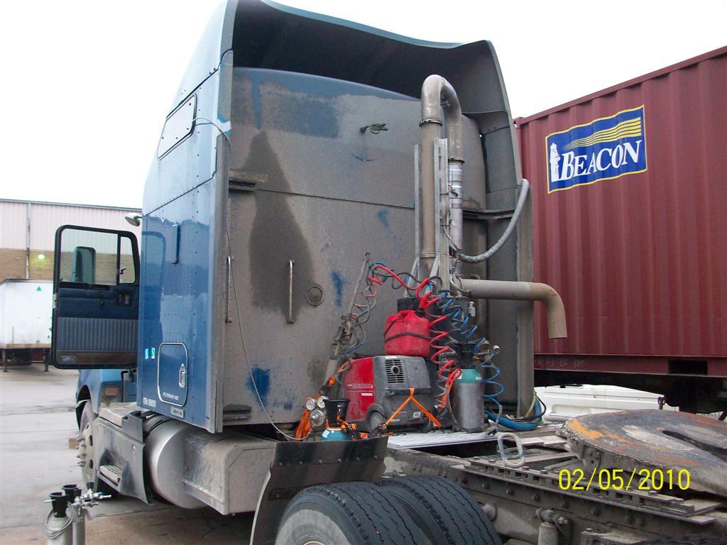
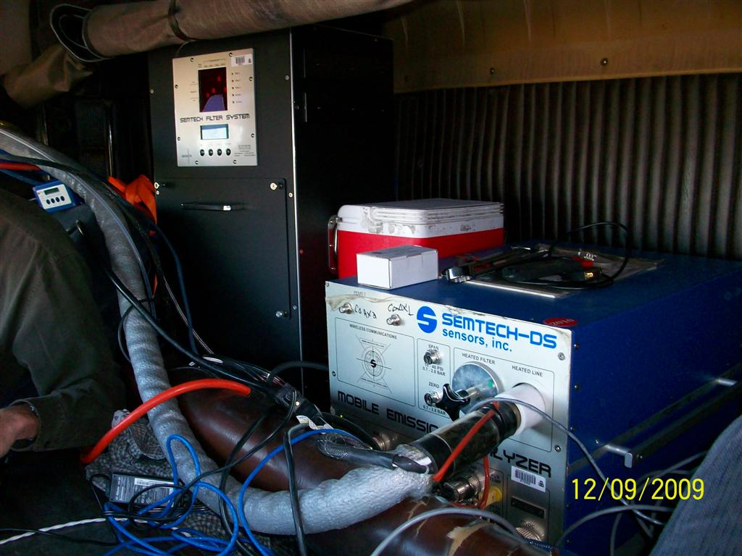
PEMS partially inside with Filters/MPS outside cab
PEMS filters and DS inside cab with MPS flowmeter outside

Slide 11
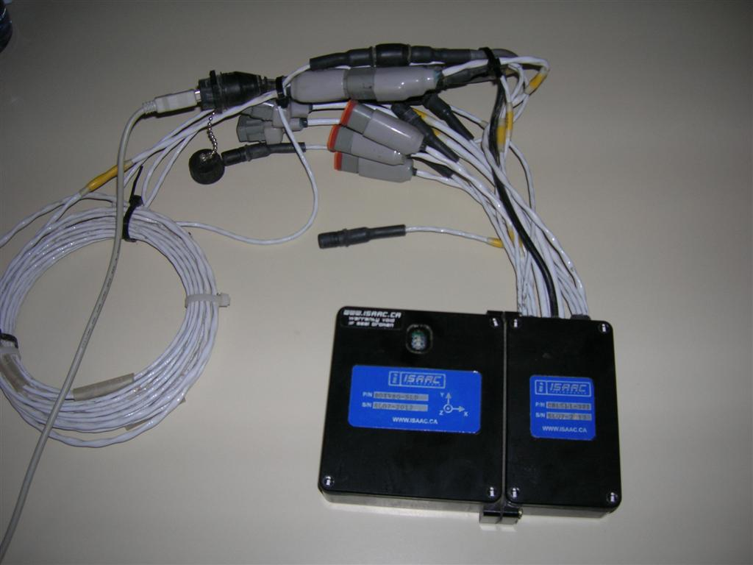
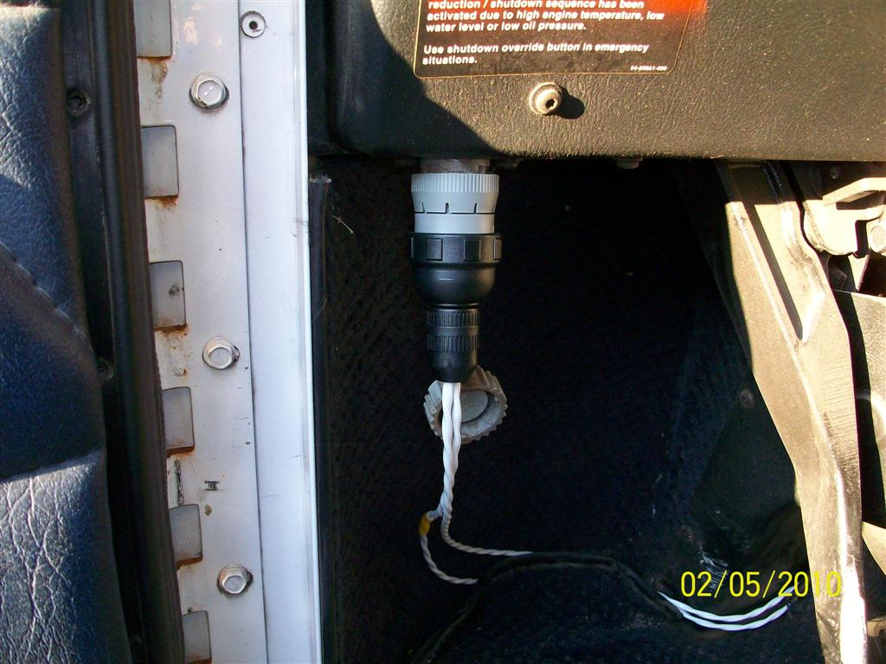
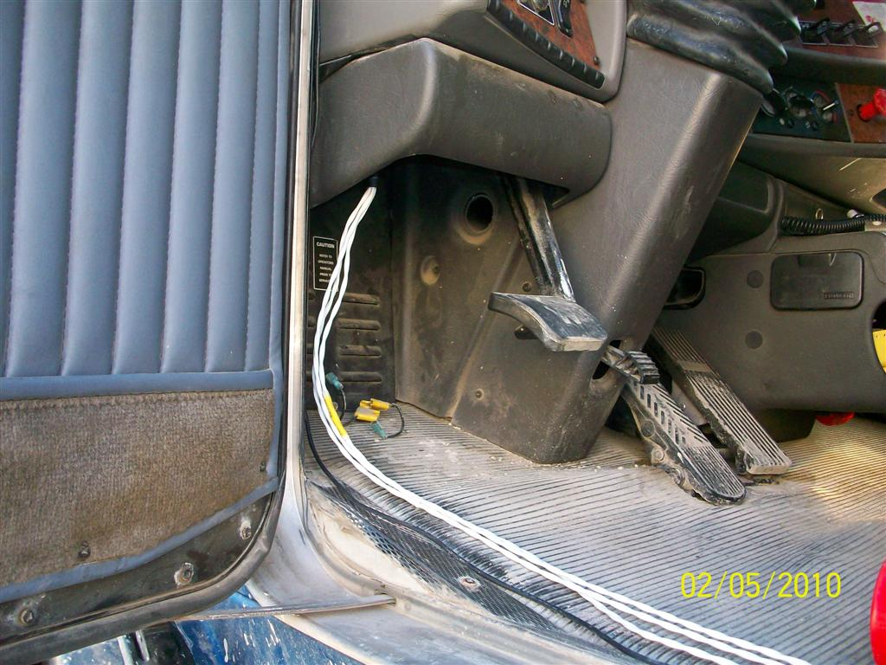
Typical PAMS installation to gather activity:
GPS & RPM (older vehicles)
GPS & engine parameters (J1708/J1939)

Slide 12
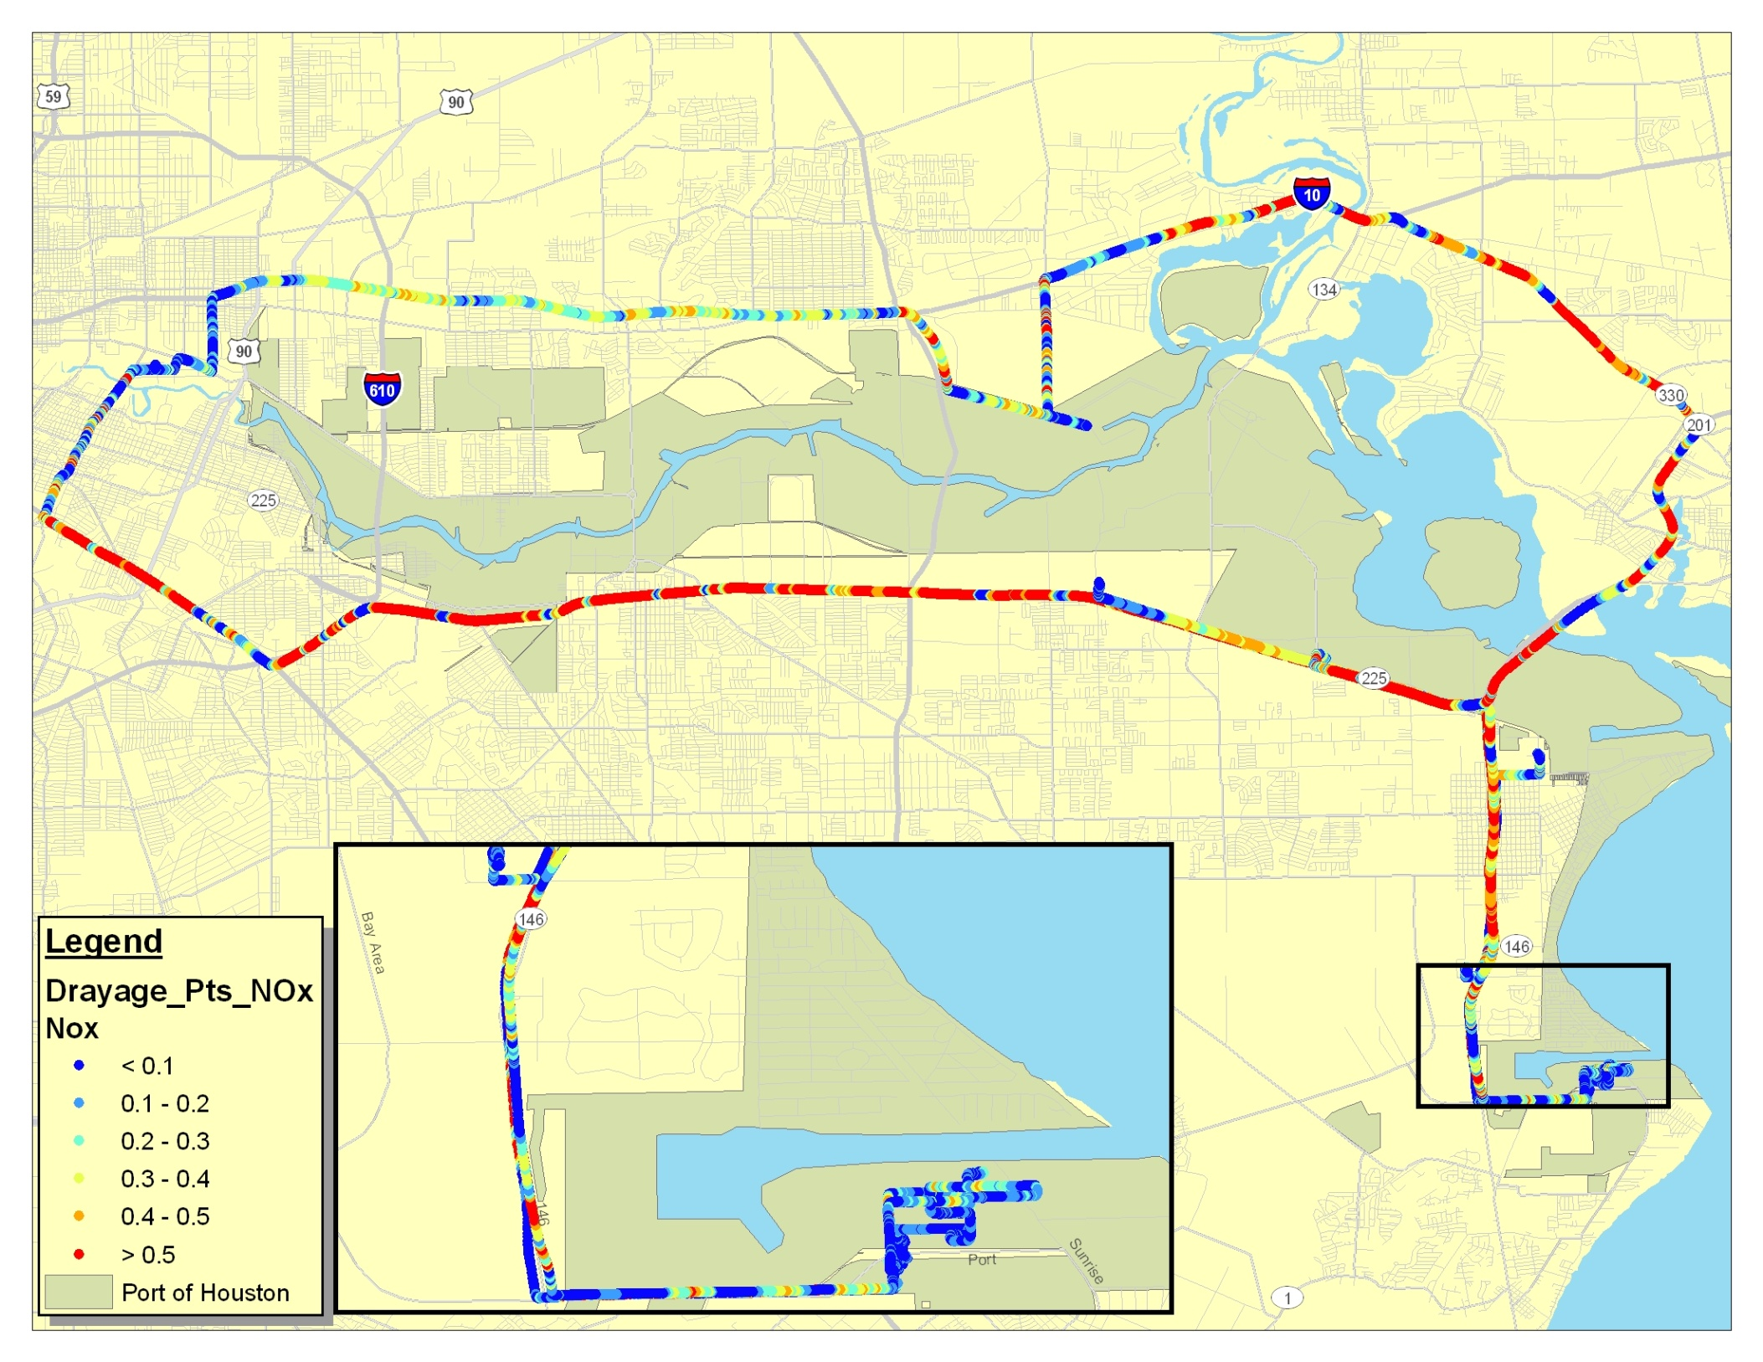
Port: Barbours Cut

Slide 13
Emissions Analysis
Assign second-by-second measurements from PEMS into MOVES operating mode bins
  Function of vehicle speed and Scaled Tractive Power (STP)
  Consist of idle, braking, coast, and cruise modes
  Additional detail provided in the Appendix
Calculate average emission rates by model year groups

Slide 14
Emissions Analysis (cont’d)
Apply population weights based on RSD sampling methodology
  Why apply the weights?
    In order to capture ‘high-emitting’ trucks in the sample, trucks were recruited with unequal probabilities of selection
    Thus, it is necessary to adjust the sample distribution to conform to the known distribution in the RSD population
  Trucks without RSD measurements excluded from the analysis
Compare “in the wild” emissions data to MOVES emission rates for heavy-duty short-haul combination trucks

Slide 15
PEMS NOx vs. STP by RSD NOx Bin
Cleaner
Deterioration??
Bottom line: correlation between RSD readings and PEMS measurements can be improved.

Slide 16
MOVES compares well with the data

Slide 17
Without matching RSD measurement; thus, not included in the comparison in previous slide
Potentially due to deterioration and mal-maintenance

Slide 18
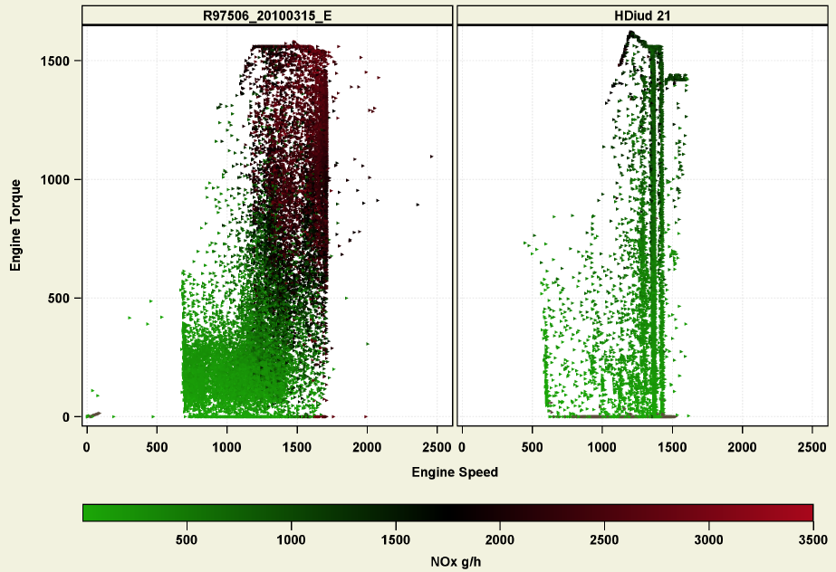
NOx Maps for Common Engine Family (MY 2005)
EGR Failure ??
Houston Drayage
5 yrs old, 750K miles
Compliance Program
2 yrs old, 350K miles

Slide 19
Summary – Emissions Analysis
Pre-MY2003
  Drayage compares well with MOVES
  Applying the population weights does not change the overall picture
  No proposed update for MOVES2013
MYG2003-2006
  Drayage shows higher NOx compared to MOVES, but within variability of the data.
  No proposed update for MOVES2013
    Comparisons to other independent sources of data, such as Heavy-Duty In-Use Compliance data, suggest current MOVES heavy-duty rates are reasonable

Slide 20
Summary – Emissions Analysis (cont’d)
RSD sampling methodology
  Correlation between RSD and PEMS measurements was lower than expected due to difficulties in recruiting trucks from a broad range of RSD bins, test-to-test and temporal variability in RSD measurement.
  Potential area of improvement for future studies
Based on our review, the drayage truck operations may be estimated using MOVES default “short-haul combination truck” category
Drayage emissions data invaluable in confirming and validating the existing on-road heavy-duty truck emission rates in MOVES
Further data gathering on newer MY vehicles to understand how they age would be beneficial

Slide 21
HD “Drayage” Activity Analysis
Analyzed 18 months of data from two terminals within the Port of Houston: (HGAC MSA area: Barbour s Cut and Bayport)
  Each Terminal Separate
  Terminal to Terminal Entry Points Similarities/Differences in Vehicle Registration, Activity (total visits, time within port) & type of driving (Idle, creep, transit, & highway)
Port Terminal Entry Data linked to TxDOT registration databases (2009/2010) via license plate to give vehicle parameters (e.g. MY, model, make, etc.)
Port Vehicles Similarities/Differences to TxDOT Database
Port vs Non-Port Activity Similarities/Differences (key on/off, trip lengths, idle, creep, transient & highway times, etc)

Slide 22
Datasets

Slide 23
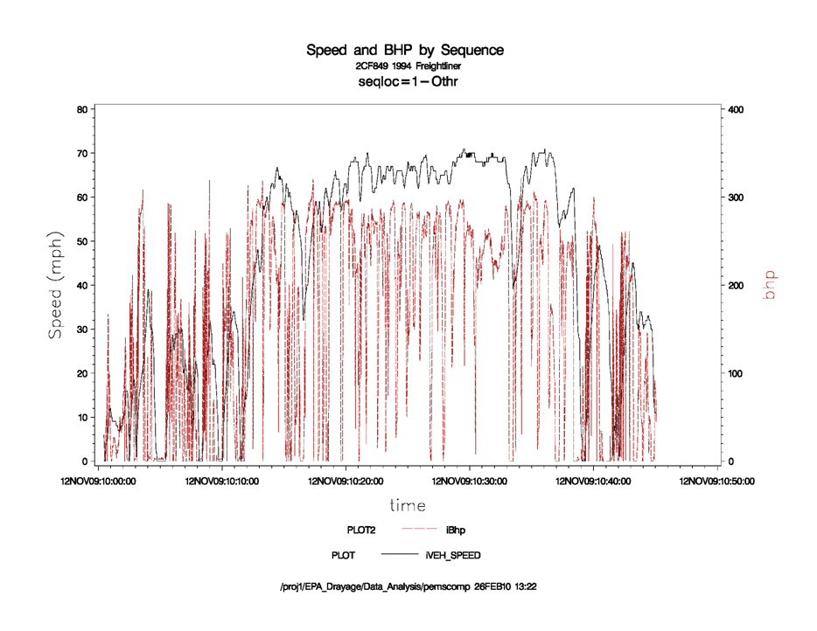
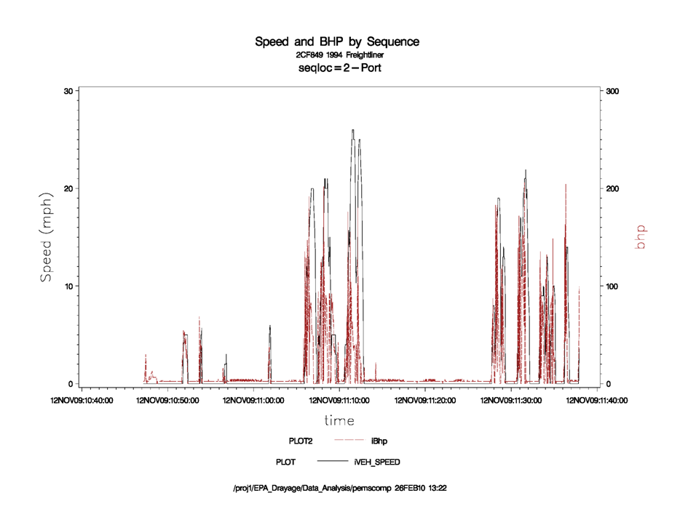
Non-Port Activity Example
Engine Idle Periods
Port Activity Example
23

Slide 24
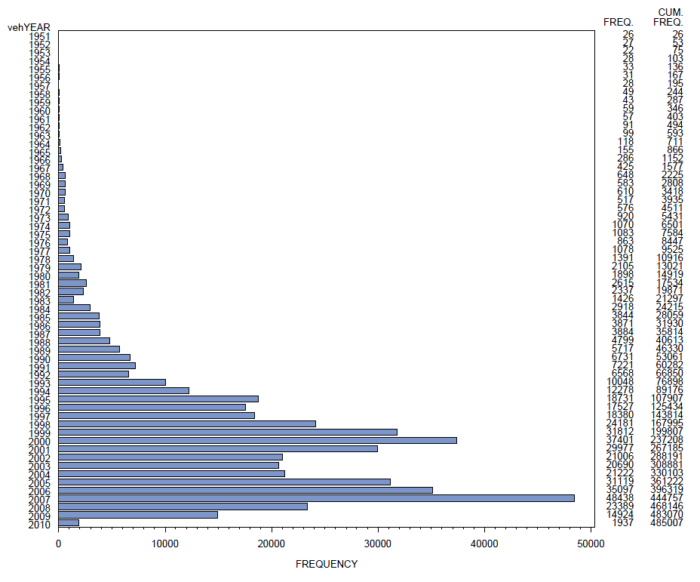
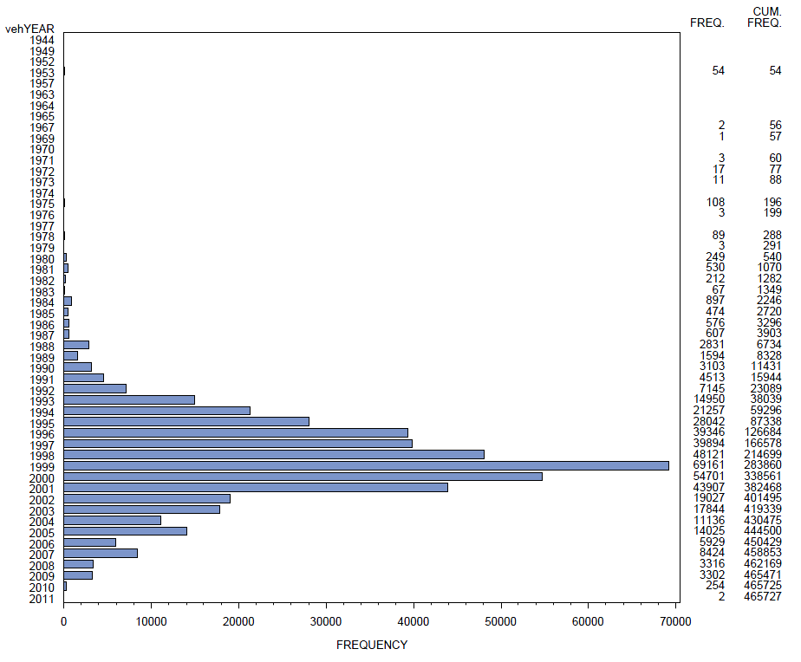
2009 TxDOT Registration HD Vehicle Database
Typical Houston Terminal Entry HD Vehicle Database over 18 months
Both Terminals Have Same MY Distribution
Barbours Cut ~ MY1999
Bayport ~ MY1999
Over 27 month period in Terminal Entry HD visits (BC: 01/08 – 04/10 & BP: 01/09 – 04/10):
  MY distribution is older than TxDOT HD database.
  Less than 5% of HD vehicles which visit terminals are new MY vehicles (MY2006 – 2010)

Slide 25
Truck Activity to Terminals:
How many visits by the same vehicle?
Barbours Cut Terminal:
Jan 2008 – April 2010
Avg # of visits per month¹ | Total # of trucks in this group² | Total % of trucks in this group | Total # of visits by trucks in this group³ | % of total visits by trucks in this group
0 or more (all visitors) | 37,300 | 100 | 688,991 | 100.0%
4 or more | 5,910 | 15.84 | 414,078 | 60.1%
8 or more | 1,506 | 4.04 | 172,392 | 25.0%
12 or more | 464 | 1.24 | 78,722 | 11.4%
16 or more | 209 | 0.56 | 47,956 | 7.0%
20 or more | 118 | 0.32 | 33,799 | 4.9%
24 or more | 74 | 0.2 | 25,442 | 3.7%
28 or more | 60 | 0.16 | 22,482 | 3.3%
32 or more | 43 | 0.12 | 17,588 | 2.6%
36 or more | 33 | 0.09 | 14,070 | 2.0%
40 or more | 24 | 0.06 | 10,872 | 1.6%
44 or more | 17 | 0.05 | 8,366 | 1.2%
Note: Define “Drayage” truck as visiting a terminal 20 or more times per month (~ 1 trip per day)
Question: What are the truck’s operations? They are not visiting the port on a regular basis.
Note:
84% of trucks visit less than 4 times per month (31,400 trucks) which
represents 40% of total trips to terminal.
Only 118 trucks representing 0.32% of total truck fleet but makes up about 5%
of trips to terminal
1,506 trucks representing 4% of fleet makes up 25% of trips to terminal

Slide 26
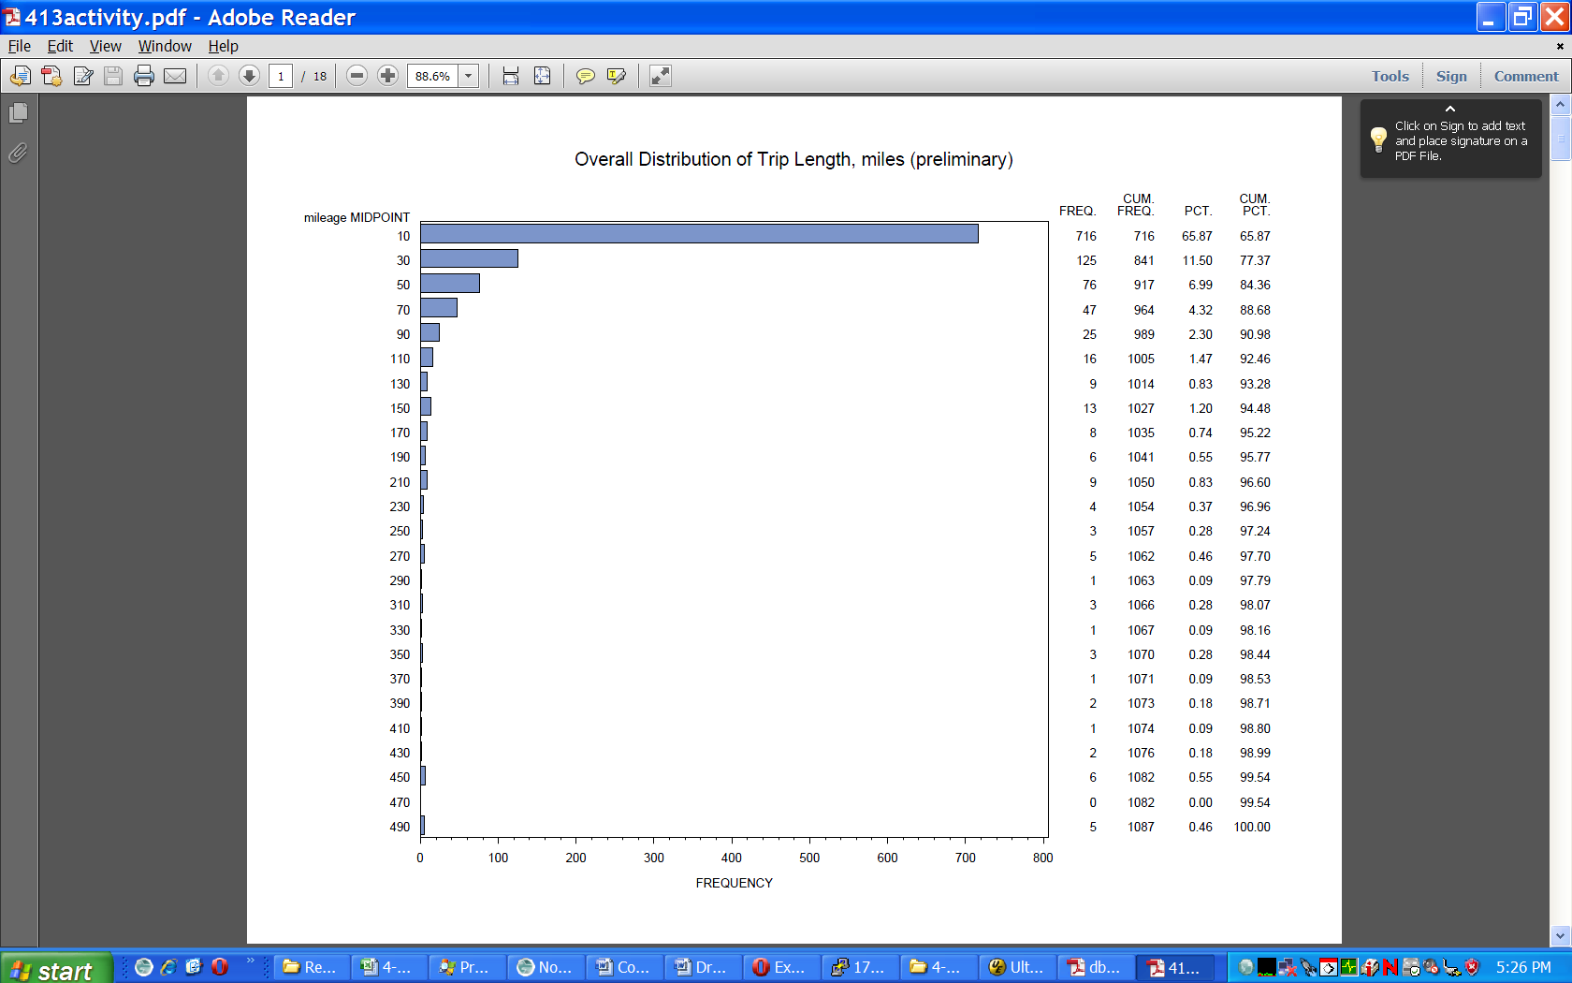
Overall Activity Analysis from PAMS/PEMS
How far are these Drayage Truck traveling?
42 vehicles recording trip activity using PEMS/PAMS. (Note: Data is from 1 day to 1 week from five different companies)
66% of all trips < 10 miles in length
Compared each company for trip length distributions and found little difference
89% of all trips (“key on/off”) are less than 70 miles

Slide 27
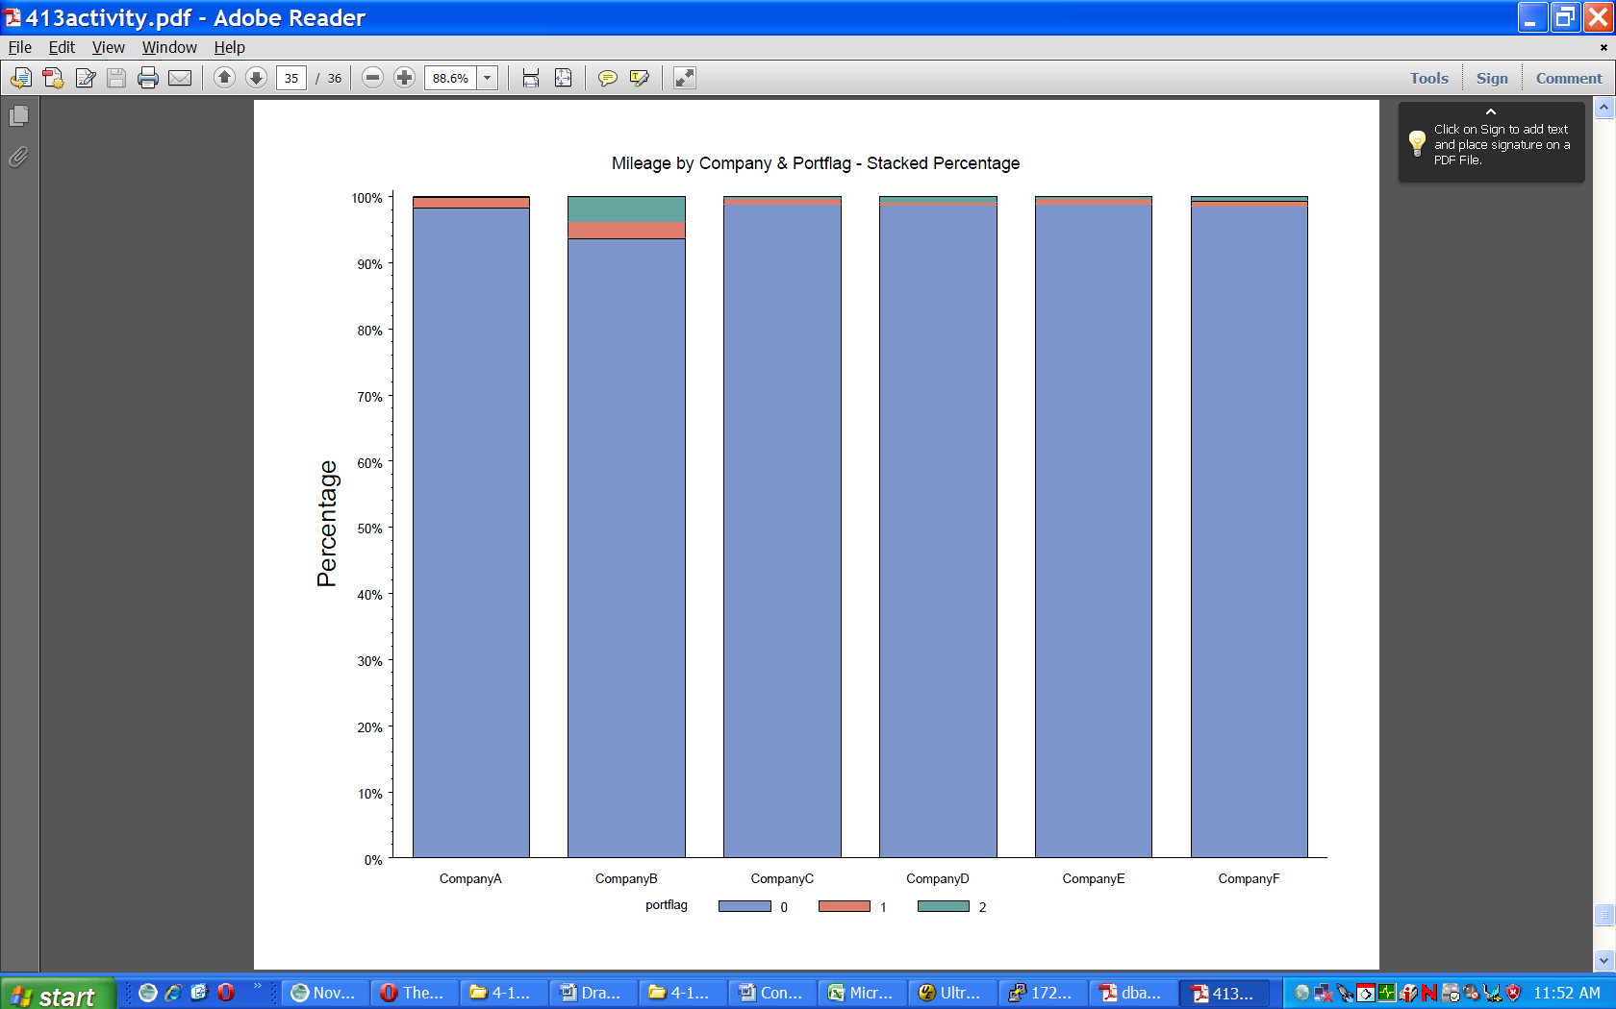
Port vs Non-Port Operations based on Total Mileage
Average for all companies was less than 3%
Less than 6% of total trip mileage was within the Port area for one company.

Slide 28
Percent Time in Operating Modes
Question: How Different are HD (container) vehicles in Operating Modes between Port and non-Port Activities?
Location | Type | Idle | Creep | Transient | Cruise
Non-Port |  | 39.4 | 8.3 | 17.7 | 34.3
Port Terminals:
Barbours Cut | PHA | 68.9 | 18.5 | 12.6 | 0
Bayport | PHA | 66.1 | 18.6 | 15.3 | 0
Greens Port | Private | 71.9 | 18.3 | 9.7 | 0
Jacintoport | Private | 70.9 | 19.3 | 9.7 | 0
Note:
Very little difference in percentage of time between four different terminals
Data from PEMS/PAMS Activity including GPS
Creep mode: up to 8.2 mph
Transient mode: 8.2 – 47.5 mph
Cruise mode: > 47.5 mph

Slide 29
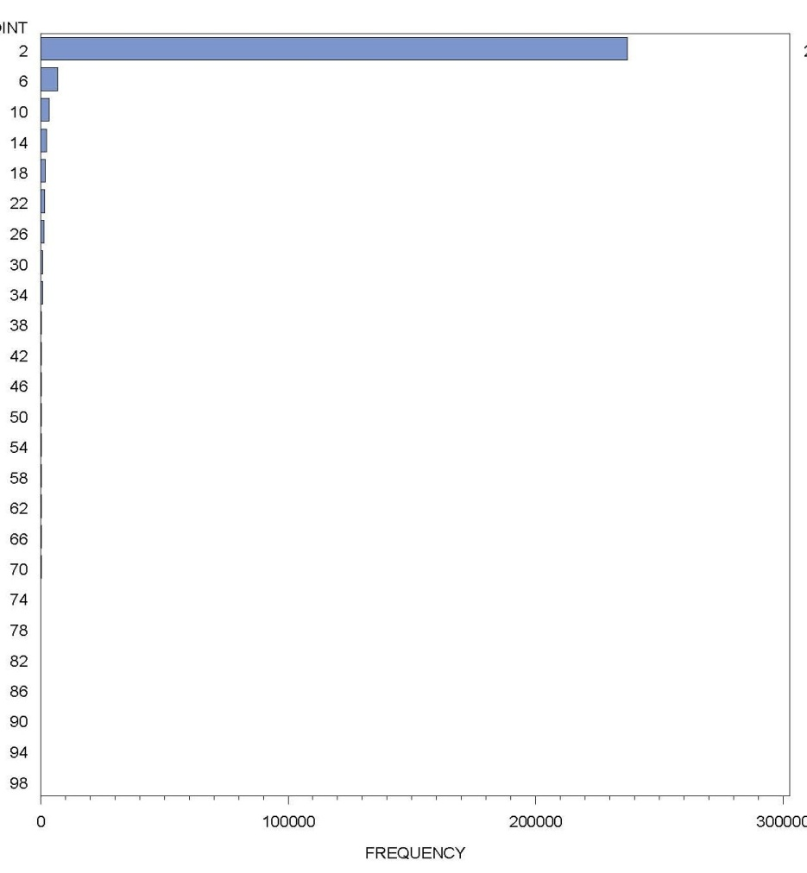
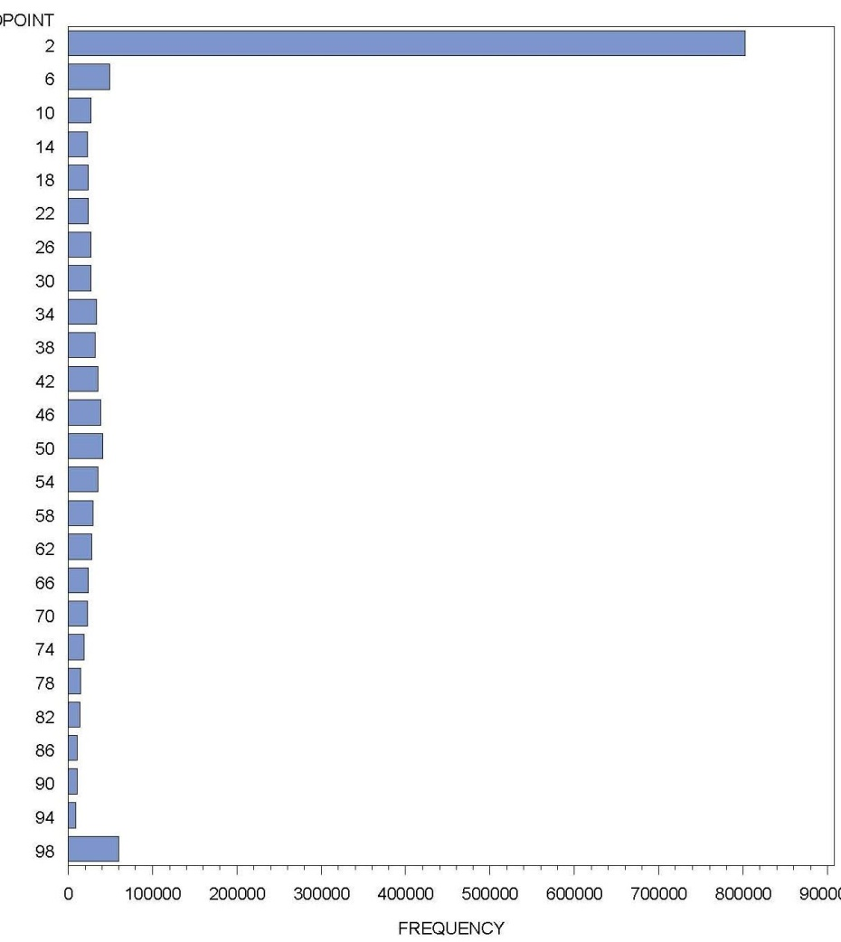
Vehicle Engine Load % Analysis from PEMS/PAMS data
Engine load profiles when combined with speed profiles gives a good indication of MOVES opmodes being used (very few) in Port when compared to non-Port
Port Operations
Engine load: Idle
Non-Port Operations
Note: Frequency of engine load %
Engine load at Idle - 92%
Engine load % decreases quickly
Engine load % is below 34%
(low gears)
Note: Frequency of engine load %
Engine load at Idle - 55%
Engine load distribution like
“Gauss normal”
Engine load 50% - 3%
Engine load 100% - 4%

Slide 30
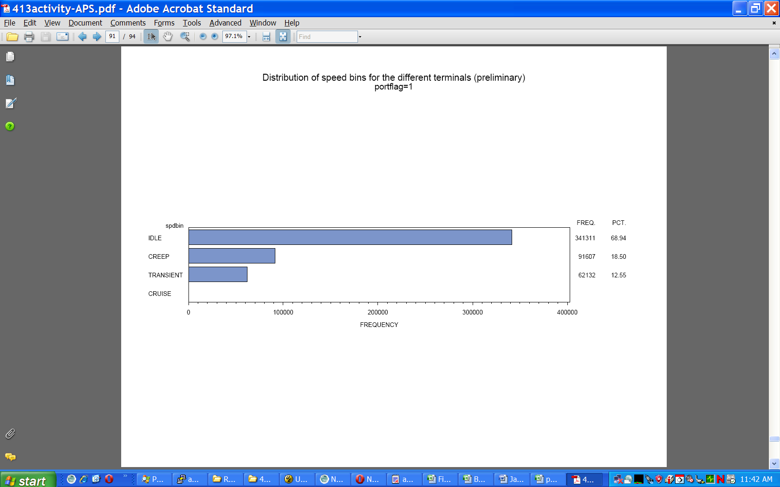
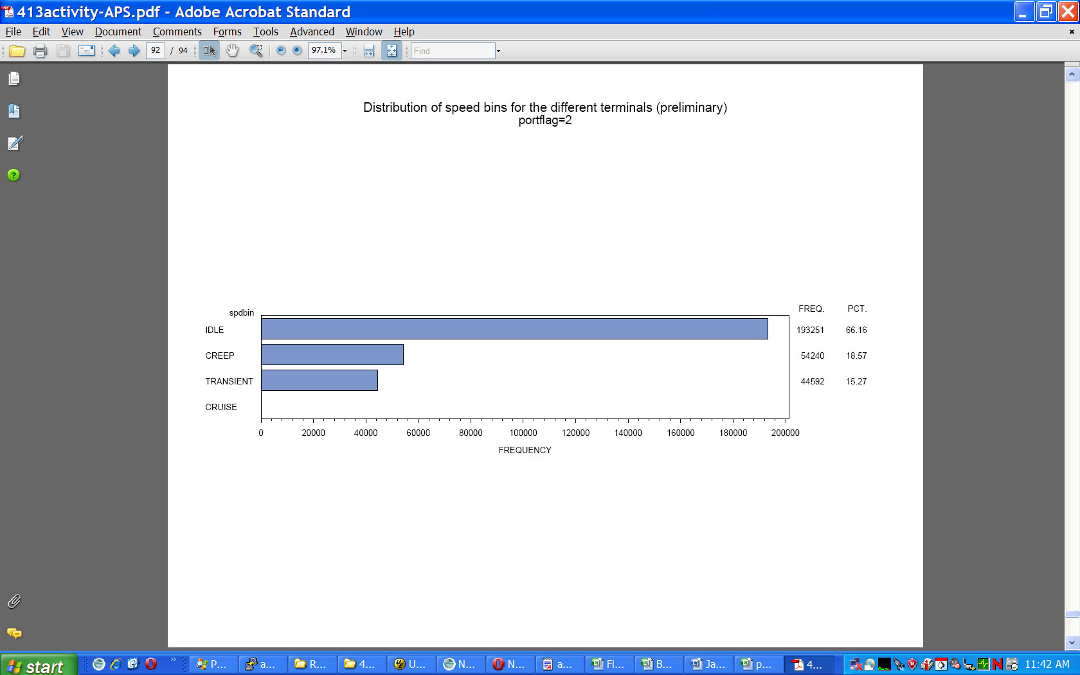
Speed Bin Distributions for All Trucks inside Terminals
(Based on Tioga’s Report parameters)
Are Speed Bins Different between two Terminals?
Speed Bin | Speed Range, mph
Idle | speed = 0
Creep | 0 < speed ≤ 8.2
Transient | 8.2 < speed ≤ 47.5
Cruise | speed > 47.5
Similar Results
Port: Barbours Cut
Port: Bayport

Slide 31
Comparing Time Spent in each Speed Bin from Tioga’s Report vs PEMS/PAMS Data
In-Port
Speed Bin | Speed Range, mph
Idle | speed = 0
Creep | 0 < speed ≤ 8.2
Transient | 8.2 < speed ≤ 47.5
Cruise | speed > 47.5
Non-Port
Note:
In-Port: Higher Operating Time for Idle/Transient Modes ….. Lower for Creep
Non-Port: Higher Idle Mode and Lower Time for Cruise Mode

Slide 32
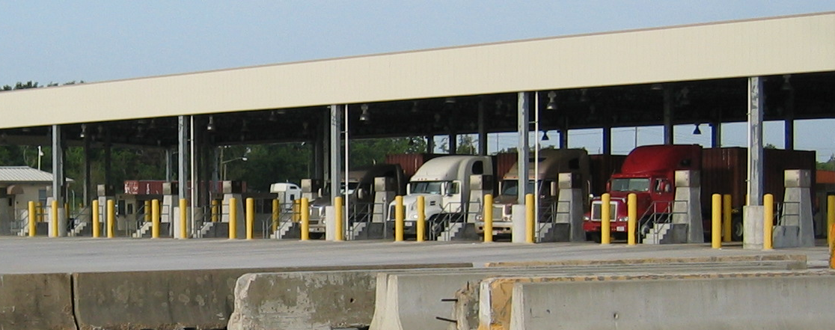
Port Terminal Visit Duration Statistics
How long are vehicles staying at the port?
*Note that the Gate Database data was adjusted for apparently erroneous values by removing visits < 1 min and visits > 8 hrs. The gate data time period is October 2009 – April 2010

Slide 33
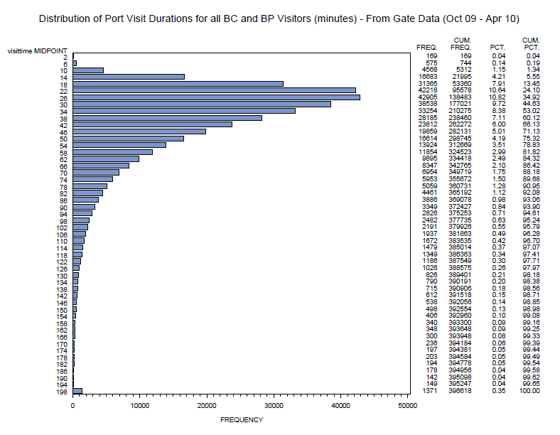
Typical Distribution of Port Visit Time for PHA (Barbours Cut/Bayport)
~1 hr -
~3 hrs -
Frequency

Slide 34
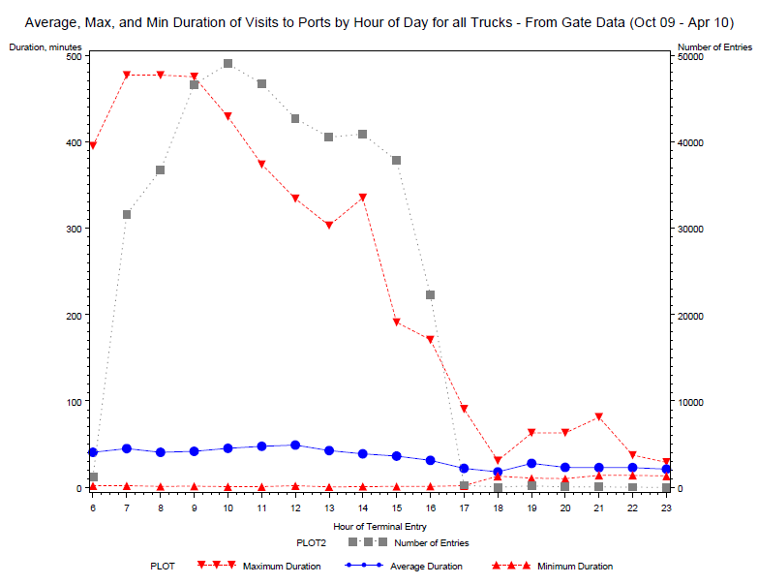
Typical Distribution of Port Visit Time for PHA by Time of Day:
(Barbours Cut/Bayport)
Question: When Do Trucks Arrive at Terminals?
High Traffic Volumes in Morning & mid-Day
Duration - Minutes

Slide 35
Preliminary Findings:
  PEMS’s gathered emission rates compare very well with MOVES rates for most Mys
  Newer MY HDVs with age (mileage) might have higher emission rates (deterioration and/or malmaintenance)
  “Drayage” HDVs are not that “special”
  Looks like “Short-Hauler” HDVs category in MOVES
  “Drayage” Fleet is older (MYs) than overall Houston HDV fleet
  Most trips are short (time & mileage) and local (MSA)

Slide 36
Preliminary Findings:
  Trip Frequency to terminal very low per week compared to overall trips that vehicle takes.
  It appears that economic activity does not change fleet MYs or time spent in Port.
  Engine load % very low within Port (low emission rates) when compared to engine load % distribution outside of Port
  Both Terminals analyzed were very similar to each other in time and operational modes
  Houston Data shows some differences in modes operations than what is referenced as defaults settings for both in-Port and non-Port.

Slide 37
Preliminary Findings:
  Houston Terminal data and PEMS/PAMS data similar for average port time.
  No Difference in weekday Terminal Traffic
  Higher terminal frequency in the morning vs afternoon
  Estimated HDV emissions within Port are small (low load/low speeds) when compared to overall HDV driving operations outside of Port.

Slide 38
CRADA Benefits:
CRADA allows for partnerships to be formed to address common need(s).
Major benefit to EPA that allows us to get local cooperation to conduct ‘real world” testing
Allows State and local governments to gain a better understanding on proper testing methods for gathering data and conducting modeling for their specific needs
Allows EPA to refine sampling protocols, testing procedures & equipment to gather data for MOVES.
Major leverage of resources :
  (staff/equipment/contractor(s)/partnership(s)/$$$
  Estimated total cost: Over $2 million including equipment use

Slide 39
Acknowledgments
EPA Office of Transportation & Air Quality:
  Carl Fulper, Connie Hart, David Hawkins, James Warila, Robert Caldwell, Ethan Schauer, Brian Ratkos, Craig Swan, Charles Schenk, Michael Christianson, Prashanth Gururaja, Phil Carlson, David Choi
Eastern Research Group:
  Sandeep Kishan, Timothy DeFries, Michael Sabisch, Alan Stanard, Scott Fincher, Gopi Manne, Rick Baker, Diane Preusse
Sensors, Inc:
  Christopher Darby, Louis Moret
Houston-Galveston Area Council (HGAC):
  Shelley Whitworth, Patricia Franco Lawhorn, Melissa Bain-Dorney
Texas Commission on Environmental Quality (TCEQ):
  Donna Huff, Mary McGarryBarber, Amy Muttoni, David Brymer
Port of Houston Authority:
  Dana Blume, Ken Gathright
EPA Region 6:
  Sandra Rennie, Carl Young

Slide 40
Reports & Data Location:
www.epa.gov/otaq/research.htm
Contact Information:
Carl Fulper, US EPA
fulper.carlr@epa.gov

Slide 41
Questions?

Slide 42
Appendix

Slide 43
Sampling ‘classes’ based on RSD scores¹
NOx Bin -2
(2.5%)
NOx Bin -1
(20%)
NOx Bin 0
(55%)
NOx Bin 1
(20%)
NOx Bin 2
(2.5%)
  ¹ Data Collection of Drayage Trucks in Houston-Galveston Port Area Draft Report. EP-C-06-080. May 27, 2011

Slide 44
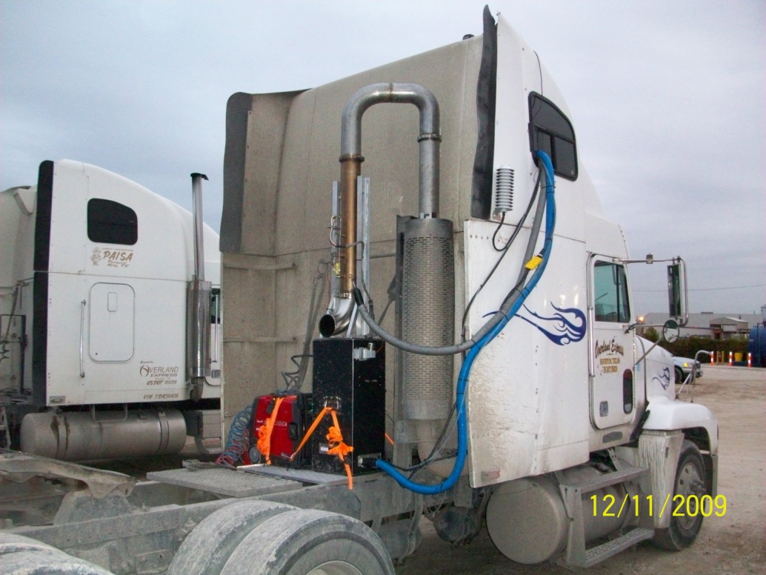
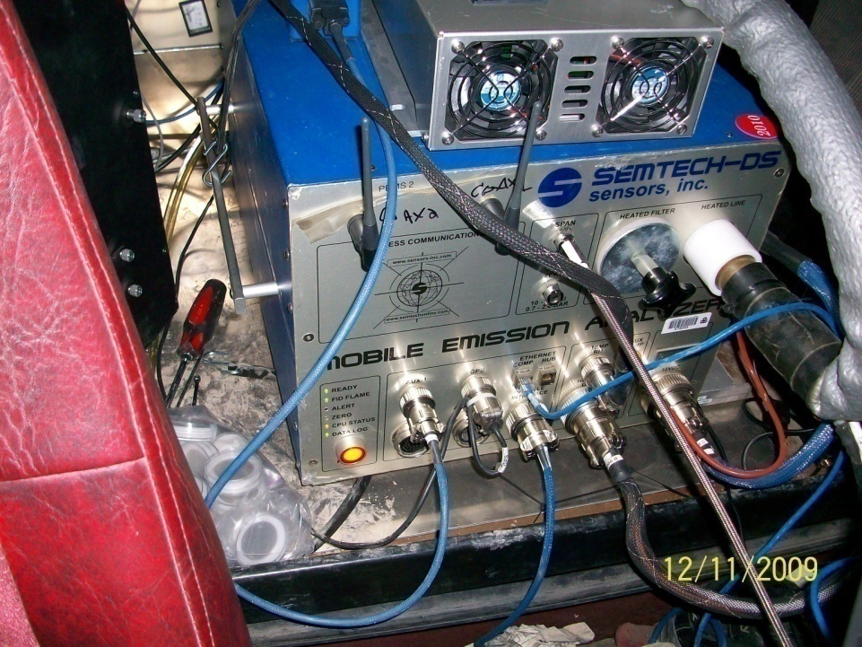
PEMS Vehicle Example
Portable Emissions – Semtech DS
Gaseous Emissions (CO2, CO, NO,
NO2 & THC)
PM filters via Proportional Sampling
MY 1994 Freightliner
PM Proportional
Sampler System
Exhaust System
Semtech_DS
PM Filters

Slide 45
MOVES compares well with the data

Slide 46
MOVES compares well with the data
NOTE: only a single vehicle

Slide 47
MOVES under-predicts the drayage data, but within the data variability

Slide 48
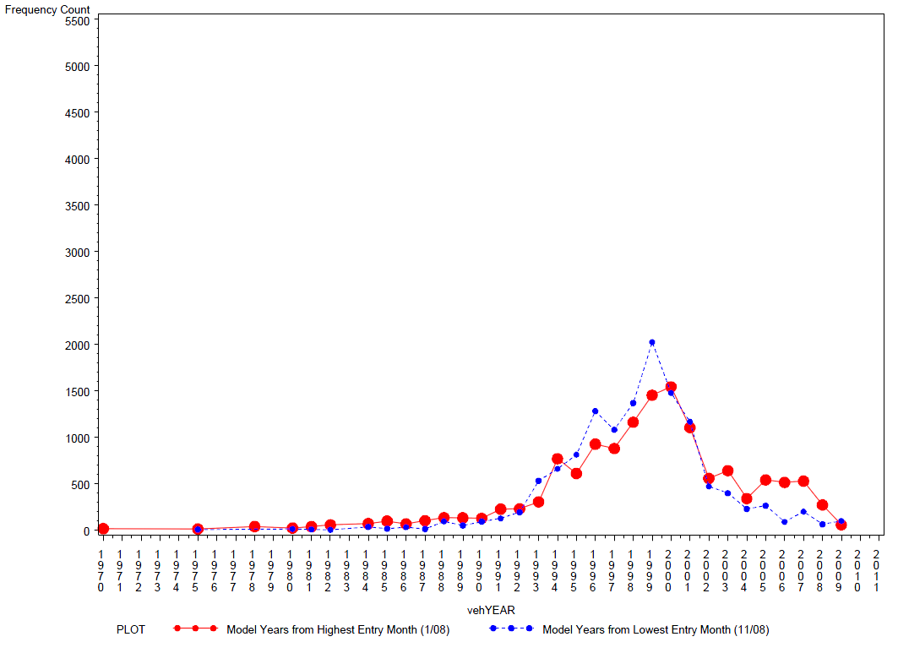
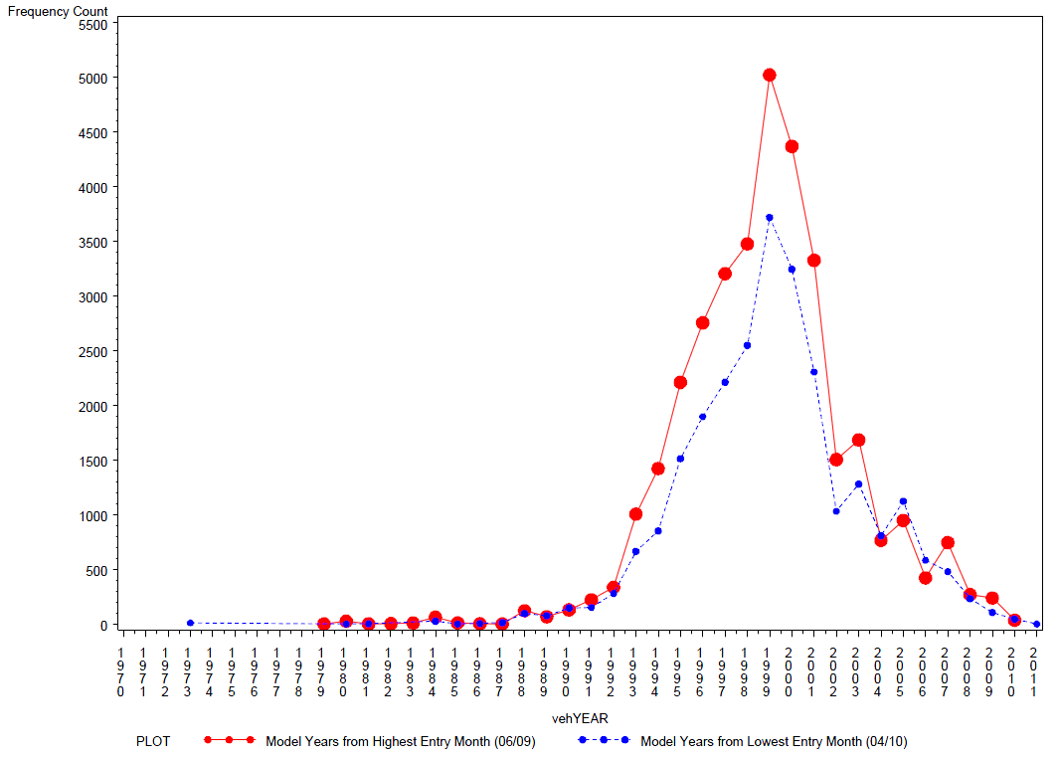
Barbours Cut Terminal:
Highest month: Jan ’08
Lowest month: Nov ‘08
Question: Does the change in economic activity play a role on MY distribution?
Answer: Probably No.
Bayport Terminal :
Highest month: June ‘09
Lowest month: April ‘10
Compared highest and lowest monthly vehicle traffic over 18 months time period

Slide 49
Truck Activity to Terminals:
How many visits by the same vehicle?
Bayport Terminal:
Jan 2009 – April 2010
Avg # of visits per month¹ | Total # of trucks in this group² | Total % of trucks in this group | Total # of visits by trucks in this group³ | % of total visits by trucks in this group
0 or more (all visitor) | 21,594 | 100 | 584,456 | 100.0%
4 or more | 5,366 | 24.85 | 454,339 | 77.7%
8 or more | 2,818 | 13.05 | 331,882 | 56.8%
12 or more | 1,495 | 6.92 | 226,429 | 38.7%
16 or more | 861 | 3.99 | 156,143 | 26.7%
20 or more | 520 | 2.41 | 108,635 | 18.6%
24 or more | 321 | 1.49 | 76,084 | 13.0%
28 or more | 187 | 0.87 | 49,344 | 8.4%
32 or more | 109 | 0.5 | 32,971 | 5.6%
36 or more | 53 | 0.25 | 16,506 | 2.8%
40 or more | 31 | 0.14 | 11,703 | 2.0%
44 or more | 13 | 0.06 | 5,071 | 0.9%
Note: Define “Drayage” truck as visiting a terminal 20 or more times per month (~ 1 trip per day in month)
Question: What are these truck’s operations? They are not visiting the port on a regular basis.
Question: Why the difference between terminals?
Note:
75% of trucks visit less than 4 times per month (16,100 trucks) which
represents 22% of total trips to terminal.
520 trucks representing 2.41% of total truck fleet but makes up about 19%
of trips to terminal
2,818 trucks representing 13% of fleet makes up 57% of trips to terminal.

Slide 50
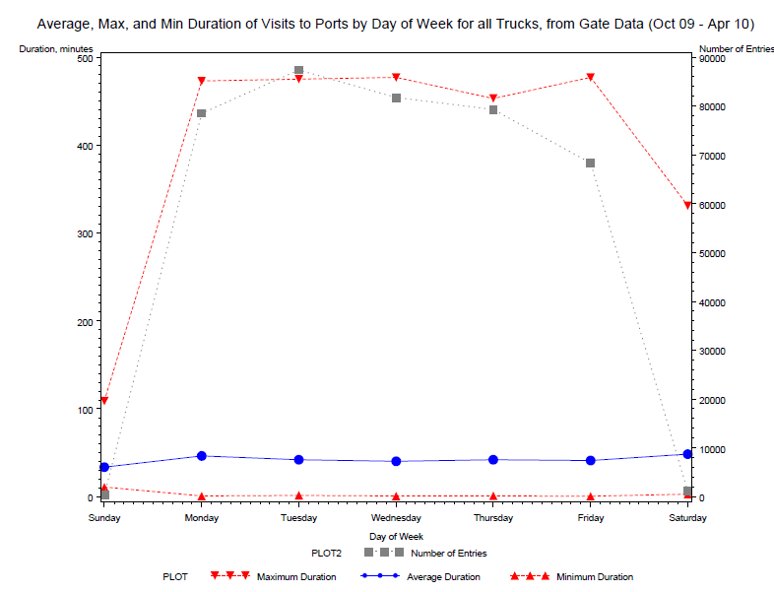
Typical Distribution of Port Visit Time for PHA by Week: (Barbours Cut/Bayport)
Question: Any Difference in Traffic by Weekday?

Slide 51
Estimated Total Emissions of Gaseous Pollutants from the Barbours Cut and Bayport Fleet in Port and non-Port
(Nov 1, 2009 to April 30, 2010, trucks visiting at least 1 time per month)
Question: What are the “Drayage” HDVs Emissions missed within Port?
Pollutant (metric tons): | HC | CO | CO2 | NOx
Estimated In-Port Emissions | 7.85 | 34.74 | 3716.59 | 59.38
Estimated Non-Port Emissions | 221.77 | 1,275.50 | 383,548.18 | 5,199.38
Total Emissions | 229.62 | 1,310.24 | 387,264.77 | 5,258.76
In-port percentage of total | 3.4% | 2.7% | 1.0% | 1.1%
Based on: port entry data (PHA), model year distribution at ports, estimated average activity in and out of port (PEMS/PAMS) using PEMS emissions rates (no MOVES emission rates used in analysis)

Slide 52
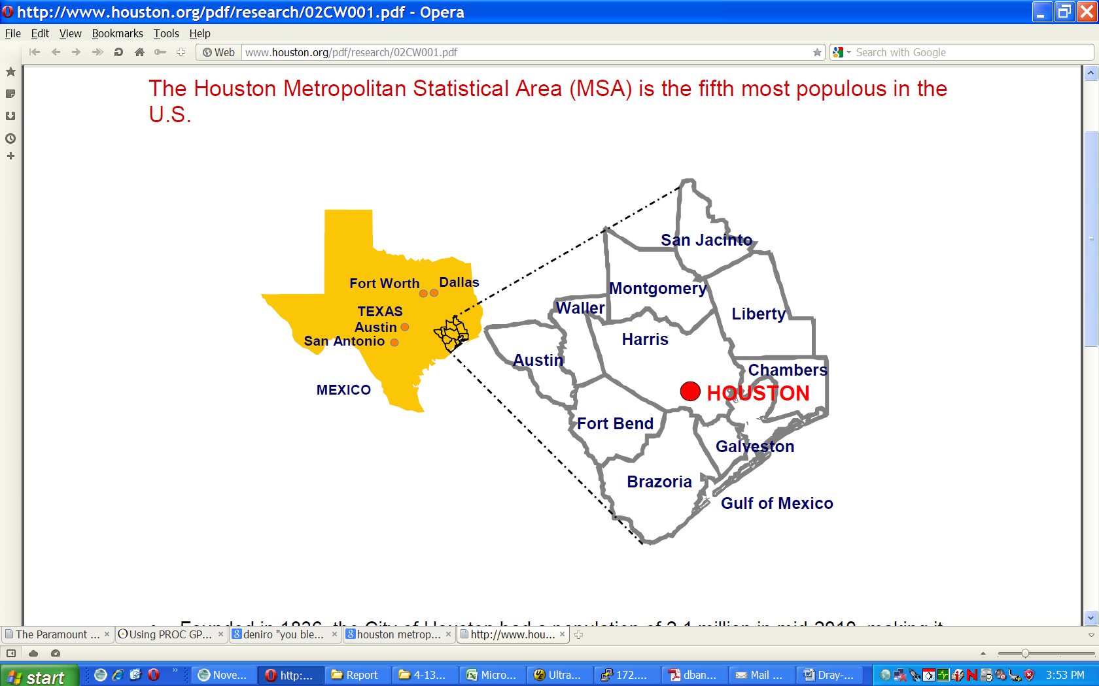
Question: Where are HD trucks located (stationed) who visit the Terminals? Within Houston MSA or outside?
County | Barbours Cut |  | Bayport
 | # Trucks | % | # Trucks | %
Harris, MSA | 8,625 | 66.0 | 7,934 | 70.0
Fort Bend, MSA | 452 | 3.0 | 423 | 4.0
Brazoria, MSA | 286 | 2.0 | 221 | 2.0
Montgomery, MSA | 168 | 1.0 | 169 | 1.0
Galveston, MSA | 106 | 1.0 | 104 | 1.0
Five Other MSA | 90 | 1.0 | 157 | 1.0
Hidalgo (370 miles) | 775 | 6.0 | 503 | 4.0
Tarrant (Ft Worth, 290 miles) | 225 | 2.0 | 227 | 2.0
Dallas ( Dallas, 270 miles) | 315 | 2.0 | 258 | 2.0
All 239 other counties | 1,794 | 14 | 1,171 | 10.0
Total | 13,131 |  | 11,353
Note:
HD “Drayage” very similar distribution
between Terminals
Local Trucks (MSA) represent:
74% (Barbours Cut) &
79% (Bayport) of Truck Traffic
Other Counties located 225 to 380
miles from MSA represent (22–27%)
Trucks visiting the Port in top five MSA
counties represent 4 -10% of total trucks
registered in county when compared to
about 1% in other counties
About 2% of all Trucks registered in the
state visit these PHA terminals

Slide 53
HD “Drayage” Emissions Analysis
Objective:
To validate and potentially improve/update the heavy-duty emission rates , which is the core of the MOVES framework
Number of Trucks with PEMS measurements
Model Year | With RSD measurements | Without RSD measurements
1989 and prior | 1 | -
1990 | - | -
1991-1997 | 8 | 2
1998 | 1 | 2
1999-2002 | 10 | 2
2003-2006 | 8 | 2
TOTAL | 28 | 8
Notes:
Occasionally some of the drayage trucks were recruited for PEMS testing even though they were not part of the 1,877 RSD-tested fleet – they did not receive a pre-study RSD test. The decision to test non-RSD sampled trucks was made to maximize the number of trucks since the number of RSD-sampled trucks was insufficient to meet the sampling needs at some facilities.

