Slide 1
PEMS Testing of Plug-in Hybrids
April 3, 2014
Ed Kellogg
Southern California Edison
Advanced Technology

Slide 2

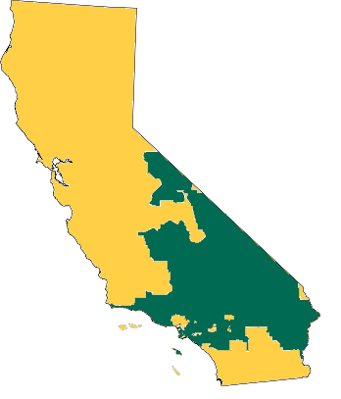
Southern California Edison Overview
  50,000 square-mile service area
  5 million meters
  20% renewable energy (2010)
    10% of U.S. renewable energy
    65% of nation’s solar delivered
    50% of U.S. geothermal
  33% renewable standard (2020)
  SCE operates a fleet of over 6,000 assets ranging from powered trailers to Class 8 trucks
  Largest, most successful EV fleet
    20 million miles
  Safe and Reliable Electric Service
SCE
Service
Territory

Slide 3
SCE Fleet
Over 5000 vehicles
  Split between light duty and heavy duty
Issues
  Reliability of new technology
  SAFETY
  Affordability
  Effectiveness
  Minimize system impact

Slide 4
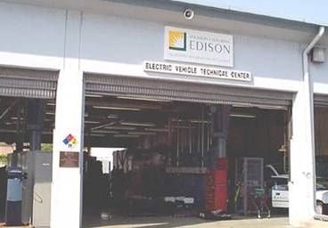
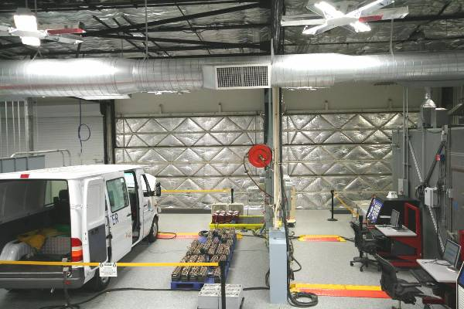
Electric Vehicle Technical Center
Established in 1993
Unique in utility history
Recognized by DOE
ISO 9001 Registered
Known for quality services
  Energy storage testing in transportation and stationary fields
  Vehicle and power train testing and evaluation
  Employee training and customer education

Slide 5
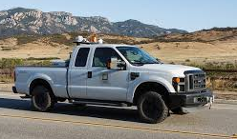

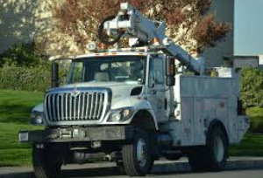
WHY PEMS Testing at SCE?
Independently validate emissions, fuel economy, and other claims of vehicle/equipment manufacturers.
What does it do?
Comprehensive Performance
Characterization
Does it work?
Can we use it?
Reliability Test
Fleet Trial
Deployment

Slide 6
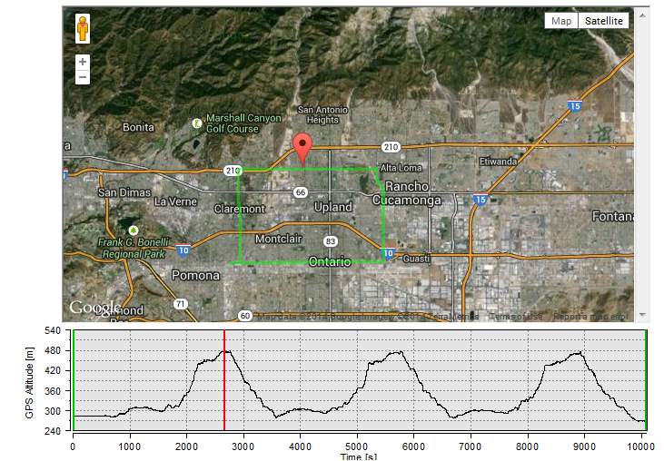
POMONA URBAN LOOP
20 miles
100% Urban driving
Elevation changes
Run all vehicles on this route

Slide 7
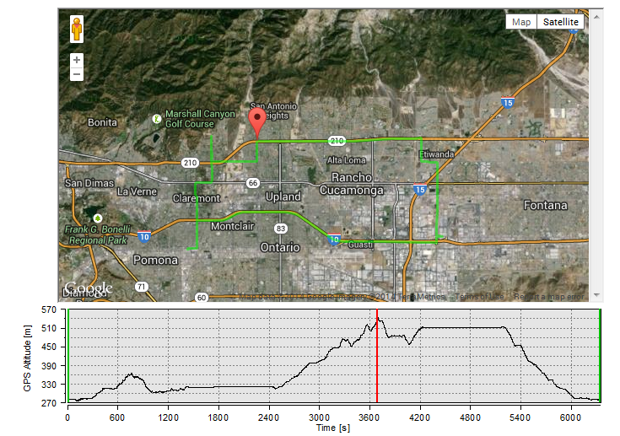
TROUBLEMAN LOOP
2 stationary work positions
37 miles
Freeway and Urban driving
Simulates half a work day.
Work trucks/ bucket trucks

Slide 8
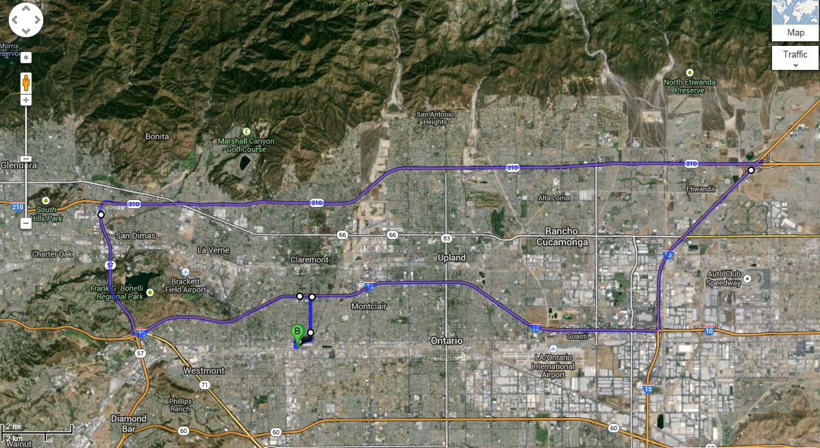
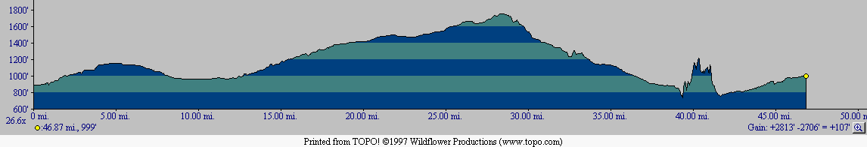
FREEWAY LOOP
49 mile loop.
  4 miles urban,
  45 miles freeway
Vehicles that drive safe freeway speeds

Slide 9
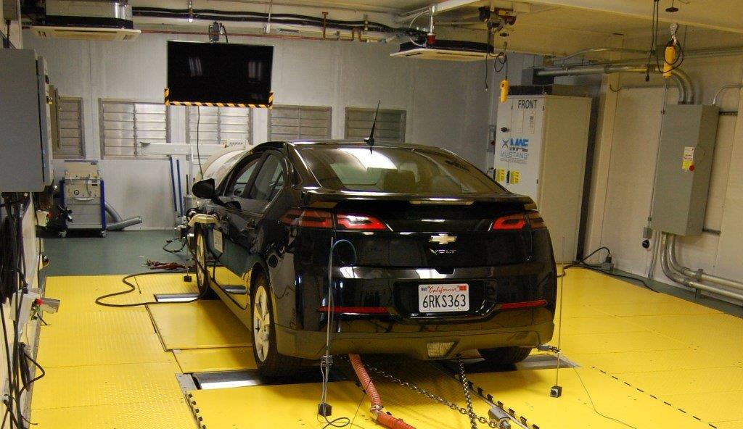
Play Back Route on Dynamometer
Notes:
5% repeat for onroad testing 3% for dyno testing

Slide 10
SCE Test Cycles

Slide 11
SCE Test Cycles

Slide 12
Loop Comparison
Loop | Kinetic Intensity (mi^-1) | KI (km^-1)
Pomona Urban | 1.299 | 0.801
UDDS | 1.284 | 0.797
HWFET | 0.220 | 0.14
Pomona Freeway | 0.874 | 0.54
Troubleman P1 | 0.265 | 0.165
Troubleman P2 | 0.500 | 0.311
Troubleman P3 | 1.909 | 1.186

Slide 13
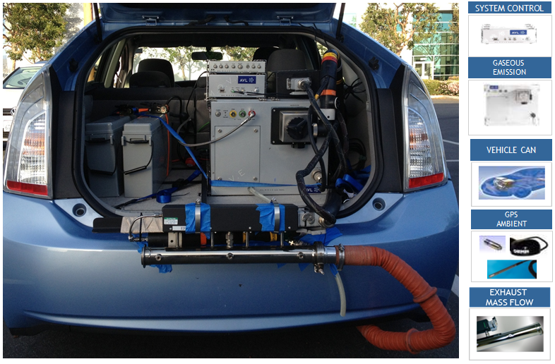
Instrumented Plug-in Prius

Slide 14
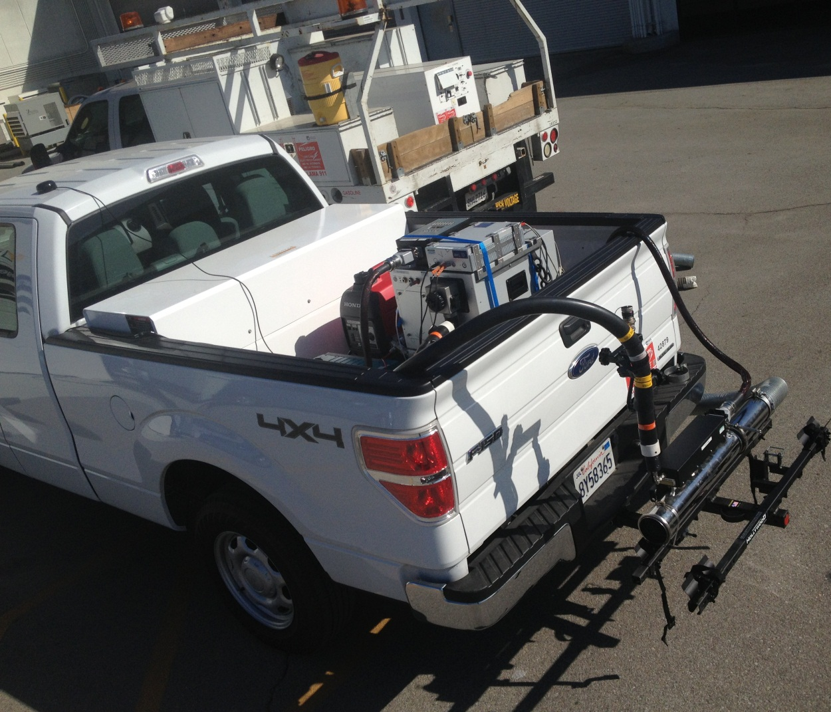
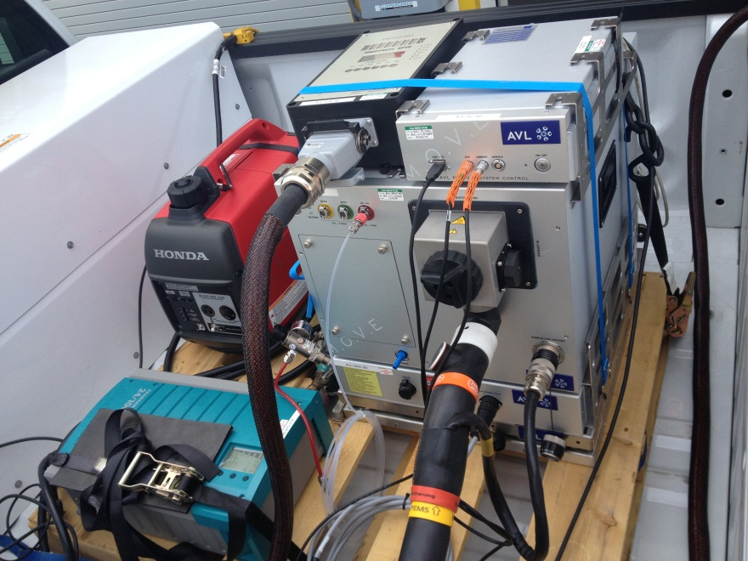
Instrumented PHEV F-150
Pallet used for easy install.
Generator for longer runs
EFM mounting using hitch rack.

Slide 15
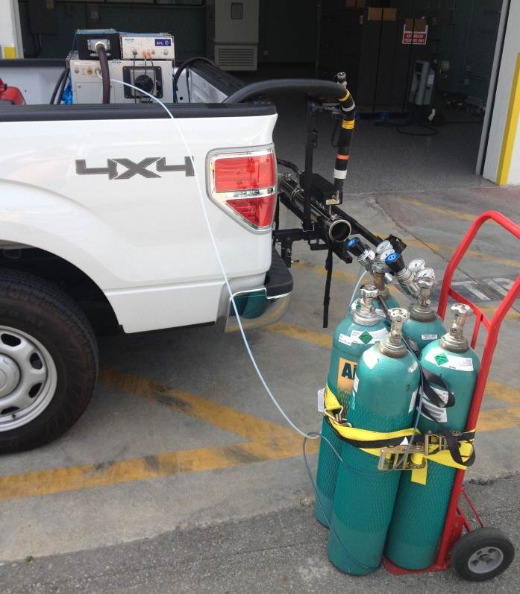

Test Protocol
Pre and Post Calibration
Test log
Charging log
Same driver
Repeat with different loading conditions
  Payload driver only, no auxiliary loads
  Payload driver only, A/C on max, headlights on, radio on
  Full payload, no auxiliary loads
  Full payload, , A/C on max, headlights on, radio on

Slide 16
F-150 PHEV Troubleman 2
total CO2 DC 1619 g
Trip Fuel Economy US 206 mpg US,
1.02 AC kWh/mi

Slide 17
F-150 PHEV Urban 2
tot CO2 DC 11396 g
Trip Fuel Economy US 49.4 mpg US

Slide 18
PHEV Prius – Urban Loop 2
Trip Distance 61.13 mi
Trip Fuel Cons 1.02 gall
tot CO2 = 9118.23771 g
Trip Fuel Econ 59.77 mpg

Slide 19
PHEV PRIUS - URBAN LOOP 2

Slide 20
ZOOM to point of engine start (HV)

Slide 21
Next Steps
Continue Testing PHEV F-150
  TM2 Long version
  Urban drives, 1-4
  Freeway drives, 1-4
  Dynamometer testing

