Slide 1
Real-world Fuel Economy and Particle Number Emissions of a Hybrid-Electric Passenger Car Under Cold Climate, Hilly Terrain
2014 PEMS International Conference & Workshop
CE-CERT, Riverside, CA April 3-4, 2014
Britt A. Holmén
bholmen@uvm.edu
Notes:
ABSTRACT
Abstract for 2014 PEMS Conference & Workshop
UC Riverside April 3-4, 2014
Real-world Fuel Economy and Particle Number Emissions of a Hybrid-Electric Passenger Car Under Cold Climate, Hilly Terrain Operation
Britt A. Holmén*, Karen Sentoff, Mitchell Robinson, Matthew Conger
Civil & Environmental Engineering, School of Engineering, University of Vermont, Burlington, VT 05405
Over an 18-month test period, a single driver operated two 2010 Toyota Camry vehicles (one hybrid-electric, one conventional) outfitted with the Total On-board Tailpipe Emissions Measurement System (TOTEMS) developed for real-world 1Hz vehicle emissions and activity monitoring. TOTEMS records second-by-second gas-phase and size-resolved particle number concentrations, exhaust flowrate and temperature, in addition to vehicle operating parameters, vehicle location and ambient temperature and relative humidity. Road grade (at 3 m spatial resolution) information is incorporated to enable real-world quantification of vehicle specific power (VSP, kW/ton). Pollutant emission rates and fuel economy of the HEV were directly compared to the same make/model conventional vehicle (CV) measured with TOTEMS over the same 51 km driving route. Patterns of the HEV fuel consumption “benefit” (compared to CV) as a function of VSP reveal a strong link to HEV engine operating behavior under different driving conditions. Particle number emissions from the HEV were characterized by a significant number of high emission events (HEEs) associated with intermittent restart of the HEV’s internal combustion engine (ICE). Differences in total particle number emission rates between the vehicle types as well as particle number distributions as a function of HEV operating behavior will be presented.
[196 words]
-------
The TOTEMS on-board emissions instrumentation package developed at the UVM Transportation Air Quality Laboratory quantifies tailpipe gas and particle pollutant concentrations, exhaust flow rates, exhaust and sample temperatures, vehicle position, engine operating behavior, ambient and instrument conditions while a test vehicle is driven on the real-world road network. Unlike previous “portable emissions measurement systems” (PEMS) that collect chiefly regulated gases, TOTEMS collects: (i) the full number distributions of particle emissions using an EEPS (TSI, Inc.) particle spectrometer; and (ii) quantifies mobile source air toxic (MSAT) gaseous emissions in addition to criteria pollutant (CO, NOx, HC) and greenhouse gases (CO₂, N₂O, CH₄) using a high-speed FTIR instrument specifically designed for on-board vehicle exhaust testing. Here, ultrafine particle and greenhouse gas emissions from two MY 2010 Toyota Camry vehicles, one hybrid-electric and one conventional, are compared based on repeated real-world operation on a 32-mile route in Chittenden County, Vermont by a single driver. Road grade and road type effects on hybrid-electric vehicle emissions and performance will be discussed.

Slide 2
TAQ Lab “TOTEMS” Team
TAQ = Transportation-Air Quality
Karen Sentoff (CEE, M.S. – Jan 2013)
Mitchell Robinson (CEE, M.S. – March 2011)
Matthew Conger (CEE, M.S. student)
Sponsor: US DOT via UVM Transportation Research Center (TRC)

Slide 3
Overview
Real-World Light-Duty HEV Emissions
  What do we really know?
TOTEMS Approach & Study Methods
TOTEMS Results
  Carbon Dioxide (CO₂) – a greenhouse gas
  Particle Number (PN) – unregulated (in USA)
  Fuel Consumption Rate (FCR)
Summary and Observations

Slide 4
HEV Perceptions
“...hybrid cars are marketed by a singular benefit; increased fuel economy.”
“..the much more important benefit is the very significant reduction in emissions.”
---www.hybrid-car.org
Notes:
When we set out on this project we did so because there was very little robust data on HEV emisisons from light-duty cars.
Our goal was to quantify HEV fuel economy (a “performance” metric) improvements and tailpipe emission reductions.
ARE THESE STATEMENTS REALLY TRUE? What “emissions” do they refer to? How much is the fuel economy benefit? What are the “very significant” emissions reductions?
Are certain driving conditions needed to achieve these benefits?

Slide 5
HEV Strategies
To achieve Fuel and Emissions Benefits:
ICE-off mode (“all electric”)
  No fuel combustion = no emissions
Electric-Assist
  Combined power from ICE + e-motor
Regenerative Braking
  Recoup the friction energy to charge battery
Notes:
The ICE does not have to work as hard as it otherwise would..
Gets energy back to use again in (1) or (2) instead of throwing it away

Slide 6
Gasoline-Electric Hybrids
Sparse data for gasoline HEV emissions:
  ‘Regulated’ Gases (CO, HC, NOx) ✔
  ‘Un-Regulated’ Pollutants:
    Particle Number
    Air Toxics
    Greenhouse Gases
      Fuel Economy & Energy Consumption ✔
Important to compare HEV to “equal” CV
Vehicle size/ aerodynamics / engine

Slide 7
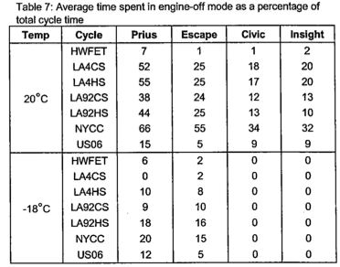
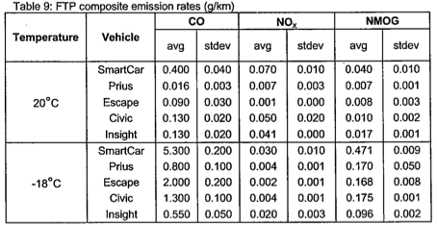
Christenson et al. (2007)
Criteria Gases (CO, NOx, NMOG) and Fuel Consumption
PM and particle size in companion paper
Dynamometer study – Aggregate Test Bag Samples
  7 drive cycles @ 2 temperatures; 4 HEVs + 1 CV
No Scantool Data – “Engine-Off” time estimated from CO₂
Comparison CV not of same vehicle make/model: “Smart Car”
Notes:
ENVIRONMENT CANADA STUDY.
7 different drive cycles – 5 transient cycles and 2 SS (40 and 80 km/hr)
2 temperatures (+20 and -18 C)
4 hybrids – MY 200 to 2004
1 CV – SmartCar
Thus no SbS operational (some gas emissions) data for modal emissions modeling

Slide 8
Objectives & Approach
Quantify Real-world Emissions & Performance of HEV in Cold Climate/Hilly Terrain by comparison to CV of same make/ model
On-Board second-by-second tailpipe emissions measurement for CV and HEV, driving in Vermont, all seasons:
  regulated gases (CO, HC, NOx)
  unregulated (GHG, MSAT) gases
  particle number (PN) – total and size distributions

Slide 9



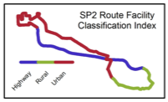
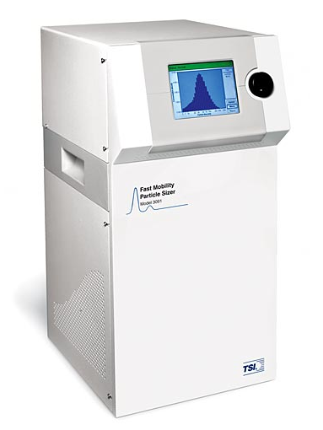

On-Board Methodology
Conventional
Hybrid
Same Make/Model: 2010 CAMRY
Total
Onboard
Tailpipe
Emissions
Measurement
System
Same Route
4 “seasons”
35 miles total, 3 road types
    Grade: -13.2 to +11.5%
Outbound: urban and highway driving
Inbound: rural and suburban arterial
One Driver
75 Runs
32 CV
43 HEV
Female, 24 yr
Notes:
75 Tests Completed: Jan 2010 to Sep 2011

Slide 10
2010
Camry Specs
 | HYBRID | CONVENTIONAL
MPG | 33/34 (city/highway) | 22/32 (city/highway)
Fuel Tank Size | 17.2 gallon | 18.5 gallon
Fuel Type | Unleaded 87 | Unleaded 87
Fuel Injection | Sequential Multi-point Injection | Sequential Multi-point Injection
Gasoline engine | 2362 cc (2.4 L) DOHC | 2494 cc (2.5 L) DOHC
 | in-line 4 (VVT-i 4) | in-line 4 (VVT-i 4)
 | 88.5 mm bore | 90 mm bore
 | double overhead cam | double overhead cam
 | variable valve timing | variable valve timing
 | 4 valves per cylinder (2AZ-FXE) | 4 valves per cylinder (2AR-FE)
 | 96.5 mm stroke | 98 mm stroke
compression ratio | 12.5 | 10.4
Power | 140 kW | 126 kW
 | 147 HP @ 6000 RPM | 169 HP SAE @ 6000 RPM
 | 138 lb-ft @ 4400 RPM | 167 lb-ft (226 Nm) @ 4100 RPM
Electric motor | 199 lb-ft @ 0-1500 RPM | N/A
 | 105 kW @ 4500 RPM | N/A
Motor Type | Permanent magnet AC synchronous motor | N/A
voltage | 650 volt max | N/A
Traction Battery | Sealed Nickel-Metal Hydride | N/A
 | 40 HP (30 kW) | N/A
voltage | 244.8 volts | N/A
Drivetrain | Front engine, FWD | Front engine, FWD
Transmission | Electronically Controlled Continuously Variable Transmission (ECVT) | 6-speed electronically controlled automatic overdrive with intelligence (ECT-i) and sequential shift
Ignition | Electronic, Toyota Direct Injection | Electronic, Toyota Direct Injection
Curb Weight | 3680 lbs | 3373 lbs
Emissions Ratings | AT-PZEV (SULEV-II) | SULEV-II
Emissions controls | Warm-up Three-way catalyst | Warm-up Three-way catalyst
 | Three-way catalyst | Three-way catalyst
 | Air-fuel ratio sensor | Air-fuel ratio sensor
 | Heated oxygen sensor | Heated oxygen sensor
 | Full on-board diagnostics | partial on-board diagnostics
Toyota “Hybrid Synergy Drive” a series-parallel hybrid
Notes:
Hybrid was 307 pounds heavier than CV.

Slide 11
TOTEMS: Total On-Board Tailpipe Emissions Measurement System
A suite of 22 instruments to log at 1 Hz:
“Criteria” Gases (CO, HC, NOx)
MSAT & GHGs
Particle Number (Distributions) (TSI, Inc. EEPS & UCPC)
Vehicle Location (GPS)
Engine and Vehicle Parameters (Techstream®)
Ambient Conditions (RH, T) (Onset loggers)
Exhaust Q & T (Pitot w/4 dP transducers; thermocouples)
Exhaust Dilution for PN (Matter Engr. MD19-2E/ASET-15)
No electrical load on vehicle (AGM Batteries/Inverter)
(MKS MultiGas 2030HS FTIR)

Slide 12
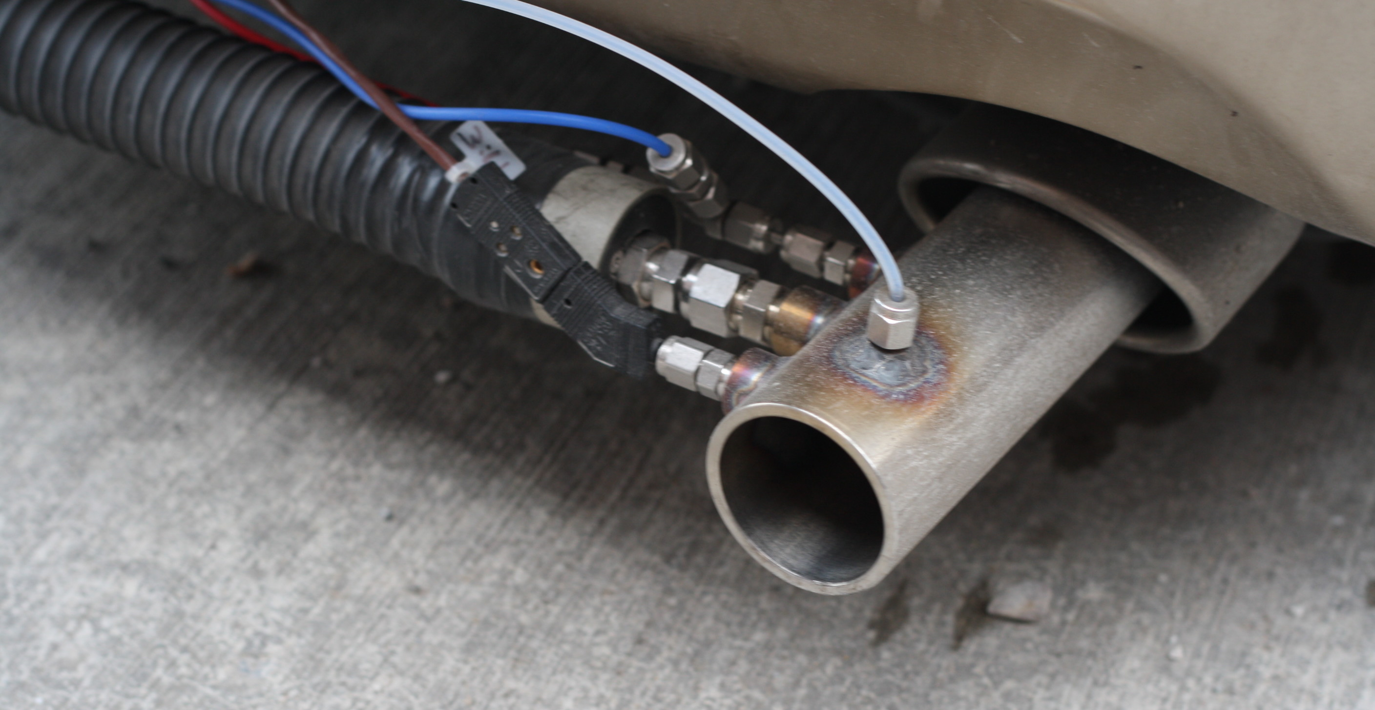
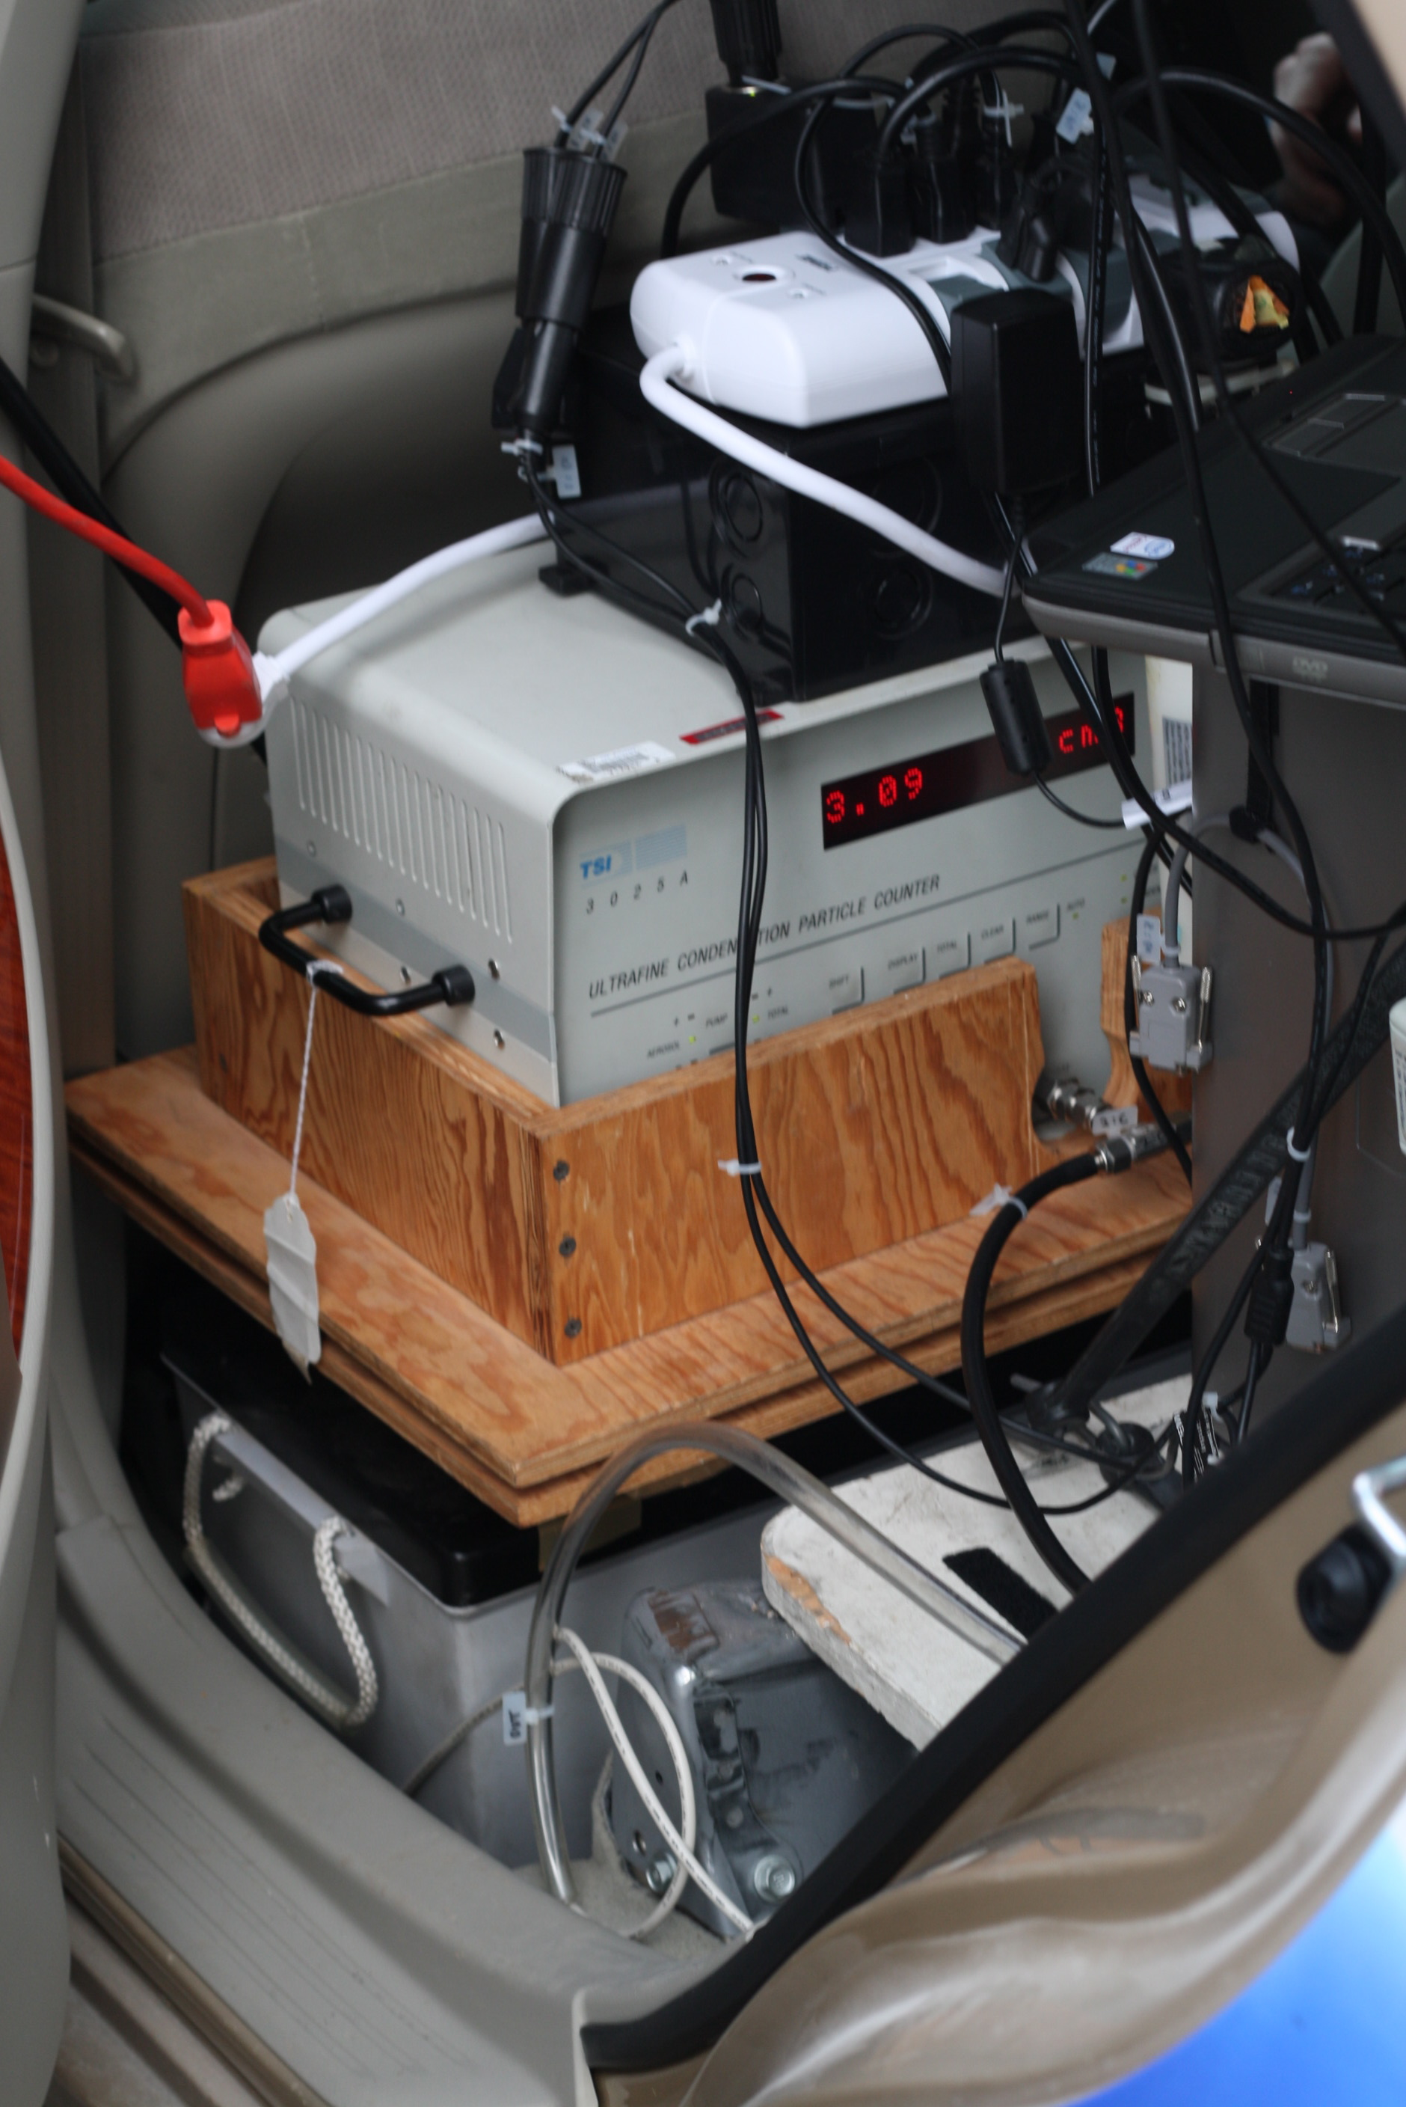
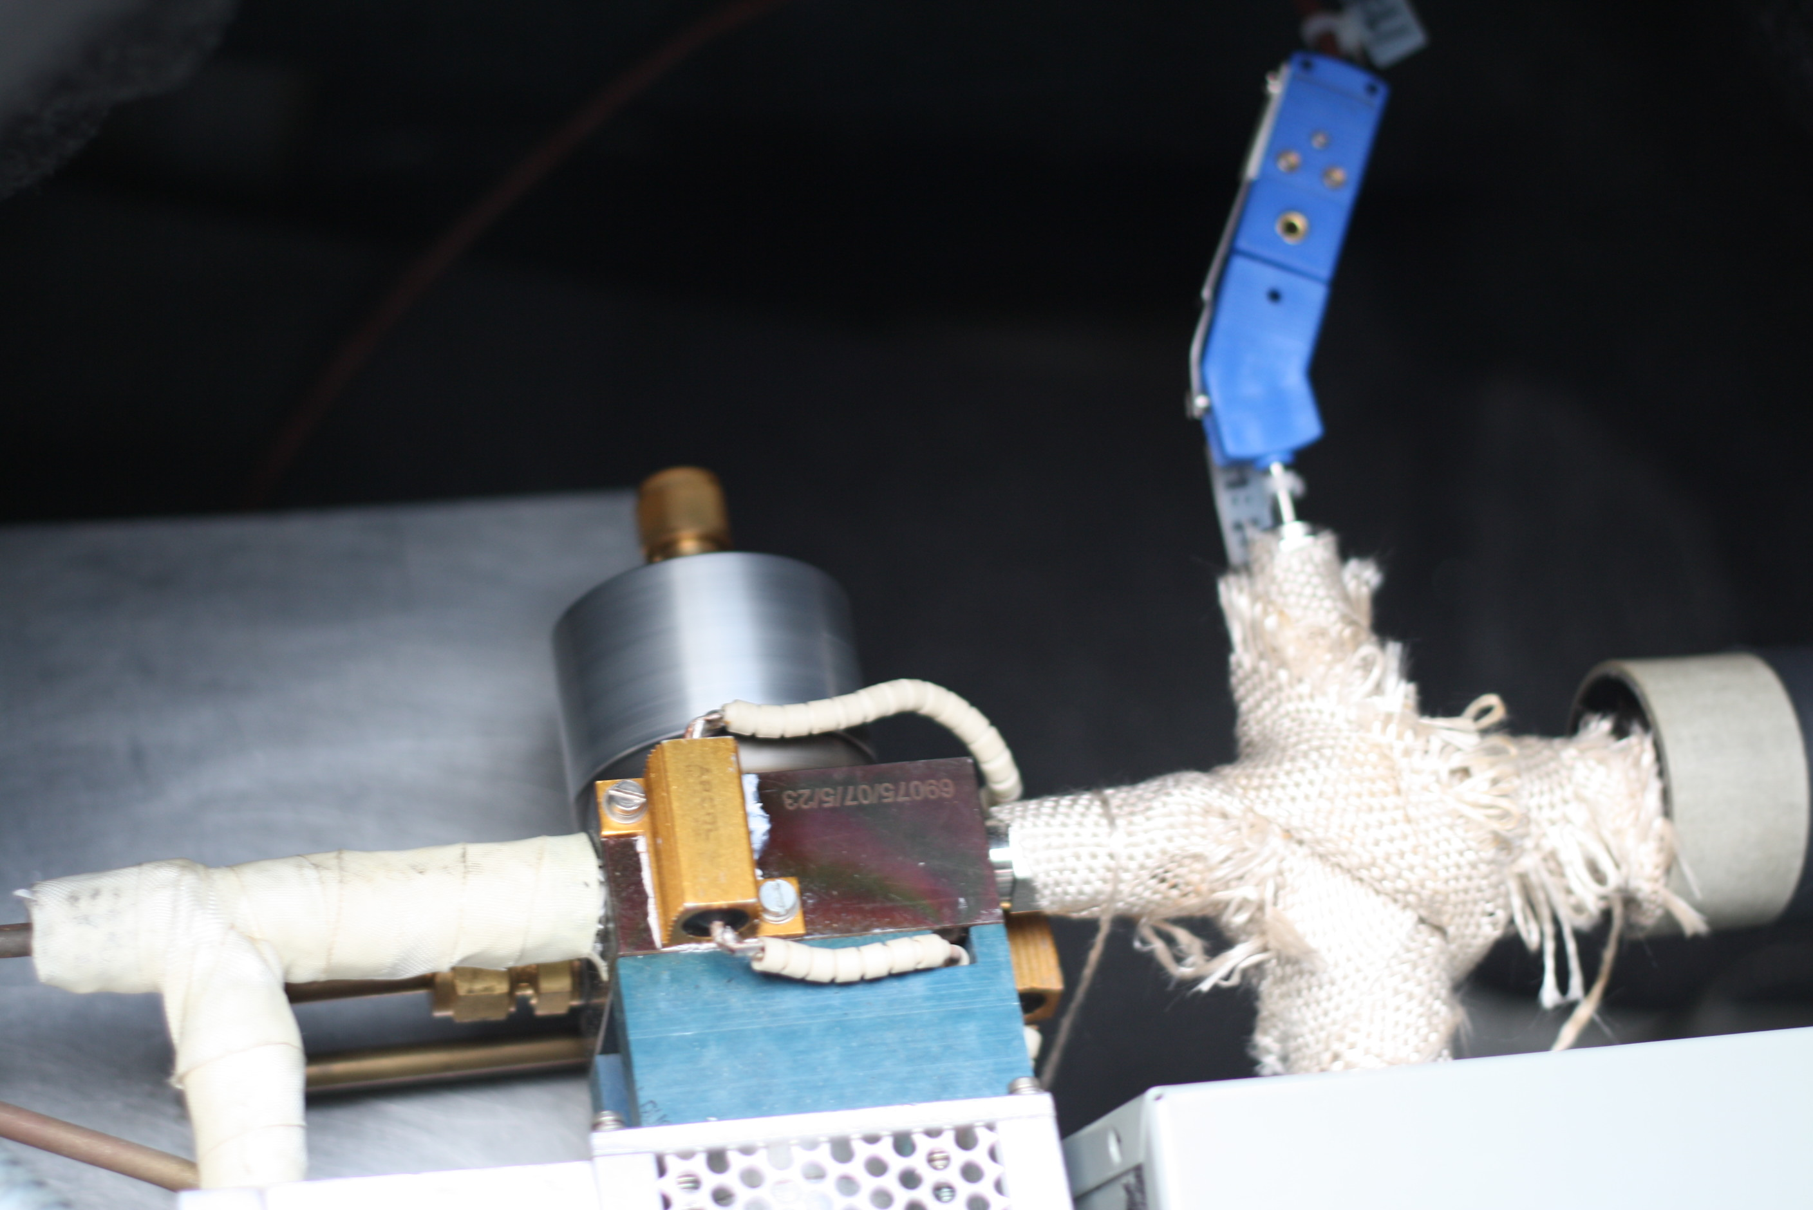
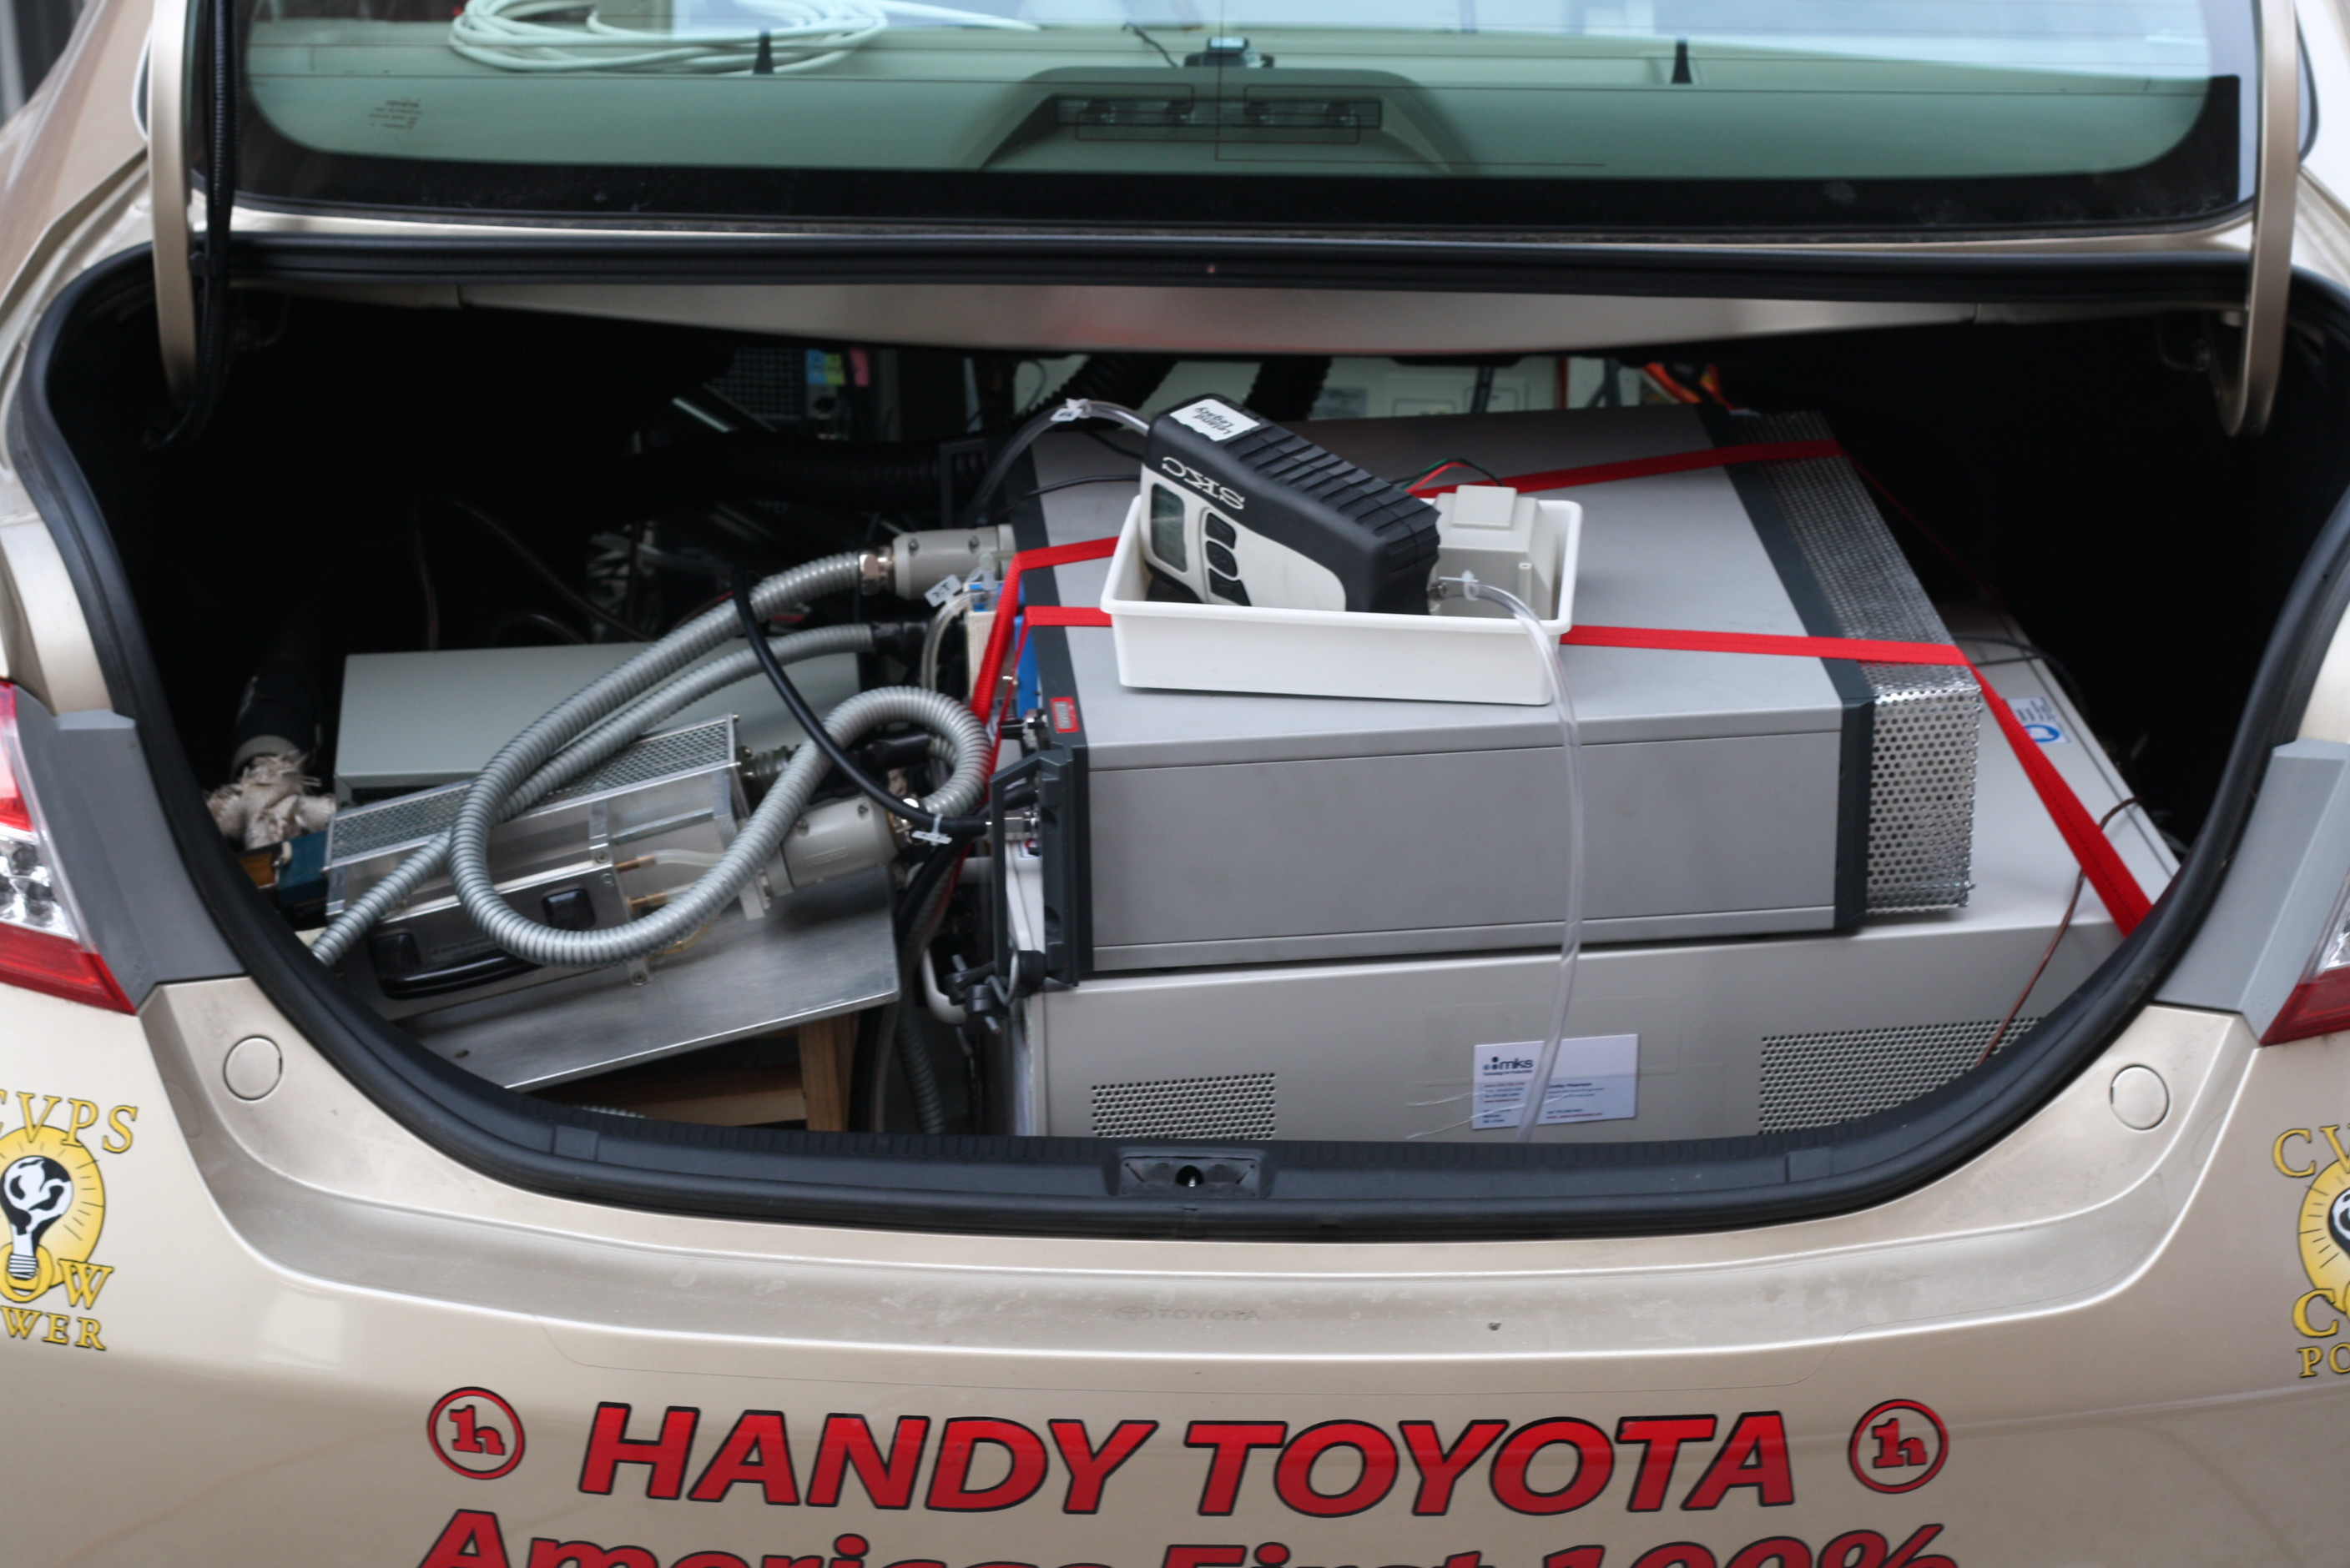
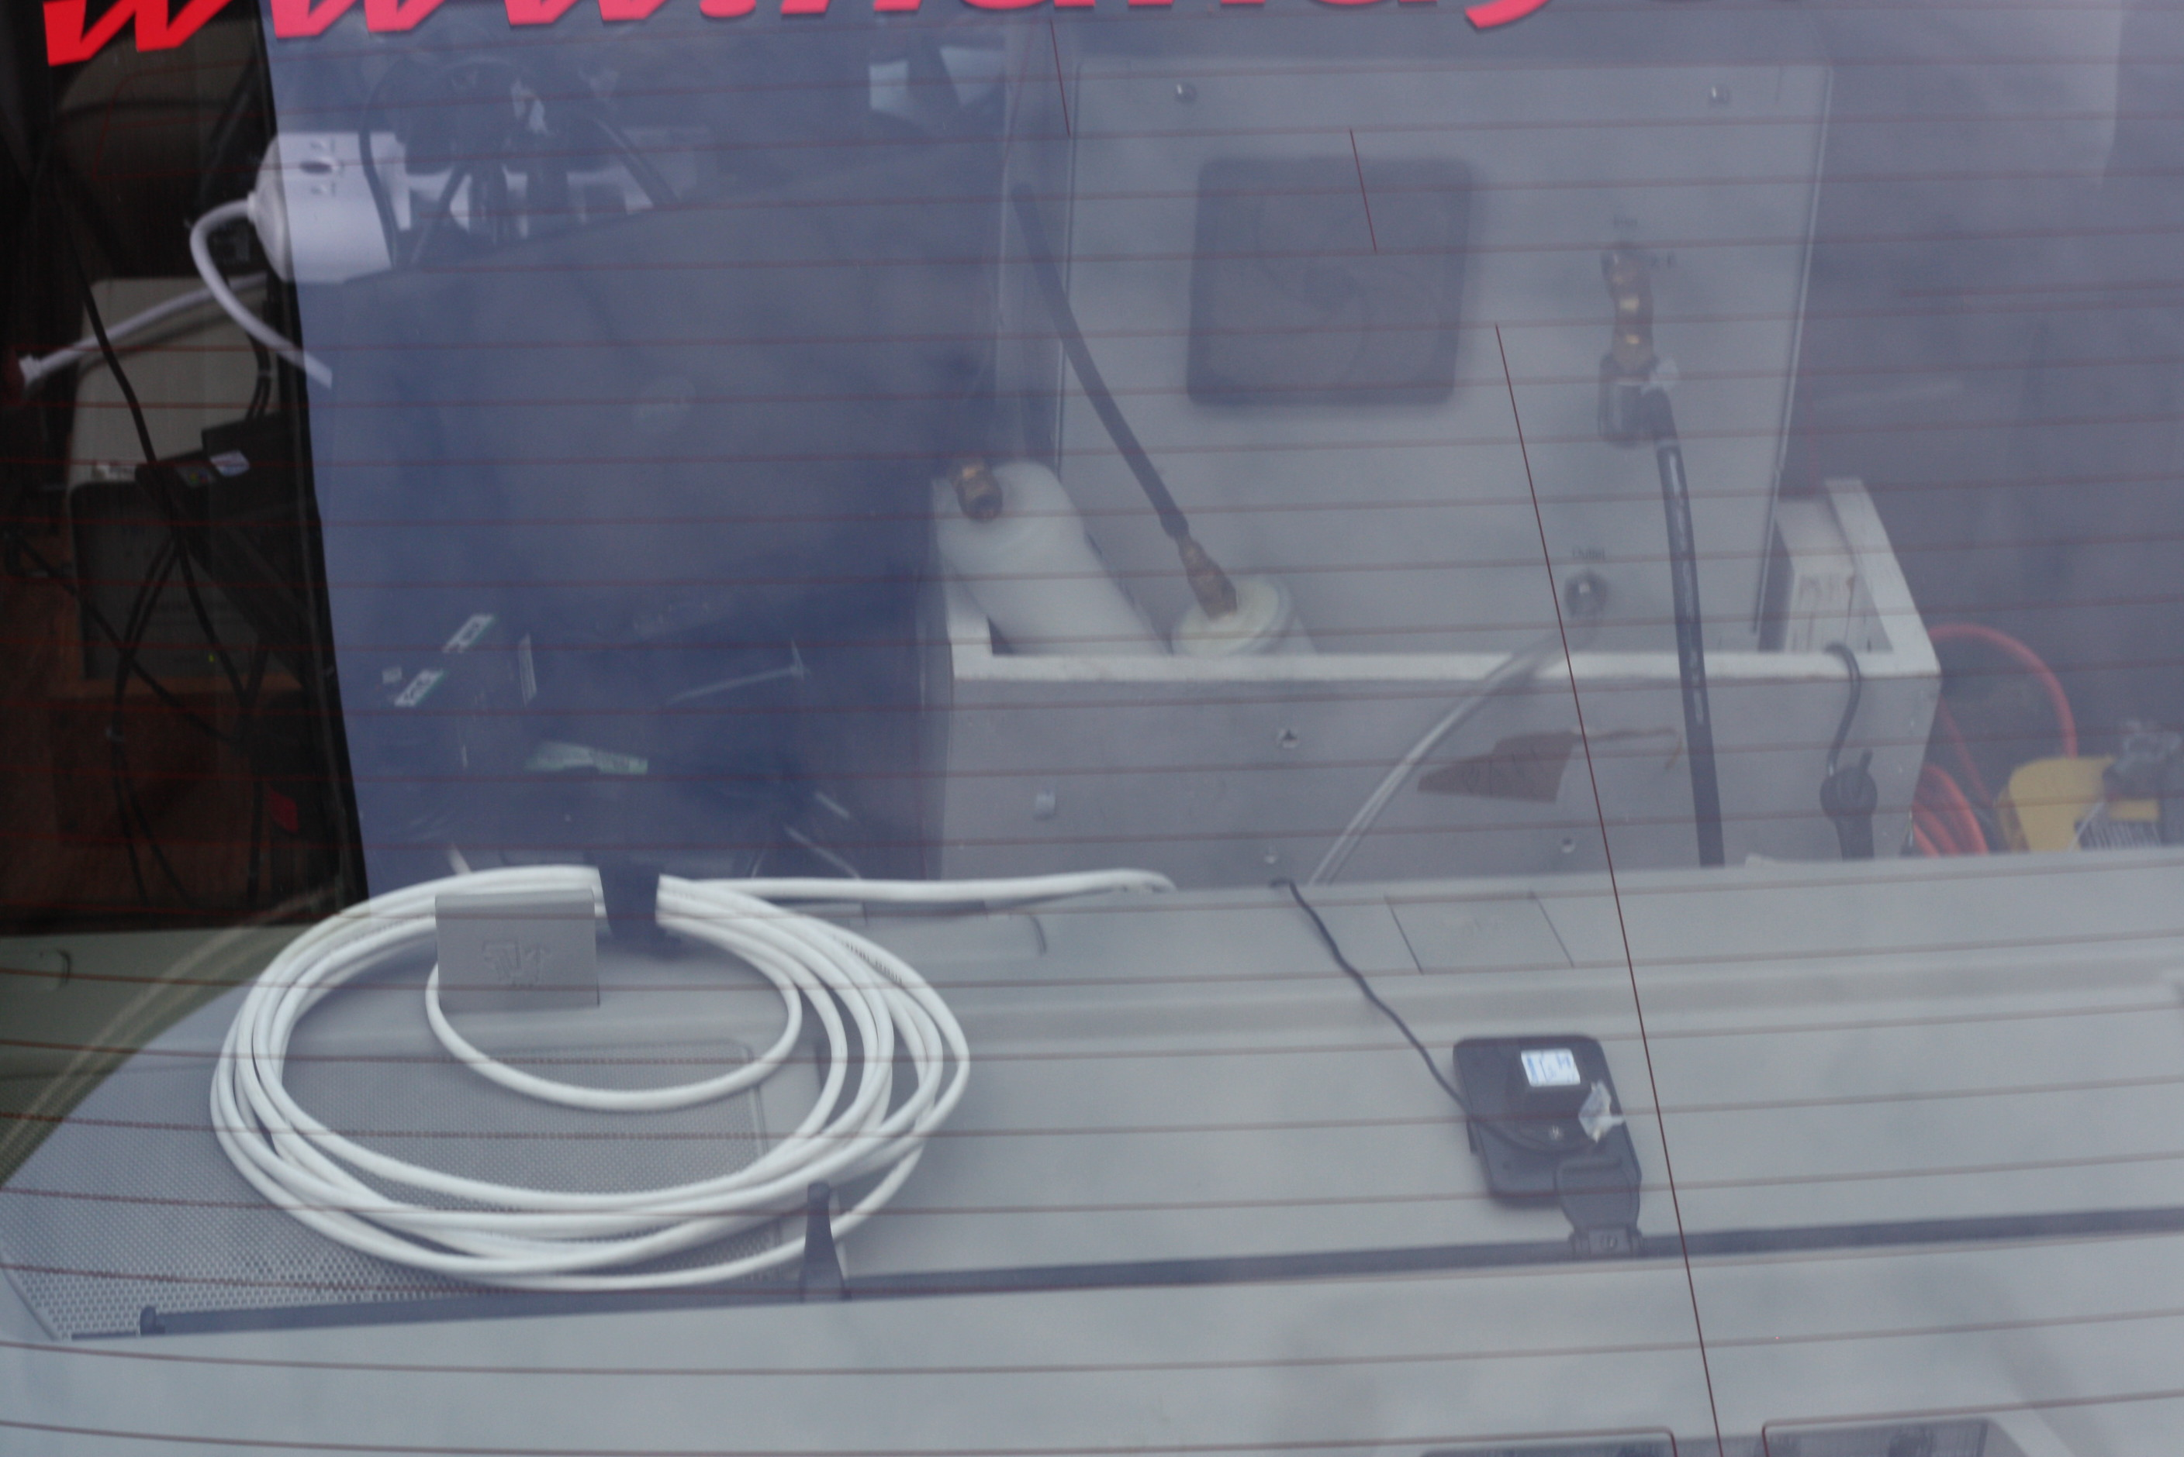
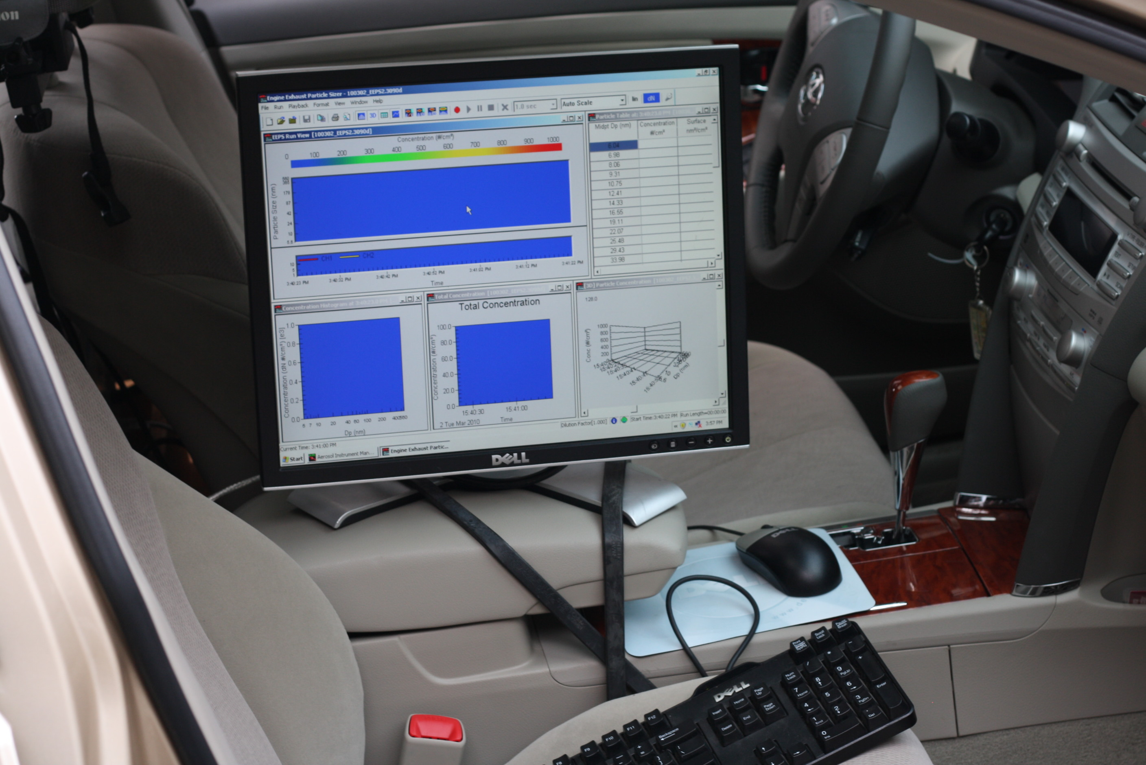
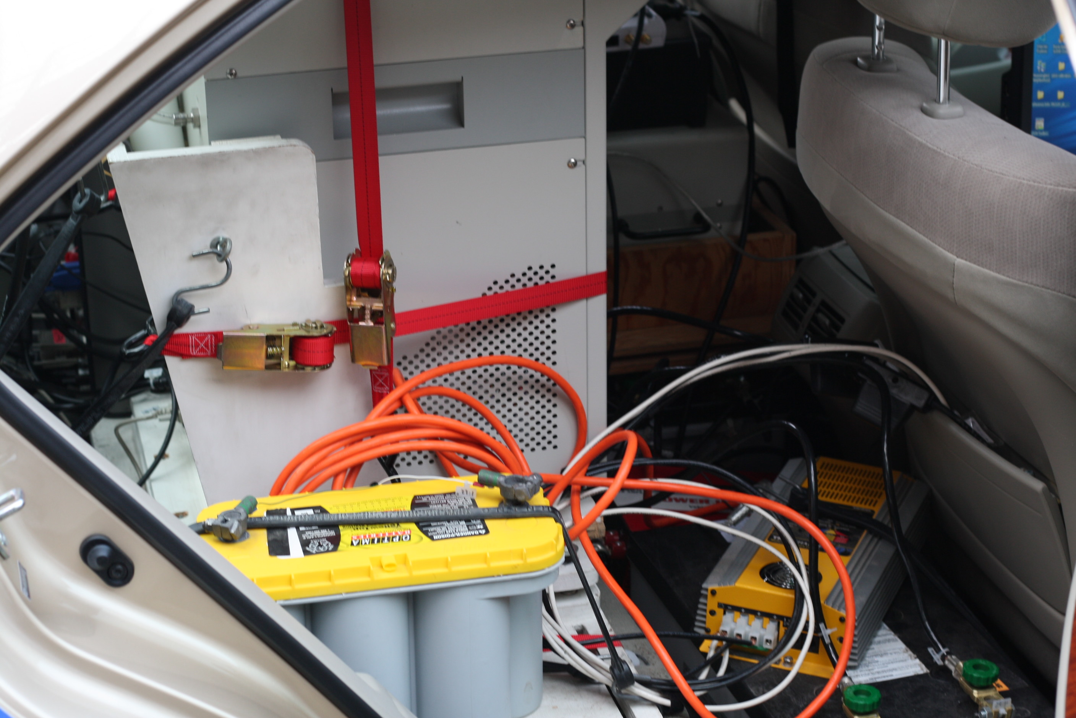

TOTEMS Instruments

Slide 13
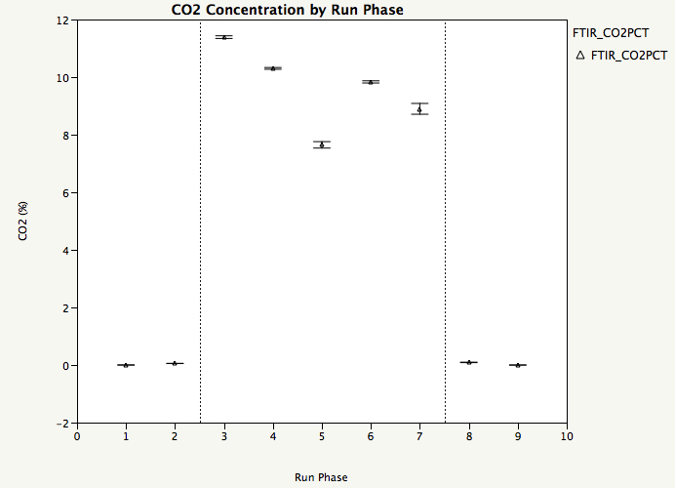
Full Test Sequence
Post-Run
Blanks
Pre-Run
Blanks
Warm-Up
Outbound Run
Park and Ride
Inbound Run
Post-Run Driving

Slide 14
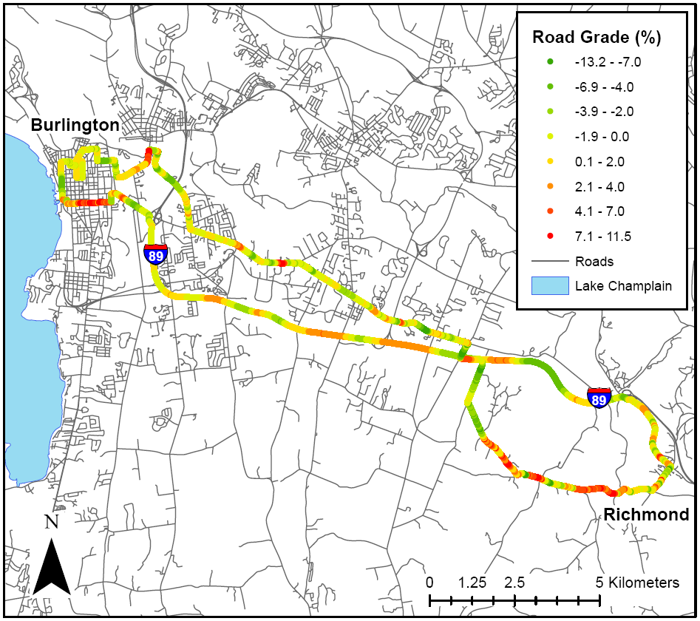
Route with Road Grade
Grade
Range:
-13.2 %
to
+ 11.5 %
ARAN Data (VTrans)
~ 0.002 mi
0.1% res
K. Sentoff (2012)
Notes:
Vermont Agency of Transportation ARAN (Automatic Road Analyzer) van – drove route to obtain road grade every 0.002 miles (= 10.56 feet!). (to 0.1% grade resolution)

Slide 15
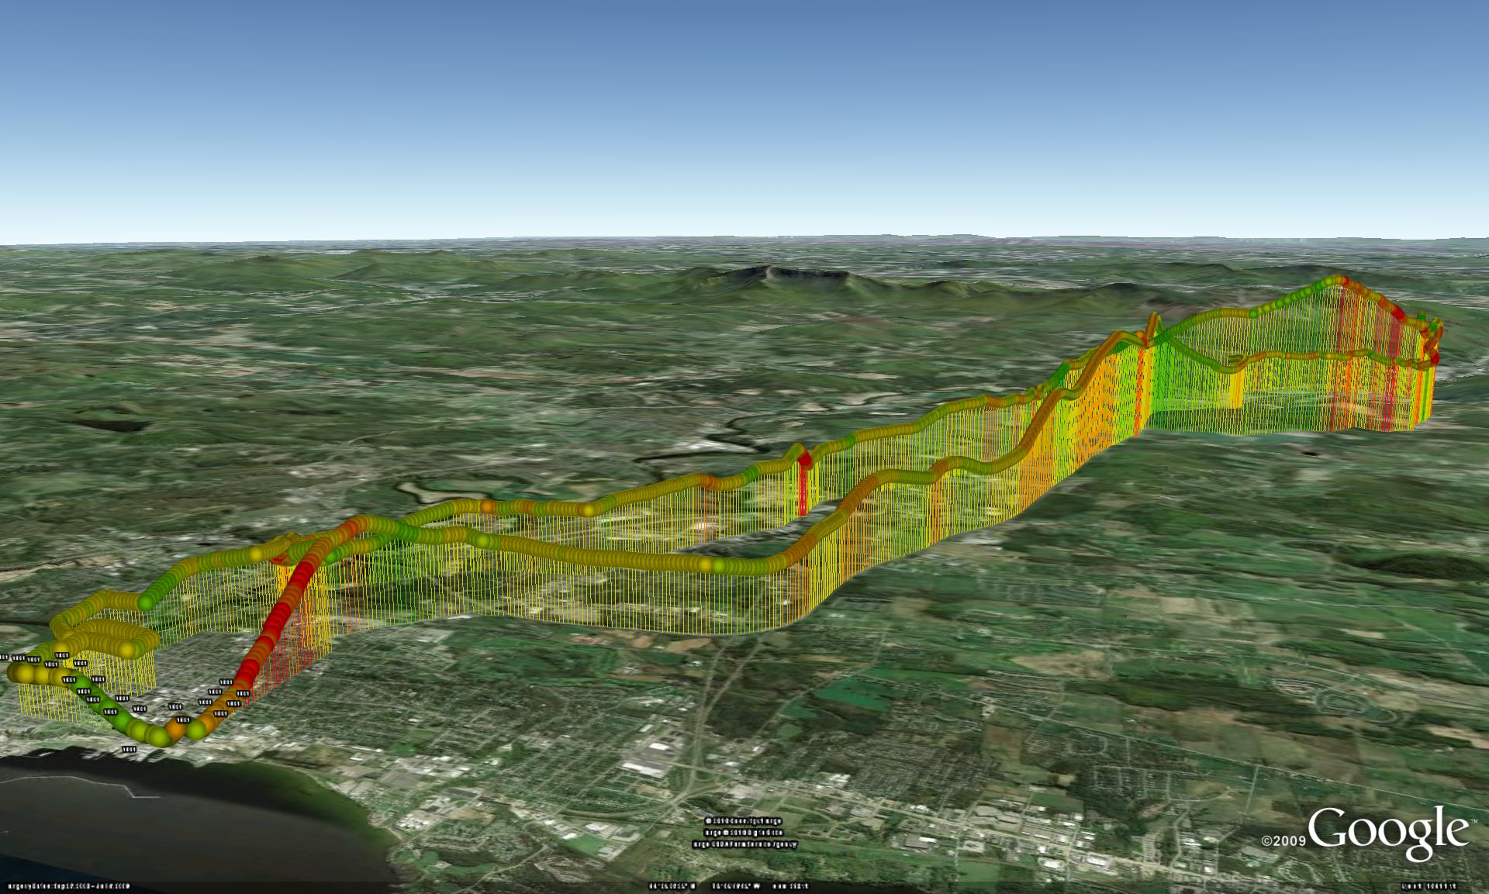
Color = Grade; Height = Elevation
uphill
flat
downhill
Kevin Hathaway, 2010

Slide 16

TOTEMS RESULTS
* Vehicle Activity
* Fuel Economy
* Emissions
CO₂, PN

Slide 17
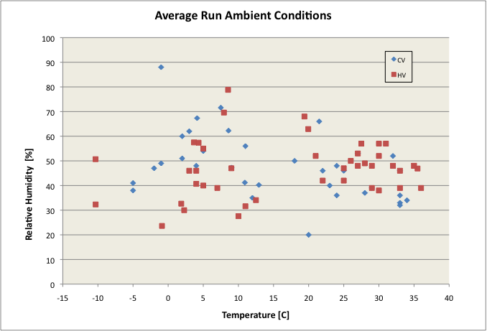
Camry Test Conditions
COLD < 5 C
COOL 5 - 22
WARM
HOT > 29 C
Notes:
Temperature range over study was -13C to + 35.2C

Slide 18
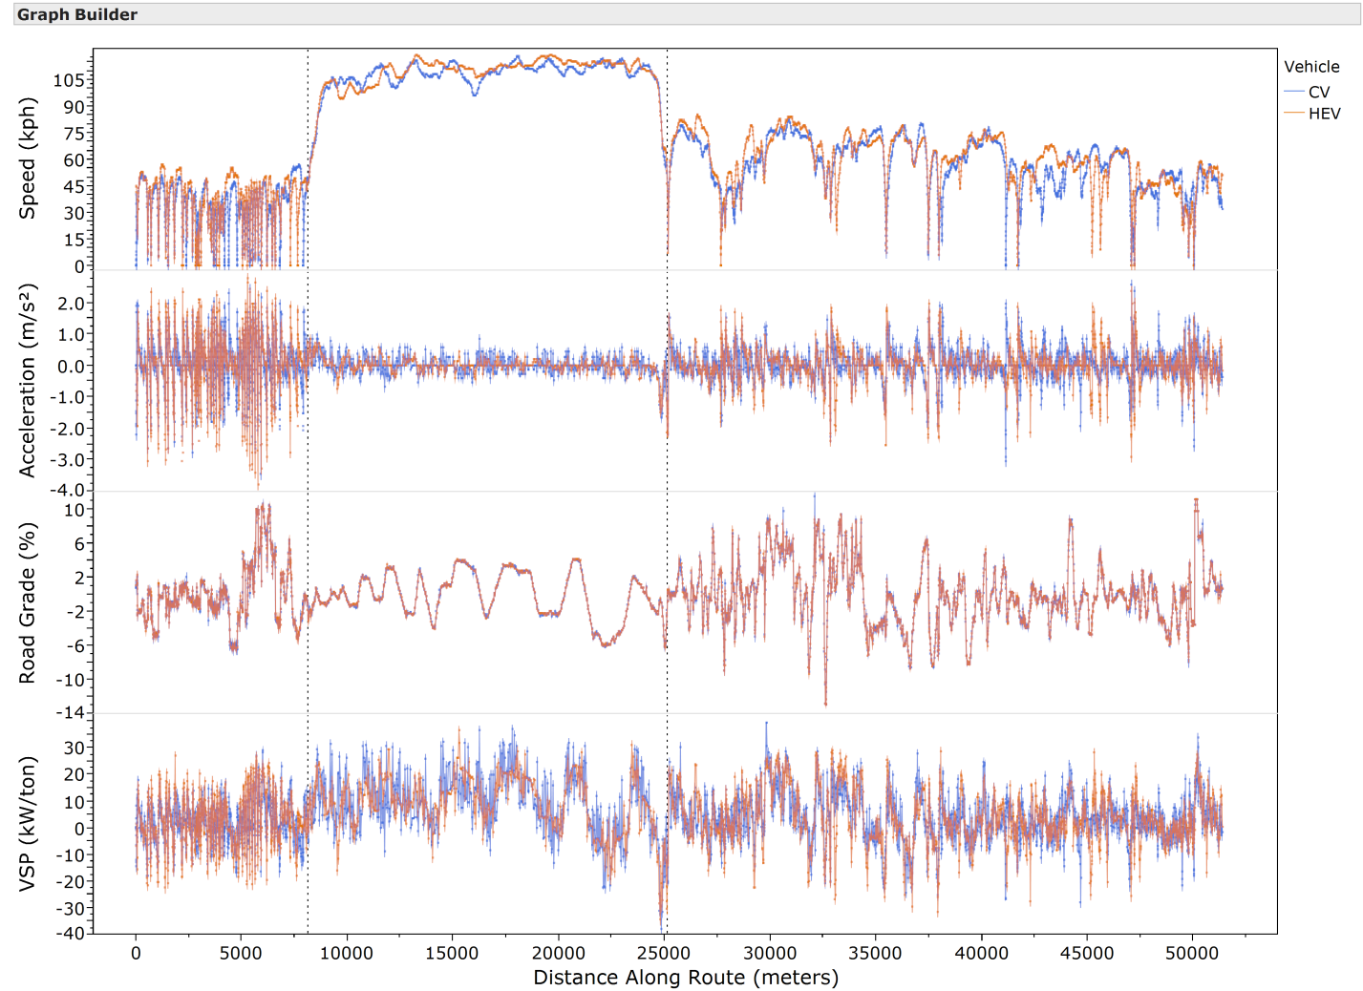
CV,HEV Activity was Similar

Slide 19
CV,HEV: Comparable VSP over Full Route
Notes:
While VSP distributions are similar, should note that VSP cannot quantify the ICE-off behavior that “benefits” the HEV

Slide 20
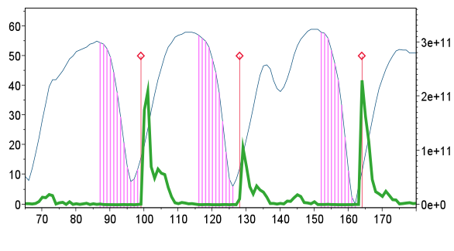
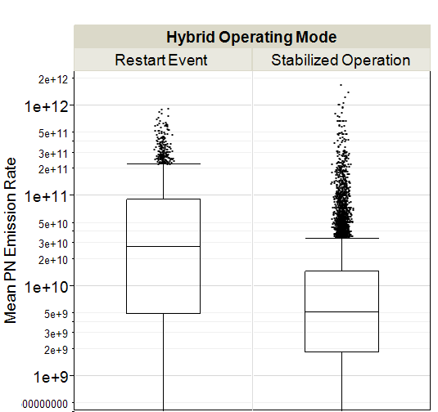
Restarts Particle Number Emissions
Pink = ICE-OFF events
Speed (km/h)
PN Emission Rate (#/s)
Time (sec)
Speed (kph)
PN Emission Rate (#/s)
Notes:
From Conger 2012 TRB poster
Addition of Speed trace here shows ICE turns off on decelerations (low speed, coming to stop) and RED DIAMONDS show ICE “restarts” are associated with HUGE peaks in PN Emission Rate (GREEN LINE).
NOTE – speed is kilometers per hour.

Slide 21
CO₂ Emission Rate
HEV behaves more like CV at VSP >21 kW/ton
VSP Bins (kW/ton)
Notes:
30.8 mpg for hybrid; 22.9 mpg for Conventional.

Slide 22
CO₂ Emissions Rate Ratio
CV up to 6.4x higher emissions (at VSP=0)

Slide 23
CO₂ Emissions Rate Ratio
By Road Type, HEV “benefit” even higher
 | City | Arterial | Highway
Range | 0.7 - 12.7 | 1.0 - 6.1 | 0.7 - 3.3
Mean (sd) | 4.5 (3.8) | 2.7 (1.5) | 1.6 (0.6)

Slide 24
Fuel Consumption
Difference at Pump (gal over run)
OBD-II Fuel Injector data (CV-only)
Carbon Balance Calculation from Gas-speciation

Slide 25
Fuel Economy– Full Run (pump)
Hybrid 23-30% higher MPG than CV
Trends with Temp
Notes:
30.8 mpg for hybrid; 22.9 mpg for Conventional.

Slide 26
Fuel Consumption (C Balance)
HEV behaves like CV at VSP >21 kW/ton

Slide 27
Particle Number Emission Rate
There is a low (+)VSP range where HEV > CV
VSP Bins (kW/ton)
Notes:
30.8 mpg for hybrid; 22.9 mpg for Conventional.

Slide 28
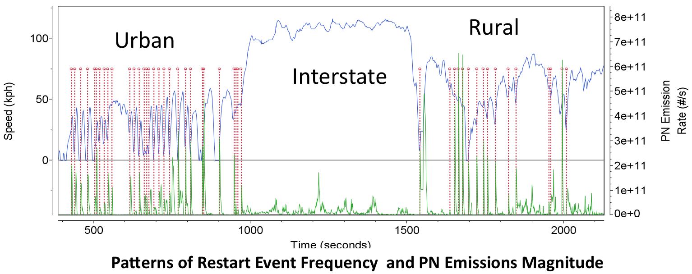
HEV Restarts
Restart event frequency varies with road type
Restart PN events of variable magnitude & duration
Conger et al. (2012; TRB)

Slide 29
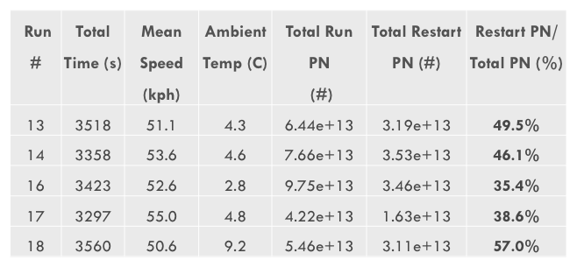
HEV: Restart/ Run PN
Notes:
The magnitude of the Restart Emissions for 5 Hybrid Runs is shown in this table. Cumulative Restart emissions comprise 35 to 57% of the TOTAL RUN PARTICLE NUMBER!!!

Slide 30
Mean PN Distributions
 | City
ICE-off | 56%
Restart | 26%
Stable | 17%
 | Arterial
ICE-off | 43%
Restart | 22%
Stable | 35%
 | Highway
ICE-off | 4%
Restart | 2%
Stable | 94%
Notes:
30 to 70 nm restart PN concentrations are 5 to 10 times higher than STABLE HEV and CV on City and Arterial, but overlaps with CV on Highway
Stable HEV lower than restart HEV (all roads)
Stable HEV ~ CV (City & Arterial)
Restart HEV ~ CV (Highway where little ICE-off)
Restart high 30-70 nm emissions possibly due to:
lower exhaust & catalyst temperatures
“quick start” fuel management strategies

Slide 31
Summary
On-Board Sampling Lessons
  Real-World Vehicle Behavior & Relevance
    Incorporates Actual Road Grade
  Data Alignment and Validation Critical
  Scantool “friendliness” issue
    Types of parameters that can log (Engine + HEV)
    Resolution of data (sig figs and temporal)
  New SULEV gases hard to detect
  TOTEMS not so “portable”, study limited to 2 vehicles, but quantified unregulated pollutant species

Slide 32
Summary 2
HEV vs. CV Performance
  CO₂ & Fuel Consumption benefits of HEV track with ICE-off frequency
    23-30 % improved Fuel Economy over run (pump)
    CO₂ and FCR CV/HEV ratio 0.9 to 6.4 by VSP bin
    “Benefit” magnitude & variability by VSP bin depends on road type:
      City > Arterial > Highway
 | City | Arterial | Highway | Full Route
Range | 0.7 - 12.7 | 1.0 - 6.1 | 0.7 - 3.3 | 0.9 – 6.4
Mean (sd) | 4.5 (3.8) | 2.7 (1.5) | 1.6 (0.6)
Notes:
Restart is like a less-intense Cold Start (2.3x lower TPN)
“Benefit” calculated as Erate Ratio of CV/HEV…

Slide 33
Summary 3
HEV vs. CV Performance
  2. “Restart” PN Emissions for HEV:
    35-57% of total run emissions occur on Restarts
    PN Distributions:
      Restart HEV >> Stable HEV
        Stable HEV ~ CV (City & Arterial)
      Restart HEV ~ CV (Highway – where little ICE-off)
      Restart high 30-70 nm emissions possibly due to:
        lower exhaust & catalyst temperatures
        “quick start” fuel management strategies
  3. We did not see significant Temp effect
Notes:
Restart is like a less-intense Cold Start (2.3x lower TPN)

Slide 34
Questions?
Many thanks to the dedication and hard work of HolmenGroup students and the USDOT and UVM Transportation Research Center for research funding.

Slide 35
References
Christenson, M.; Loiselle, A.; Karman, D.; Graham, L. A. The Effect of Driving Conditions and Ambient Temperature on Light Duty Gasoline-Electric Hybrid Vehicles (2): Fuel Consumption and Gaseous Pollutant Emission Rates; 2007-01-2137; SAE International: Warrendale, PA, 2007.
Fontaras, G.; Pistikopoulos, P.; Samaras, Z. Experimental evaluation of hybrid vehicle fuel economy and pollutant emissions over real-world simulation driving cycles. Atmospheric Environment 2008, 42, 4023–4035.
Reyes, F.; Grutter, M.; Jazcilevich, A.; González-Oropeza, R. Tecnical Note: Analysis of non-regulated vehicular emissions by extractive FTIR spectrometry: tests on a hybrid car in Mexico City. Atmospheric Chemistry and Physics 2006, 6, 5339–5346.
Robinson, M.; Holmén, B. A. Onboard, Real-World Second-by-Second Particle Number Emissions from 2010 Hybrid and Comparable Conventional Vehicles. Transportation Research Record: Journal of the Transportation Research Board 2011, 2233, 63–71.
Robinson, M.; Sentoff, K.; Holmén, B. A. Particle Number and Size Distribution of Emissions During Light-Duty Vehicle Cold Start. Transportation Research Record: Journal of the Transportation Research Board 2010, 2158, 86–94.

Slide 37
TOTEMS Instruments

Slide 38
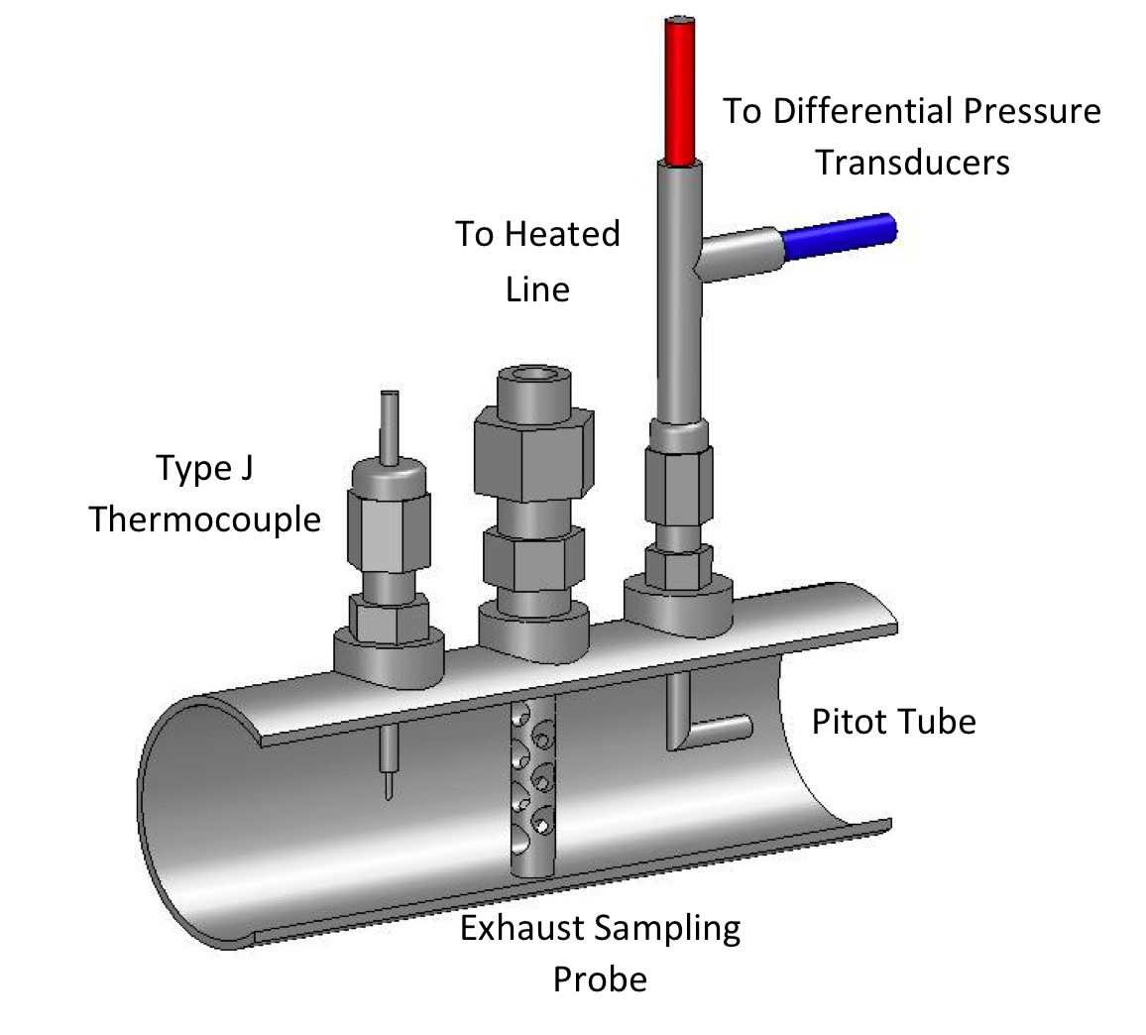
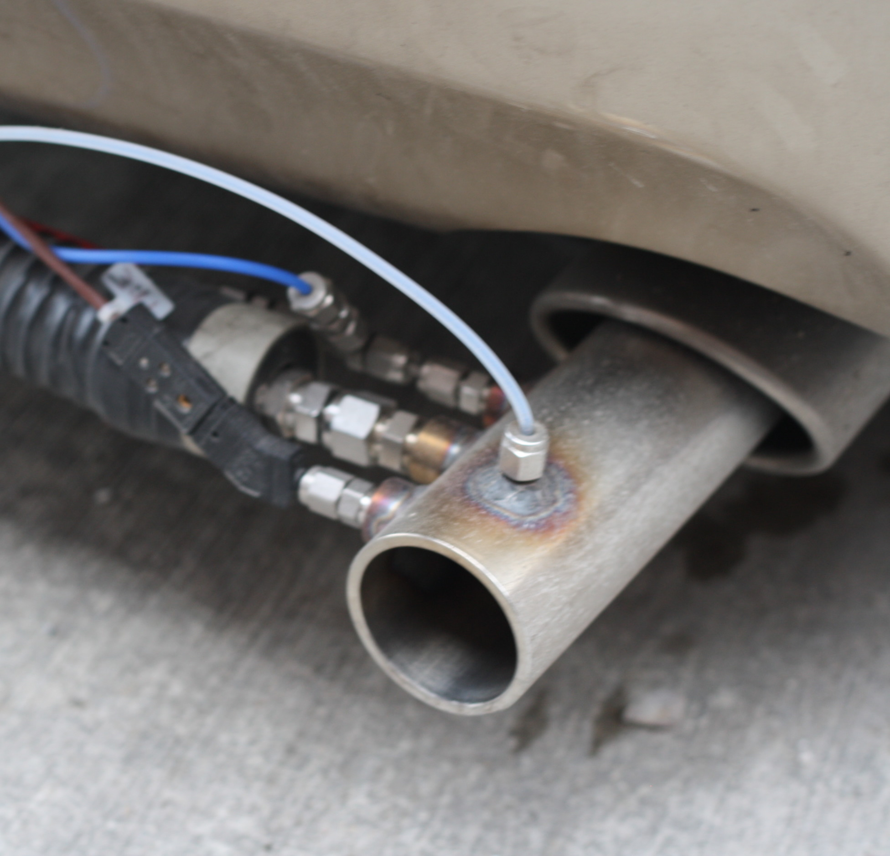
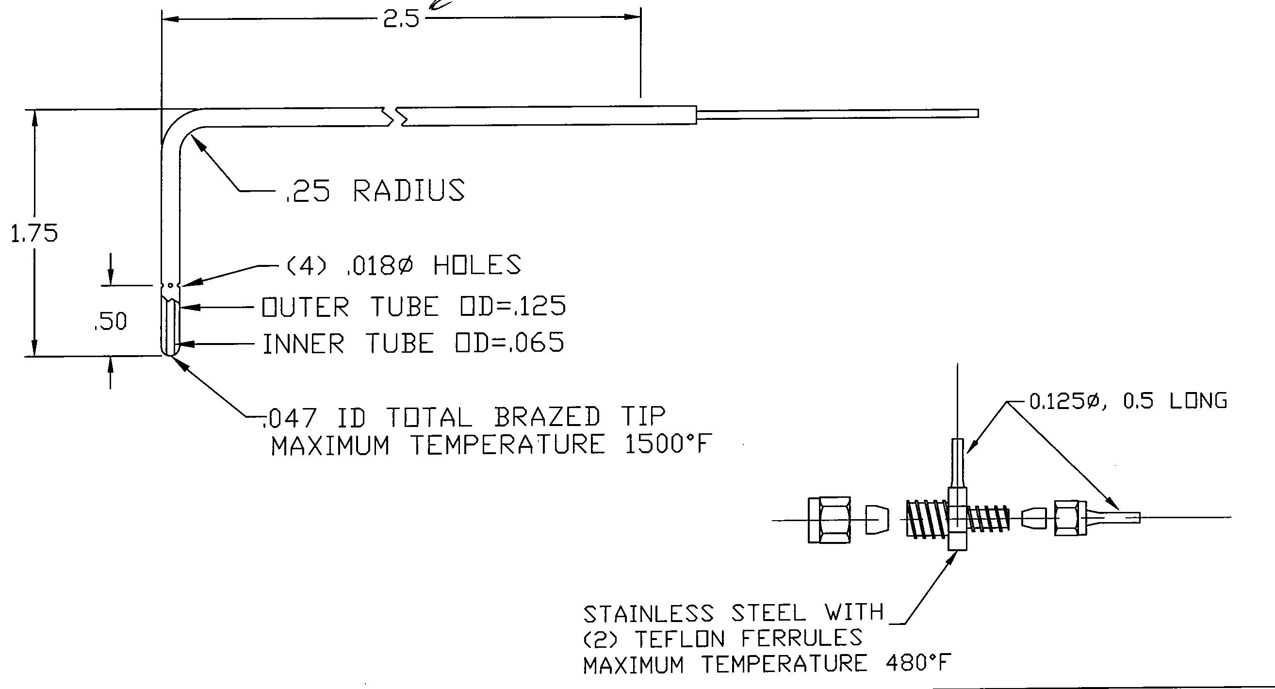
Heated Transfer Line
Tailpipe Adapter:
Pitot Tube for Q_{exh}
Thermocouple (T_{exh})
Sample Probe
Heated Transfer Line

Slide 39
Raw Data Handling Steps
Total test records (>500,000)
Lag-correct Data Alignment
  Pearson’s correlation
Validate data; omit by run “section”
  If >15% missing data
Blank subtraction from raw Conc
Temperature Correction – Q_{exh}
Compute Emission Rates [mg or #/sec]
Resulting Data Analysis Records (N):
  174,624 (57% HEV, 43% CV)

Slide 40
Emission Rate Calculation
ER = Emission Rate of Gas [mg/sec] or Particles [#/sec]
C = Blank-subtracted Gas Concentration [ppm or %]
Q_{TempAdjusted} = Temperature-Adjusted Tailpipe Flowrate [L/min]
MW_{gas} = Molecular Weight of Gas [g/mol]
P_{FTIR} = Pressure of Sample at Point of Analysis [atm]
R = Universal Gas Constant [L-atm/mol K]
T_{FTIR} = Temperature of Gas Sample at Point of Analysis [K]
X_{units} = Units Conversion Factor
For particles, similar, but multiply by additional Dilution Factor (=108)

Slide 41
Fuel Consumption Rate (FCR) Calculation
Carbon Content = 639.6 grams carbon/L gasoline
(adapted from EPA and 40 CFR 600.113-78)
E_{CO2}, E_{CO}, and E_{C3H8} = measured emission rates

Slide 42

Vehicle Specific Power (VSP)
  Forces vehicle must overcome for forward propulsion during real- world driving
  [kW/ton]
  VSP Calculation:
Vehicle Specific Power
(Adapted from Jimenez, 1999)
F_{Aerodynamic}
Mass * Acceleration
F_{Rolling}
Mass * g * sin(Grade)
Kinetic
VSP_{K}
Potential
VSP_{P}
Rolling Resistance
VSP_{R}
Drag
VSP_{D}
Notes:
Assumed constants for passenger cars, per Jimenez (1999) [MIT thesis]

Slide 43
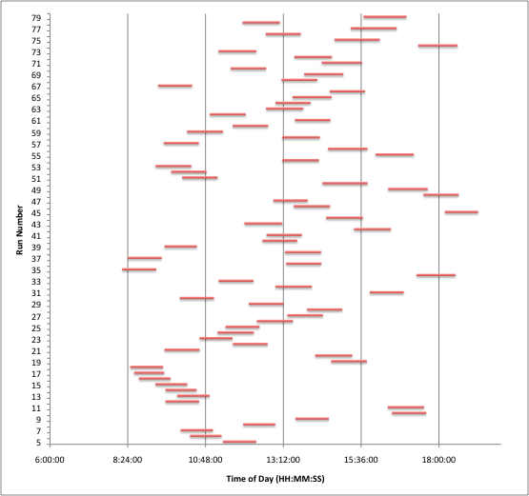
TOTEMS Runs: time of day
Notes:
Particle Diameter ~ Health Effects

Slide 44
HEV City Driving
Accelerate away from a stop:
Increase in CO₂
Increase in VSP
Engine Restart
Drop in MPG
Burst of particles
Notes:
Arrows and text are animated

Slide 45
Route Road Grade by Facility
Notes:
30.8 mpg for hybrid; 22.9 mpg for Conventional.

Slide 46
Route Activity Like Drive Cycles

Slide 47
Mean PN Distributions

Slide 48
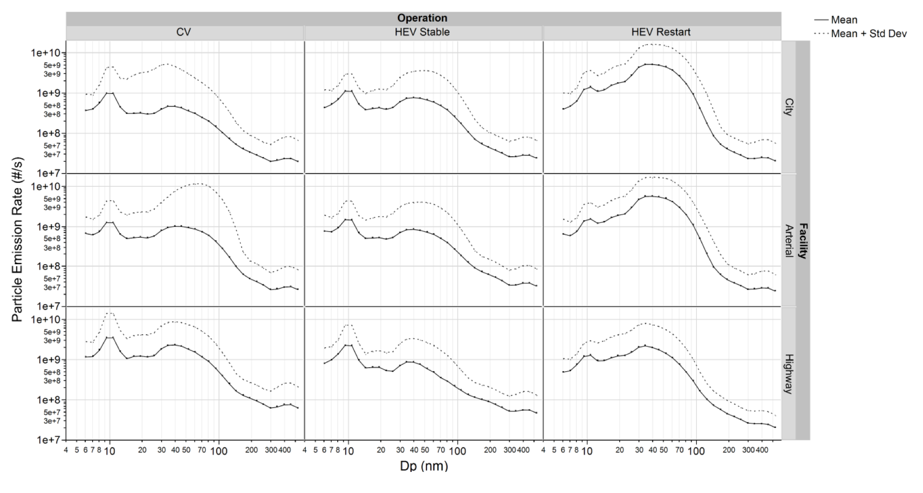
PN Distributions

Slide 49
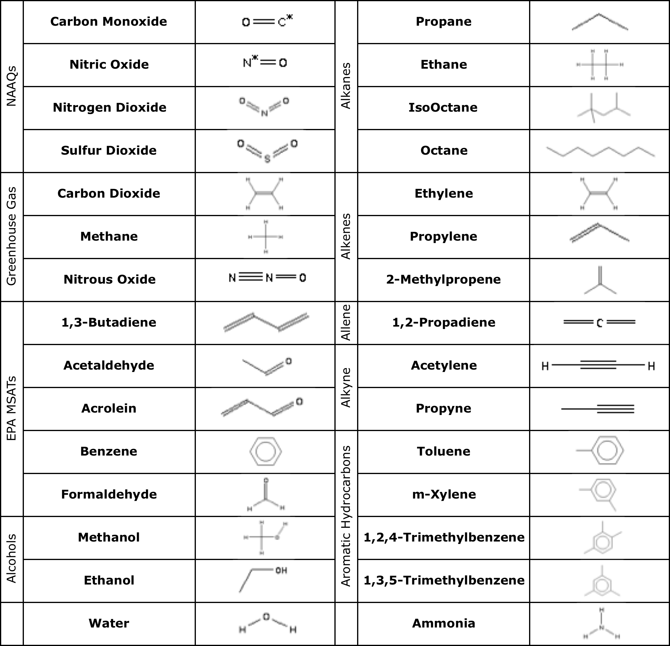
MKS MultiGas
FTIR Gasoline Emissions Method
30 gas species
@ 1 Hz

Slide 50
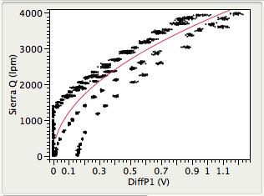
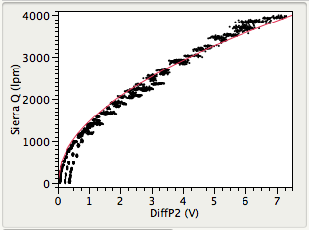
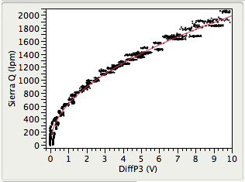
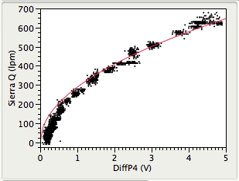
Converting Pressure to Flow with Pitot Calibration Curves
Differential Pressure Sensor 1 (High Flow Range)
Differential Pressure Sensor 2 (Mid-High Flow Range)
Differential Pressure Sensor 3 (Low-Mid Flow Range)
Differential Pressure Sensor 4 (Low Flow Range)
Notes:
--global pitot calibration with 8 calibration events throughout the data collection process

Slide 51
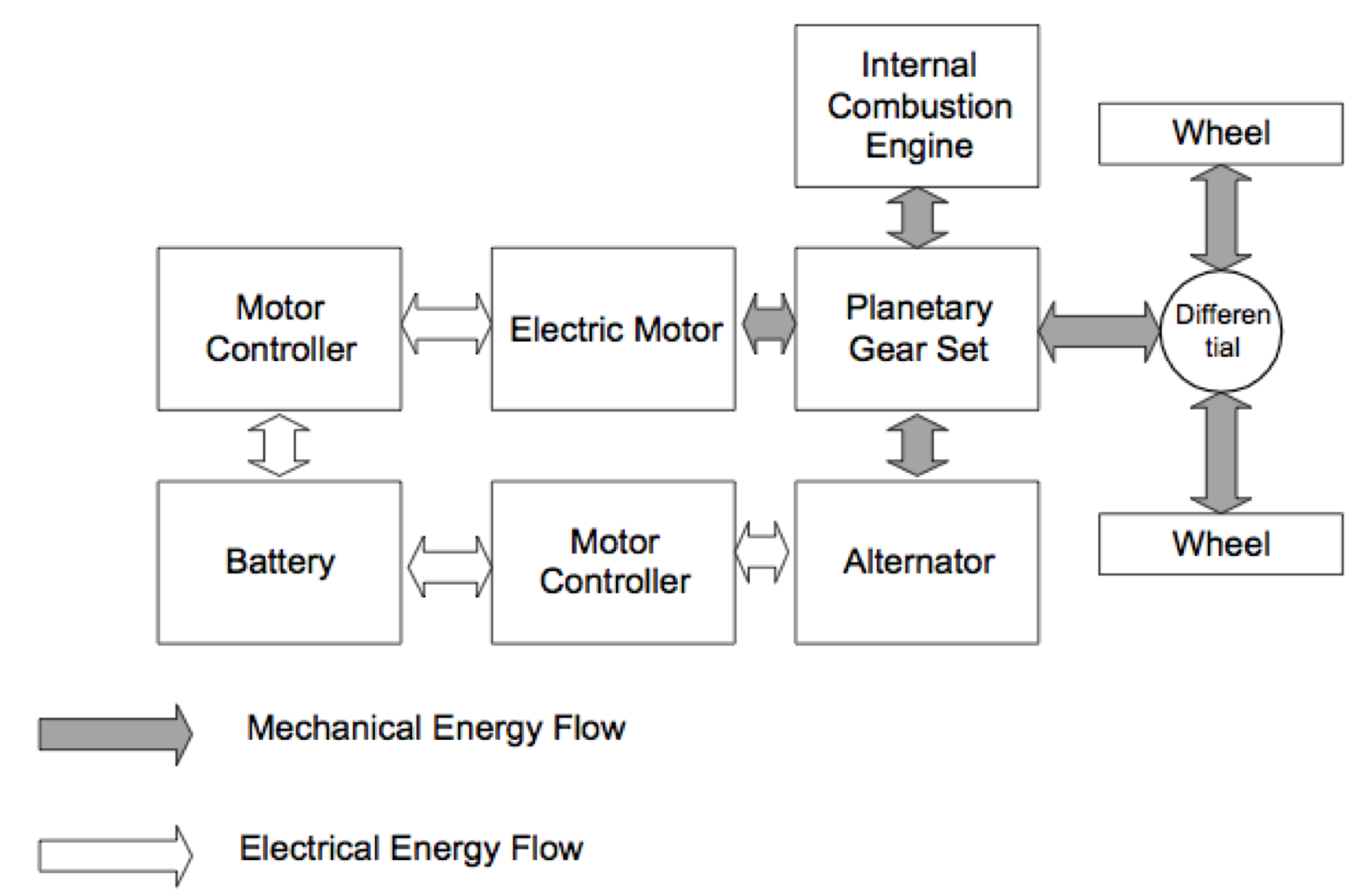
Hybrid Design = Less Fuel Use
ICE-off mode
Electric-Assist
Regenerative Braking
Toyota “Hybrid Synergy Drive” --- a series-parallel hybrid
Adapted from Toth-Nagy, C. (2004) West Virginia University.
Notes:
Hybrids achieve Better FE (miles/gal) because an electric motor can propel the vehicle Without the ICE under SOME operating conditions. Battery is also “recharged” during braking.
There are “Full” and “mild” versions of HEV.
We study FULL – Toyota Synergy Drive --- used by FORD too. “series-parallel” design

Slide 52
No Temperature Trend – HEV Engine-Off
Notes:
30.8 mpg for hybrid; 22.9 mpg for Conventional.

Slide 53
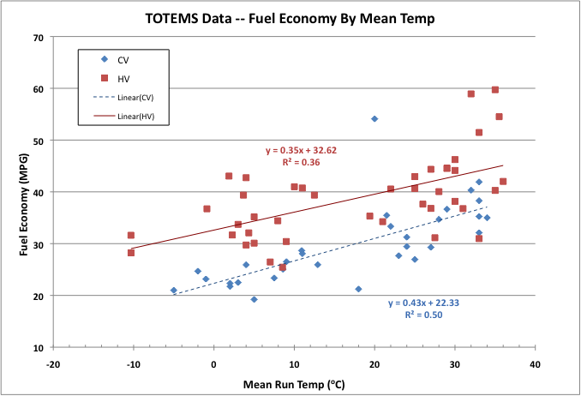
MPG & Ambient Temp.
Mean (sd):HV = 38.2 (7.7) CV = 29.3 (7.3) MPG
HV more scatter and less T-sensitive than CV
Notes:
30.8 mpg for hybrid; 22.9 mpg for Conventional.

Slide 54
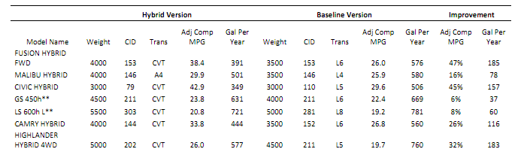
EPA Fuel Economy for Hybrids
Our Real-world Fuel Economy Comparison (23 – 30%) Agrees with EPA Estimates (26%)
26%
EPA, 2010

Slide 55
Emissions by VSP bin

Slide 56
Detection Limits and Blank Correction of Raw Data
Notes:
Very conservative approach – all data were blank corrected:
GASES – Pre and Post-Run TBs means were used to define IDL
PN – Pre-Tunnel used only

Slide 57
Hybrid ICE-Off / Restart Concerns
Idle-stop fuel savings vs. fuel use during ICE Restart
Need good drivability via quick Restart
Minimize vibration & noise on Stop/Restart
Frequency ON/OFF ~ emission problems
  More transient = higher emissions
Yu et al. (2008)

Slide 58
Experimental Data on HEVs
Dynamometer Testing –
National Labs (not much published)
UK Real-world ? (No comparable CV)
Canada – Christenson et al. (2007)
‘Criteria’ Gases + Fuel Economy Focus
Notes:
Early studies of HEV emissions and performance were conducted on dynamometers, measured only criteria pollutants – CO, HC, NOx and fuel economy

