Slide 1
Developing Test Programs to Achieve Quality Results
James Warila, Carl Fulper, David Hawkins
USEPA National Vehicle & Fuel Emissions Laboratory
Ann Arbor, Michigan
2014 PEMS International Conference
April 3-4, 2014
Riverside, California

Slide 2
Quality is Demanding
“Quality” means
  Accuracy AND
  Representativeness
Measurement is Difficult and Expensive
  Vehicles and Engines are diverse
  Vehicles difficult to acquire or recruit
  Techniques detailed and expensive
  Emissions are highly variable
  Vehicles becoming very clean
Small fractions of “dirty” vehicles contribute much emissions
  But they are harder to find
PEMS, PAMS have much to contribute!

Slide 3
Start with the Objectives
Experiments
  suited to some questions
    Effect of temperature on emissions
    Effect of fuels on emissions
Fleet Surveys
  Needed to characterize fleets
  Needed to characterize “real world”
  Needed to get representative averages

Slide 4
What are the Right Tools?
Depends on Objectives
For Experiments
  Stick with laboratory?
    Better repeatability?
    Better experimental control?
  Can try PEMS?
    Less expensive?
    Less experimental control?
For Fleet Surveys
  Can use laboratory instruments
  PEMS, PAMS ideal
    Quicker
    Less expensive?
    Can take instruments to vehicle
    Incorporate real behavior
    Integrate external conditions

Slide 5
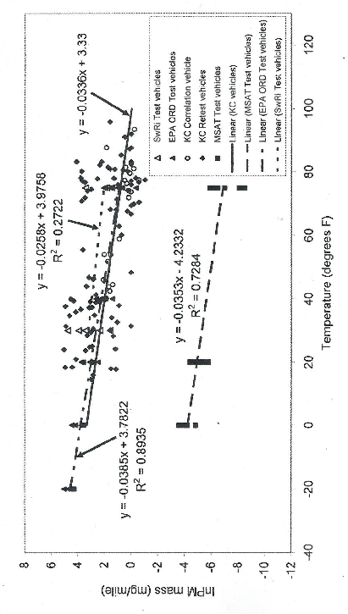
Survey and Experiment
Estimating Temperature Trends (PM)
Experiment
Fleet Survey
Experiment

Slide 6
What is “Good” Data?
Accuracy
  Instrument calibration, etc.
  Congruence of scale?
    Scale of phenomenon vs. scale of measurement?
Representativeness
  Is the vehicle sample representative?
    Critical for fleet surveys?
    Less important for experiments
  Is the behavior representative?
    Laboratory: is the test cycle representative?
Difficult to get both simultaneously

Slide 7
Measurement Accuracy
Calibrations
  Spans, audits, etc.
  Linearity of response, etc.
  Drift
Alignment of time series

Slide 8
Congruence of Scale
Scale of Phenomenon vs. Acquisition rate?
  We measure emissions @ ~1.0 Hz
  Do emissions occur at 1.0 Hz?
    Effects of lag, history, etc.
    Dilution, mixing in sample train
    Alignment of exhaust flow, analyzers, etc.
Scale of Phenomenon vs. Measurement Period
  How long to characterize the operation of a dozer?

Slide 9
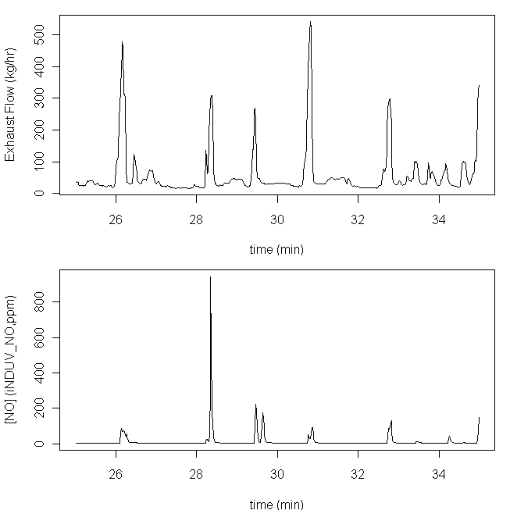
Exhaust Flow (kg/hr)
Are the time series aligned?
If YES, emissions response lags exhaust flow?
[NO] (ppm)
If NO, we need to re-align? How?

Slide 10
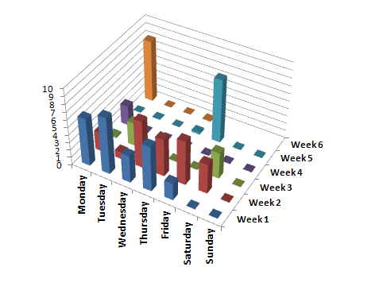
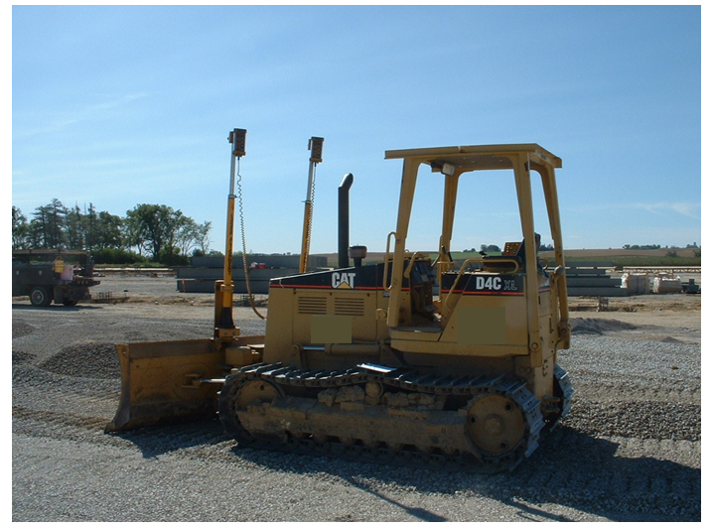
A Month in the Life of a Dozer
Hours of operation
by week and day
9/16-10/25, 2007
Are these typical weeks?
Is this a typical month?
<insert pic>
Can we project:
seasonal operation?
annual operation?

Slide 11
Representative Samples
Is the target population defined?
  May be effortless
  May be quite difficult
  Depends on objectives
How to sample the population?
  Sample and average across differences?
  Stratify and sample independently?

Slide 12
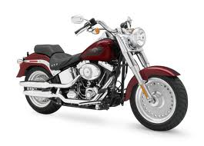
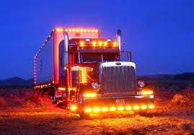

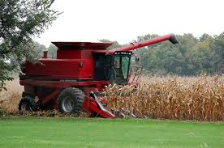

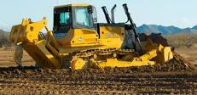
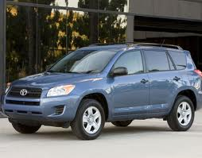
Defining Populations Can be Easy

Slide 13
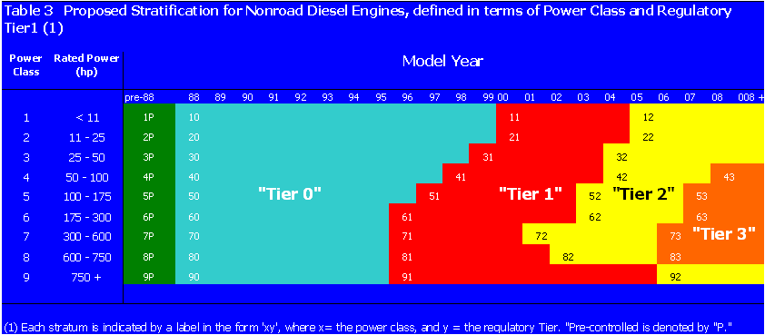
Defining Populations can be Hard
Example: Dozers
Simply seeking dozers? Easy
Seeking dozers in size range? Need rated power
Seeking dozers certified to Tier-2 Standard? Need rated power and MY

Slide 14
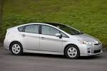
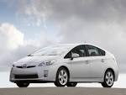
Distinguishing Populations can be Hard
Example: Gasoline-Electric hybrids
All Priuses look alike,
but are they the same?
Since 2004, Priuses certified to
Bin-3 standard, OR
SULEV standard
How distinguish?
Model year not enough
Need Engine Family

Slide 15
Sampling
Convenience Sample
  Acquire the vehicles that are handy
Judgment Sample
  Develop selection criteria
  Acquire “typical” examples
Probability Samples
  Select vehicles at known probabilities
    Equal
    Unequal
  Important for fleet surveys

Slide 16
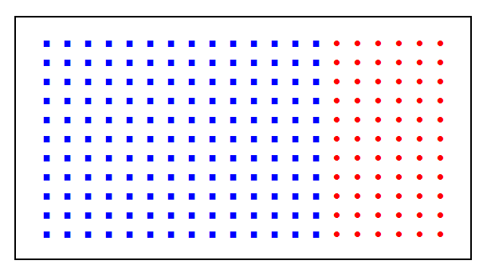
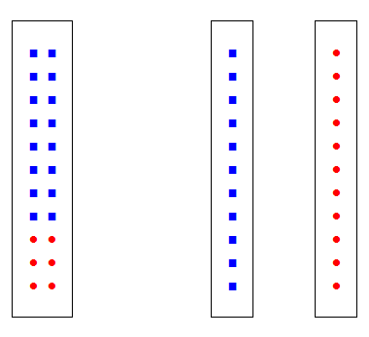
Sampling a Population with internal differences
n = 20
n = 10
n = 10
N = 200
f = 7/10
f = 3/10

Slide 17
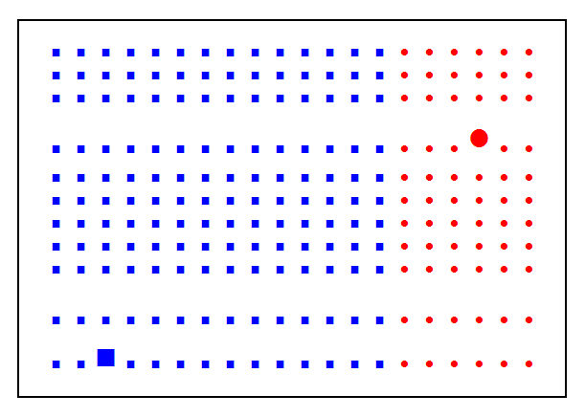
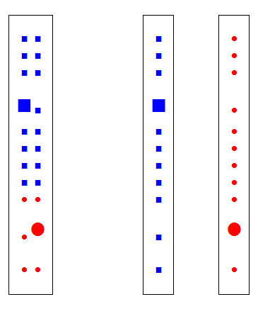
Sampling a Population with internal differences AND a rare trait
Like high emissions …
n = 20
n = 10
n = 10
N = 200 frare = 2/100
f = 7/10
f = 3/10

Slide 18
If you can’t measure the one you want, should you measure the one you have?
It may be worth the trouble to screen first
Screen for technology, standards, etc.
Screen for emissions level

Slide 19
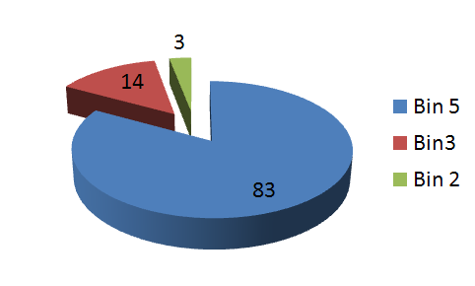
Screening for Standard
Example: Nissan Altima
Sales by Standard (%)

Slide 20
Screening for Emissions Level
Evaporative Hydrocarbons
Hot-Soak Emissions (g/15-min)
Measured Sample
Vehicles: Cars and Trucks
MY: 1991-1995
Index: Remote sensing
“Truth”: Hot-soak
Evaporative Index (EI23)

Slide 21
Screening for Emissions Level
Evaporative Hydrocarbons
ScSc
Hot-Soak Emissions (g/15-min)
Projected Fleet
Vehicles: Cars and Trucks
MY: 1991-1995
Index: Remote sensing
“Truth”: Hot-soak
Evaporative Index

Slide 22
Unweighted: MY 1996-2003
Screening for Emissions Level
Evaporative Hydrocarbons
Hot-Soak Emissions (g/15-min)
Measured Sample
Vehicles: Cars and Trucks
MY: 1996-2003
Index: Remote sensing
“Truth”: Hot-soak
Evaporative Index (EI23)

Slide 23
Weighted: MY 1996-2003
Screening for Emissions Level
Evaporative Hydrocarbons
Hot-Soak Emissions (g/15-min)
Projected Fleet
Vehicles: Cars and Trucks
MY: 1996-2003
Index: Remote sensing
“Truth”: Hot-soak
Evaporative Index (EI23)

Slide 24
Representative Behavior?
PEMS and PAMS come into their own
Heavy Duty Trucks and Buses
  Can the chassis dyno simulate high-speed driving while loaded?
Heavy Nonroad Equipment
  Can the engine dyno simulate different equipment types
Cars and Trucks
  Can the dynamometer simulate road grade?
Advanced technologies
  Can a test cycle capture a hybrid’s start/stop pattern?

Slide 25
Capturing Representative Behavior
The right instrument over the right period
Heavy Equipment?
  Emissions
    How long does it take to characterize a “duty cycle”?
    Dozer vs. excavator vs. articulated hauler?
Cars?
  Emissions?
    How long to profile canister purge patterns?
    How long to profile a hybrid’s start/stop pattern?
  Activity?
    How long to characterize vehicles’ driving patterns?
      Starts, soaks, operation?
      Including business trips, vacations, etc.

Slide 26
Calculating Vehicle-Specific Power
Basis for MOVES emission rates
  Exhaust emissions
  Running operation
Goals
  Relate emissions to power
    PEMS over short time period (hours – days)
  Characterize operating profiles
    PAMS over longer time period (hours – months)
Method 1: Road-Load method
Method 2: Direct torque measurement

Slide 27
Method 1: PAMS without OBD
All vehicles
Fields
  Vehicle speed (v_{t}, mph, m/sec) (by GPS)
  Road-load coefficients (A,B,C)
  Vehicle weight (m, Mg)
Calculations
  Acceleration by difference (a_{t} = v_{t} − v_{t-1})
  VSP by equation
  Braking by deceleration

Slide 28
Method 2: PAMS with enhanced OBD very useful for hybrids
Fields
  Vehicle speed (v_{t}, mph, m/sec)
  Engine speed (n_{t}, RPM)
  Torque (τ, Nm)
  Vehicle weight (m, Mg)
  Brake light indicator
Calculations
  VSP by equation
  Braking by indicator

Slide 29
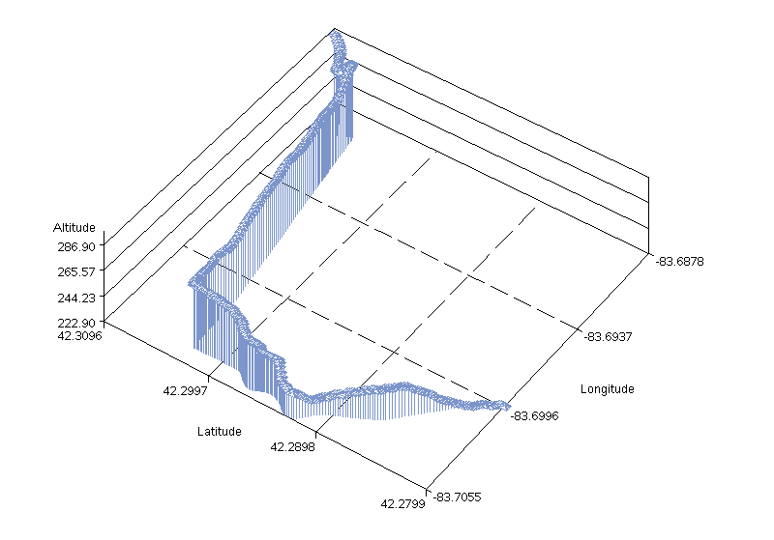
The Route in Ann Arbor
Driving a Prius (with PAMS)
down the hill

Slide 30
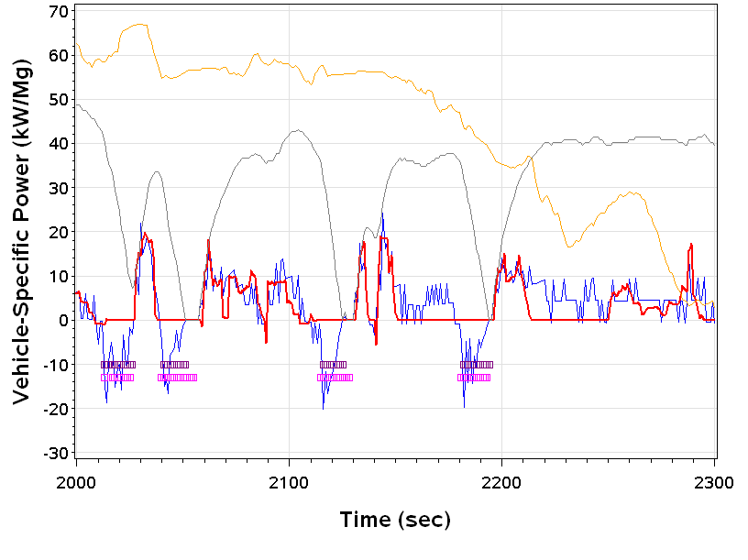
Driving down the Hill
Altitude (ft)
Vehicle Speed (mph)
Decel/braking mode
Brake-light indicator
VSP (kW/Mg, method 1)
VSP (kW/Mg, method 2)

Slide 31
Summary
Define your objectives
Define your population(s) under study
Sample the population
  Convenience sample?
  Judgment sample?
  Probability sample?
Measure accurately
Measure representative behavior
  Right instrument over
  Right period
Result: High Quality data!

