Slide 1

Off-Cycle Emission Evaluation on Hybrid Gasoline Bus
John Karim
In-Use Retrofit Section
Monitoring & Laboratory Division
California Air Resources Board
PEMS 2014 International Conference and Workshop
April 3, 2014

Slide 2
Background
Background
Transit agencies requested to extend the engine swap interval from 110,000 to 150,000 miles
Engines were certified to an FTP engine test cycle
Evaluate the hybrid buses using PEMS as a surrogate for an engine test
Test low, medium, and high mileage buses to determine their emission deterioration factor
Notes:
ISE has gone out of business

Slide 3
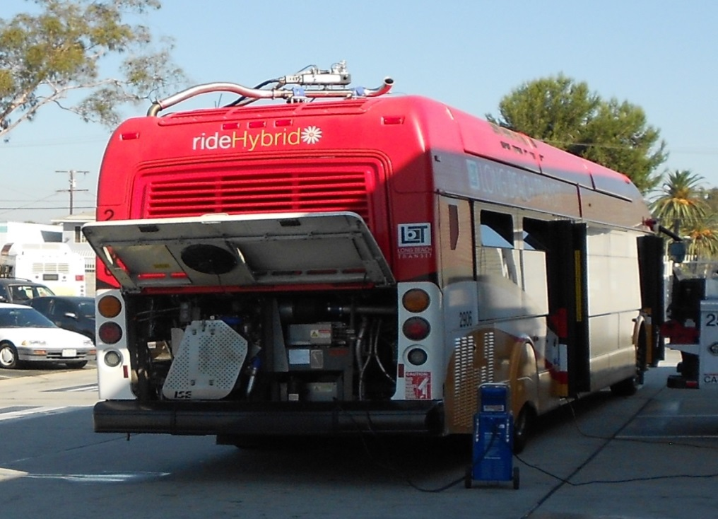
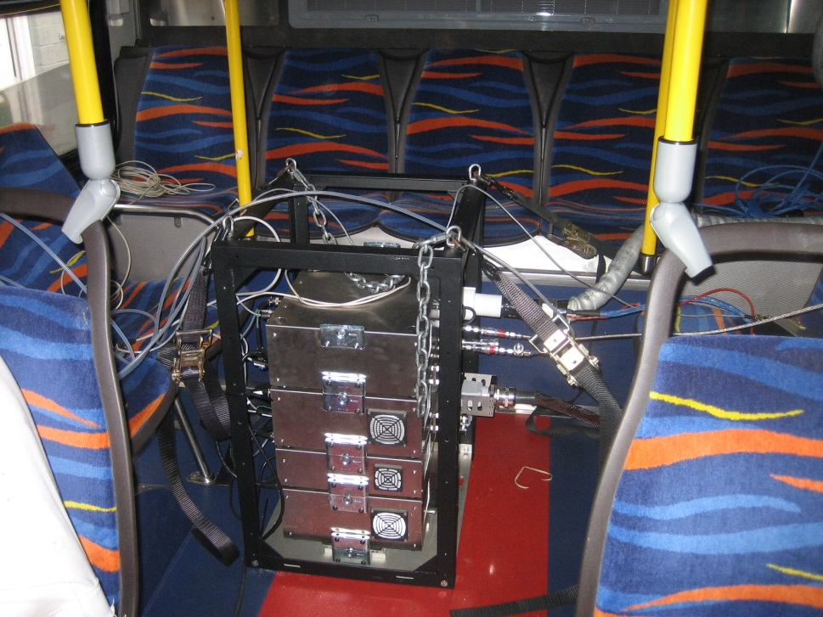
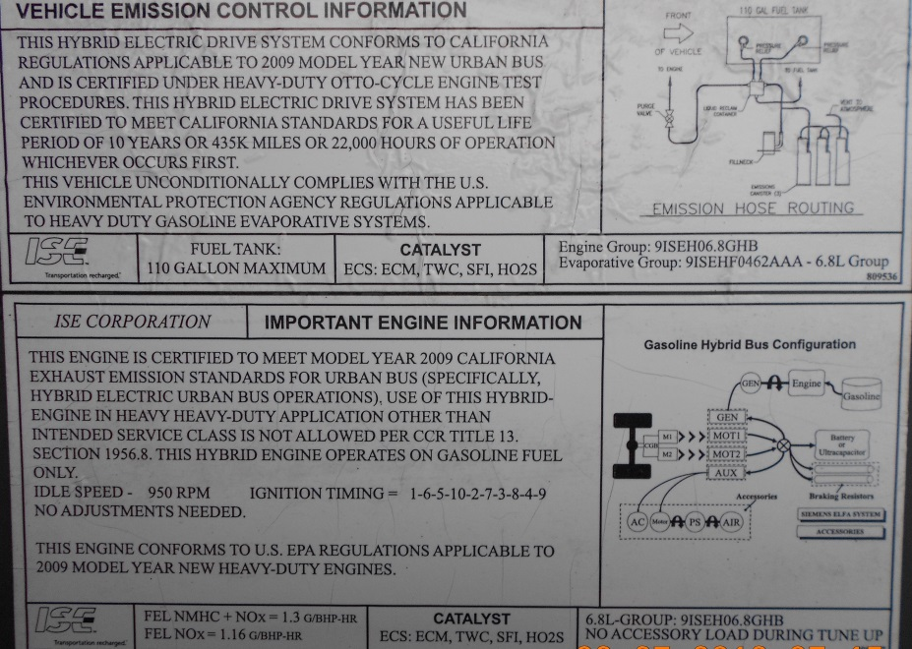
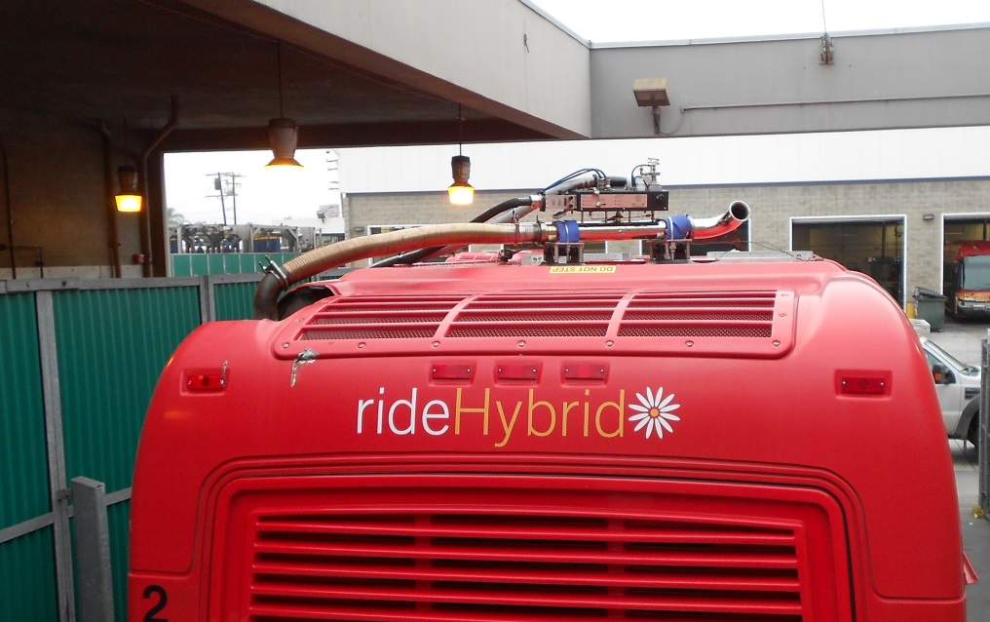
Test Set-Up

Slide 4
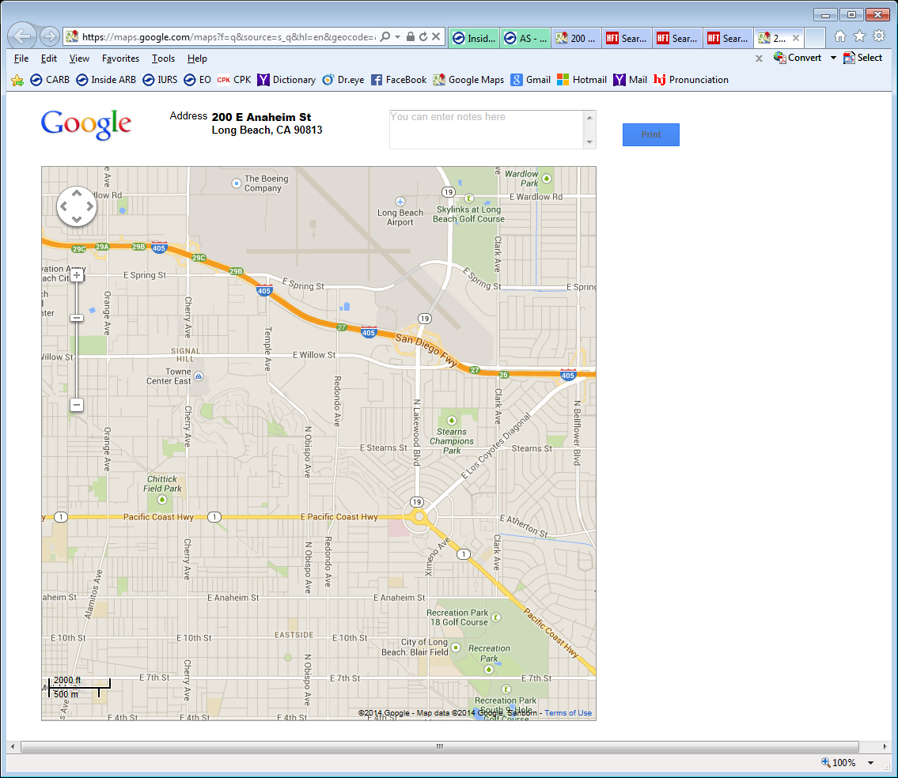
Test Route
3 mi
2 mi
4 mi
1 mi
5 mi
6 mi
Start
Stop
7 mi

Slide 5
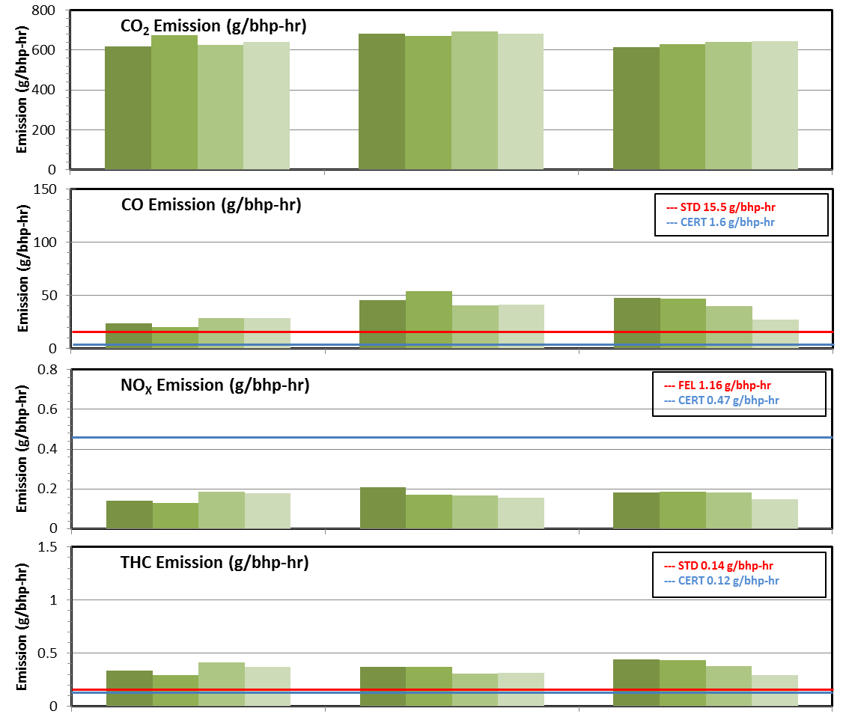
Emission Results
120 K Miles
42 K Miles
4 K Miles
Notes:
Driver effect

Slide 6
Emission Deterioration Factor
  Based on the emission rates from low mileage engine (40 CFR 94.218)
 | High Mileage | Med Mileage
 | vs Low Mileage | vs Low Mileage
CO | 1.000 | 1.127
NOx | 1.000 | 1.001
THC | 1.000 | 1.000
Notes:
40 CFR : less than 1 ➔ 1 Three decimal point
Deterioration Factors :High mileage engine compared to new engine (both with “old” CAT)

Slide 7
Findings
  No significant emission deterioration observed when comparing a remanufactured engine to high mileage engine
  Based on the results, engine swap time interval may be extended

Slide 8
Further Analyses
  Deterioration of TWC
  Off-cycle emissions

Slide 9
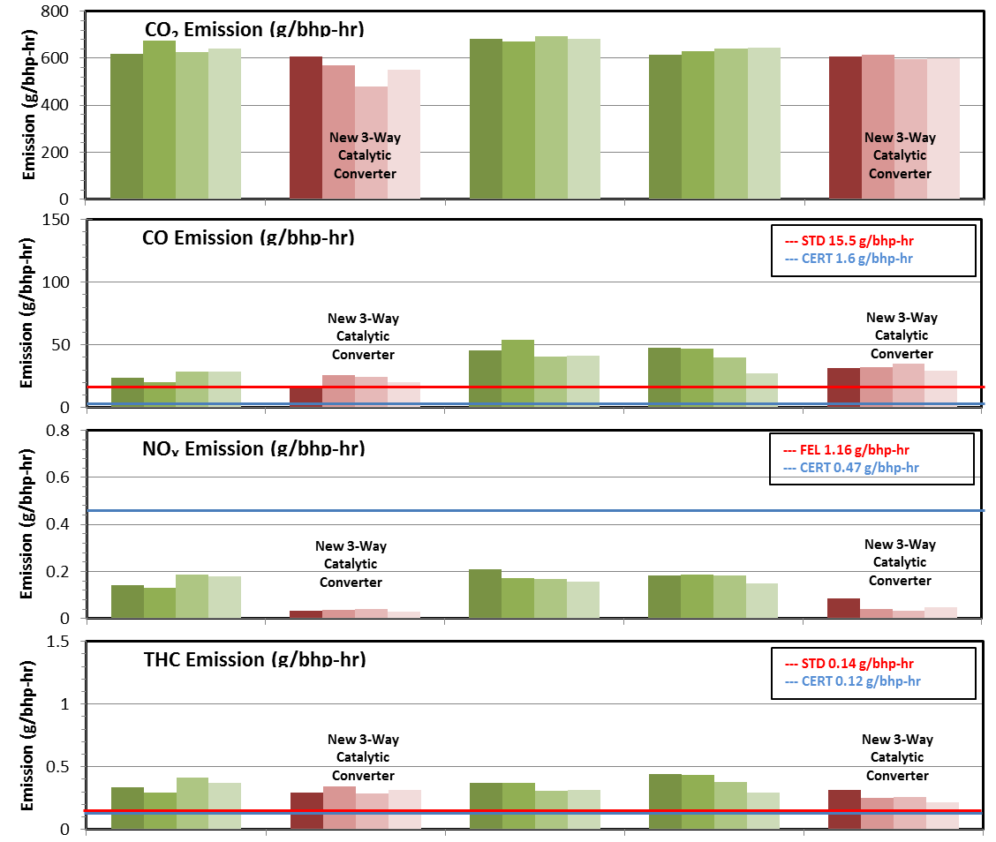
Test Results
120 K Miles
42 K Miles
4 K Miles
Notes:
Driver effect

Slide 10
Cumulative Mass Emissions
(Original TWC)
120K Miles
42K Miles
4K Miles

Slide 11
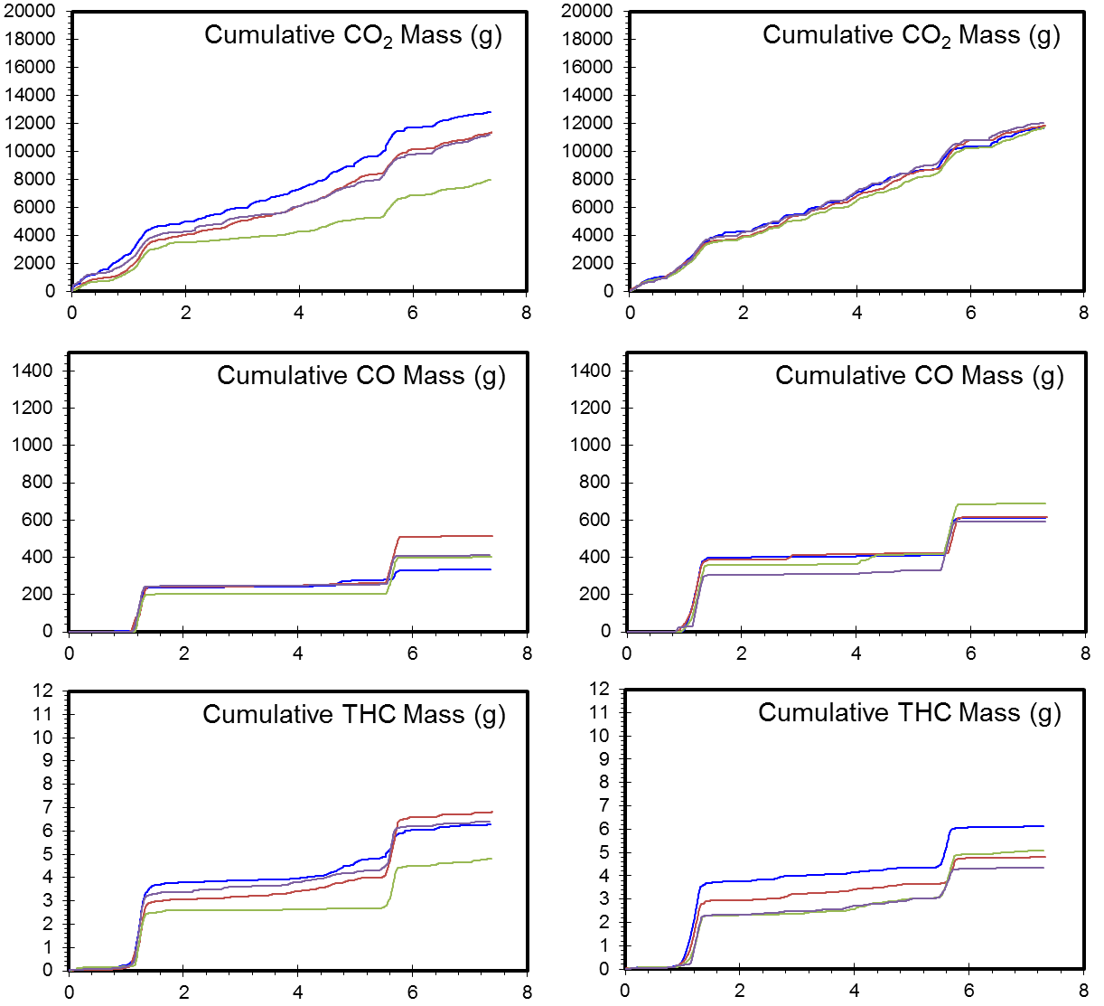
Cumulative Mass Emissions
(New TWC)
120K Miles
4K Miles

Slide 12
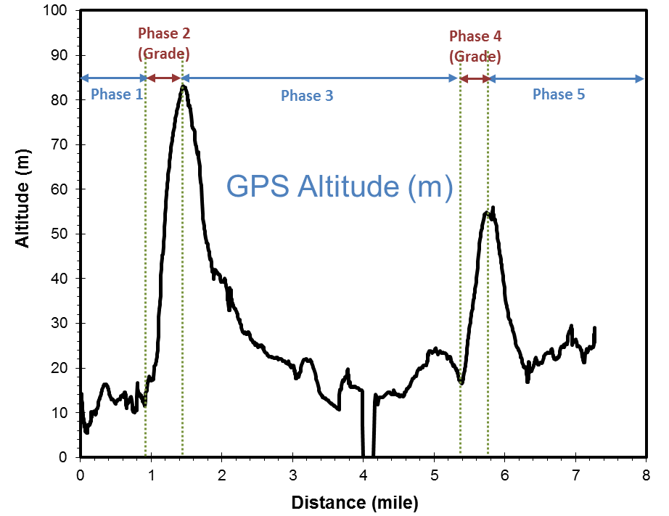
Altitude Profile
No GPS signal

Slide 13
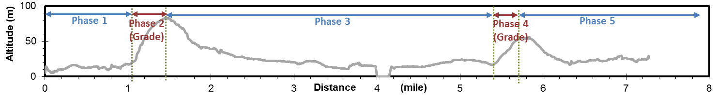
Test Results
Complete Trip
Phase 1
Phase 2 (Grade)
Phase 3
Phase 4 (Grade)
Phase 5
Notes:
100 times the cert level

Slide 14
Old vs. New TWC
 | High Mileage Bus | Med Mileage Bus
 | Old TWC vs New TWC | Old TWC vs New TWC
CO | 18% | 26%
NOx | 376% | 238%
THC | 14% | 48%
  Significant emission benefits with new TWC
Notes:
Deterioration Factor purely from TWC

Slide 15
Findings
  Emission control system(s) should be replaced during the engine swap as required
  “Real World” conditions reveal that emissions are much higher during off cycle driving

Slide 16
Future Studies
  Comparison of FTP emissions with “Real World” emissions
  Hybrid vs. Non-Hybrid configurations
  Further investigation of variability associated with real world operations
  Effects of driver behavior

Slide 17
Thank you
Special Thanks to
In-Use Retrofit Section
Dr. Jesse Tu, George Gatt, Gloria Pak, Tony Nassar, Tung Tran

