Slide 1



Real World Emissions Testing Based on FTIR Technology
PEMS Conference 2014
Ron Tandy
Acknowledgements (Data Provided):
Hong Kong EPD – Carol Wong
West Virginia University – Arvind Thiruvengadam

Slide 2
Contents
What is FTIR
FTIR Technology Explained
Features and Benefits of FTIR for Automotive and PEMS use
FTIR Accuracy and Correlation (Real World Data)
Conclusions

Slide 3
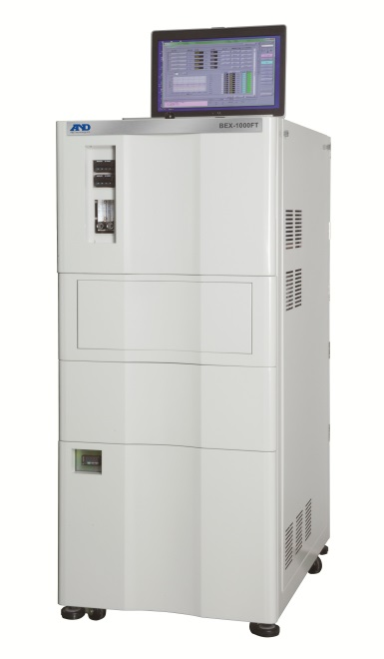
What is FTIR
Multi-component gas analyzer based on
Fourier Transform Infra-Red technology.
Current FTIR technology allows for the continuous measurement of up to 40 gases, at 5Hz data acquisition and fast response time, makes an FTIR the ideal instrument for the R&D of engines, aftertreatment calibration, and catalytic converters.
(Not your daddy’s FTIR from 15-30 years ago)

Slide 4
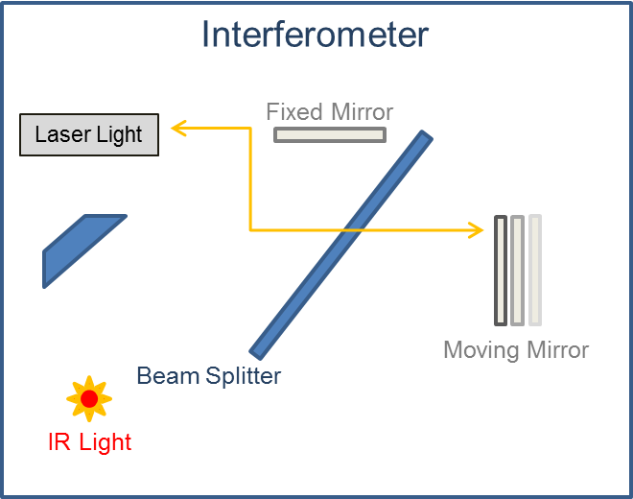
Interferometer Technology
Michelson Interferometer creates interfering beams using
IR Light source
Beam splitter
Moving mirror
Fixed mirror
A Helium Neon (HeNe) Laser determines mirror position, velocity and travel direction
(Used to control mirror velocity)
The output is a Interferogram, containing information about all wavenumber frequencies within the mid-infrared spectral range
(~625 to ~6000 cm⁻¹)
Sample Cell
Notes:
Wavenumber - reciprocal of actual wavelength of light

Slide 5
Sample Gas Cell
(Interferogram)
Multi-reflection Heated Sample Cell
Heated to 191° C
  Prevents condensation
5.1m Path
For high sensitivity
200 mL cell volume
  For fast response time
GAS
GAS
5.1 meter path (32 passes)

Slide 6
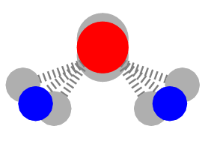
Frequency Absorption
Each molecule has a specific Infrared frequency where it absorbs the IR radiation
(bending, stretching, twisting , vibrating , etc. the molecule).
Because of the constructive (and destructive) interfering beams, the detector can read information about every wavelength in the infrared range simultaneously.
The interfering beams travel through the sample gas, where some energy is absorbed by gas molecules and some is transmitted to the detector.
The transmitted portion (not absorbed) reaches the
detector.
The absorbed portion does not reach the detector, and is directly proportional to the amount of gas molecules in the sample.
Detector

Slide 7
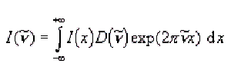
Inteferogram to Gas Concentration
Interferogram
Single Beam
Absorbance Spectrum
Method Analysis
Signal as a function of time
Signal as a function of frequency
Fourier Transform
algorithm
Remove
Background
A= -Log(I/Io)
Spectrum Analysis
Method Determination
(Gas, Diesel, Etc.)
Analysis of absorption regions
Speciation of gases

Slide 8
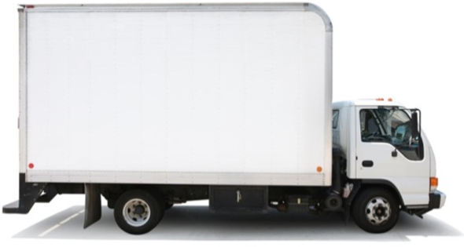
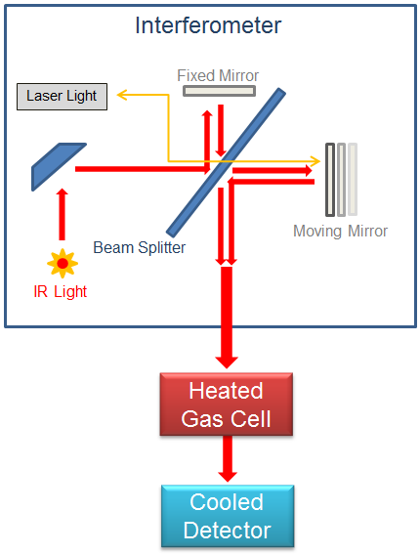
FTIR System Configuration (Vacuum)
PC
Heated Line
LAN
LAN
Communication
Hub
Heated Filter
Span Gas
Span / Audit
Gas Handling
Audit Gas
Purge / B.G.
N2 / Zero Air
Cell Pressure Control
Waste
Heated Line
Sample
Sample
Conditioning
120 VAC
110 VAC
Power
Conditioning
or
24 VDC *
Spectrometer
Conditioning Unit
* PEMS Version Only

Slide 9
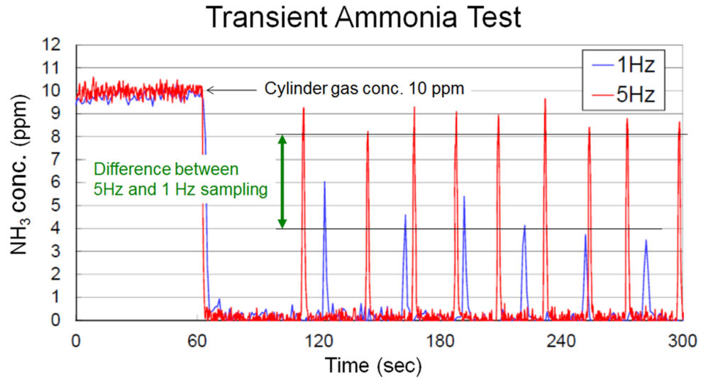
Sampling Rate
The FTIR spectrometer can sample at selectable rates, up to 5 Hz.
5 Hz sampling rates provide superior transient sampling, capturing more data fluctuations than 1 Hz.

Slide 10
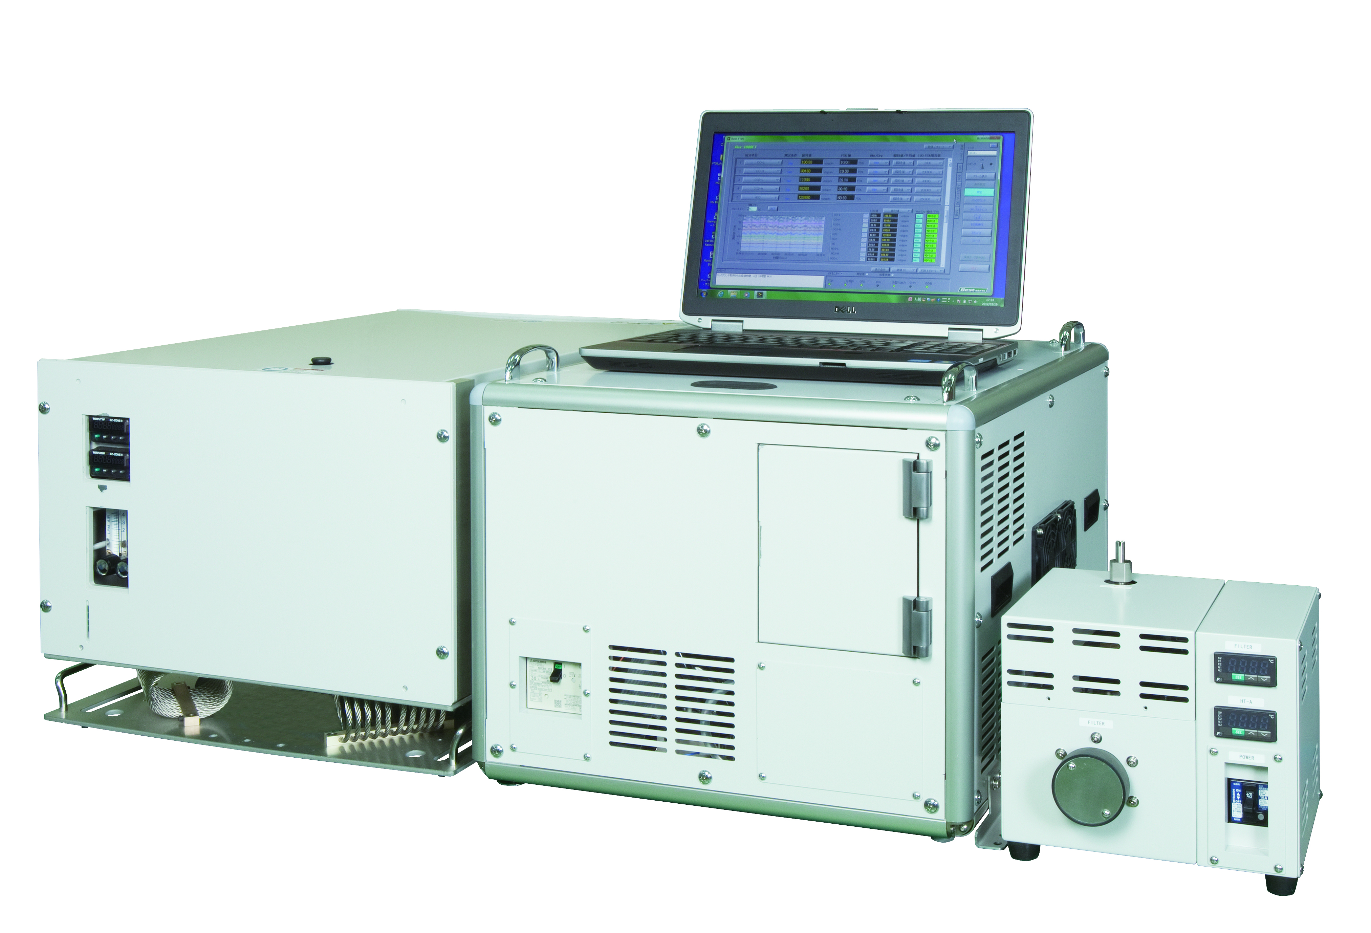
Benefits of FTIR - One Instrument
Replaces
Doesn’t Require
NDIR
CVS / Dilute
NDUV / CLD
Dry to Wet Conversion
GC FID
Time Align Gas Instruments
Impinger Systems
Daily Calibrations
Cutter FID
Linearization
Laser Diode or QCL
Drift Correction
(of gases)

Slide 11
Benefits of FTIR- One Instrument
Raw measurements:
Avoids additional error posibilities from dilute measurements
Measures up to 40 Gases Synchronously with one detector:
(already time aligned)
Gas analysis methods for different fuel types
Raw data files can be reprocessed with a modified gas analysis method
No need to repeat the actual test.
Fast data acquisition, and time response

Slide 12
Measuring Gases
Gas | Formula |  |  | Concentration |  | Units
REGULATED COMPONENTS:
Carbon Monoxide (Low) |  | CO (L) | 0 - 5000 |  |  | ppm
Carbon Monoxide (High) |  | CO (H) | 0 - 8 |  |  | %
Carbon Dioxide (Low) |  | CO₂ | 0 - 4 |  |  | %
Carbon Dioxide (High) |  | CO₂ | 0 - 20 |  |  | %
Oxides of Nitrogen |  | NO_{X} | Calculated (sum of NO, NO₂)
Hydrocarbons |  | HC | Calculated (sum of Carbons)
Nitrous Oxide (Low) |  | N₂O (L) |  |  | 0 - 100 | ppm
Nitrous Oxide (High) |  | N₂O (H) |  |  | 0 - 300 | ppm
NON-REGULATED COMPONENTS:
Nitrogen Oxide (Low) |  | NO (L) | 0 - 300 |  |  | ppm
Nitrogen Oxide (High) |  | NO (H) | 0 - 3000 |  |  | ppm
Nitrogen Dioxide (Low) |  | NO₂ (L) | 0 - 100 |  |  | ppm
Nitrogen Dioxide (High) |  | NO₂ (H) | 0 - 1000 |  |  | ppm
Ammonia |  | NH₃ |  |  | 0 - 500 | ppm
Formaldehyde |  | HCHO |  |  | 0 - 1000 | ppm
Ethanol |  | C₂H₆O |  |  | 0 – 1000 | ppm
Methane |  | CH₄ |  |  | 0 - 2000 | ppm
Water |  | H₂O |  |  | 0 - 30 | %
Acetaldehyde |  | MeCHO (CH₃CHO) |  |  | 0 - 1000 | ppm
Sulfur Dioxide |  | SO₂ |  |  | 0 - 1000 | ppm
Isocyanic Acid |  | HNCO |  |  | 0 - 1000 | ppm
Formaldehyde |  | HCHO |  |  | 0 - 1000 | ppm
Hydrogen Cyanide |  | HCN |  |  | 0 - 1000 | ppm
Methanoic Acid |  | HCOOH |  |  | 0 - 1000 | ppm
Carbonyl Sulfide |  | COS |  |  | 0 - 200 | ppm
DIFFERENTIATED HYDROCARBONS:
Methane |  | CH₄ |  |  | 0 - 2000 | ppm
Acetylene |  | C₂H₂ |  |  | 0 - 1000 | ppm
Ethylene |  | C₂H₄ |  |  | 0 - 1000 | ppm
Ethane |  | C₂H₆ |  |  | 0 - 1000 | ppm
Propylene |  | C₃H₆ |  |  | 0 - 1000 | ppm
Propane |  | C₃H₈ |  |  | 0 - 1000 | ppm
Butadiene |  | C₄H₆(1-3C₄H₆) |  |  | 0 - 1000 | ppm
Butane |  | NC₄ (C₄H₁₀) |  |  | 0 - 1000 | ppm
Octane |  | NC₈ (C₈H₁₈) |  |  | 0 - 1000 | ppm
Measurement of all gases absorbing in the Mid Infra-Red Spectral Range
Measurement of all regulated gas components*
Multiple and customizable ranges for many gases (e.g. CO_{Low} and CO_{High}).
Future-proof analyzer will measure gases of future concerns
*THC is calculated (sum of HC’s) and based upon a FID correlation factor

Slide 13
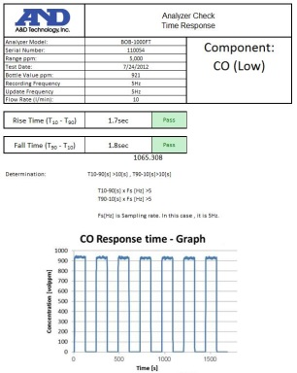
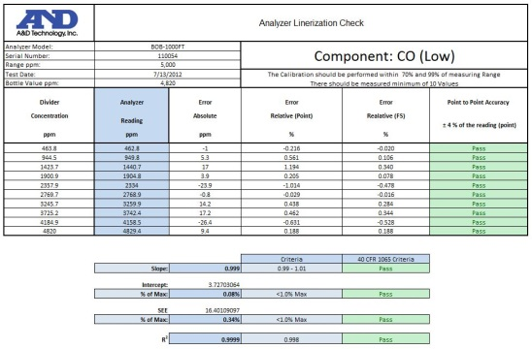
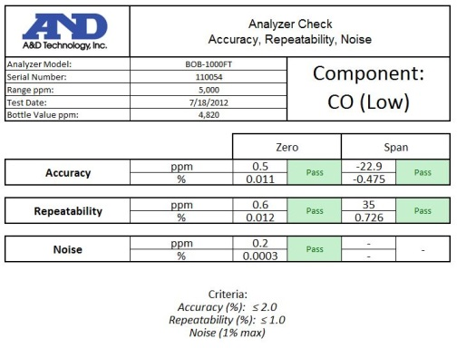
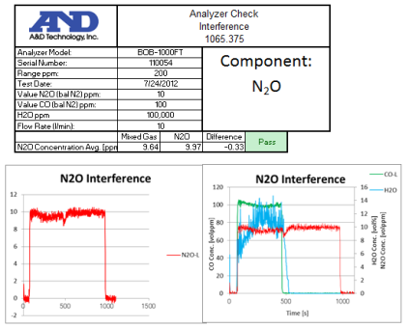
Evaluation by Regulatory Agencies
40 CFR Part 1065:
System Response Linearity Verification Accuracy, Repeatability, Noise Interference Verification
40 CFR §1065.308 40 CFR §1065.307 40 CFR §1065.305 40 CFR §1065.375
*1065 only specifies N₂O for FTIR measurement, but we also verify for many other components.
Meets or Exceeds US EPA and European Regulations

Slide 14
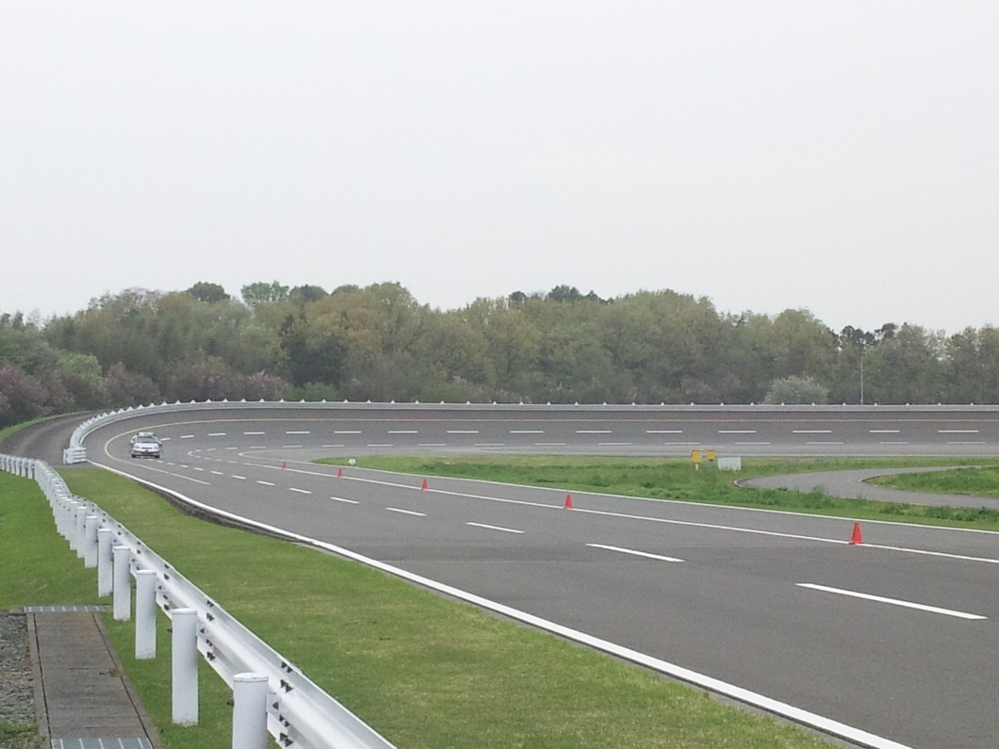
PEMS FTIR Application
Problem
Solution
AC power availability
DC power inlet (24V)
Road vibration
Vibration dampening system
Pressure changes (altitude)
Pressure control system
Weather conditions
Environment control box
Battery charge level
Charge indicator with alarm
Size / Weight
Redesign under evaluation

Slide 15
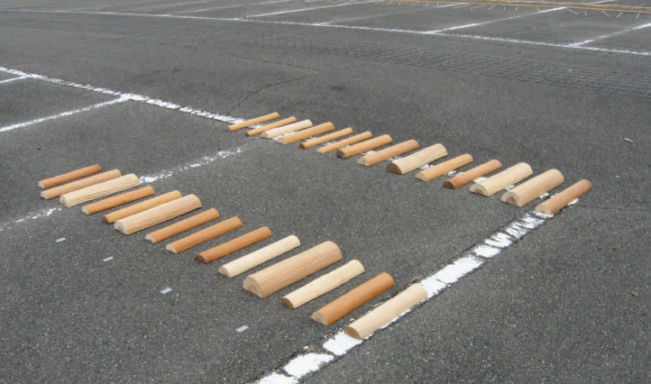
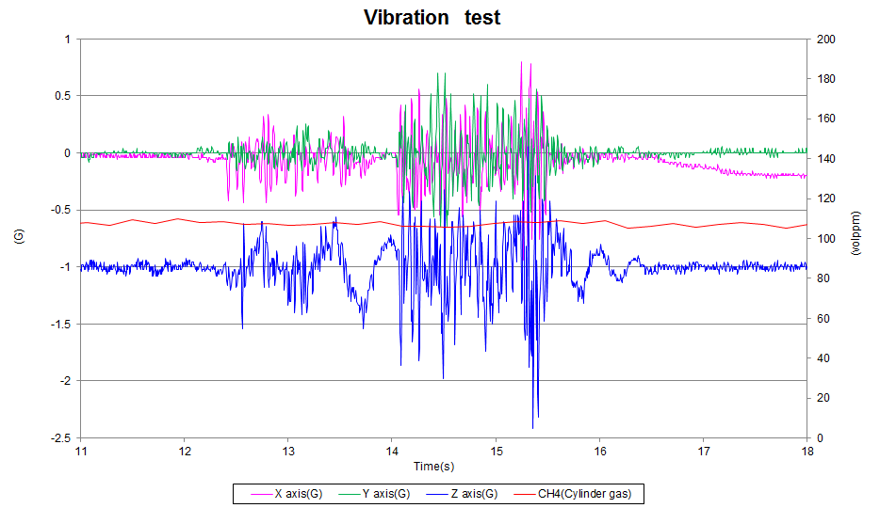
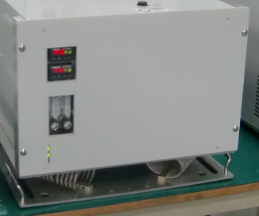
On-Board Vibration Dampening

Slide 16

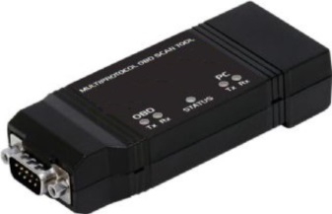
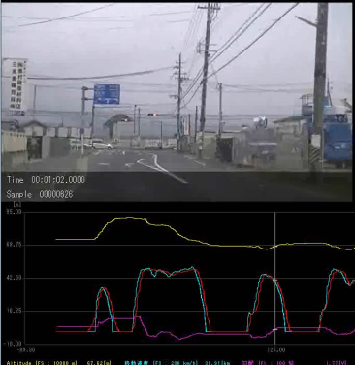
Typical PEMS Components
GPS Acquisition Unit and Software
Allows for GPS data (latitude, longitude altitude and speed), to be recorded and time-aligned with the emissions data.
ECU Acquisition Unit and Software
Allows for the vehicle ECU data to be recorded and time-aligned with the emissions data.
Video Camera Monitoring System and Software
Allows for live on-road video recording, time aligned with emissions data, GPS and ECU vehicle data .

Slide 17
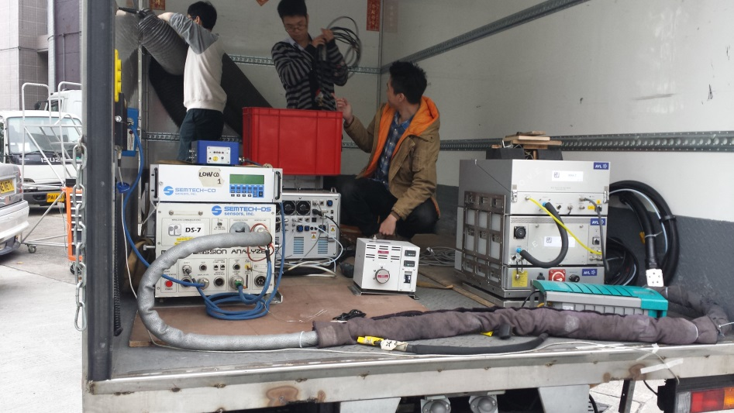
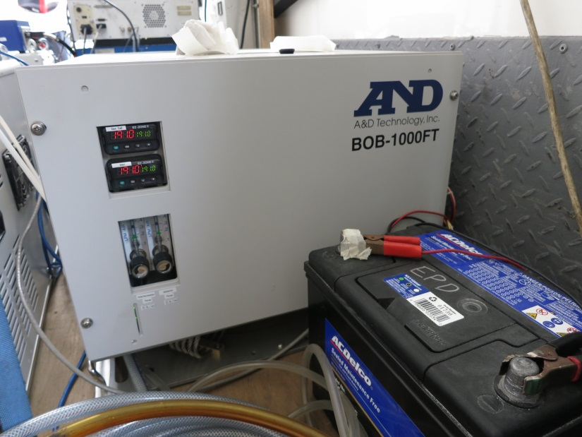
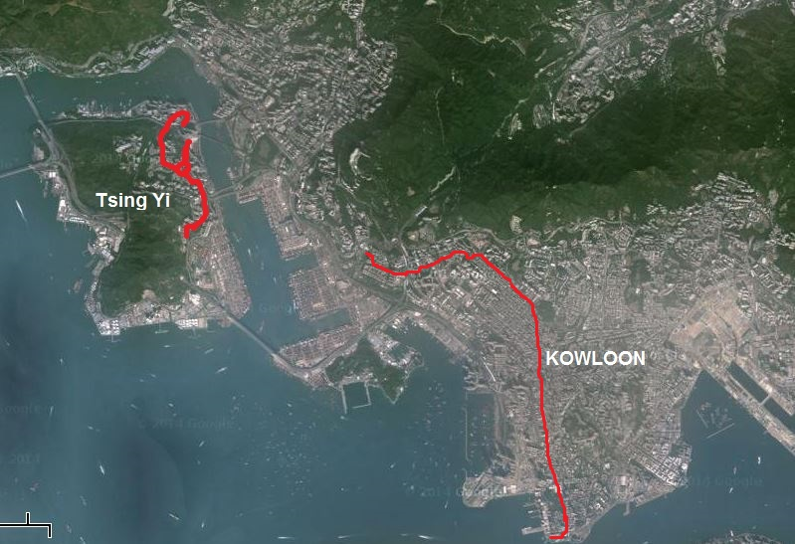
PEMS FTIR In-Use
Hong Kong EPD Testing
Coach Vehicle
Tsing Yi – Stop & Go . 7.14L Diesel
12-DEC-2012
Double Decker Bus
Kowloon – Urban
10.8L Diesel
08-JAN-2013
“one of the most dense
streets in the world”

Slide 18
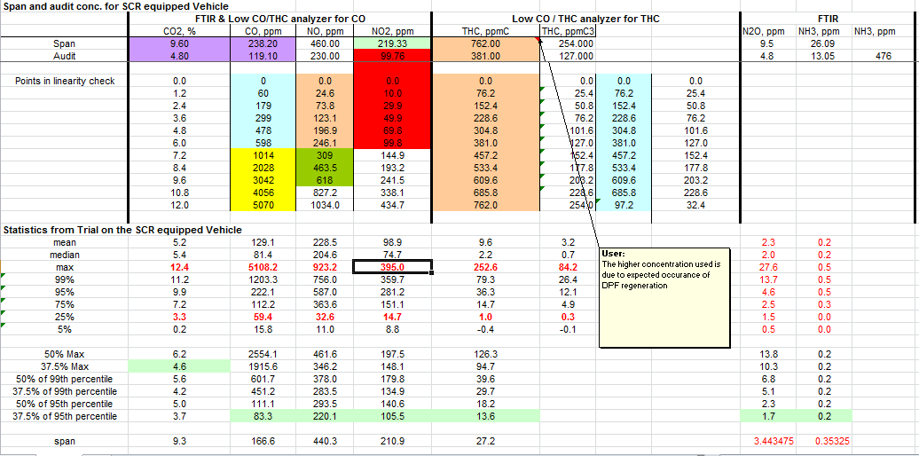
In-Use Hong Kong Coach
Gaseous Measurement A&D PEMS FTIR and SEMTECH-DS
HK-EPD Defendable Data Methods:
SEMTECH-DS: 1065 Verification Tests current
1065 In-use recommendations (e.g. drift corrections, etc.)
Linearize, Span (2) and multiples Audit’s (3 hour interval)
Algorithm based on concentrations from vehicle pre-test (3 values)

Slide 19
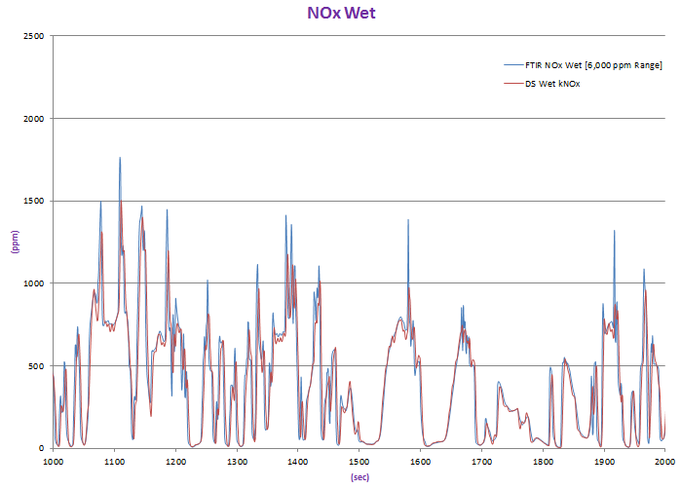
Hong Kong Coach - Data
NO_{X} Agrees*
FTIR Readings Slightly Larger
5Hz vs 1Hz
(higher transient peaks)?
FTIR has more flow?
NDIR Chiller Loss?
(5% allowed per 1065.376)
*SEMTECH-DS wet (Calculated)

Slide 20
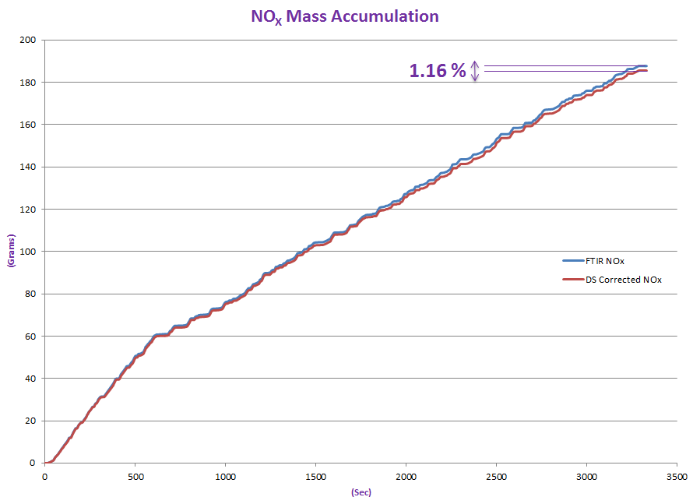
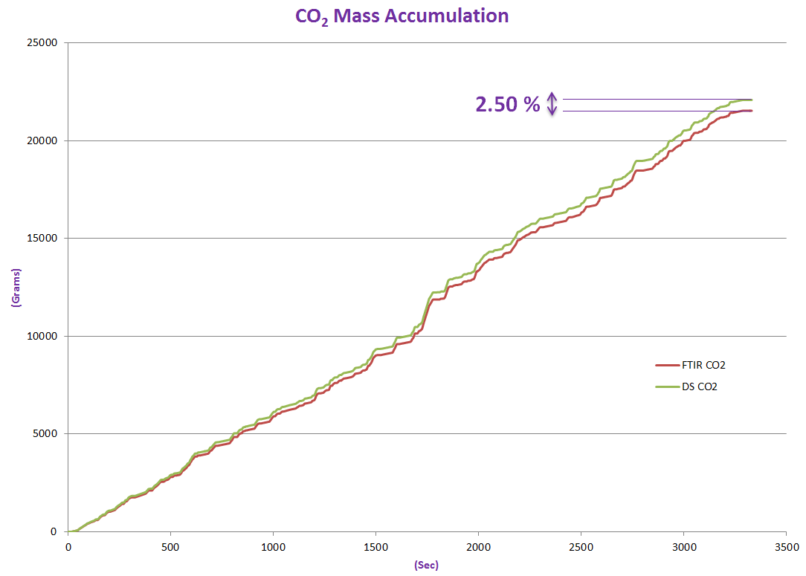
Hong Kong Coach - Data

Slide 21
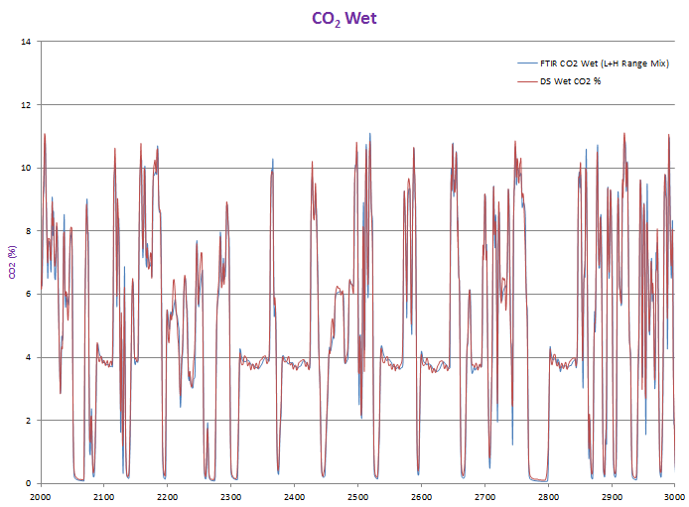
Hong Kong Coach - Data
CO₂ Agrees*
*DS Wet (Calculated)

Slide 22
Hong Kong Coach - Data

Slide 23
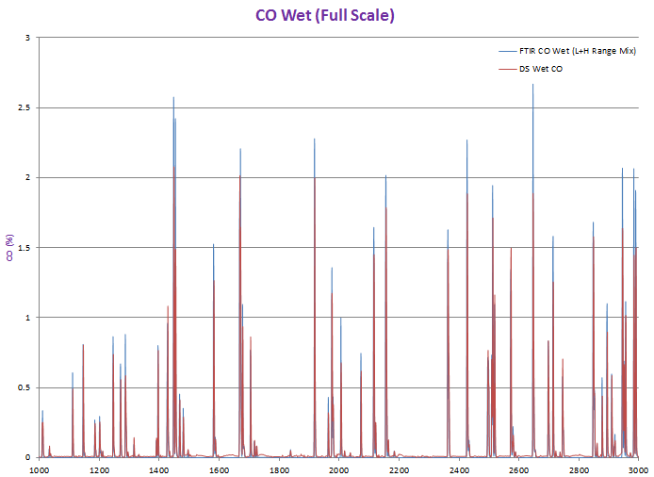
Hong Kong Coach - Data
CO Peaks Generally Agree
FTIR Peaks are larger
5Hz vs 1Hz
(higher transient peaks)?
FTIR high Range @ 4% CO
Peaks significantly above NDIR Span (2K ppm)

Slide 24
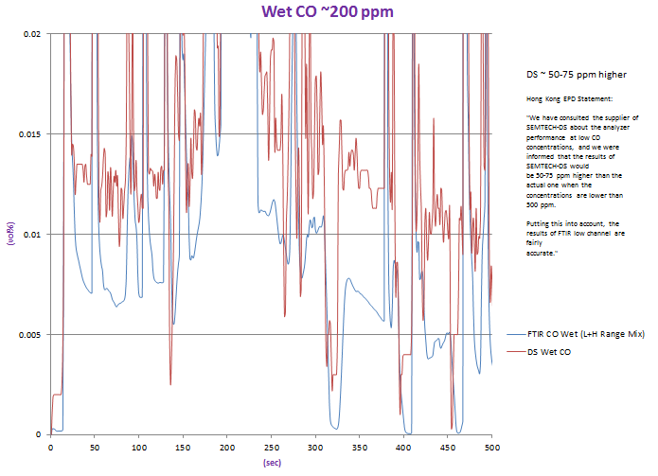
Hong Kong Coach - Data
At low concentrations
CO Follows same trend
FTIR Readings approximately
~50-75ppm lower

Slide 25
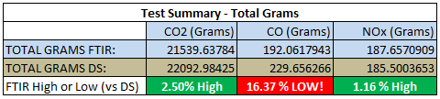

Hong Kong Coach - Data

Slide 26
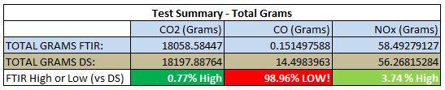
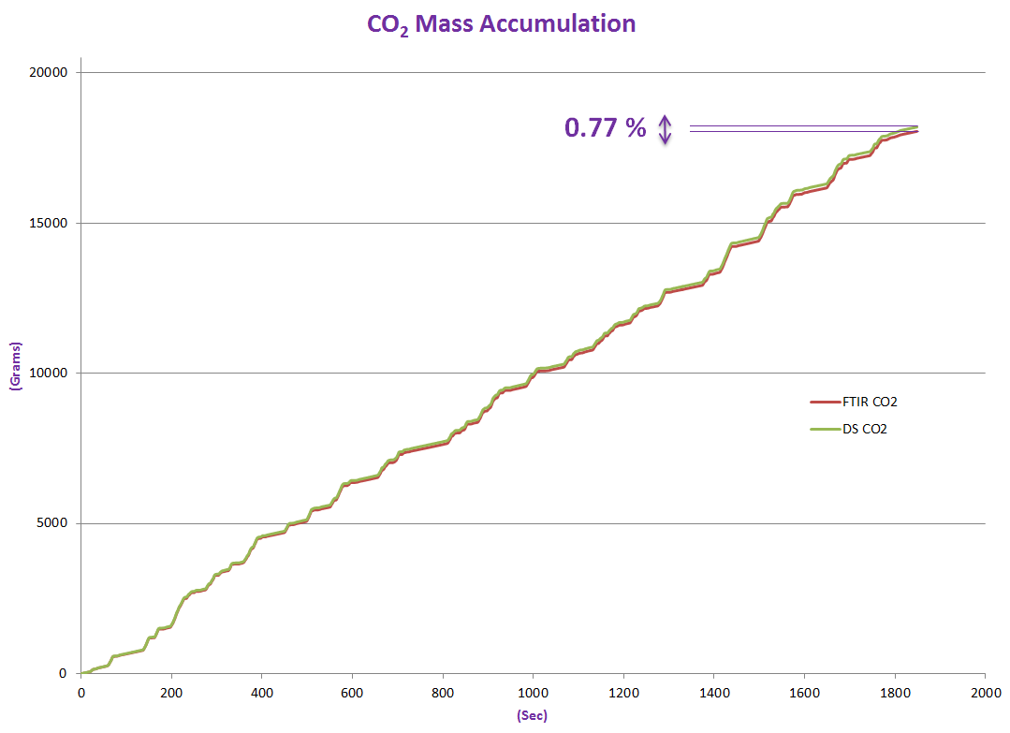
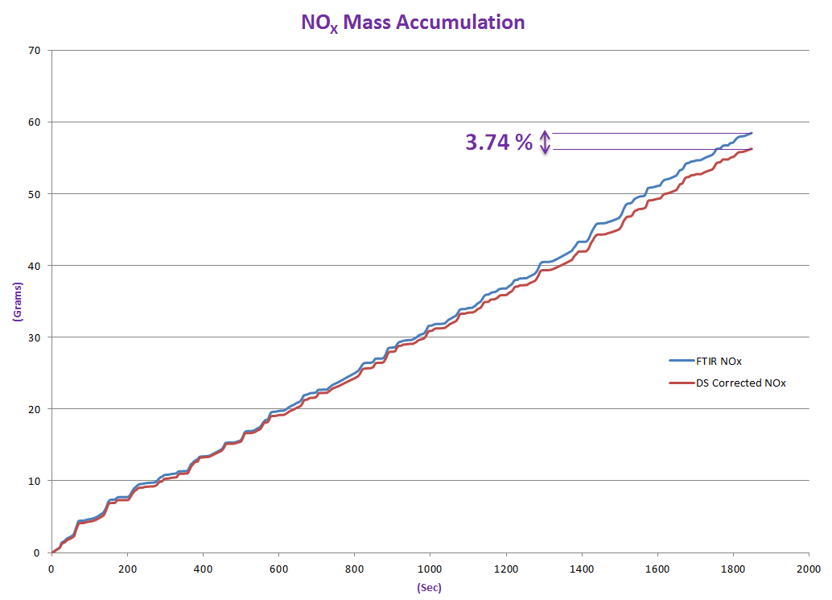
Hong Kong Double Decker Bus - Data

Slide 27
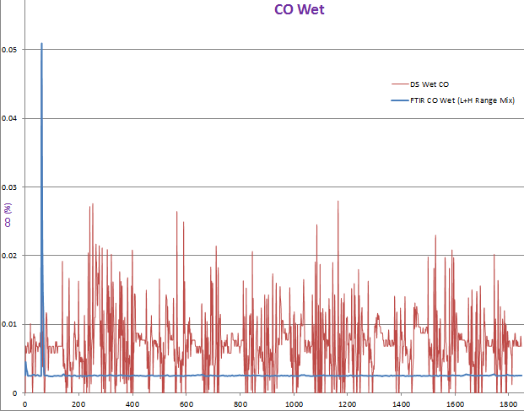
Hong Kong Double Decker Bus - Data
Unlike the previous test, CO data does not correlate
Peak in the beginning matches up well
Remainder of test, FTIR is constant DS shows a shift and deflections
Needs more analysis

Slide 28
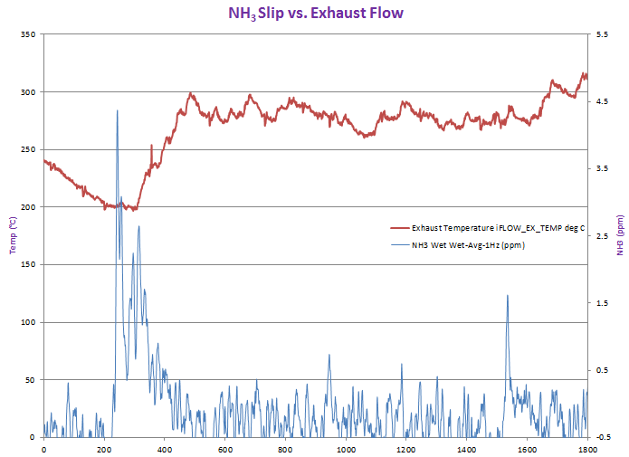
Hong Kong Double Decker Bus - Data
With FTIR, you can analyze many different variables – such as NH₃ slip when exhaust temperature drops

Slide 29
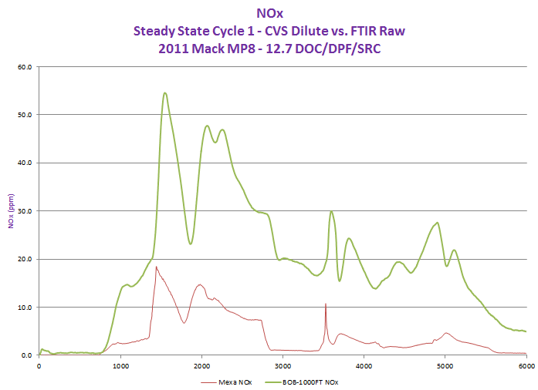
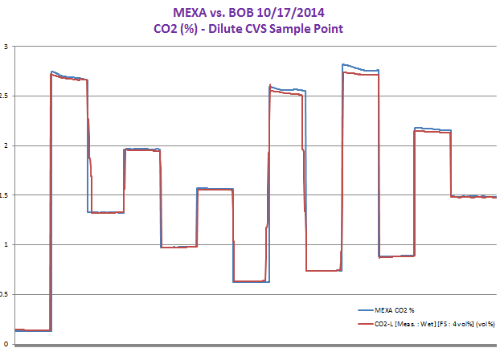
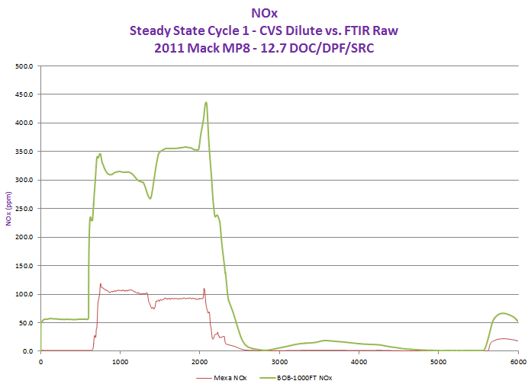
West Virginia University Test Cell
BOB-1000FT and Mexa 7200
All Mexa = diluted
FTIR Mixed sample points
(some raw, Some diluted)
Do not have adequate information yet to calculate Mass values for correlation

Slide 30
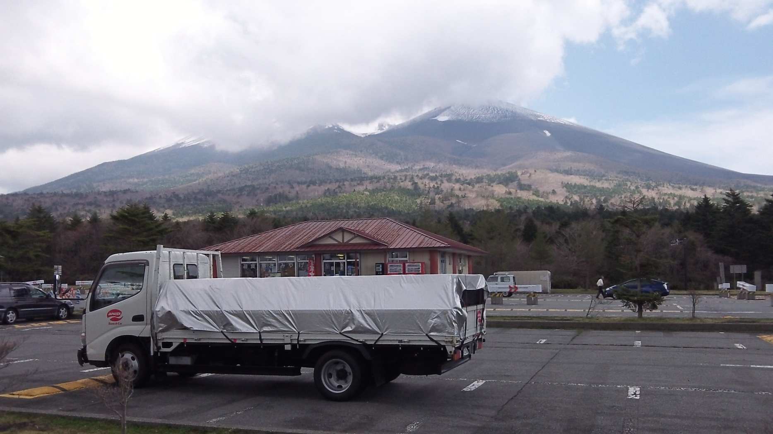
Climbing Mount Fuji

Slide 31
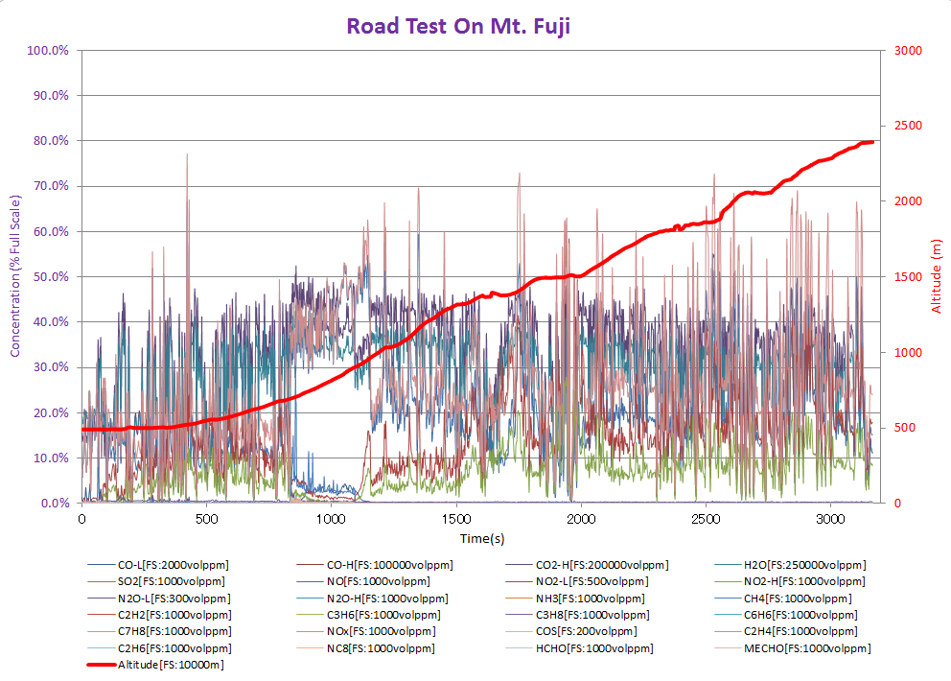
FTIR 25 Gas Graph

Slide 32
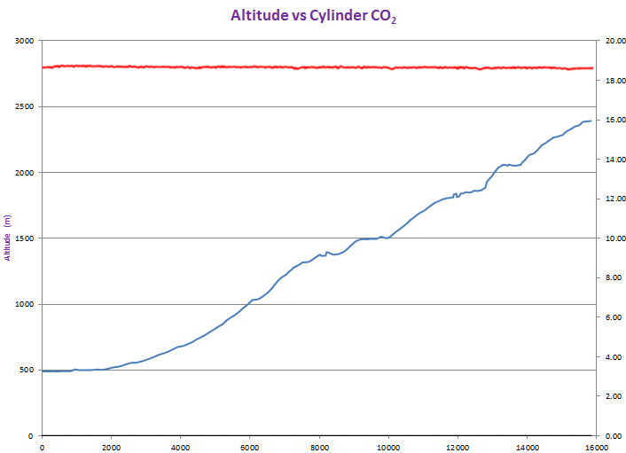
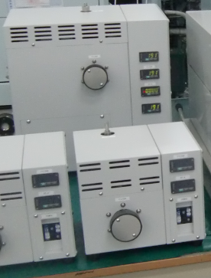
Mount Fuji Cylinder Gas
High Altitude Pressure Option
Maintains required Sample Cell Pressure, regardless of changing barometric pressure conditions.
Stable concentrations have been verified up to 3,200m (11,000 feet)

Slide 33
Conclusion
FTIR is a highly accurate (good correlation) method for exhaust gas measurement
There are a lot of advantages in using FTIR
FTIR has good correlation to conventional analyzers, for regulated components – while also measuring all gases of interest, with one analyzer
FTIR as a PEMS instrument will become increasingly important, as we continue to monitor and research additional gases

Slide 34
Thank You !

