Slide 1
Characterization of an
In Situ Electrostatic Soot Sensor
with Laboratory Measurement Instruments
Jim Steppan¹, Brett Henderson, Anthoniraj Lourdhusamy,
Victor Wang, Joe Fitzpatrick, Klaus Allmendinger
EmiSense Technologies, LLC
Matti Maricq, Dave Kubinski
Ford Motor Company
1. Presenter
Notes:
1
1

Slide 2
Presentation Outline
Introduction: PM OBD Requirements, PMTrac Theory of Operation
Soot generator setup and results
Engine dynamometer setup and results
Summary
Notes:
2
2

Slide 3
Why A Real-Time PM Sensor is Needed for OBD
Demanding environmental emission legislation has created a need for robust PM sensors for OBD that are low-cost, sensitive, and accurate
EPA PM Emission Limits
  - Light-duty vehicles (chassis-certified): 0.01 g/mi
  - Heavy-duty (HD) engines (engine-certified): 10 mg/bhp-hr (~2.7 mg/m³)
The HD OBD system¹ shall detect a malfunction prior to a decrease in the filtering capability of the PM filter (e.g., cracking) that would cause an engine's PM emissions to exceed the following thresholds :
  - Pre 2013: 70 mg/bhp-hr (~19 mg/m³)
  - 2013 – 2015: 50 mg/bhp-hr (~14 mg/m³)
  - 2016 and future: 30 mg/bhp-hr (~8 mg/m³)
1. http://www.arb.ca.gov/regact/2009/hdobd09/fro19711.pdf ; page 48; downloaded 3/28/11

Slide 4
PM Sources and Characterization of PM Sensors
PM measurement and calibration of PM measurement instruments are more complex than other gaseous pollutants
Certified combustion gas mixtures are readily available for calibrating gas analyzers, but this is not the case for PM
Additional complexity for PM as the chemical composition, particle size distribution (PSD), and particle charge distribution (PCD) of PM varies with engine combustion and exhaust pipe conditions
Most commercially-available reference instruments can’t directly measure the high PM concentrations typical in the exhaust. A representative exhaust sample must be drawn and diluted
Dilution can cause new particle nucleation and/or condensation of gaseous materials
There may be differences between in-situ and reference measurements

Slide 5
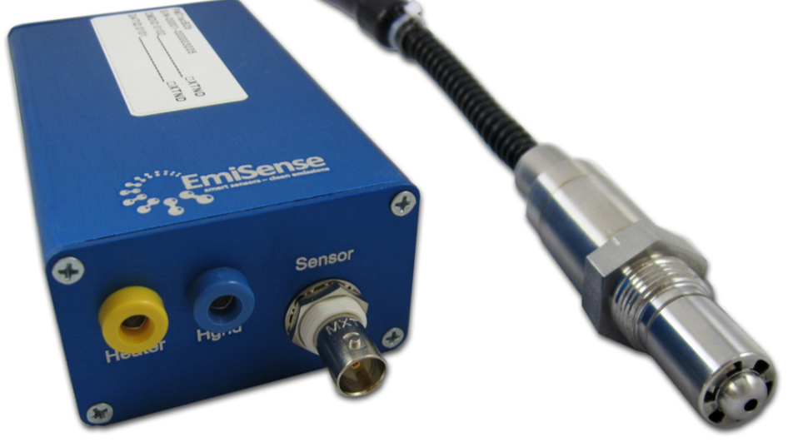
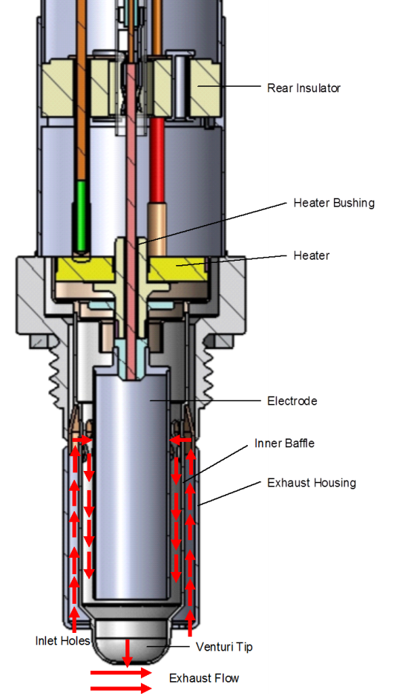
PMTrac® PMB2 Electrostatic Soot Sensor
Electrostatic measurement principle
In situ soot measurement with no dilution
High accuracy and outstanding correlation with AVL MSS
High resolution (detection limit < 0.25 mg/m³)
Fast (real-time) transient response
Wide measurement range (0 to 630 mg/m³)
Simple, robust, and cost-effective design and construction
Suitable for OBD sensor for DPF failure detection
5
5
5
Notes:
5
5

Slide 6
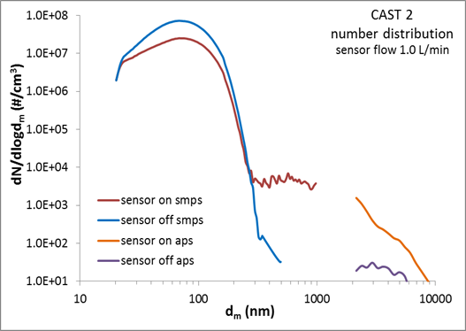
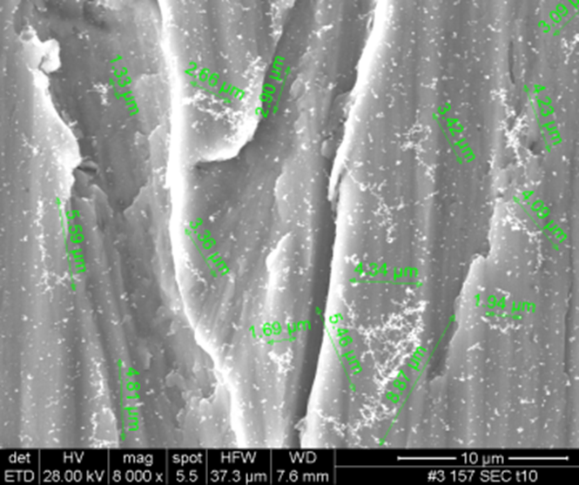
PMTrac Sensor Captures Charged Particles, Agglomerates, and Amplifies Charge up to ~1000 Times
Venturi draws exhaust gas through sensor
Concentric electrode configuration similar to DMA
Gas flows through electric field between electrode (+) and inner baffle (-); field strength ~800 kV/m
Naturally-charged, combustion-generated particles captured
Captured particles assemble (agglomerate) via electrostatic force-directed assembly (ESFDA) into filamentous structures with high surface charge density at filament tips
At growth limit of surface charge density newly captured particles or part of filaments break off and transition to opposite polarity electrode, carrying surface area proportional charge
Process repeats at opposite electrode
Result is a ~3 orders of magnitude charge current amplification
2-5 micron agglomerates evident on HV electrode at later stages and exiting sensor via SMPS and APS
6
6
6
Notes:
6
6

Slide 7
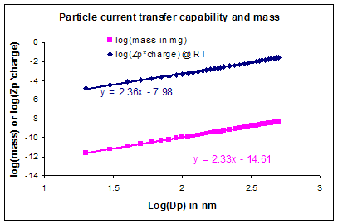
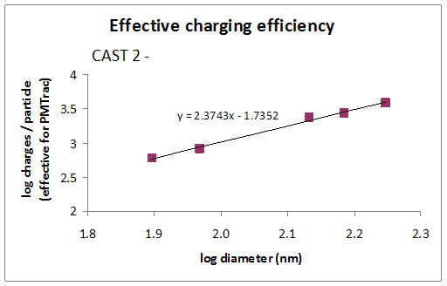
PMTrac Sensor Response (nA) is Proportional to Mass
Diesel particle mass¹⁻⁴ follows a Dp^{2.33} power law in particle diameter (Dp)
PMTrac sensor output (nA) shows a Dp^{2.37} power law response
PMTrac sensor response (nA) is proportional to particle mass for “typical” diesel combustion-generated particles
Calculation
Experiment
1) Visser et al, A Potential Soot Mass Determination Method from Resistivity Measurement of Thermophoretically Deposited Soot, Aerosol Science 45:2, 284-294, fit to table 3 data
2) Maricq et al, The effective density and fractal dimension of soot particles from premixed flames and motor vehicle exhaust, Aerosol Science 35 (2004) 1251 – 1274
3) D.B. Kittelson et al, Structural Properties of Diesel Exhaust Particles Measured
by Transmission Electron Microscopy (TEM): Relationships to Particle Mass and Mobility, Aerosol Science and Technology, 38:881–889, 2004
4) J. Riessler et al, Mass-mobility relationship of soot generator and diesel soot, European Aerosol Conference 2009, Karlsruhe
7
7
7
Notes:
7
7

Slide 8
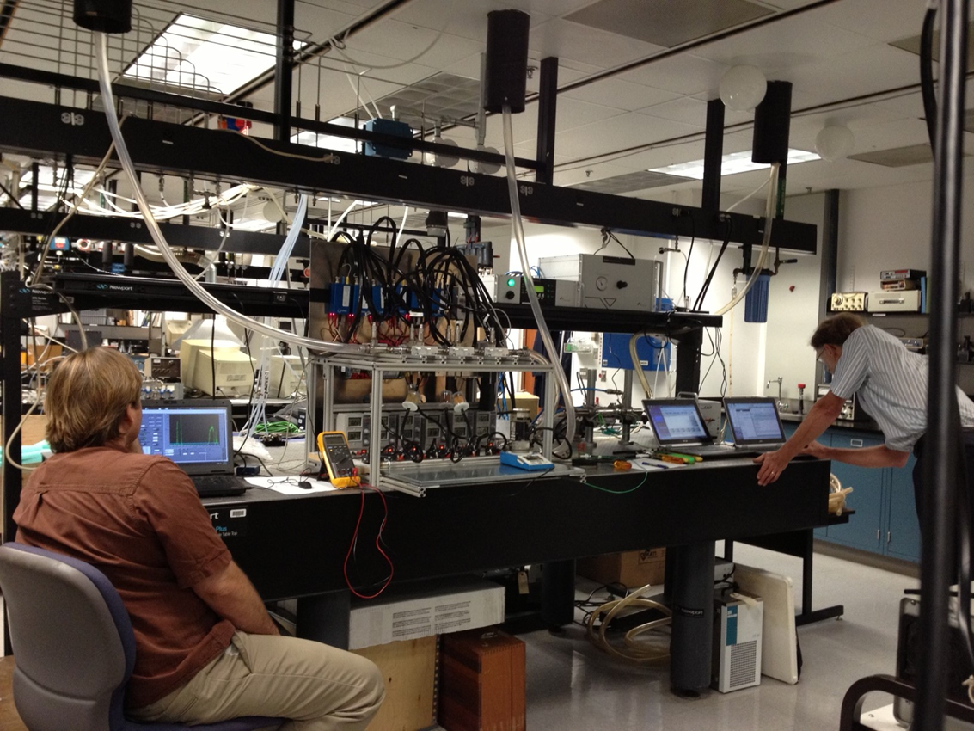
Multi-Sensor Characterization Test Rig: P&ID
Designed, built, and demonstrated multi-sensor test rig for characterizing sensors at Ford
Jing Mini-CAST 1 soot generator with Dekati FPS-4000 diluter
AVL MSS
TSI Dusttrak
Constant EGT = 24 ºC
0.5, 1, 2 LPM sample flow rates
EGV ~ 14, 30, 70 m/s
8
Notes:
8

Slide 9
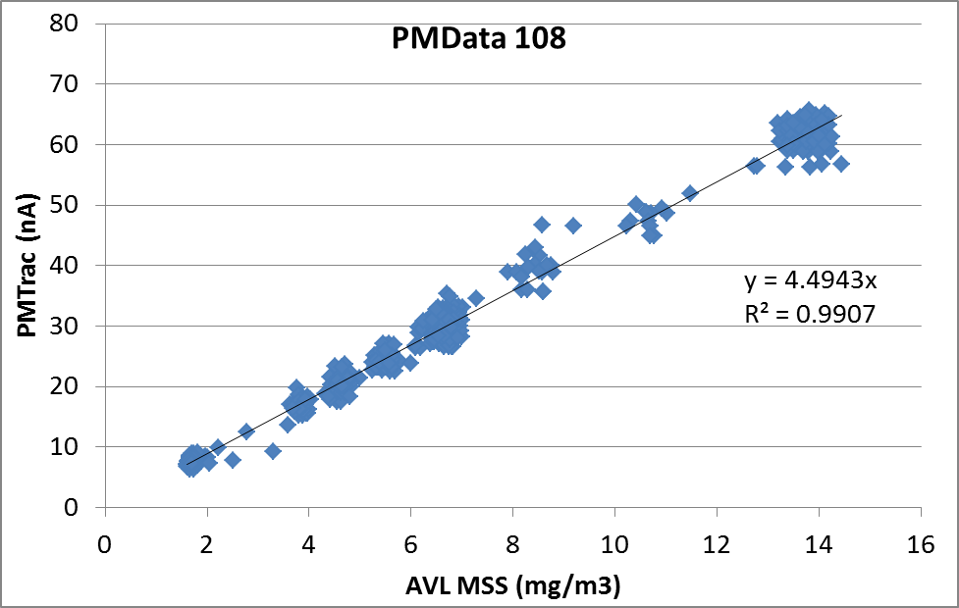
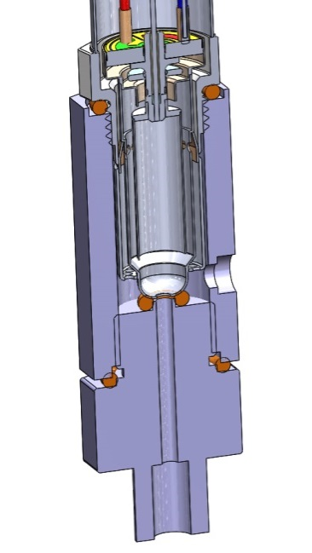
PMTrac Sensor Demonstrates Good Linearity with PM Concentration at Constant EGV and EGT
Mean of 21 Sensors
4.32 +/- 0.36 nA/(mg/m3)
Jing Mini-CAST 1
Constant EGT = 24 ºC
1 LPM sample flow
Constant EGV ~ 30 m/s
1 each PMTrac Sensor
9
9
9
Notes:
9
9

Slide 10
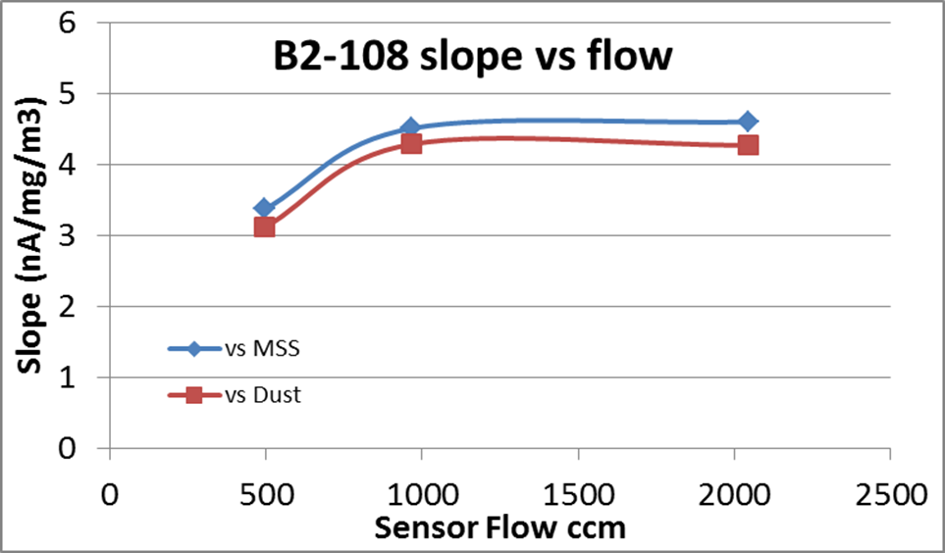
PMTrac Sensor Demonstrates Repeatable Flow Response at Constant EGT for A Wide PM Range
EGV~ 30 m/s
EGV~ 70 m/s
EGV~ 14 m/s
Jing Mini-CAST 1
Constant EGT = 24 ºC
1.7 < PM (mg/m3) < 15
10
10
10
Notes:
10
10

Slide 11
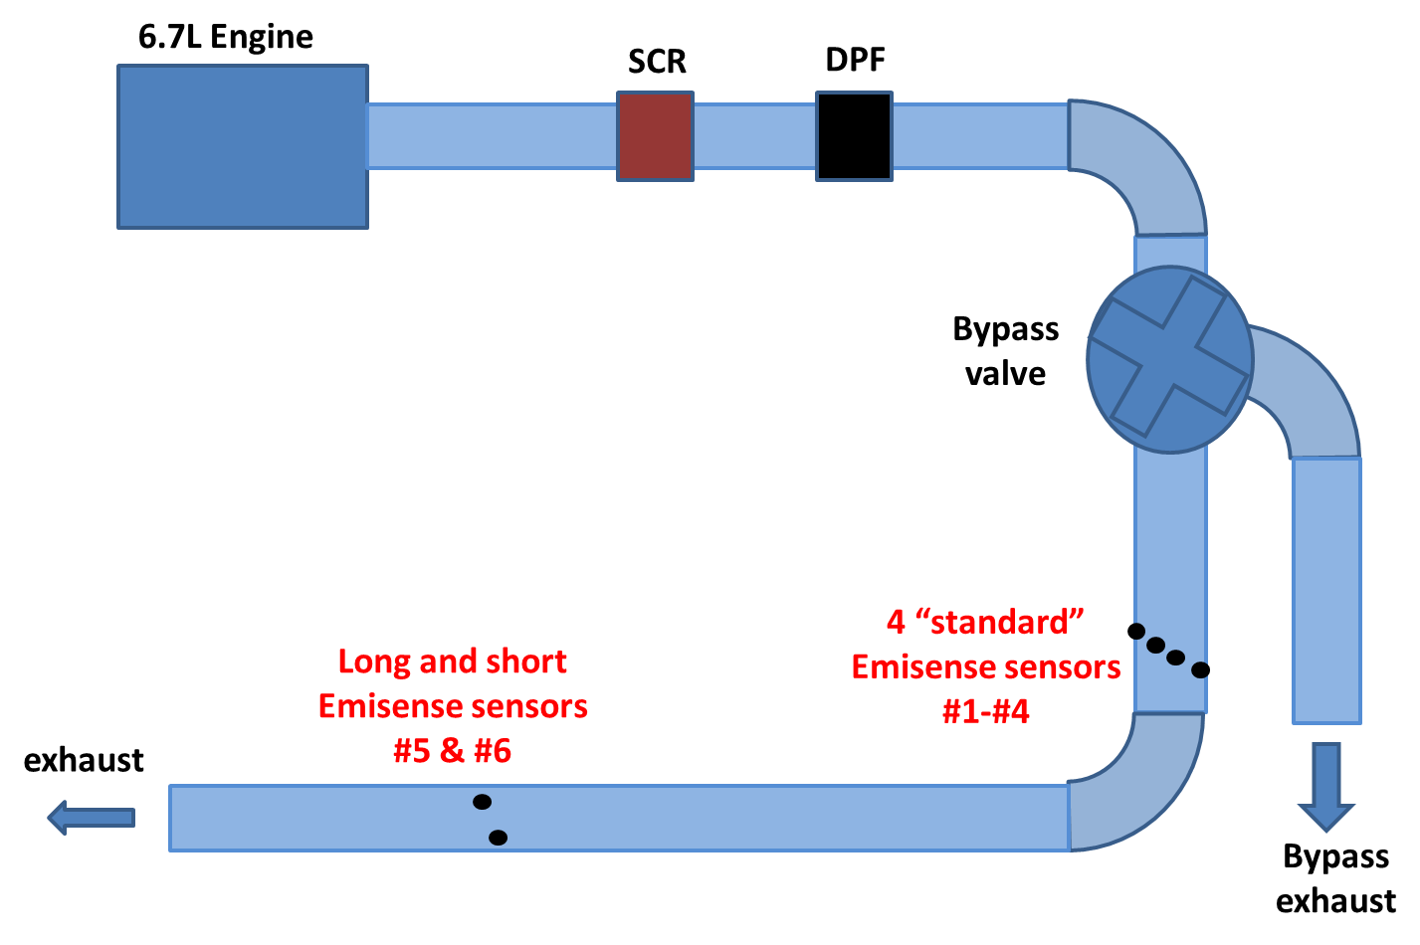
PMTrac Sensor Testing on Ford RIC 9 Dynamometer
11
11
11
Notes:
11
11

Slide 12
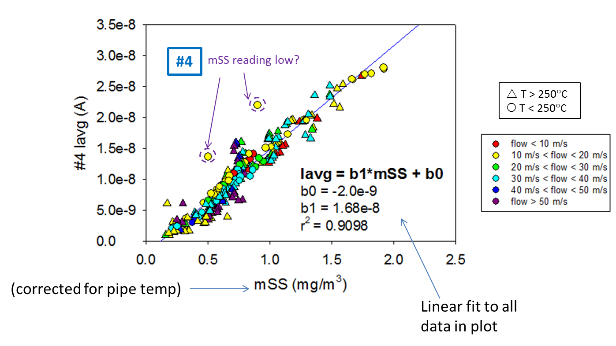
PMTrac Sensor SS T-Corrected Example Ford RIC 9 Engine Dynamometer Test Results
All steady-state data (9/20/2013 – 12/06/2013), 275 runs
Avg. sensor current for entire steady-state run vs. avg. mSS reading.
Similar EGT-corrected sensitivities (16.3 +/- 0.6 nA/(mg/m³)) for all sensors
Sensors can measure <0.25 mg/m³
Positive x-axis offset for all sensors
12
12
12
Notes:
12
12

Slide 13
Summary and Future Efforts
EmiSense PMTrac sensor is an in-situ, real-time PM sensor that correlates well with the AVL MSS over a wide range of SS test conditions and different soot sources
30 < EGT (ºC) < 340
10 < EGV (m/s) < 60
1 < PM (mg/m³) < 15
PMTrac sensitivity (nA/(mg/m3)) is consistent for a given soot source and exhaust configuration
PMTrac sensor appears relatively insensitive to EGV and EGT
PMTrac sensor measures charged particles, but not neutral particles
SMPS, APS, and SEM results confirm that larger (0.4 to 10 um) break-off agglomerates exit the sensor, verifying ESFDA
PMTrac sensor signal (nA) is amplified several orders of magnitude higher than if the observed current were solely caused by combustion-generated charged particles
Transient analyses for FTP, NRTC, and LA92 underway
First-principles-based model and transfer function that converts the PMTrac sensor’s signal (nA) to soot mass concentration (mg/m3) as a function of EGT, EGV, soot characteristics, and sensor characteristics is being developed
13
13
13
Notes:
13
13

