Slide 1
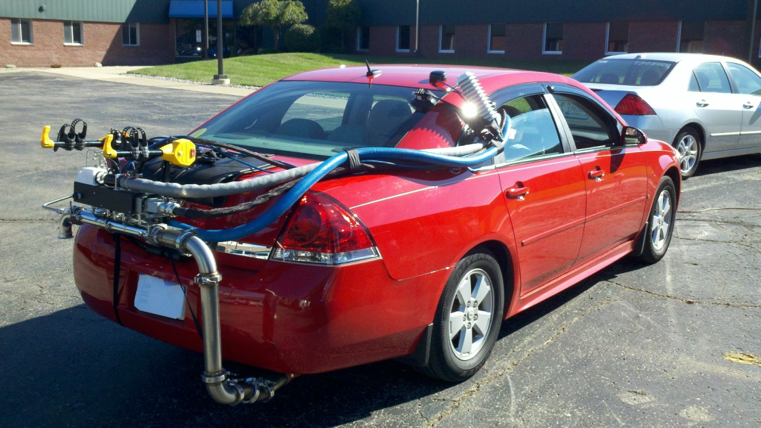
Advances in
Data Gathering
David Hawkins
James Warila
Carl Fulper
PEMS Conference

Slide 2
POPULATION
MOVES
EMISSIONS
ACTIVITY

Slide 3
Before PEMS/PAMS
Emissions
Lab Dyno Testing
Certification Data
Small fleet testing
Bag-level emissions
Engine Dyno
In-use Vehicle Program
Activity
Surveys
FHWA
  HPMS (Highway Performance Monitoring System)
Chase car studies

Slide 4
TESTING
MODELING
ADDITIONAL
CAPABILITY

Slide 5
POPULATION
MOVES
PEMS
PAMS

Slide 6
Now
PEMS
Full vehicle characterization
Custom cycle
Time-series (1Hz)
“Big Data”
PAMS
Real Driving
Unbiased
Time-series (1Hz)
OBD / Enhanced
“Big Data”
Notes:
“Big data” is data that has both breadth and depth.

Slide 7
Vertical Integration
Emissions Characterization
PEMS
Fewer Tests, Shorter Duration
Activity Characterization
PAMS
More Tests , Longer Duration

Slide 8
Vertical Integration
EMISSIONS
ACTIVITY
POPULATION
OPMODE
OPMODE
Inventory

Slide 9
Data Collection
PEMS and PAMS vastly widen testing domain
  Instrumentation
  Population
  Public Interaction
  Data Processing/Storage
  Geographic

Slide 10
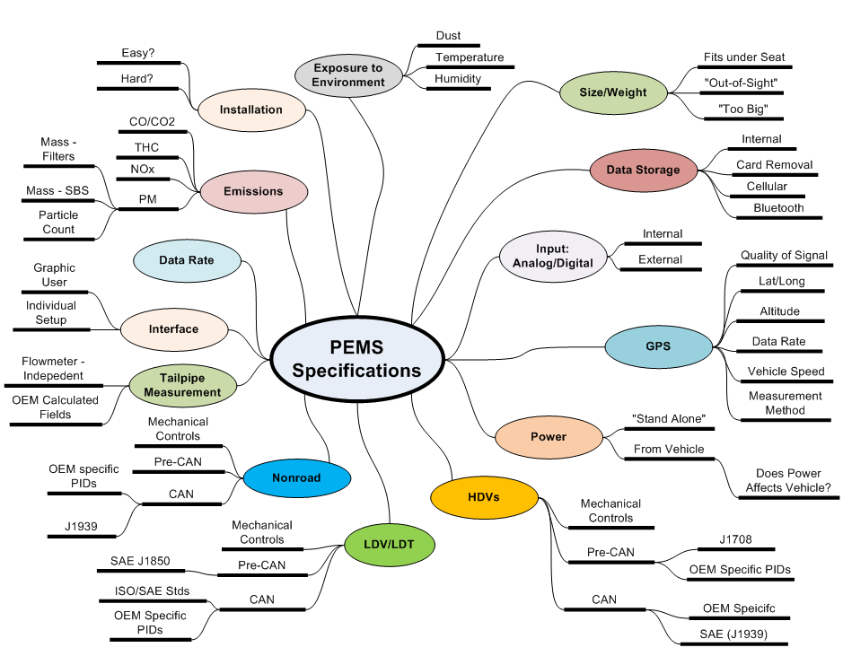

Slide 11
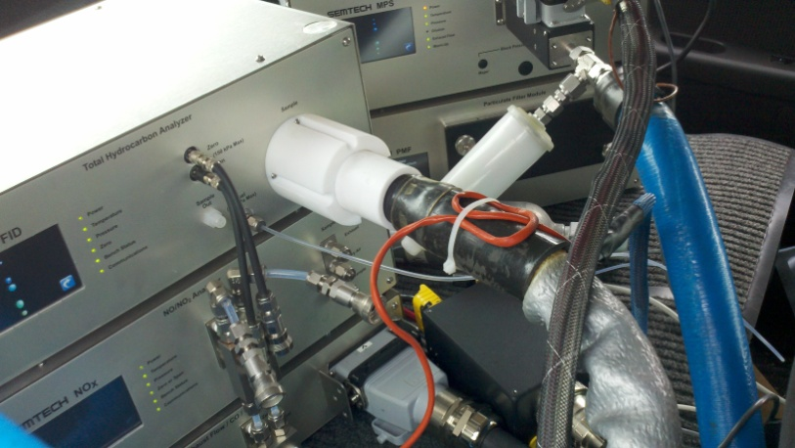
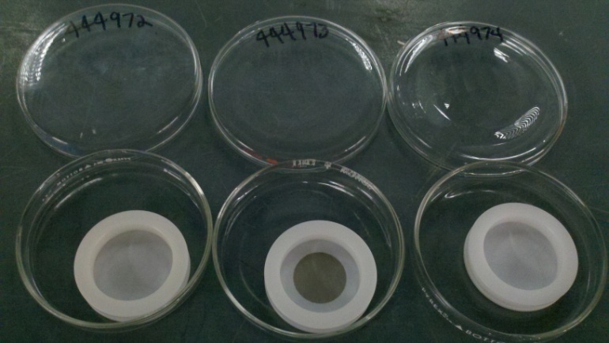
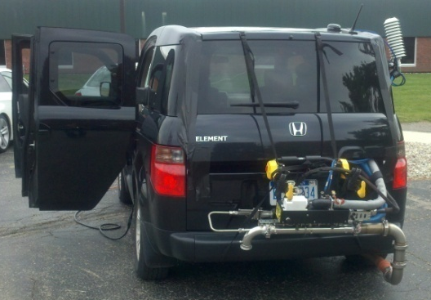
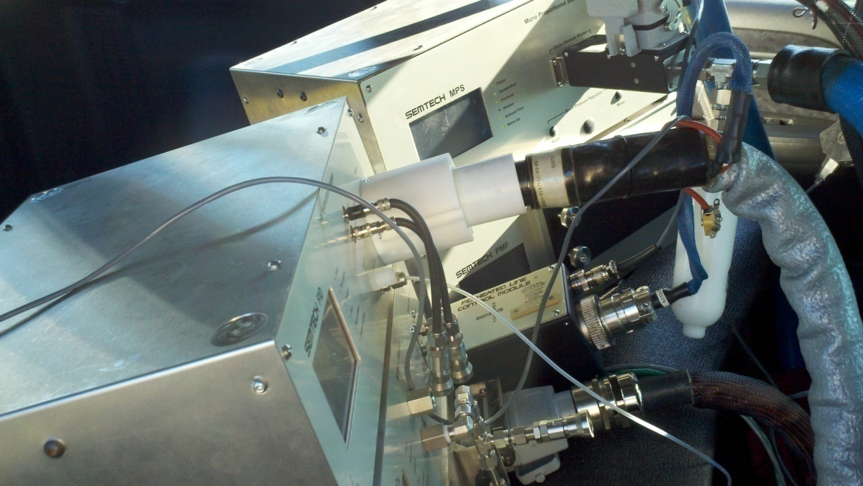
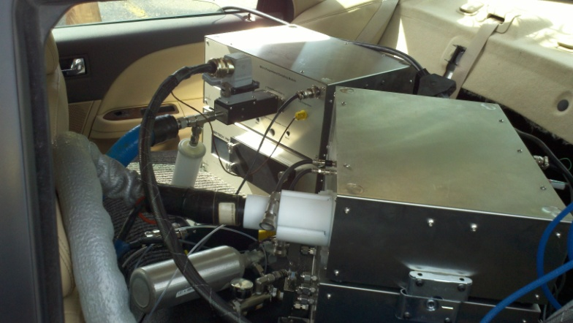

Slide 12
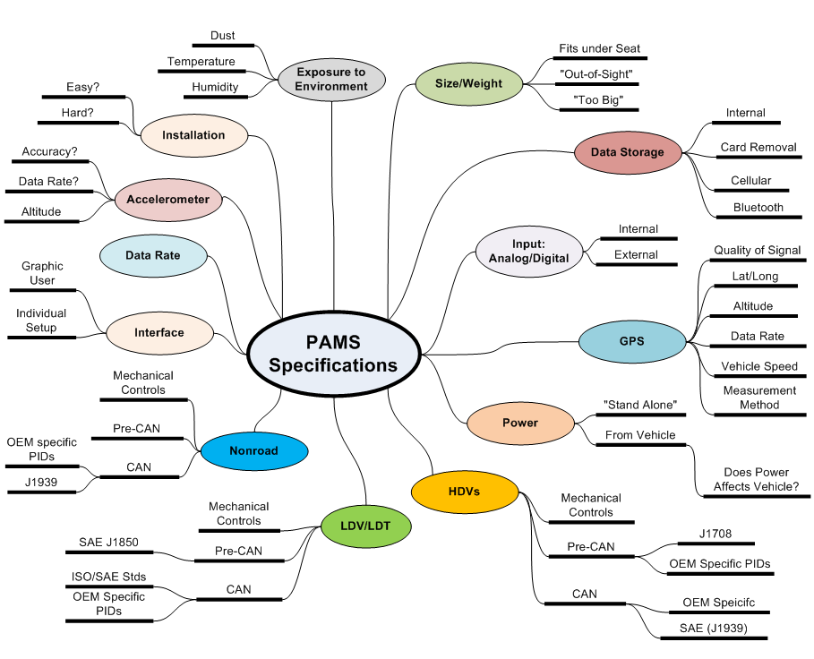
Notes:
Must be out of sight. Not affect or distract driver. Safety#1 always.

Slide 13
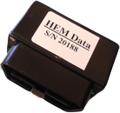
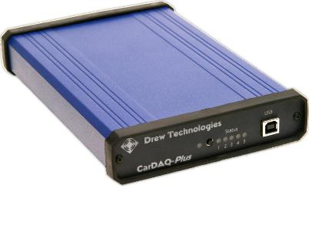
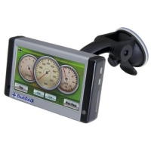
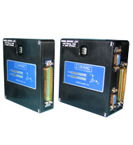
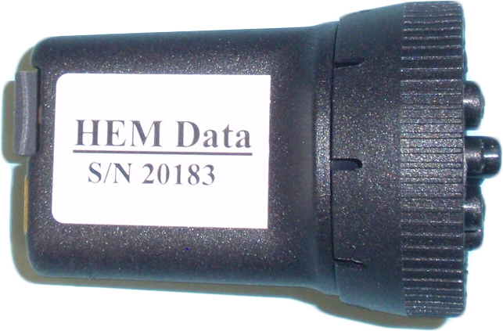
PAMS
Notes:
Add other data logger photos

Slide 14
PAMS parameters
Date/Time Stamp
GPS
OBD Parameters
Standard
  Engine Speed (RPM)
  Vehicle Speed
  Load %
  Air/Fuel Ratio
  Catalyst Temperature
  Short-Term Fuel Trim
  Long Term Fuel Trim
  Ambient Temperature
  MAP or MAF
  Inlet Temperature
  OBD Codes
  Accelerator Position
  Others
Enhanced
Fuel Economy
Fuel Rate
MAF
Fuel Injector Timing
Fuel Injector Duration
Battery State of Charge (hybrid)
Brake Light
Air conditioning
Mode (“Eco” vs. “Power” vs. “…”)

Slide 15
PAMS Data Collection
Ann Arbor Drive Cycle
2-3 hours
All MOVES op modes
Uphill/Downhill
City/Highway
Hybrid Data
Enhanced PIDS

Slide 17
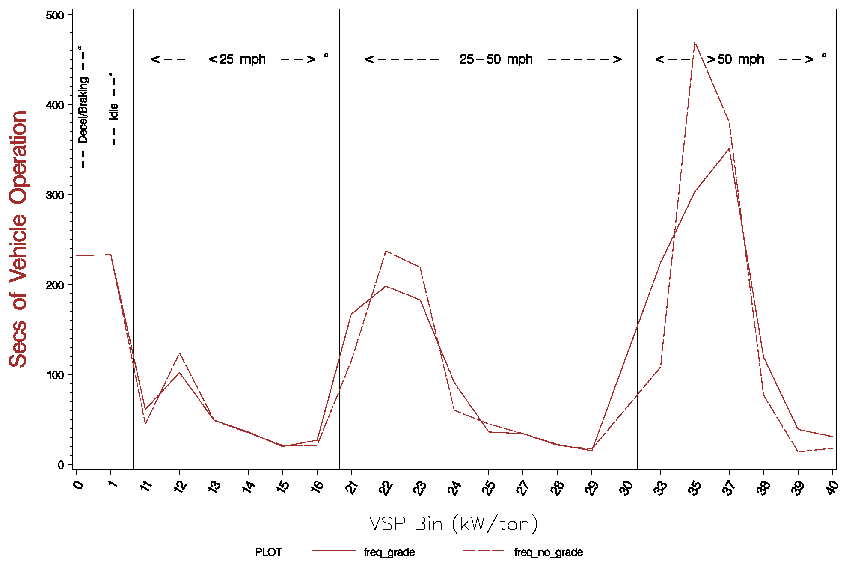
VSP Bin Frequency

Slide 19
Notes:
Zoom in on highway entrance for contrast

Slide 29
Data Quality Assurance
Lab generated data
  QA procedures well established
  Consistent instrumentation
Field data
  QA procedures exist?/evolving?
    Range check, drift check, signal alignment
  Instrumentation changing rapidly
  New challenge: Spatial Allocation
  OBD signals (Direct/Calibrated/Calculated)

Slide 30
Big Data solutions
Open Source:
Python - General purpose language
R – Statistical/Data Analysis
MySQL/PostgreSQL – Database
Licensed:
SAS – Stats
NI Diadem – GUI/scripting data analysis
Oracle/Access – Database/QL
Excel -

Slide 31
Future Plans
Continue to develop testing procedures
  Instrumentation
  Recruitment
Further automate data QA and aggregation

Slide 32
Thanks!
Questions?

