Slide 1
Development of Novel, Low-Cost Signal Processing for Single-Cell NOx Sensors
UC Riverside PEMS 2014 International Conference & Workshop
April 3, 2014
Leta Y. Woo and R. S. Glass
R. F. Novak and J. H. Visser
(Ford Motor Company)
J. Fitzpatrick, K. Allmendinger, J. Steppan, V. Wang, B. Henderson, and A. Lourdhusamy
(EmiSense Technologies, LLC)

Slide 2
Diesel engines have better efficiency – require exhaust after-treatment to meet regulations
NOx (NO and NO₂) sensors to monitor and control
  Solid-state electrochemical sensing
  Now available – costly multiple-cell amperometric (current)
  Our method – single-cell impedancemetric (ac impedance)
    High sensitivity (< 5 ppm NOx) with good stability (small ac signal possibly stabilizes interface)
    Simple device without exotic materials
    Metal or ceramic electrodes with yttria-stabilized zirconia (YSZ) O²⁻ conducting ceramic electrolyte
Demonstrate novel, low-cost signal processing using single-cell
Notes:
The motivation for my work on nox sensors is to enable more widespread use and adoption of diesel engines for passenger and light-duty vehicles. Diesel engines have much better efficiency than gasoline engines with much higher fuel economy, but require additional exhaust after-treatment systems to meet stringent emission regulations for light-duty passenger vehicles. A major concern for diesel engines are NOx emissions, no and no2. Sensors will be required for monitoring and controlling these emissions, with a number of strategies being developed. One strategy would involve using an electrochemical solid state sensor to directly measure NOx emissions (that means measuring the electrical signal from two electrodes separated by an electrolyte; this is the general method used in the oxygen sensor in vehicles). There are different types of solid-state electrochemical sensors in terms of how they are operated. Right now, there is only one type of commercially available Nox sensor, and the sensor signal is the dc current; the expensive amperometric type sensor uses multiple cells and its performance may not be able to keep up with the increasing emission requirements; our method is an alternative approach to solid-state electrochemical sensors that instead uses ac (alternating current) impedance as the sensor signal; our so-called impedancmetric type sensor has shown potential advantages over the more traditional dc techniques including high sensitivity, very good stability, a simple device structure that doesn’t rely on exotic materials or complex electronics; sensing electrodes can be either metal or ceramic with yttria-stabilized zirconia as the oxygen ion conducting ceramic electrolyte (same ceramic used in oxygen sensors). After providing some background information, today I’ll be talking about the development of our single-cell (as opposed to the commercial multiple cell) sensors and demonstrating a low-cost signal processing method.

Slide 3
Materials for impedance-based (impedancemetric) solid-state electrochemical sensors
Electrolyte: Yttria-stabilized zirconia (YSZ), O²⁻ conductor at > 600°C
Electrodes: Require at least one sensing electrode
  Symmetric or asymmetric
  Sensing
    Metal: Au- and Pt-based compositions
    Ceramic: electronically conducting metal oxides (perovskites)
  Non-sensing counter – porous metal or ceramic
Non equilibrium
multiple reactions
Notes:
The materials for impedance-based or impedancemetric sensing include the electrolyte, which is YSZ, an oxygen ion conductor at temperature above 600C, then there are the two electrodes. For impedancemetric sensing, unlike other types of electrochemical sensors, we are adding the responses of the two different electrodes, so that means only one electrode needs to be sensing, but of course, both of the electrodes could also be sensing leading to a symmetric cell; we have demonstrated performance with various sensing electrodes including au and pt-based compositions and ceramic perovskites, which are electornically conducting metal oxides. In the work I’m talking about today, I’ll focus on Au-based sensing electrode in an asymmetric cell with a porous platinum non-sensing counter electrode. I also want to emphasize that in our single cell, both electrodes are exposed to the test gas. This means that in our single cell, there are multiple reactions with both the oxygen and the Nox reaction occuring simultaneously leading to non-equilibrium thermodynamics

Slide 4
Complex impedance relationships
Im(Z)
Ohm’s Law:
V(t)=I(t)•Z(ω)
time
Complex impedance: AC response to small amplitude signals over a range of frequencies
Z''
Z
Output Current
I(t)
θ
θ
Applied Voltage
V(t)
Z'
Re(Z)
Z(ω) = Re(Z) +jIm(Z)
Re(Z) = |Z|cosθ and Im(Z) = |Z|sinθ
Real impedance
Imaginary impedance
Phase angle
Magnitude
Impedancemetric sensing: choose signal at specified frequency
Notes:
So, our approach is to use impedance-based signals for the sensor. Here is a schematic of the applied signal and the measured signals, showing the phase angle relationship, theta between the two. Impedance or the measured response to low-amplitude alternating signal over a range of frequencies and is a complex quantity including both real and imaginary components, as I’ve shown here in these relationships, and contains magnitude and phase angle information, as I’ve shown here in these relationships. Here’s a complex plane schematic illustrating the relationships. For sensor operation, a signal needs to be chosen as a specified frequency.

Slide 5
For impedancemetric operation, choose phase angle (θ) at 5-50 Hz and 100 mV excitation
Less than ~1 kHz: Impedance (phase angle, θ, and magnitude, |Z|) decrease with increasing NOx and O₂
  Oxygen – need methods for extraction and compensation
  Phase angle (): better stability and sensitivity than |Z|
  Electrode polarization and interfacial phenomena; bulk ionic transport phenomena for > ~ 10 kHz
Notes:
Just as I showed in the last slide, here is the complex plane or nyquist plot for the response of a typical sensor in different gas compositions. This complex plane has Real impedance on the x-axis and -imaginary impedance on the y-axis. Each open data point on this plot is taken at a different frequency increasing from right to left, where the darkened point are log of frequency in Hz, or from 1 Hz to 1MHz.The blue circles represent the response in 10.5% o2, the red squares are the response when 100 ppm of NO are added, and the green triangles are when O2 is increased by 8.4%, both showing a decrease in impedance. For sensor operation, a frequency and a signal are chosen; for example, here is the sensing behavior using phase angle (theta) as the signal and 5 Hz as the frequency, with 100 mV excitation over a range of NO concentrations, showing sensitivity to less than 10 ppm. We have found in previous work that phase angle serves as a stable and very sensitive signal. For the cell, the impedance decreases with increasing NOx for frequencies less than about 100 Hz, higher frequencies are not affected by changes in NOx. In terms of understanding the sensing mechanism, processes occurring in the frequency range less than about 1 kHz is typically attributed to electrode polarization

Slide 6
Sensing relies on electrochemical reaction rates at the electrode/electrolyte interfaces
Impedance – reaction rates with different frequency dependencies
  NOx and O₂ influence < 1 kHz
  Parallel contributions from both
electrolyte
electrode
Resolve ppm NOx changes in large 2-21% O₂ background by limiting O₂ reaction rate with porous YSZ electrolyte
Low sensitivity
High sensitivity
Adsorption
Adsorption
YSZ
O⁻²
YSZ
O⁻²
Diffusion
Diffusion
Charge-transfer
e⁻
e⁻
Electrode
Charge-transfer
Electrode
Minimal NO_{x} response when electrode surface dominates
Larger NO_{x} response: controlling microstructure and composition is key
Notes:
We are focusing on electrode polarization phenomena as our sensing mechanism, and we believe our system relies on parallel contributions from both the oxygen and nox reactions at the electrode/electrolyte interface. Here I’ve shown the overall reactions at that interface. As I showed previously, increasing either oxygen or nox concentration contributes to these reactions and reduces electrode polarization. Now in order to resolve ppm changes in nox in a background of 2-21% o2, which are the conditions in diesel exhaust, we are controlling the relative contributions of the two parallel reactions. To be abel to resolve the nox contributions, we use a sensing electrode with porous ysz where there is a low catalytic activity for orr relative to the nox reaction. Here I’m showing simplified cartoons of the electrode/electrolyte interface, where there is minimal nox senstivity when the oxygen reduction reaction dominates on the electrode surface, now by controlling the microstructure, composition,and operating temperature, there is high sensitivity when the electrode surface no longer dominates and the parallel nox reaction better competes with the oxygen reaction and ppm changes can be resolved. In previous work we have found that Au and LSM provide good Nox sensitivity.

Slide 7
Various test designs: focus on Au wire sensing electrode with porous Pt counter electrode
Top view
Cross-section
Au wire
YSZ
Pt
Al₂O₃
Asymmetric stacked design
10 mm x 10 mm x 0.5 mm substrate
Paint Pt electrode – fire 1200°C
Apply 8% Y₂O₃-stabilized ZrO₂ (YSZ) slurry (powder with ethanol, binder, dispersant, and plasticizer)
Attach Au wires and fired at 1000°C
Straight-forward fabrication with good performance
Notes:
In our previous work we looked at various designs, materials, and sensor configurations. Today, I will focus on an asymmetric stacked electrode design using Au wire sensing electrode with porous Pt non-sensing counter electrode. We start with a 10 x 10 mm alumina substrate, apply the Pt counter, apply the YSZ slurry, and then attach Au wires as the sensing electrode. For practical application in conventional mass manufacturing process, it would be better incorporate some more traditional commercial processing techniques such as higher temperature co-firing, instead of separate firing steps, of materials and using screen printed pastes instead of the Au wire. Nevertheless, this design provided a straight-forward lab fab with good results for studying impedance based sensing and for developing signal processing methods.

Slide 8
Demonstrated laboratory performance
Phase angle, 10 Hz,
100 mV (degrees)
650°C
NOx sensitivity to less than 5 ppm
Fast response times of less than 5 sec when adding 10 ppm
Stable reproducible performance to more than 1000 hours
Durability to more than 3800 hours
Low cross-sensitivity to water
Good sensitivity, speed, and stability
Notes:
Here is an overview of the measured laboratory sensor performance with sensitivity to less than 5 ppm, and more recent results demonstrating single ppm and better sensitivity. Even without optimizing the sensor geometry, we have measured fast response times of less than 5 sec when adding 10 ppm. The sensor has stable reproducible performance to more than 1000 hrs of continuous operation and durability to more than 3800 hrs; we have also seen good tolerance to water.

Slide 9
Performance alongside two different commercial amperometric NOx sensors
Various NO concentrations with 30 second steps
Commercial #1 and #2 data are superimposed
Low NO concentrations: 20 to 0 to 20 ppm in 5 ppm increments
High NO concentrations: 100 to 0 to 100 ppm in 25 ppm increments
O₂ concentrations of 10.5 and 18.9% and H₂O of ~4 and ~8%
Good tolerance to water with expected effect of oxygen
Notes:
More advanced laboratory testing of the Au wire sensor prototype was performed alongside commercial amperometric Nox sensors from two different suppliers. Here on the left I’m showing the dynamic gas profile for the different concentrations with time in seconds on the x-axis, the profile consisted of a low NO range from 20 to 0 in 5 ppm increments as well as a high NO concentration range from 100 to 0 in 25 ppm increments; oxygen concentrations were either 10.5 or 18.9% and water concnetrations were either about 4 or 8%. The overall results for the au sensor, the red curve corresponding to the left axis is shown on the right along with the results for the two commercial sensors, the blue and green curve, corresponding to the right axis. The testing showed excellent performance of the au sensor prototype in both the high and low ranges for NO concentration with similar behavior as the commercial sensors, and also similarly good tolerance to water where we also see the expected effect of large changes in oxygen (as I showed earlier in the complex plane/nyquist plots). In very early work we showed that oxygen interference could potentially be removed using a multiple frequency technique. Also, it should be noted that the commercial sensor have complicated electronics leading to high costs and that the prototype data I’m showing are raw signal output. We’ve shown in previous work the development of algorithms for corrections.

Slide 10
Durability in dynamometer testing in real diesel exhaust at Ford
Portion of EPA US06, a high acceleration aggressive dynamometer driving schedule
Gas
analyzer
Commercial sensor output (ppm)
Robust performance when mounted directly into tailpipe
Notes:
We’ve also performed even more advanced testing outside of the laboratory using an engine dynamometer at Ford Motor Company. Here are results for a sensor packaged into a housing and directly mounted in the tailpipe. Here I’m showing data from a portion of EPA US06, which is a high acceleration aggressive dynamometer driving schedule. On the left is the commercail sensor output, in blue as well as the raw output from te au prototype, in red, showing good agreement. On the right, I’m also showing data taken simultaneously using bench analyzers, including chemiluminescence, the black curve corresponding to the left axis and oxygen, the green curve corresponding to the right axis. Again, the raw signal from the au prototype responded to oxygen as expected. click

Slide 11
Agreement with commercial sensor in real diesel exhaust at Ford
Portion of EPA US06, a high acceleration aggressive dynamometer driving schedule
Gas
analyzer
Commercial sensor output (ppm)
O₂ response
O₂ response
Expected oxygen response – compensation strategies required
Notes:
As I’ve circled here for emphasis. This recent data confirmed previous results indicating robust and durable performance of our most recent generation of prototype sensors in engine testing.

Slide 12
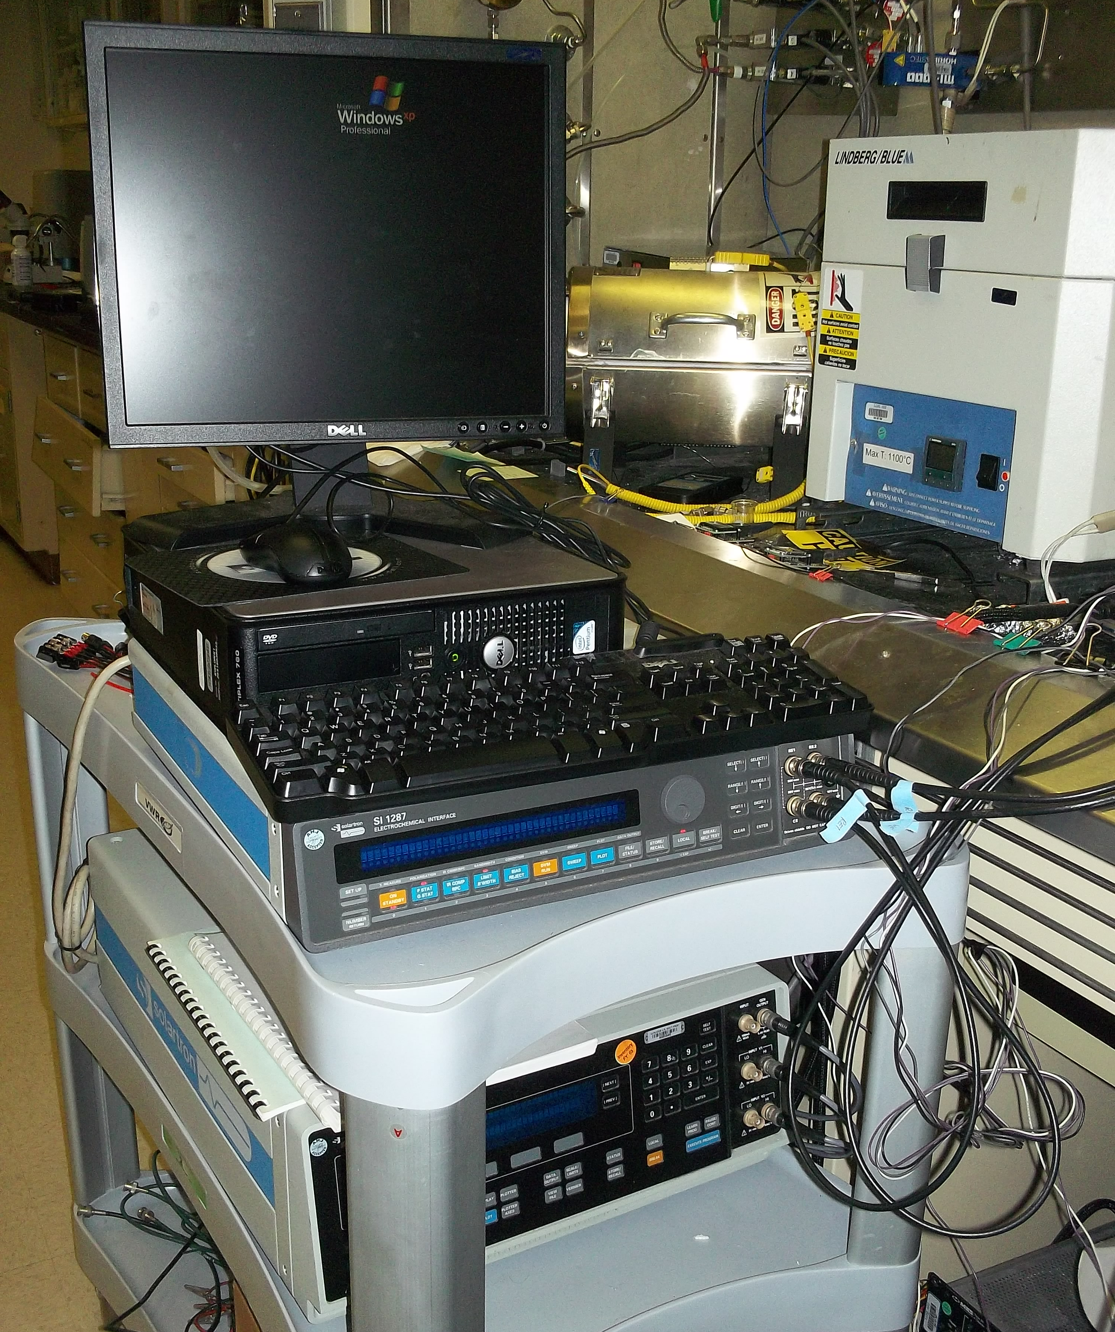
Laboratory Testing – Analytical equipment for electrochemical characterization
Computer-controlled precision instruments - Frequency Response Analyzer and Potentiostat/Galvanostat
Solartron Analytical 1260 Impedance Analyzer and 1287 Electrochemical interface
Patented single-sine correlation technique to remove noise and harmonic distortion
~$50k high-performance instrument
Suitable for development, but need portable low-cost electronics
Notes:
For laboratory testing, we rely on analytical equipment used for electrochemical characterization. These are computer-controlled precision instruments including a frequnecy response analyzer and a potentiostat/galvanostat. There are a number of different makers, but we have relied on solartron equipment, which is one of the more expensive, and one of the things you’re paying for is their patented technique to remove noise and harmonic distortion; this is great for sensor development, but we really need something portable and low-cost for deploying the sensor.

Slide 13
1st generation electronics developed by Ford
Wave
Generator
Current
Amplifier
Sensor
0 deg
Summing
Filter
Rectifying
Amplifier
Calculate phase shift from analog voltages
90 deg
Summing
Filter
Rectifying
Amplifier
Analog phase measurement operated with triangle wave input
Notes:
Our first attempt was in collaboration with Ford Motor Company and we developed analog electronics shown in this block diagram. (~$150) There is a triangle wave generator and for signal processing, there is a current amplifier, and then rectifying amplifiers and summing filters to produce a sensor output with two different voltages that could then be used to calculate the phase shift.

Slide 14
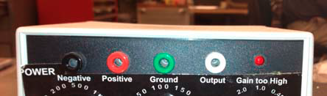
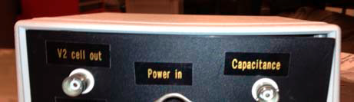
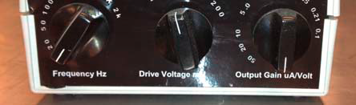
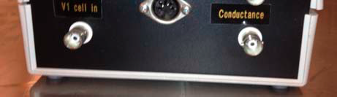
Two voltage outputs associated with capacitance and conductance
Demonstrated reasonable NOx detection
Notes:
Here is some data showing the two different measured voltages, one associated with capacitance and the other with conductance, for our sensor stepping through some different concentrations of Nox, this was a demonstration for the low cost signal processing method for operating the sensor using an ac method and a good first attempt at portable electronics. Here I’m showing the front panel, which had dials to control the frequency of operation, the drive voltage and the output gain and here is the back panel with the connectors for the source and output.

Slide 15
Initial electronics using signal processing with digital measurements developed by EmiSense
Triangle Wave
Generator
Current
Amplifier
Sensor
Zero
Crossing
Detector
Zero
Crossing
Detector
Phase shift should have direct relationship with time
Timer/counter control on CPU for time-based phase measurement
Dramatically simpler than analog phase measurement
Notes:
$15 for small quantity development; building on our successful first demonstration, we then worked with EmiSense to make major advancements in the electronics and also to better understand the signal processing. One of the next major advances was using digital measurements instead of the previous analog measurements. A digital method should allow a more direct measurement of the phase shift by using its realtionship with time, as I’ve shown here. The top blue shows the source and the red shows the output as a function of time with the anticipated phase shift, directly below, you can see how the zero crossing for each can be used to relate the phase shift to time as a more direct measurement of the phase shift. The block diagram now has zero crossing detectors for the source and output and no more rectifying amplifiers or summing filters for a very simple time-based phase measurement with even lower cost electronics.

Slide 16
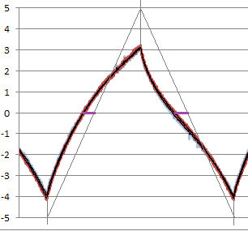
Complex wave form of sensor in response to triangle wave source
Sensor
output
Peak of sensor response relatively unchanged – no phase shift!
Complex changes in asymmetric wave form – changes in measured zero-crossing
NOx and oxygen concentration alter different portions of wave in time – basis for extracting oxygen
Triangle source
Source/Output
time
Digital measurement based on voltage-current time differential
Notes:
Jim – label curves; Here I’m showing the waveform of the sensor output in response to the triangle wave source. It turns out that the sensor has a complex waveform and that the peak of the response remains relatively unchanged so that there is no phase shift. Nevertheless less, there are complex changes in the curvature of the asymmetric wave form that produces changes in the measured zero-crossing. We also saw that Nox and oxygen alter different portions of the wave in time, which can be used as the basis for extracting and compensating for oxygen. The anlaysis of the complex waveform indicates that our signal processing method is based on this voltage-current time differential as opposed to a real phase shift.

Slide 17
Improved electronics with added functionality
Digital Waveform
Generator
Current
Amplifier
Synchronous Wave Sampling
Sensor
Programmable Threshold Detection
High-frequency timer/counter
Programmable Threshold Detection
Tuning waveform shape to improve NOx sensitivity
Higher frequency sine waves to measure bulk resistance and temperature
Multiple programmable threshold detectors with values other than zero crossing to measure both NOx and O₂ in a single excitation cycle
Digital sampling of current wave synchronous with generation – peak current detection and future auto detection of gain and threshold
Notes:
Now that we saw that the AC response was more complex and that oxygen information could be obtained, additional modifications were made. The first was a digital waveform generator that could generate not only the triangle wave, but also multiple waveforms, that could be used to exaggerate the Nox response. Also, higher frequency sine waves can be used to measure bulk resistance and temperature, which is a high resolution measurement for heater control. Instead of fixed zero-crossing detectors, we now have programmable threshold detection capable of measuring both Nox and O2 in a single excitation cycle. Finally, we added digital sampling of the current synchronous with the waveform generator, which can be used for diagnostic purposes to detect peak currents for temperature diagnostics and in the future could be used for auto detection of gain and threshold.
Slightly more expensive.
Originally we just looked for an overall impedance shift. Once it because clear that the AC response was more complex and that additional information, like O2, could be extracted, we made the following changes:
1. Went to digital waveform generation
This allows the shape of the wave to be easily altered to exaggerate AC response. It also allows us to inject higher frequency sine waves to periodically measure bulk resistance (a fairly high resolution measurement for heater control)
2. Added multiple threshold detectors and made the thresholds programmable instead of fixed at 0
We did this so that we could get the measurements required for both O2 and NOx in a single excitation cycle
3. Digital sampling of the current wave (synchronous with digital waveform generation)
This was added for future auto detection of gain and threshold settings, and is also currently used to sample and hold peak currents achieved for thermal monitoring.
4. Heater control in the form of a PWM output and current/voltage monitoring
This permits monitoring heater resistance, but we believe that the higher sensitivity bulk resistance measurement is required.
5. A thermocouple input
Purely for diagnostics and testing

Slide 18
Electronics for driving heater and monitoring temperature
Heater PWM Output
Heater Current and Voltage Monitoring
Substrate Heater
Thermocouple Input
Pulse-width modulation (PWM) output for driving heater
Heater resistance monitored with current and voltage
Thermocouple input for diagnostics
Better temperature resolution with bulk resistance measurement
Notes:
We also developed electronics for driving the resistive substrate heater with pulse-width modultion output with the heater resistance monitored using current and voltage and a thermocouple input was added for diagnostic purposes. As I already mentioned in the last slide, it is anticipated that the bulk resistance measurement with high frequency sine waves will provide the best resolution for temperature.
Originally we just looked for an overall impedance shift. Once it because clear that the AC response was more complex and that additional information, like O2, could be extracted, we made the following changes:
1. Went to digital waveform generation
This allows the shape of the wave to be easily altered to exaggerate AC response. It also allows us to inject higher frequency sine waves to periodically measure bulk resistance (a fairly high resolution measurement for heater control)
2. Added multiple threshold detectors and made the thresholds programmable instead of fixed at 0
We did this so that we could get the measurements required for both O2 and NOx in a single excitation cycle
3. Digital sampling of the current wave (synchronous with digital waveform generation)
This was added for future auto detection of gain and threshold settings, and is also currently used to sample and hold peak currents achieved for thermal monitoring.
4. Heater control in the form of a PWM output and current/voltage monitoring
This permits monitoring heater resistance, but we believe that the higher sensitivity bulk resistance measurement is required.
5. A thermocouple input
Purely for diagnostics and testing

Slide 19
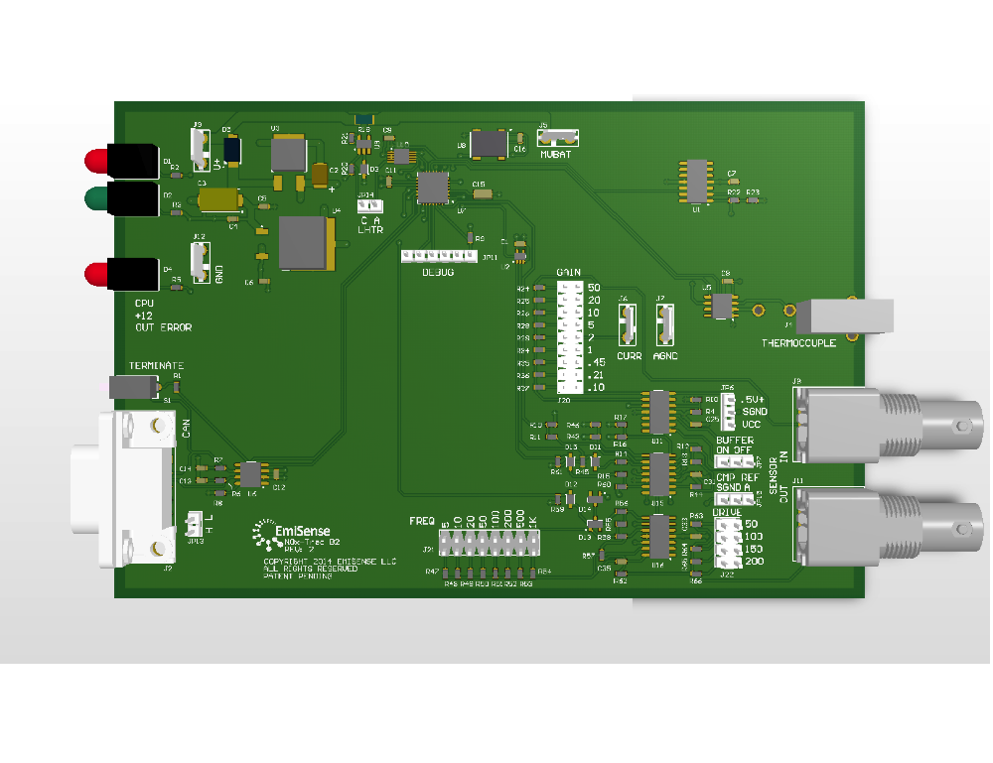
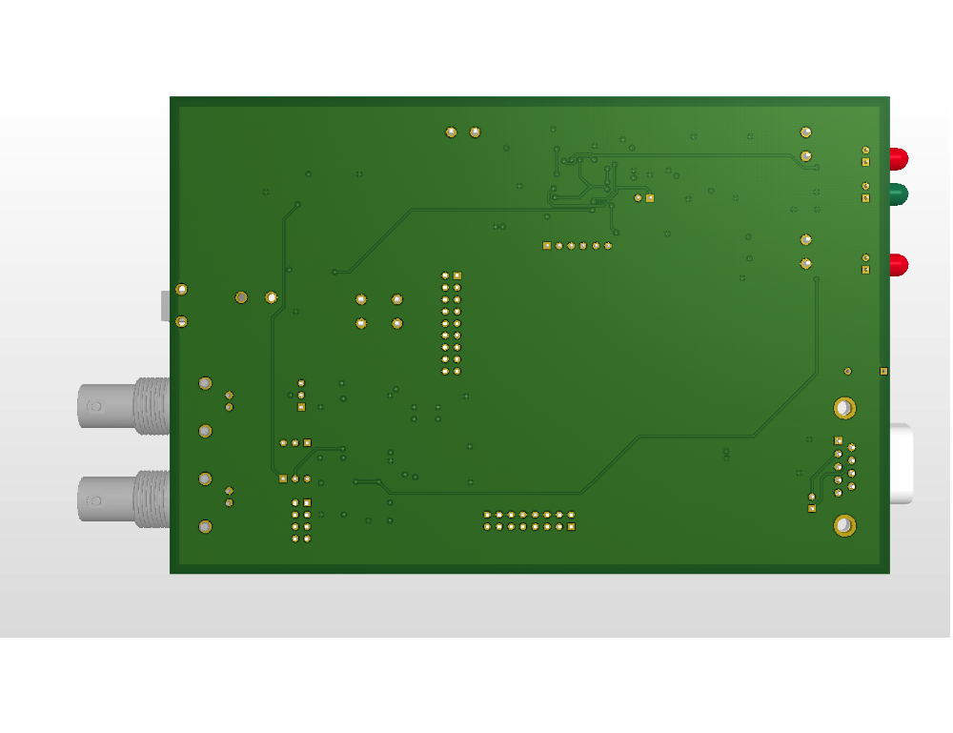
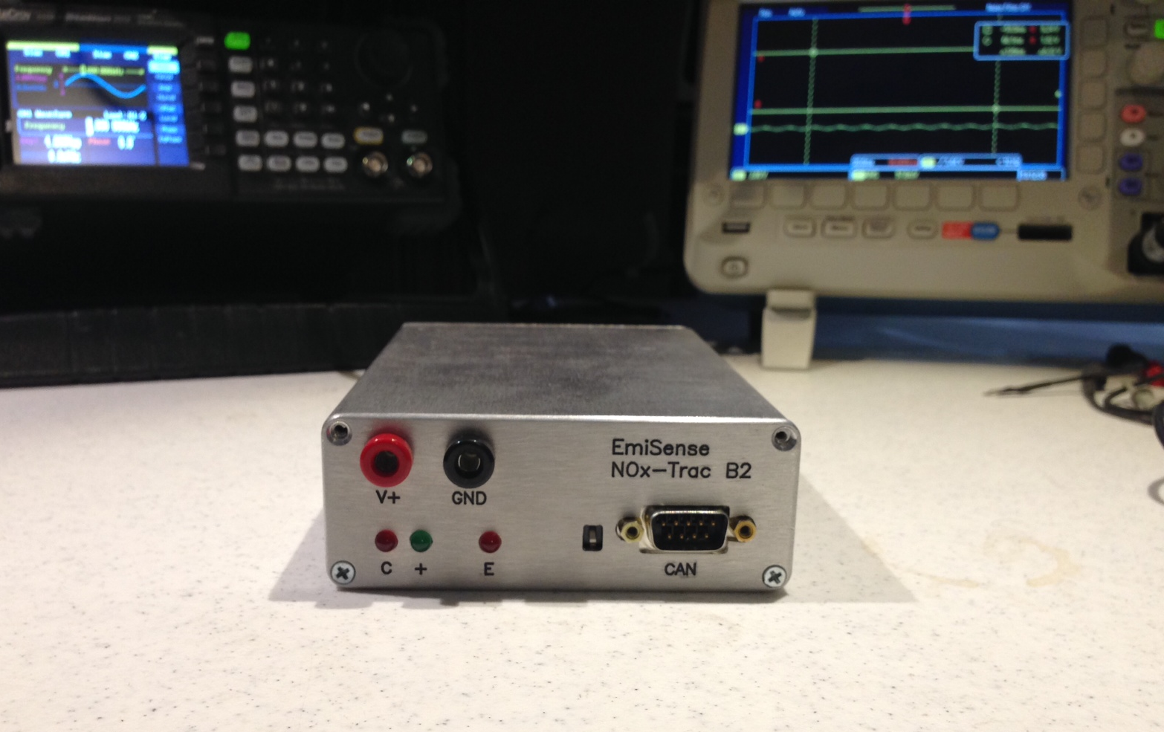
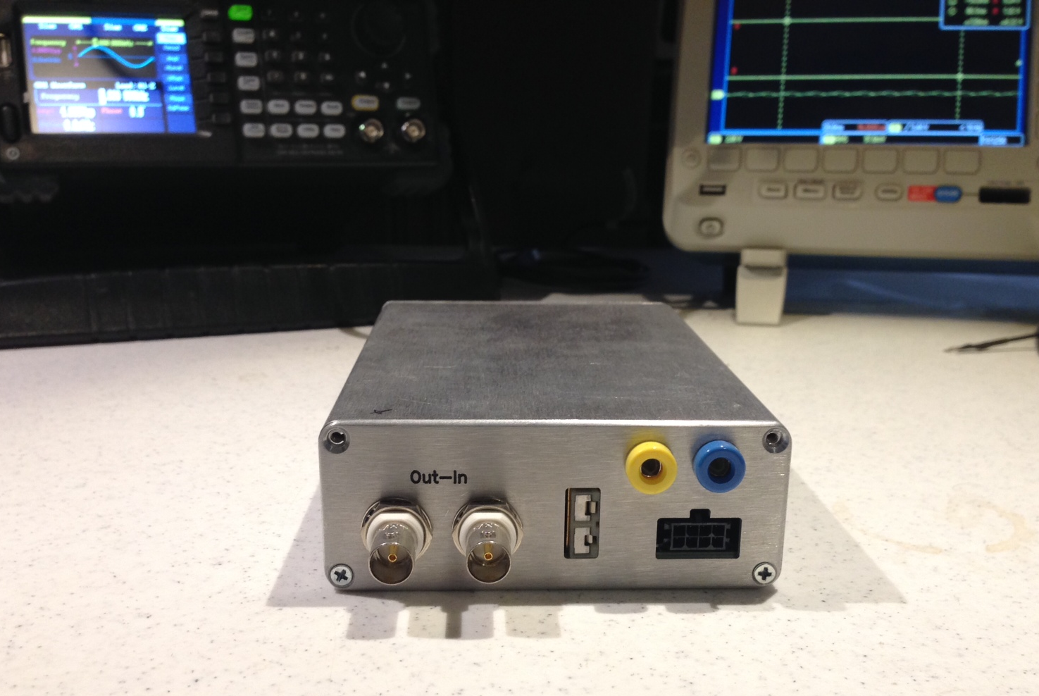
Novel signal processing with EmiSense electronics
Notes:
Here is a look at the electronics, with the top of the board on the top left and the top right showing the back of the board and connections. Components are spaced out to allow for easy access with probes at this development stage. I’m showing the front and back panel of the portable electronics on the bottom. Instead of the dials on the previous electronics, settings are made with jumpers on the circuit board.

Slide 20
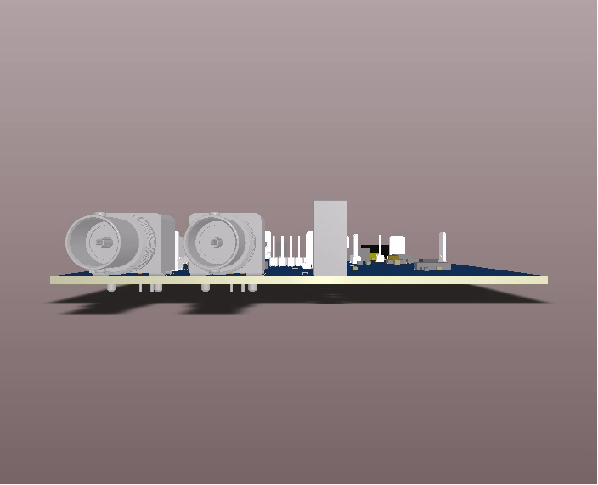
Closer look at the electronics
Notes:
Here is a short 20 sec. movie with a closer look at the electronics.

Slide 21
Agreement between Solartron and low-cost digital EmiSense electronics for Au wire sensor
EmiSense Electronics
650°C
650°C
Electronics show potential to exceed Solartron performance
Notes:
Here are side-by-side results comparing the solartron to the EmiSense electronics for the Au wire sensor showing excellent agreement. Whereas the solartron showed about a 1.5 degree phase shift when adding 90 ppm, the EmiSense electronics had almost a 5 degree change indicating that it has the potential to exceed the solartron capabilities for detection.

Slide 22
Tunable EmiSense signal processing enables more flexibility in sensor operation and design
Incorporating more desirable traditional processing
  Screen-printed metal pastes and inks
  Higher firing (>1500°C) for compatibility with green Al₂O₃
Top view
Cross-section
High-fired
porous YSZ
Au/Pt
paste
Al₂O₃
Notes:
With the potential for higher resolution and sensitivity, the tunable EmiSense signal processing allows for more flexibility in the sensor operation and design. For example, in terms of incorporating more desirable traditional processing techniques such as screen-printed metal pastes and inks as well as higher firing of the components for compatibility to cofire with the alumina substrate. Here I’m showing an example of another sensor using high-fored porous YSZ and Au/Pt paste with good response with the EmiSense electronics.

Slide 23
Summary and conclusions
Advantages of impedancemetric NO_{x} sensing include high sensitivity, good stability, simple device structure, and design flexibility
Sensing relies on electrochemical reaction rates at the electrode/electrolyte interfaces
A novel low-cost signal processing method showed agreement with expensive analytical equipment used in laboratory development
  Digital method for measuring voltage-current differential – complex asymmetric wave form
  Changes in NOx and oxygen alter different portions (in time) of complex asymmetric wave forms
Tunable signal processing enables more flexibility in designs – using screen-printed paste electrodes and higher fired porous electrolytes

Slide 24
Acknowledgements
Ford Motor Company (David Kubinski and Mike Parsons)
Department of Energy, Office of Vehicle Technologies, Propulsion Materials (Jerry Gibbs)
California Energy Commission (Marla Mueller)
Thank you for your attention!
Leta Woo
woo21@llnl.gov

