Slide 1
PEMS International Conference & Workshop April 3-4, 2014
High-Speed Portable FTIR Measurements From In-Use Heavy-Duty CNG Transit Buses
Xu Wang¹, Saroj Pradhan², Arvind Thiruvengadam²,
Marc Besch², David Quiros¹, Tao Huai¹
¹ Monitoring & Laboratory Division, California Air Resources Board
² Center for Alternative Fuels, Engines & Emissions, West Virginia University

Slide 2
Motivation and Background
Transit buses are commonly powered by compressed natural gas (CNG); designed to meet the 2010 NO_{X} standard (0.2 g/bhp-hr) with a simple three-way catalyst (TWC).
However, under certain conditions, stoichiometric CNG buses with a TWC can favor emissions of ammonia (NH₃) and nitrous oxide (N₂O) affecting secondary PM formation and global climate, respectively.
Laboratory measurements of NH₃, and other unregulated pollutants, have been conducted in the controlled laboratory.
On-road measurements of many gaseous pollutants is possible with a portable FTIR instruments (PEMS), but further evaluation needed.

Slide 3
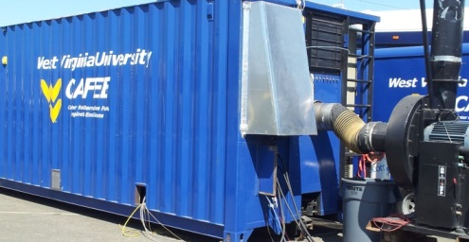
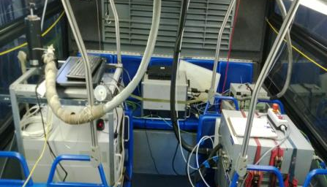
Objectives
Compare emissions measured over DYNAMOMETER and two ON-ROAD routes for the same stoichiometric TWC-equipped CNG urban transit buses during operation in a typical CA city.
Evaluate the performance of a portable FTIR, the MKS 2030 HS, in reference to CFR 1065 compliant measures.
Using a portable FTIR, report emission factors for: ammonia (NH₃), nitrous oxide (N₂O), and methane (CH₄).
West Virginia University
Transportable Emissions Measurement System (TEMS)
Sacramento Regional Transit Bus
PEMS for on-road measurement

Slide 4
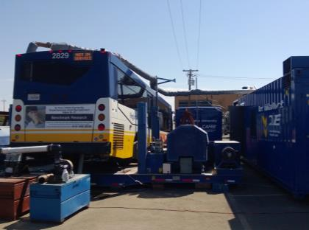
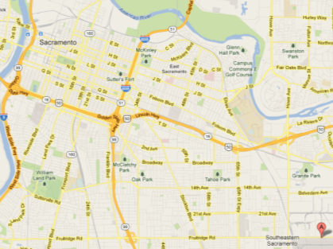
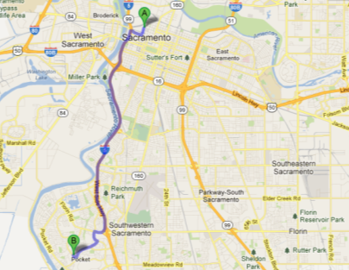
Study Design: 3 routes, 3 buses 2008 Cummins Westport ISL-G Stoichiometric CNG with TWC
OC BUS Cycle Orange County Bus Cycle Transportable Dynamometer | In-use LOCAL Route Sacramento RT #51 (with all regular stops) | In-use HIGHWAY Route Sacramento RT #7 (with all regular stops)
Distance: 6.5 mi Time: 2000 sec 11.7 mph Bus A & Bus B | Distance: 11 mi Time: 3000 sec 13.3 mph Bus B & Bus C | Distance: 9 mi Time: 1000 sec 32.4 mph Bus B & Bus C
WVU 1065-compliant Transportable Emissions Measurement System: NO, NO_{X,} CO, CO_{2,} CH_{4,} THC, NMHC MKS 2030HS FTIR: CO, CO₂, NO, NO₂, CH₄, NH₃, N₂O | Horiba OBS 2200: CO, CO₂, NO, NO_{2,} NO_{X} MKS 2030 HS FTIR: NH₃, N₂O, CH₄
B

Slide 5
Gaseous Emissions by Driving Cycle
CO₂, /1000
NO
NO_{X}
CO /100

Slide 6
Verification of the FTIR with TEMS (Dynamometer Cycle)
NO
NO_{X}
CO /100
CO₂ /5000

Slide 7
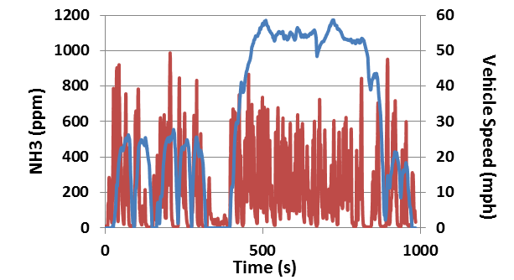
Portable FTIR: Real-Time NH_{3,} BUS B
Dynamometer
Max: 1040 ppm
Average: 145 ppm
On-road LOCAL
Max: 1062 ppm
Average: 155 ppm
On-road HIGHWAY
Max: 986 ppm
Average: 208 ppm

Slide 8
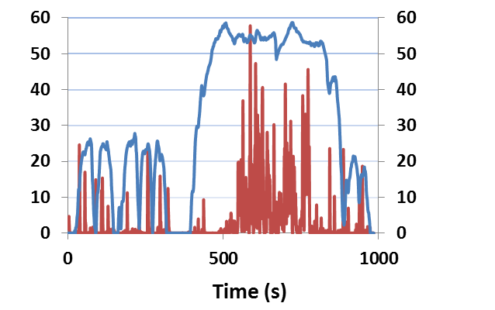
Portable FTIR: Real-Time N₂O, BUS B
Vehicle Speed (mph)
N2O (ppm)
Dynamometer
Max: 42 ppm
Average: 1.19 ppm
Vehicle Speed (mph)
N2O (ppm)
Vehicle Speed (mph)
On-road LOCAL
Max: 32 ppm
Average: 0.54 ppm
N2O (ppm)
On-road HIGHWAY
Max: 57 ppm
Average: 3.09 ppm

Slide 9
Highway Route: N₂O Emissions Vary Between Buses Tested Over Same In-Use Route
Bus B
Bus C

Slide 10
On-Road HIGHWAY: Weak Relationship Between
Road Load (Power) and Emission Rate

Slide 11
Portable FTIR: NH₃, N₂O and CH₄ Emission Factors
NH₃
CH₄
N₂O (x100)

Slide 12
Comparison of CNG Emission Factors
*Average of UDDS, CBD, and Cruise Cycles, converted using 3 bhp-hr = 1 mi.
Configuration | CO₂ (kg/mi) | NO_{X} (g/mi) | CH₄ (g/mi) | NH₃ (g/mi) | N₂O (mg/mi)
This study, OC BUS | 2.7 | 0.78 | 6.9 | 3.1 | 16
This study, on-road LOCAL | 1.8 | 0.84 | 6.0 | 1.7 | 39
This study, on-road HIGHWAY | 1.0 | 0.70 | 3.7 | 1.0 | 83
CNG Buses w/TWC, UDDS¹ | 1.7 | 0.52 | 3.5
CNG Buses w/TWC, 45 mph¹ | 0.7 | 0.11 | 1.3
CNG Buses w/OC (Lean), UDDS¹ | 1.5 | 14.9 | 6.4
HD CNG w/TWC² |  | 0.15* |  | 1.2*
LD CNG w/TWC, FTP³ |  |  |  |  | 25-85
HD CNG^{4,5} |  |  |  |  | 36-93
Yoon, S. et al. Criteria pollutant and greenhouse gas emissions from CNG transit buses equipped with three-way catalysts compared to lean-burn engines and oxidation catalyst technologies. JAWMA 63(8):926–933, 2013.
Johnson, K. Emissions from In-Use NG, Propane, and Diesel Fueled Heavy Duty Vehicles. DEER 2011.
Vanderlei Borsari & João Vicente de Assunção, Nitrous oxide emissions from gasohol, ethanol and CNG light duty vehicles, Climatic Change (2012) 111:519–531
Graham, L.A. et al. Greenhouse gas emissions from heavy-duty vehicles. Atmospheric Environment 42 (2008) 4665–4681.
Becker, et al. Nitrous Oxide (N2O) Emissions from Vehicles. ES&T. 1999, 33, 4134-4139.

Slide 13
Key Findings
NH₃ and CH₄ emission factors scale with CO₂ emissions (OC BUS > ON-ROAD), but N₂O emission factors exhibit opposite trend: 2-4 times higher for local and highway ON-ROAD routes than OC BUS.
Real-time emissions of NH₃ and N₂O poorly explained by engine output alone; and test-to-test, or bus-to-bus, variability was observed.
Six tests from three buses over three routes show FTIR emissions of NH₃, CH₄, and N₂O were within broad literature ranges.
Future use of portable FTIR as a PEMS warranted for measuring a diverse array of regulated and unregulated gaseous pollutants.

