Slide 1
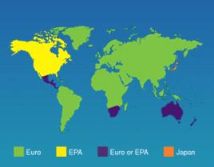
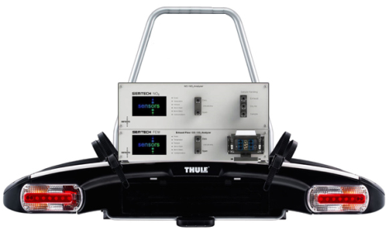
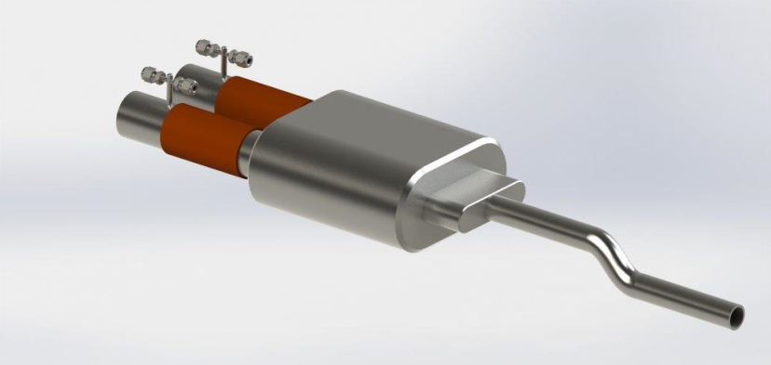
Challenges and Solutions for Light Duty Real-World PEMS Testing
David Booker, Carl Ensfield (Sensors Inc)
PEMS Conference UCR,CE-CERT, April 2014
Company Focus: Regulatory Driven PEMS Markets

Slide 2
Presentation Overview
PEMS Background
  Application Experience and Outlook
Challenges and Implications
  Performance Criteria
  Power, Size and Weight
  Usability
Solutions for NOx, PM and PN
Data Processing

Slide 3
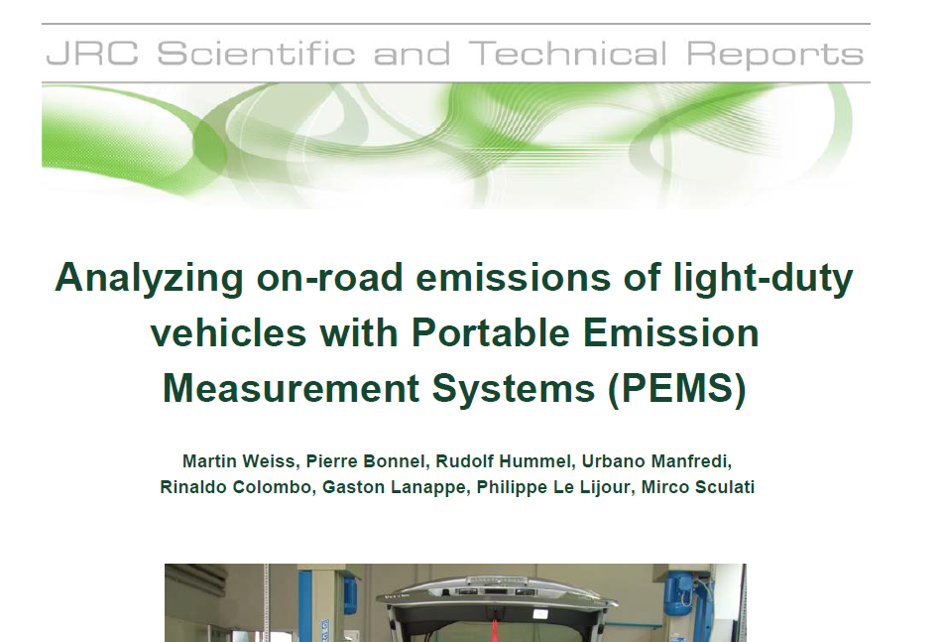
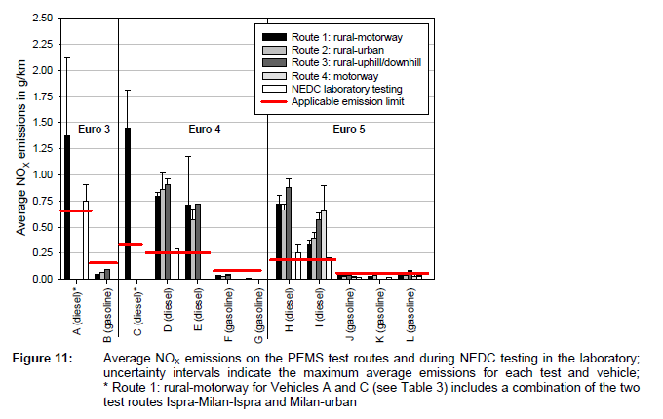

Regulator Motivation: Legal Framework and strong desire in place to address ambient air pollution for NOx and PN
2017 Implementation

Slide 4

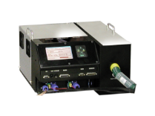
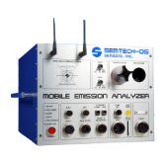





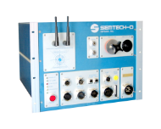
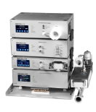
PEMS Past & Future
US EPA
Heavy Duty
In-Use
Program
Heavy Duty
Off Road
In-Use
Program
Potential
In Use
Compliance
Programs
GHG?
Fuel Economy?
Expanded Cert
& Compliance?
1990
1995
2000
2005
2010
2015
2020
European
In-Use
Programs
RDE-LDV
Certification
& Compliance
Program
Measurement
Allowance
Program
& SAE J1321
Asia
Programs
From 2005 to 2013: 300+ PEMS systems delivered World-Wide with Significant growing markets in Europe and Asia (2014+)

Slide 5

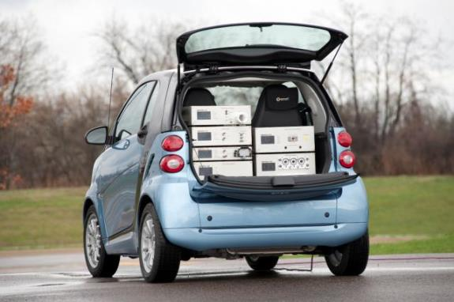
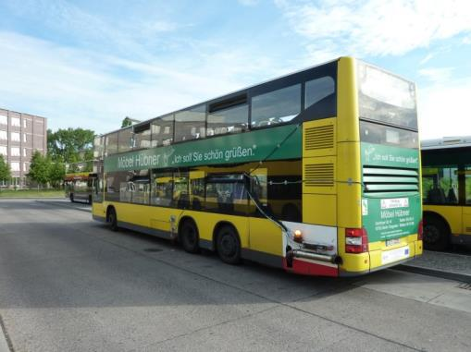
PEMS Experience Across Multiple Platforms
Light Duty
Heavy Duty
Off Road - Various

Slide 6
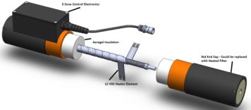
Clearly, from an European perspective, and in particular with reference to the LDV/RDE initiatives, ECOSTAR product differentiation / development will likely always be associated with the following 4 key components:-
Regulatory Compliance
“Perceived” Value, Cost of Ownership
“Usability”
  Size, Weight and Power
  Ease-of-Use
  MTBF, MTTR
  Functionality
  Flexibility
  Support
Relationships
  Regulatory agencies “approval” / “use”
  Customers
Testing / Evaluation
Criteria Changes
Power < 120 Ah (2 Hour Test)
Installed Weight <50Kg
Low Power Heated Lines (50% Power Saving using Aerogel Insulation)
TUV Certificate of Conformity (Euro VI)

Slide 7
PEMS Experience Across Multiple Platforms
- Light Duty
Von: Nick Molden [mailto:nick@emissionsanalytics.com]
Gesendet: Freitag, 15. November 2013 12:05
An: Oliver Franken
Betreff: RE: No. of valid tests
Hi Oliver,
We have now conducted about 500 successful tests (in 2.5 years). Early on we probably had a failure rate of 20-25%, but now it is less than 10%. But it depends on exactly what you mean by failure.
If the equipment and installation pass out integrity checks at the start of the test, that is when the failure rate would be <10%, and this assumes the weather holds. Reasons for rejection in this case would be that the data has not demonstrated repeatability, was divergent from earlier successful tests of the same/similar models.
Add to that failures due to weather (mostly when it starts raining mid-way through), that can be 5-10% extra failures, mostly in the non-summer months. Usually we can use forecasts to minimise this.
Finally, you would have where there is some equipment or installation malfunction during the test, e.g. a leak develops in the tailpipe connection. This accounts for another <5% approximately.
All in all, I would say that failure rate is typically in the 10-20% range now, primarily dependent on the time of year.
I hope this helps.
Best regards,
Nick.
Nick Molden
Founder & CEO
EMISSIONS ANALYTICS
+44 (0)7765 105902
emissionsanalytics.com

Slide 8
Measurement Requirements
Euro VI – No Differentiation between Lab or PEMS use
Measurement Intercept Slope SEE r2
Gas analyzers ≤ 0,5 % max 0,99 – 1,01 ≤ 1 % max ≥ 0,998
Temperatures ≤ 1 % max 0,99 – 1,01 ≤ 1 % max ≥ 0,998
Pressures ≤ 1 % max 0,99 – 1,01 ≤ 1 % max ≥ 0,998
9.3.1.2. Accuracy
The accuracy, defined as the deviation of the analyser reading from the reference value, shall not exceed ± 2 per cent of the reading or ± 0,3 per cent of full scale whichever is larger.
9.3.1.3. Precision
The precision, defined as 2,5 times the standard deviation of 10 repetitive responses to a given calibration or span gas, shall be no greater than 1 per cent of full scale concentration for each range used above 155 ppm (or ppm C) or 2 per cent of each range used below 155 ppm (or ppm C).
9.3.1.4. Noise
The analyser peak-to-peak response to zero and calibration or span gases over any 10 seconds period shall not exceed 2 per cent of full scale on all ranges used.
Bench Improvements

Slide 9
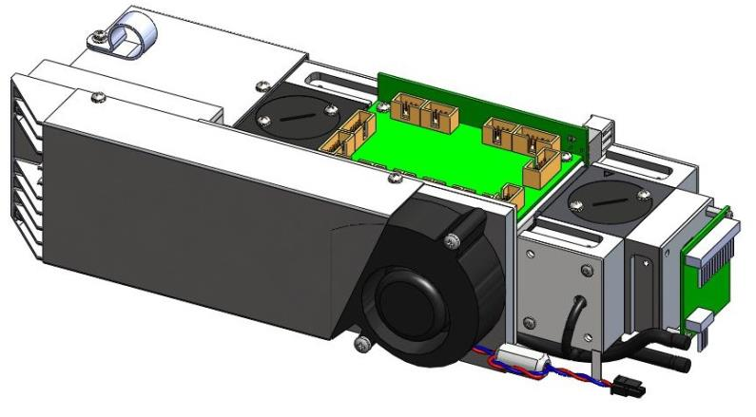
Measurement Technologies
NOx
9.3.2.6.1. Chemiluminescent detector (CLD)
If measured on a dry basis, the oxides of nitrogen analyser shall be of the chemiluminescent detector (CLD) or heated chemiluminescent detector (HCLD) type with a NO2/NO converter. If measured on a wet basis, a HCLD with converter maintained above 328 K (55 °C) shall be used, provided the water quench check (see paragraph 9.3.9.2.2) is satisfied. For both CLD and HCLD, the sampling path shall be maintained at a wall temperature of 328 K to 473 K (55 °C to 200 °C) up to the converter for dry measurement and up to the analyser for wet measurement.
9.3.2.6.2. Non-dispersive ultraviolet detector (NDUV)
A non-dispersive ultraviolet (NDUV) analyser shall be used to measure NOx concentration. If the NDUV analyser measures only NO, a NO2/NO converter shall be placed upstream of the NDUV analyser. The NDUV temperature shall be maintained to prevent aqueous condensation, unless a
NDUV Added

Slide 10
9.3.5. Response time check of the analytical system
The system settings for the response time evaluation shall be exactly the same as during measurement of the test run (i.e. pressure, flow rates, filter settings on the analysers and all other response time influences). The response time determination shall be done with gas switching directly at the inlet of the sample probe. The gas switching shall be done in less than 0,1 s. The gases used for the test shall cause a concentration change of at least 60 per cent full scale (FS).
The concentration trace of each single gas component shall be recorded. The response time is defined to be the difference in time between the gas switching and the appropriate change of the recorded concentration. The system response time (t90) consists of the delay time to the measuring detector and the rise time of the detector. The delay time is defined as the time from the change (t0) until the response is 10 per cent of the final reading (t10). The rise time is defined as the time between 10 per cent and 90 per cent response of the final reading (t90 – t10).
For time alignment of the analyser and exhaust flow signals, the transformation time is defined as the time from the change (t0) until the response is 50 per cent of the final reading (t50).
The system response time shall be ≤ 10 s with a rise time of ≤ 2,5 s in accordance with paragraph 9.3.1.7 for all limited components (CO, NOx, HC or NMHC) and all ranges used.
Challenge

Slide 11
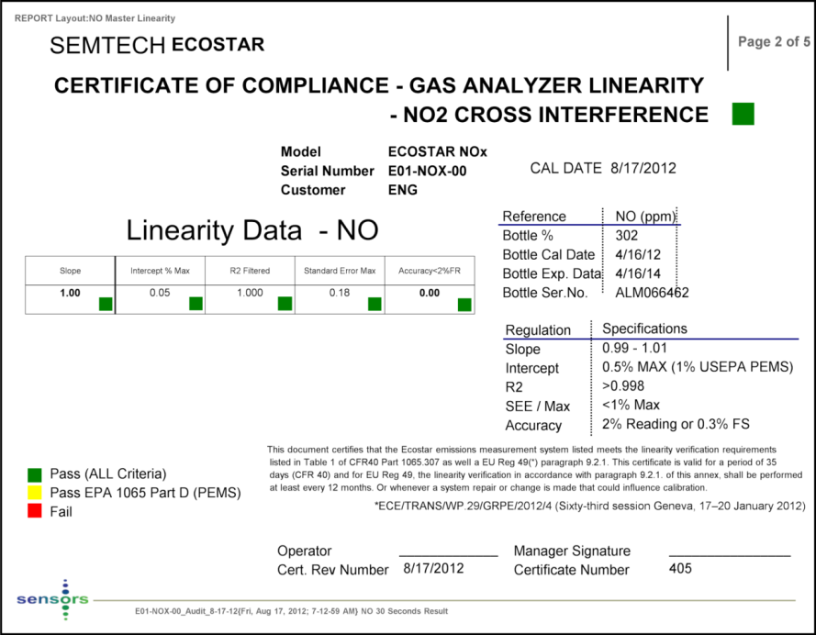

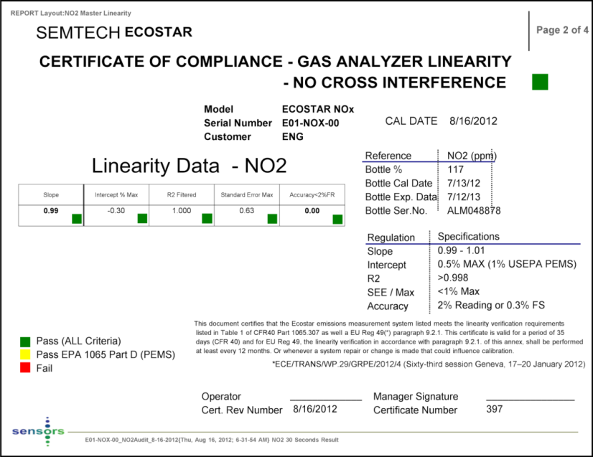
Ecostar PEMS meets
Worldwide Regulations

Slide 12
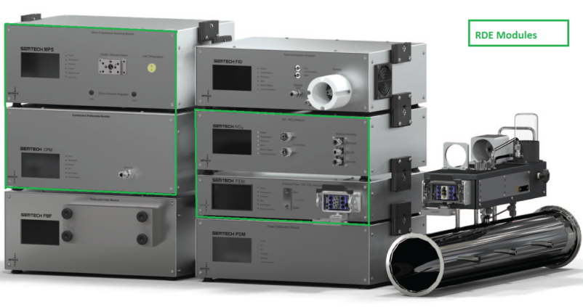




SEMTECH ECOSTAR
Real-Time Gaseous & Particle Mass and Particle Number for Automotive PEMS and Test Cell applications. Completes ECOSTAR full product range for Gaseous and Particulate includes Low CO and Dual FID not shown)
LDV/RDE Expected to ONLY use a sub-set of the complete range of modules and consequently packaging has been further optimized.
Gaseous
Fuel Economy Meter (1)
  Exhaust Flow
  CO2,CO
  GPS, Weather probe
NOX Module (2)
  NDUV > NO and NO2
PM
Particle Diluter (3)
Continuous Particulate Module (4)
  CPM with Pegasor Transducer
(2)
(1)
Inca
GPS
ECM
Exhaust Flow Tubes

Slide 13
SEMTECH ECOSTAR – Product Enhancements / Options (1)
Weight 20Kg, Power 12 VDC < 150W
Size 44cm W x 22cm H X 31cm D 67% smaller than DS with EFM Electronics Box
Gaseous
FEM Module and NOX Module Chassis Joined
Smaller, Lighter
Reduced External Cabling
Reduced Power
PN
CPM Module and Diluter integrated into CPM Module
Smaller, Lighter
Reduced External Cabling
Reduced Power
Compared to “Lab-in-a-box” PEMS, Ecostar LDV is already 67% smaller
Power consumption continually being reduced, 60% lower than “Lab-in-a-Box”
Inca
GPS
ECM
Exhaust Flow Tubes

Slide 14
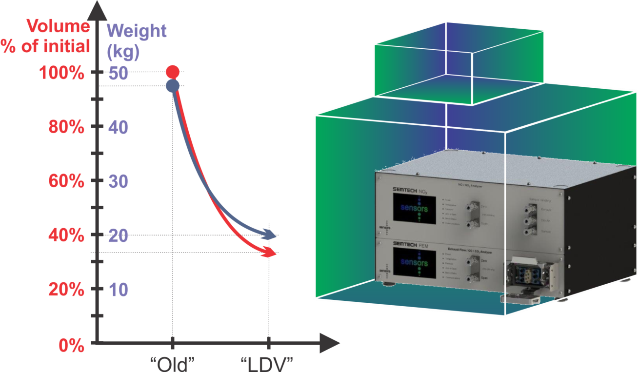
RDE/LDV PEMs
Improvements to Size and Weight

Slide 15
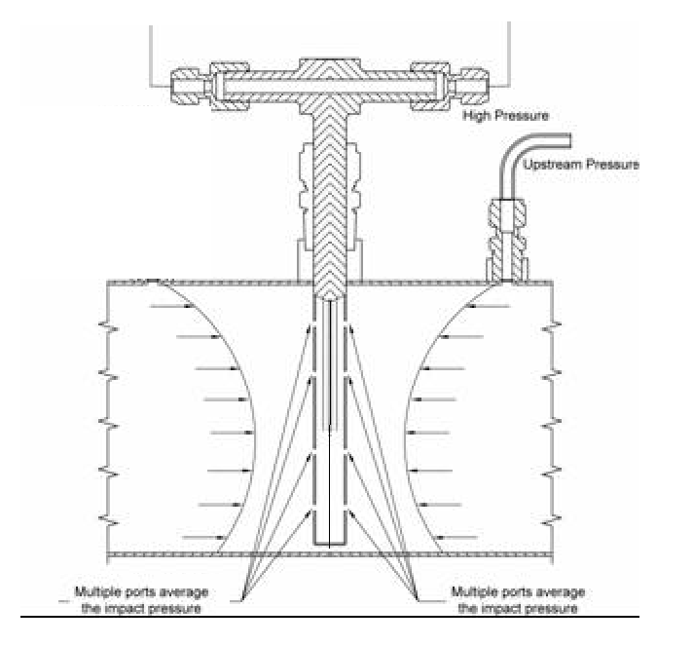
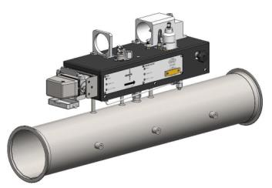
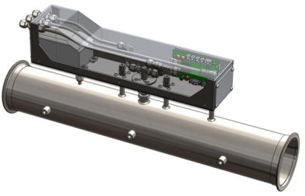

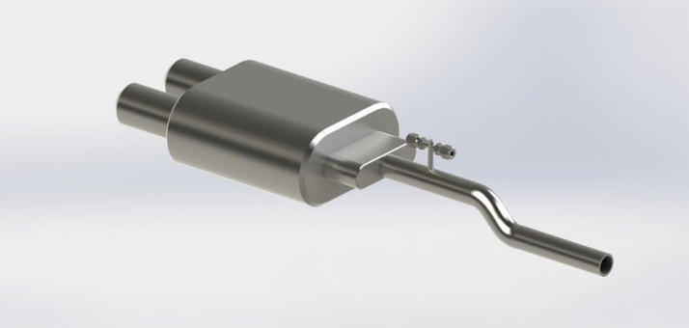
SEMTECH ECOSTAR – Product Enhancements / Options (2)
EFM Option / Solution^{(Patent Pending)}:- In-situ calibration methodology to provide significant reductions to size, weight and easier installation.
EFM Pitot / Tube extension 100mm x 50mm
EFM - Pitot
EFM Pitot mounted on Tail-Pipe
Dual flow Available , < 0.5 Kg Mounted
EFM Pitot mounted in Exhaust System
Bespoke Engineering Solutions

Slide 16
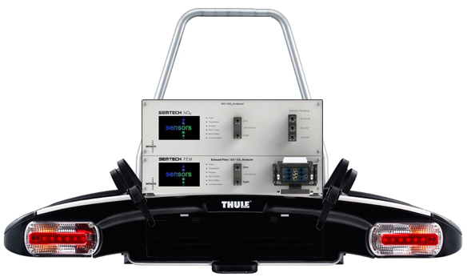
SEMTECH ECOSTAR – Product Enhancements / Options (3)
External – Customized Bicycle Racks
  PEMS (Gaseous and PN) + Battery + GPS + Weather Probe
  Aerodynamic Weather Enclosure
  EFM Mounting Hardware
  <50Kg

Slide 17
SEMTECH ECOSTAR – Product Enhancements / Options (4)
Service Cart
  Auto Zero and Span Calibration Module
  Battery Charger
Auto “One Click” PEMS legal compliance Software Wizard
  Gas Divider Control – Auto Linearization
  Time Alignment and Pre- and Post-Audit tests
Driver Aid
  Mitigate Laptop distraction with simple Driver Display (e.g. Green / Red Status)

Slide 18
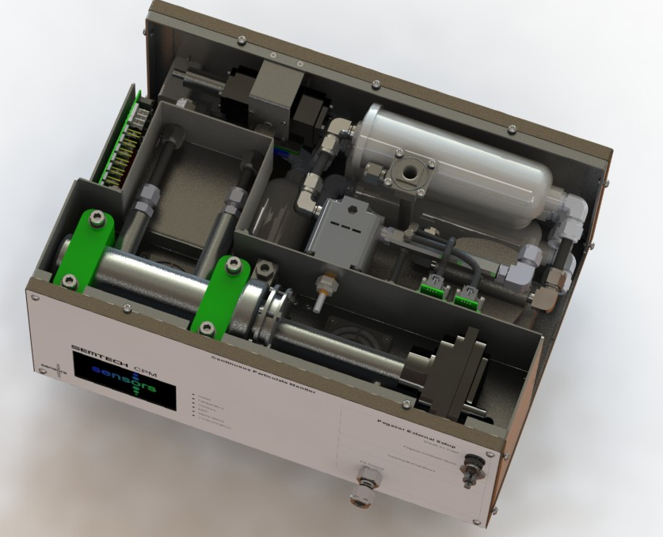
CPM Module Design
3-Way Sample /
Zero Air Solenoid
HEPA Filtration
(Purge, Zero Air, Exhaust, MPS Make-up)
HEPA Filters
Purge Flow
PPS-M Sensor Outlet
PFS make-up
Real Time Pegasor-PPS-M Measurements Number and Mass
Purge Pressure Regulator
Purge Flow and Pressure Measurement
Thermal Control (40-50 °C)
Dimensions: | 43cm x 18cm x 31cm
Weight: | <20kg
RH Measurement of Purge Air
Communication: USB, Ethernet, CAN (ETAS – INCA), AK Protocol

Slide 19
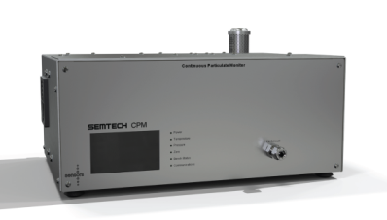
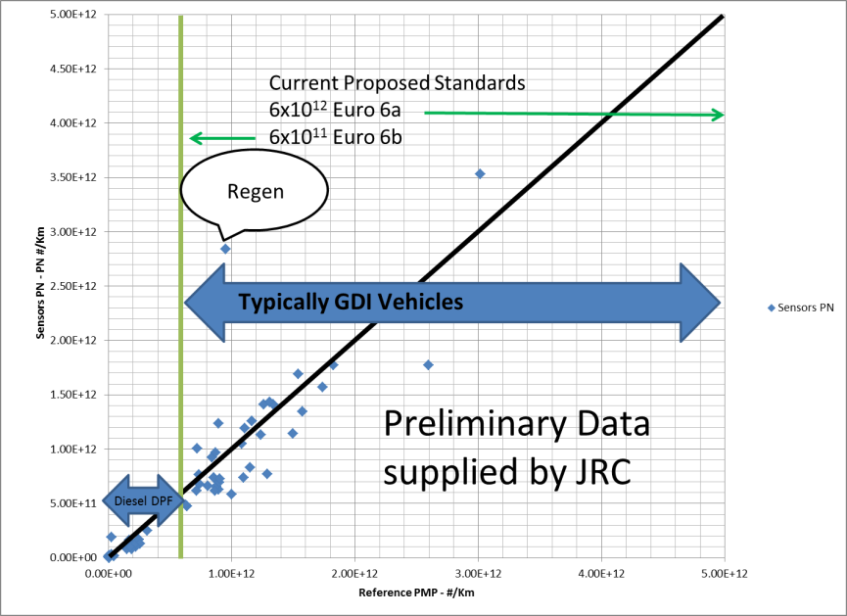
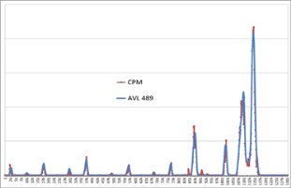

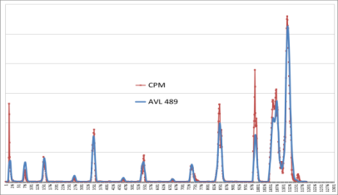
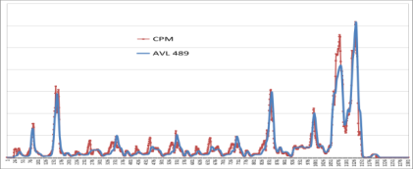
Performance Data
Particle Number Measurements (Test Cells)
CPM (Low Trap Voltage) With Dilution System (MPS)
Regulation Approach
Improved Correlation to Reference Device
Reduced Cleaning

Slide 20
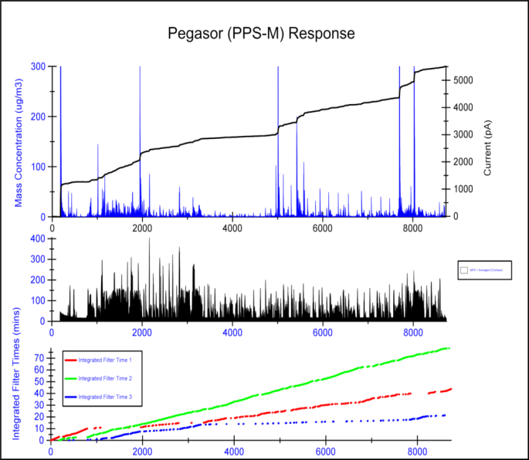
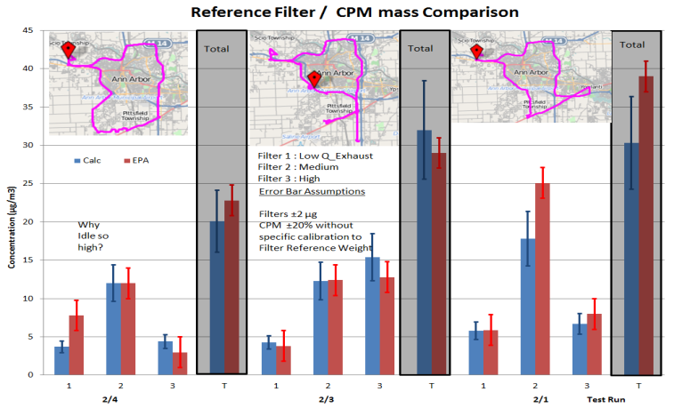
Performance Data
Particle Mass Measurements
CPM (High Trap Voltage) With Dilution System (MPS) and Optional Filter System (PFS)
Regulation Approach
Reduced Cleaning
PFDS with Gravimetric filter

Slide 21
SENSOR Tech-CT Europe
Specialized analysis and reporting software to meet the needs for European PEMS testing
Performs all regulatory requirements for
  Averaging window analysis and pass/fail decisions
  Test validation
  Data consistency checks
  Reporting
Designed for ease-of-use, with no additional analysis required by the user

Slide 22
Ease of Use Features
New Ease-of-Use Features in standard post-processor
Automated time alignment
Automated drift correction
Single-click output groups
Up to 4x faster

Slide 23
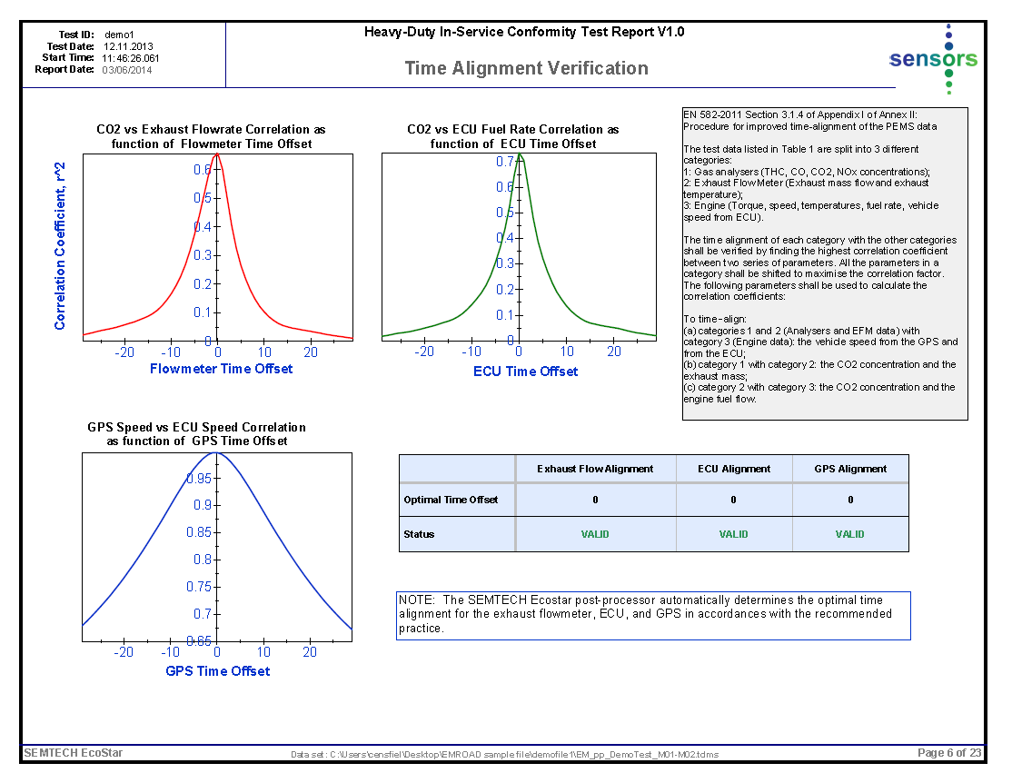

Slide 24
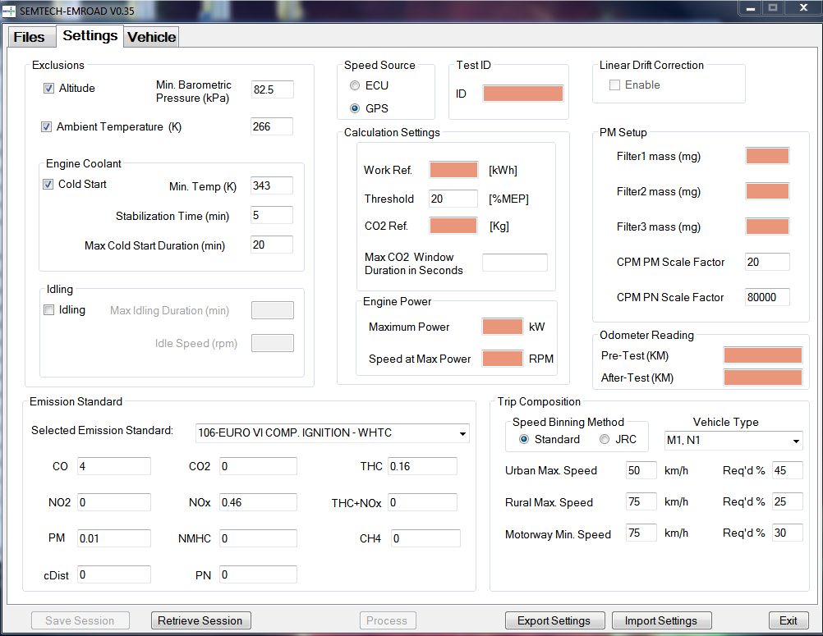

Slide 25
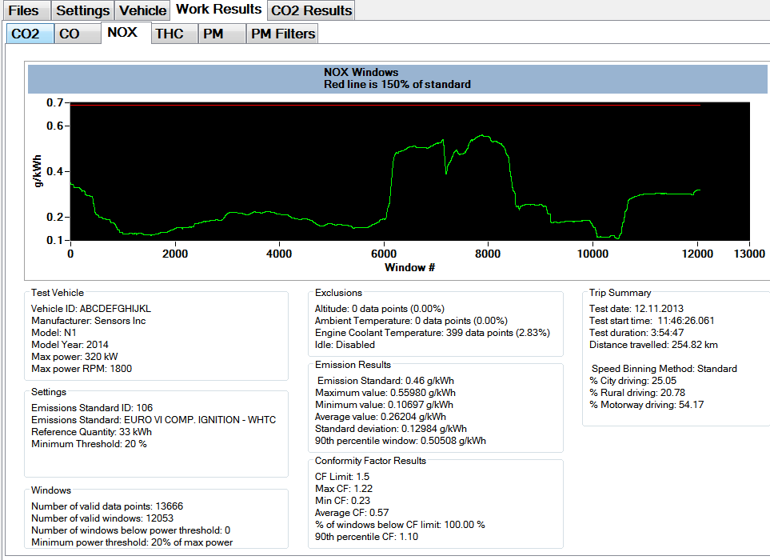

Slide 26
SENSOR Tech-CT Europe
Reporting Features
One-click report generation using Diadem
  Averaging window summaries and charts
  Raw and calculated parameter charts
  All test validation checks automated
  All data consistency checks automated
  Single page summary

Slide 27
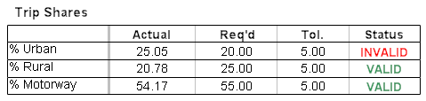
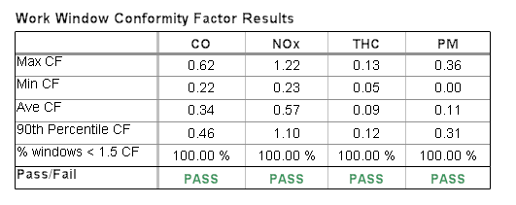
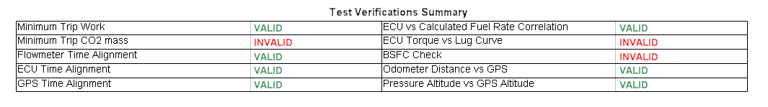
Report Summary Examples
Single Page Summary show all results and test validity checks at a glance

Slide 28
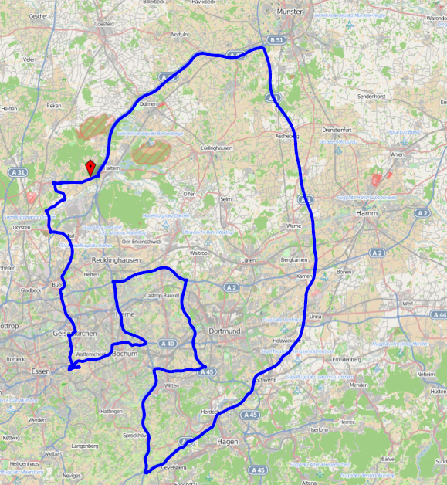
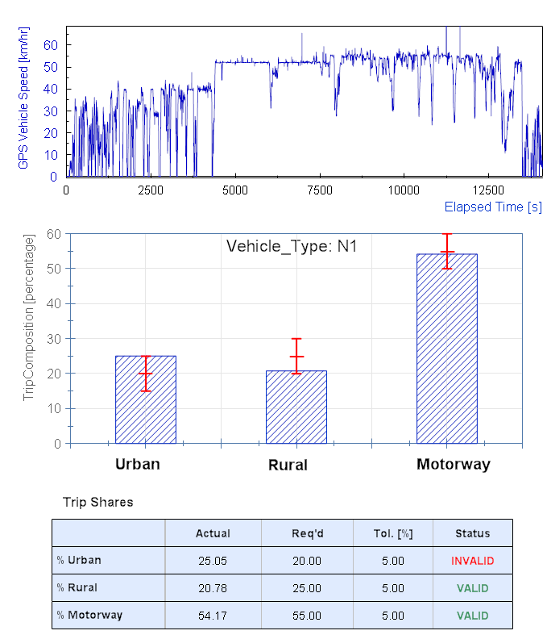
SENSOR Tech-CT Europe
Example Report Pages

Slide 29
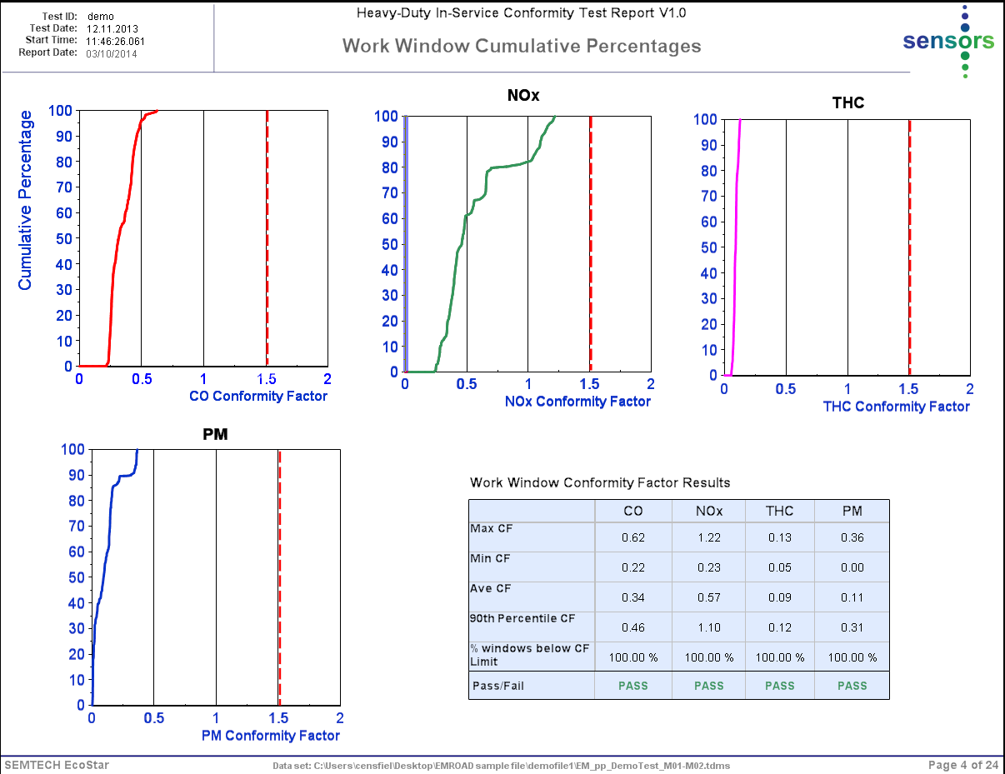
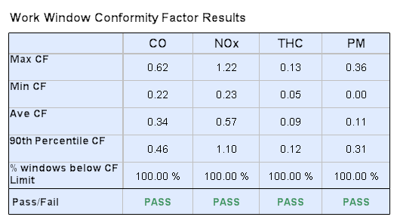

Slide 30
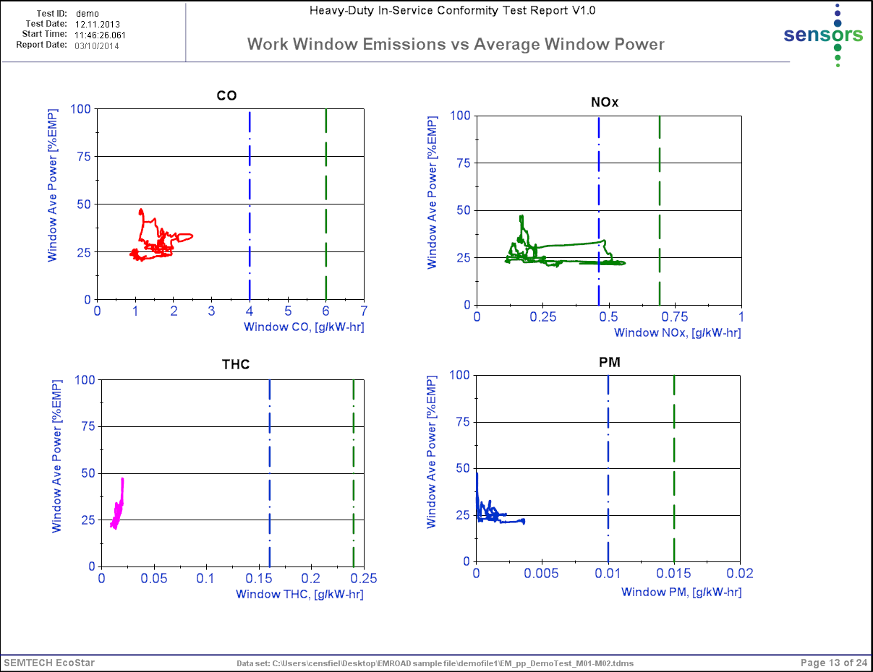

Slide 31
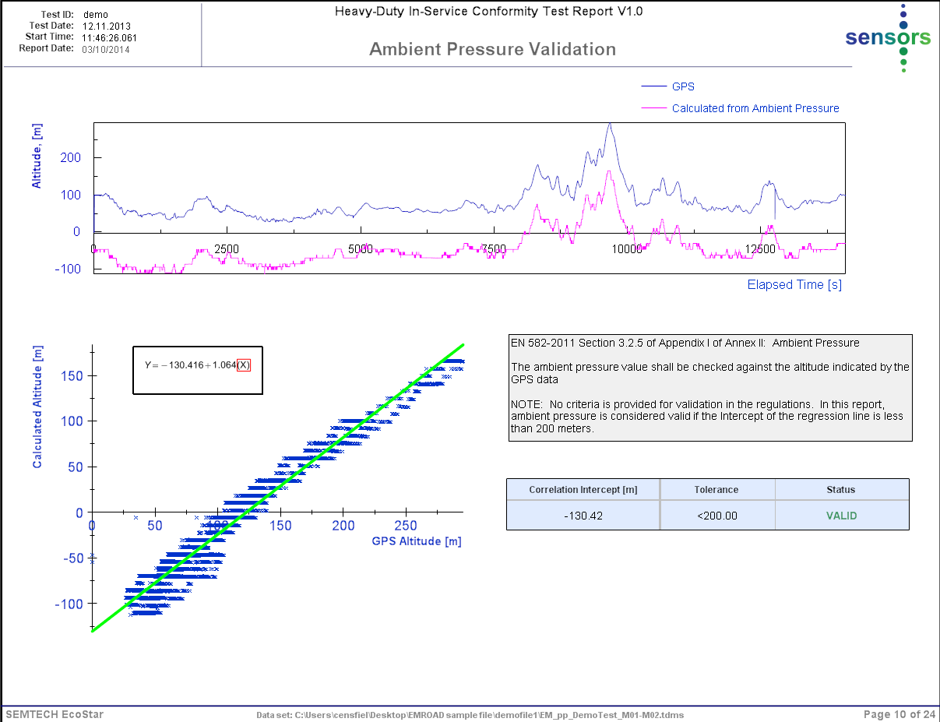
SENSOR Tech-CT Europe
Example Report Pages

Slide 32
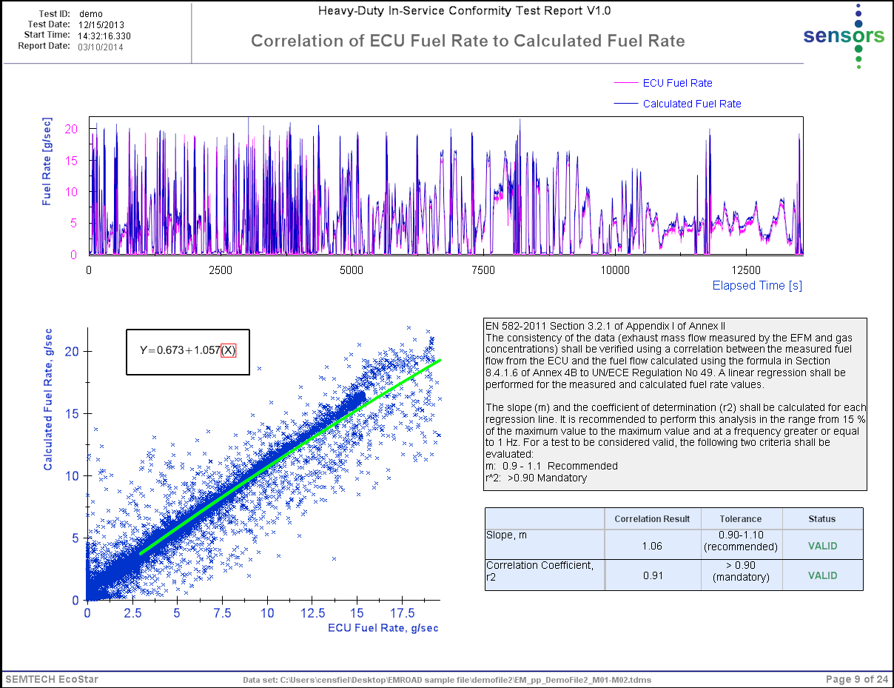
SENSOR Tech-CT Europe
Example Report Pages

Slide 33
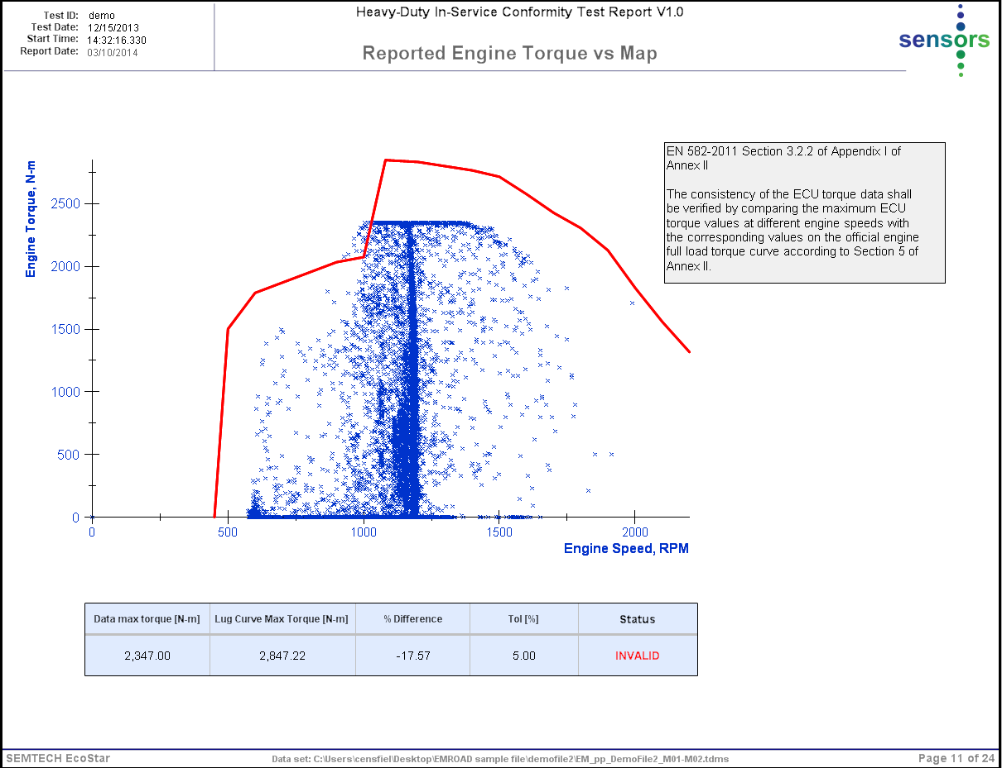
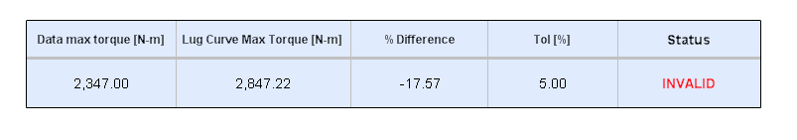
SENSOR Tech-CT Europe
Report Summary Example
Example of failed data consistency check for engine torque

Slide 34

“In summary, PEMS measurements will soon be the focal point for regulatory emission testing, and new engine development target setting. This shift we see as a big step forwards towards improving air quality” ---
Thank You!
For More Information Contact
Rob Wilson
VP Sales & Marketing
rwilson@sensors-inc.com
Oliver Franken
Managing Director of Sensors Europe
oliver.franken@sensors-europe.eu

