Slide 1

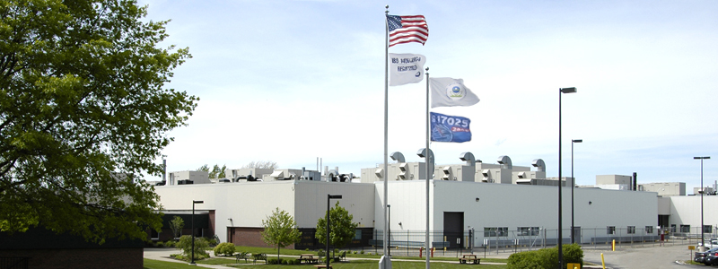
EPA OTAQ Methodology and Data Gathering Efforts
PEMS International Conference & Workshop
April 3, 2014
US Environmental Protection Agency, Office of Transportation & Air Quality
National Vehicle, Fuel & Emissions Laboratory, Ann Arbor, MI

Slide 2
Outline
Partnerships
Data Gathering Methodology
Three General Data Areas for Modeling & Regulations
Testing Tools: Laboratory, PEMS & PAMS
Mobile Source Data Fields
Current Work
Future Work

Slide 3
Partnerships: Data Gathering Efforts
Partnerships
Federal, State, Local gov’t;
Universities, Associations, Regulated Community, Councils, International regulators, Key Stakeholders & other Groups
Testing Facilities
“Controlled” Lab Testing
“Real World” Testing
Laboratory Facilities
Chassis: LDV/HDV 2/4 wheel drive
Engine Dynos Evap SHEDs
Cold/Hot Temperature Testing
Small Engine Unregulated Pollutants
Fuels Testing
PEMS
PAMS

Slide 4
Data Gathering Methodology
Research
Question(s)
Design Test Programs
Test Program:
Data Gathered
Validate
Model
Modeling
Data Analysis

Slide 5
In Regulatory and Modeling Worlds:
Population, Emission & Activity
Population:
MY, Make, Mfg, VIN Engine, Engine VIN, emission std, etc.
PEMS &
Laboratory
MOVES
Emissions /Activity:
Gaseous Measurements
(THC, CO, CO2, NO, NO2, etc.)
Particulate Matter (PM)
(Batch, second-by-second)
Environmental Data
Date/Time
OBD – Vehicle Parameters
GPS
PAMS
Activity:
Date/Time
OBD – Vehicle Parameters
Cold/Hot Starts
Vehicle Soak
Environmental Data
GPS

Slide 6
Mobile Sources - Some Regulated Areas
On-Highway
  Light-duty vehicles
  Light-duty Trucks
  Medium-duty vehicles
  Heavy-duty vehicles
  Motorcycles
Evaporative Emissions
GHG
Fuels
  Gasoline (E10, E85, RFG, etc), RFS, CNG, Propane, Diesel, Hydrogen, Biofuels, etc.
Nonroad
  Marine
  Construction, Agriculture, etc.
  Aircraft
  Locomotive
  Motorcycles (off-road)

Slide 7
Testing Tools
Laboratory
  Able to “control variables” that effect emissions
  Accurate measurements
  Time consuming to test a vehicle
  High costs
PEMS
  “Real-World” testing – on-the-road testing - all variables change
  Accurate measurements – both emissions, vehicle parameters and activity
  Up to 8-10 hours of continuous testing
  Medium costs
PAMS
  “Real-World” testing – on-the-road testing - all variables change
  Accurate measurements – vehicle parameters and activity
  Multiple days, weeks or months of testing
  Quick Installation
  Lower cost

Slide 8
Medium & Heavy-duty Vehicle Sector GHG Emissions
U.S. Transportation Related Greenhouse Gas Emissions (Tg CO2eq) in 2010
MD/HD
Source: U.S. Greenhouse Gas Emissions and Sinks 1990-2010 (EPA 2012)

Slide 9
New Test Programs & Data (incorporated into Regulations & MOVES2014)
Fuel Effects
  EPAct study on Gasoline fuel effects
  Effects of E85 on emissions
  EPA In-Use Sulfur Test Program (PEMS)
Evaporative Emissions
  CRC E-77 – Ethanol, RVP, leak magnitude
  High Evap Field Study – leak frequency
  Running loss vapor leak study
  Multiday Diurnal Testing
PM Emissions
  Kansas City light-duty gasoline study (PEMS)
Temperature Effects
  EPA Cold Temperature Study
Heavy Duty
  In-Use Compliance Program PEMS data
  HDV “Drayage” PEMS/PAMS
Population and Activity
  R.L. Polk 2011 Vehicle Population
  2011 FHWA VMT
  2014 AEO Vehicle Sales and VMT Projections
  2011 National average speed distribution using TomTom GPS data
Fuel Supply
  Refinery batch fuel certification
  Updated AEO fuel distributions projections

Slide 10
Current Projects in Modeling
Retrospective modeling provides solid foundation on which to project future emissions
  Regulatory Control programs (e.g. OTAQ regs and IM)
  Deterioration rate (and high emitters) analysis
EPA Regulations implemented in MOVES2014
  Heavy-Duty Greenhouse Gas (HD GHG) MY 2014-2018
    Decrease in heavy-duty energy consumption rates
    Decrease in criteria pollutant emissions as a result of improved aerodynamics and rolling resistance.
    Increase in criteria emissions from auxiliary power units
  Light-Duty Greenhouse Gas (LD GHG) MY 2017-2025
    Decrease in light duty energy consumption rates
  Tier 3 Vehicle Emissions and Fuel Standards Program MY 2017-2025
    Decrease in light-duty and medium-duty emission rates
    Reduction in gasoline sulfur level
    Significant reductions in vapor venting, permeation and evaporative leakage
  Renewable Fuel Standard (RFS)
    Updated mandated ethanol volumes
    Updated flex-fuel vehicle (FFV) penetrations

Slide 11
Current EPA Work
Greenhouse Gas Emissions Model (GEM) refinements and validation
  Update driver model and engine model
  New transmission models
  Chassis dynamometer testing of over 100 vehicle variants for model validation
Powertrain test procedure development and evaluation
  For conventional and hybrid powertrain GHG certification
  Medium Heavy-duty work underway at NVFEL and at Southwest Research Institute
  Heavy Heavy-duty work in development at Oakridge National Laboratory
  Includes investigation of new duty cycles for vocational vehicles and cruise cycles with grade
Additional NVFEL testing
  Benchmark new diesel pick-up performance on chassis tests
  Heavy-duty engine mapping procedures and child rating evaluations
Additional work
  VMT rebound study
  Vocational vehicle market characterization
  Aerodynamic test procedure evaluation and technology testing at SwRI
  Teardown cost analyses for CNG trucks
  Mass reduction for pick-ups

Slide 12
HD GHG Technologies to be Evaluated for Phase 2 Effort
(not all inclusive)
Engine Down-Speeding
Low Friction Engine Oil
Engine Friction Reduction
Fuel System Improvements
Improved SCR Conversion
Air Handling System Efficiency Improvements
Turbocompounding – Electric and Mechanical
Waste-Heat Recovery
Engine Down-Sizing
VVT
Cylinder Deactivation
Additional aerodynamic improvement technologies for tractor, trailers, pickups, vans
Improved Transmissions
Lower Rolling Resistance Tires
Mass Reduction
Range of Electrification
  Start/stop, mild to full hybrids
Air Conditioning System improvements
Other Accessory Improvements

Slide 13
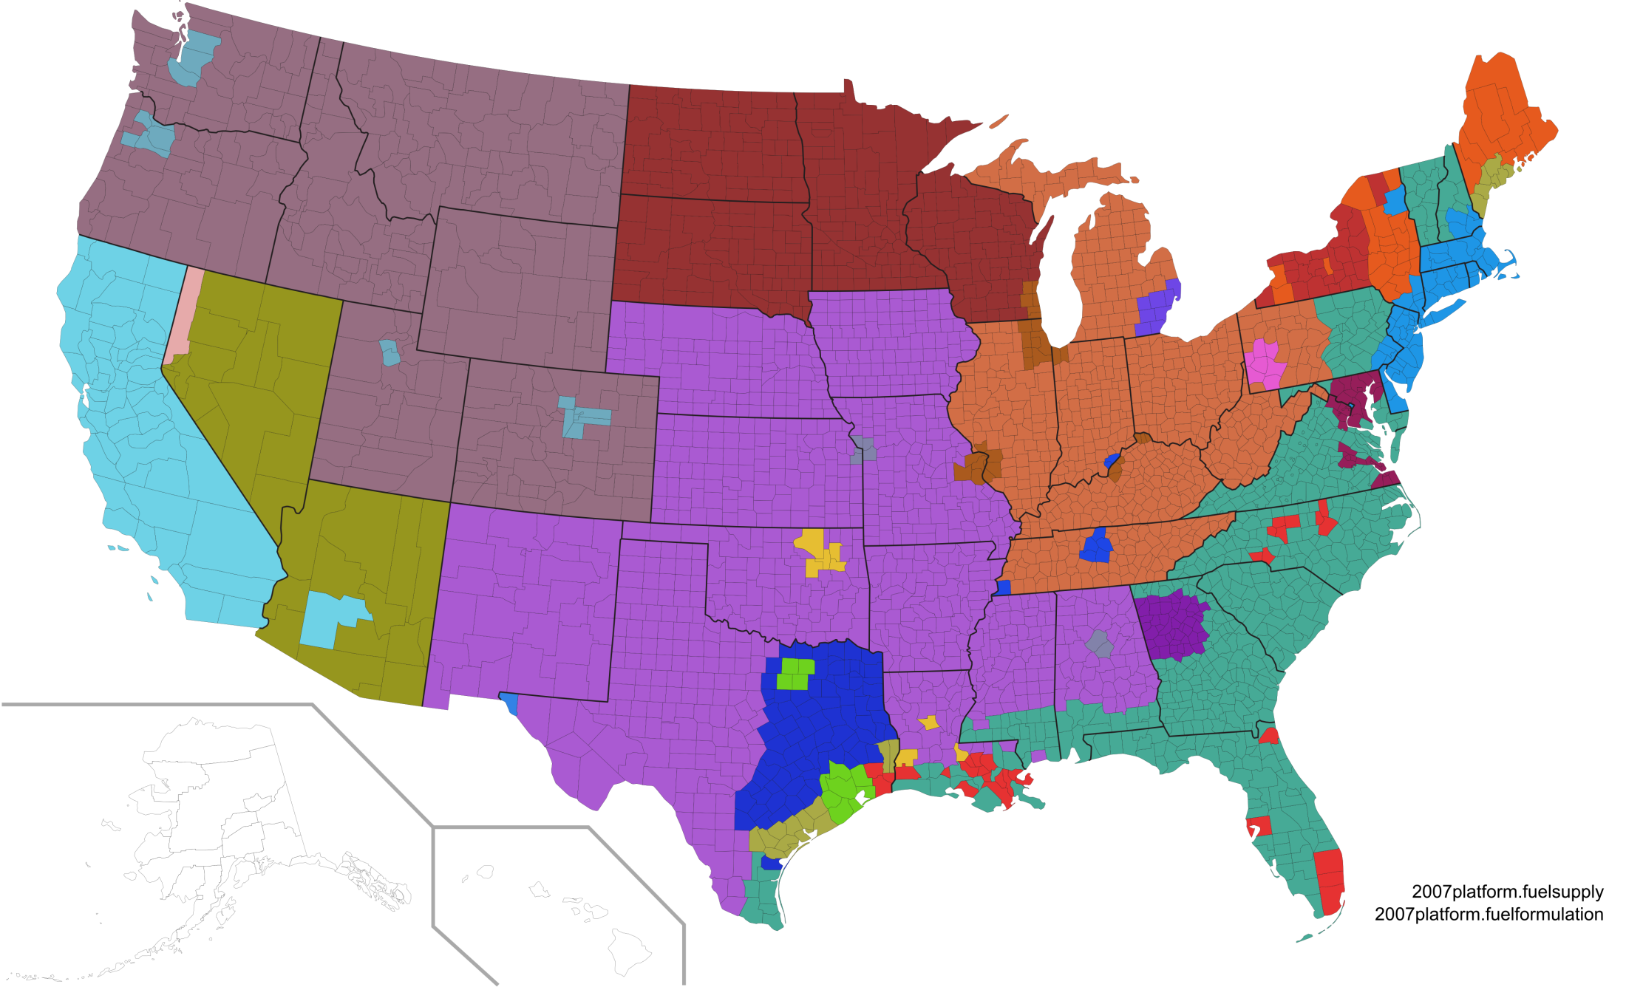
Fuel Effects/Fuel Supply Updates
Fuel Supply Regions in MOVES2014
EPAct Tier 2 Gasoline Model
  27 fuels tested in 15 Tier 2 vehicles, E85 tested in 4 FFVs
  Impacts of ethanol and other key fuel properties
EPA Sulfur Affects Model
  Impact of ultra-low gasoline sulfur levels on emissions from in-use Tier 2 gasoline vehicles
E85 Fuel Effects
  Analyzed data from four E85 test programs
Compressed Natural Gas
  Based on literature review of 9 studies

Slide 14
Heavy-Duty Exhaust (PEMS)
Two Real-world in-use data sets available for MOVES2014
Heavy-Duty Diesel In-Use Testing (HDIU) - PEMS
  Data collected by manufacturers during normal operation and use
  ~5 engines tested per family
  Within useful life (< 435,000 miles), well-maintained
  MY: 2005-2010
Houston Drayage Data
  Cooperative research agreement (CRADA)with Houston Galveston Area Council
  Collected emissions and activity data on HD drayage trucks using PEMS and PAMS in 2009-2010
  Trucks selected for PEMS testing based on remote sensing scores
  Generally higher mileage (> useful life)

Slide 15
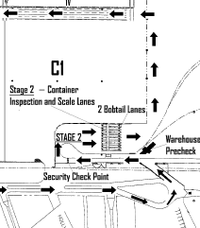
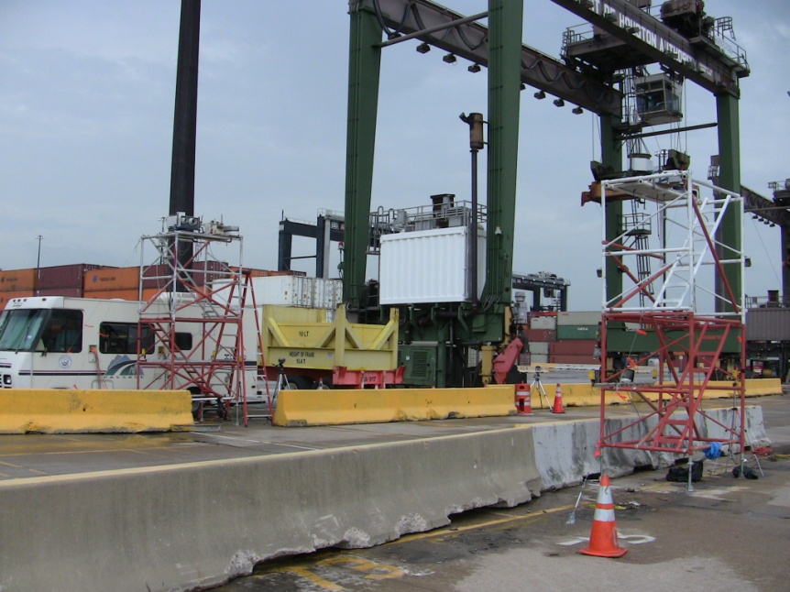
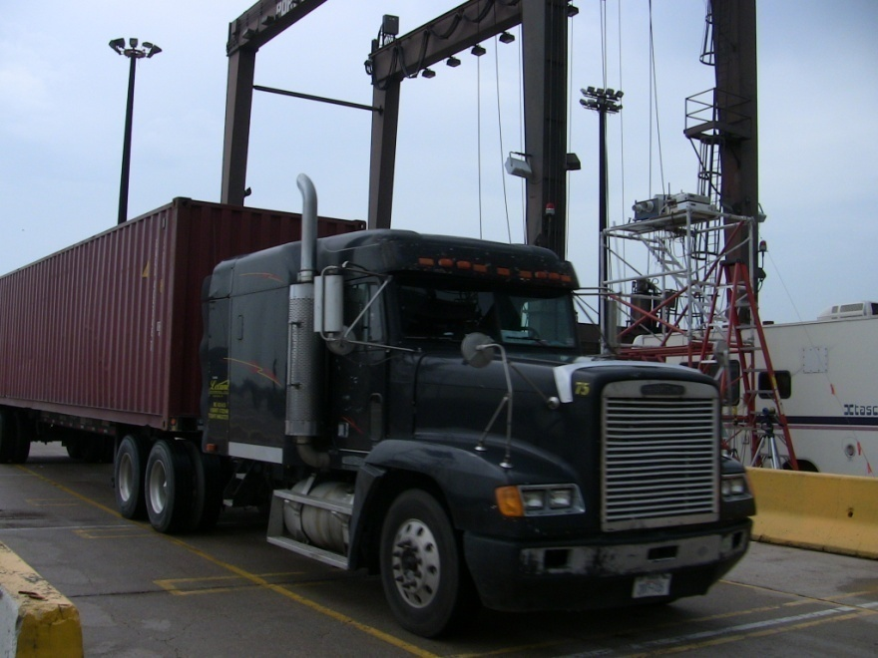
Location of RSD
equipment
RSD equipment

Slide 16
Heavy-Duty Exhaust
Studies validated current heavy-duty NOx MOVES rates for
  1991-2006 model year (4 categories of emission stds)
NOx rates updated from HDIU program for
  MY 2007-2009
  Indicate larger NOx emissions than MOVES2010
Notes:
Drayage program were short-haul combination trucks were the high-mileage trucks.
. Drayage had slightly higher rates than the MOVES and HDIU, but within the variability.
n=8 2003-2006

Slide 17
Future Test Programs & Improvements
Searching and looking to initiate new data collection surveys:
  Nonroad (Lab, PEMS & PAMS)
  On-road (light, medium & heavy-duty) (Lab, PEMS & PAMS)
    Newer technologies (hybrids, control technologies, etc)
  Fleet population and activity (PEMS & PAMS)
  Improvements to sampling methodologies
Continue to improve testing equipment:
  PEMS
    Smaller Size, Less Weight & Less Power
    Data Quality & Data Review
    PM (mass-based filter/second-by-second)
  PAMS (LD/HD/Nonroad)
    Functionality, Performance, Data Quality
  Laboratory (NVFEL)
    New HD Chassis (Being built-2014, operational 2015)
    Improvements to Engine Dynos & LDV/LDT Chassis sites (1065/1066)
    Cold/Hot Temperature Testing Site

Slide 18
Questions?

Slide 19
