Slide 1

In-Situ Emissions Performance of EPA2010-Compliant On-Highway Heavy-Duty Diesel Engines
James D. Smith, Justin Greuel, Brian Ratkos, Ethan Schauer
Presented by: Allen Duncan
United States Environmental Protection Agency
April 3, 2014

Slide 2
Compliance Goals
Assist manufacturers in achieving compliance with regulations
  Avoids future (and costly) encounters with enforcement and/or other regulators
Ensure that the anticipated benefits from emission rules are being realized
Ensure a “level playing field” for all regulated entities
  Manufacturers who “cheat” may be at an economic advantage
How do we do this?
Forecasting compliance
  Certification
    Relies on manufacturer data
    In-depth technical descriptions
  Confirmatory testing
    Verifies that manufacturer data is valid and accurate
Verifying compliance
  In-use testing
    Manufacturer testing
    EPA testing
  Auditing
  Defect investigation

Slide 3
Demonstrating Compliance
Engines/vehicles are operated over infinite combinations of routes and ambient conditions
  Impossible to test over all of them
  Test cycles are specified to elicit particular behaviors
    For example, heavy-duty diesel engines have two test cycles:
      FTP – 2-Part test typical of mixed driving
      SET – Steady-state test typical of highway cruising
    These are conducted in a narrow range of ambient conditions
      Also do not address other types of driving
“Off-cycle” emission control is demonstrated and validated through two means
  Auxiliary emission control device (AECD) descriptions
  Not-to-exceed (NTE) limits
    Specific rules for when emissions can be measured
    Emissions can be 1.5x standard during NTE “events”
Primary means for verifying off-cycle emissions levels is through in-use testing

Slide 4
In-Use Test Program Goals
Are 2010+ engines complying with not-to-exceed (NTE) emission standards?
Are these engines achieving the expected reduction in emissions under conditions not covered by NTE test procedures?
  Extended idling
  Light loading
  Transient conditions
Testing over mostly highway routes with a loaded trailer
  Large number of NTE “events”
Urban test route
Unloaded (no trailer) testing
Advanced data analysis
  Total NOx (per testing day)
  Extended idling analysis
Information from this type of study provides valuable information for EPA certification staff
  Accuracy of emission control system descriptions from certification
  Strengths and areas of future improvement for each system

Slide 5
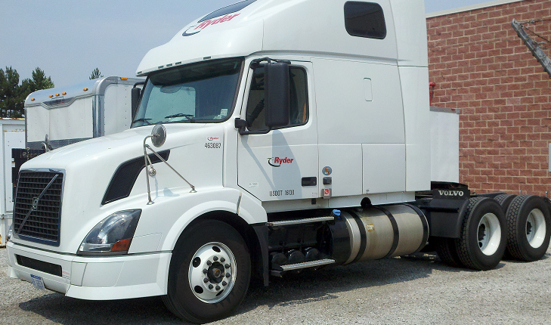
Test Subjects
For heavy-duty vehicles, the engines are regulated (and certified) independent of the vehicle
  In-use testing can involve in-situ methods (engine-in-vehicle) using NTE procedures
  Engine can be removed and tested on a dynamometer over the certification test cycles or evaluated under NTE procedures
This program tested engines while they remained in the vehicles
  Class-8 semi-trucks
  Engines are generally 6-cylinder diesels
    Power: 400-500 hp
    Torque: 1500-1700 ft-lbs
  Rated to haul up to 80,000 lbs
  Manufacturers: Cummins, Detroit Diesel, Navistar,
        PACCAR, Volvo
Focusing on 2010 and newer engines
  Final phase-in of 0.20 g/bhp-hr NO_{x} emision standard
  Technologies (typical):
    Selective catalytic reduction (SCR) aftertreatment
    Cooled exhaust gas recirculation (EGR)
    Diesel particulate filters (DPF)

Slide 6
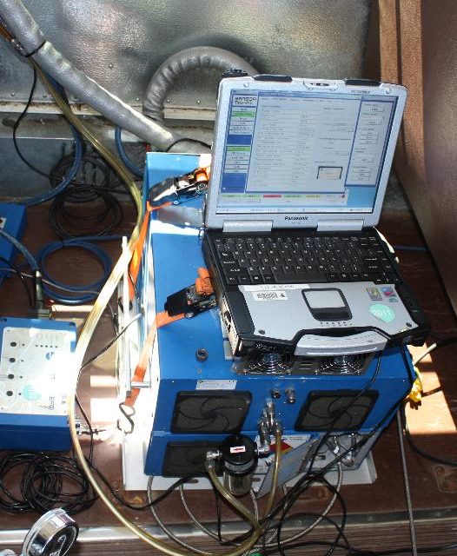
Test Program Outline/Methods
Test program is based on 3 elements
  Highway emissions testing (loaded)
    5 Predominantly highway routes
  Highway emissions testing (unloaded)
  City emissions testing
    Test route that involves more stop & go driving
Emissions are measured using a portable emissions measurement system (PEMS) & exhaust flowmeter
  Can measure CO₂, CO, HC, & NO_{x} (g/hr basis)
  Torque estimated from engine controller
  Combined, we achieve measurements in the same units as the emission standards (g/bhp-hr)
Data processing
  NTE-specific (discrete events with specific boundary conditions
  Overall NOx emissions (total emissions vs total work over a testing day)
  Overall NOx without idle (emissions excluded if vehicle speed = 0)

Slide 7
Initial Observations – NTE Performance
All vehicles have had no issues meeting NTE requirements when tested according to §86, subpart T
  Required to meet NTE standards 90% of the time
    “Pass ratio”
NTE performance was similar over different drive types
  However, urban driving led to fewer NTE events (transient effect)
  No-trailer driving led to even fewer NTE events (light load)
Average pass ratios over all testing (2 vehicles per engine family). Pass ratio error bars are the limits witnessed during testing.

Slide 8
NTE NO_{x} Emission Levels
NO_{x} emission rates during NTE events were generally reflective of emission control technology and certified emission level
  Maxxforce 13 used high-EGR to control NO_{x} and was certified to a NO_{x} emissions level of 0.50 g/bhp-hr (vs 0.20 standard)
  ISX15 was certified to a NO_{x} emissions level of 0.35 g/bhp-hr
  All others were certified to the emission standard (0.20 g/bhp-hr)
SCR-equipped engines performed quite well under NTE conditions
  High exhaust temperatures
Average NO_{x} emission rates for each engine family during NTE events. The emission rates of the SCR-equipped engines typically scale to brake-specific emissions in the 0.05 to 0.25 g/bhp-hr range under NTE-type power output conditions,

Slide 9
Overall NO_{x} Performance
In addition to NTE performance, its important to consider overall NO_{x} control
  Looked at total NO_{x} vs total work per testing day (including idle)
DD13, DD15 and D13 engines showed exceptional NO_{x} control
  MX13 slightly higher than the other engines certified to the 0.20 g/bhp-hr standard (will be addressed later)
  ISX15 and MF 13 certified to higher emissions levels (0.35 and 0.50 g/bhp-hr, resp.)
Some of the SCR-equipped engines had challenges with light-load conditions (low exhaust temp)
Average NO_{x} emission rates for each engine family over the each testing day (including idle). Generally, no-trailer conditions were most challenging to the SCR-based systems.

Slide 10
Overall NO_{x} Performance – No Idle
By excluding NOx contributions from idling, we get a clearer picture of how each engine/system performs in-use
The SCR engines all exhibited well-controlled NOx emissions during freeway and urban driving
  No-trailer operation remained somewhat challenging due to low exhaust temperatures
  ISX15 particularly sensitive to low exhaust temperature
  MX13 emissions much lower when excluding idle
High-EGR NOx control scaled to work done, with no-trailer emissions being much lower than loaded conditions
Average NO_{x} emission rates for each engine family over the each testing day (excluding idle).

Slide 11
Overall NO_{x} Performance – Idle
Average NOx emissions from idle operation are shown at right
  Most engines demonstrated emissions consistent with California’s 30 g/hr standard
    Even though these were not the official test conditions
MX13 had much higher emissions
  Only engines not certified to the CA standard
Demonstrates the importance of idle emissions reduction programs
  In some cases, idle emission rates are much higher than driving with a fully loaded trailer

Slide 12
Observations
The engines tested in this study were found to be broadly compliant with NTE emission standards (pass-ratio based)
  In addition, most test candidates showed emission levels during NTE events to be similar to the applicable emission standard
  The number of qualifying NTE events was highly dependent on drive conditions and vehicle loading
Total NO_{x} emissions over each testing day revealed differences in emission control system capabilities
  In general, SCR systems performed well over conditions that produce high exhaust temperature
  Light-load conditions are challenging to these systems and measures taken to counteract the loss of emission control vary by manufacturer
    Effective thermal management strategies are essential
  NO_{x} emissions from high-EGR systems were primarily a function of engine loading

Slide 13
Observations (cont.) & Next Steps
NOx emissions from periods of extended idle were found to have potentially large impacts on overall NOx emissions
  Particularly true for the engine family not certified to the CA idle standard
  Demonstrates the importance of idle-reduction programs
Next Steps
Five midrange heavy-duty engines have been tested. Results will be presented internally summer 2014 and publically spring 2015
Testing of higher-mileage engines (deterioration effects)
Nonroad CI engine testing to begin summer 2014
Dynamometer testing of On Highway engines to begin calendar 2014

Slide 14
Thank you for your attention
Questions?
Presenter contact information:
  Allen Duncan, Ph.D., P.E.
  Mechanical Engineer - Compliance Division
  United States Environmental Protection Agency
  2000 Traverwood Dr.
  Ann Arbor, MI 48105
  Ph: (734) 214-4273
  Duncan.allen@epa.gov

