Slide 1
Recent Development of On-Board Vehicle Emissions Measurements in Hong Kong
Dr. Carol Wong
Senior Environmental Protection Officer
Environmental Protection Department
Hong Kong
3 April 2014

Slide 2
Outline
Background and our goal
On-road PEMS testing
Conclusion

Slide 3
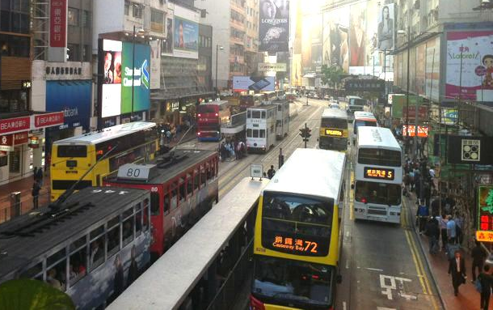
Background for Using PEMS
Have only a couple of small scale vehicle testing facilities for light-duty vehicles
Have very limited local vehicle emission data before using PEMS.
Traffic conditions at busy corridors
The traffic conditions and driving habits in HK are very different from those in U.S. and Europe
Wish to implement in-use conformity check
Notes:
Have adapted EMFAC from California Air Resources Board (CARB).
Up to now, we have used vehicle emission database from U.S.
Need to build up a local vehicle emission database that can reflect the local effects.
May follow European Union and introduce in-use conformity check for heavy-duty vehicles.
Our solution -- portable emission measurement systems (PEMS) for measuring real-time, in-use vehicle emissions.

Slide 4
Our Goal
To set up a vehicle emission database which is segregated into groups according to --
  different vehicle classes
  different land use
  different traffic conditions
  different average speeds for trips
To use this database for zero mile emission factors, deterioration rates and speed correction factors for our vehicle emission model
To evaluate the performance of various after-treat. devices, like SCR & DPF.
Notes:
Within each group, work out the base emission factors of a particular average speed and their corresponding speed correction factors.
These factors will form the basis of vehicle emission model for estimating vehicle emissions.

Slide 5
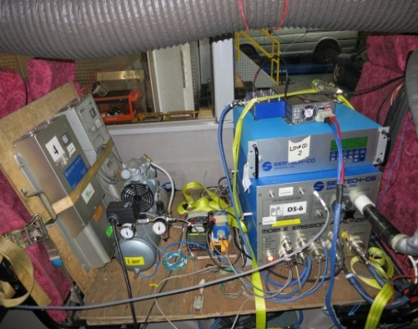
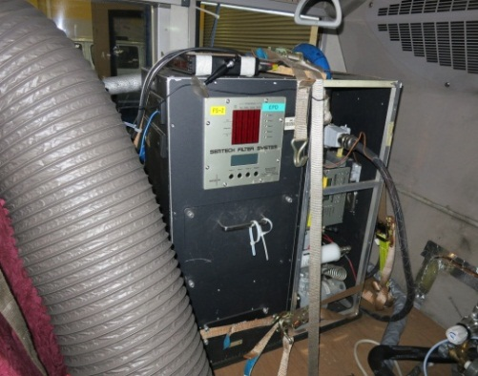
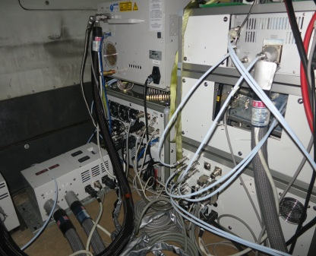
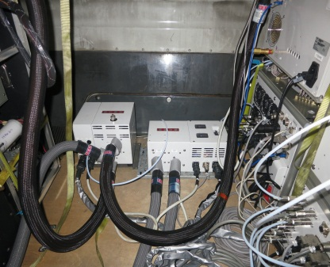
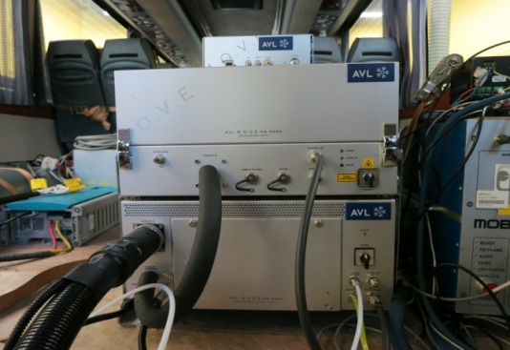
Various PEMS being used in HK
Analyzers | Pollutants
7 SEMTECH-DS | CO, CO2, NO, NO2, THC
1 ECOSTAR | NO, NO2, CO, CO2, THC (PM is still on trial)
2 A&D portable FTIR | N2O, NH3, CO, CO2, NO, NO2 & various hydrocarbon species
2 Low CO analyzers | CO in low conc.
1 A&D THC/Low CO analyzer | CO in low conc. and THC
1 AVL GAS PEMS (demo) | NO, NO2, CO, CO2, THC
5 MPS & 3 Filter Systems | PM_{2.5} on filter
2 AVL PM PEMS | Real-time EC & PM on filter
Low CO analyzer
Filter System
SEMTECH-DS
MPS
FTIR
THC/low CO analyzer
Micro-soot sensor

Slide 6
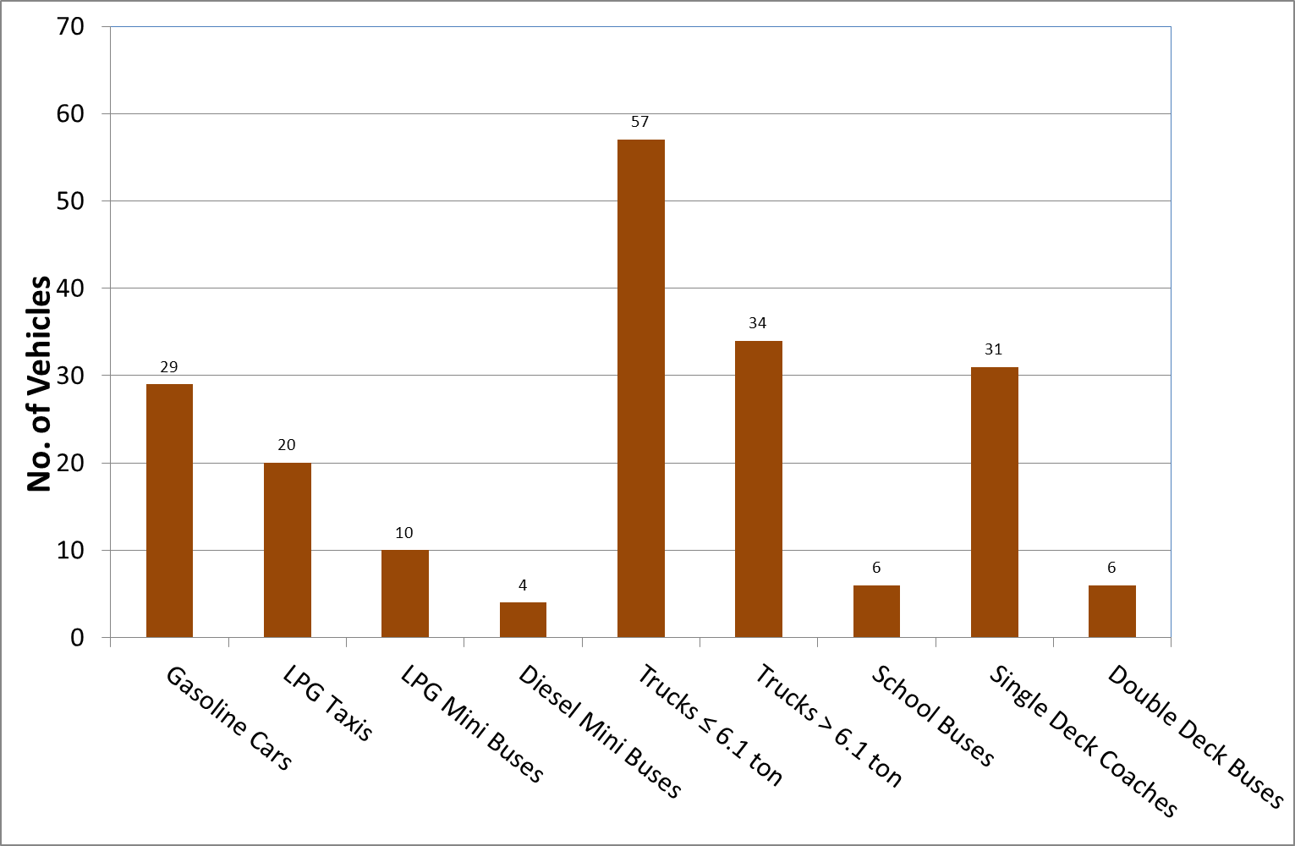
Current Status
measuring real-world vehicle emissions using PEMS since 2008
  Collected ~ 14 million seconds of measurement data
  Tested ~ 200 vehicles
  Test most vehicles for all their business hours
  Emission standards: from pre-Euro to Euro V

Slide 7
Vehicles Explored up to mid Mar., 2014
Vehicle Class | Fuel Type | Emission Standard |  |  |  |  |  | Total
 |  | Pre-Euro | Euro I | Euro II | Euro III | Euro IV | Euro V
Cars | Petrol |  |  | 3 | 10 | 15 | 1 | 29
Taxis | LPG |  |  | 12 | 4 | 4 |  | 20
Mini buses | LPG |  |  |  | 6 | 4 |  | 10
 | Diesel |  |  | 1 | 2 | 1 |  | 4
Trucks ≤ 6 ton | Diesel | 5 | 4 | 9 | 21# | 15# | 3# | 57
Trucks > 6 ton | Diesel | 3 | 1 | 4 | 16 | 8 | 2 | 34
School Buses | Diesel |  | 1 | 1 | 3 | 1 |  | 6
Single Deck Coaches | Diesel |  |  | 2 | 7 | 17 | 5 | 31
Double Deck Buses* | Diesel |  |  | 4 | 2 |  |  | 6
Total |  | 8 | 6 | 36 | 71 | 65 | 11 | 197
* Double deck buses are retrofitted with DPF.
# Including 3 Euro 3, 4 Euro 4 & 1 Euro 5 tested with dyno
7
Notes:
7
7
updated

Slide 8
Euro III, IV & V Diesel Vehicles
Explored up to mid Mar., 2014
Vehicle Class | Euro III |  |  |  |  | Euro IV |  |  |  |  | Euro V
 | Nil | DOC | DOC & EGR | EGR | DPF | DOC & EGR | POC & DOC, EGR | DPF | DPF & EGR | SCR* | DOC & EGR | DPF & EGR | SCR
Mini buses |  | 2 |  |  |  |  |  |  | 1
Trucks <= 6 ton |  | 4 | 17# |  |  | 8# | 4 |  | 3 |  |  | 3#
Trucks > 6 ton | 5 | 4 | 6 | 1 |  | 3 | 3 |  | 2 |  | 1 | 1
School Buses |  | 1 | 2 |  |  |  |  |  | 1
Single Deck Coaches | 1 |  | 5 | 1 |  | 1 |  | 1 | 3 | 12 |  | 3 | 2
Double Deck Buses (w DPF) |  |  |  |  | 2
Total | 6 | 11 | 30 | 2 | 2 | 12 | 7 | 1 | 10 | 12 | 1 | 7 | 2
*The vehicle may also be fitted with DOC
# Including 3 Euro III, 4 Euro IV & 1 Euro V tested with dynamometer.
8
Notes:
8
8
updated

Slide 9
PEMS Test procedures
Follow most stringent testing requirements:
  ISO16183/PEMS requirements in Euro VI
  US CFR 1065 Subpart J
zero every hour, audit every three hours & calibrate twice a day of the gas analyzers
Implement ‘duplication of measurements’ principle
Analyze 2-3 fuel samples from the fuel tank of each test vehicle
Notes:
updated

Slide 10
PEMS Test procedures
On-road testing
  Professional drivers
  Driving on a pre-determined routes as well as following a vehicle of the same class
  >50% of maximum payload for light-duty vehicles
  50-60% of maximum payload for heavy-duty vehicles
  Traffic are captured by video camera mounted in front of the vehicle
Notes:
updated

Slide 11
Vehicle information
Vehicle Class | Private Car | Taxi
Make | Toyota | Toyota
Fuel Type | Gasoline | LPG
Model | Corona ST210R-AEPNK | Crown Comfort
Engine Capacity | 2 litre | 2 litre
Emission Standard | Euro 2 | Euro 2*
Manu. year | 1999 | 2001
Engine rated power | 133 hp @ 6000 RPM | 78 hp @ 4400 RPM
Engine rated torque | 134 ft-lb @ 4400RPM | 118 ft-lb @ 2400RPM
Control device | CAT | CAT and EGR
* use equivalent Japanese emission standards
Notes:
11
updated

Slide 12
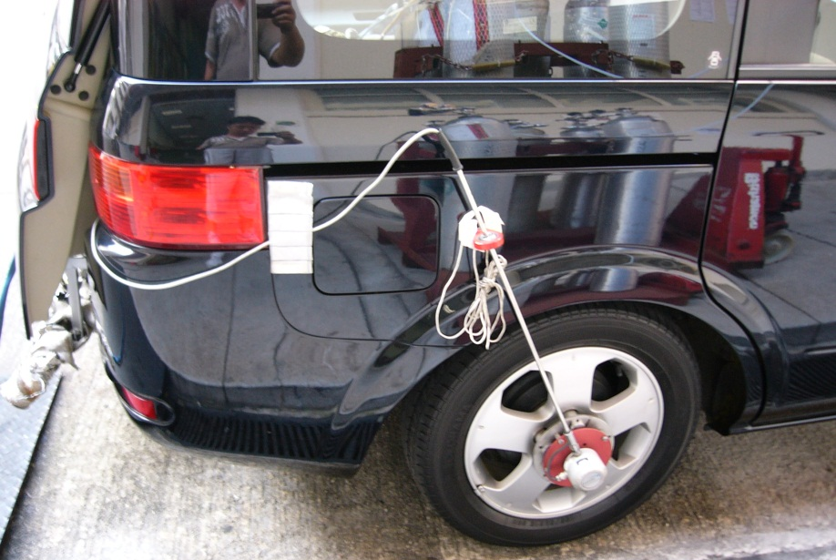
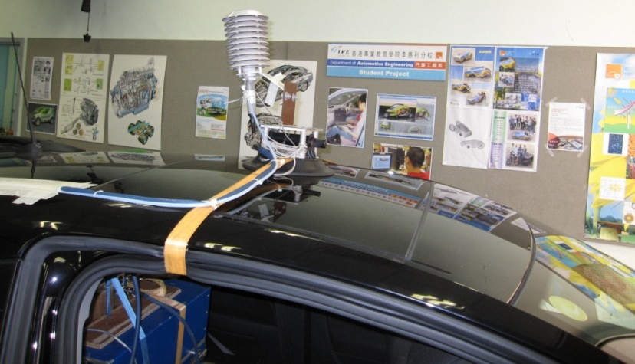
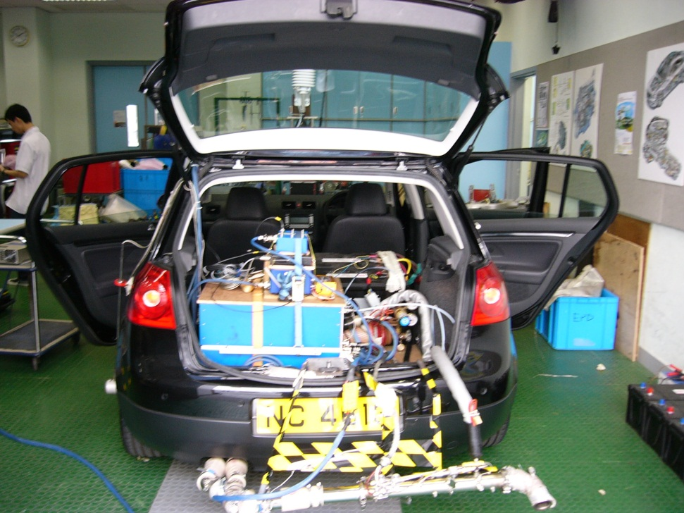
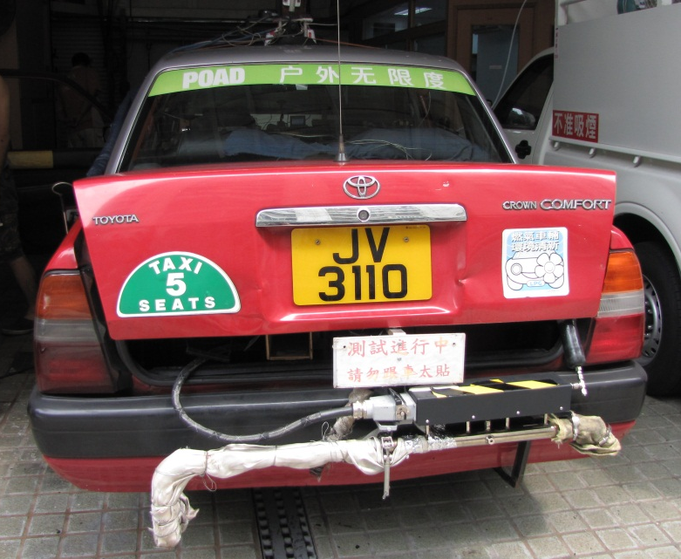
PEMS Installation on Private Car
GPS, RH & temp. sensors
SEMTECH-DS for measuring gaseous pollutants
Speed meter
Exhaust flow meter

Slide 13
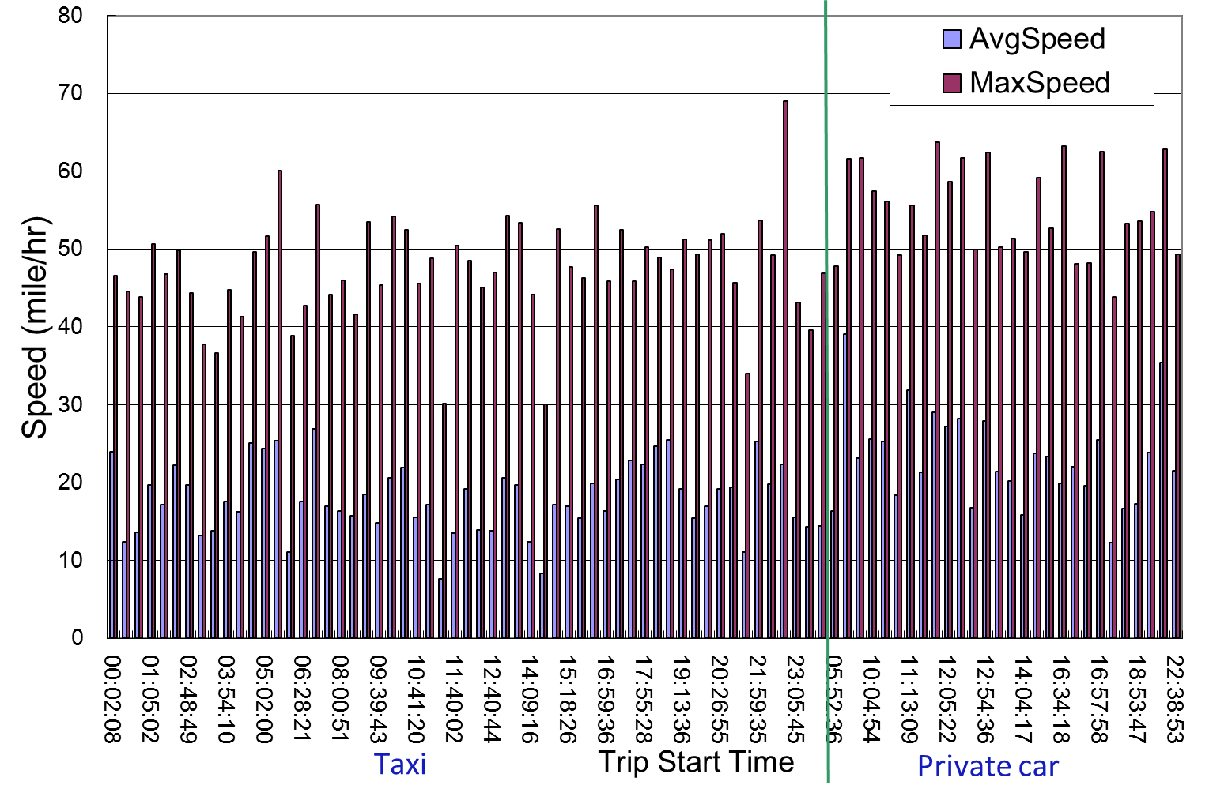
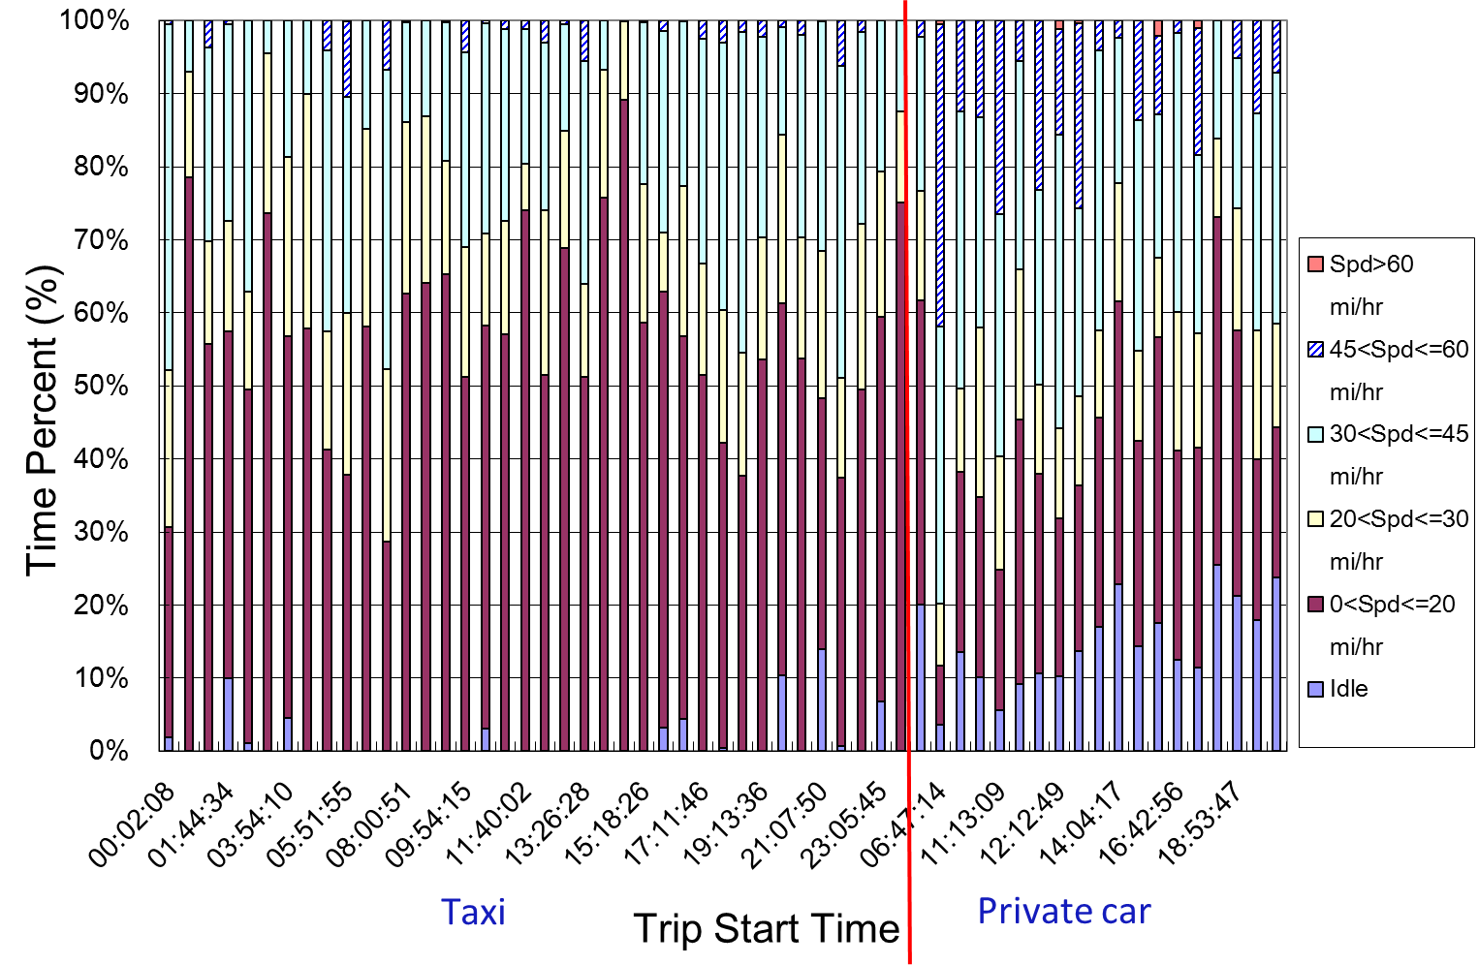
Maximum and Average Speed for a gasoline car & a LPG taxi
Private car
Speed Range for a gasoline car & a LPG taxi

Slide 14
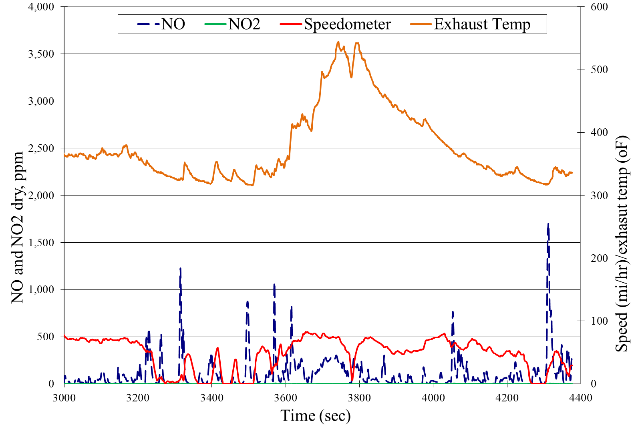
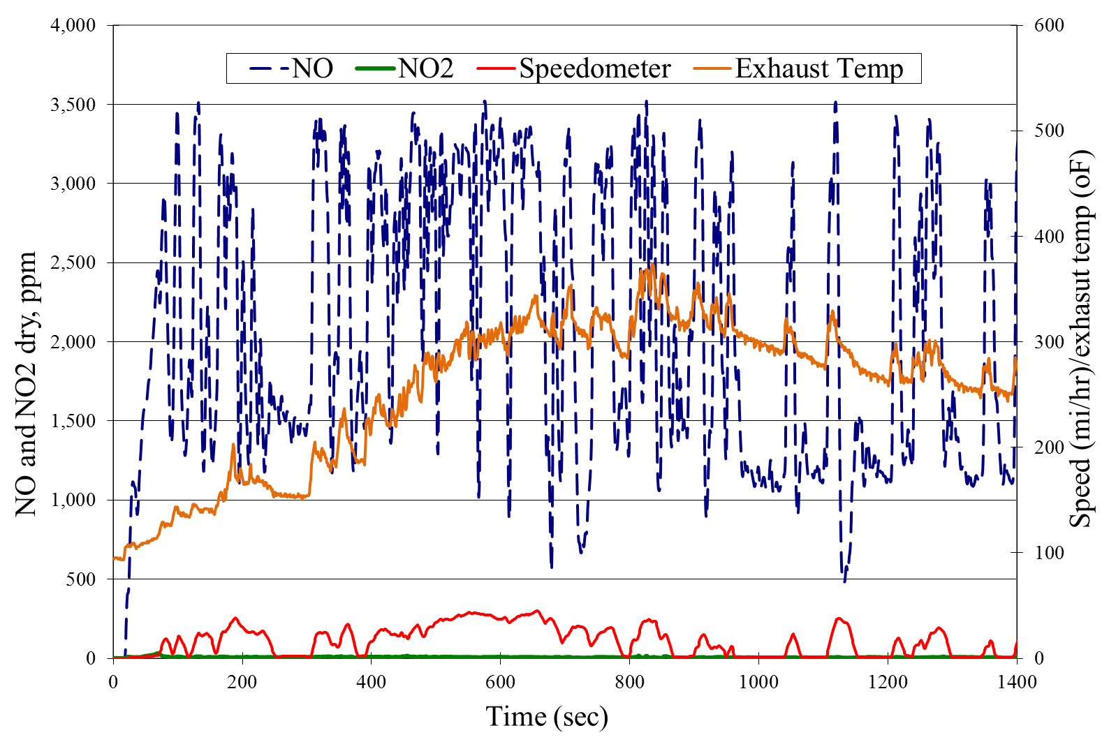
NOx real-time snapshot for Euro 2 gasoline private car
NOx real-time snapshot for Euro 2 LPG taxi

Slide 15
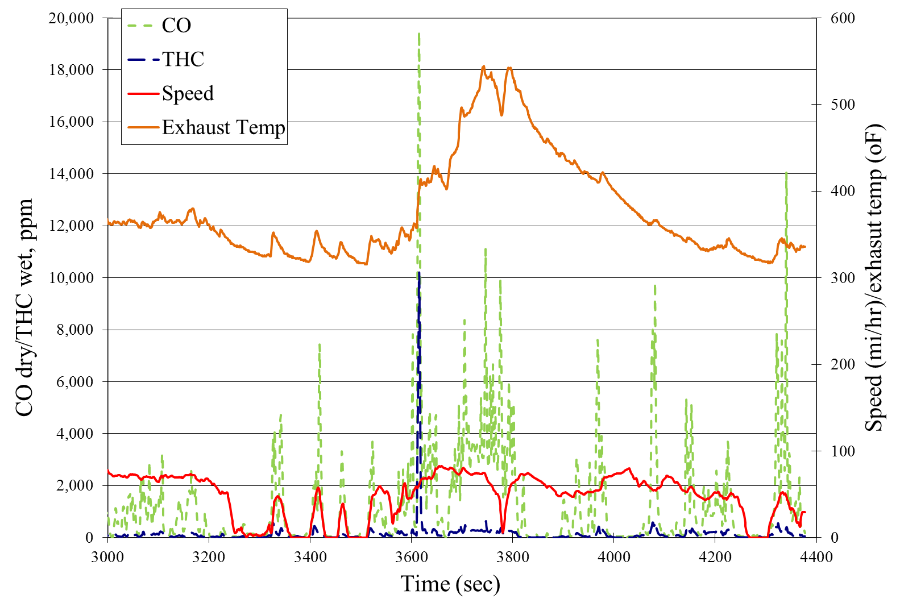
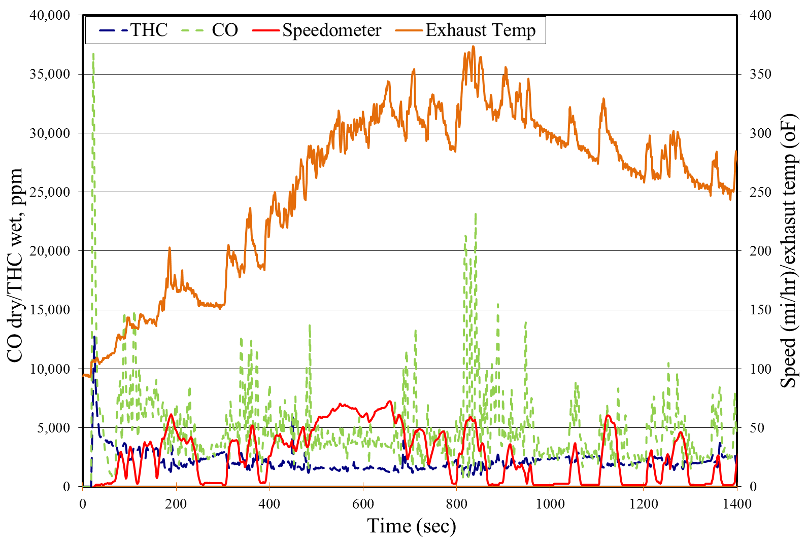
THC and CO real-time snapshot for Euro 2 gasoline private car
  THC and CO real-time snapshot for Euro 2 LPG taxi

Slide 16
Comparison of PEMS results with certification data and emission standard
Identify the driving mode of PEMS data
  Highway
  Highway-urban
  Urban
Compare the average emissions with certification data and emission standards

Slide 17
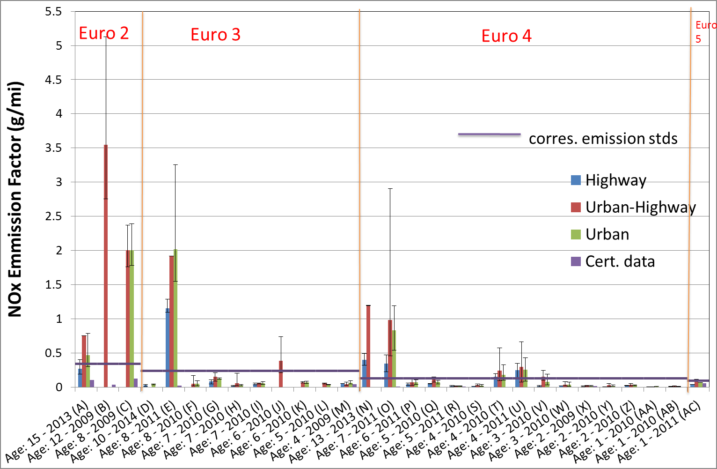
PEMS Results on Gasoline Private Cars

Slide 18
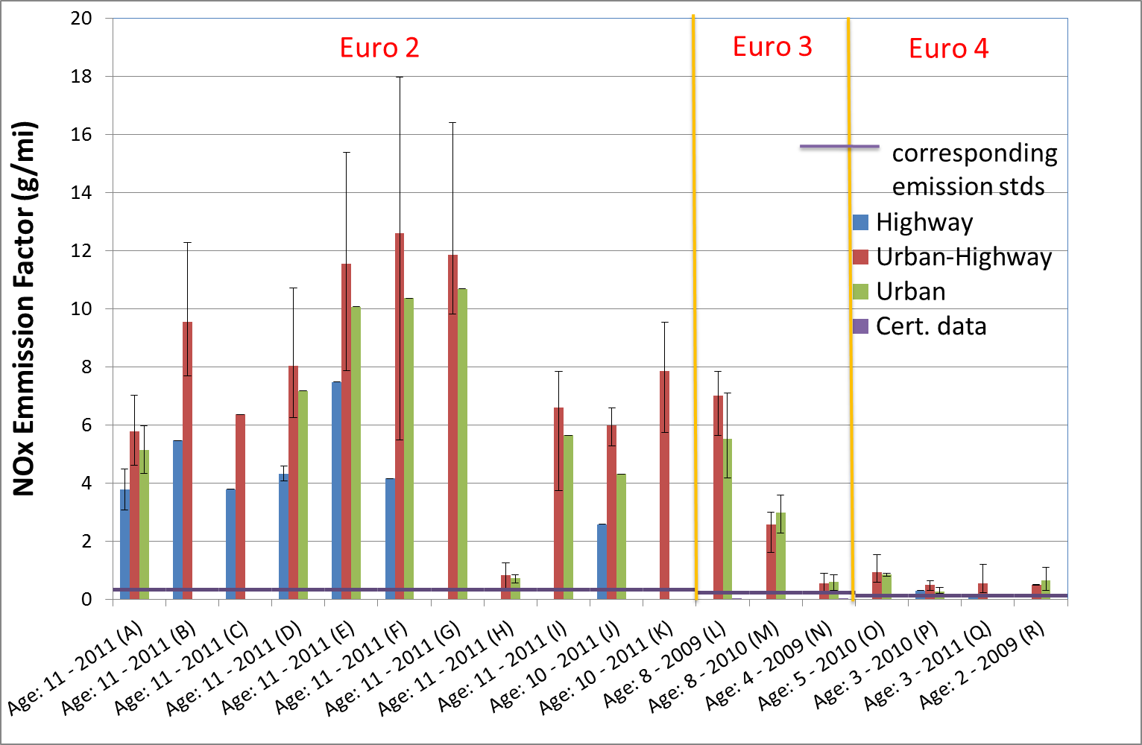
PEMS Results on LPG Taxis
* All LPG vehicles use equivalent Japanese emission standards

Slide 19
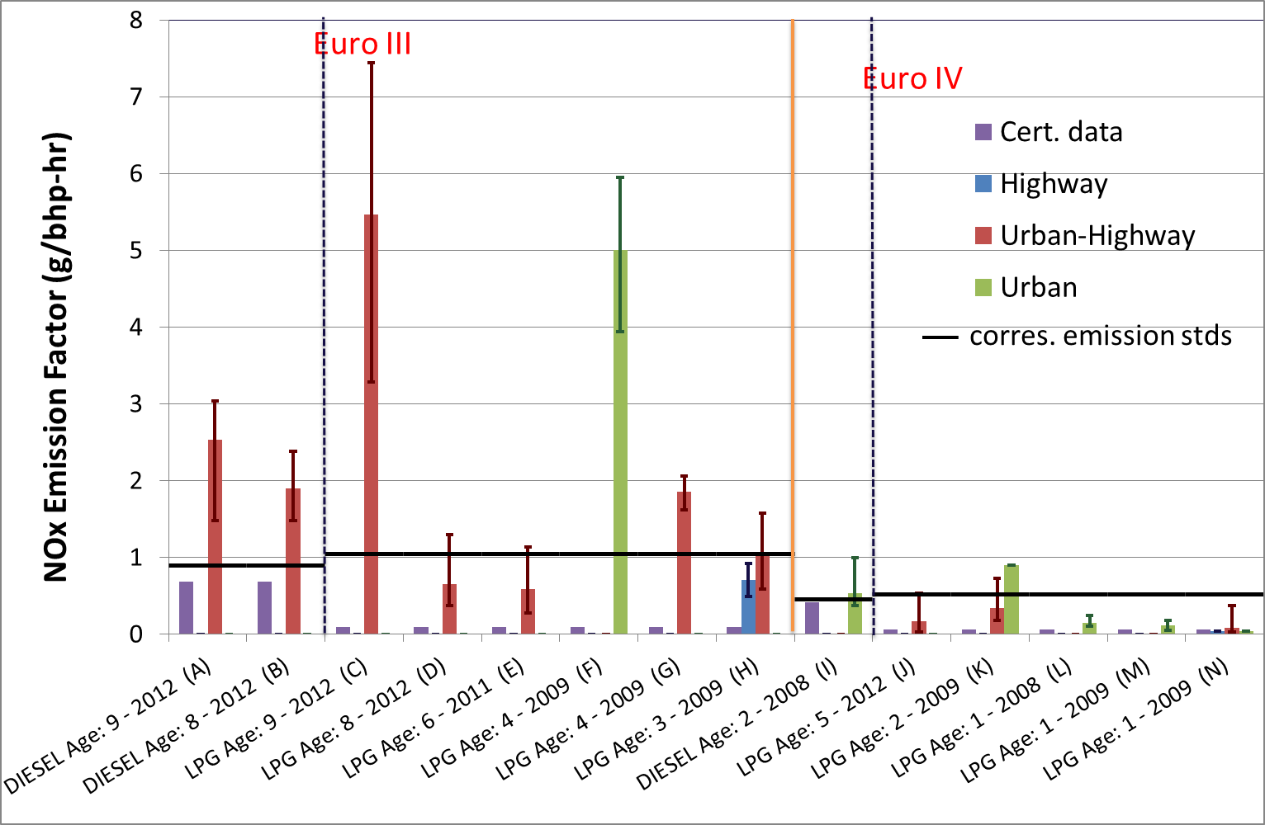
PEMS Results on Minibus~5.8 ton (LPG & Diesel)
* All LPG vehicles use equivalent Japanese emission standards

Slide 20
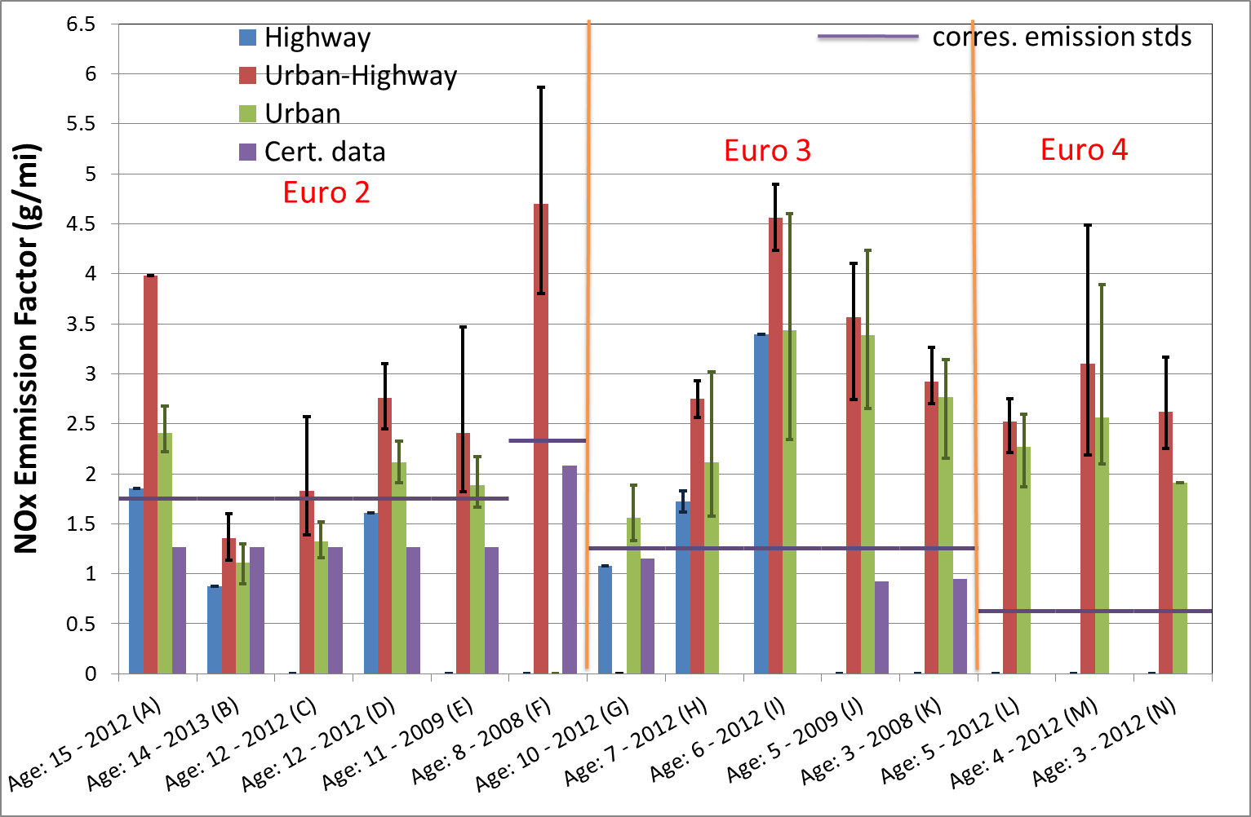
PEMS Results on Diesel Truck <=3.9 ton

Slide 21
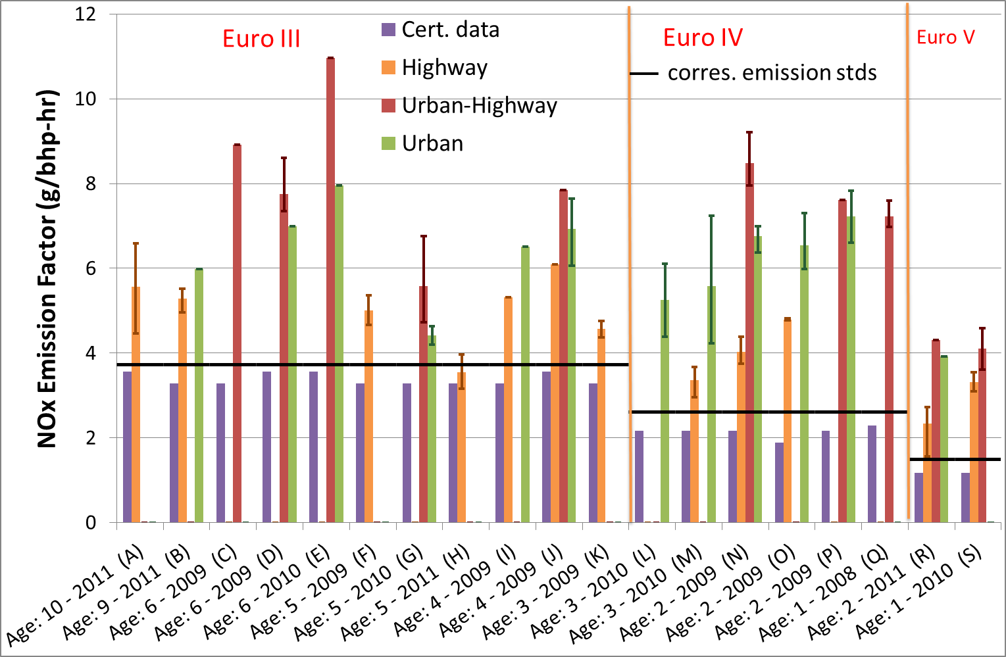
PEMS Results on Diesel Truck 3.9 – 6.1 ton

Slide 22
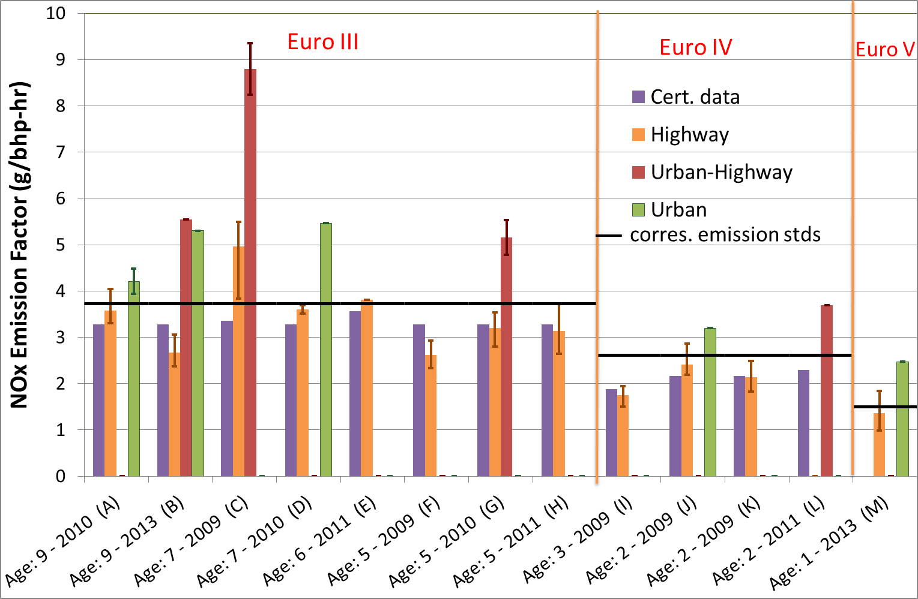
PEMS Results on Diesel Truck 6.1 – 16.5 ton

Slide 23
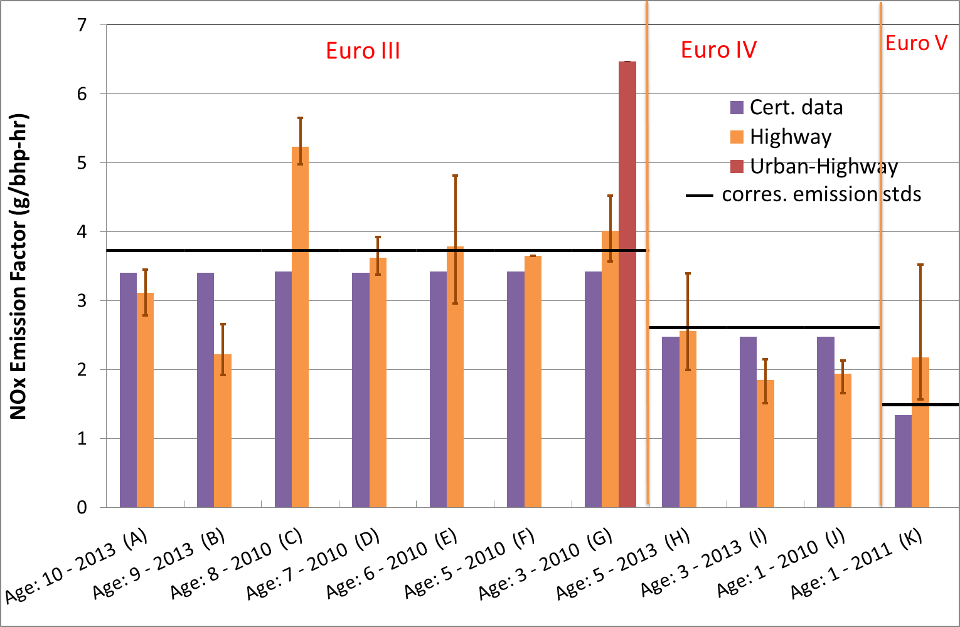
PEMS Results on Diesel Truck > 16.5 ton

Slide 24
SCR performance for different driving modes
Retrofit SCR/DPF+SCR into double deck buses
Study the performance of SCR in highway and urban driving

Slide 25
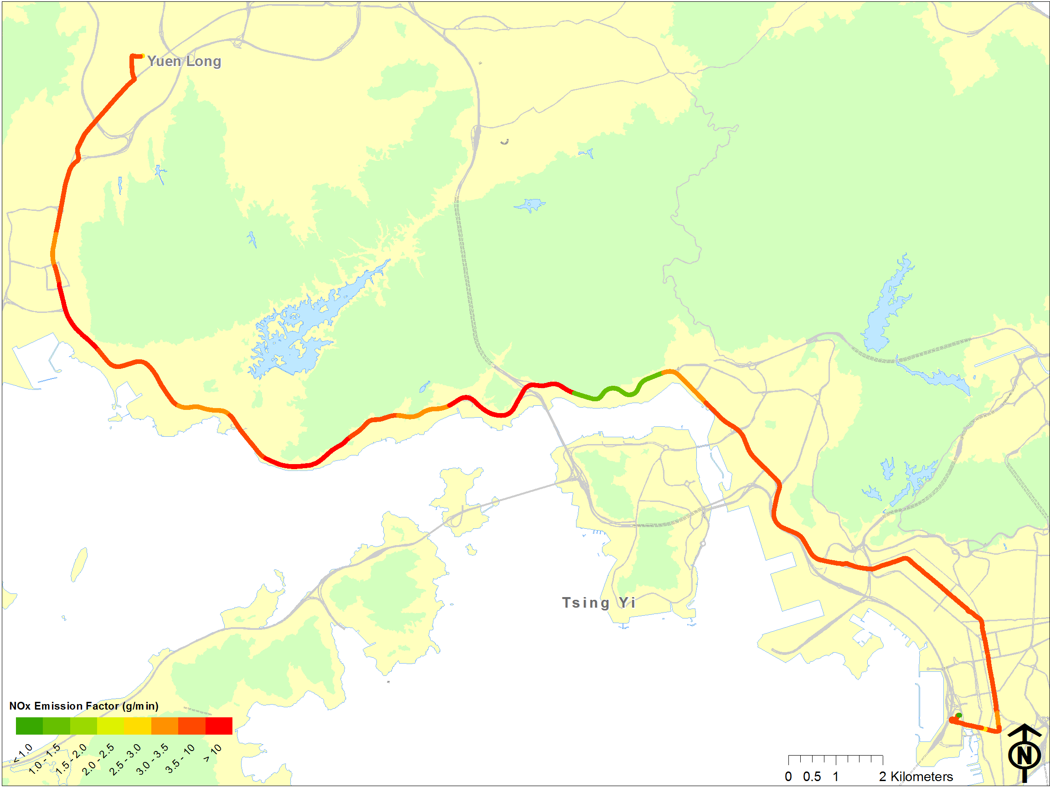
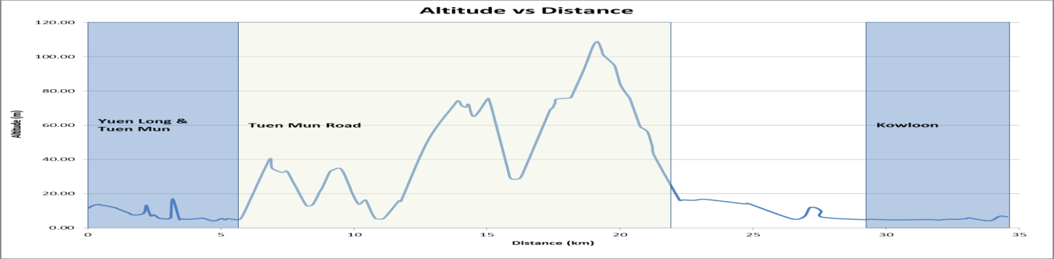
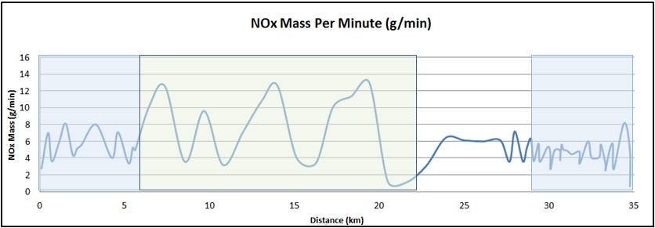
NOx emission rates (g/min)
Dennis Trident Euro III bus
retrofitted with DPF
Baseline

Slide 26
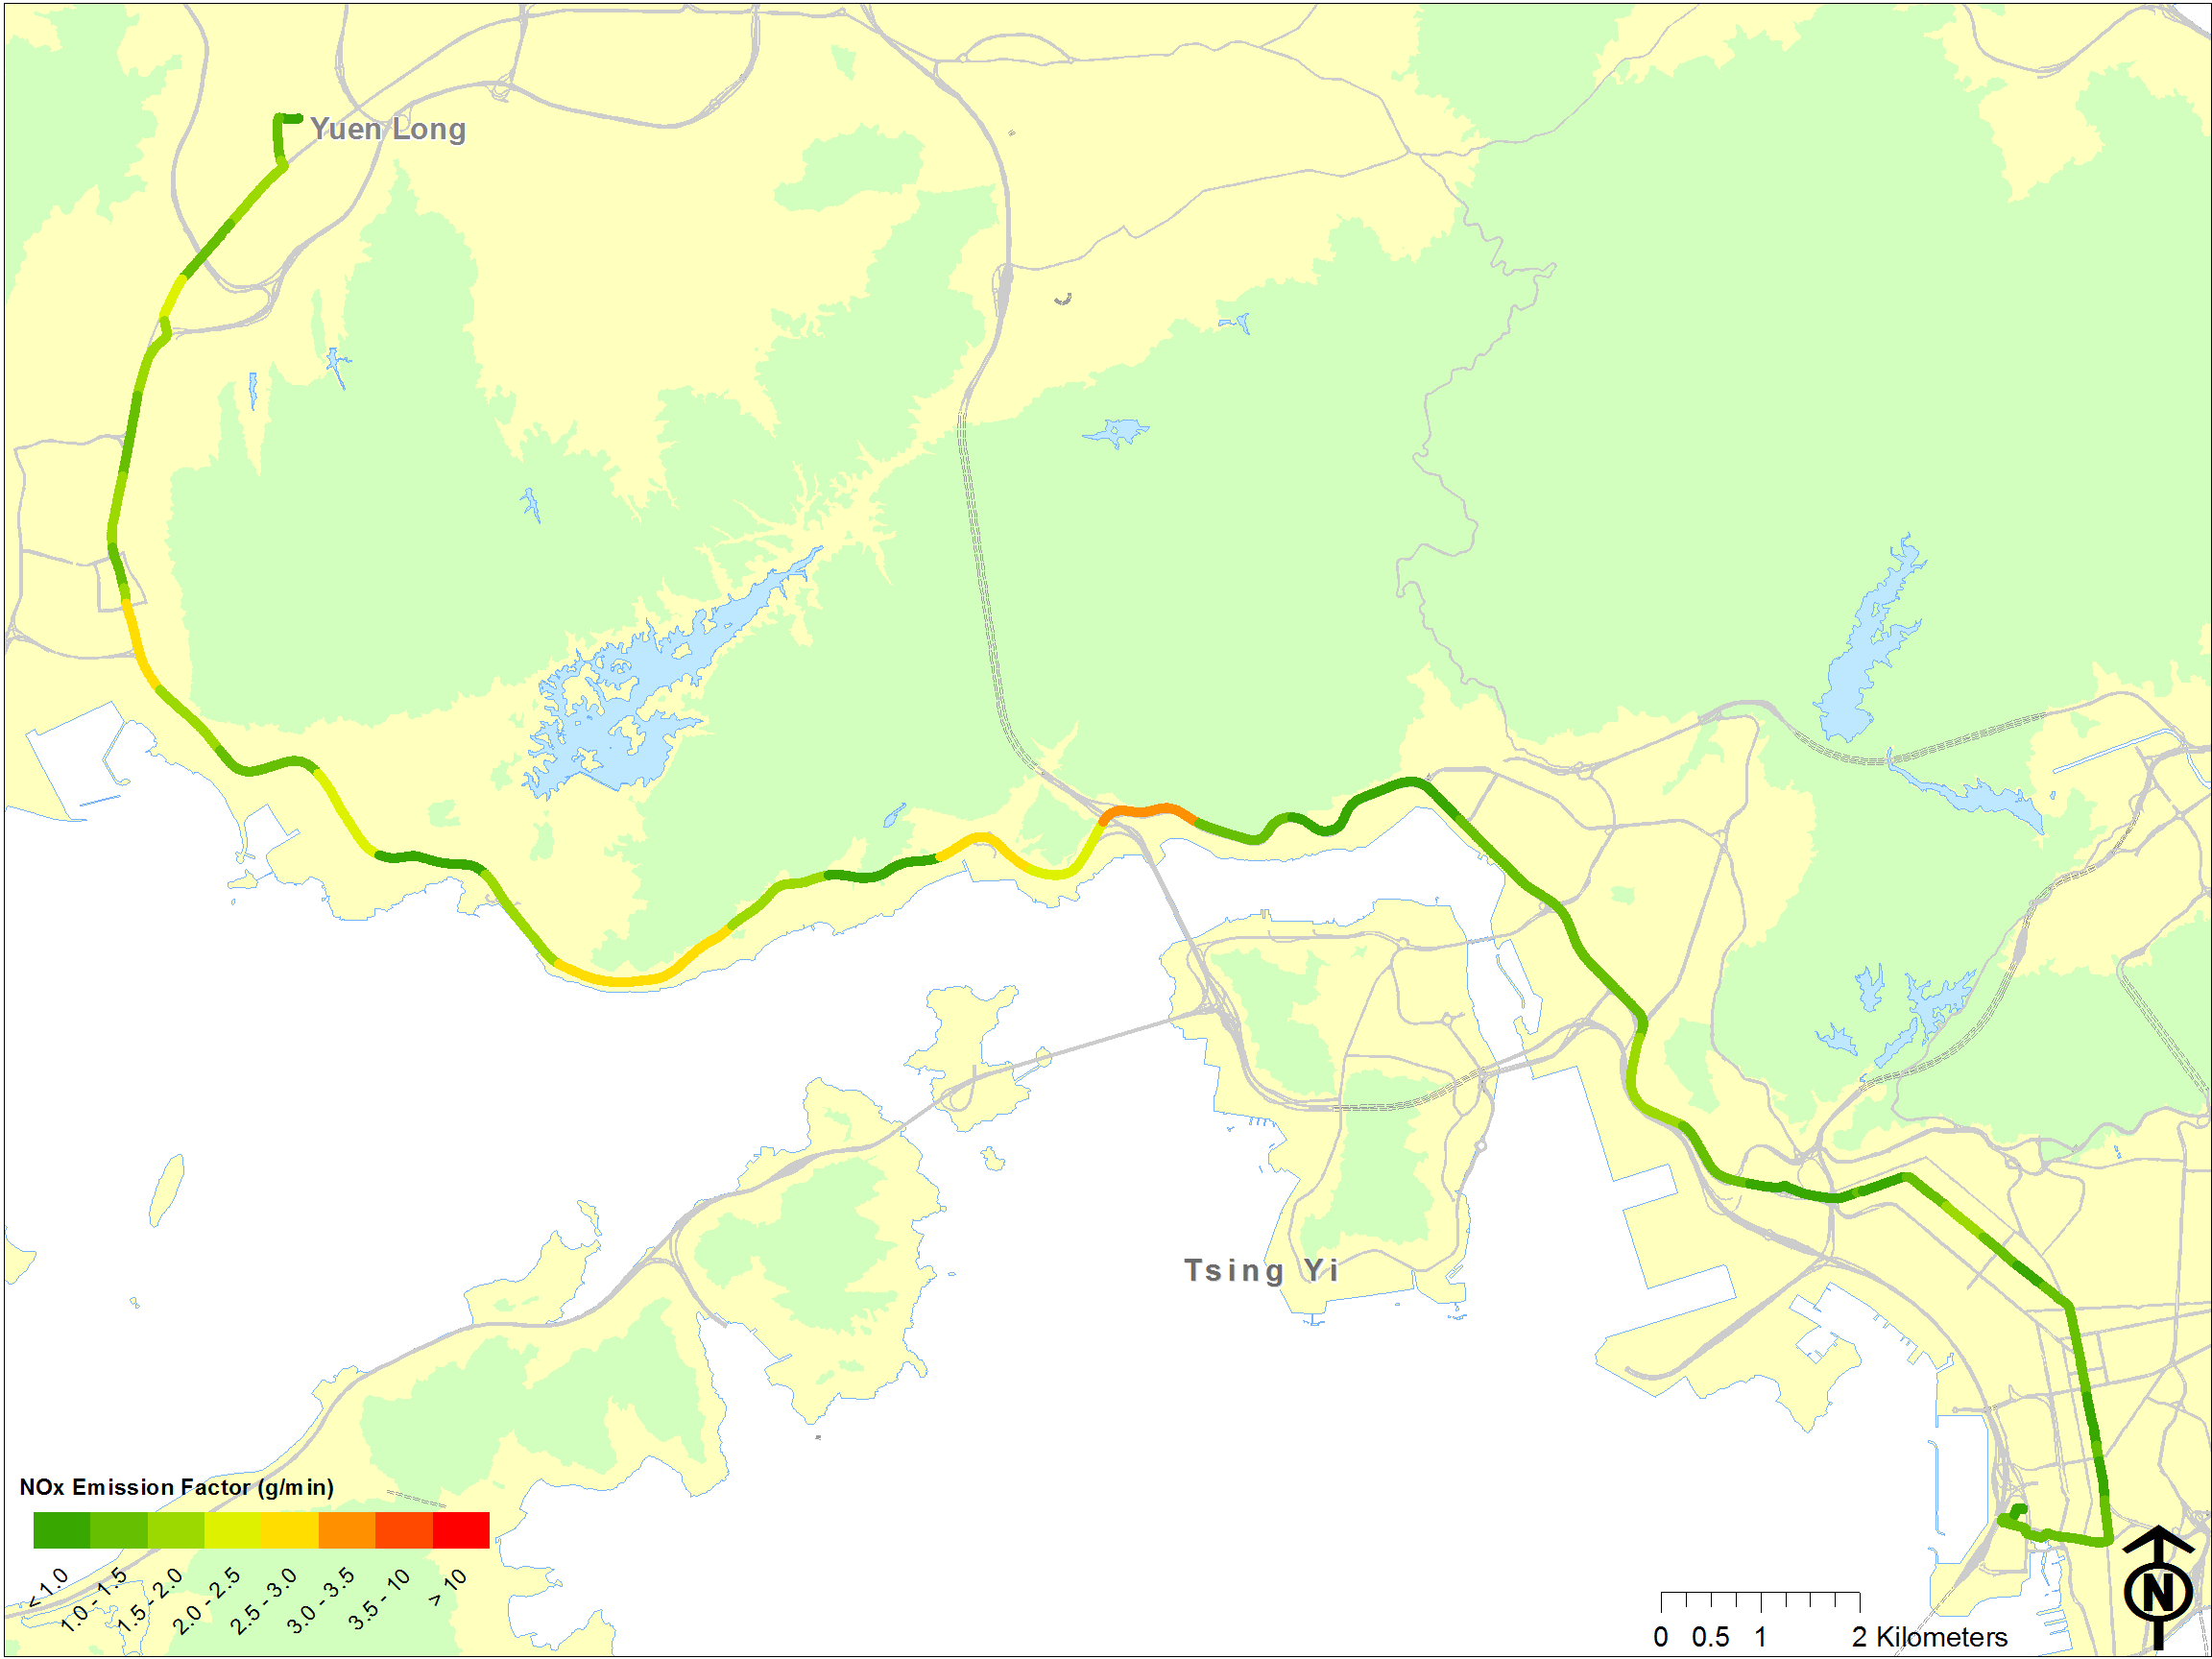
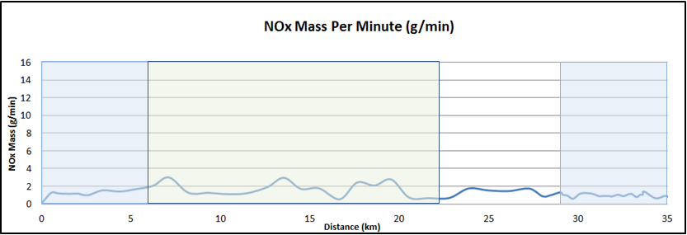
NOx emission rates (g/min)
Dennis Trident Euro III bus
retrofitted with DPF
1 month after retrofitted with
SCR+DPF

Slide 27
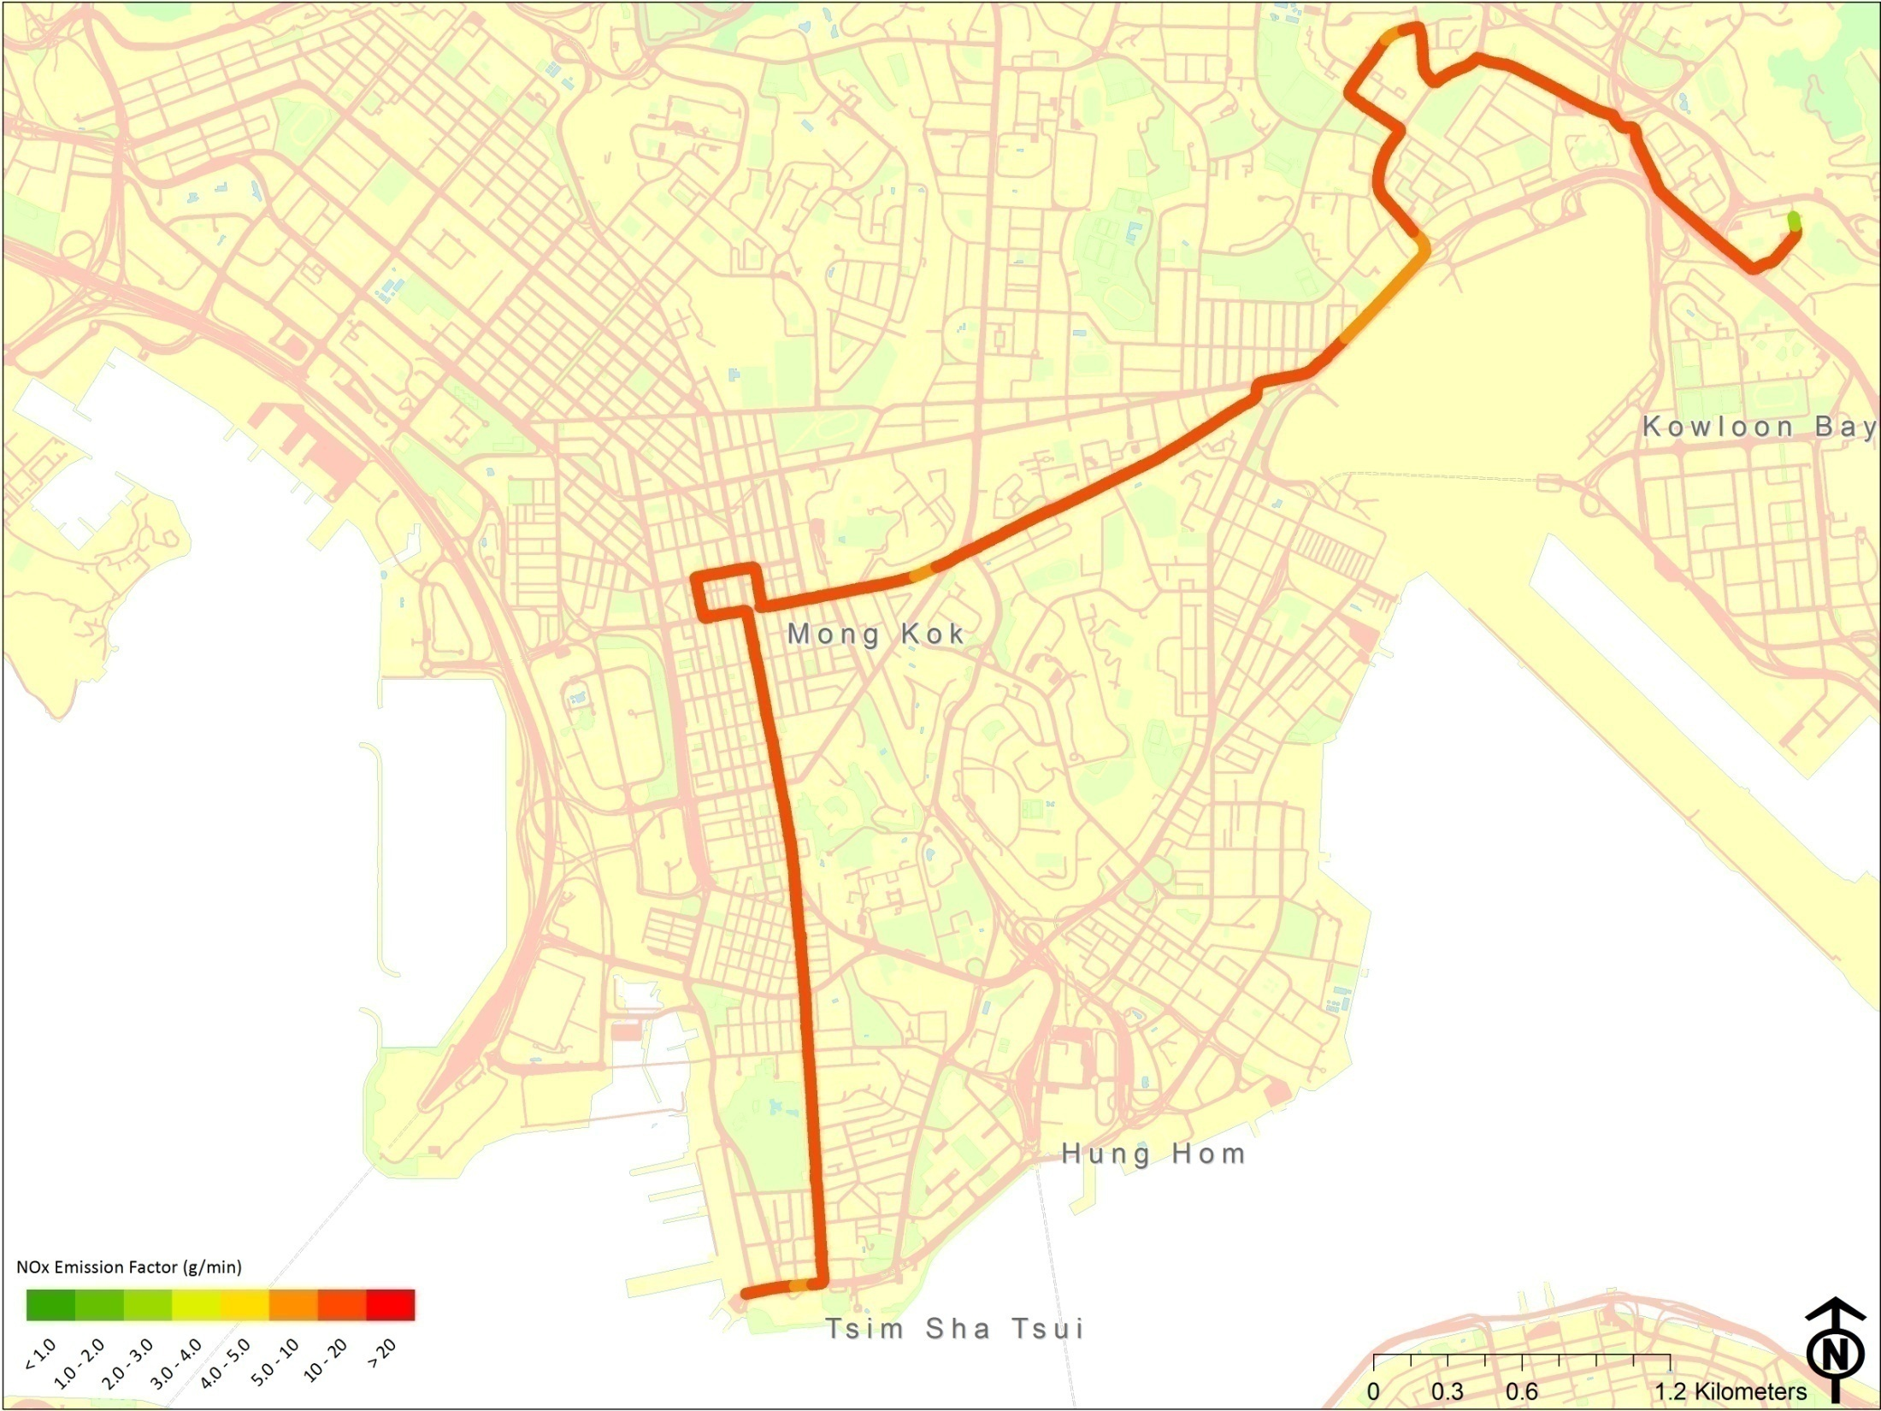
NOx emission rates in g/min
Volvo Olympian Euro II bus retrofitted with DPF
Baseline

Slide 28
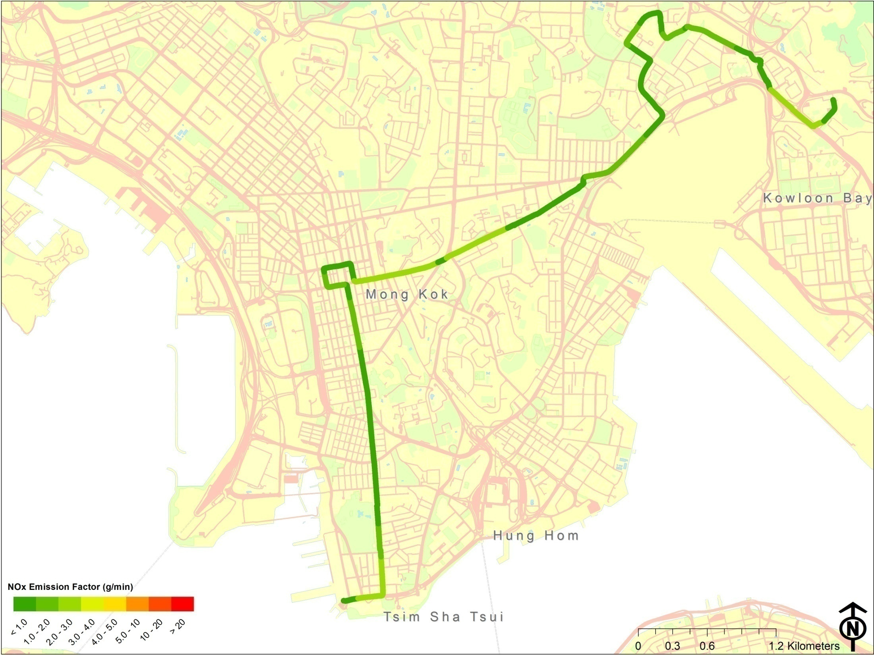
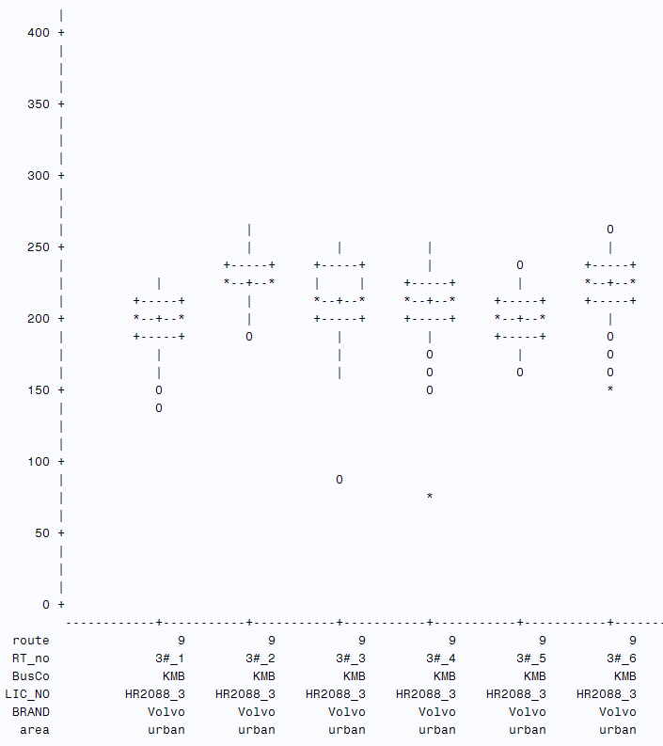
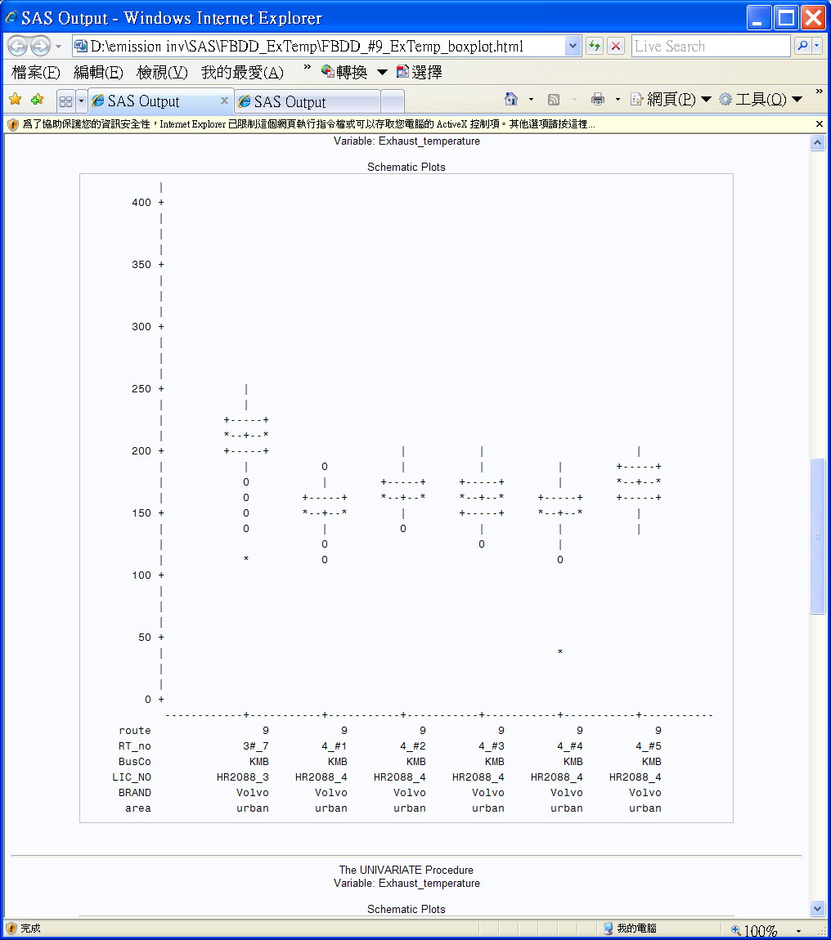
NOx emission rates in g/min
Volvo Olympian Euro II bus retrofitted with DPF and SCR
1 month after SCR retrofit
Exhaust temp oC
28

Slide 29
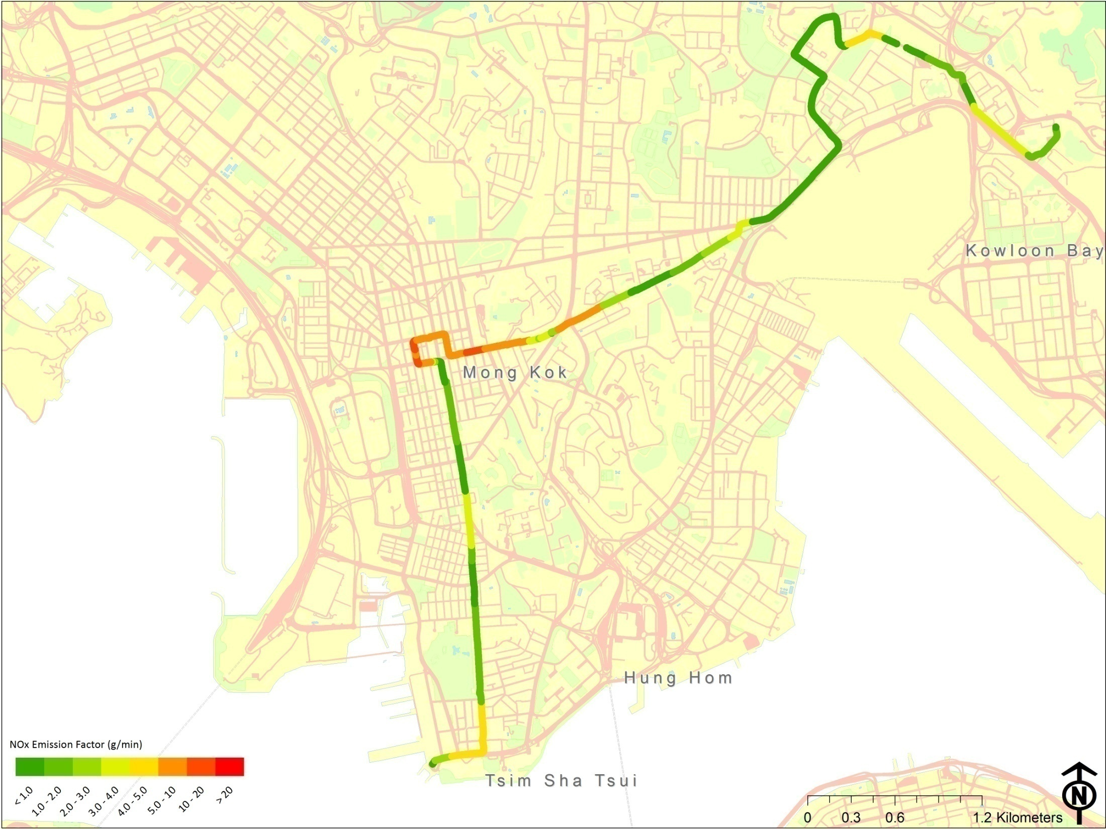
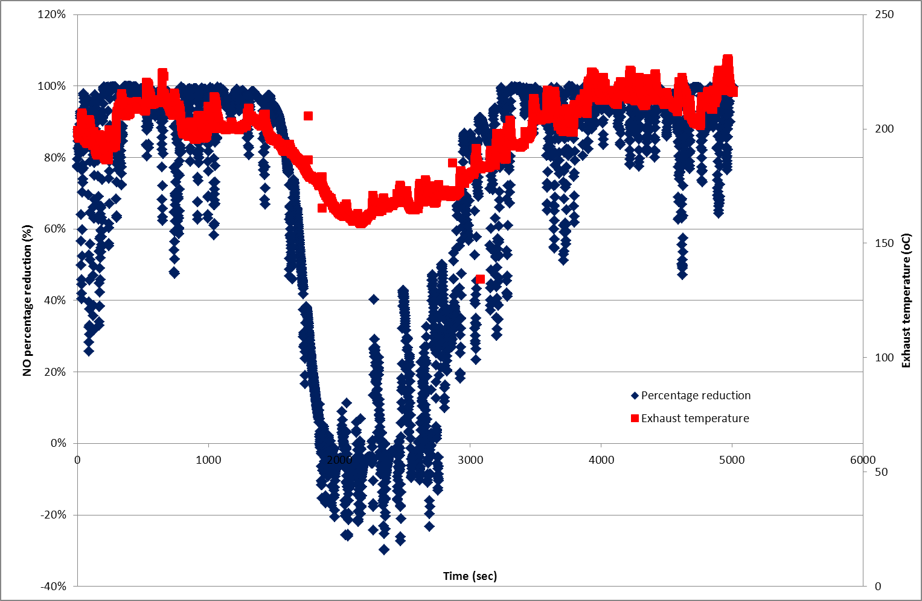

NOx emission rates in g/min
Volvo Olympian Euro II bus retrofitted with DPF and SCR
1 month after SCR retrofit with traffic jam at Mong Kok
Exhaust temp oC

Slide 30
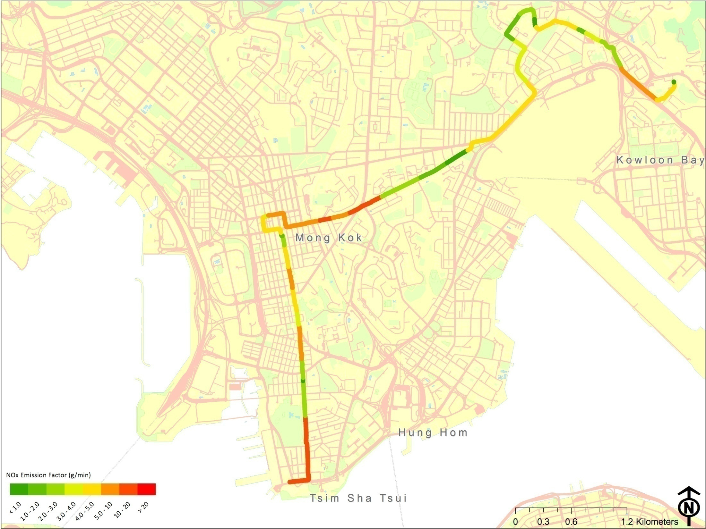

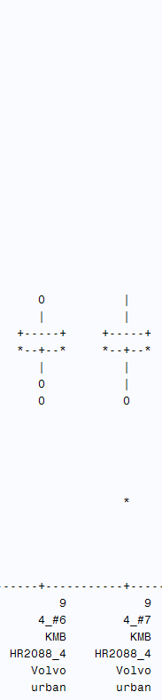
NOx emission rates in g/min
Volvo Olympian Euro II bus retrofitted with DPF and SCR,
6 month after SCR with low exhaust temp (<=200ºC)
Exhaust temp oC
30

Slide 31
Conclusion
Up to Mar 2014, emissions of 200 vehicles are measured using PEMS
Except for private cars, emissions measured by PEMS are higher than the emission standard
Emission rates in highway travelling is lower than that of highway-urban and urban travelling
The performance of SCR is affected by the traffic conditions. NOx emission increases dramatically during traffic congestion
Notes:
Have just started using the filter systems for PM measurements.

Slide 32

Thank you.

