Slide 1
The Path to Clean Air Requires Good Data
Matt Miyasato, Ph.D.
Deputy Executive Officer
Science & Technology Advancement

Slide 2
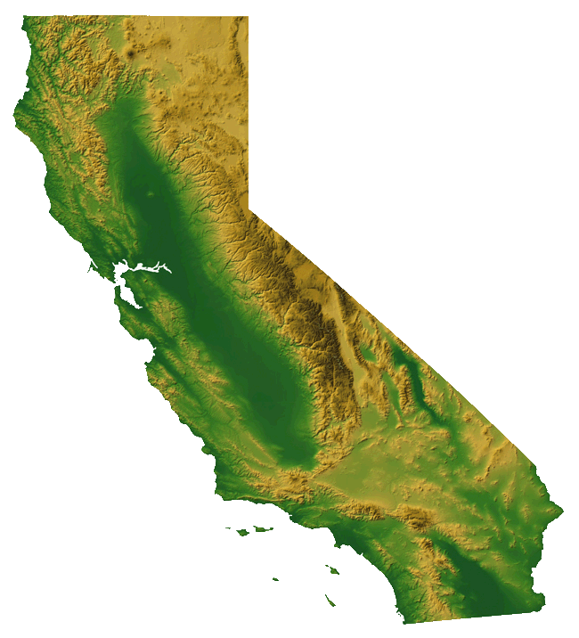
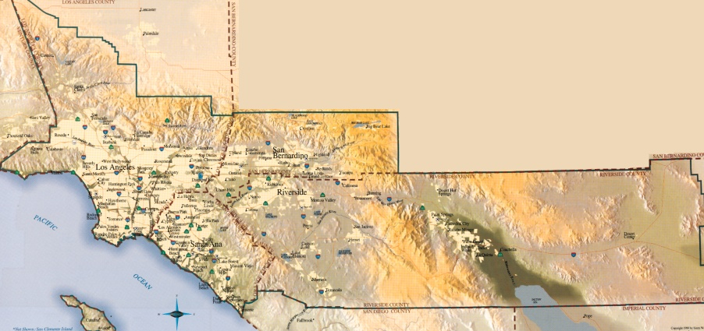
South Coast Air Basin
44%
Population

Slide 3
South Coast Air Basin
40%
US Freight Import
44%
Population

Slide 4
South Coast Basin
17 million residents
6th largest cargo gateway
+10 million passenger cars
+1.5 million heavy-duty trucks

Slide 5
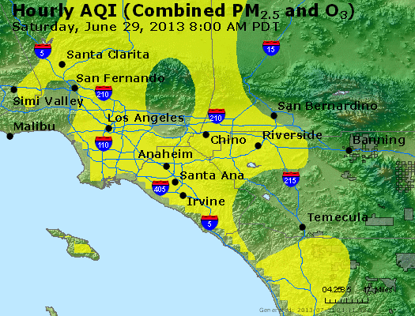
Worst Air Quality in the Nation

Slide 6
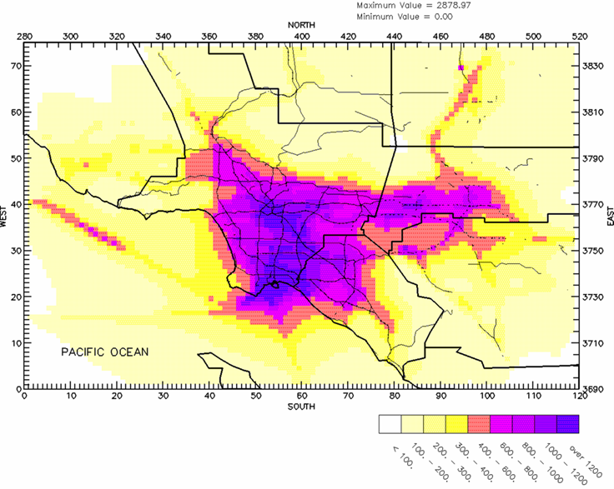
Cancer Risk
6

Slide 7
+5,000
deaths
year
Additional costs include
Hospitalizations
Cases respiratory illness
School absences
Lost workdays
$ Billions

Slide 8
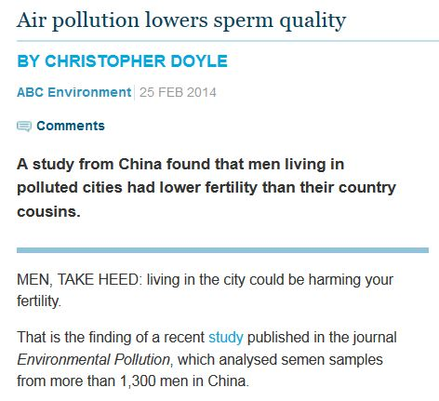
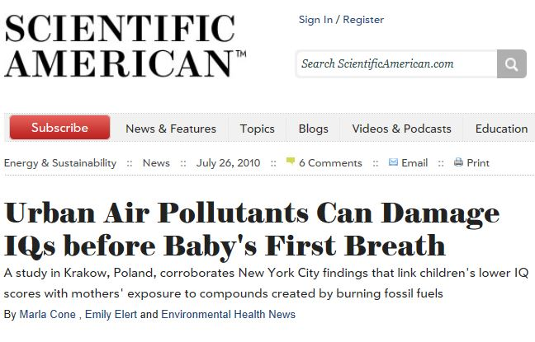

Slide 9
Top NOx Sources in the Region
Tons/Day
2023
2032
In 2023 with all regulations implemented
Notes:
NOx tons/day
Required to meet 2023 and 2032 federal deadlines

Slide 10
Top NOx Sources in the Region
70-90%

Tons/Day
2023
2032
In 2023 with all regulations implemented
Notes:
NOx tons/day
Required to meet 2023 and 2032 federal deadlines

Slide 11
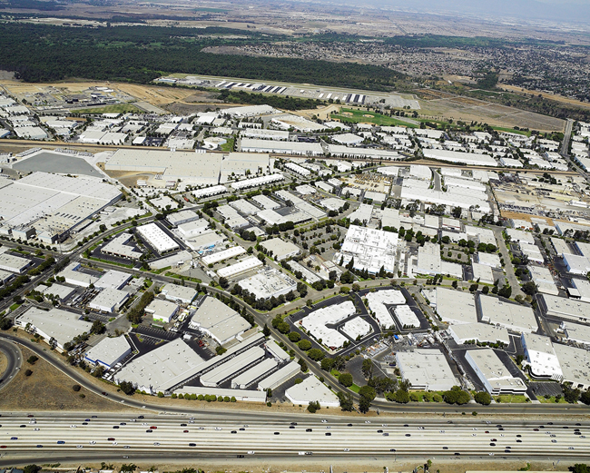
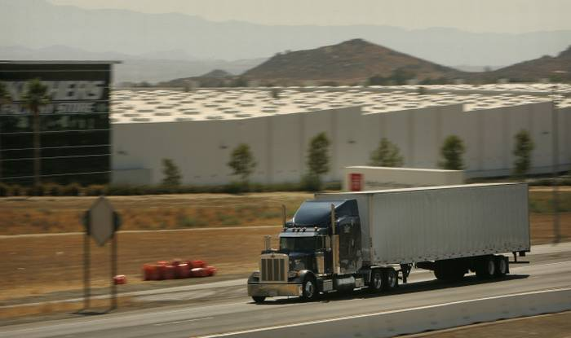

Slide 12
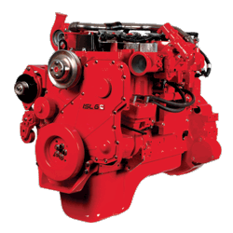
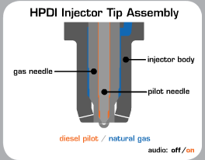
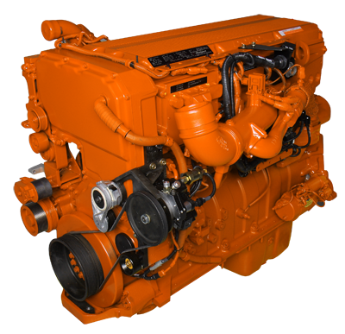
Past NG Engine Development
Cummins Westport 8.9L ISL-G
NGNGV2 Initiated ~2001
Certified in 2007
Westport Innovations 15L ISX (HPDI)
Development in 2004
Certified in 2010

Slide 13
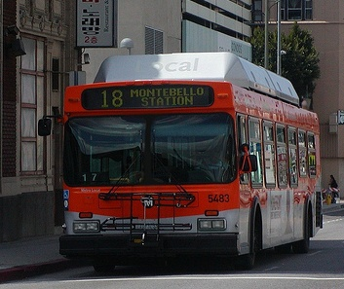
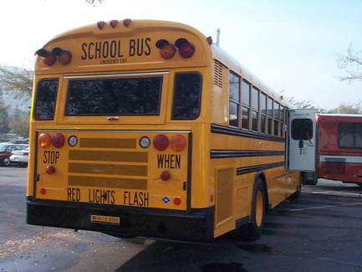
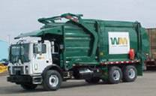
Success Stories
LAMTA – Transit Buses
California’s largest transit agency (3rd largest in Nation)
100% CNG in January 2011
School Buses
Replaced close to 1,000 pre-1987 buses with new CNG buses since 2001
Largest number of replacements in CA ($150 million)
Refuse Haulers
34% alternative fuel
Waste Management has largest NG fleet in the nation

Slide 14
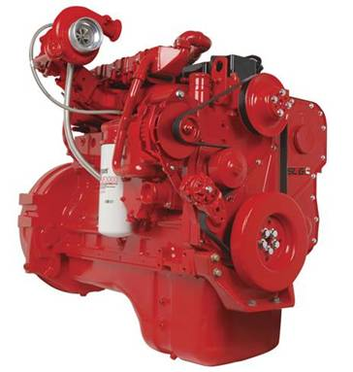
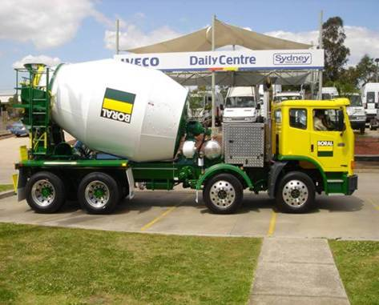
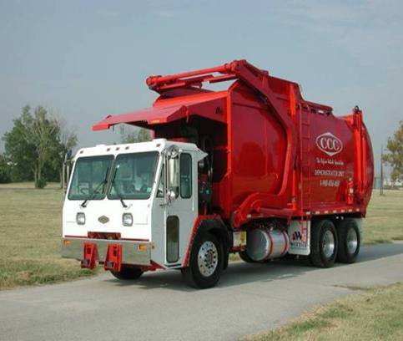
Current Engine Projects
ISX 12L Cummins Westport
Successfully completed and certified at:
0.15 g/bhp-hr NOx
Less than 0.01 g/bhp-hr PM
Commercially launched in 2013
Now offered by OEMs in Class 8 trucks applications
11L Doosan
Southwest Research Institute
Engine development work is on-going
Anticipated completion date is 2015

Slide 15
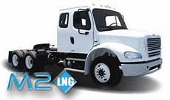
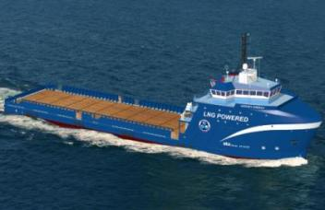
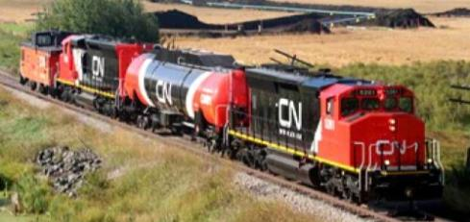
Heavy-duty Natural Gas Applications
Economics driving turnover to NG
Domestic fuel supply
Develop power-plant equivalent tailpipe emission technologies
“Electric Vehicle Equivalent”
High-horsepower engines

Slide 16
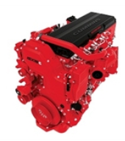
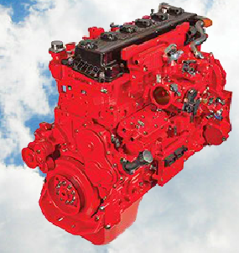
Next Generation NG Engines
Targeting order of magnitude NOx reduction – 0.02 g/bhp-hr
Awarded October 2013, $3.5M each
Cummins – 15L
Cummins Westport – 8.9L
Partnering with CEC and SoCalGas
Both using TWC and combustion mods
Notes:
http://aqmd.gov/hb/attachments/2011-2015/2013Oct/2013-Oct4-009.pdf

Slide 18
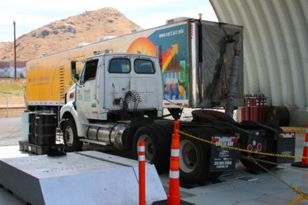
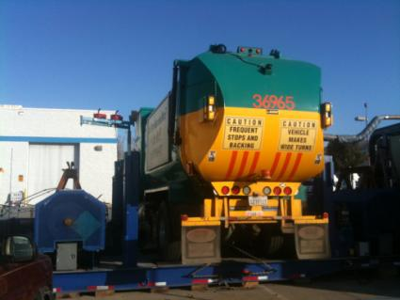
In-use Emissions Study
As with fuel use, emissions believed to be highly dependent on duty-cycle
Natural gas and diesel school buses, transit buses, refuse haulers and class 8 drayage trucks
West Virginia University and University of California, Riverside
Chassis dynamometer duty cycles

Slide 19
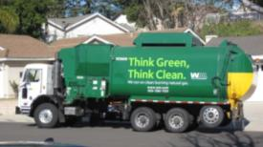
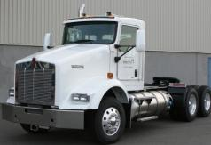
Vocational Comparison
3.4x
3.9x
UDDS
Notes:
Refuse

Slide 20
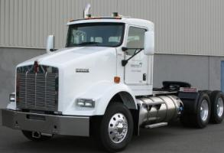
Duty-Cycle Comparison
14.9x
Diesel highly dependent on SCR temperature
11.5x
6.6x

Slide 21
Takeaways
Emission solutions needed now in South Coast Basin
Duty-cycle specific emission advantages
Need to get to next level of NOx reductions and address lifecycle GHG issues
Need to measure and confirm criteria and GHG emissions reductions

