Slide 1
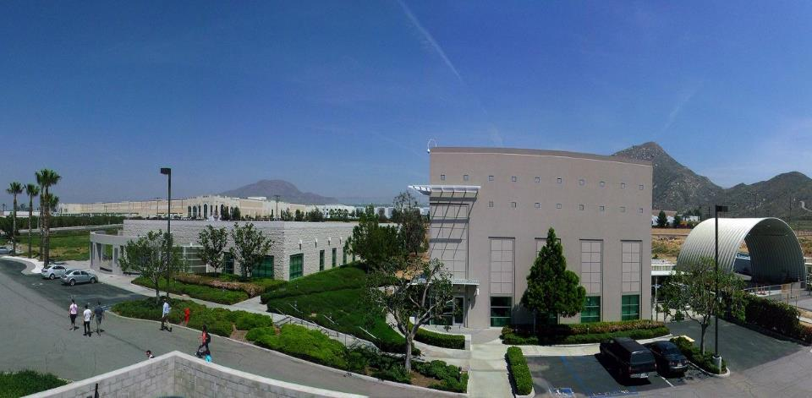
Welcome To the 4th Annual PEMS/In-Use Testing Workshop
PEMS 2014 Workshop
April 3rd 2014
Presented By:
Kent Johnson
University of California, Riverside
Center for Environmental Research and Technology
(CE-CERT)

Slide 2
In-Use Testing is Important
In-Use Test

Slide 3
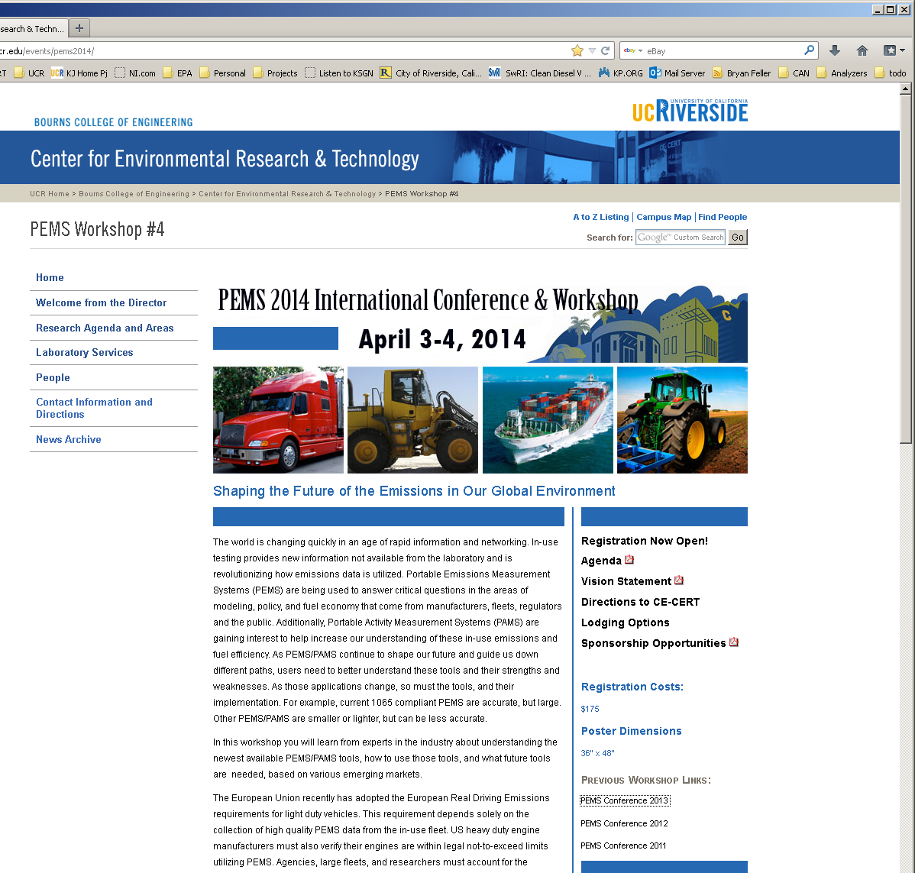

Slide 4
Tonight April 3rd 7:00
Go-Karting: K1 Carts
April 4th 4:00-7:00 (Go-Pro video)
Emissions Workshop Bike Ride
Sycamore Canyon Wilderness Park
Bikes Provided by
Peddles Bike Shop Riverside Ca.
April 4th In-Vehicle Demo’s
Instrumented Hybrid 8:30 to 2:00

Slide 5
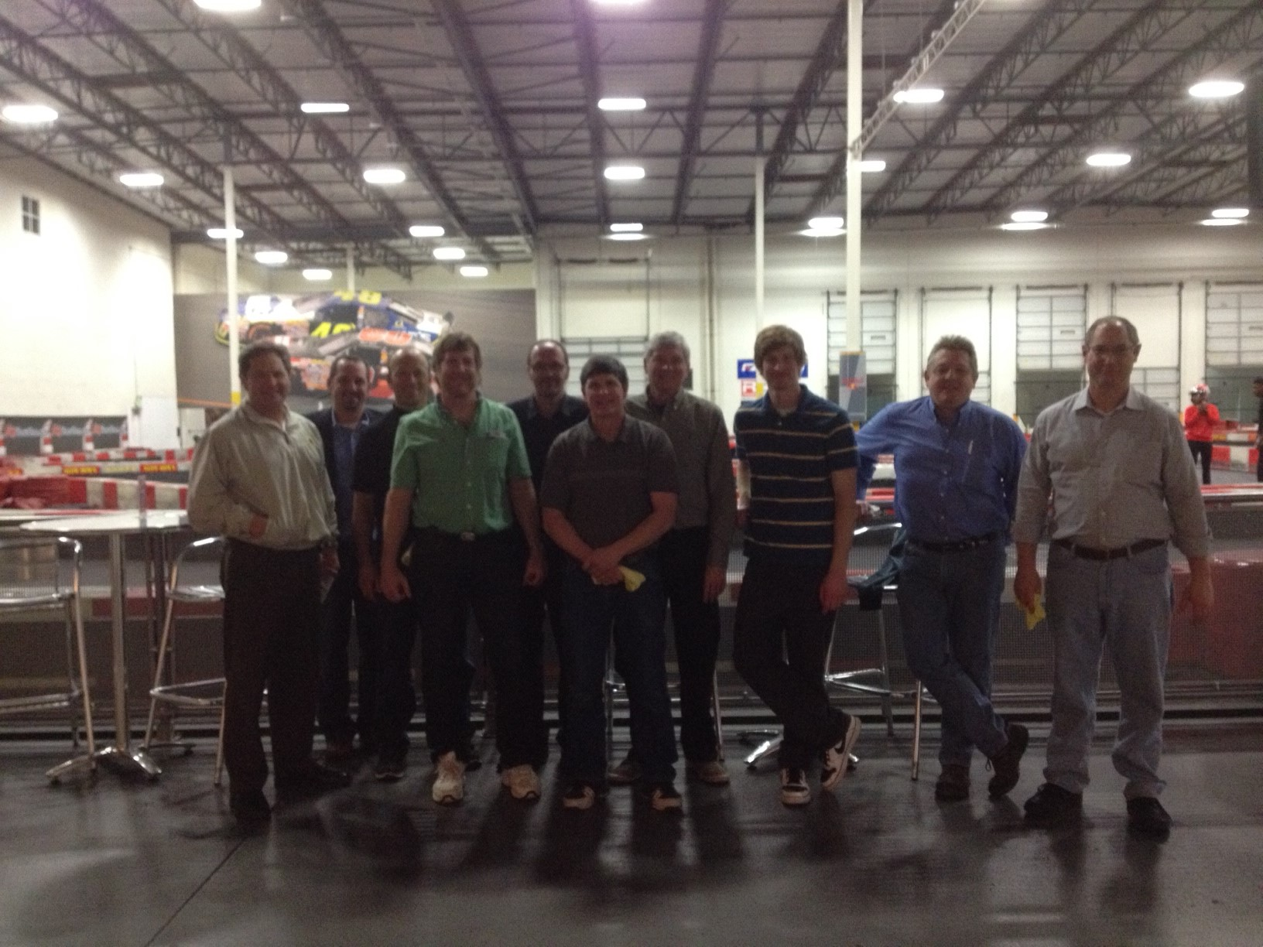
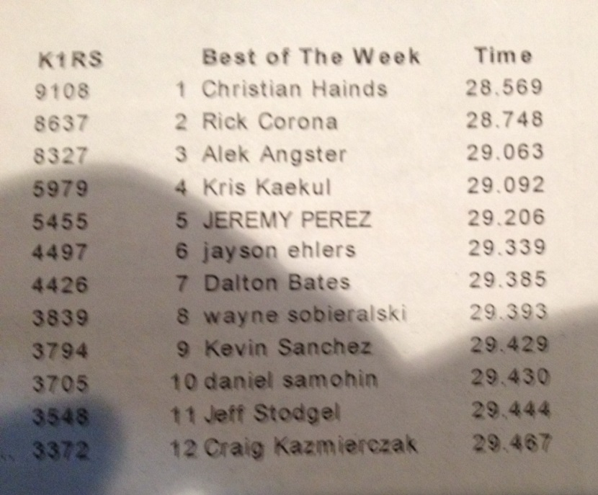
Karting K1-Racing Results

Slide 6
Program Sessions and Focus
Regulatory Developments and Trends
Research Developments
In-use Approaches for Advanced Vehicles
In-use Fuel Consumption Approaches
Panel Discussion

Slide 7
In-Use Testing is Important
Hybrids sound great, but sometimes increase emissions
NOx and PM emissions were higher for the hybrid construction equipment (Tao et al 2014)
Nitrogen oxide emissions were unexpectedly higher for the hybrid buses than for the control buses. (Hallmark et al 2013 JAMA)

